Slide 1
Sprint 3 Review

Slide 2
Agenda
Product Backlog
Sprint Backlog
TaskBoard
Sprint Burndown Chart
Test Cases
Lessons Learned
Demo

Slide 3
Product Backlog
The Product Owner made certain requirement changes in this sprint.
These are the newly added requirements:

Slide 4
Product Backlog
Reqt. | Requirement Description | Priority | Effort
A1.1a | In the first release, the game will run on the Internet with four human players. | 01 | 25
A.1.1a.1 | Potentially multiple Spades games will be played on the Internet simultaneously, so the game environment shall support a community of users. | 01a | 30
A.1.1a.2 | A player shall be able to sign in for a game with four pre-arranged players to occur at a specified time within a 10-minute window. | 01b | 20
A.1.1a.3 | A player shall be able to sign up for a first-come-first served game with whomever is available. | 01c | 40
A1.2 | In the third release, the game shall support one human player and three simulated players. | 99 | 25
A1.4 | In the fourth release, the game will support Monte Carlo simulation with no human players (to test various strategies). | 99 | 25

Slide 5
Reqt. | Requirement Description | Priority | Effort
A3.1 | The game shall display the number of tricks taken by each player along with the number of tricks bid by the player throughout the hand. | 05 | 8
A3.6 | At the end of the hand, the game shall display the number of tricks bid and taken for the hand along with the score for this hand | 05a | 10
A3.5 | The suits in the human player’s hand shall be sorted by alternating color (e.g., red/black/red/black). | 06b | 5

Slide 6
Sprint Backlog
Reqt. | Requirement Description | Priority | Effort
A1.1a | In the first release, the game will run on the Internet with four human players. | 01 | 10
A.1.1a.1 | Potentially multiple Spades games will be played on the Internet simultaneously, so the game environment shall support a community of users. | 01a | 12
A.1.1a.2 | A player shall be able to sign in for a game with four pre-arranged players to occur at a specified time within a 10-minute window. | 01b | 11
A.1.1a.3 | A player shall be able to sign up for a first-come-first served game with whomever is available. | 01c | 13
A3.5 | The suits in the human player’s hand shall be sorted by alternating color (e.g., red/black/red/black). | 06b | 2
A3.6 | At the end of the hand, the game shall display the number of tricks bid and taken for the hand along with the score for this hand. | 05a | 6
Total |  |  | 54

Slide 7
Splitting of Stories
Reqt. | Requirement Description | Effort
A1.1a.a | The game will run on the Internet. | 4
A.1.1a.b | The game should support 4 human players | 6
A.1.1a.1.a | Multiple Spades game instance is allowed to run on internet simultaneously | 6
A.1.1a.1.b | Players for the game should be picked from a community of users | 6
A.1.1a.2.a | Players should sign in to be able to play a game | 5
A.1.1a.2.b | Players shall be provided with 10 minute window to appear to be able to participate in a game. | 6

Slide 8
Tech Stories
We shifted back to ASP.Net because the Product Owner changed requirements of the game to be multiplayer with 4 human players.
Client’s connections to server would be easier since ASP.NET supports server side applications. That way it would be easier for us to support a community of users and make the task of having 4 human players play the game, possible

Slide 9
Taskboard
Task | User story | Status
Game runs on server end/ Internet. | A1.1a.a | Done
Each game has 4 human players with their respective hands shown to them. | A1.1a.b | Done
Application should be able to run multiple instance of the game. | A.1.1a.1.a | Checked
Game support community of users | A.1.1a.1.b | Not Checked
Player should login to play the game. | A.1.1a.2.a | Done
Player will be provided with 10-minute window to be able to take part in the game. | A.1.1a.2.b | Not Checked
Participation of player depends on First come First serve | A.1.1a.3 | Not Checked
Cards in hand of players should be sorted with alternate color suits | A3.5 | Done
Display the current stand of each player with every trick played | A3.6 | Done

Slide 10
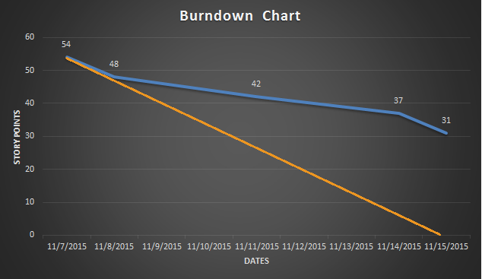
Sprint Burndown Chart

Slide 11
Test Cases
Login not allowed without username password.
Cards are not distributed before deal button.
Bid cannot be done without entering a value and before seeing the hand of cards.
Bid allowed between only 0 to 13. No other bid is accepted.
Every player sees his own hand which is different from other players hand
Users cannot play without logging in.
Every Player should have cards in sorted order with alternate color suits.
Every player’s stat is updated with every trick played accordingly.

Slide 12
Lessons Learned
Refactoring
We learned that start with small changes instead of major changes.
We decided that we would prioritize the parts of code that needed refactoring according to their reusability and their requirement in the later phases of the development.
We learned that small changes, if applied continuously , add up to huge improvements.
if we tried to do all the refactoring at once then it will be difficult for us to keep track of our progress. Therefore we decided to adopt incremental approach to refactoring. Incremental changes made:
Start with assigning meaningful names for methods and variables
extract and remove duplicate lines of code
Abstract the logic like conditional statement and give relevant name
This way we were able to delegate the refactoring process and divide the work equally among us.

Slide 13
Lessons Learned
Test Driven Development
We don't find TDD is helpful because when you begin trying new technologies, you want them just work in the case of happy day scenario. After that, you have more depth understanding of what you are doing, so then you can target other scenarios. In the case of this project, the TDD would be helpful if we applied on the sprint 2 because we had more stable requirements.
Less rework : In TDD, we write the test case and then try to write the code that can pass that test case while in other approaches we first write the code and then test. So, if that code fails to pass the test case we need to make changes in our code that is causes waste of time.
It is much easier for TDD for the project that was done using TDD from the beginning than trying TDD on existing code as some previous parts of code can still fail a test case.
TDD help us develop better code in terms of having less possibility of failure as it has passed the test cases.

Slide 14
Walking Skeleton
We felt that applying walking skeleton in Sprint 3, where the product owner made big change in requirements was helpful because that way we could work on a small piece of code to implement the change and then use the same piece to build the rest of the requirement.
Example: Make a static user and password database first. Then make sure that the 4 players are able to play the game perfectly and once everything is done, we can make implement the part of adding a database and connect the front end to the back end as well as provide the functionality of registering new users.

Slide 15
We overestimated the effort needed to complete some stories in the product backlog.
We underestimated our capabilities to finish the user stories for the sprint.

Slide 16
Demo

