Slide 1
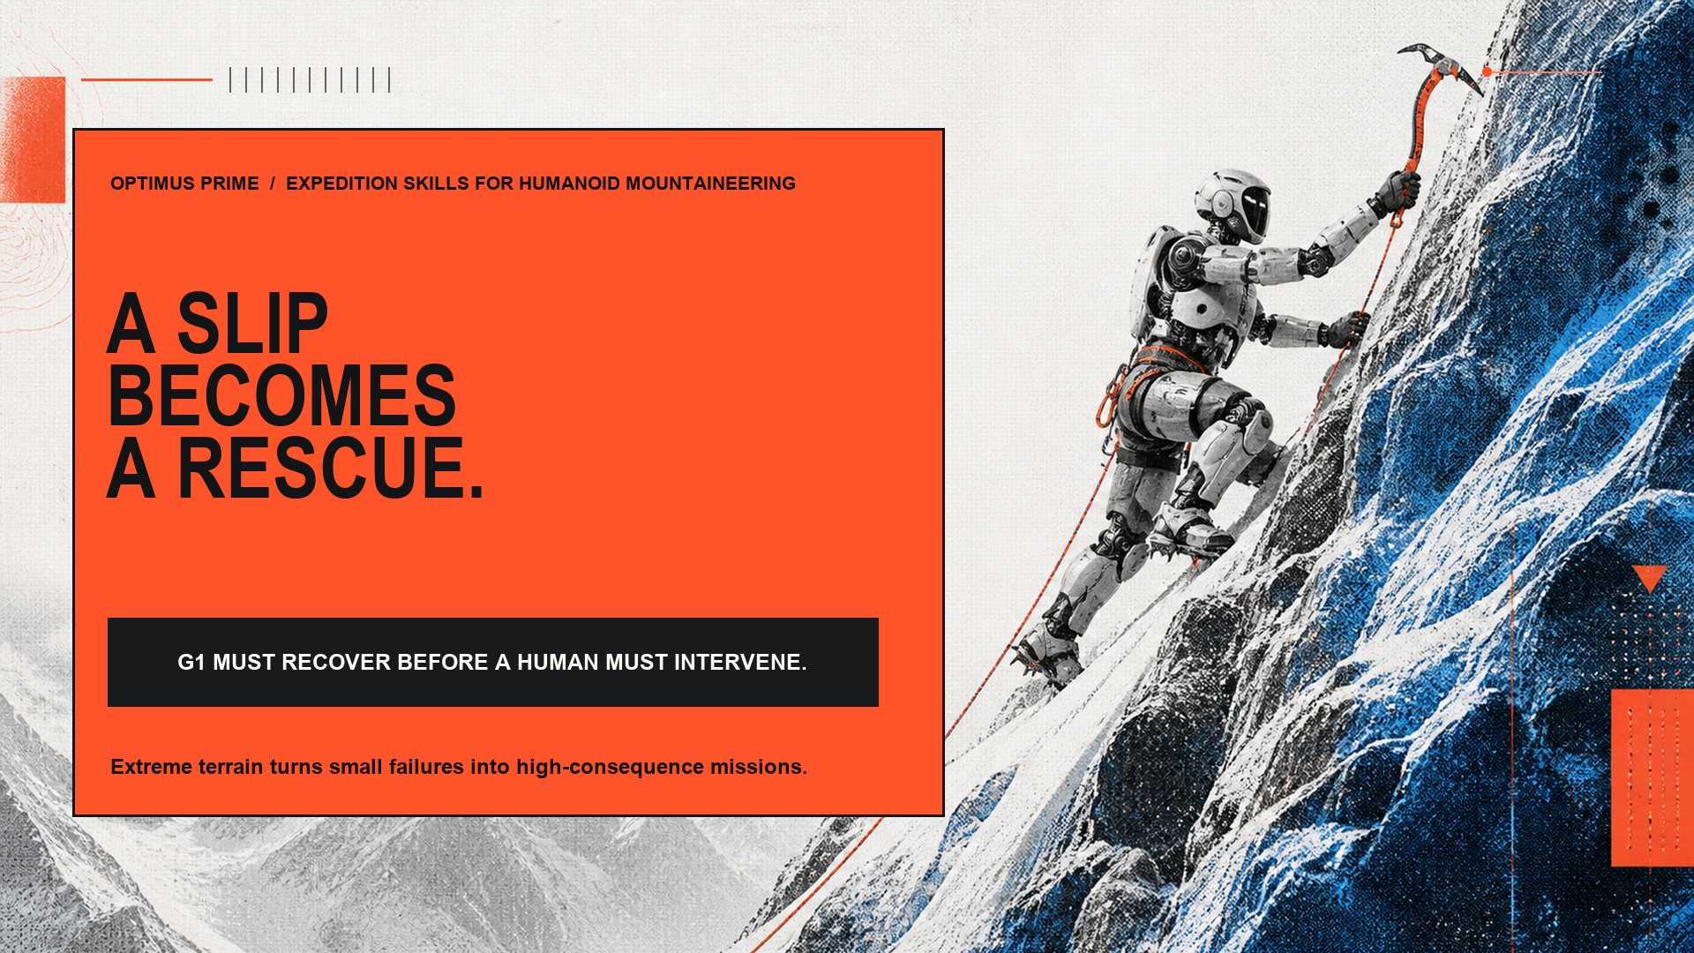
Notes:
0:00–0:15 — The mountain amplifies small errors. Our goal is simple: when G1 slips, reaches a cliff, or finds a blocked route, it can recover or keep moving without sending a person into danger.

Slide 2
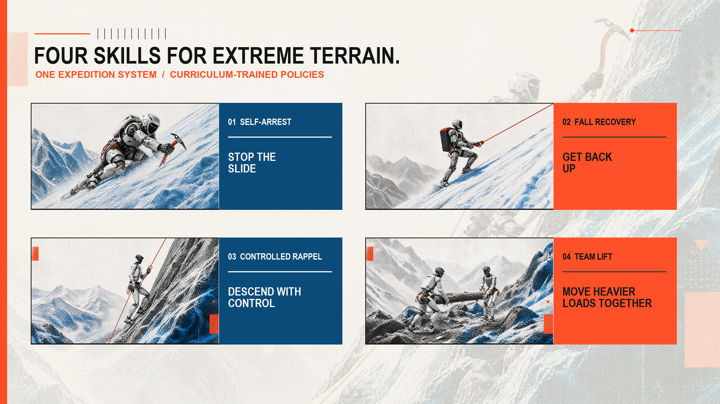
Notes:
0:15–0:30 — We built four skills: stop a slide, recover on a fixed line, descend under control, and move a load that one robot cannot.

Slide 3
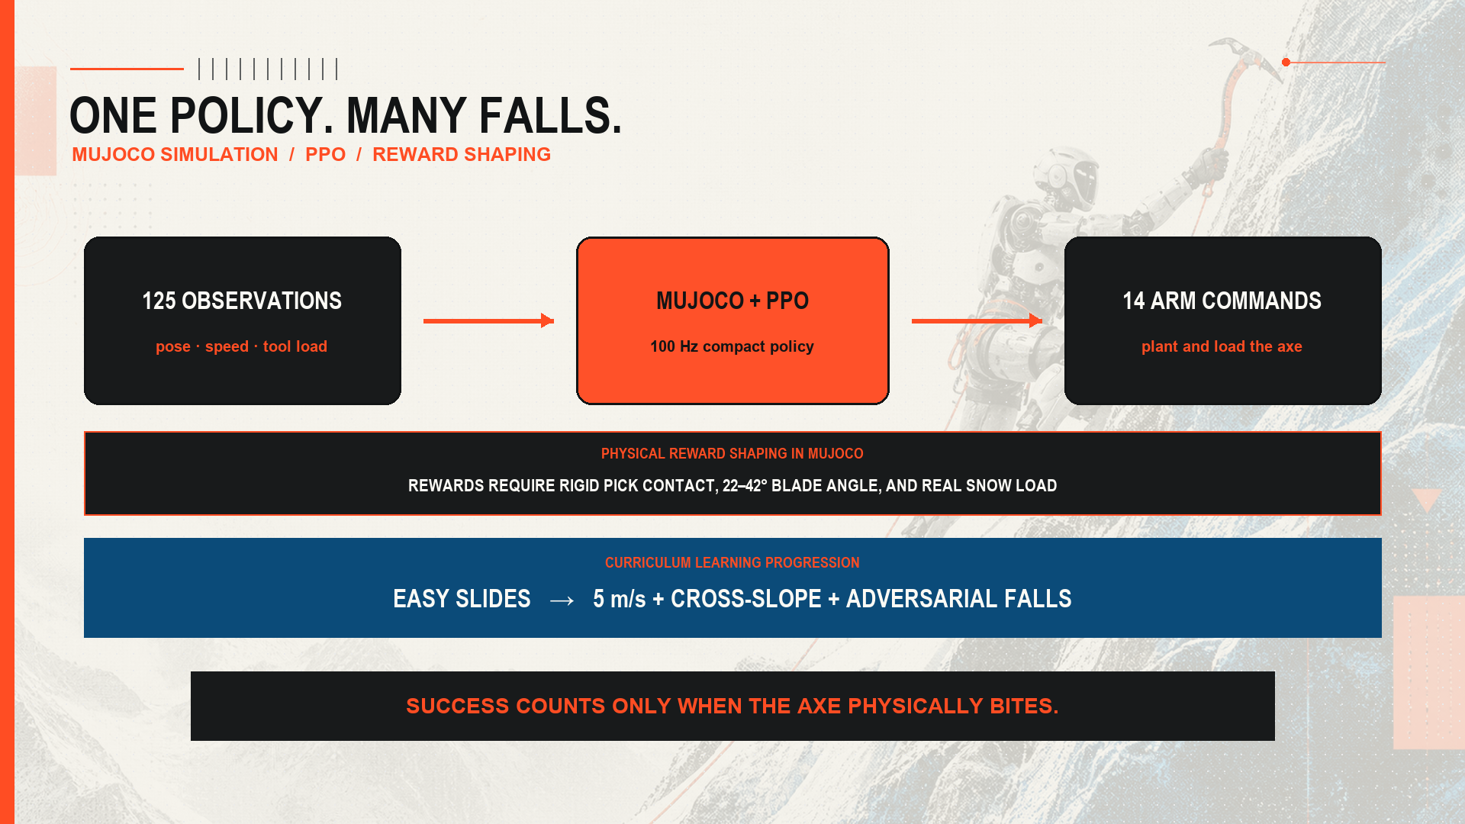
Notes:
0:30–0:45 — In MuJoCo, 125 observation features enter a compact PPO policy for single-robot skills. Physical reward shaping enforces true pick contact and blade angle, while curriculum learning progresses from easy slides to fast cross-slope falls.

Slide 4
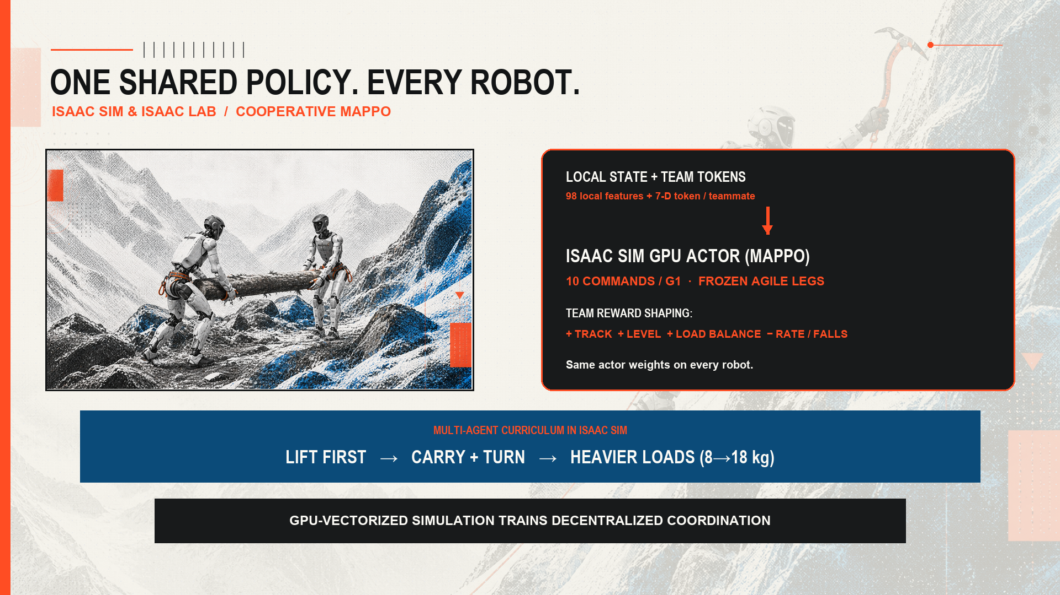
Notes:
0:45–1:00 — In Isaac Sim, every G1 runs the same MAPPO actor trained with centralized team reward shaping for load balance and levelness. A multi-agent curriculum teaches lift first, then carry, turn, and heavier loads.

Slide 5
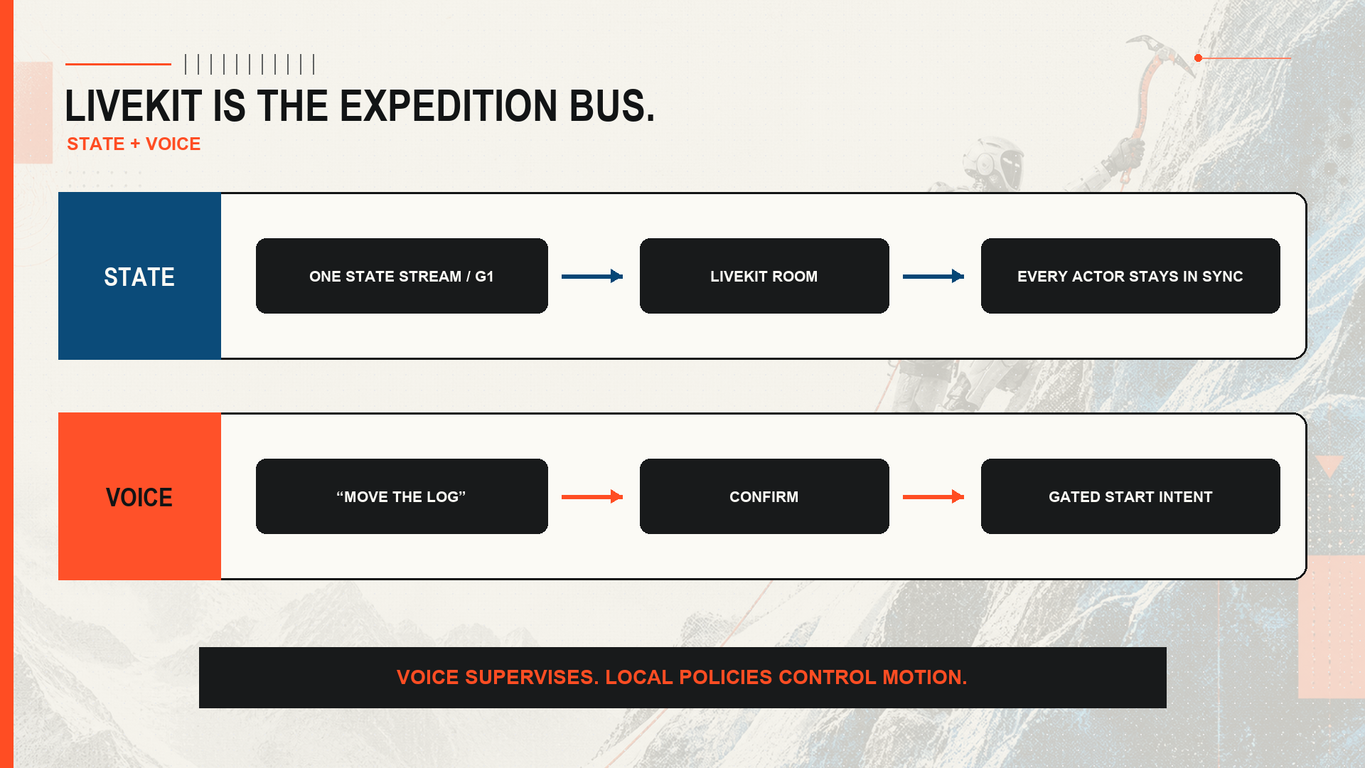
Notes:
1:00–1:15 — LiveKit is the field bus. Each robot publishes one state stream. Voice can ask for load or issue ‘move the log’; confirmation gates the mission, while local policies control joints.

Slide 6
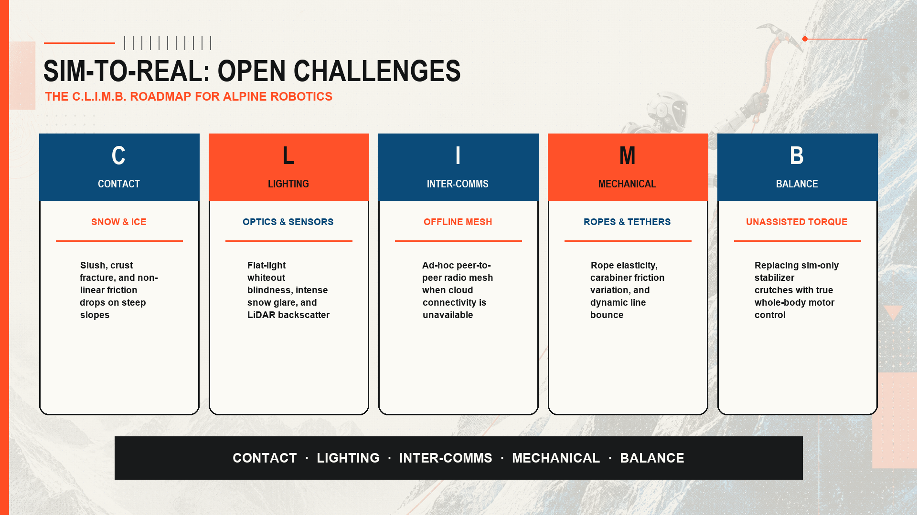
Notes:
1:15–1:30 — The C.L.I.M.B. roadmap captures the open sim-to-real challenges: contact dynamics on snow, harsh lighting & whiteouts, offline inter-robot comms, rope mechanics, and unassisted balance.

