Slide 1
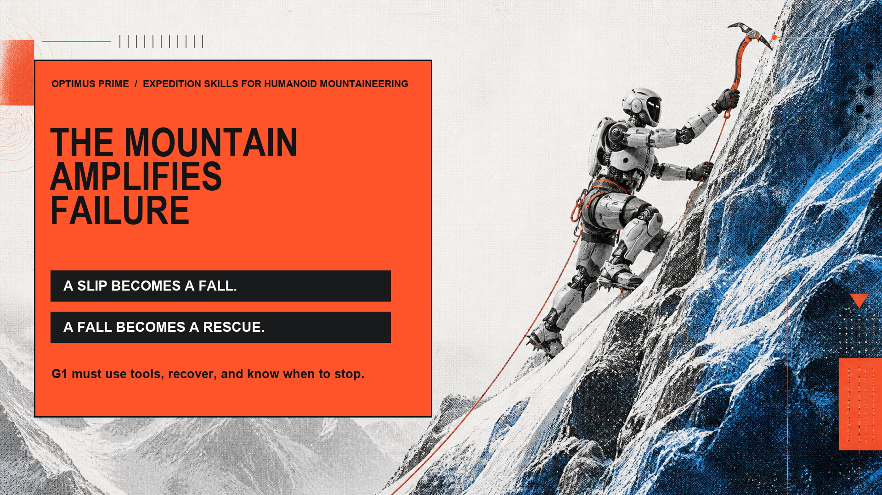
Notes:
0:00–0:15 — Mountains punish small failures. A slip becomes a fall; storm debris blocks the route. The G1 we bring to the Himalayas needs skills that use alpine tools, recover, and know when to stop.

Slide 2
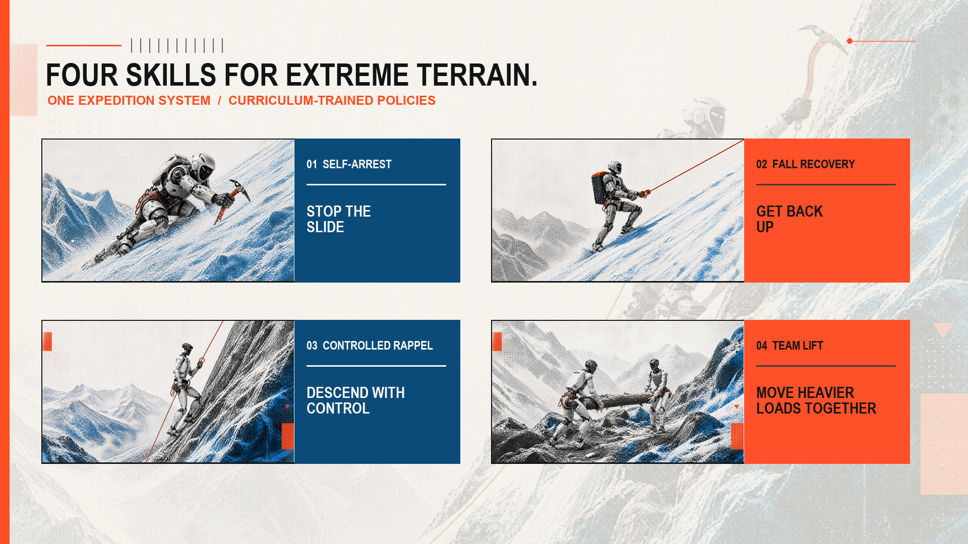
Notes:
0:15–0:30 — Optimus Prime built four skills: ice-axe self-arrest, fixed-line recovery, controlled rappel, and coordinated lifting that shares a long load.

Slide 3
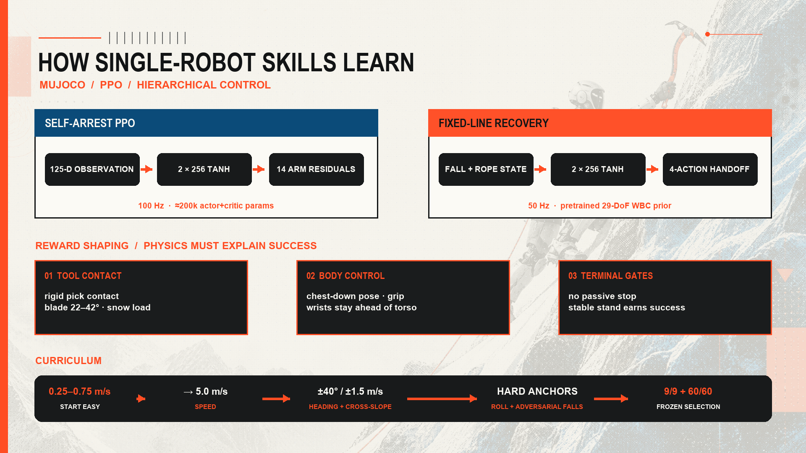
Notes:
0:30–0:47 — Single-robot skills are simulated in MuJoCo. Self-arrest maps 125 measurements to 14 arm residuals at 100 hertz using PPO. Physical reward shaping requires real pick contact, blade angle, grip, and body pose. Progressive curriculum learning expands from gentle slides to 5 m/s cross-slope and adversarial falls.

Slide 4
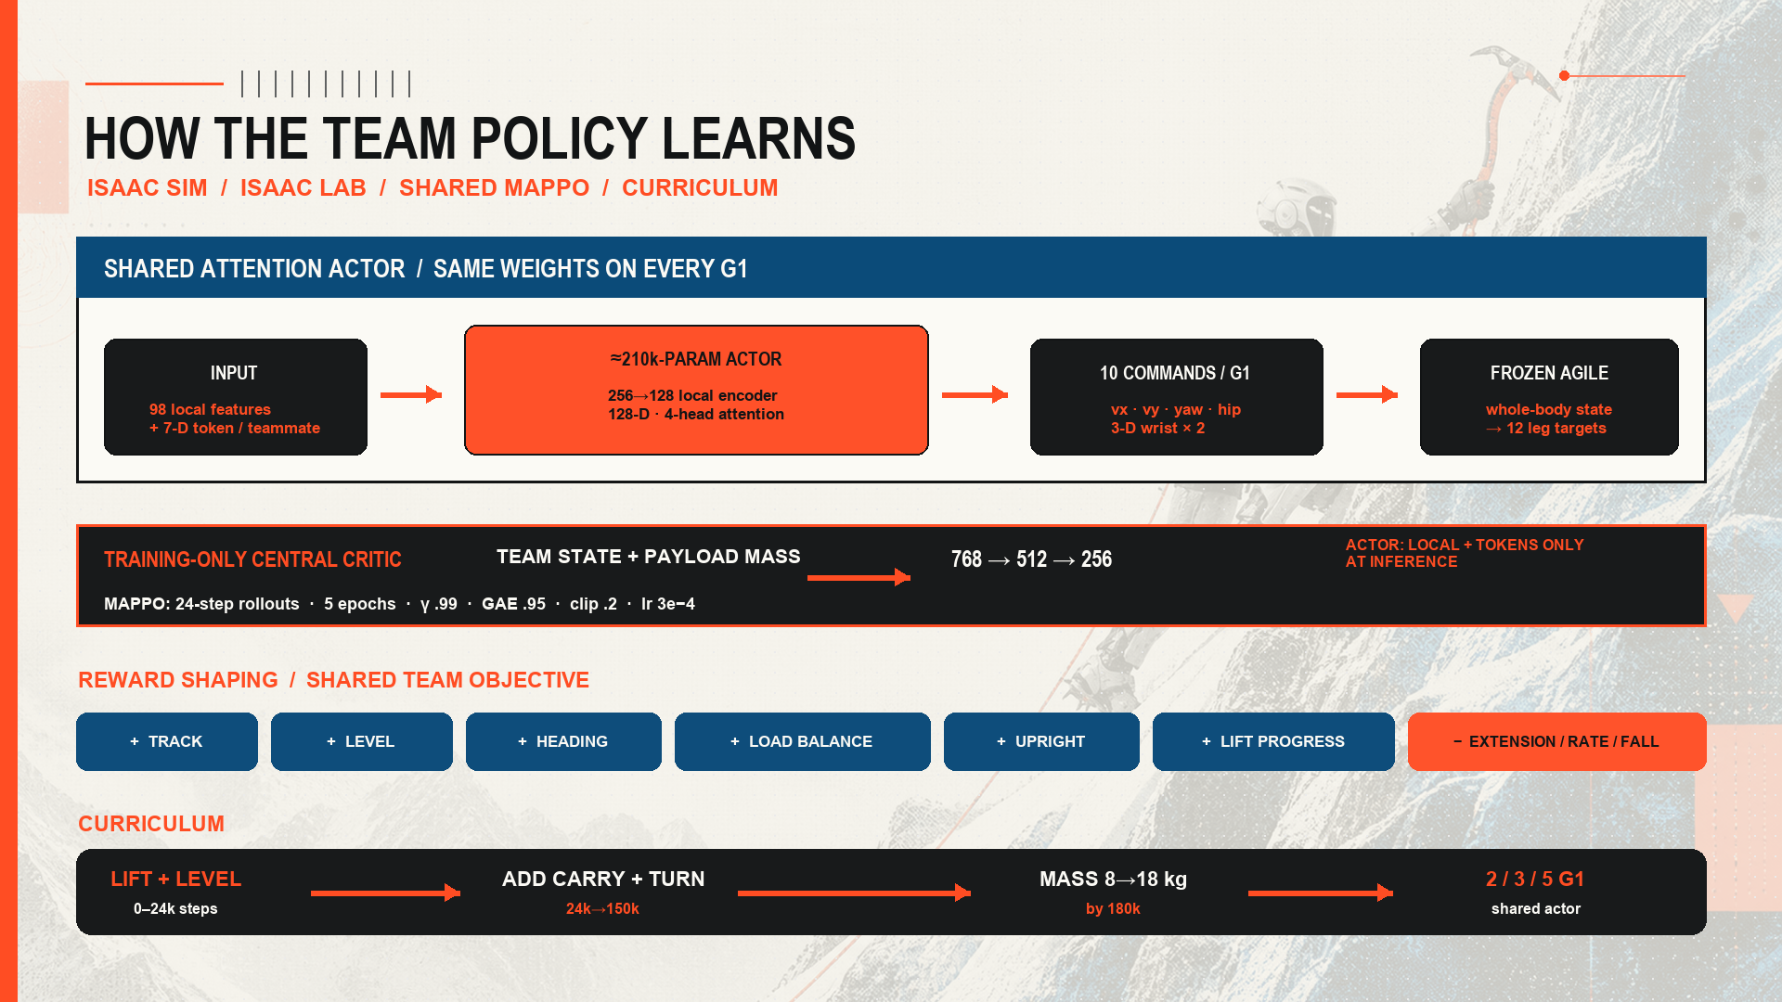
Notes:
0:47–1:04 — In Isaac Sim and Isaac Lab, one shared MAPPO actor embeds 98 local features and 7-value teammate tokens with 4-head attention. A centralized critic trains a shaped team reward for tracking, levelness, load balance, and upright stance across a multi-stage curriculum from lifting to carrying and turning.

Slide 5
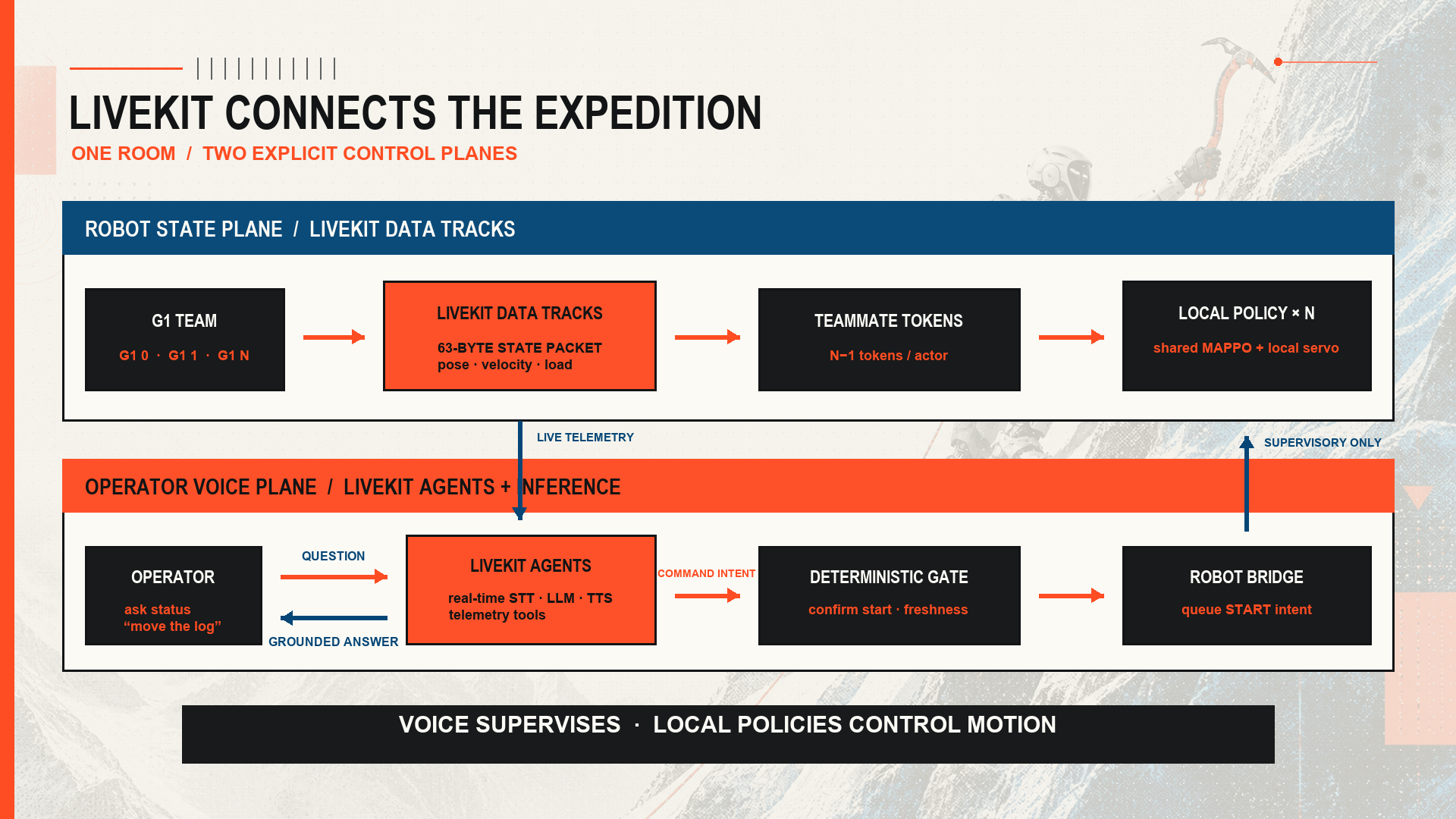
Notes:
1:04–1:17 — At inference, LiveKit carries state and voice. One uplink per robot feeds every actor. The agent answers telemetry questions and turns ‘move the log’ into a confirmed, gated start intent. Local policies still control motion.

Slide 6
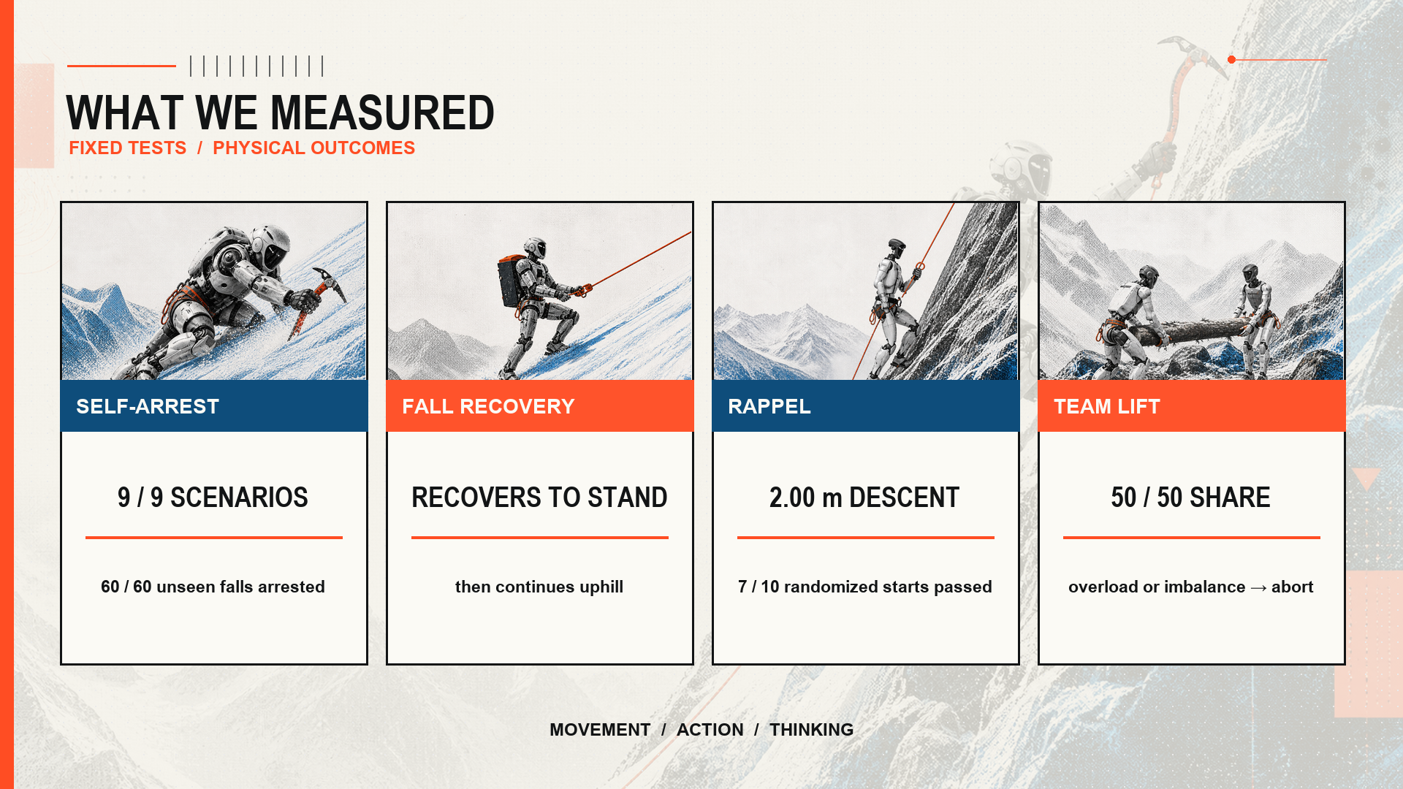
Notes:
1:17–1:30 — Frozen tests arrested nine of nine named and sixty of sixty randomized falls. Rappel descended two meters; the lift split load evenly. Now, the demo.

Slide 7
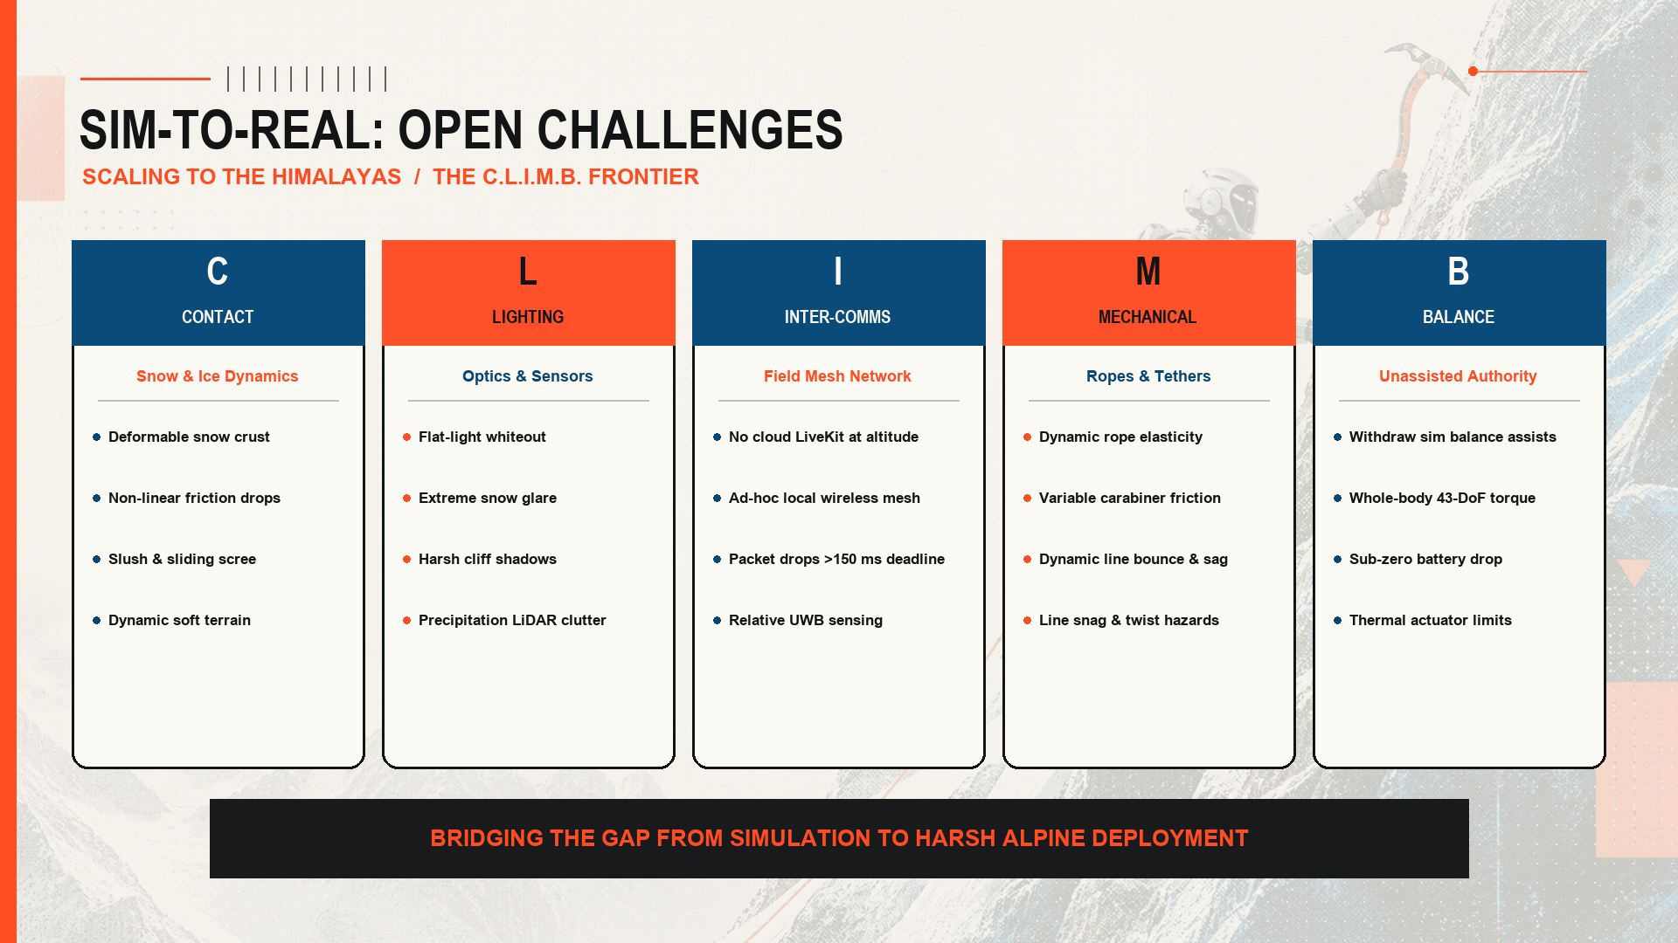
Notes:
1:30–1:45 — Open challenges & sim-to-real roadmap: the C.L.I.M.B. framework addresses contact dynamics on snow/ice, lighting/sensor breakdown, ad-hoc inter-robot mesh comms without cloud, dynamic mechanical tethers, and balance without simulation stabilizer crutches.

