Slide 2
Meeting Attendees
Liz Alexander, Planning Director, Third Revolution Projects
Sandy Scott, Senior Planner, Third Revolution Projects
Josh Rogers, Graduate Planner, Third Revolution Projects
Corey Isolda, Senior Development Manager, Renewable Connections
Jennifer Cheung, Project Assistant, Renewable Connections
Martha Hughes, Warrington Borough Council

Slide 3

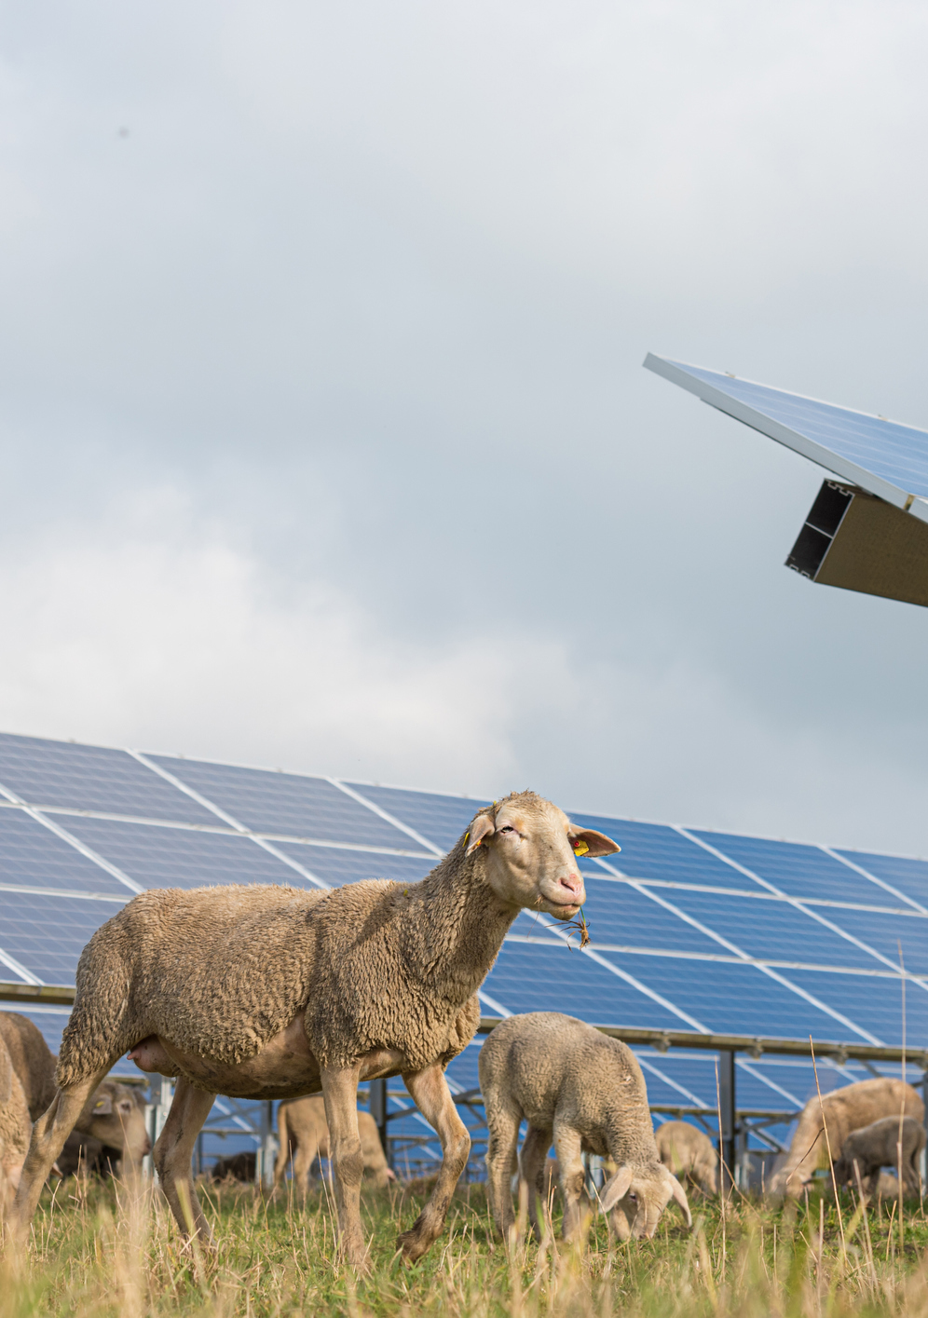

Background
Renewable Connections was established by sustainable energy investment specialist, Armstrong Capital Management and is one of the UK’s leading solar and battery developers.
We deliver highly innovative renewable energy developments across the UK and take a responsible, community-led approach to the planning and design of our projects.
With an outstanding success record of achieving 23 project consents as of Nov 2024, the Renewable Connections team are unlocking hundreds of megawatts of solar and storage, increasing energy independence in the UK, and supporting the Government to reach its net zero targets.

Slide 4

Introduction
The proposed description of development is: “Proposed solar photovoltaic farm and associated infrastructure”
The purpose of the pre-application request is to explore all key planning matters relating to the proposed development prior to the submission of a formal planning application.

Slide 5
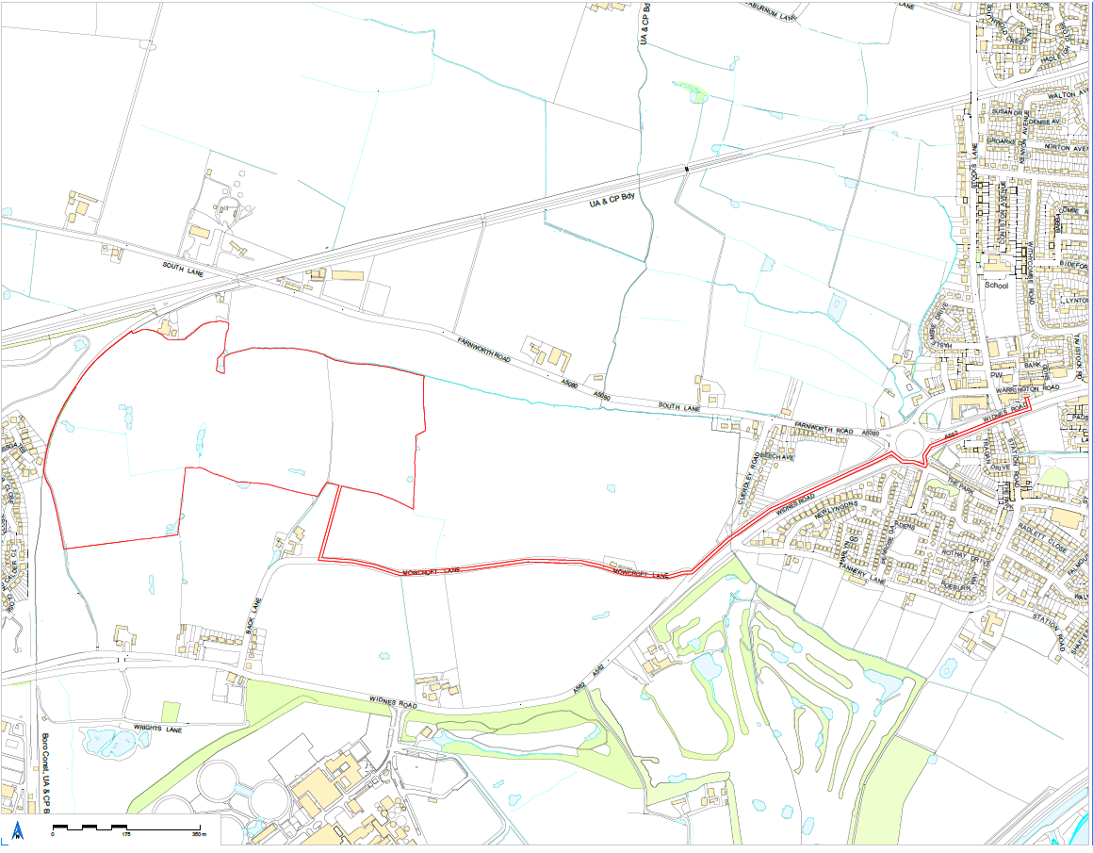
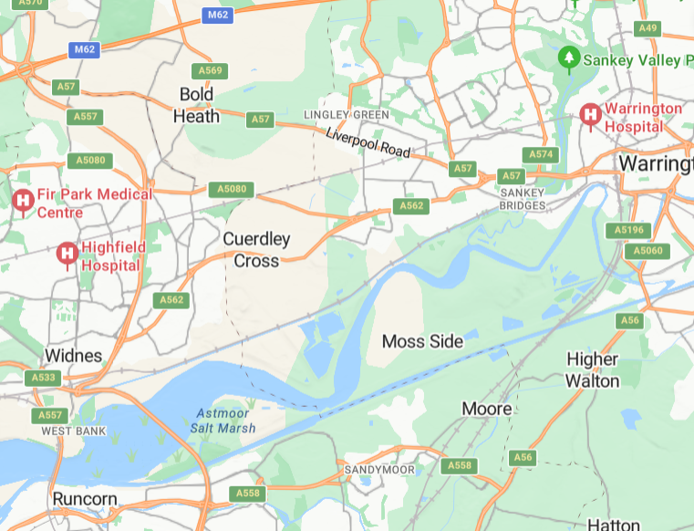
Site Context
The Proposed Site comprises approximately 32 hectares of land located at Fowl Farm, Cuerdley, Warrington WA5 2XQ

Slide 6
Proposed Development
Proposed Development:
Solar Panels no more than 3m above the ground
DNO Substation within the eastern parcel
Likely to include post and wire deer fence approximately 2m high
CCTV cameras mounted on posts
Associated transformers and maintenance tracks
Existing vegetation retained across the site
New vegetation screening as necessary to reduce any perceived visual impact

Slide 7

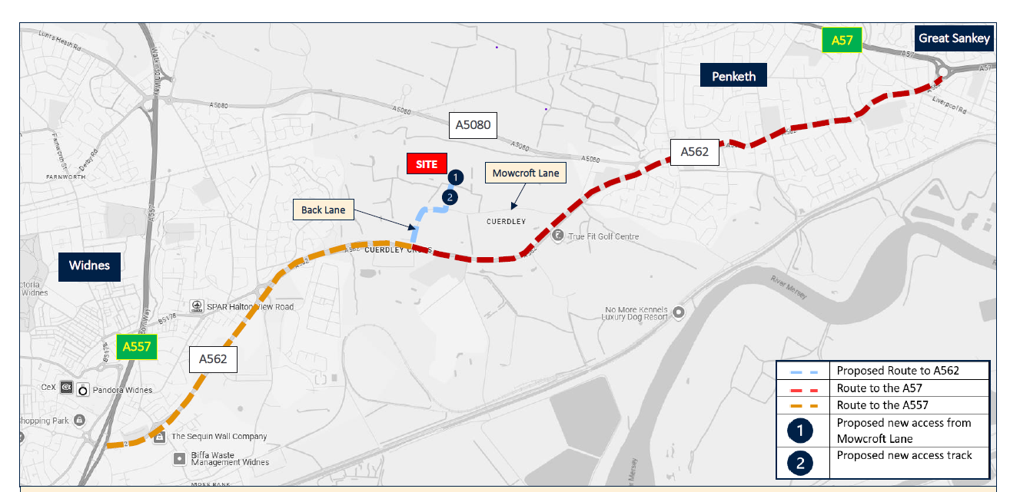
Highways, Access and Construction
Sites are accessed via A562, and on to Back Lane
Notes:
All vehicles will travel to and from the site via the A562 and Back Lane. Vehicles could travel to or from the west or east, although it’s more likely only inbound vehicles would travel from the east due to the radii constraints at the Back Lane junction

Slide 8
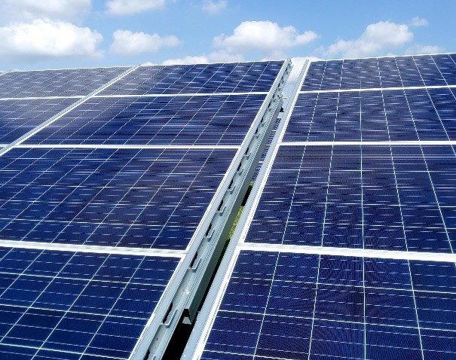

Principle of Development
ENV7 (Renewable Energy and Low Carbon Energy Development) states that renewables developments will be permitted provided they ‘satisfy the requirements of other relevant Plan policies and would not result in unacceptable harm to the local environment’.
Part 14 of NPPF, para. 157 states that planning plays a key role in helping to shape places to secure radical reductions in greenhouse gas emissions and supporting the delivery of renewable energy infrastructure.
Para. 163 states that local planning authorities should not require applicants to demonstrate the need for renewable energy development and that applications should be approved if the impacts are (or can be made) acceptable.
Project will directly address the climate emergency declared by the Government on 1st May 2019 and Warrington Borough Council in 2019, supporting the transition away from fossil fuels.

Slide 9
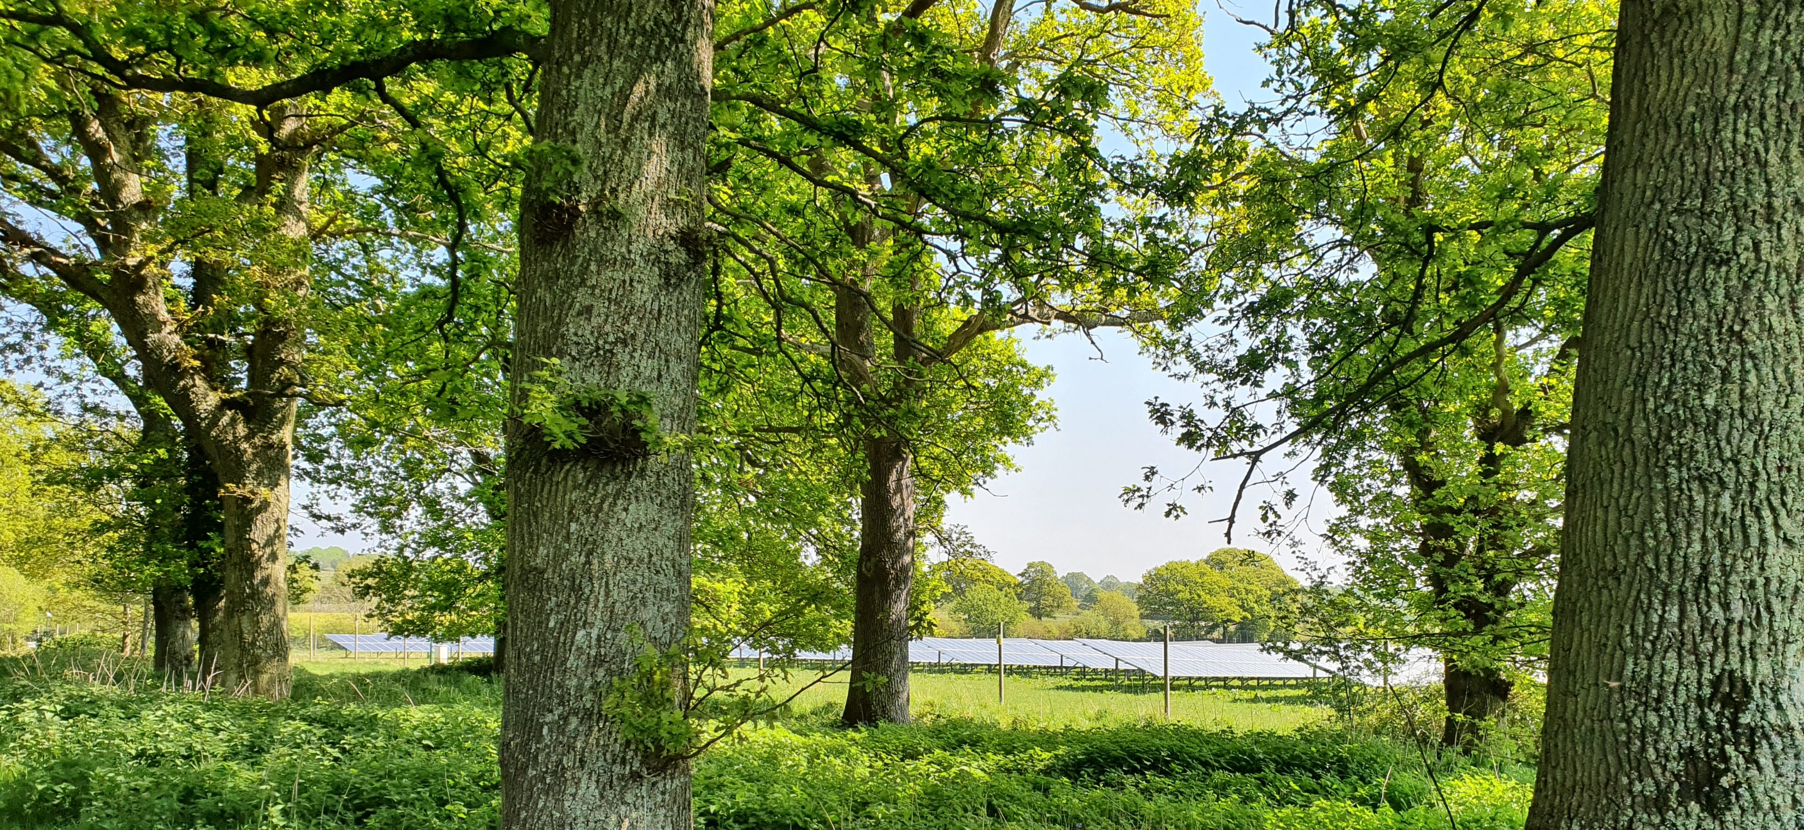
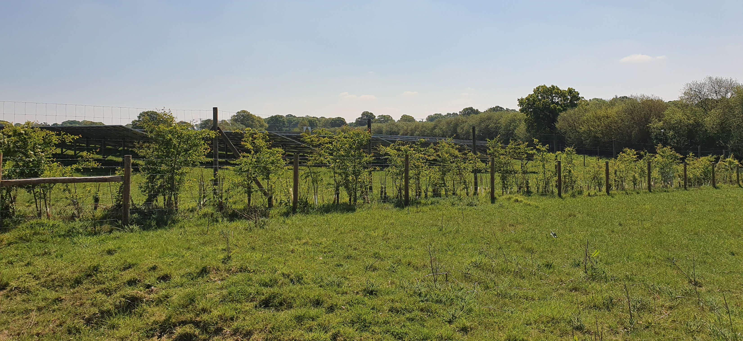
Key Considerations
Landscape and Visual
Heritage / Archaeology
Ecology / Biodiversity
Flood Risk and drainage
Transport and access
Amenity
Agricultural Land
Planning obligations

Slide 10
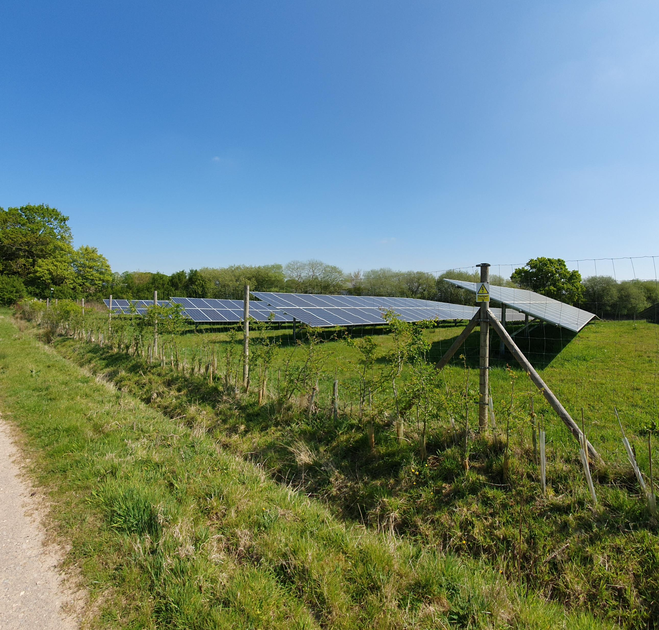
Green Belt Designation
Application site is within the Greenbelt and in terms of existing policy is considered inappropriate development
Analysis of the site’s contribution to the five purposes of the Green Belt as set out in the NPPF will accompany the planning application
If necessary, a case for very special circumstances will support the proposal - including the wider environmental benefits associated with increased production of energy from renewable sources.

Slide 11
Scope of Supporting Information
Based on our understanding of the site context and the proposed validation requirements for this type of development we consider that the following might be required:
Flood Risk Assessment/SUDS/ Water Management Scheme
Cultural Heritage Statement
Noise Impact Assessment
Agricultural Land Classification Report
Levels survey information and cross sections
Construction Traffic Management Plan
Planning Statement/Statement of Community Involvement inc allocation specific as relevant
Tree Survey
Ecological Survey, Protected Species surveys and BNG proposals
Landscape and Visual Impact Assessment
Transport Assessment/ Statement
Photographs and Photomontages
Details of Materials (DAS)
Glint & Glare Assessment

Slide 12
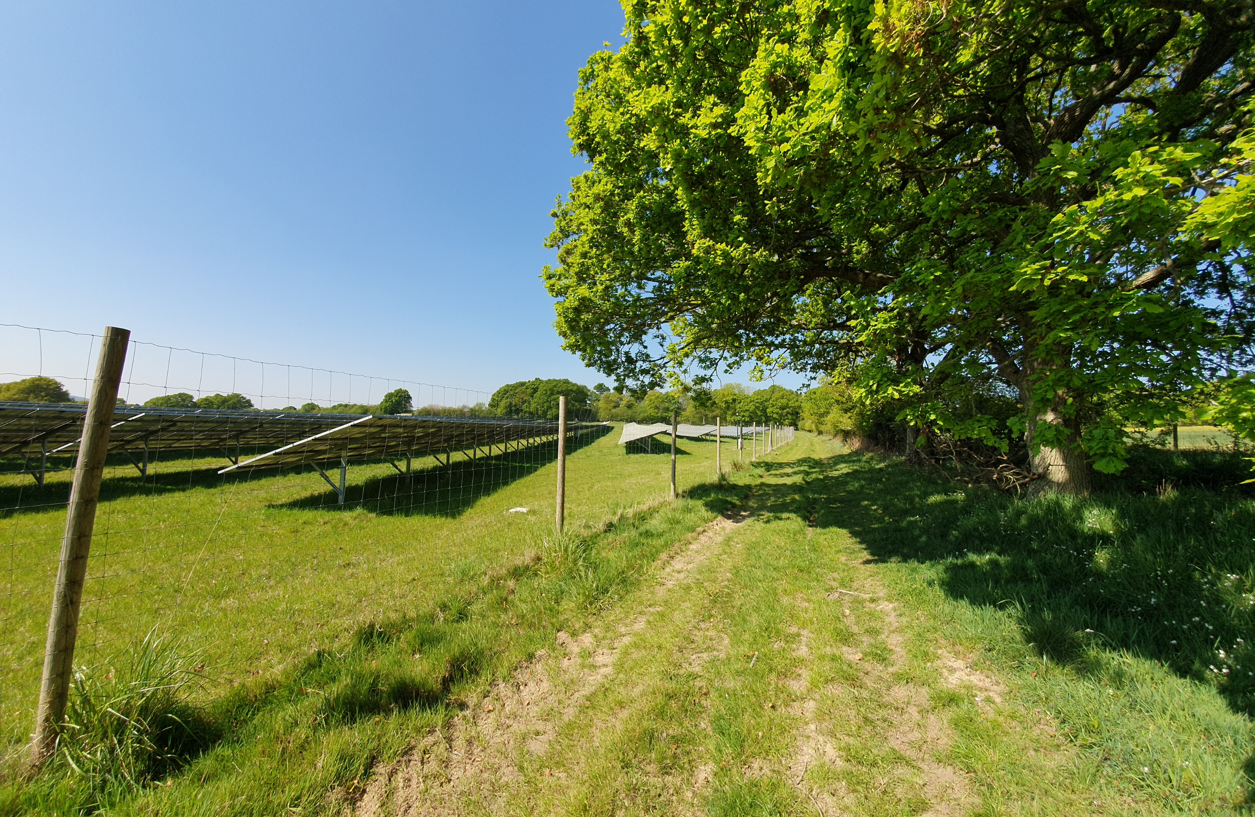
Liz Alexander
Planning Director, Third Revolution Projects
liz.alexander@thirdrevolutionprojects.co.uk
Notes:
Andrew Dowell
Associate Planner, Third Revolution Projects
Andrew.dowell@thirdrevolutionprojects.co.uk

