Slide 1



Slide 2

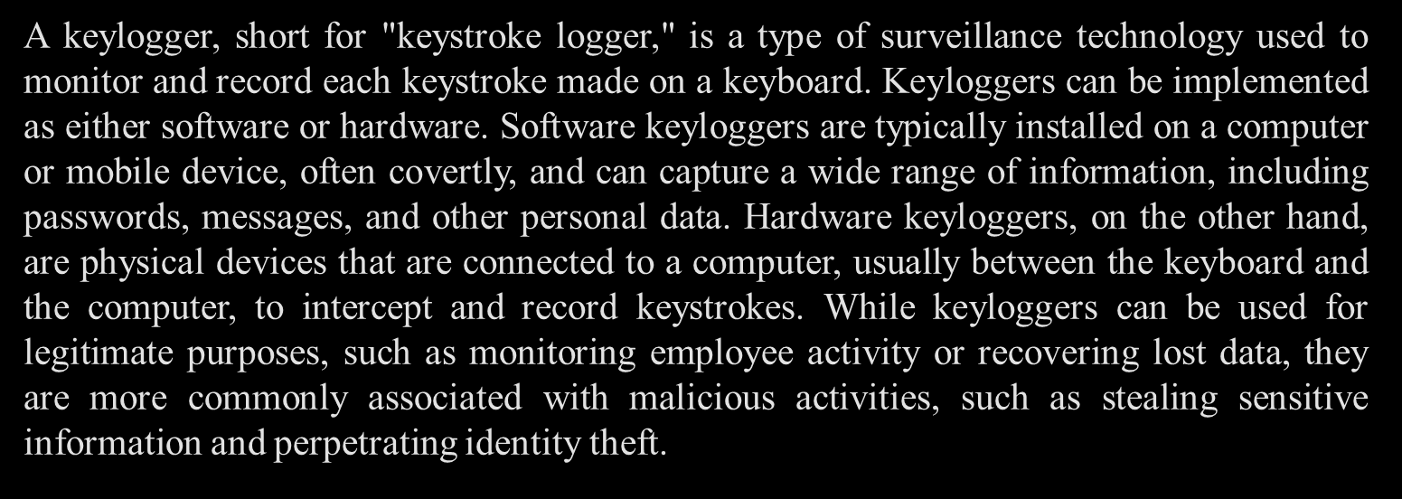

Slide 3



Slide 4



Slide 5



Slide 6



Slide 7



Slide 8



Slide 9

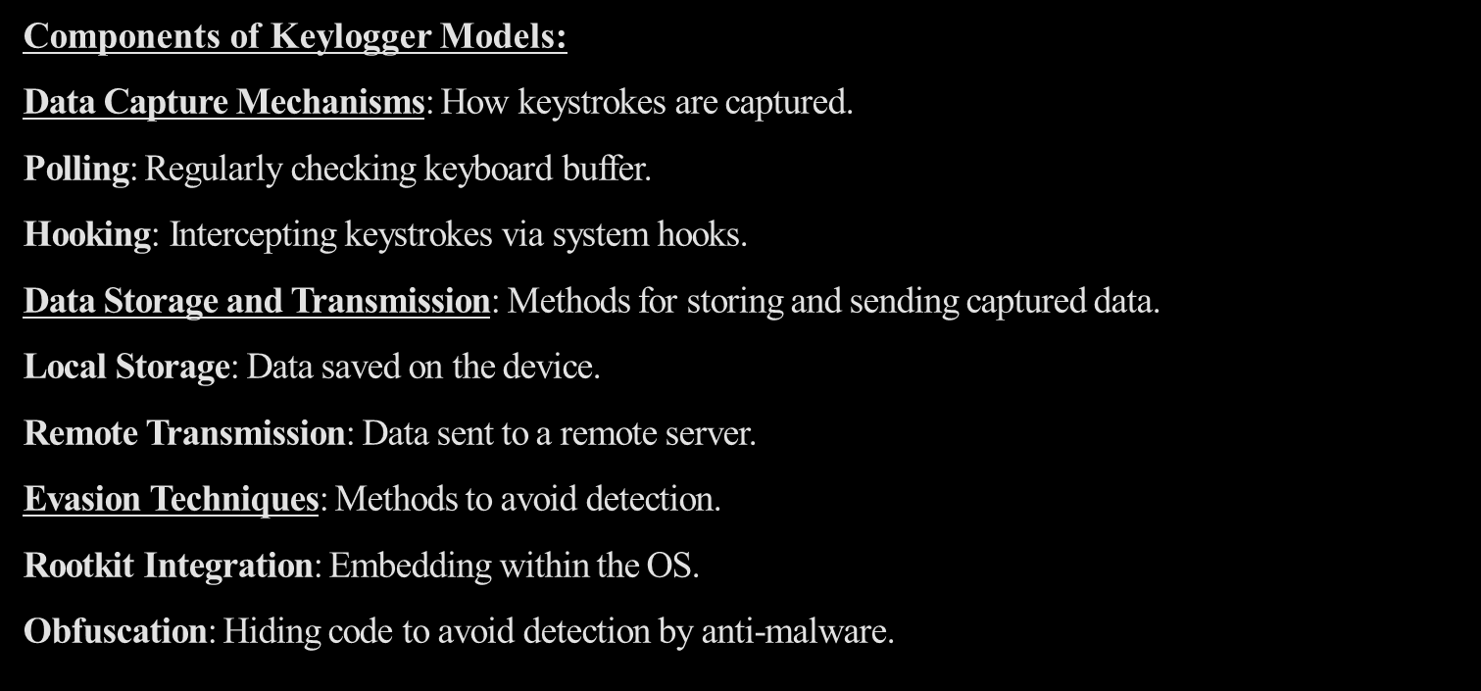

Slide 10


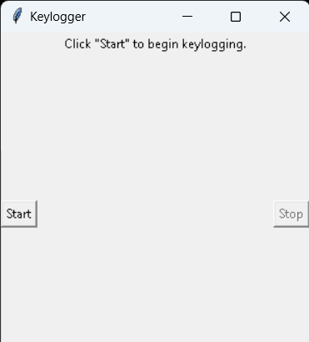
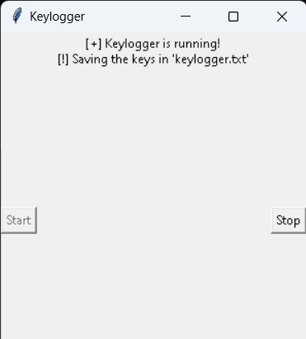
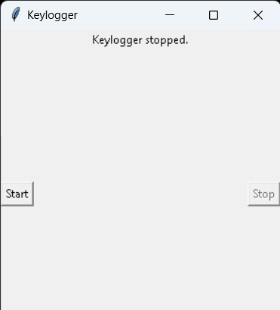

Slide 11


Slide 12
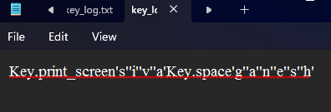

Slide 13


Slide 14
For any queries contact padmapriyankan@gmail.com

