Slide 1
A/B testing
aka split testing, bucket testing, and multivariant testing

Slide 2
Empirical
Field study

Slide 3
What is it?
Controlled experiments
Web site
Authentic users
Split users into two groups:
Control
Test variant
Cookies can ensure an individual gets consistent version.
A metric (the overall evaluation criteria, or OEC) eg
Click-through rate
Purchases

Slide 4
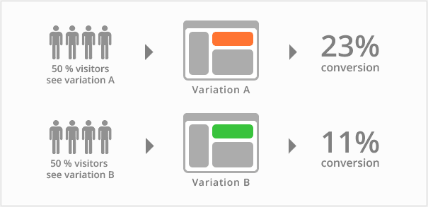
https://vwo.com/ab-testing/

Slide 5
Process
Driving question:
eg Can I increase click through rates from my home page
Hypothesis:
eg. Underlined links will outperform my current links
Calculate time to run test:
eg A/B Test Duration Calculator.
Run the test:
x% of users get underlined links
How to decide x?
Review results

Slide 6
https://vwo.com/ab-testing/

Slide 7
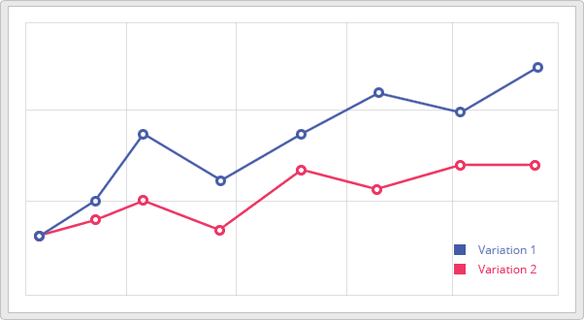
https://vwo.com/ab-testing/

Slide 8
Holson, Laura M. [2009]. Putting a Bolder Face on Google. New York Times. 1st Mar 2009. http: //www.nytimes.com/2009/03/01/business/01marissa.html

Slide 9

Mayer, Marissa [2009]. “Design @ Google”. In: AIGA Design Conference 2009. AIGA. 9th Oct 2009. http://www.aiga.org/content.cfm/video-makethink-2009-mayer 41 shades of blue … gmail blue was a little more green and the search blue was more blue
Oct, 2015

Slide 10
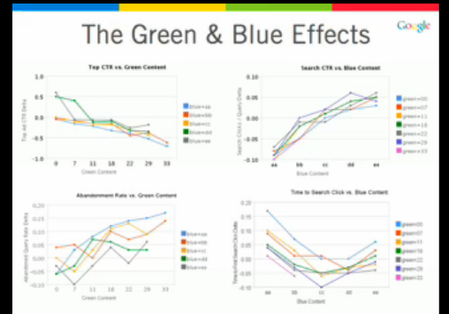
More green, worse clicks on search and more abandonment
More blue, brighter the blue, faster to search click

Slide 11
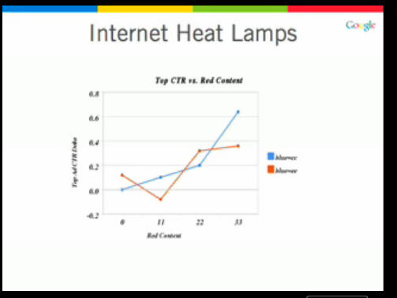
Adding red improves performance

Slide 12
http://www.nngroup.com/articles/ab-testing-usability-engineering/
A/B Testing, Usability Engineering, Radical Innovation: What Pays Best?
by Jakob Nielsen on March 26, 2012

Slide 13
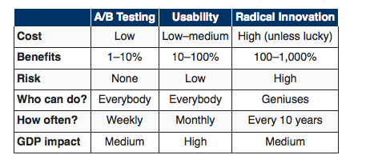

Slide 14
http://www.itworld.com/article/2703183/it-management/a-b-tests--cut-the-fluff-and-spend-the-pixels-on-design-elements-of-interest-to-users.html
There are dozens of A/B consultants, tools and compendiums of tips and tricks. Here are a few links to check out:
Robin Johnson, writing earlier this year in Optimizely, gives you 71 different ideas on things to test, including website copy, visual elements and just plain common sense things such as whether you have a positive or negative spin on what you are trying to sell.
Uri Bar-Joseph, writing in SearchEngineWatch, has eight rules for A/B testing, including focusing on one variable, choosing your groups randomly and measuring the results carefully.
Brian Conklin of Vocus has his own nine rules in this blog post, including doing an 10-10-80% split: meaning start with ten percent of your users testing each of two options. Once you determine a winner, send the results to the remaining 80 percent of your audience.
And if you want to have some fun with A/B tests of the past, take a look at these 12 results that were somewhat counter-intuitive from WhichTestWon.com, a commercial A/B testing provider.

Slide 15
12 results somewhat counter-intuitive A/B tests.
https://whichtestwon.com/

Slide 16
https://whichtestwon.com/test/with-sliders-or-without/ Oct 13, 2015
Key Performance Indicator (KPI):
clicks on the sponsorship Call To Action button
Difference between versions: Version A: Sponsor a child page formatted with sliders Version B: Radically redesigned sponsorship page, without sliders

Slide 17
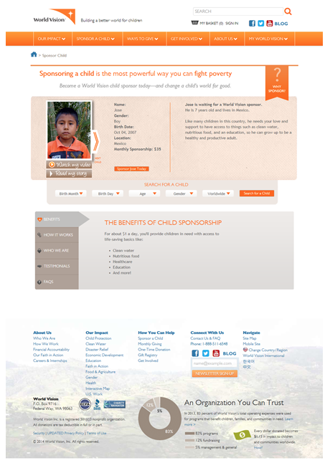
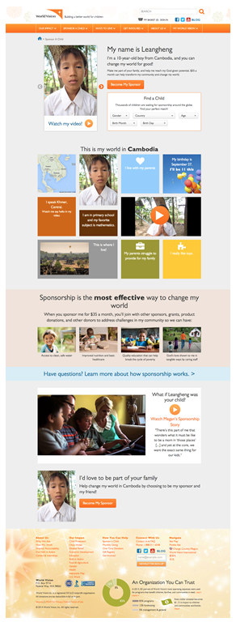

Slide 18
And the winner is
Version B
60.4% increase in clicks on the sponsorship button!
Used:
Optimizely used
14 days 8,600 visitors.
Key differences
Story, narrative
updated visual flow
clickable colored boxes were interactive

Slide 19
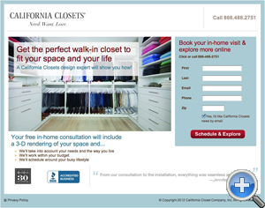
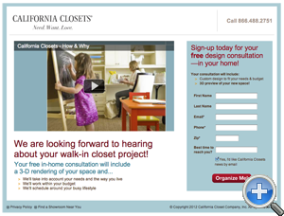
Final Page in a 4 Step Sequence

Slide 20
Both pages are well-designed and both, seemingly, doing a good job
Version B.
video centrepiece, well-structured copy; it should convert
Version A had 439% higher performance.
Post-hoc rationalisation
text within the image brings focus
Form has fewer of fields looks shorter
“two images give the page a more authentic and trustworthy feel”

Slide 21
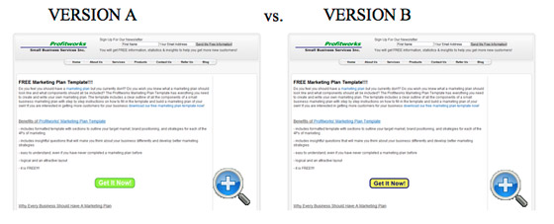
Test 11: A/B Button Color Test: Which Page Drove More Clicks to a Lead Generation Form?

Slide 22
Ah! The simple button color test.
“Green is an affirming color that signifies positive action, in this case it’s been used with white text which completely washes the button out. It’s hard to know what the button is for at first glance.”
“Version B’s yellow and black button may be ugly (and I mean ugly), but it is clear and led to a 14.5% increase in conversions.”

Slide 23
Summary
Studying user’s actual behaviour
Web as experimental platform
Ease of testing
A/B testing as an example of
Field studies…. Authenticity
Large scale empirical study cf Think-Aloud

