Slide 1

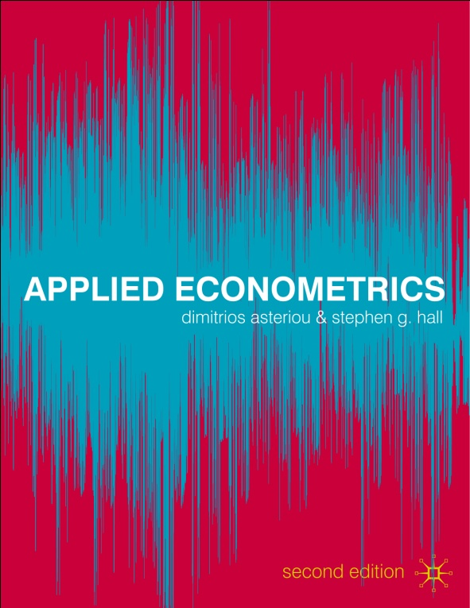

Applied Econometrics Second edition
Dimitrios Asteriou and Stephen G. Hall

Slide 2
HETEROSKEDASTICITY
1. What is Heteroskedasticity
2. Consequences of Heteroskedasticity
3. Detecting Heteroskedasticity
4. Resolving Heteroskedasticity

Slide 3
Learning Objectives
1. Understand the meaning of heteroskedasticity and homoskedasticity through examples.
2. Understand the consequences of heteroskedasticity on OLS estimates.
3. Detect heteroskedasticity through graph inspection.
4. Detect heteroskedasticity through formal econometric tests.
5. Distinguish among the wide range of available tests for detecting heteroskedasticity.
6. Perform heteroskedasticity tests using econometric software.
7. Resolve heteroskedasticity using econometric software.

Slide 4
What is Heteroskedasticity
Hetero (different or unequal) is the opposite of Homo (same or equal)…
Skedastic means spread or scatter…
Homoskedasticity = equal spread
Heteroskedasticity = unequal spread

Slide 5
What is Heteroskedasticity
Assumption 5 of the CLRM states that the disturbances should have a constant (equal) variance independent of t:
Var(u_{t})=σ²
Therefore, having an equal variance means that the disturbances are homoskedastic.

Slide 6
What is Heteroskedasticity
If the homoskedasticity assumption is violated then
Var(u_{t})=σ_{t}²
Where the only difference is the subscript t, attached to the σ_{t}², which means that the variance can change for every different observation in the sample t=1, 2, 3, 4, …, n.
Look at the following graphs…

Slide 7
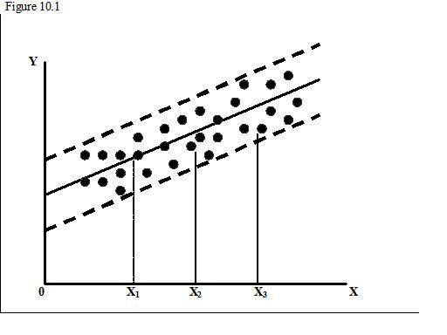
What is Heteroskedasticity

Slide 8
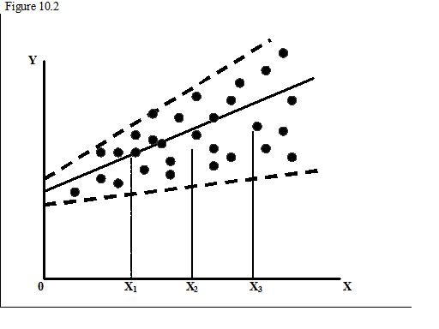
What is Heteroskedasticity

Slide 9
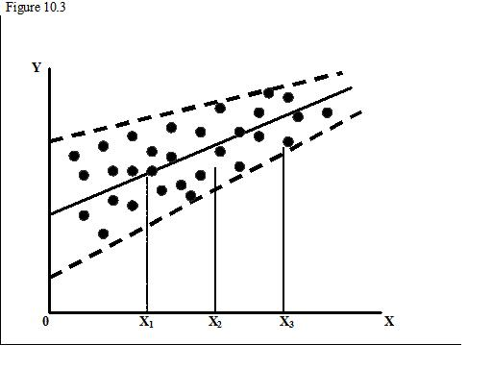
What is Heteroskedasticity

Slide 10
What is Heteroskedasticity
First graph: Homoskedastic residuals
Second graph: income-consumption patterns, for low levels of income not much choices, opposite for high levels.
Third graph: improvements in data collection techniques (large banks) or to error learning models (experience decreases the chance of making large errors).

Slide 11
Consequences of Heteroskedasticity
The OLS estimators are still unbiased and consistent. This is because none of the explanatory variables is correlated with the error term. So a correctly specified equation will give us values of estimated coefficient which are very close to the real parameters.
Affects the distribution of the estimated coefficients increasing the variances of the distributions and therefore making the OLS estimators inefficient.
Underestimates the variances of the estimators, leading to higher values of t and F statistics.

Slide 12
Detecting Heteroskedasticity
There are two ways in general.
The first is the informal way which is done through graphs and therefore we call it the graphical method.
The second is through formal tests for heteroskedasticity, like the following ones:
The Breusch-Pagan LM Test
The Glesjer LM Test
The Harvey-Godfrey LM Test
The Park LM Test
The Goldfeld-Quandt Tets
White’s Test

Slide 13
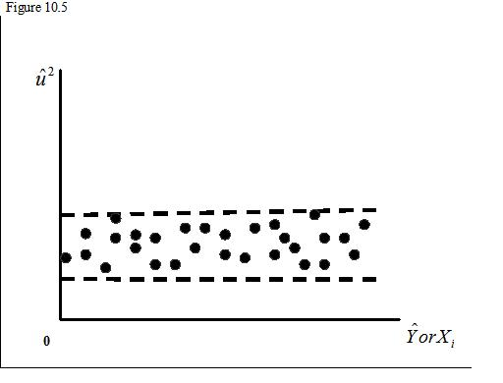
Detecting Heteroskedasticity
We plot the square of the obtained residuals against fitted Y and the X’s and we see the patterns.

Slide 14
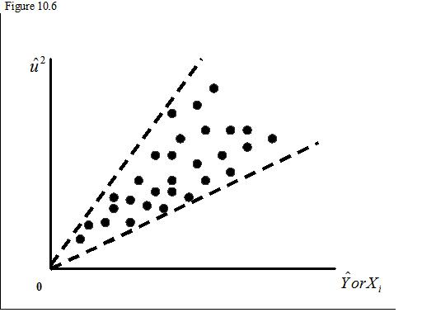
Detecting Heteroskedasticity

Slide 15
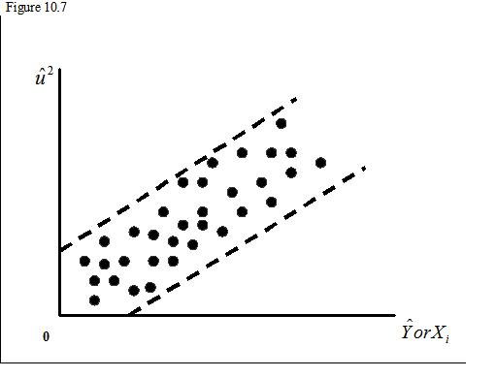
Detecting Heteroskedasticity

Slide 16
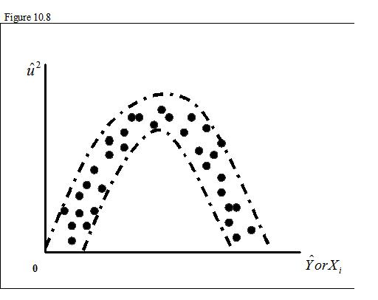
Detecting Heteroskedasticity

Slide 17
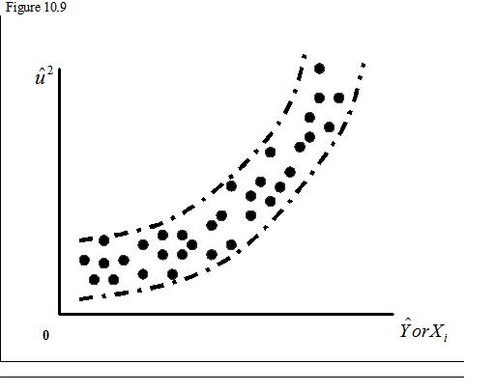
Detecting Heteroskedasticity

Slide 18
The Breusch-Pagan LM Test
Step 1: Estimate the model by OLS and obtain the residuals
Step 2: Run the following auxiliary regression:
Step 3: Compute LM=nR², where n and R² are from the auxiliary regression.
Step 4: If LM-stat>χ²_{p-1} critical reject the null and conclude that there is significant evidence of heteroskedasticity

Slide 19
The Glesjer LM Test
Step 1: Estimate the model by OLS and obtain the residuals
Step 2: Run the following auxiliary regression:
Step 3: Compute LM=nR², where n and R² are from the auxiliary regression.
Step 4: If LM-stat>χ²_{p-1} critical reject the null and conclude that there is significant evidence of heteroskedasticity

Slide 20
The Harvey-Godfrey LM Test
Step 1: Estimate the model by OLS and obtain the residuals
Step 2: Run the following auxiliary regression:
Step 3: Compute LM=nR², where n and R² are from the auxiliary regression.
Step 4: If LM-stat>χ²_{p-1} critical reject the null and conclude that there is significant evidence of heteroskedasticity

Slide 21
The Park LM Test
Step 1: Estimate the model by OLS and obtain the residuals
Step 2: Run the following auxiliary regression:
Step 3: Compute LM=nR², where n and R² are from the auxiliary regression.
Step 4: If LM-stat>χ²_{p-1} critical reject the null and conclude that there is significant evidence of heteroskedasticity

Slide 22
The Engle’s ARCH Test
Engle introduced a new concept allowing for hetero-skedasticity to occur in the variance of the error terms, rather than in the error terms themselves.
The key idea is that the variance of u_{t} depends on the size of the squarred error term lagged one period u²_{t-1} for the first order model or:
Var(u_{t})=γ₁+γ₂u²_{t-1}
The model can be easily extended for higher orders:
Var(u_{t})=γ₁+γ₂u²_{t-1}+…+ γ_{p}u²_{t-p}

Slide 23
The Engle’s ARCH Test
Step 1: Estimate the model by OLS and obtain the residuals
Step 2: Regress the squared residuals to a constant and lagged terms of squared residuals, the number of lags will be determined by the hypothesized order of ARCH effects.
Step 3: Compute the LM statistic = (n-ρ)R² from the LM model and compare it with the chi-square critical value.
Step 4: Conclude

Slide 24
The Goldfeld-Quandt Test
Step 1: Identify one variable that is closely related to the variance of the disturbances, and order (rank) the observations of this variable in descending order (starting with the highest and going to the lowest).
Step 2: Split the ordered sample into two equally sized sub-samples by omitting c central observations, so that the two samples will contain ½(n-c) observations.

Slide 25
The Goldfeld-Quandt Test
Step 3:Run and OLS regression of Y on the X variable that you have used in step 1 for each sub-sample and obtain the RSS for each equation.
Step 4: Caclulate the F-stat=RSS₁/RSS₂, where RSS₁ is the RSS with the largest value.
Step 5: If F-stat>F-crit_{(1/2(n-c)-l,1/2(n-c)-k)} reject the null of homoskedasticity.

Slide 26
The White’s Test
Step 1: Estimate the model by OLS and obtain the residuals
Step 2: Run the following auxiliary regression:
Step 3: Compute LM=nR², where n and R² are from the auxiliary regression.
Step 4: If LM-stat>χ²_{p-1} critical reject the null and conclude that there is significant evidence of heteroskedasticity

Slide 27
Resolving Heteroskedasticity
We have three different cases:
Generalized Least Squares
Weighted Least Squares
Heteroskedasticity-Consistent Estimation Methods

Slide 28
Generalized Least Squares
Consider the model
Y_{t}=β₁+β₂X_{2t}+β₃X_{3t}+β₄X_{4t}+…+β_{k}X_{kt}+u_{t}
where
Var(u_{t})=σ_{t}²

Slide 29
Generalized Least Squares
If we divide each term by the standard deviation of the error term, σ_{t} we get:
Y_{t}=β₁ (1/σ_{t}) +β₂X_{2t}/σ_{t} +β₃X_{3t}/σ_{t} +…+β_{k}X_{kt}/σ_{t} +u_{t}/σ_{t}
or
Y*_{t}= β*₁+ β*₂X*_{2t}+ β*₃X*_{3t}+…+ β*_{k}X*_{kt}+u*_{t}
Where we have now that:
Var(u*_{t})=Var(u_{t}/σ_{t})=Var(u_{t})/σ_{t}²=1

Slide 30
Weighted Least Squares
The GLS procedure is the same as the WLS where we have weights, w_{t}, adjusting our variables.
Define w_{t}=1/σ_{t}, and rewrite the original model as:
w_{t}Y_{t}=β₁w_{t}+β₂X_{2t}w_{t}+β₃X_{3t}w_{t}+…+β_{k}X_{kt}w_{t}+u_{t}w_{t}
Where if we define as w_{t}Y_{t-1}=Y*_{t} and X_{it}w_{t}=X*_{it}
we get
Y*_{t}= β*₁+ β*₂X*_{2t}+ β*₃X*_{3t}+…+ β*_{k}X*_{kt}+u*_{t}

