Slide 1
The EM Algorithm

Slide 2
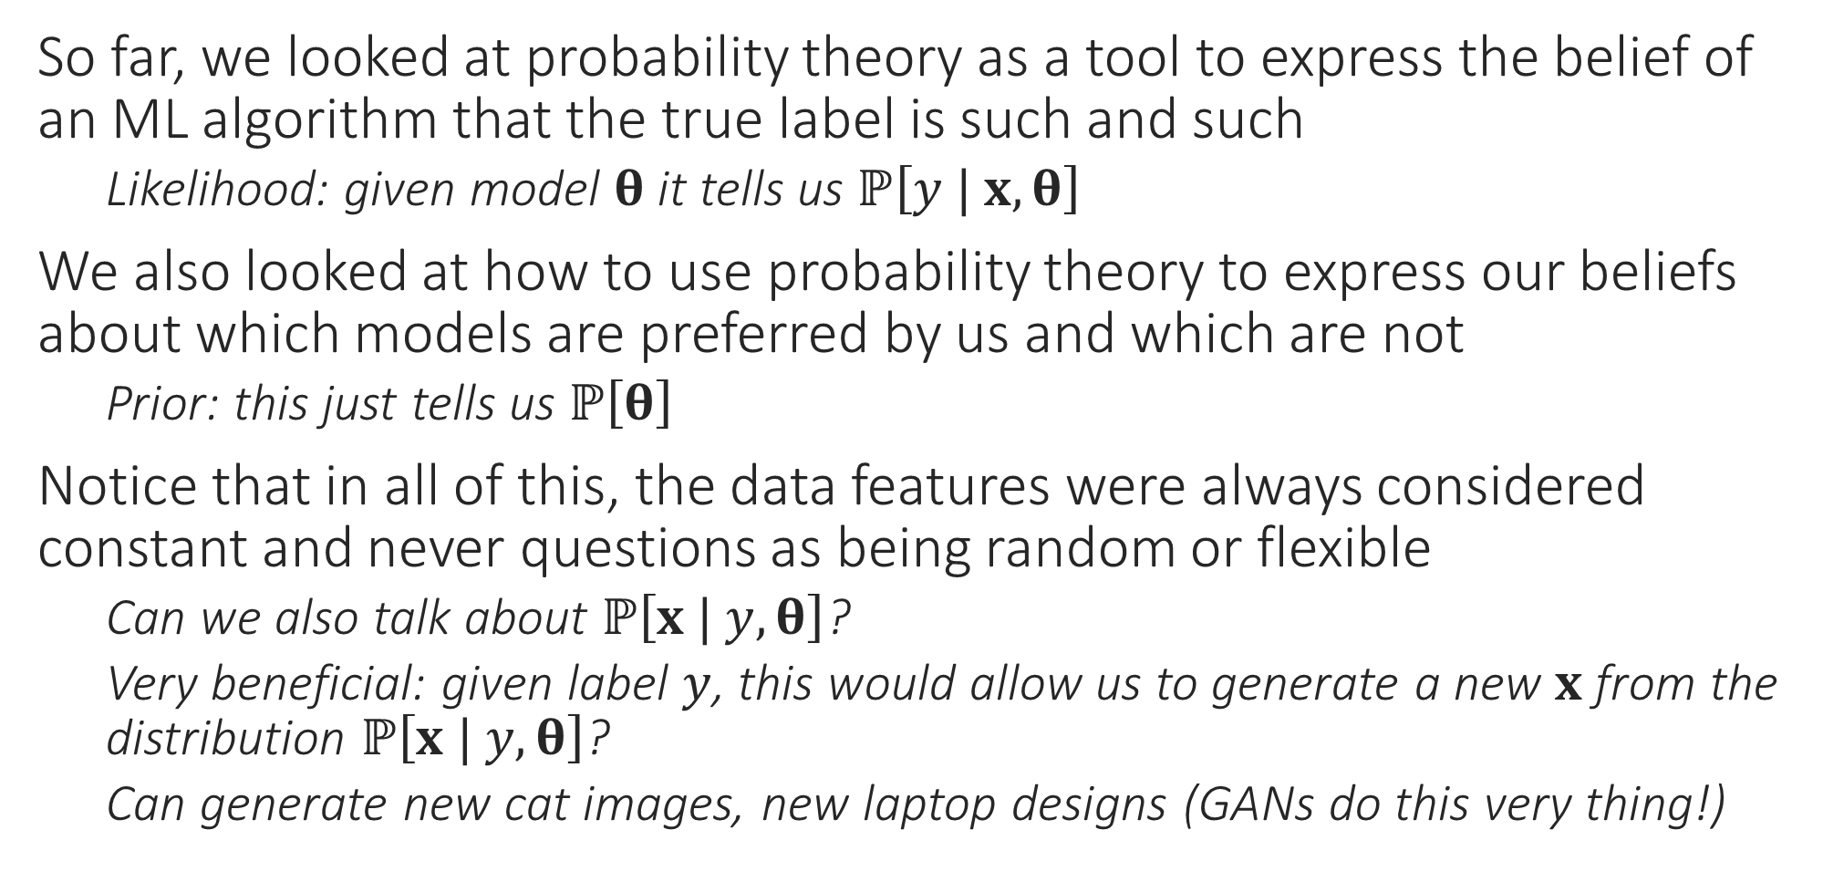
Generative Models
So far, we looked at probability theory as a tool to express the belief of an ML algorithm that the true label is such and such
Likelihood: given model $θ$ it tells us $ℙ\left[y | x,θ\right]$
We also looked at how to use probability theory to express our beliefs about which models are preferred by us and which are not
Prior: this just tells us $ℙ\left[θ\right]$
Notice that in all of this, the data features were always considered constant and never questions as being random or flexible
Can we also talk about $ℙ\left[x | y, θ\right]$?
Very beneficial: given label $y$, this would allow us to generate a new $x$ from the distribution $ℙ\left[x | y, θ\right]$?
Can generate new cat images, new laptop designs (GANs do this very thing!)

Slide 3
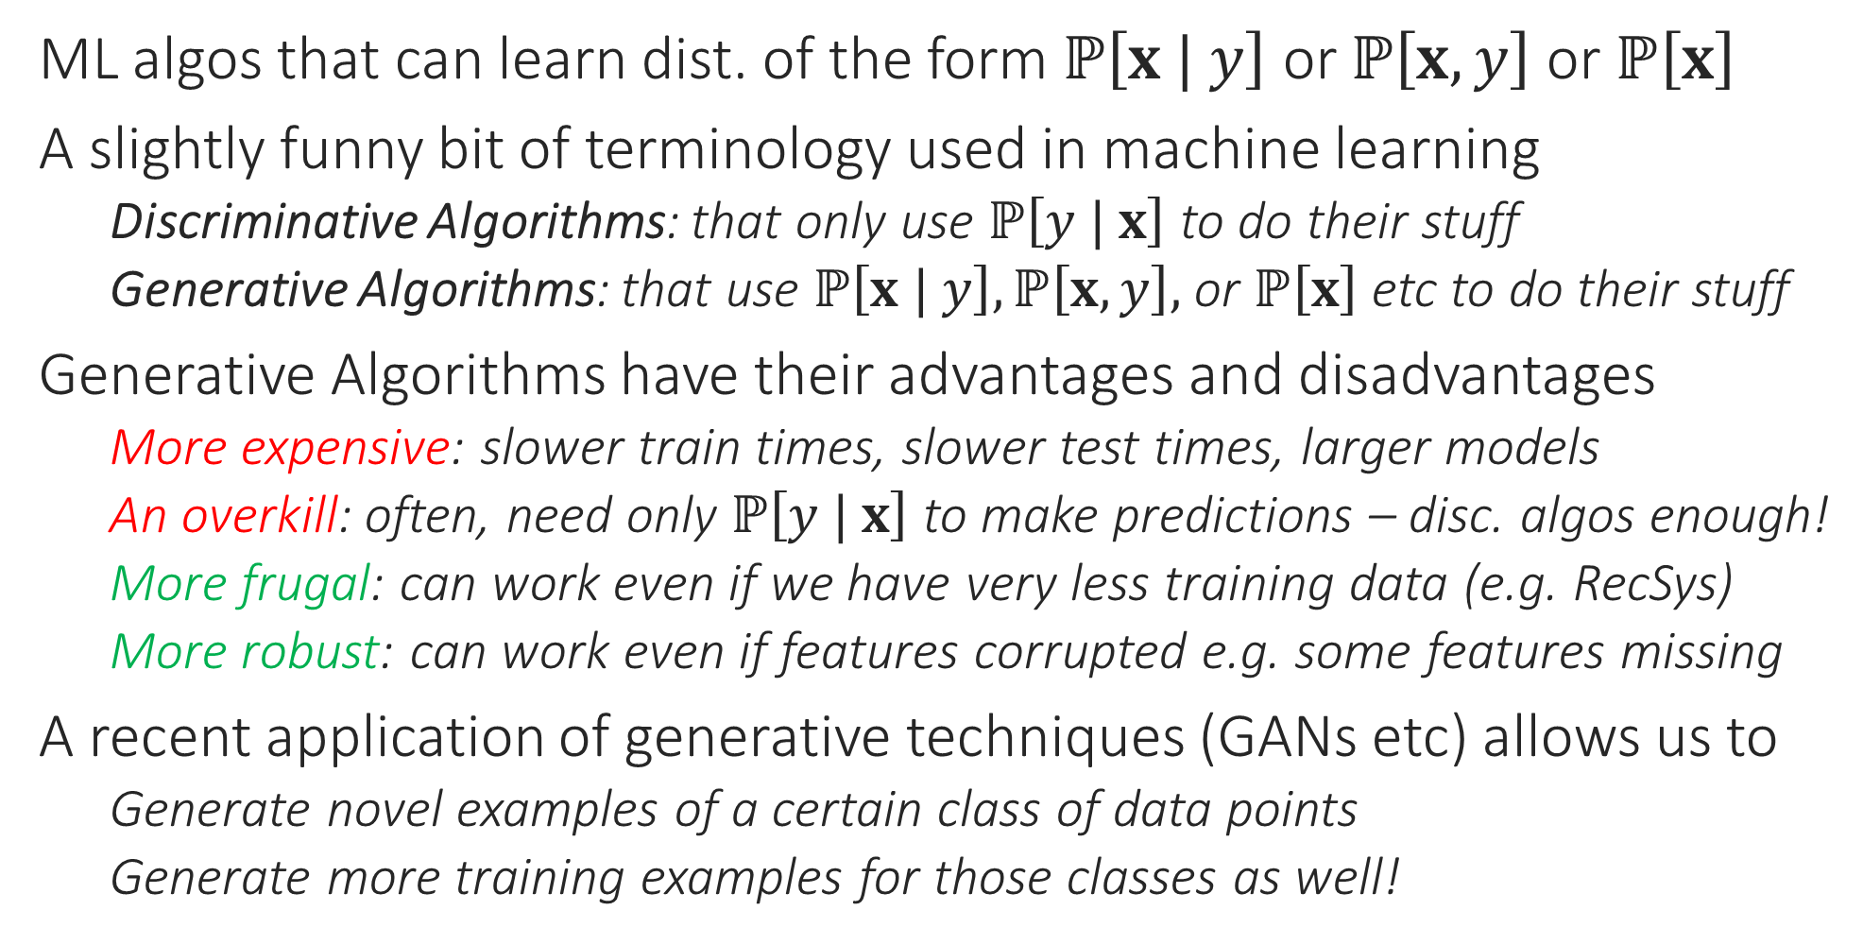
Generative Algorithms
ML algos that can learn dist. of the form $ℙ\left[x | y\right]$ or $ℙ\left[x,y\right]$ or $ℙ\left[x\right]$
A slightly funny bit of terminology used in machine learning
Discriminative Algorithms: that only use $ℙ\left[y | x\right]$ to do their stuff
Generative Algorithms: that use $ℙ\left[x | y\right],ℙ\left[x,y\right],$ or $ℙ\left[x\right]$ etc to do their stuff
Generative Algorithms have their advantages and disadvantages
More expensive: slower train times, slower test times, larger models
An overkill: often, need only $ℙ\left[y | x\right]$ to make predictions – disc. algos enough!
More frugal: can work even if we have very less training data (e.g. RecSys)
More robust: can work even if features corrupted e.g. some features missing
A recent application of generative techniques (GANs etc) allows us to
Generate novel examples of a certain class of data points
Generate more training examples for those classes as well!

Slide 4
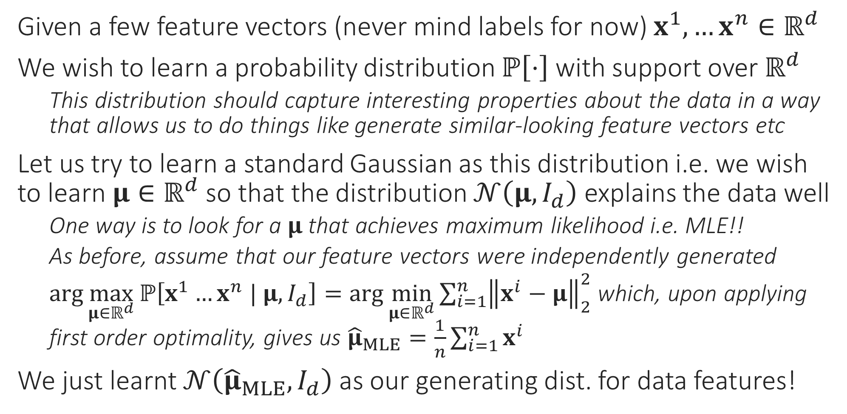
A very simple generative model
Given a few feature vectors (never mind labels for now) $x^{1},…x^{n}∈ℝ^{d}$
We wish to learn a probability distribution $ℙ\left[⋅\right]$ with support over $ℝ^{d}$
This distribution should capture interesting properties about the data in a way that allows us to do things like generate similar-looking feature vectors etc
Let us try to learn a standard Gaussian as this distribution i.e. we wish to learn $μ∈ℝ^{d}$ so that the distribution $𝒩\left(μ,I_{d}\right)$ explains the data well
One way is to look for a $μ$ that achieves maximum likelihood i.e. MLE!!
As before, assume that our feature vectors were independently generated
$\arg{\max_{μ∈ℝ^{d}}{ℙ\left[x^{1}…x^{n} | μ,I_{d}\right]}}=\arg{\min_{μ∈ℝ^{d}}{\sum_{i=1}^{n}{{\left\|x^{i}−μ\right\|}_{2}^{2}}}}$ which, upon applying first order optimality, gives us ${\hat{μ}}_{MLE}=\frac{1}{n}\sum_{i=1}^{n}{x^{i}}$
We just learnt $𝒩\left({\hat{μ}}_{MLE},I_{d}\right)$ as our generating dist. for data features!

Slide 5
Still more powerful generative model?
Suppose we are concerned that a single Gaussian cannot capture all the variations in our data
Can we learn 2 (or more) Gaussians to represent our data instead?
Such a generative model is often called a mixture of Gaussians
The Expectation Maximization (EM) algorithm is a very powerful technique for performing this and several other tasks
Soft clustering, learning Gaussian mixture models (GMM)
Robust learning, Mixed Regression
Also underlies more powerful variational algorithms such as VAE

Slide 6



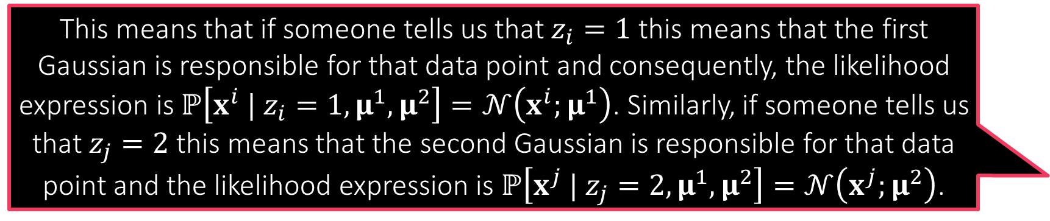

Learning a Mixture of Two Gaussians
This means that if someone tells us that $z_{i}=1$ this means that the first Gaussian is responsible for that data point and consequently, the likelihood expression is $ℙ\left[x^{i} | z_{i}=1,μ^{1},μ^{2}\right]=𝒩\left(x^{i};μ^{1}\right)$. Similarly, if someone tells us that $z_{j}=2$ this means that the second Gaussian is responsible for that data point and the likelihood expression is $ℙ\left[x^{j} | z_{j}=2,μ^{1},μ^{2}\right]=𝒩\left(x^{j};μ^{2}\right)$.
We suspect that instead of one Gaussian, two Gaussians are involved in generating our feature vectors
Let us call them $𝒩\left(μ^{1},I_{d}\right)$ and $𝒩\left(μ^{2},I_{d}\right)$
Each of these is called a component of this GMM
Covariance matrices, more than two components can also be incorporated
Since we are unsure which data point came from which component, we introduce a latent variable $z_{i}∈\left\{1,2\right\}$ per data point to denote this
The English word “latent” means hidden or dormant or concealed
Nice name since this variable describes something that was hidden from us
These latent variables may seem similar to the one we used in (soft) k-means
Not an accident – the connections will be clear soon!
Latent variables can be discrete or continuous

Slide 7
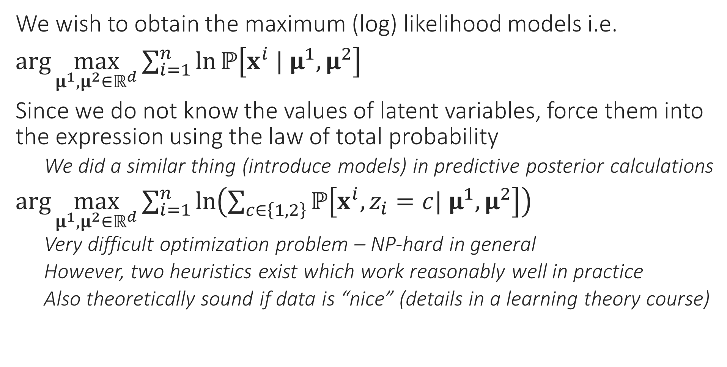
MLE with Latent Variables
We wish to obtain the maximum (log) likelihood models i.e.
$\arg{\max_{μ^{1},μ^{2}∈ℝ^{d}}{\sum_{i=1}^{n}{\ln{ℙ\left[x^{i} | μ^{1},μ^{2}\right]}}}}$
Since we do not know the values of latent variables, force them into the expression using the law of total probability
We did a similar thing (introduce models) in predictive posterior calculations
$\arg{\max_{μ^{1},μ^{2}∈ℝ^{d}}{\sum_{i=1}^{n}{\ln\left(\sum_{c∈\left\{1,2\right\}}{ℙ\left[x^{i},z_{i}=c| μ^{1},μ^{2}\right]}\right)}}}$
Very difficult optimization problem – NP-hard in general
However, two heuristics exist which work reasonably well in practice
Also theoretically sound if data is “nice” (details in a learning theory course)

Slide 8


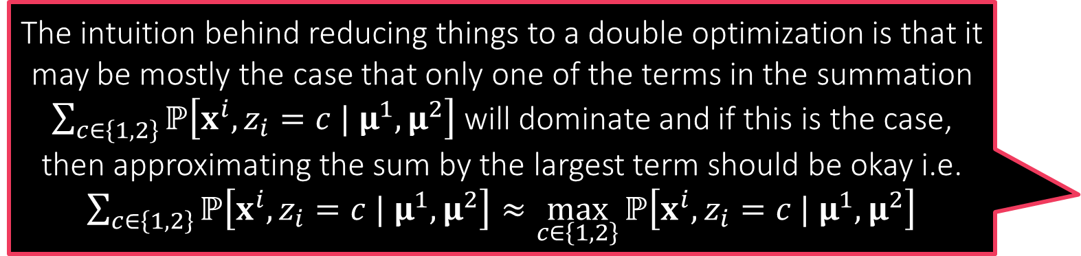
Heuristic 1: Alternating Optimization
Keep alternating between step 1 and step 2 till you are tired or till the process has converged!
Convert the original optimization problem
$\arg{\max_{μ^{1},μ^{2}∈ℝ^{d}}{\sum_{i=1}^{n}{\ln\left(\sum_{c∈\left\{1,2\right\}}{ℙ\left[x^{i},z_{i}=c | μ^{1},μ^{2}\right]}\right)}}}$
to a double maximization problem (assume $ℙ\left[z_{i} | μ^{1},μ^{2}\right]=$ const)
$\underset{μ^{1},μ^{2}∈ℝ^{d}}{argmax}{\underset{z_{i}∈\left\{1,2\right\}}{argmax}{\sum_{i=1}^{n}{\ln{ℙ\left[x^{i} | z_{i},μ^{1},μ^{2}\right]}}}}$
In several ML problems with latent vars, although the above double optimization problem is (still) difficult, following two problems are easy
Step 1: Fix $μ^{1},μ^{2}∈ℝ^{d}$ and update latent variables $z_{i}$ to their optimal values
$\arg{\max_{z_{i}∈\left\{1,2\right\}}{\sum_{i=1}^{n}{\ln{ℙ\left[x^{i} | z_{i},μ^{1},μ^{2}\right]}}}}=\arg{\max_{z_{i}∈\left\{1,2\right\}}{\ln{ℙ\left[x^{i} | z_{i},μ^{1},μ^{2}\right]}}}$
Step 2: Fix latent variables $z_{i}$ and update $μ^{1},μ^{2}∈ℝ^{d}$ to their optimal values
$\arg{\max_{μ^{1},μ^{2}∈ℝ^{d}}{\sum_{i=1}^{n}{\ln{ℙ\left[x^{i} | z_{i},μ^{1},μ^{2}\right]}}}}$
The intuition behind reducing things to a double optimization is that it may be mostly the case that only one of the terms in the summation $\sum_{c∈\left\{1,2\right\}}{ℙ\left[x^{i},z_{i}=c | μ^{1},μ^{2}\right]}$ will dominate and if this is the case, then approximating the sum by the largest term should be okay i.e. $\sum_{c∈\left\{1,2\right\}}{ℙ\left[x^{i},z_{i}=c | μ^{1},μ^{2}\right]}≈\max_{c∈\left\{1,2\right\}}{ℙ\left[x^{i},z_{i}=c | μ^{1},μ^{2}\right]}$
The most important difference between the original and the new problem is that original has a sum of log of sum which is very difficult to optimize whereas the new problem gets rid of this and looks simply like a MLE problem. We know how to solve MLE problems very easily!

Slide 9



Heuristic 1 at Work
Isn’t this like the k-means clustering algorithm?
As discussed before, we assume a mixture of two Gaussians
$ℙ\left[x^{i} | z_{i}=1,μ^{1},μ^{2}\right]=𝒩\left(x^{i};μ^{1}\right)$ and $ℙ\left[x^{j} | z_{j}=2,μ^{1},μ^{2}\right]=𝒩\left(x^{j};μ^{2}\right)$
Step 1 becomes
$\arg{\max_{z_{i}∈\left\{1,2\right\}}{\ln{ℙ\left[x^{i} | z_{i},μ^{1},μ^{2}\right]}}}={\arg{\min_{z_{i}∈\left\{1,2\right\}}\left\|x^{i}−μ^{z_{i}}\right\|}}_{2}^{2}$
Step 2 becomes
$\arg{\max_{μ^{1},μ^{2}∈ℝ^{d}}{\sum_{i=1}^{n}{\ln{ℙ\left[x^{i} | z_{i},μ^{1},μ^{2}\right]}}}}$
$=\arg{\min_{μ^{1} ∈ℝ^{d}}{\sum_{i:z_{i}=1}{{\left\|x^{i}−μ^{1}\right\|}_{2}^{2}}}}+\arg{\min_{μ^{2}∈ℝ^{d}}{\sum_{i:z_{i}=2}{{\left\|x^{i}−μ^{2}\right\|}_{2}^{2}}}}$
Thus, $μ^{1}=\frac{1}{n_{1}}\sum_{i:z_{i}=1}{x^{i}}$ and $μ^{2}=\frac{1}{n_{2}}\sum_{i:z_{i}=2}{x^{i}}$ where $n_{c}$ is the number of data points for which we have $z_{i}=c$
Repeat!
Not just “like” – this is the k-means algorithm! This means that the k-means algorithm is one heuristic way to compute an MLE which is difficult to compute directly!
Indeed! Notice that even here, instead of choosing just one value of the latent variables $z_{i}$ at each time step, we can instead use a distribution over their support $\left\{1,2\right\}$
I have a feeling that the second heuristic will also give us something familiar!

Slide 10
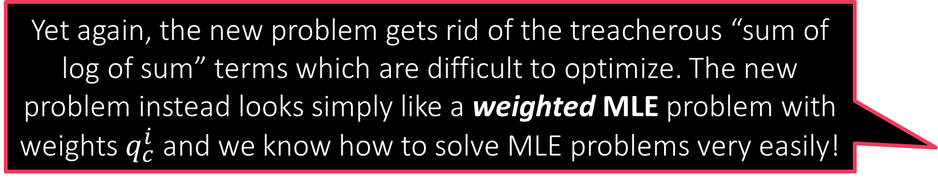

Heuristic 2: Expectation Maximization
Original Prob: $\arg{\max_{μ^{1},μ^{2}∈ℝ^{d}}{\sum_{i=1}^{n}{\ln\left(\sum_{c∈\left\{1,2\right\}}{ℙ\left[x^{i},z_{i}=c | μ^{1},μ^{2}\right]}\right)}}}$
Step 1 (E Step) Consists of two sub-steps
Step 1.1 Assume our current model estimates are $μ^{1}=p,μ^{2}=q$
Use the current models to ascertain how likely are different values of $z_{i}$ for the $i$-th data point i.e. compute $q_{c}^{i}=ℙ\left[z_{i}=c | x^{i},p,q\right]$ for both $c∈\left\{1,2\right\}$
Step 1.2 Use weights $q_{c}^{i}$ to set up a new objective function
As before, assume $ℙ\left[z_{i} | μ^{1},μ^{2}\right]=$ constant for sake of simplicity
$\sum_{i=1}^{n}{\sum_{c∈\left\{1,2\right\}}{q_{c}^{i}⋅\ln{ℙ\left[x^{i}, | z_{i}=c,μ^{1},μ^{2}\right]}}}$
Step 2 (M Step) Maximize the new obj. fn. to get new models
$\arg{\max_{μ^{1},μ^{2}∈ℝ^{d}}{\sum_{i=1}^{n}{\sum_{c∈\left\{1,2\right\}}{q_{c}^{i}⋅\ln{ℙ\left[x^{i}, | z_{i}=c,μ^{1},μ^{2}\right]}}}}}$
Repeat!
Yet again, the new problem gets rid of the treacherous “sum of log of sum” terms which are difficult to optimize. The new problem instead looks simply like a weighted MLE problem with weights $q_{c}^{i}$ and we know how to solve MLE problems very easily!

Slide 11
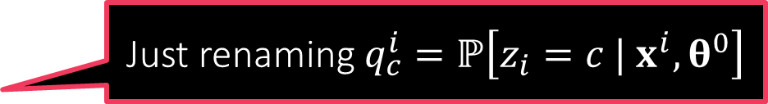
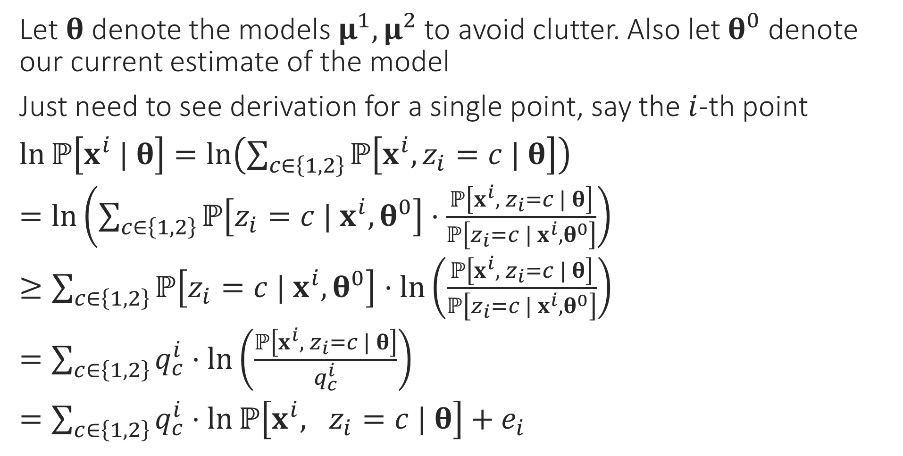

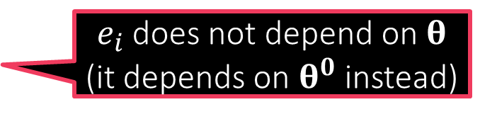
Derivation of the E Step
Jensen’s inequality tells us that $f\left(𝔼X\right)≤𝔼\left[f\left(X\right)\right]$ for any convex function. We used the fact that $\ln\left(⋅\right)$ is a concave function and so the inequality reverses since every concave function is the negative of a convex function
Let $θ$ denote the models $μ^{1},μ^{2}$ to avoid clutter. Also let $θ^{0}$ denote our current estimate of the model
Just need to see derivation for a single point, say the $i$-th point
$\ln{ℙ\left[x^{i} | θ\right]}=\ln\left(\sum_{c∈\left\{1,2\right\}}{ℙ\left[x^{i},z_{i}=c | θ\right]}\right)$
$=\ln\left(\sum_{c∈\left\{1,2\right\}}{ℙ\left[z_{i}=c | x^{i},θ^{0}\right]}⋅\frac{ℙ\left[x^{i}, z_{i}=c | θ\right]}{ℙ\left[z_{i}=c | x^{i},θ^{0}\right]}\right)$
$≥\sum_{c∈\left\{1,2\right\}}{ℙ\left[z_{i}=c | x^{i},θ^{0}\right]}⋅\ln\left(\frac{ℙ\left[x^{i}, z_{i}=c | θ\right]}{ℙ\left[z_{i}=c | x^{i},θ^{0}\right]}\right)$
$=\sum_{c∈\left\{1,2\right\}}{q_{c}^{i}}⋅\ln\left(\frac{ℙ\left[x^{i}, z_{i}=c | θ\right]}{q_{c}^{i}}\right)$
$=\sum_{c∈\left\{1,2\right\}}{q_{c}^{i}}⋅\ln{ℙ\left[x^{i}, z_{i}=c | θ\right]}+e_{i}$
Law of total probability
Simply multiply and divide by the same term
Jensen’s inequality
Just renaming $q_{c}^{i}=ℙ\left[z_{i}=c | x^{i},θ^{0}\right]$
$e_{i}$ does not depend on $θ$ (it depends on $θ^{0}$ instead)

Slide 12



The EM Algorithm
Note: assumptions such as $ℙ\left[z_{i} | μ^{1},μ^{2}\right]=$ const are made for sake of simplicity. Can execute EM perfectly without making these assumptions as well. However, then updates get more involved – be careful not to make mistakes
If we instantiate the EM algorithm with the GMM likelihoods, we will recover the soft k-means algorithm
Thus, the soft k-means algorithm is yet another heuristic way (the k-means algo was the first) to compute an MLE which is difficult to compute directly!
The EM algorithm has pros and cons over alternating optimization
Con: EM is usually more expensive to execute than alternating optimization
Pro: EM will ensures that objective value of the original problem i.e.
$\arg{\max_{μ^{1},μ^{2}∈ℝ^{d}}{\sum_{i=1}^{n}{\ln\left(\sum_{c∈\left\{1,2\right\}}{ℙ\left[x^{i},z_{i}=c | μ^{1},μ^{2}\right]}\right)}}}$
… always keeps going up at every iteration – monotonic progress!!
However, no guarantee that we will ever reach the global maximum
May converge to, and get stuck at, a local maximum instead
EM for GMM
Initialize means ${\left\{μ^{c}\right\}}_{c=1…C}$
For $i∈\left[n\right]$, update $π_{c}^{i}$ using $\left\{μ^{c}\right\}$
Let $p_{c}^{i}=\exp\left(−\frac{{\left\|x^{i}−μ^{c}\right\|}_{2}^{2}}{2}\right)$
Let $q_{c}^{i}=\frac{p_{c}^{i}}{\sum_{c=1}^{C}{p_{c}^{i}}}$ (normalize)
Let $n_{c}=\sum_{i=1}^{n}{q_{c}^{i}}$
Update $μ^{c}=\frac{1}{n_{c}}\sum_{i=1}^{n}{q_{c}^{i}⋅x^{i}}$
Repeat until convergence

Slide 13



The Q Function
We call it $Q_{t}\left(⋅\right)$ instead of just $Q\left(⋅\right)$ since $Q_{t}\left(⋅\right)$ uses the values $q_{c}^{i,t}$ which are calculated using $θ^{t}$. Thus, the $Q_{t}\left(⋅\right)$ function keeps changing
Let $Q_{t}\left(θ\right)=\sum_{i=1}^{n}{\sum_{c∈\left\{1,2\right\}}{q_{c}^{i,t}}⋅\ln{ℙ\left[x^{i}, z_{i}=c | θ\right]}+e_{i}}$ be the new objective function constructed at time step $t$
The EM algorithm constructs a new $Q_{t}$ function at each time during the E-step and maximizes it during the M-step
$θ^{t+1}=\arg{\max{Q_{t}\left(θ\right)}}$
We have already seen that $Q_{t}\left(θ\right)≤\sum_{i=1}^{n}{\ln{ℙ\left[x^{i} | θ\right]}}$ for all $θ$
Easy enough to show that $Q_{t}\left(θ^{t}\right)=\sum_{i=1}^{n}{\ln{ℙ\left[x^{i} | θ^{t}\right]}}$
Some indication as to why EM increases likelihood at each iteration
Alternating optimization can be seen as a cousin of EM that uses a $Q$ fn of the form $Q_{t}\left(θ\right)=\sum_{i=1}^{n}{\ln{ℙ\left[x^{i}, {\tilde{z}}_{i}| θ\right]}}$ where ${\tilde{z}}_{i}=\arg{\max_{z_{i}∈\left\{1,2\right\}}{\ln{ℙ\left[x^{i} | z_{i},θ^{t}\right]}}}$
The Generic EM Algorithm
Initialize model $θ^{0}$
For every latent variable $z_{i}$ and every possible value $z∈𝒵$ it could take, compute $q_{z}^{i,t}=ℙ\left[z_{i}=z | x^{i},θ^{t}\right]$
Compute the Q-function $Q_{t}\left(θ\right)=\sum_{i=1}^{n}{\sum_{z∈𝒵}{q_{z}^{i,t}\ln{ℙ\left[x^{i},z^{i}=z | θ\right]}}}$
Update $θ^{t+1}=\arg{\max_{θ}{Q_{t}\left(θ\right)}}$
Repeat until convergence

Slide 14










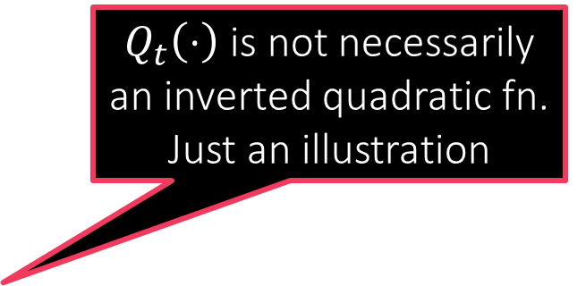
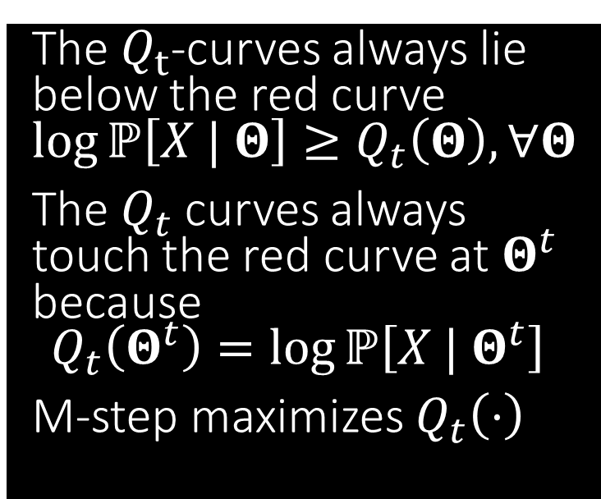
A pictorial depiction of the EM
$Q_{t}\left(⋅\right)$ is not necessarily an inverted quadratic fn. Just an illustration
The $Q_{t}$-curves always lie below the red curve $\log{ℙ\left[X | Θ\right]}≥Q_{t}\left(Θ\right), ∀Θ$
The $Q_{t}$ curves always touch the red curve at $Θ^{t}$ because $Q_{t}\left(Θ^{t}\right)=\log{ℙ\left[X | Θ^{t}\right]}$
M-step maximizes $Q_{t}\left(⋅\right)$
Stuck!!

Slide 15




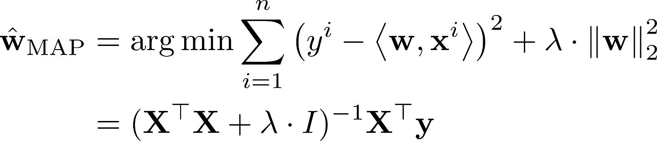

Mixed Regression
An example of latent variables in a supervised learning task
We have regression train data ${\left\{\left(x^{i},y^{i}\right)\right\}}_{i=1}^{n}$ $x^{i}∈ℝ^{d},y^{i}∈ℝ$
Example: $x$ denotes age and $y$ denotes time spent on website
There are two subpopulations in data (gender) which behave differently even if age is same
An indication that our features may be incomplete/latent
Sure, we could try clustering this data first and then apply regression models separately on both clusters. However, using latent variables may be beneficial since 1) clustering e.g. k-means may not necessarily work well since the points here are really not close to two centroids (instead, they lie close to two lines which k-means is really not meant to handle) and 2) using latent variables, we can elegantly cluster and learn regression models jointly!!
?

Slide 16

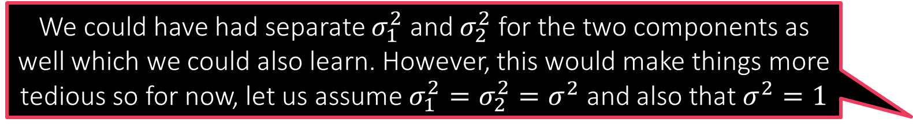
Latent Variables to the Rescue
We could have had separate $σ_{1}^{2}$ and $σ_{2}^{2}$ for the two components as well which we could also learn. However, this would make things more tedious so for now, let us assume $σ_{1}^{2}=σ_{2}^{2}=σ^{2}$ and also that $σ^{2}=1$
As before, if we believe that our data is best explained using two linear regression models instead of one, we should work with a mixed model (aka mixture of experts)
Will fit two regression models to the data and use a latent variable $z_{i}∈\left\{1,2\right\}$ to keep track of which data point belongs to which model
Let us use Gaussian likelihoods since we are comfortable with it
$ℙ\left[y^{i} | x^{i},z_{i}=1,w^{1},w^{2}\right]=𝒩\left(y^{i};\left\langle w^{1},x^{i}\right\rangle ,σ^{2}\right)$
$ℙ\left[y^{i} | x^{i},z_{i}=2,w^{1},w^{2}\right]=𝒩\left(y^{i};\left\langle w^{2},x^{i}\right\rangle ,σ^{2}\right)$
Note: this is not generative learning since we are still learning discriminative distributions of the form $ℙ\left[y^{i} |{ x}^{i},w^{c}\right]$
Will see soon how to perform generative learning in supervised settings

Slide 17

MLE for Mixed Regression
$\arg{\max_{w^{1},w^{2}∈ℝ^{d}}{\sum_{i=1}^{n}{\ln{ℙ\left[y^{i} | x^{i},w^{1},w^{2}\right]}}}}$ which, upon introducing latent variables gives $\arg{\max_{w^{1},w^{2}∈ℝ^{d}}{\sum_{i=1}^{n}{\ln\left(\sum_{c∈\left\{1,2\right\}}{ℙ\left[y^{i},z_{i}=c| x^{i},w^{1},w^{2}\right]}\right)}}}$
Method 1: Alternating Optimization
$\arg{\max_{w^{1},w^{2}∈ℝ^{d},z_{i}∈\left\{1,2\right\}}{\sum_{i=1}^{n}{\ln{ℙ\left[y^{i},z_{i} | x^{i},w^{1},w^{2}\right]}}}}$
As before, assume $ℙ\left[z_{i} | x^{i},w^{1},w^{2}\right]=$ constant for sake of simplicity to get
$\arg{\max_{w^{1},w^{2}∈ℝ^{d},z_{i}∈\left\{1,2\right\}}{\sum_{i=1}^{n}{\ln{ℙ\left[y^{i} | x^{i},z_{i},w^{1},w^{2}\right]}}}}$
Step 1: Fix $w^{1},w^{2}$ and update all $z_{i}=\arg{\max_{c∈\left\{1,2\right\}}{\ln{ℙ\left[y^{i} | x^{i},z_{i}=c,w^{1},w^{2}\right]}}}$
Step 2: Fix all $z_{i}$ and update the models $\arg{\max_{w^{1},w^{2}∈ℝ^{d} }{\sum_{i=1}^{n}{\ln{ℙ\left[y^{i} | x^{i},z_{i},w^{1},w^{2}\right]}}}}$

Slide 18


Alternating Optimization for MR
AltOpt for MR
Initialize models ${\left\{w^{c}\right\}}_{c∈\left\{1,2\right\}}$
For $i∈\left[n\right]$, update $\left\{z_{i}\right\}$ using $\left\{w^{c}\right\}$
Let $z_{i}=\arg{\min_{c}\left|y^{i}−\left\langle w^{c},x^{i}\right\rangle \right|}$
Update $\left\{w^{c}\right\}$ using $\left\{z_{i}\right\}$
Let $w^{c}=\arg{\min_{w∈ℝ^{d}}{\sum_{i:z_{i}=c}{{\left(y^{i}−\left\langle w,x^{i}\right\rangle \right)}^{2}}}}$
Repeat until convergence
As before, we assumed the likelihood distributions as
$ℙ\left[y^{i} | x^{i},z_{i}=c,w^{1},w^{2}\right]=𝒩\left(y^{i};\left\langle w^{c},x^{i}\right\rangle ,1\right)$ for $c∈\left\{1,2\right\}$
Step 1 becomes
$\arg{\max_{c∈\left\{1,2\right\}}{\ln{ℙ\left[y^{i} | x^{i},z_{i}=c,w^{1},w^{2}\right]}}}=\arg{\min_{c∈\left\{1,2\right\}}\left|y^{i}−\left\langle w^{c},x^{i}\right\rangle \right|}$
i.e. assign every data point to its “closest” line or the line which fits it better
Step 2 becomes
$\arg{\max_{w^{1},w^{2}∈ℝ^{d} }{\sum_{i=1}^{n}{\ln{ℙ\left[y^{i} | x^{i},z_{i},w^{1},w^{2}\right]}}}}$
$=\arg{\min_{w^{1} ∈ℝ^{d}}{\sum_{i:z_{i}=1}{{\left(y^{i}−\left\langle w^{1},x^{i}\right\rangle \right)}^{2}}}}+\arg{\min_{w^{2}∈ℝ^{d}}{\sum_{i:z_{i}=2}{{\left(y^{i}−\left\langle w^{2},x^{i}\right\rangle \right)}^{2}}}}$
i.e. perform least squares on the data points assigned to each component
May incorporate a prior as well to add a regularizer (ridge regression)
Repeat!

Slide 19


EM for Mixed Regression
EM for MR
Initialize models ${\left\{w^{c}\right\}}_{c=1…C}$ (for $C$ components)
For $i∈\left[n\right]$, update $q_{c}^{i}$ using $\left\{w^{c}\right\}$
Let $p_{c}^{i}=\exp\left(−\frac{{\left(y^{i}−\left\langle w^{c},x^{i}\right\rangle \right)}_{2}^{2}}{2}\right)$
Let $q_{c}^{i}=\frac{p_{c}^{i}}{\sum_{c=1}^{C}{p_{c}^{i}}}$ (normalize)
Update $w^{c}=\arg{\min_{w∈ℝ^{d}}{\sum_{i=1}^{n}{q_{c}^{i}⋅{\left(y^{i}−\left\langle w,x^{i}\right\rangle \right)}_{2}^{2}}}}$ $=\arg{\min_{w∈ℝ^{d}}{{\left(Xw−y\right)}^{⊤}Q_{c}\left(Xw−y\right)}}$ where $Q_{c}=diag\left(q_{c}^{1},…,q_{c}^{n}\right)$ $={\left(X^{⊤}Q_{c}X\right)}^{−1}\left(X^{⊤}Q_{c}y\right)$ (apply first order optimality)
Repeat until convergence
Original Prob: $\arg{\max_{w^{1},w^{2}∈ℝ^{d}}{\sum_{i=1}^{n}{\ln\left(\sum_{c∈\left\{1,2\right\}}{ℙ\left[y^{i},z_{i}=c| x^{i},w^{1},w^{2}\right]}\right)}}}$
Step 1 (E Step) Consists of two sub-steps
Step 1.1 Assume our current model estimates are $w^{1}=p,w^{2}=q$
Use the current models to ascertain how likely are different values of $z_{i}$ for the $i$-th data point i.e. compute $q_{c}^{i}=ℙ\left[z_{i}=c | y^{i},x^{i},p,q\right]$ for both $c∈\left\{1,2\right\}$
Step 1.2 Use weights $q_{c}^{i}$ to set up a new objective function
As before, assume $ℙ\left[z_{i} | x^{i},p,q\right]=$ constant for sake of simplicity
$\sum_{i=1}^{n}{\sum_{c∈\left\{1,2\right\}}{q_{c}^{i}⋅\ln{ℙ\left[y^{i} | x^{i},z_{i}=c,w^{1},w^{2}\right]}}}$
Step 2 (M Step) Maximize the new obj. fn. to get new models
$\arg{\max_{w^{1},w^{2}∈ℝ^{d}}{\sum_{i=1}^{n}{\sum_{c∈\left\{1,2\right\}}{q_{c}^{i}⋅\ln{ℙ\left[y^{i} | x^{i},z_{i}=c,w^{1},w^{2}\right]}}}}}$
Repeat!

