Slide 1
Generative Classification

Slide 2
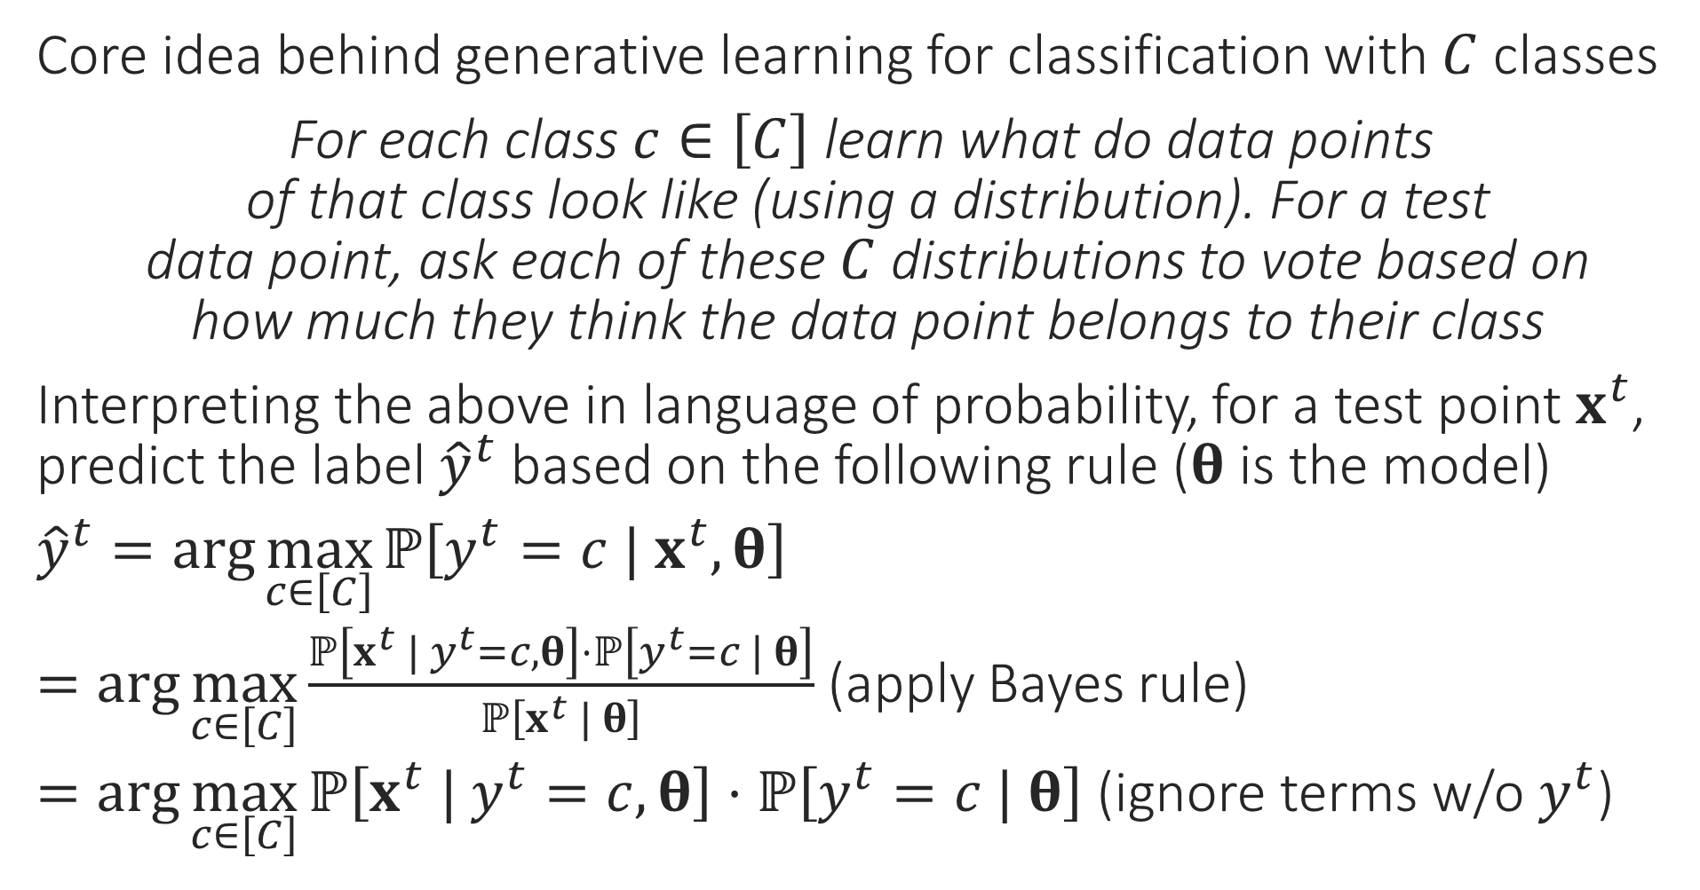
Generative Supervised Learning
“
Core idea behind generative learning for classification with $C$ classes
For each class $c∈\left[C\right]$ learn what do data points of that class look like (using a distribution). For a test data point, ask each of these $C$ distributions to vote based on how much they think the data point belongs to their class
Interpreting the above in language of probability, for a test point $x^{t}$, predict the label ${\hat{y}}^{t}$ based on the following rule ($θ$ is the model)
${\hat{y}}^{t}=\arg{\max_{c∈\left[C\right]}{ℙ\left[y^{t}=c | x^{t},θ\right]}}$
$=\arg{\max_{c∈\left[C\right]}{\frac{ℙ\left[x^{t} | y^{t}=c,θ\right]⋅ℙ\left[y^{t}=c | θ\right]}{ℙ\left[x^{t} | θ\right]}}}$ (apply Bayes rule)
$=\arg{\max_{c∈\left[C\right]}{ℙ\left[x^{t} | y^{t}=c,θ\right]⋅ℙ\left[y^{t}=c | θ\right]}}$ (ignore terms w/o $y^{t}$)
“
Every generative learning algo takes a decision on how to learn these probability distributions from data. Let us see one example of how this can be done

Slide 3
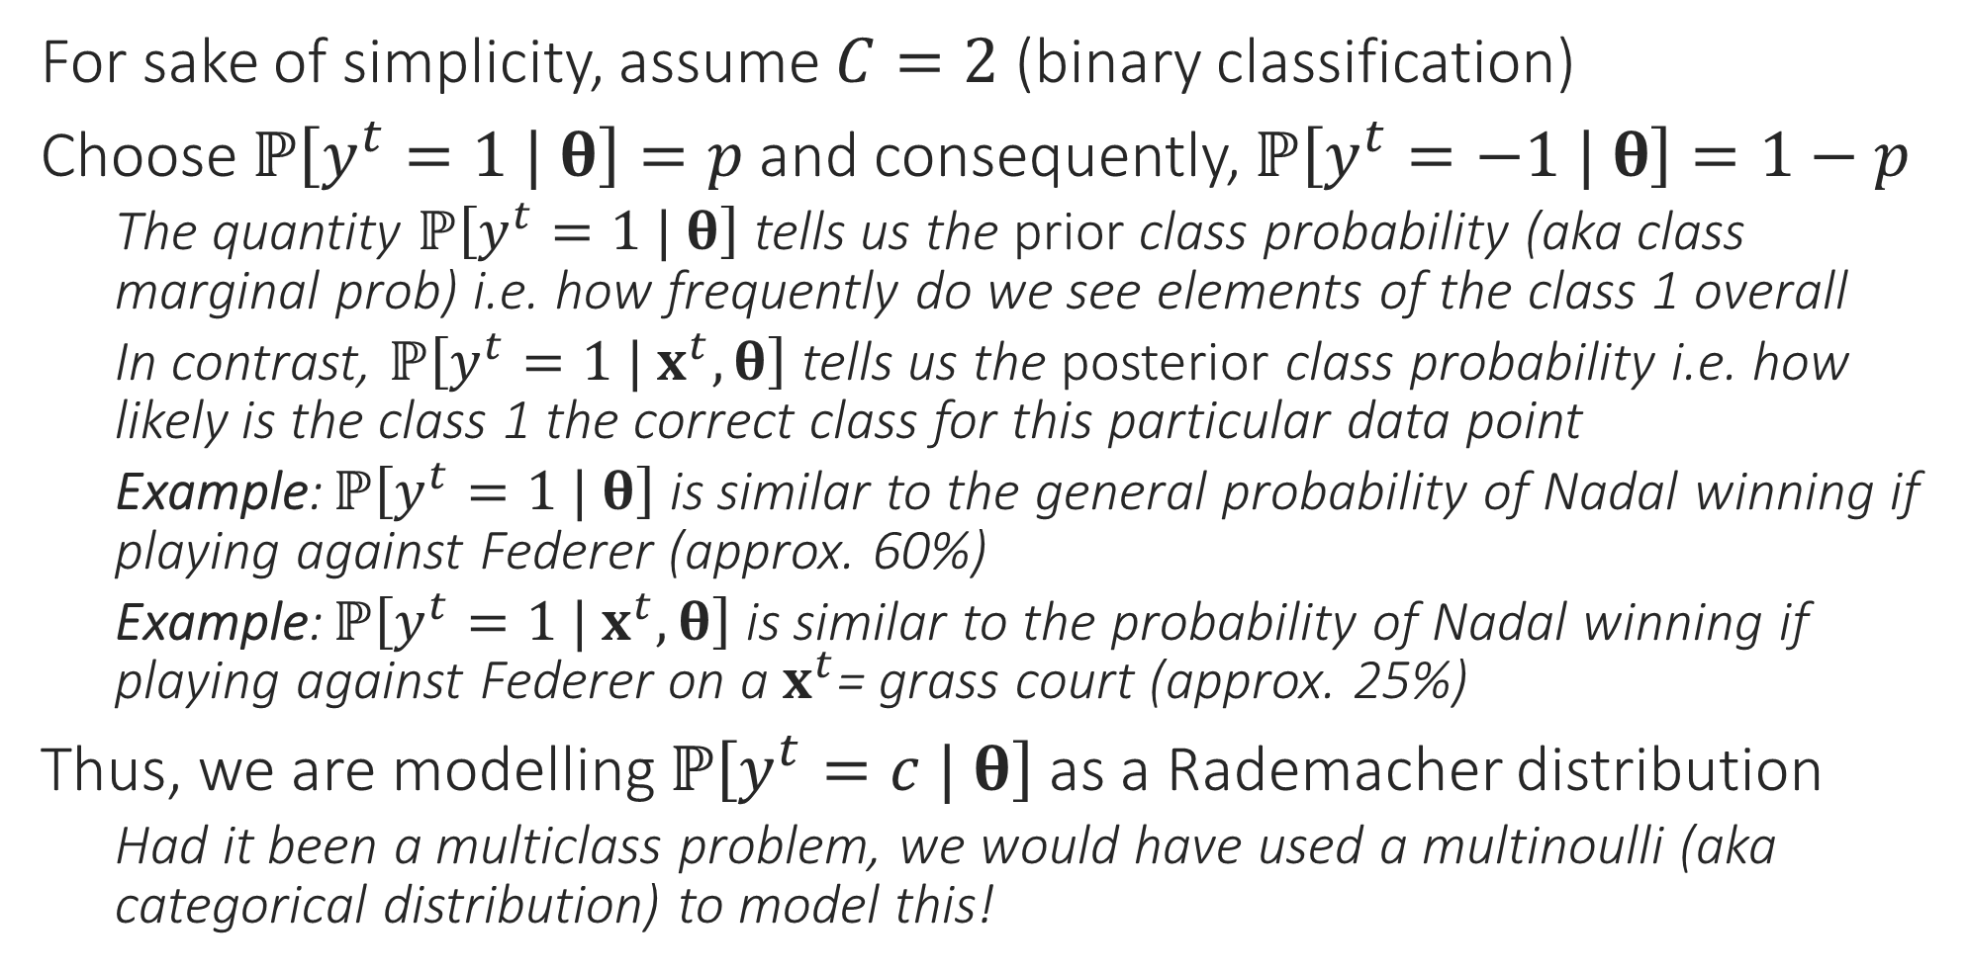
A simple generative model
For sake of simplicity, assume $C=2$ (binary classification)
Choose $ℙ\left[y^{t}=1 | θ\right]=p$ and consequently, $ℙ\left[y^{t}=−1 | θ\right]=1−p$
The quantity $ℙ\left[y^{t}=1 | θ\right]$ tells us the prior class probability (aka class marginal prob) i.e. how frequently do we see elements of the class 1 overall
In contrast, $ℙ\left[y^{t}=1 | x^{t},θ\right]$ tells us the posterior class probability i.e. how likely is the class 1 the correct class for this particular data point
Example: $ℙ\left[y^{t}=1 | θ\right]$ is similar to the general probability of Nadal winning if playing against Federer (approx. 60%)
Example: $ℙ\left[y^{t}=1 | x^{t},θ\right]$ is similar to the probability of Nadal winning if playing against Federer on a $x^{t}$= grass court (approx. 25%)
Thus, we are modelling $ℙ\left[y^{t}=c | θ\right]$ as a Rademacher distribution
Had it been a multiclass problem, we would have used a multinoulli (aka categorical distribution) to model this!

Slide 4
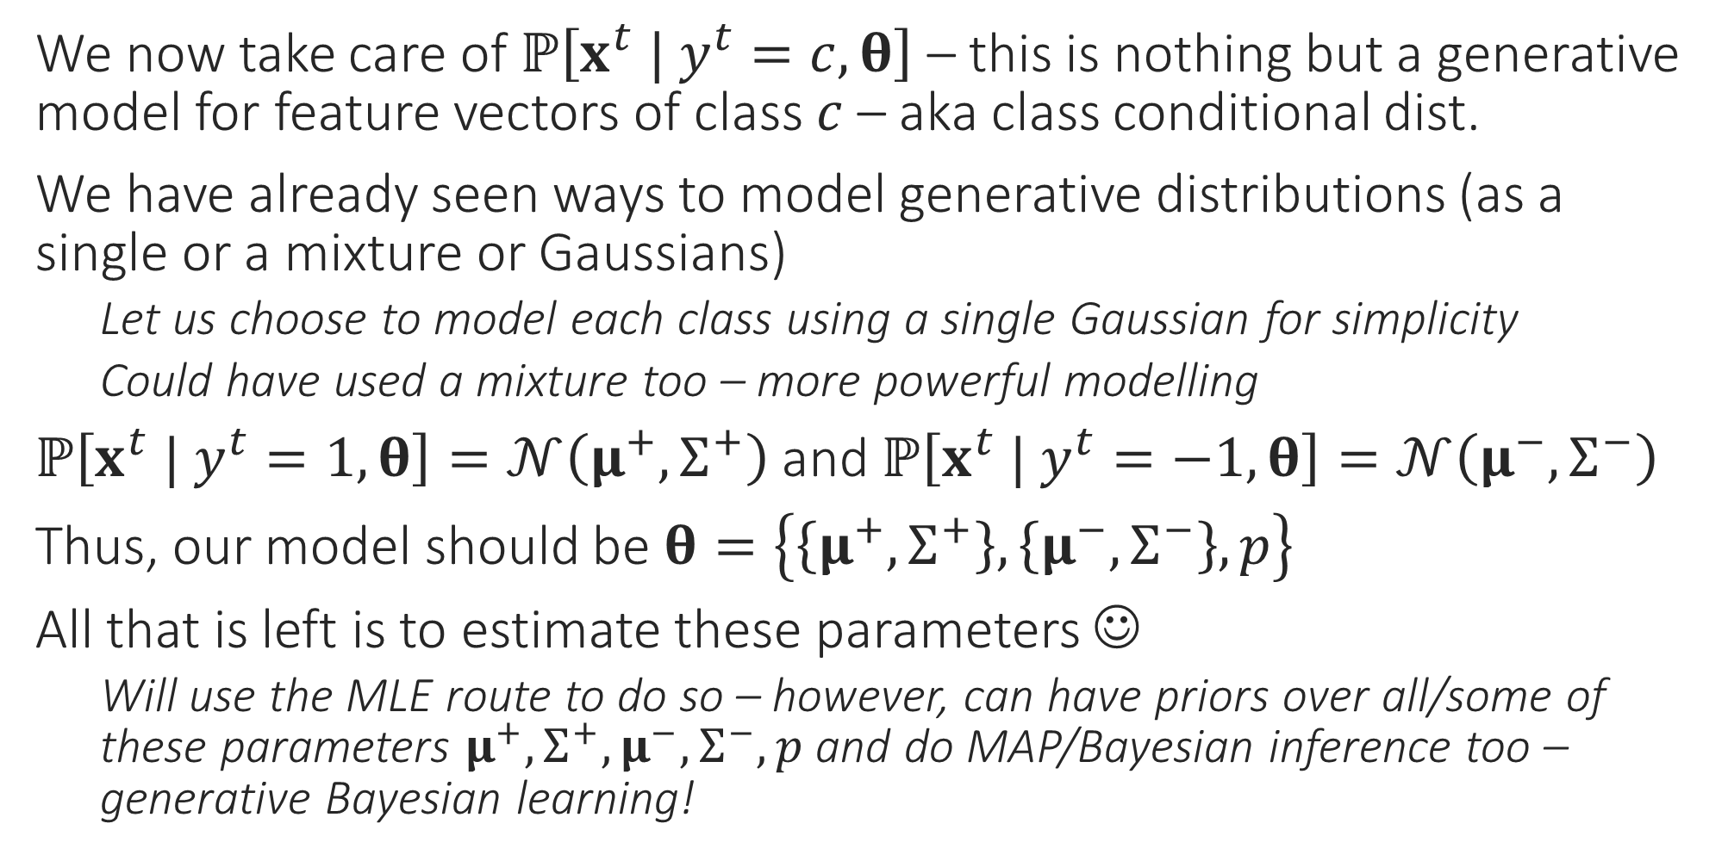
A simple generative model
We now take care of $ℙ\left[x^{t} | y^{t}=c,θ\right]$ – this is nothing but a generative model for feature vectors of class $c$ – aka class conditional dist.
We have already seen ways to model generative distributions (as a single or a mixture or Gaussians)
Let us choose to model each class using a single Gaussian for simplicity
Could have used a mixture too – more powerful modelling
$ℙ\left[x^{t} | y^{t}=1,θ\right]=𝒩\left(μ^{+},Σ^{+}\right)$ and $ℙ\left[x^{t} | y^{t}=−1,θ\right]=𝒩\left(μ^{−},Σ^{−}\right)$
Thus, our model should be $θ=\left\{\left\{μ^{+},Σ^{+}\right\},\left\{μ^{−},Σ^{−}\right\},p\right\}$
All that is left is to estimate these parameters ☺
Will use the MLE route to do so – however, can have priors over all/some of these parameters $μ^{+},Σ^{+},μ^{−},Σ^{−},p$ and do MAP/Bayesian inference too – generative Bayesian learning!

Slide 5
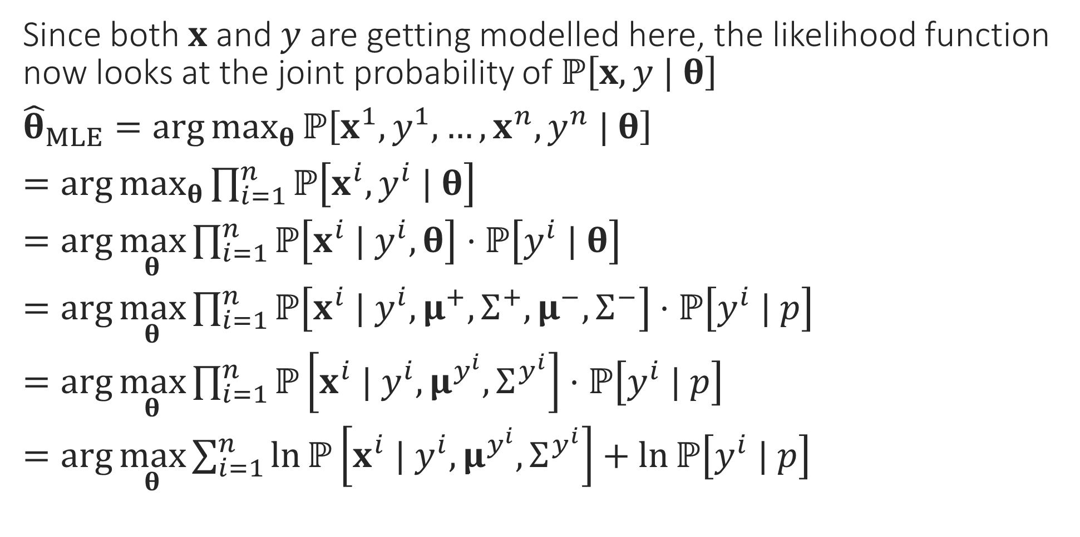
MLE for generative classification
Since both $x$ and $y$ are getting modelled here, the likelihood function now looks at the joint probability of $ℙ\left[x,y | θ\right]$
${\hat{θ}}_{MLE}=\arg{\max_{θ}{ℙ\left[x^{1},y^{1},…,x^{n},y^{n} | θ\right]}}$
$=\arg{\max_{θ}{\prod_{i=1}^{n}{ℙ\left[x^{i},y^{i} | θ\right]}}}$
$=\arg{\max_{θ}{\prod_{i=1}^{n}{ℙ\left[x^{i} | y^{i}, θ\right]⋅ℙ\left[y^{i} | θ\right]}}}$
$=\arg{\max_{θ}{\prod_{i=1}^{n}{ℙ\left[x^{i} | y^{i},μ^{+},Σ^{+},μ^{−},Σ^{−}\right]⋅ℙ\left[y^{i} | p\right]}}}$
$=\arg{\max_{θ}{\prod_{i=1}^{n}{ℙ\left[x^{i} | y^{i},μ^{y^{i}},Σ^{y^{i}}\right]⋅ℙ\left[y^{i} | p\right]}}}$
$=\arg{\max_{θ}{\sum_{i=1}^{n}{\ln{ℙ\left[x^{i} | y^{i},μ^{y^{i}},Σ^{y^{i}}\right]}+\ln{ℙ\left[y^{i} | p\right]}}}}$
Independence
Chain Rule
Get rid of conditioning that does not matter
Get rid of conditioning that does not matter
Take logs

Slide 6
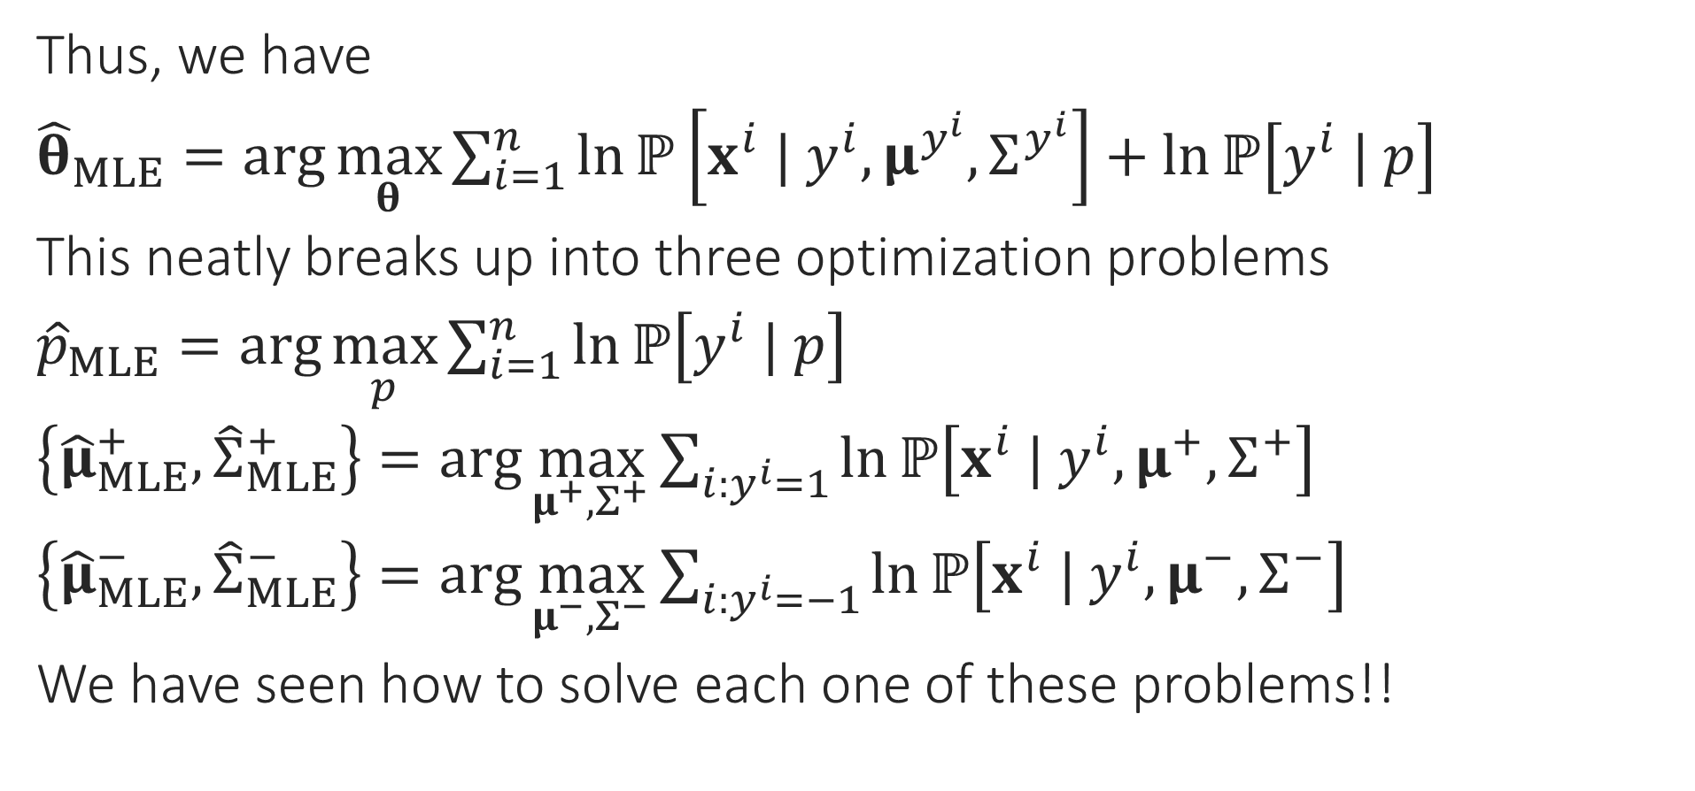
MLE for generative classification
Thus, we have
${\hat{θ}}_{MLE}=\arg{\max_{θ}{\sum_{i=1}^{n}{\ln{ℙ\left[x^{i} | y^{i},μ^{y^{i}},Σ^{y^{i}}\right]}+\ln{ℙ\left[y^{i} | p\right]}}}}$
This neatly breaks up into three optimization problems
${\hat{p}}_{MLE}=\arg{\max_{p}{\sum_{i=1}^{n}{\ln{ℙ\left[y^{i} | p\right]}}}}$
$\left\{{\hat{μ}}_{MLE}^{+},{\hat{Σ}}_{MLE}^{+}\right\}=\arg{\max_{μ^{+},Σ^{+}}{\sum_{i:y^{i}=1}{\ln{ℙ\left[x^{i} | y^{i},μ^{+},Σ^{+}\right]}}}}$
$\left\{{\hat{μ}}_{MLE}^{−},{\hat{Σ}}_{MLE}^{−}\right\}=\arg{\max_{μ^{−},Σ^{−}}{\sum_{i:y^{i}=−1}{\ln{ℙ\left[x^{i} | y^{i},μ^{−},Σ^{−}\right]}}}}$
We have seen how to solve each one of these problems!!

Slide 7
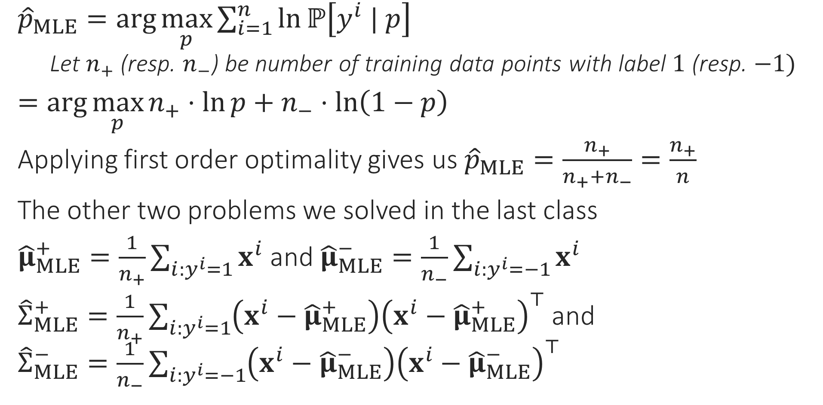
MLE for generative classification
${\hat{p}}_{MLE}=\arg{\max_{p}{\sum_{i=1}^{n}{\ln{ℙ\left[y^{i} | p\right]}}}}$
Let $n_{+}$ (resp. $n_{−}$) be number of training data points with label $1$ (resp. $−1)$
$=\arg{\max_{p}{n_{+}⋅\ln{p}+n_{−}⋅\ln\left(1−p\right)}}$
Applying first order optimality gives us ${\hat{p}}_{MLE}=\frac{n_{+}}{n_{+}+n_{−}}=\frac{n_{+}}{n}$
The other two problems we solved in the last class
${\hat{μ}}_{MLE}^{+}=\frac{1}{n_{+}}\sum_{i:y^{i}=1}{x^{i}}$ and ${\hat{μ}}_{MLE}^{−}=\frac{1}{n_{−}}\sum_{i:y^{i}=−1}{x^{i}}$
${\hat{Σ}}_{MLE}^{+}=\frac{1}{n_{+}}\sum_{i:y^{i}=1}{\left(x^{i}−{\hat{μ}}_{MLE}^{+}\right){\left(x^{i}−{\hat{μ}}_{MLE}^{+}\right)}^{⊤}}$ and ${\hat{Σ}}_{MLE}^{−}=\frac{1}{n_{−}}\sum_{i:y^{i}=−1}{\left(x^{i}−{\hat{μ}}_{MLE}^{−}\right){\left(x^{i}−{\hat{μ}}_{MLE}^{−}\right)}^{⊤}}$

Slide 8
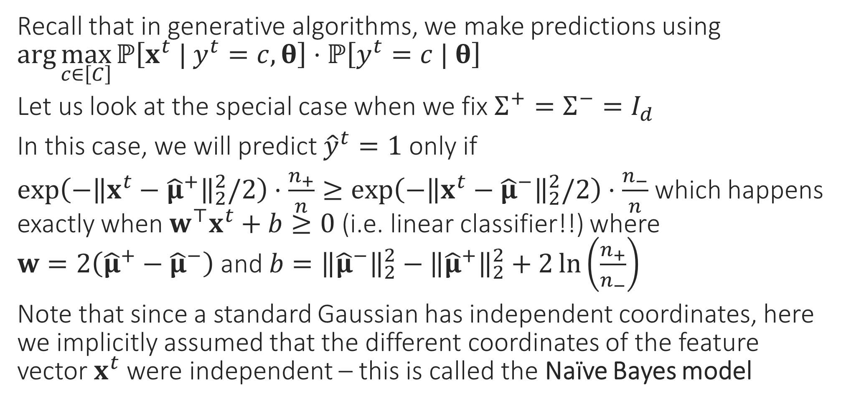
Special Cases – I
Recall that in generative algorithms, we make predictions using $\arg{\max_{c∈\left[C\right]}{ℙ\left[x^{t} | y^{t}=c,θ\right]⋅ℙ\left[y^{t}=c | θ\right]}}$
Let us look at the special case when we fix $Σ^{+}=Σ^{−}=I_{d}$
In this case, we will predict ${\hat{y}}^{t}=1$ only if
$\exp\left(−{\left\|x^{t}−{\hat{μ}}^{+}\right\|}_{2}^{2}/2\right)⋅\frac{n_{+}}{n}≥\exp\left(−{\left\|x^{t}−{\hat{μ}}^{−}\right\|}_{2}^{2}/2\right)⋅\frac{n_{−}}{n}$ which happens exactly when $w^{⊤}x^{t}+b≥0$ (i.e. linear classifier!!) where $w=2\left({\hat{μ}}^{+}−{\hat{μ}}^{−}\right)$ and $b={\left\|{\hat{μ}}^{−}\right\|}_{2}^{2}−{\left\|{\hat{μ}}^{+}\right\|}_{2}^{2}+2\ln\left(\frac{n_{+}}{n_{−}}\right)$
Note that since a standard Gaussian has independent coordinates, here we implicitly assumed that the different coordinates of the feature vector $x^{t}$ were independent – this is called the Naïve Bayes model

Slide 9
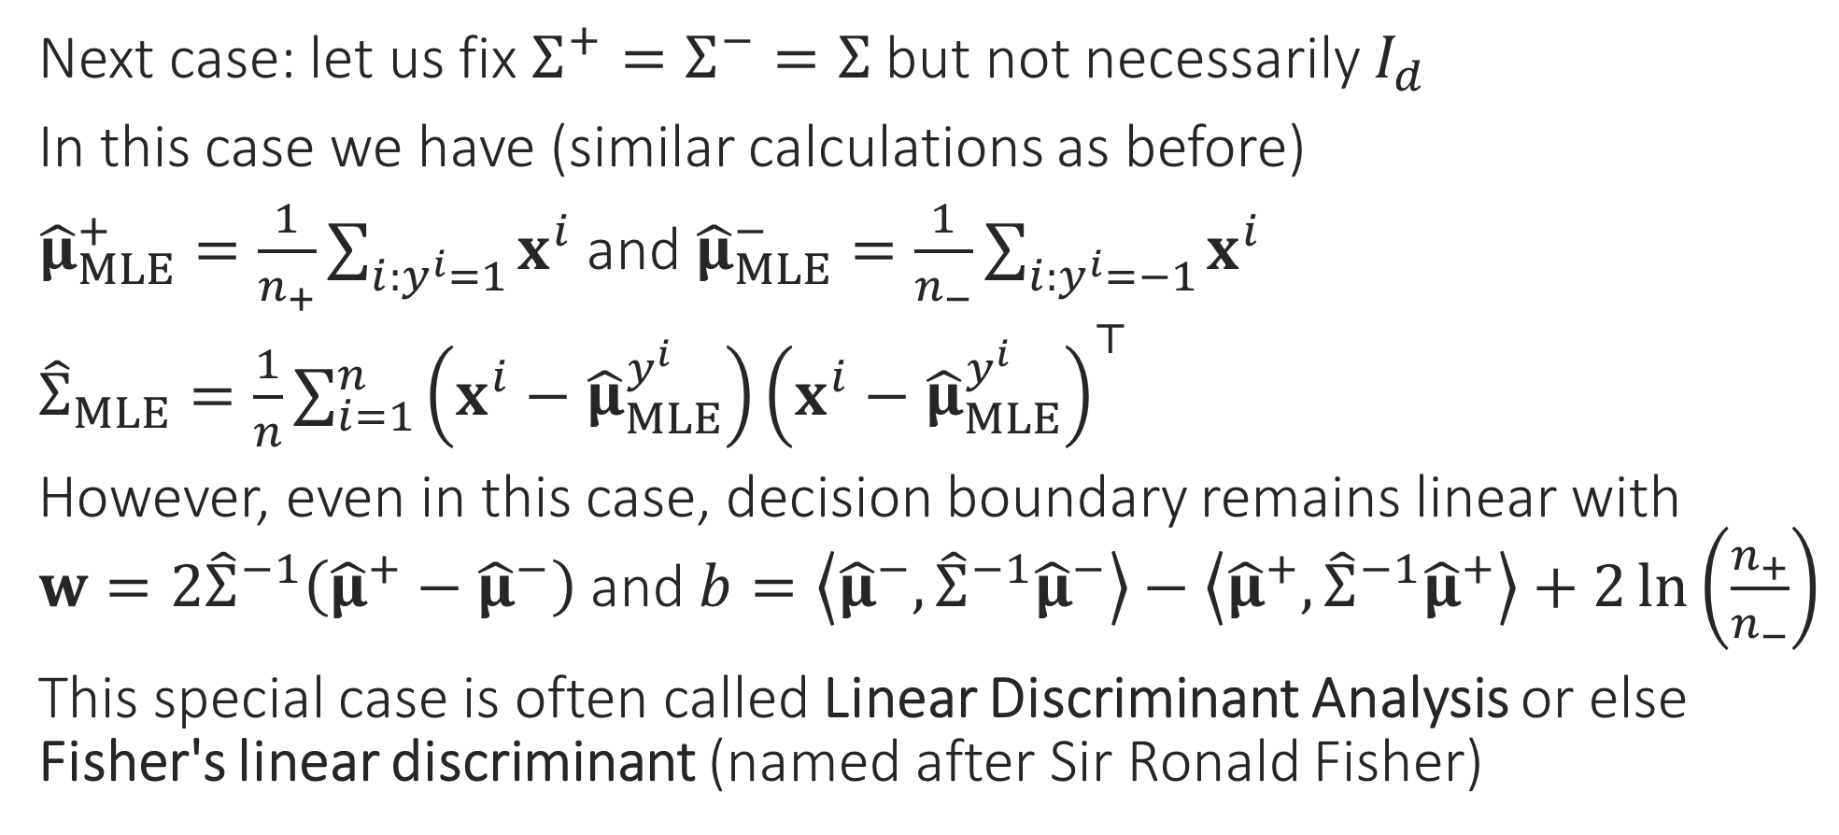
Special Cases – II
Next case: let us fix $Σ^{+}=Σ^{−}=Σ$ but not necessarily $I_{d}$
In this case we have (similar calculations as before)
${\hat{μ}}_{MLE}^{+}=\frac{1}{n_{+}}\sum_{i:y^{i}=1}{x^{i}}$ and ${\hat{μ}}_{MLE}^{−}=\frac{1}{n_{−}}\sum_{i:y^{i}=−1}{x^{i}}$
${\hat{Σ}}_{MLE}=\frac{1}{n}\sum_{i=1}^{n}{\left(x^{i}−{\hat{μ}}_{MLE}^{y^{i}}\right){\left(x^{i}−{\hat{μ}}_{MLE}^{y^{i}}\right)}^{⊤}}$
However, even in this case, decision boundary remains linear with $w=2{\hat{Σ}}^{−1}\left({\hat{μ}}^{+}−{\hat{μ}}^{−}\right)$ and $b=\left\langle {\hat{μ}}^{−},{\hat{Σ}}^{−1}{\hat{μ}}^{−}\right\rangle −\left\langle {\hat{μ}}^{+},{\hat{Σ}}^{−1}{\hat{μ}}^{+}\right\rangle +2\ln\left(\frac{n_{+}}{n_{−}}\right)$
This special case is often called Linear Discriminant Analysis or else Fisher's linear discriminant (named after Sir Ronald Fisher)

Slide 10
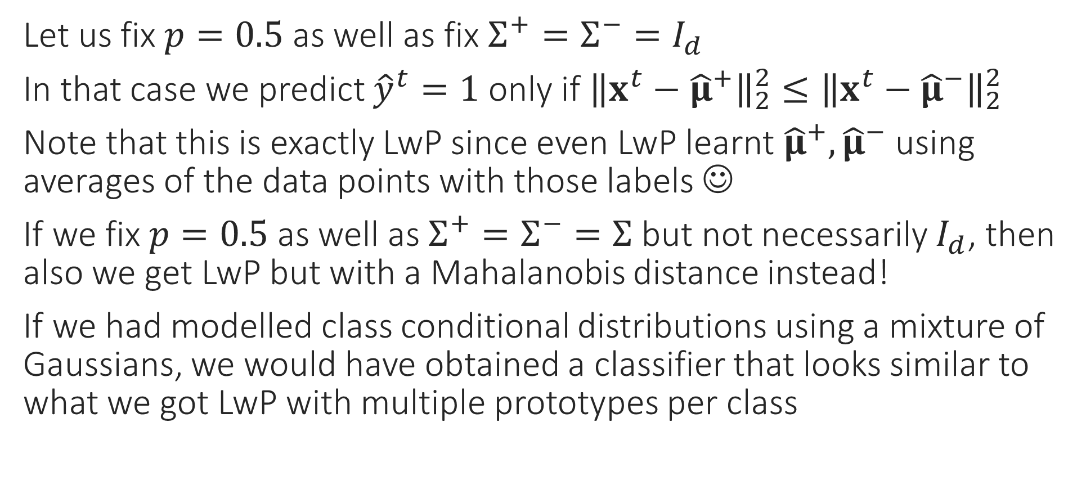
Special Cases – III
Let us fix $p=0.5$ as well as fix $Σ^{+}=Σ^{−}=I_{d}$
In that case we predict ${\hat{y}}^{t}=1$ only if ${\left\|x^{t}−{\hat{μ}}^{+}\right\|}_{2}^{2}≤{\left\|x^{t}−{\hat{μ}}^{−}\right\|}_{2}^{2}$
Note that this is exactly LwP since even LwP learnt ${\hat{μ}}^{+},{\hat{μ}}^{−}$ using averages of the data points with those labels ☺
If we fix $p=0.5$ as well as $Σ^{+}=Σ^{−}=Σ$ but not necessarily $I_{d}$, then also we get LwP but with a Mahalanobis distance instead!
If we had modelled class conditional distributions using a mixture of Gaussians, we would have obtained a classifier that looks similar to what we got LwP with multiple prototypes per class

Slide 11
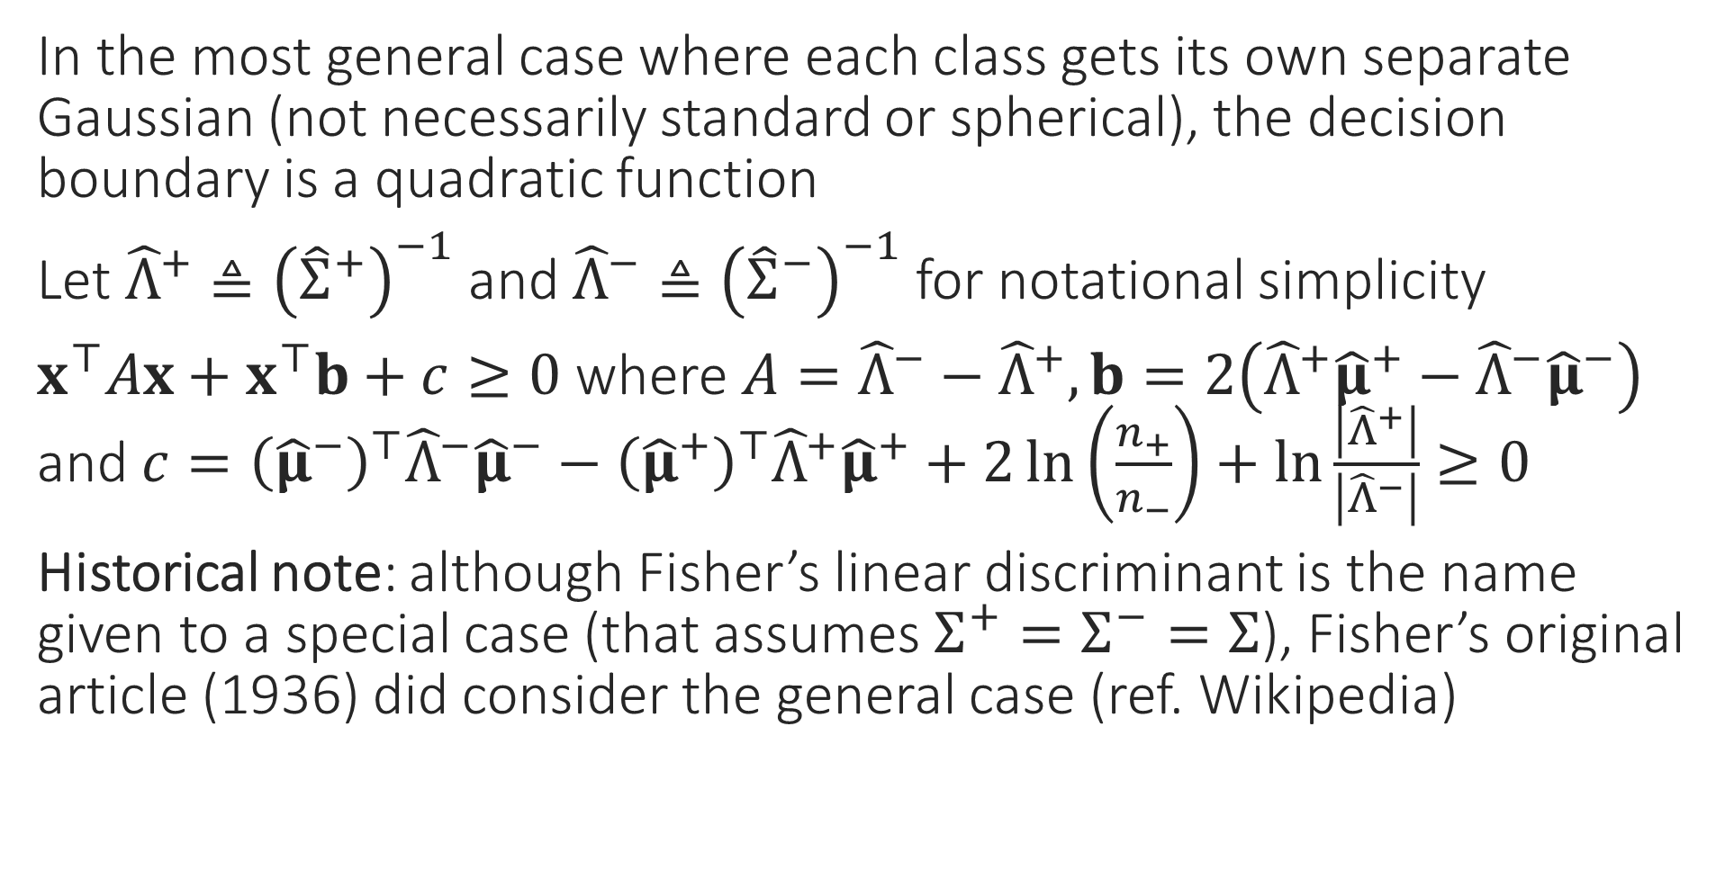
General Case
In the most general case where each class gets its own separate Gaussian (not necessarily standard or spherical), the decision boundary is a quadratic function
Let ${\hat{Λ}}^{+}≜{\left({\hat{Σ}}^{+}\right)}^{−1}$ and ${\hat{Λ}}^{−}≜{\left({\hat{Σ}}^{−}\right)}^{−1}$ for notational simplicity
$x^{⊤}Ax+x^{⊤}b+c≥0$ where $A={\hat{Λ}}^{−}−{\hat{Λ}}^{+},b=2\left({\hat{Λ}}^{+}{\hat{μ}}^{+}−{\hat{Λ}}^{−}{\hat{μ}}^{−}\right)$ and $c={\left({\hat{μ}}^{−}\right)}^{⊤}{\hat{Λ}}^{−}{\hat{μ}}^{−}−{\left({\hat{μ}}^{+}\right)}^{⊤}{\hat{Λ}}^{+}{\hat{μ}}^{+}+2\ln\left(\frac{n_{+}}{n_{−}}\right)+\ln{\frac{\left|{\hat{Λ}}^{+}\right|}{\left|{\hat{Λ}}^{−}\right|}}≥0$
Historical note: although Fisher’s linear discriminant is the name given to a special case (that assumes $Σ^{+}=Σ^{−}=Σ$), Fisher’s original article (1936) did consider the general case (ref. Wikipedia)

Slide 12


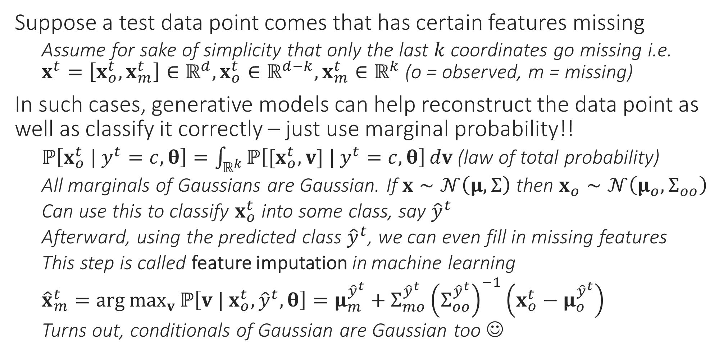
Generative Learning for Missing Data
What if I don’t know which coordinates are missing (e.g. a pixel in an image is white – is it because it was supposed to be white or is it because the color information for that pixel is missing). What can we do then?
Suppose a test data point comes that has certain features missing
Assume for sake of simplicity that only the last $k$ coordinates go missing i.e. $x^{t}=\left[x_{o}^{t},x_{m}^{t}\right]∈ℝ^{d},x_{o}^{t}∈ℝ^{d−k},x_{m}^{t}∈ℝ^{k}$ (o = observed, m = missing)
In such cases, generative models can help reconstruct the data point as well as classify it correctly – just use marginal probability!!
$ℙ\left[x_{o}^{t} | y^{t}=c,θ\right]=\int_{ℝ^{k}}{ℙ\left[{[x}_{o}^{t},v] | y^{t}=c,θ\right]}dv$ (law of total probability)
All marginals of Gaussians are Gaussian. If $x∼𝒩\left(μ,Σ\right)$ then $x_{o}∼𝒩\left(μ_{o},Σ_{oo}\right)$
Can use this to classify $x_{o}^{t}$ into some class, say ${\hat{y}}^{t}$
Afterward, using the predicted class ${\hat{y}}^{t}$, we can even fill in missing features
This step is called feature imputation in machine learning
${\hat{x}}_{m}^{t}=\arg{\max_{v}{ℙ\left[v | x_{o}^{t},{\hat{y}}^{t},θ\right]}}=μ_{m}^{{\hat{y}}^{t}}+Σ_{mo}^{{\hat{y}}^{t}}{\left(Σ_{oo}^{{\hat{y}}^{t}}\right)}^{−1}\left(x_{o}^{t}−μ_{o}^{{\hat{y}}^{t}}\right)$
Turns out, conditionals of Gaussian are Gaussian too ☺
All these questions can be dealt with (to some extent) but require more sophisticated methods. Entire sub-areas of ML e.g. adversarial learning, robust learning are devoted to these
What if my training data is itself incomplete, e.g. has missing features or even completely wrong labels. What if these corruptions are adversarial i.e. the result of mischief designed to make the ML algo fail?

