Slide 1
Non-linear Models

Slide 2
The key tricks to non-linear models
Two key methods to learning non-linear ML models
Method 1: memory-based models
E.g., decision trees, nearest neighbors
These usually have massive model sizes
Can be super fast at prediction
Method 2: reduction to linear models
E.g., kernel methods, deep learning
These can have smaller model sizes but can be large as well
Offer reasonably fast predictions but not super fast

Slide 3

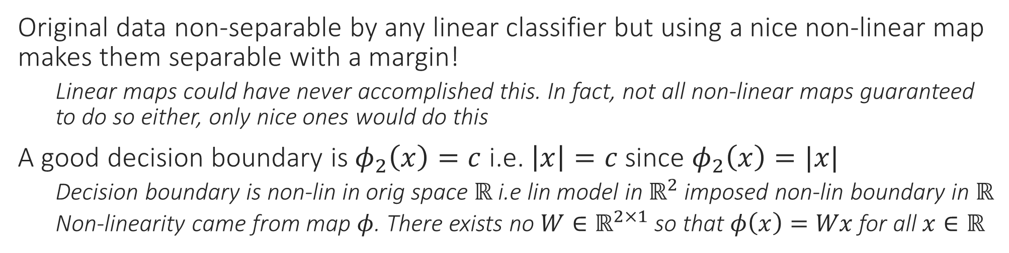
Non-linear Classification
Original data non-separable by any linear classifier but using a nice non-linear map makes them separable with a margin!
Linear maps could have never accomplished this. In fact, not all non-linear maps guaranteed to do so either, only nice ones would do this
A good decision boundary is $φ_{2}\left(x\right)=c$ i.e. $\left|x\right|=c$ since $φ_{2}\left(x\right)=|x|$
Decision boundary is non-lin in orig space $ℝ$ i.e lin model in $ℝ^{2}$ imposed non-lin boundary in $ℝ$
Non-linearity came from map $φ$. There exists no $W∈ℝ^{2×1}$ so that $φ\left(x\right)=Wx$ for all $x∈ℝ$

Slide 4

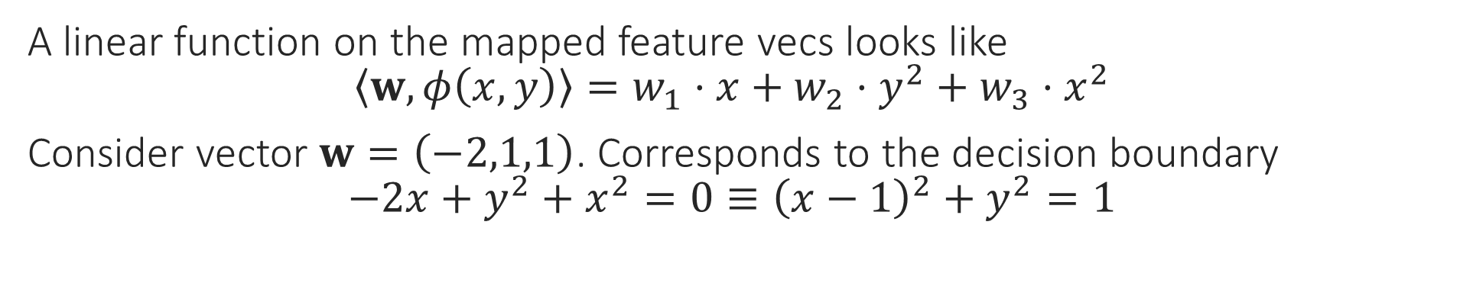
Non-linear Classification
A linear function on the mapped feature vecs looks like $\left\langle w,φ\left(x,y\right)\right\rangle =w_{1}⋅x+w_{2}⋅y^{2}+w_{3}⋅x^{2}$
Consider vector $w=\left(−2,1,1\right)$. Corresponds to the decision boundary $−2x+y^{2}+x^{2}=0≡{\left(x−1\right)}^{2}+y^{2}=1$

Slide 5
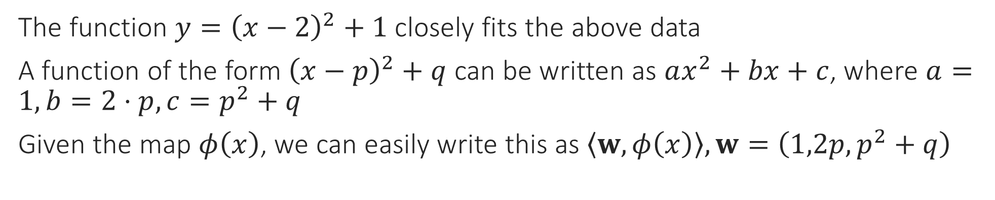
Non-linear Regression
The function $y={\left(x−2\right)}^{2}+1$ closely fits the above data
A function of the form ${\left(x−p\right)}^{2}+q$ can be written as $ax^{2}+bx+c$, where $a=1,b=2⋅p,c=p^{2}+q$
Given the map $φ\left(x\right)$, we can easily write this as $\left\langle w,φ\left(x\right)\right\rangle ,w=\left(1,2p,p^{2}+q\right)$

Slide 6
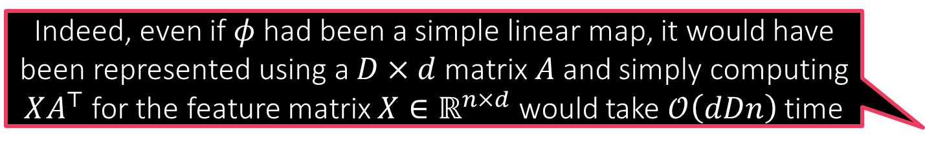
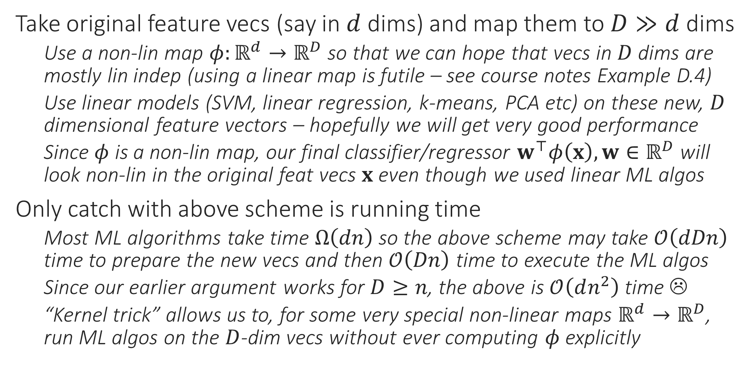
The Kernel Trick
Take original feature vecs (say in $d$ dims) and map them to $D≫d$ dims
Use a non-lin map $φ:ℝ^{d}→ℝ^{D}$ so that we can hope that vecs in $D$ dims are mostly lin indep (using a linear map is futile – see course notes Example D.4)
Use linear models (SVM, linear regression, k-means, PCA etc) on these new, $D$ dimensional feature vectors – hopefully we will get very good performance
Since $φ$ is a non-lin map, our final classifier/regressor $w^{⊤}φ\left(x\right),w∈ℝ^{D}$ will look non-lin in the original feat vecs $x$ even though we used linear ML algos
Only catch with above scheme is running time
Most ML algorithms take time $Ω\left(dn\right)$ so the above scheme may take $𝒪\left(dDn\right)$ time to prepare the new vecs and then $𝒪\left(Dn\right)$ time to execute the ML algos
Since our earlier argument works for $D≥n$, the above is $𝒪\left(dn^{2}\right)$ time ☹
“Kernel trick” allows us to, for some very special non-linear maps $ℝ^{d}→ℝ^{D}$, run ML algos on the $D$-dim vecs without ever computing $φ$explicitly
Indeed, even if $φ$ had been a simple linear map, it would have been represented using a $D×d$ matrix $A$ and simply computing $XA^{⊤}$ for the feature matrix $X∈ℝ^{n×d}$ would take $𝒪\left(dDn\right)$ time

Slide 7
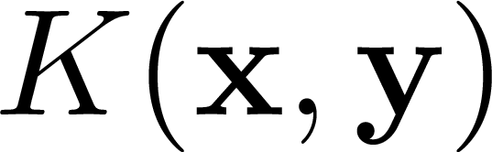
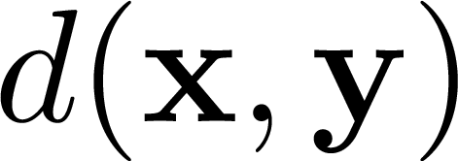
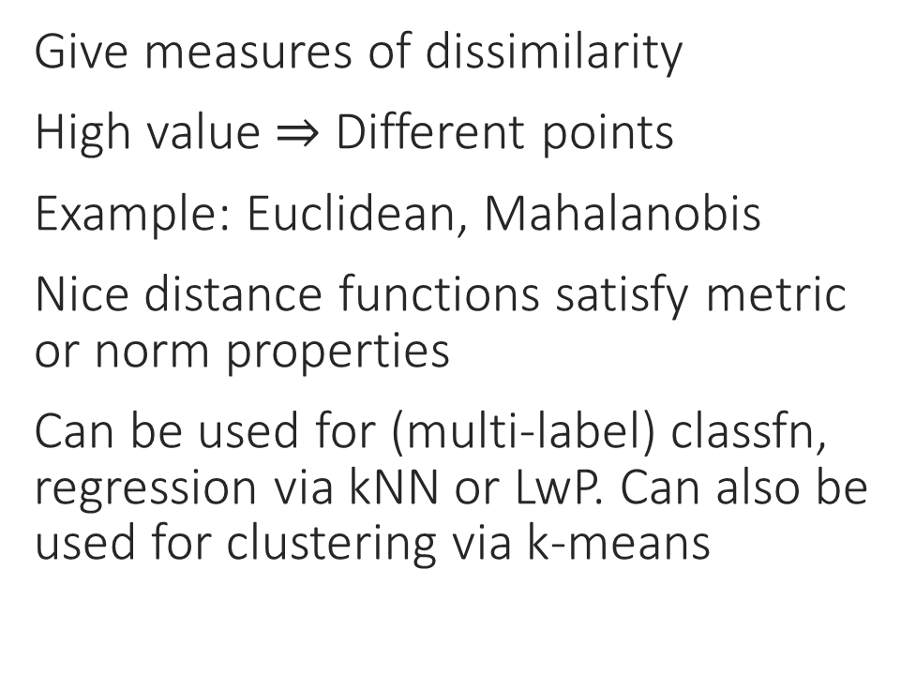
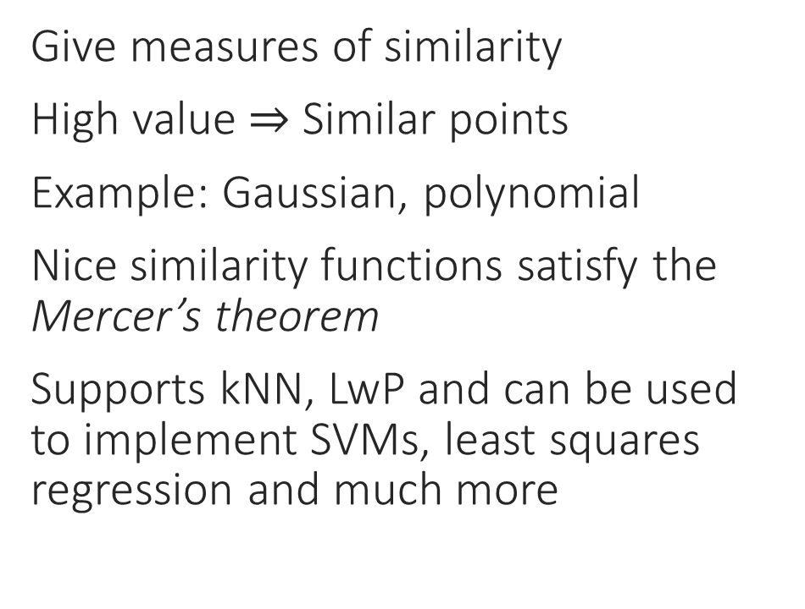
Kernels vs Distance Measures
Kernels
Distance measures
Give measures of similarity
High value $⇒$ Similar points
Example: Gaussian, polynomial
Nice similarity functions satisfy the Mercer’s theorem
Supports kNN, LwP and can be used to implement SVMs, least squares regression and much more
Give measures of dissimilarity
High value $⇒$ Different points
Example: Euclidean, Mahalanobis
Nice distance functions satisfy metric or norm properties
Can be used for (multi-label) classfn, regression via kNN or LwP. Can also be used for clustering via k-means

Slide 8
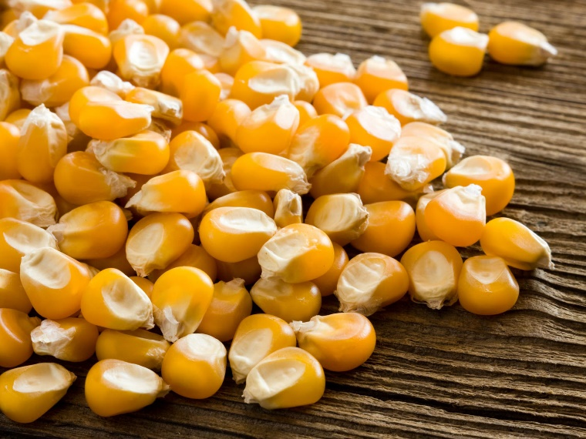
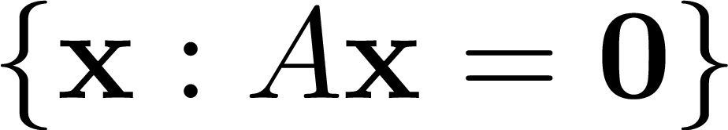

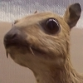


Kernels and Kernels
Kernel of linear transformation
✓
Kernels of corn
$$\left[\begin{matrix}0 & −1 & 0 \\ −1 & 5 & −1 \\ 0 & −1 & 0\end{matrix}\right]$$
Convolution kernels (masks)
OS Kernel

Slide 9

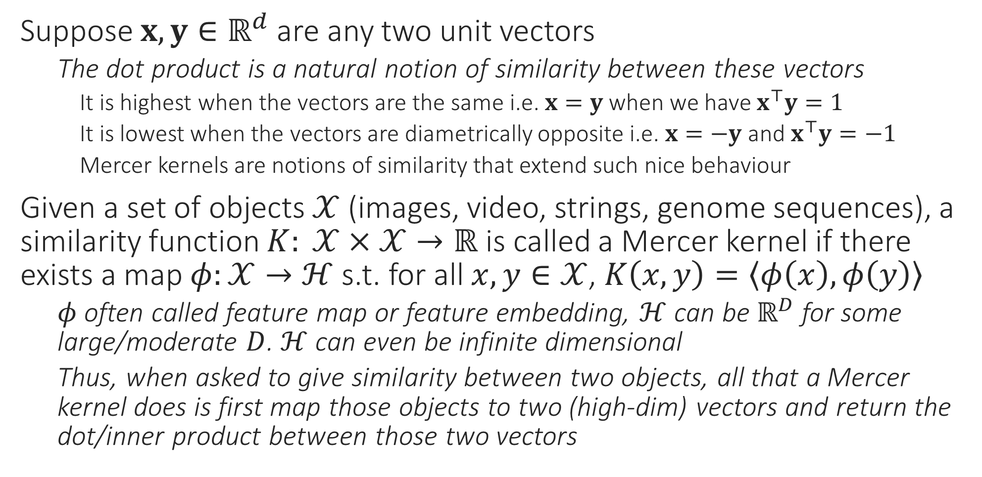

Mercer Kernels
In general, $ℋ$ has to be a Hilbert space which, technicalities aside, is very much like a real vector space such as $ℝ^{D}$ but is possibly infinite dimensional. It is always possible to define inner/dot products on Hilbert spaces
Suppose $x,y∈ℝ^{d}$ are any two unit vectors
The dot product is a natural notion of similarity between these vectors
It is highest when the vectors are the same i.e. $x=y$ when we have $x^{⊤}y=1$
It is lowest when the vectors are diametrically opposite i.e. $x=−y$ and $x^{⊤}y=−1$
Mercer kernels are notions of similarity that extend such nice behaviour
Given a set of objects $𝒳$ (images, video, strings, genome sequences), a similarity function $K: 𝒳×𝒳→ℝ$ is called a Mercer kernel if there exists a map $φ:𝒳→ℋ$ s.t. for all $x,y∈𝒳$, $K\left(x,y\right)=\left\langle φ\left(x\right),φ\left(y\right)\right\rangle$
$φ$ often called feature map or feature embedding, $ℋ$ can be $ℝ^{D}$ for some large/moderate $D$. $ℋ$ can even be infinite dimensional
Thus, when asked to give similarity between two objects, all that a Mercer kernel does is first map those objects to two (high-dim) vectors and return the dot/inner product between those two vectors

Slide 10

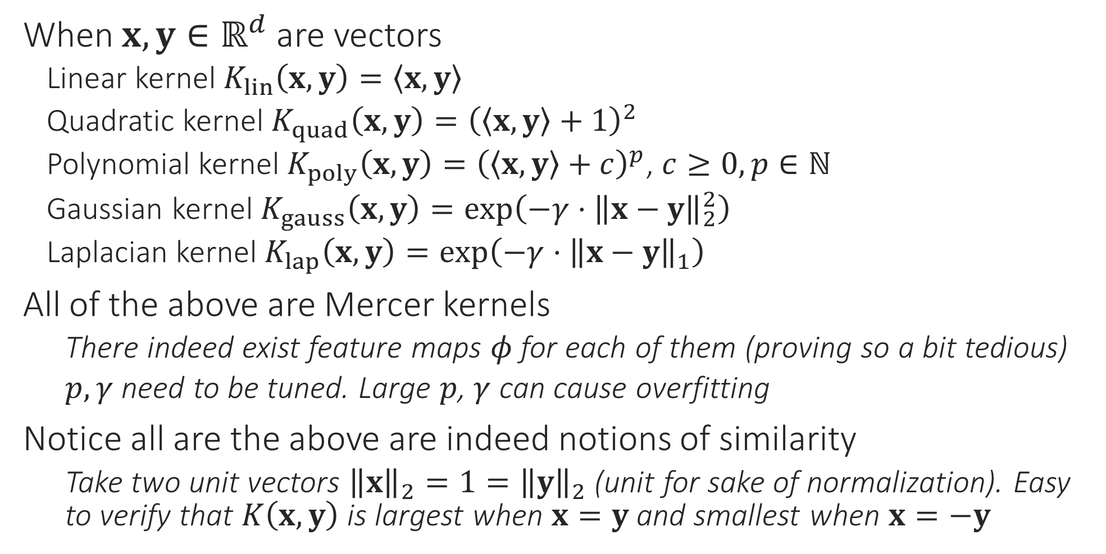
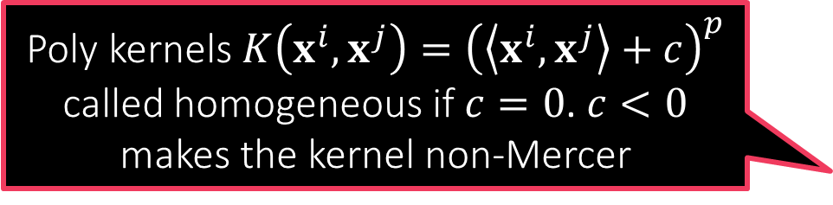
Examples of Kernels
Poly kernels $K\left(x^{i},x^{j}\right)={\left(\left\langle x^{i},x^{j}\right\rangle +c\right)}^{p}$ called homogeneous if $c=0$. $c<0$ makes the kernel non-Mercer
When $x,y∈ℝ^{d}$ are vectors
Linear kernel $K_{lin}\left(x,y\right)=\left\langle x,y\right\rangle$
Quadratic kernel $K_{quad}\left(x,y\right)={\left(\left\langle x,y\right\rangle +1\right)}^{2}$
Polynomial kernel $K_{poly}\left(x,y\right)={\left(\left\langle x,y\right\rangle +c\right)}^{p}$, $c≥0,p∈ℕ$
Gaussian kernel $K_{gauss}\left(x,y\right)=\exp\left(−γ⋅{\left\|x−y\right\|}_{2}^{2}\right)$
Laplacian kernel $K_{lap}\left(x,y\right)=\exp\left(−γ⋅{\left\|x−y\right\|}_{1}\right)$
All of the above are Mercer kernels
There indeed exist feature maps $φ$ for each of them (proving so a bit tedious)
$p,γ$ need to be tuned. Large $p$, $γ$ can cause overfitting
Notice all are the above are indeed notions of similarity
Take two unit vectors ${\left\|x\right\|}_{2}=1={\left\|y\right\|}_{2}$ (unit for sake of normalization). Easy to verify that $K\left(x,y\right)$ is largest when $x=y$ and smallest when $x=−y$

Slide 11
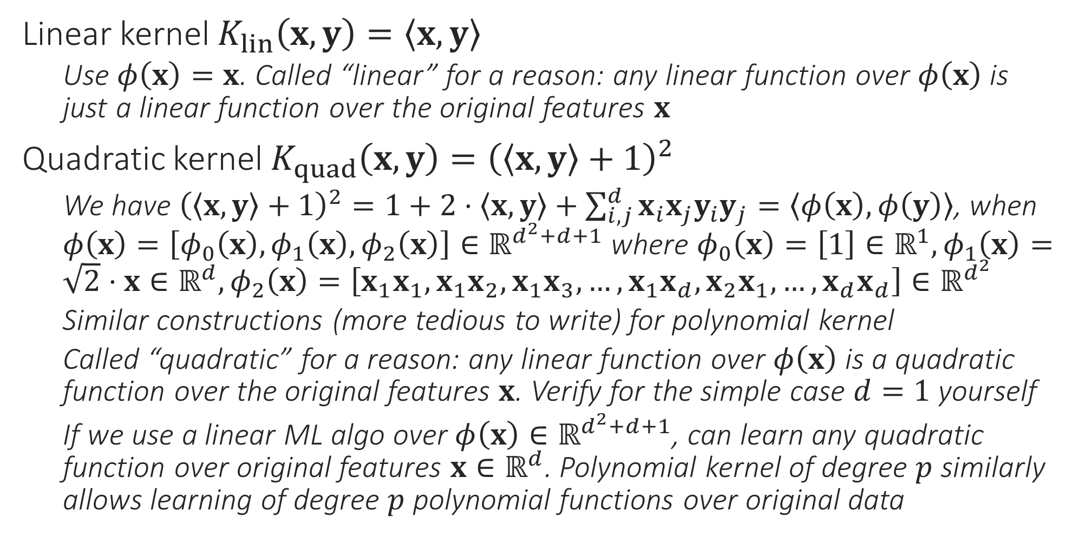
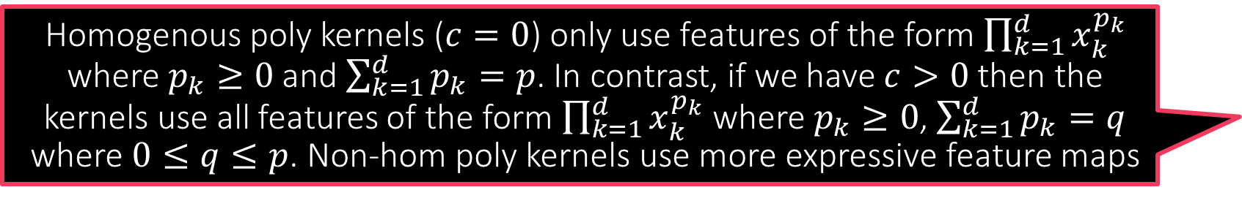
Mercer Kernel Feature Maps
Homogenous poly kernels ($c=0$) only use features of the form $\prod_{k=1}^{d}{x_{k}^{p_{k}}}$ where $p_{k}≥0$ and $\sum_{k=1}^{d}{p_{k}}=p$. In contrast, if we have $c>0$ then the kernels use all features of the form $\prod_{k=1}^{d}{x_{k}^{p_{k}}}$ where $p_{k}≥0$, $\sum_{k=1}^{d}{p_{k}}=q$ where $0≤q≤p$. Non-hom poly kernels use more expressive feature maps
Linear kernel $K_{lin}\left(x,y\right)=\left\langle x,y\right\rangle$
Use $φ\left(x\right)=x$. Called “linear” for a reason: any linear function over $φ\left(x\right)$ is just a linear function over the original features $x$
Quadratic kernel $K_{quad}\left(x,y\right)={\left(\left\langle x,y\right\rangle +1\right)}^{2}$
We have ${\left(\left\langle x,y\right\rangle +1\right)}^{2}=1+2⋅\left\langle x,y\right\rangle +\sum_{i,j}^{d}{x_{i}x_{j}y_{i}y_{j}}=\left\langle φ\left(x\right),φ\left(y\right)\right\rangle$, when $φ\left(x\right)=\left[φ_{0}\left(x\right),φ_{1}\left(x\right),φ_{2}\left(x\right)\right]∈ℝ^{d^{2}+d+1}$ where $φ_{0}\left(x\right)=\left[1\right]∈ℝ^{1},φ_{1}\left(x\right)=\sqrt{2}⋅x∈ℝ^{d},φ_{2}\left(x\right)=\left[x_{1}x_{1},x_{1}x_{2},x_{1}x_{3},…,x_{1}x_{d},x_{2}x_{1},…,x_{d}x_{d}\right]∈ℝ^{d^{2}}$
Similar constructions (more tedious to write) for polynomial kernel
Called “quadratic” for a reason: any linear function over $φ\left(x\right)$ is a quadratic function over the original features $x$. Verify for the simple case $d=1$ yourself
If we use a linear ML algo over $φ\left(x\right)∈ℝ^{d^{2}+d+1}$, can learn any quadratic function over original features $x∈ℝ^{d}$. Polynomial kernel of degree $p$ similarly allows learning of degree $p$ polynomial functions over original data

Slide 12

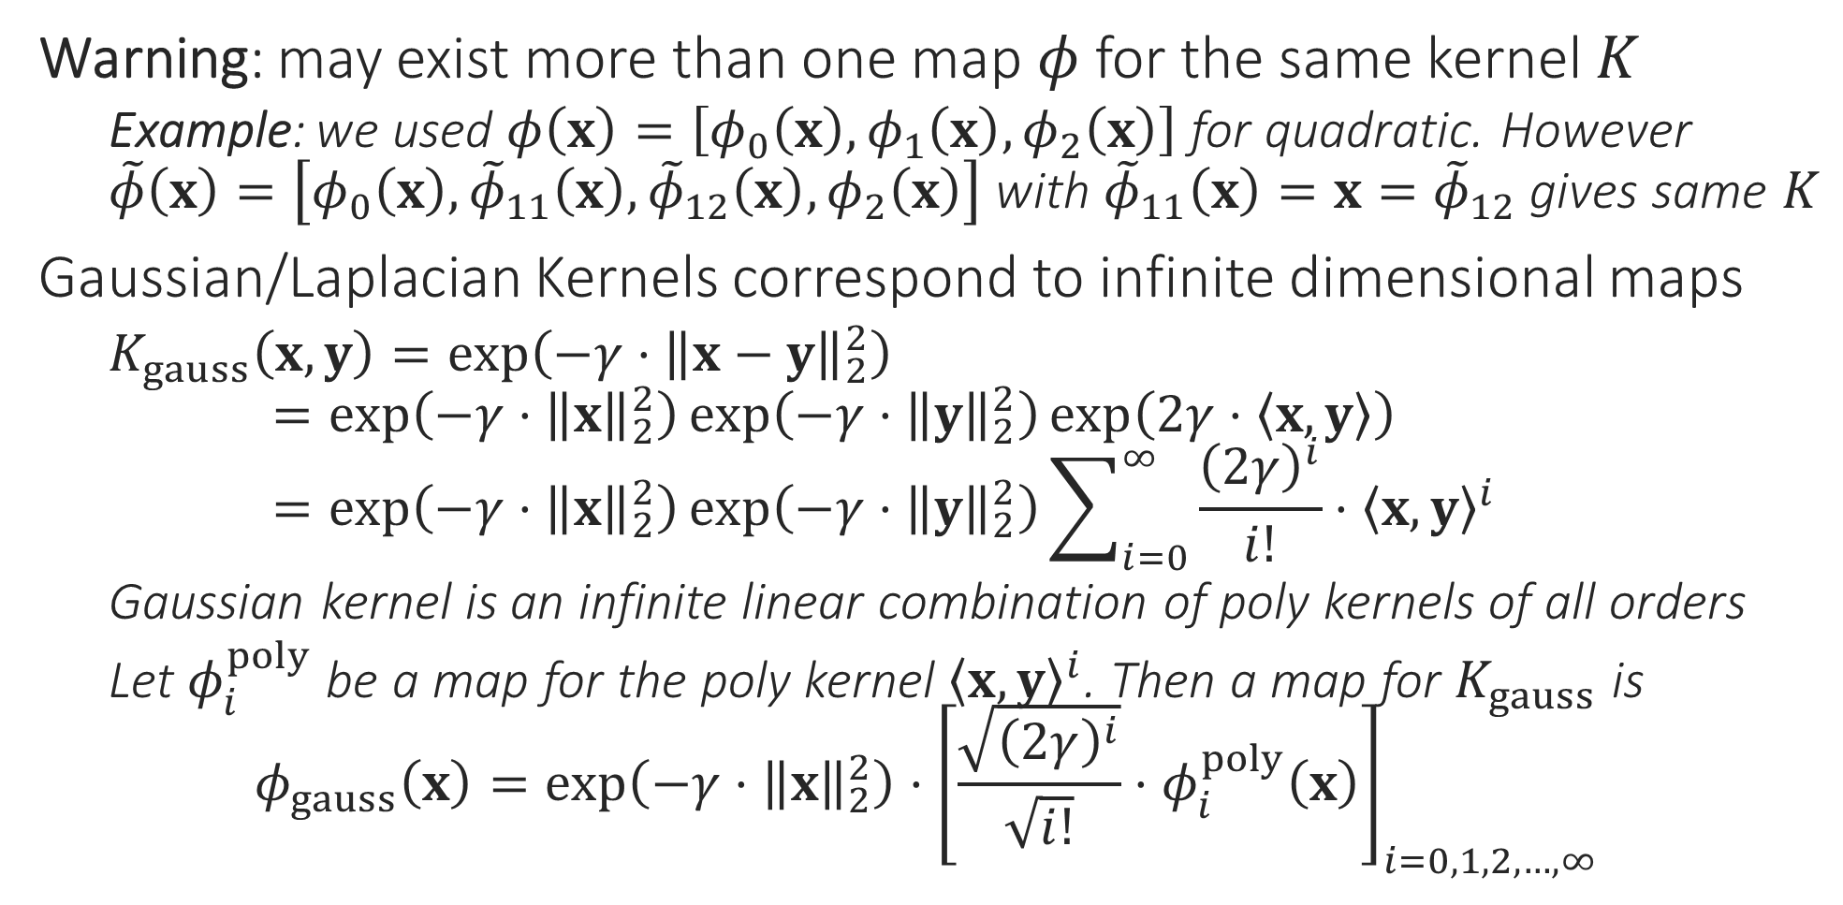
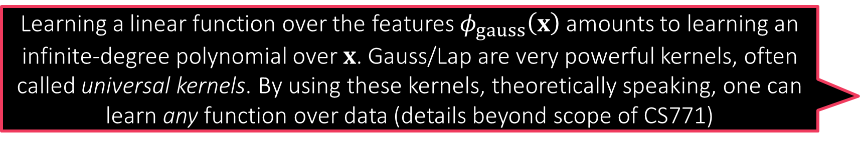
Mercer Kernel Feature Maps
Learning a linear function over the features $φ_{gauss}\left(x\right)$ amounts to learning an infinite-degree polynomial over $x$. Gauss/Lap are very powerful kernels, often called universal kernels. By using these kernels, theoretically speaking, one can learn any function over data (details beyond scope of CS771)
Warning: may exist more than one map $φ$ for the same kernel $K$
Example: we used $φ\left(x\right)=\left[φ_{0}\left(x\right),φ_{1}\left(x\right),φ_{2}\left(x\right)\right]$ for quadratic. However $\tilde{φ}\left(x\right)=\left[φ_{0}\left(x\right),{\tilde{φ}}_{11}\left(x\right),{\tilde{φ}}_{12}\left(x\right),φ_{2}\left(x\right)\right]$ with ${\tilde{φ}}_{11}\left(x\right)=x={\tilde{φ}}_{12}$ gives same $K$
Gaussian/Laplacian Kernels correspond to infinite dimensional maps
$K_{gauss}\left(x,y\right)=\exp\left(−γ⋅{\left\|x−y\right\|}_{2}^{2}\right)$ $=\exp\left(−γ⋅{\left\|x\right\|}_{2}^{2}\right)\exp\left(−γ⋅{\left\|y\right\|}_{2}^{2}\right)\exp\left(2γ⋅\left\langle x,y\right\rangle \right)$ $=\exp\left(−γ⋅{\left\|x\right\|}_{2}^{2}\right)\exp\left(−γ⋅{\left\|y\right\|}_{2}^{2}\right)\sum_{i=0}^{∞}{\frac{{\left(2γ\right)}^{i}}{i!}⋅{\left\langle x,y\right\rangle }^{i}}$
Gaussian kernel is an infinite linear combination of poly kernels of all orders
Let $φ_{i}^{poly}$ be a map for the poly kernel ${\left\langle x,y\right\rangle }^{i}$. Then a map for $K_{gauss}$ is $φ_{gauss}\left(x\right)=\exp\left(−γ⋅{\left\|x\right\|}_{2}^{2}\right)⋅{\left[\frac{\sqrt{{\left(2γ\right)}^{i}}}{\sqrt{i!}}⋅φ_{i}^{poly}\left(x\right)\right]}_{i=0,1,2,…,∞}$

Slide 13
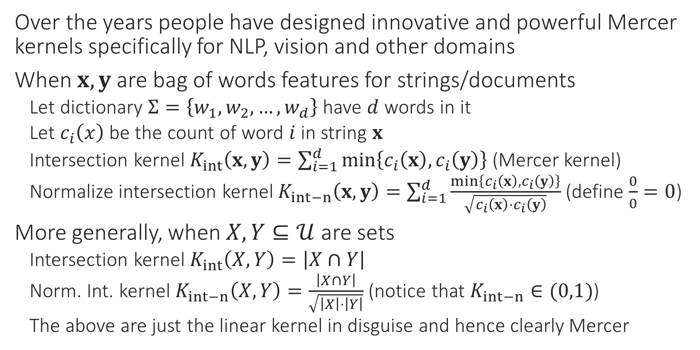

Some Domain Specific Kernels
Over the years people have designed innovative and powerful Mercer kernels specifically for NLP, vision and other domains
When $x,y$ are bag of words features for strings/documents
Let dictionary $Σ=\left\{w_{1},w_{2},…,w_{d}\right\}$ have $d$ words in it
Let $c_{i}\left(x\right)$ be the count of word $i$ in string $x$
Intersection kernel $K_{int}\left(x,y\right)=\sum_{i=1}^{d}{\min\left\{c_{i}\left(x\right),c_{i}\left(y\right)\right\}}$ (Mercer kernel)
Normalize intersection kernel $K_{int−n}\left(x,y\right)=\sum_{i=1}^{d}{\frac{\min\left\{c_{i}\left(x\right),c_{i}\left(y\right)\right\}}{\sqrt{c_{i}\left(x\right)⋅c_{i}\left(y\right)}}}$ (define $\frac{0}{0}=0$)
More generally, when $X,Y⊆𝒰$ are sets
Intersection kernel $K_{int}\left(X,Y\right)=\left|X∩Y\right|$
Norm. Int. kernel $K_{int−n}\left(X,Y\right)=\frac{\left|X∩Y\right|}{\sqrt{\left|X\right|⋅\left|Y\right|}}$ (notice that $K_{int−n}∈(0,1)$)
The above are just the linear kernel in disguise and hence clearly Mercer
Simply represent a set $X$ using an indicator vector $𝕀_{X}∈{\left\{0,1\right\}}^{\left|𝒰\right|}$ with $𝕀_{X}\left[i\right]=1$ if $i∈X$ else $𝕀_{X}\left[i\right]=0$. In this case, $\left|X∩Y\right|=\left\langle 𝕀_{X},𝕀_{Y}\right\rangle$

Slide 14
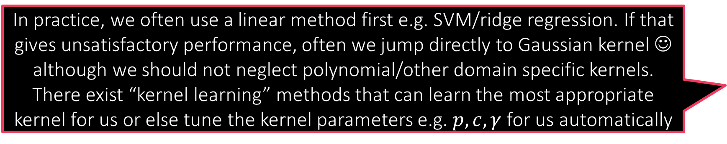
Some Domain Specific Kernels
N-gram, substring, Fisher kernels: other kernels between two strings
Random walk kernels between two graphs
Subtree, convolutional kernels between two trees
Pyramid kernel used in vision … combination of intersection kernels
In practice, we often use a linear method first e.g. SVM/ridge regression. If that gives unsatisfactory performance, often we jump directly to Gaussian kernel ☺ although we should not neglect polynomial/other domain specific kernels. There exist “kernel learning” methods that can learn the most appropriate kernel for us or else tune the kernel parameters e.g. $p,c,γ$ for us automatically

Slide 15

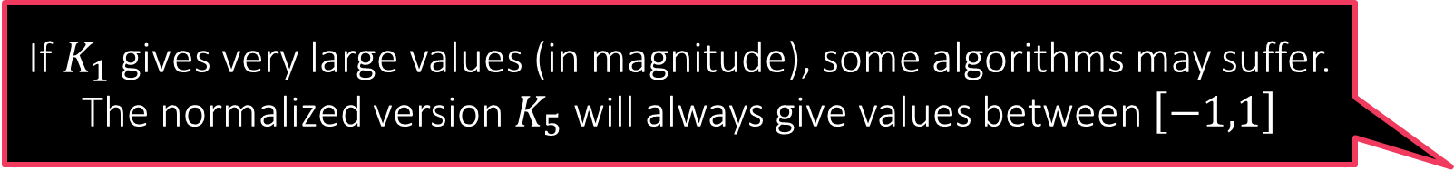

Creating New Kernels
The normalized kernel actually normalizes the feature map as well. Verify that if $φ$ is a map for $K_{1}$ then a map for $K_{5}$ is $\tilde{φ}$ where
$$\tilde{φ}:x↦\frac{φ\left(x\right)}{{\left\|φ\left(x\right)\right\|}_{ℋ}}$$
Method 1: combine old kernels. If $K_{1},K_{2}$ are existing Mercer kernels
$K_{3}=c_{1}⋅K_{1}+c_{2}⋅K_{2}$ is also a Mercer kernel if $c_{1},c_{2}≥0$ $K_{3}\left(x,y\right)=c_{1}⋅K_{1}\left(x,y\right)+c_{2}⋅K_{2}\left(x,y\right)$
$K_{4}=K_{1}⋅K_{2}$ is also a nice kernel $K_{4}\left(x,y\right)=K_{1}\left(x,y\right)⋅K_{2}\left(x,y\right)$
$K_{5}\left(x,y\right)=K_{1}\left(x,y\right)/\sqrt{K_{1}\left(x,x\right)⋅K_{1}\left(y,y\right)}$ gives a normalized kernel
Method 2: find a new feature rep. for data $φ_{new}\left(x\right)∈ℝ^{d}$ and use $K_{new}\left(x,y\right)=\left\langle φ_{new}\left(x\right),φ_{new}\left(y\right)\right\rangle$
Method 3: mix and match. Take new data rep. $φ_{new}\left(x\right)∈ℝ^{d}$ and an old kernel $K_{old}$ $K_{newer}\left(x,y\right)=K_{old}\left(φ_{new}\left(x\right),φ_{new}\left(y\right)\right)$
If $K_{1}$ gives very large values (in magnitude), some algorithms may suffer. The normalized version $K_{5}$ will always give values between $\left[−1,1\right]$

Slide 16
Kernelized Algorithms
Several algorithms we studied till now, work with kernels too!
Supervised: kNN, LWP, SVM, ridge regression
Unsupervised: k-means, PCA
Others like LASSO are harder to get working with kernels
Probabilistic/Bayesian algorithms also possible with kernels

Slide 17
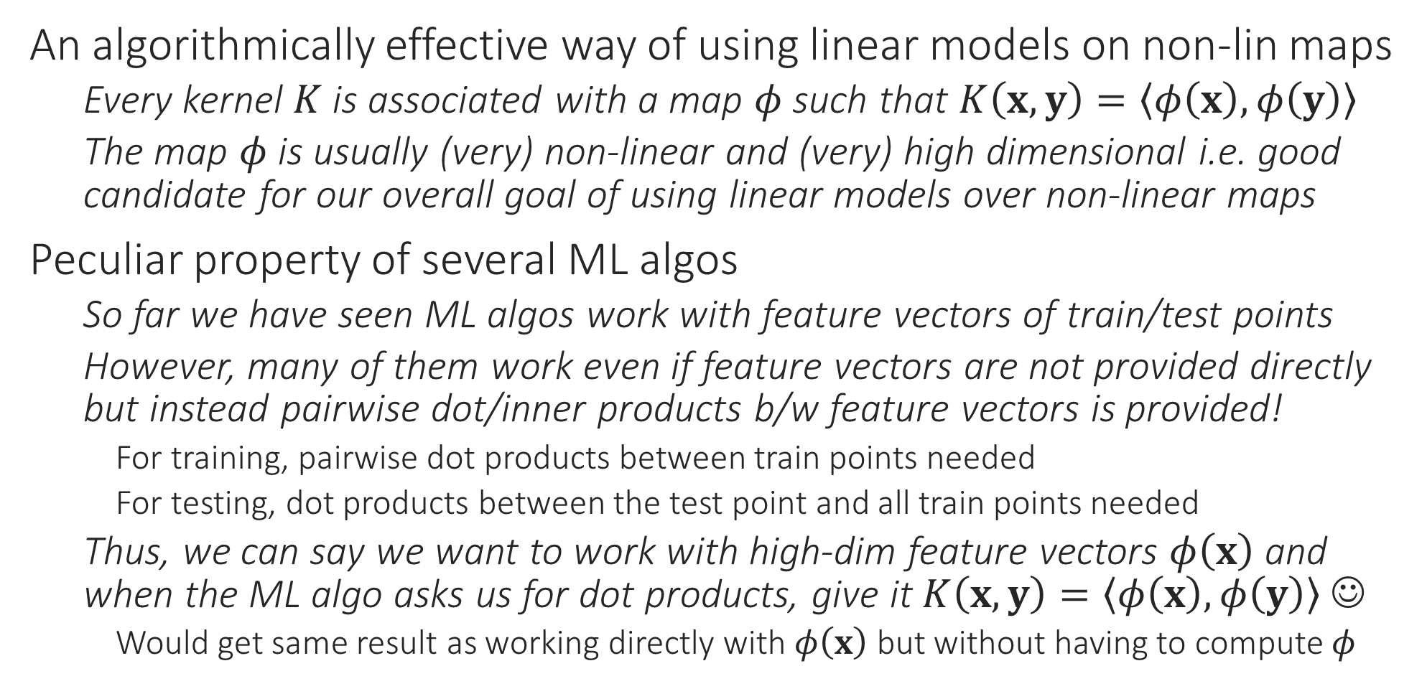
The Kernel Trick Revisited
An algorithmically effective way of using linear models on non-lin maps
Every kernel $K$ is associated with a map $φ$ such that $K\left(x,y\right)=\left\langle φ\left(x\right),φ\left(y\right)\right\rangle$
The map $φ$ is usually (very) non-linear and (very) high dimensional i.e. good candidate for our overall goal of using linear models over non-linear maps
Peculiar property of several ML algos
So far we have seen ML algos work with feature vectors of train/test points
However, many of them work even if feature vectors are not provided directly but instead pairwise dot/inner products b/w feature vectors is provided!
For training, pairwise dot products between train points needed
For testing, dot products between the test point and all train points needed
Thus, we can say we want to work with high-dim feature vectors $φ\left(x\right)$ and when the ML algo asks us for dot products, give it $K\left(x,y\right)=\left\langle φ\left(x\right),φ\left(y\right)\right\rangle$ ☺
Would get same result as working directly with $φ\left(x\right)$ but without having to compute $φ$
This peculiar property is often called kernelizability. An ML algo is said to be kernelizable if we can show that it works identically if, instead of feature vectors, we supply pairwise train-train and test-train dot products of feature vectors

Slide 18


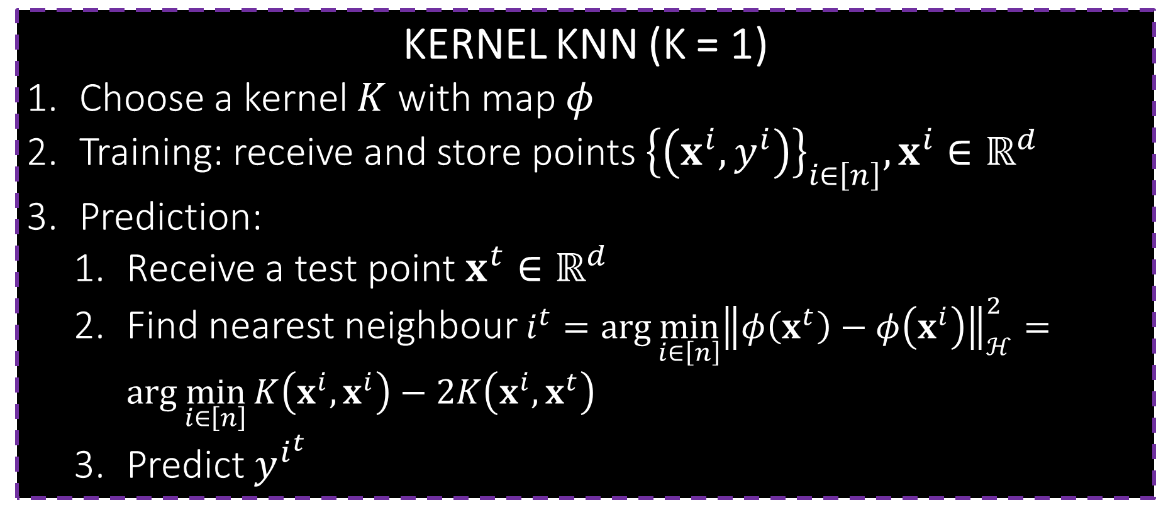
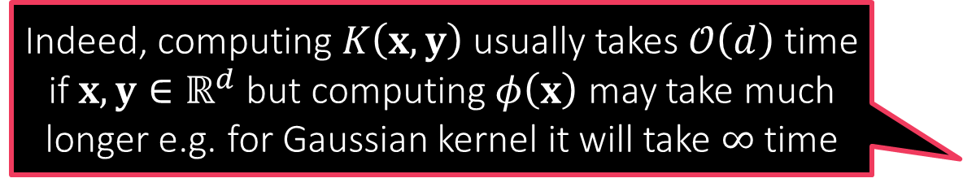
kNN with Kernels
This is a recurring theme in kernel learning. Never ever compute $φ\left(⋅\right)$. Instead, express all operations in the ML algo in terms of inner product computations which are then expressible as kernel computations
All that is needed to execute kNN is compute Euclidean distances
If working with kernel $K$ with map $φ$, need ${\left\|φ\left(x\right)−φ\left(y\right)\right\|}_{ℋ}^{2}$ ${\left\|⋅\right\|}_{ℋ} \text{is} \text{just} \text{fancy} \text{notation} \text{for} {\left\|⋅\right\|}_{2} \text{in} \text{a} \text{Hilbert} \text{space} ℋ$
$${\left\|φ\left(x\right)−φ\left(y\right)\right\|}_{ℋ}^{2}={\left\|φ\left(x\right)\right\|}_{2}^{2}−2\left\langle φ\left(x\right),φ\left(y\right)\right\rangle +{\left\|φ\left(y\right)\right\|}_{2}^{2} \\ =\left\langle φ\left(x\right),φ\left(x\right)\right\rangle −2\left\langle φ\left(x\right),φ\left(y\right)\right\rangle +\left\langle φ\left(y\right),φ\left(y\right)\right\rangle \\ =K\left(x,x\right)−2K\left(x,y\right)+K\left(y,y\right)$$
Thus, distances in $ℋ$ can be computed without computing $φ$ first ☺
1NN: Given training points $\left(x^{i},y^{i}\right),i=1,…n$ and a test point $x^{t}$
Find closest neighbor in $ℋ$ i.e. $i^{t}=\arg{\min_{i∈\left[n\right]}{{\left\|φ\left(x^{t}\right)−φ\left(x^{i}\right)\right\|}_{ℋ}^{2}}}$ which is the same as $\arg{\min_{i∈\left[n\right]}{K\left(x^{i},x^{i}\right)−2K\left(x^{i},x^{t}\right)}}$ and predict $y^{i^{t}}$ as the label
Note: if $K\left(x,x\right)≡1$ then this finds most “similar” point i.e. $\underset{i∈\left[n\right]}{argmax}{K\left(x^{i},x^{t}\right)}$
Similarly we can execute kNN for $k>1$ as well
KERNEL KNN (K = 1)
Choose a kernel $K$ with map $φ$
Training: receive and store points ${\left\{\left(x^{i},y^{i}\right)\right\}}_{i∈\left[n\right]},x^{i}∈ℝ^{d}$
Prediction:
Receive a test point $x^{t}∈ℝ^{d}$
Find nearest neighbour $i^{t}=\arg{\min_{i∈\left[n\right]}{{\left\|φ\left(x^{t}\right)−φ\left(x^{i}\right)\right\|}_{ℋ}^{2}}}=\arg{\min_{i∈\left[n\right]}{K\left(x^{i},x^{i}\right)−2K\left(x^{i},x^{t}\right)}}$
Predict $y^{i^{t}}$
Indeed, computing $K\left(x,y\right)$ usually takes $𝒪\left(d\right)$ time if $x,y∈ℝ^{d}$ but computing $φ\left(x\right)$ may take much longer e.g. for Gaussian kernel it will take $∞$ time

Slide 19


LwP with Kernels
Observe that in LwP with kernels, we now have to store entire training data whereas earlier we just had to store two prototypes. This is common in kernel learning – larger model sizes and longer prediction times
Given train data $\left(x^{i},y^{i}\right),y^{i}∈\left\{−1,1\right\}$, we earlier found prototypes $p^{+}=\frac{1}{n_{+}}⋅\sum_{y^{i}=1}{x^{i}}$ and $p^{−}=\frac{1}{n_{−}}⋅\sum_{y^{i}=−1}{x^{i}}$ and used them to predict on test point $x^{t}$ as $sign\left({\left\|x^{t}−p^{−}\right\|}_{2}^{2}−{\left\|x^{t}−p^{+}\right\|}_{2}^{2}\right)$
If using a kernel $K$ with map $φ$, we should now compute new prototypes as ${\tilde{p}}^{+}=\frac{1}{n_{+}}⋅\sum_{y^{i}=1}{φ\left(x^{i}\right)}$ and ${\tilde{p}}^{−}=\frac{1}{n_{−}}⋅\sum_{y^{i}=−1}{φ\left(x^{i}\right)}$ and predict using $sign\left({\left\|φ\left(x^{t}\right)−{\tilde{p}}^{−}\right\|}_{2}^{2}−{\left\|φ\left(x^{t}\right)−{\tilde{p}}^{+}\right\|}_{2}^{2}\right)$
Need to be careful now – cannot compute these new prototypes explicitly
Instead, as before, we reduce the above to kernel computations instead
${\left\|φ\left(x^{t}\right)−{\tilde{p}}^{+}\right\|}_{2}^{2}=\left\langle φ\left(x^{t}\right),φ\left(x^{t}\right)\right\rangle −2\left\langle φ\left(x^{t}\right),{\tilde{p}}^{+}\right\rangle +\left\langle {\tilde{p}}^{+},{\tilde{p}}^{+}\right\rangle$
The first term is simply $K\left(x^{t},x^{t}\right)$, second term is $\frac{2}{n_{+}}⋅\sum_{y^{i}=1}{K\left(x^{t},x^{i}\right)}$, third term is $\frac{1}{n_{+}^{2}}⋅\sum_{y^{i}=1}{\sum_{y^{j}=1}{K\left(x^{i},x^{j}\right)}}$ which can be pre-calculated at train time
KERNEL LWP
Choose a kernel $K$ with map $φ$
Training: receive and store points ${\left\{\left(x^{i},y^{i}\right)\right\}}_{i∈\left[n\right]},x^{i}∈ℝ^{d}$
Prediction:
Receive a test point $x^{t}∈ℝ^{d}$
Find distance to positive prototype ${\left\|φ\left(x^{t}\right)−{\tilde{p}}^{+}\right\|}_{2}^{2}$ where ${\tilde{p}}^{+}=\frac{1}{n_{+}}⋅\sum_{y^{i}=1}{φ\left(x^{i}\right)}$ using the shortcut
${\left\|φ\left(x^{t}\right)−{\tilde{p}}^{+}\right\|}_{2}^{2}=K\left(x^{t},x^{t}\right)−\frac{2}{n_{+}}⋅\sum_{y^{i}=1}{K\left(x^{t},x^{i}\right)}+\frac{1}{n_{+}^{2}}⋅\sum_{y^{i}=1}{\sum_{y^{j}=1}{K\left(x^{i},x^{j}\right)}}$
Predict $sign\left({\left\|φ\left(x^{t}\right)−{\tilde{p}}^{−}\right\|}_{2}^{2}−{\left\|φ\left(x^{t}\right)−{\tilde{p}}^{+}\right\|}_{2}^{2}\right)$
There are ways in which kernel methods can be sped up and model sizes reduced. Will see those techniques later

Slide 20


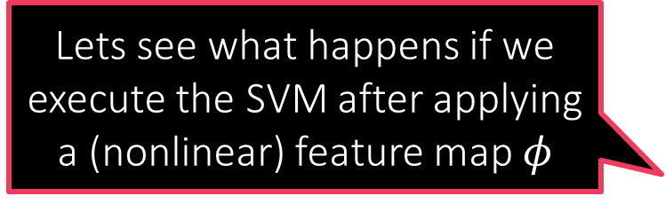
Kernel SVM
Primal formulation
Dual formulation
$\min_{w,ξ_{i}}{\frac{1}{2}{\left\|w\right\|}_{2}^{2}+C⋅\sum_{i=1}^{n}{ξ_{i}}}$
s.t. $y^{i}⋅w^{⊤}x^{i}≥1−ξ_{i}$ and $ξ_{i}≥0$
$\max_{α_{i}}{\sum_{i=1}^{n}{α_{i}}−\frac{1}{2}\sum_{i,j}{α_{i}α_{j}y^{i}y^{j}\left\langle x^{i},x^{j}\right\rangle }}$
s.t. $α_{i}∈\left[0,C\right]$
Lets see what happens if we execute the SVM after applying a (nonlinear) feature map $φ$

Slide 21




Kernel SVM
Primal formulation
Dual formulation
$\min_{w,ξ_{i}}{\frac{1}{2}{\left\|w\right\|}_{2}^{2}+C⋅\sum_{i=1}^{n}{ξ_{i}}}$
s.t. $y^{i}⋅w^{⊤}φ\left(x^{i}\right)≥1−ξ_{i}$ and $ξ_{i}≥0$
$\max_{α_{i}}{\sum_{i=1}^{n}{α_{i}}−\frac{1}{2}\sum_{i,j}{α_{i}α_{j}y^{i}y^{j}}}$
s.t. $α_{i}∈\left[0,C\right]$
$$\left\langle φ\left(x^{i}\right),φ\left(x^{j}\right)\right\rangle$$
Note that if $φ:ℝ^{d}→ℋ$ then the model itself is $w∈ℋ$

Slide 22

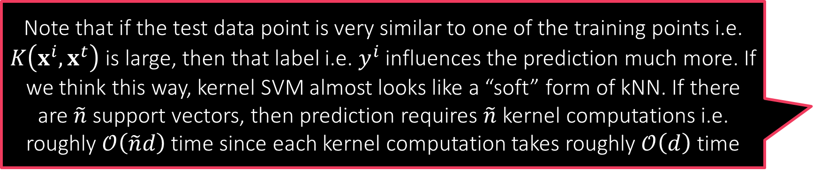

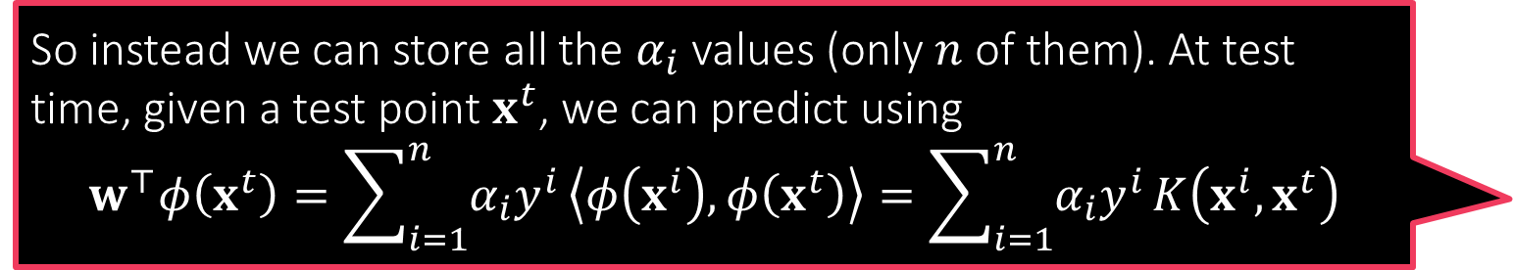


Kernel SVM
Finding/storing the model explicitly is not feasible even if we solve the dual problem perfectly since $w=\sum_{i=1}^{n}{α_{i}y^{i}φ\left(x^{i}\right)}∈ℋ$ and $\dim\left(ℋ\right)≫1$
Primal formulation
Dual formulation
KERNEL SVM
Choose a kernel $K$ with map $φ$
Training: receive train points ${\left\{\left(x^{i},y^{i}\right)\right\}}_{i∈\left[n\right]},x^{i}∈ℝ^{d}$
Solve dual problem $\max_{α_{i}∈\left[0,C\right]}{\sum_{i=1}^{n}{α_{i}}−\frac{1}{2}\sum_{i,j}{α_{i}α_{j}y^{i}y^{j}K\left(x^{i},x^{j}\right)}}$
Implicitly store $w=\sum_{i=1}^{n}{α_{i}y^{i}φ\left(x^{i}\right)}∈ℋ$ by storing $\left(x^{i},y^{i},α_{i}\right)$ for all support vectors i.e. where $α_{i}≠0$
Prediction:
Receive a test point $x^{t}∈ℝ^{d}$
Predict $sign\left(w^{⊤}φ\left(x^{t}\right)\right)=sign\left(\sum_{i=1}^{n}{α_{i}y^{i}}K\left(x^{i},x^{t}\right)\right)$
So instead we can store all the $α_{i}$ values (only $n$ of them). At test time, given a test point $x^{t}$, we can predict using $$w^{⊤}φ\left(x^{t}\right)=\sum_{i=1}^{n}{α_{i}y^{i}}\left\langle φ\left(x^{i}\right),φ\left(x^{t}\right)\right\rangle =\sum_{i=1}^{n}{α_{i}y^{i}}K\left(x^{i},x^{t}\right)$$
$\min_{w,ξ_{i}}{\frac{1}{2}{\left\|w\right\|}_{2}^{2}+C⋅\sum_{i=1}^{n}{ξ_{i}}}$
s.t. $y^{i}⋅w^{⊤}φ\left(x^{i}\right)≥1−ξ_{i}$ and $ξ_{i}≥0$
Solving the primal is infeasible
If $\dim\left(ℋ\right)=∞$ a single SGD step would take infinitely long ☹
$\max_{α_{i}}{\sum_{i=1}^{n}{α_{i}}−\frac{1}{2}\sum_{i,j}{α_{i}α_{j}y^{i}y^{j}K\left(x^{i},x^{j}\right)}}$
s.t. $α_{i}∈\left[0,C\right]$
Computing $K\left(x^{i},x^{j}\right)$ usually $𝒪\left(d\right)$ even if $\dim\left(ℋ\right)=∞$ e.g. Gaussian kernel
Can still solve this problem using SDCA
Each step of SDCA still takes $𝒪\left(n\right)$ time apart from time to compute $K\left(x^{i},x^{j}\right)$
If time taken to compute $K\left(x^{i},x^{j}\right)$ added then each SDCA takes about $𝒪\left(nd\right)$ time
Note that if the test data point is very similar to one of the training points i.e. $K\left(x^{i},x^{t}\right)$ is large, then that label i.e. $y^{i}$ influences the prediction much more. If we think this way, kernel SVM almost looks like a “soft” form of kNN. If there are $\tilde{n}$ support vectors, then prediction requires $\tilde{n}$ kernel computations i.e. roughly $𝒪\left(\tilde{n}d\right)$ time since each kernel computation takes roughly $𝒪\left(d\right)$ time
Training is more expensive, model size is larger, prediction time is more for kernel SVM than was for linear SVM – very typical of non-linear models

Slide 23

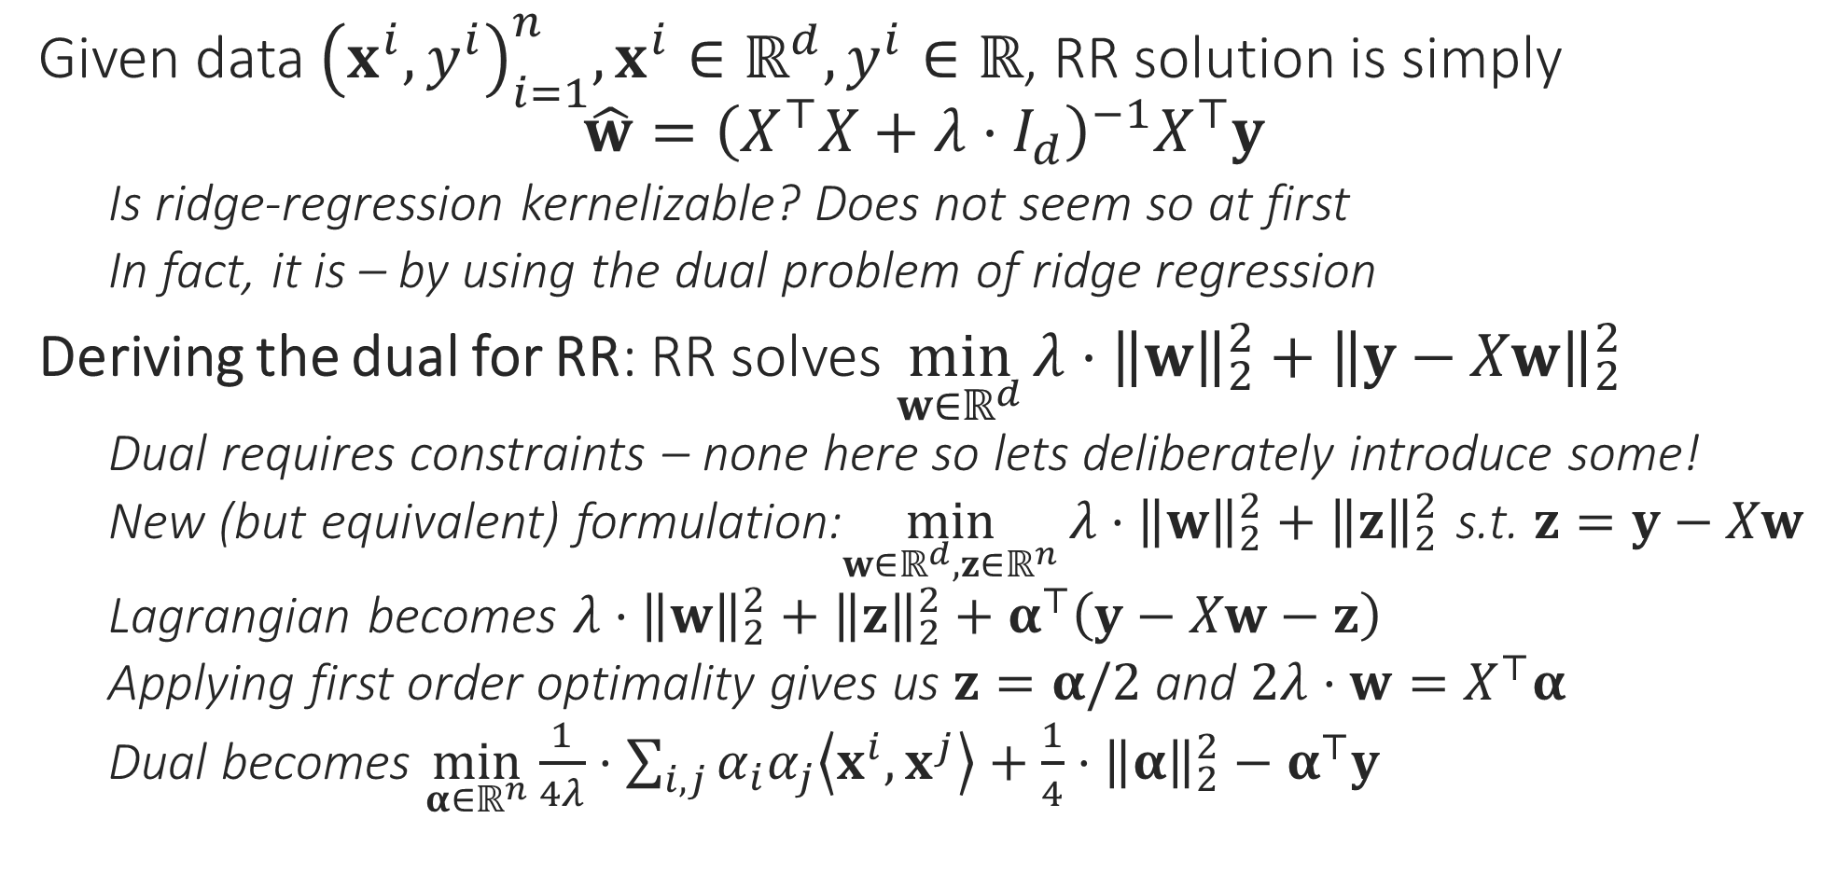

Kernel Ridge Regression
Given data ${\left(x^{i},y^{i}\right)}_{i=1}^{n},x^{i}∈ℝ^{d},y^{i}∈ℝ$, RR solution is simply $\hat{w}={\left(X^{⊤}X+λ⋅I_{d}\right)}^{−1}X^{⊤}y$
Is ridge-regression kernelizable? Does not seem so at first
In fact, it is – by using the dual problem of ridge regression
Deriving the dual for RR: RR solves $\min_{w∈ℝ^{d}}{λ⋅{\left\|w\right\|}_{2}^{2}+{\left\|y−Xw\right\|}_{2}^{2}}$
Dual requires constraints – none here so lets deliberately introduce some!
New (but equivalent) formulation:$\min_{w∈ℝ^{d},z∈ℝ^{n}}{{λ⋅{\left\|w\right\|}_{2}^{2}+\left\|z\right\|}_{2}^{2}}$ s.t. $z=y−Xw$
Lagrangian becomes ${λ⋅{\left\|w\right\|}_{2}^{2}+\left\|z\right\|}_{2}^{2}+α^{⊤}\left(y−Xw−z\right)$
Applying first order optimality gives us $z=α/2$ and $2λ⋅w=X^{⊤}α$
Dual becomes $\min_{α∈ℝ^{n}}{\frac{1}{4λ}⋅\sum_{i,j}{α_{i}α_{j}\left\langle x^{i},x^{j}\right\rangle }+\frac{1}{4}⋅{\left\|α\right\|}_{2}^{2}−α^{⊤}y}$
To handle equality constraints $f\left(x\right)=c$
Method 1: convert to a pair of inequality constraints $f\left(x\right)≤c,f\left(x\right)≥c$
Method 2: use a Lagrangian variable that has no constraints ☺

Slide 24

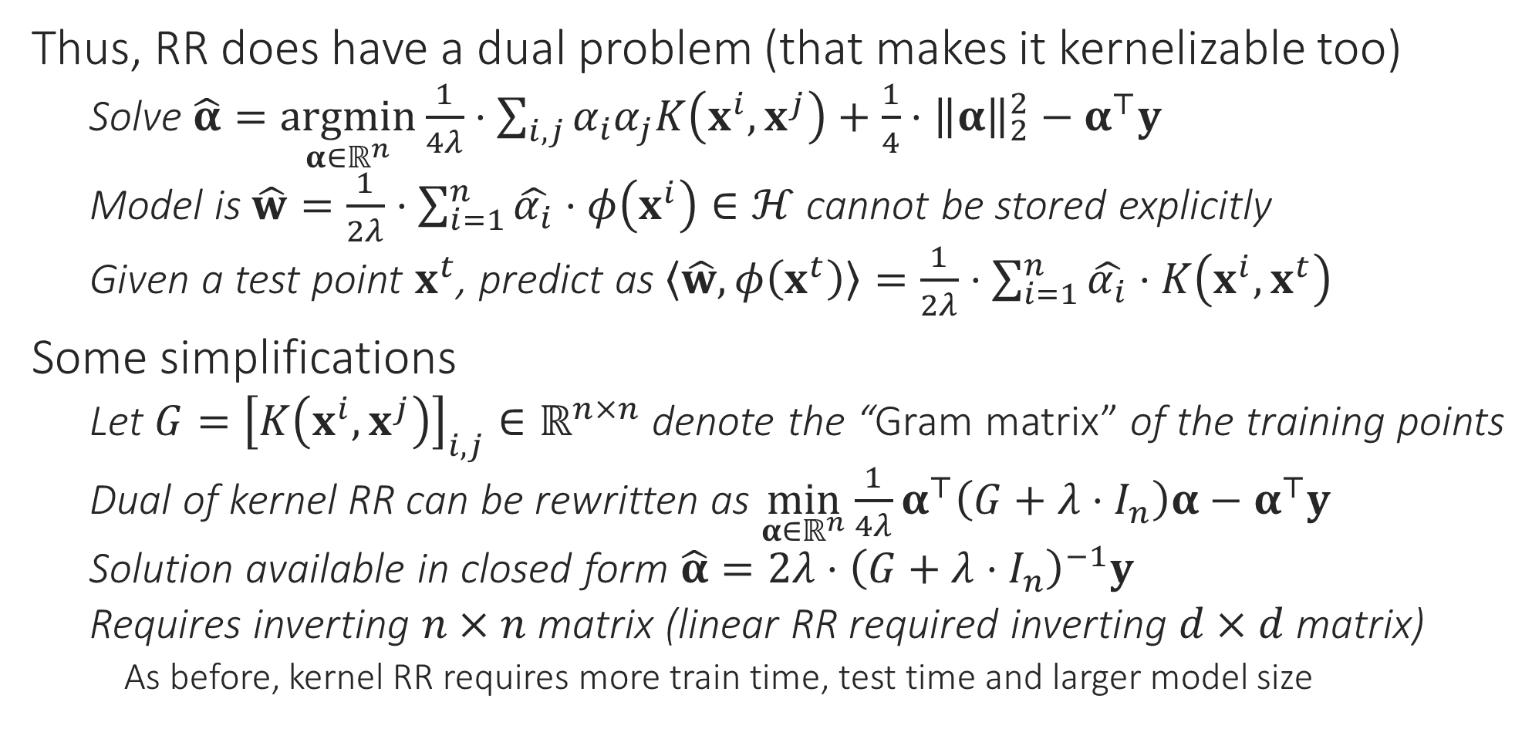
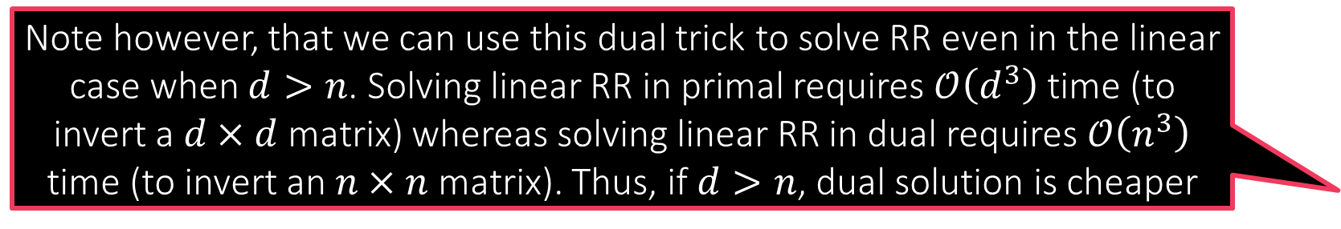
Kernel Ridge Regression
Note however, that we can use this dual trick to solve RR even in the linear case when $d>n$. Solving linear RR in primal requires $𝒪\left(d^{3}\right)$ time (to invert a $d×d$ matrix) whereas solving linear RR in dual requires $𝒪\left(n^{3}\right)$ time (to invert an $n×n$ matrix). Thus, if $d>n$, dual solution is cheaper
Thus, RR does have a dual problem (that makes it kernelizable too)
Solve $\hat{α}=\underset{α∈ℝ^{n}}{argmin}{\frac{1}{4λ}⋅\sum_{i,j}{α_{i}α_{j}K\left(x^{i},x^{j}\right)}+\frac{1}{4}⋅{\left\|α\right\|}_{2}^{2}−α^{⊤}y}$
Model is $\hat{w}=\frac{1}{2λ}⋅\sum_{i=1}^{n}{\hat{α_{i}}⋅φ\left(x^{i}\right)}∈ℋ$ cannot be stored explicitly
Given a test point $x^{t}$, predict as $\left\langle \hat{w},φ\left(x^{t}\right)\right\rangle =\frac{1}{2λ}⋅\sum_{i=1}^{n}{\hat{α_{i}}⋅K\left(x^{i},x^{t}\right)}$
Some simplifications
Let $G={\left[K\left(x^{i},x^{j}\right)\right]}_{i,j}∈ℝ^{n×n}$ denote the “Gram matrix” of the training points
Dual of kernel RR can be rewritten as $\min_{α∈ℝ^{n}}{\frac{1}{4λ}α^{⊤}\left(G+λ⋅I_{n}\right)α−α^{⊤}y}$
Solution available in closed form $\hat{α}=2λ⋅{\left(G+λ⋅I_{n}\right)}^{−1}y$
Requires inverting $n×n$ matrix (linear RR required inverting $d×d$ matrix)
As before, kernel RR requires more train time, test time and larger model size

Slide 25


Kernel Clustering
Should be relatively simple given our experience with kernel LwP, kNN
All we need to do is kernelize the distance computations and keep track of the cluster centers implicitly since now $μ^{k}∈ℋ$
K-MEANS/LLOYD’S ALGORITHM
Initialize centroids ${\left\{μ^{k}\right\}}_{k=1,…K}∈ℝ^{d}$
For $i∈\left[n\right]$, do cluster assignment, update $z^{i}∈\left[K\right]$ using $μ^{k}$
Let $z^{i}=\arg{\min_{k}{{\left\|x^{i}−μ^{k}\right\|}_{2}^{2}}}$
Update $μ^{k}=\frac{1}{n_{k}}\sum_{i:z^{i}=k}{x^{i}},where n_{k}=\left|\left\{i:z^{i}=k\right\}\right|$
Repeat until convergence

Slide 26


Kernel K-means
Note that cluster centers in k-means are always the average of data points that were assigned to that cluster - $z^{i}$ maintains this info
Need to maintain this information a bit differently for easy processing
Let $α_{i}^{k}=1$ if $z^{i}=k$ and $α_{i}^{k}=0$ if $z^{i}≠k$ i.e. $n_{k}=\sum_{i=1}^{n}{α_{i}^{k}}=1^{⊤}α^{k}$
This lets us write $μ^{k}={\left(\sum_{i=1}^{n}{α_{i}^{k}}\right)}^{−1}⋅\sum_{i=1}^{n}{α_{i}^{k}⋅φ\left(x^{i}\right)}∈ℋ$
Let $G={\left[K\left(x^{i},x^{j}\right)\right]}_{i,j}∈ℝ^{n×n}$ denote the Gram matrix of training points
Using this, we can rewrite distance computations as ${\left\|φ\left(x^{j}\right)−μ^{k}\right\|}_{ℋ}^{2}=K\left(x^{j},x^{j}\right)−2\left\langle μ^{k},φ\left(x^{j}\right)\right\rangle +\left\langle μ^{k},μ^{k}\right\rangle$
where $\left\langle μ^{k},φ\left(x^{j}\right)\right\rangle ={\left(\sum_{i=1}^{n}{α_{i}^{k}}\right)}^{−1}⋅\sum_{i=1}^{n}{α_{i}^{k}⋅K\left(x^{i},x^{j}\right)}={\left(1^{⊤}α^{k}\right)}^{−1}G_{j}^{⊤}α^{k}$ ($G_{j}$ is j-th column of $G$) and $\left\langle μ^{k},μ^{k}\right\rangle ={\left(\sum_{i=1}^{n}{α_{k}^{i}}\right)}^{−2}⋅\sum_{i,j=1}^{n}{α_{i}^{k}α_{j}^{k}K\left(x^{i},x^{j}\right)}$ which is nothing but ${\left(1^{⊤}α^{k}\right)}^{−2}{\left(α^{k}\right)}^{⊤}Gα^{k}$
KERNEL K-MEANS
Initialize ${\left\{α^{k}\right\}}_{k=1,…K}∈{\left\{0,1\right\}}^{n}$ randomly
For $i∈\left[n\right]$, do cluster assignment
Let $n_{k}=1^{⊤}α^{k}$
Let $z^{i}=\arg{\min_{k}{ n_{k}^{−2}⋅{\left(α^{k}\right)}^{⊤}Gα^{k}−2}}n_{k}^{−1}⋅G_{i}^{⊤}α^{k}$
For $k∈\left[K\right]$ update $α^{k}$
For $i∈\left[n\right]$, set $α_{i}^{z^{i}}=1$ and $α_{i}^{l}=0$ for all $l≠z^{i}$
Repeat until convergence

Slide 27

Parametric vs Non-parametric ML models
ML models for which model size independent of number of training points are called parametric
Linear SVM, LwP, Logistic regression, Ridge regression
ML models for which model size dependent on number of training points are called non-parametric (name is a bit non-intuitive)
Kernel SVM with a non-linear kernel – need to store all non-zero $α_{i}$ and corresponding $x^{i}$ and possible that all train points become support vectors
Kernel algorithms in general are non-parametric
kNN – need to store all training points

