Slide 1
Learning a Linear Classifier

Slide 2

Quiz 1
Jan 24 (Wed), 6:30PM, L18, L19, L20
Only for registered students (regular + audit)
Assigned seating – will be announced soon
Open notes (handwritten only)
No mobile phones, tablets etc
Bring your institute ID card
If you don’t bring it you will have to spend precious time waiting to get verified
Syllabus:
All videos, slides, code linked on the course discussion page (link below) till 22 Jan, 2024 https://www.cse.iitk.ac.in/users/purushot/courses/ml/2023-24-w/discussion.html
See GitHub for practice questions

Slide 3

Authentication by Secret Questions
Give me your device ID and answer the following questions
10111100
00110010
10001110
00010100
…
TS271828182845
1
0
1
0
…
SERVER
DEVICE

Slide 4


Physically Unclonable Functions
0.50ms
These tiny differences are difficult to predict or clone
0.55ms
Then these could act as the fingerprints for the devices!

Slide 5
Arbiter PUFs
If the top signal reaches the finish line first, the “answer” to this question is 0, else if the bottom signal reaches first, the “answer” is 1
Question: 1011
1
0
1
1
1
?

Slide 6
Arbiter PUFs
If the top signal reaches the finish line first, the “answer” to this question is 0, else if the bottom signal reaches first, the “answer” is 1
Question: 0110
0
1
1
0
0
?

Slide 7


Linear Models
We have $Δ_{63}=w_{0} ⋅x_{0}+w_{1}⋅x_{1}+…+w_{63}⋅x_{63}+β_{63}=w^{⊤}x+b$
where $x_{i}=d_{i}⋅d_{i+1}⋅…⋅d_{63}$ $w_{0}=α_{0}$ $w_{i}=α_{i}+β_{i−1} \left(for i>0\right)$
If $Δ_{63}<0$, upper signal wins and answer is 0
If $Δ_{63}>0$, lower signal wins and answer is 1
Thus, answer is simply $\frac{sign\left(w^{⊤}x+b\right)+1}{2}$
$$w$$
This is nothing but a linear classifier!

Slide 8


The “best” Linear Classifier
It seems infinitely many classifiers perfectly classify the data. Which one should I choose?
Indeed! Such models would be very brittle and might misclassify test data (i.e. predict the wrong class), even those test data which look very similar to train data
It is better to not select a model whose decision boundary passes very close to a training data point

Slide 9
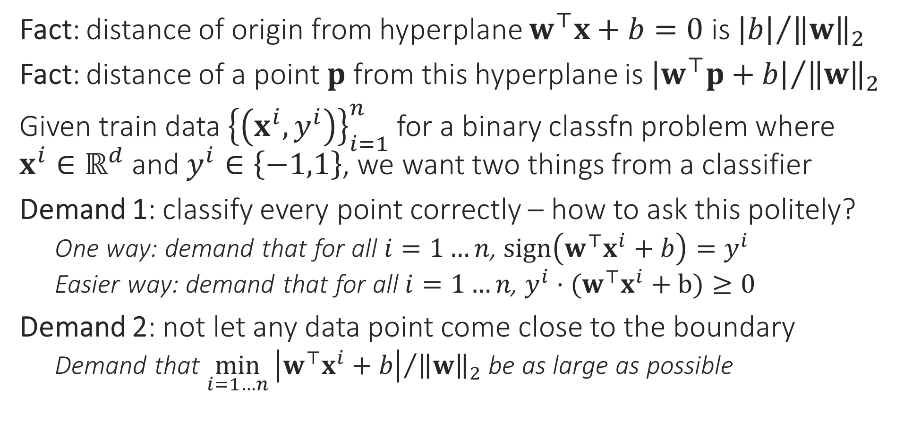
Large Margin Classifiers
Fact: distance of origin from hyperplane $w^{⊤}x+b=0$ is ${\left|b\right|}/{{\left\|w\right\|}_{2}}$
Fact: distance of a point $p$ from this hyperplane is ${\left|w^{⊤}p+b\right|}/{{\left\|w\right\|}_{2}}$
Given train data ${\left\{\left(x^{i},y^{i}\right)\right\}}_{i=1}^{n}$ for a binary classfn problem where $x^{i}∈ℝ^{d}$ and $y^{i}∈\left\{−1,1\right\}$, we want two things from a classifier
Demand 1: classify every point correctly – how to ask this politely?
One way: demand that for all $i=1…n$, $sign\left(w^{⊤}x^{i}+b\right)=y^{i}$
Easier way: demand that for all $i=1…n$, $y^{i}⋅(w^{⊤}x^{i}+b)≥0$
Demand 2: not let any data point come close to the boundary
Demand that $\min_{i=1…n}{{\left|w^{⊤}x^{i}+b\right|}/{{\left\|w\right\|}_{2}}}$ be as large as possible

Slide 10



Support Vector Machines
“
Just a fancy way of saying
Please find me a linear classifier that perfectly classifies the train data while keeping data points as far away from the hyperplane as possible
The mathematical way of writing this request is the following
$\max_{w,b}\left\{\min_{i=1…n}{{\left|w^{⊤}x^{i}+b\right|}/{{\left\|w\right\|}_{2}}}\right\}$
such that $y^{i}⋅(w^{⊤}x^{i}+b)≥0$ for all $i=1…n$
Let us simplify this optimization problem
“
Constraints
Objective
This is known as an optimization problem with an objective and lots of constraints
This looks so complicated, how will I ever find a solution to this optimization problem?

Slide 11
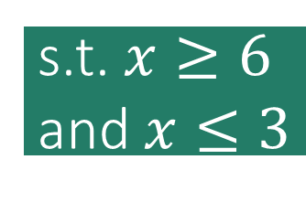
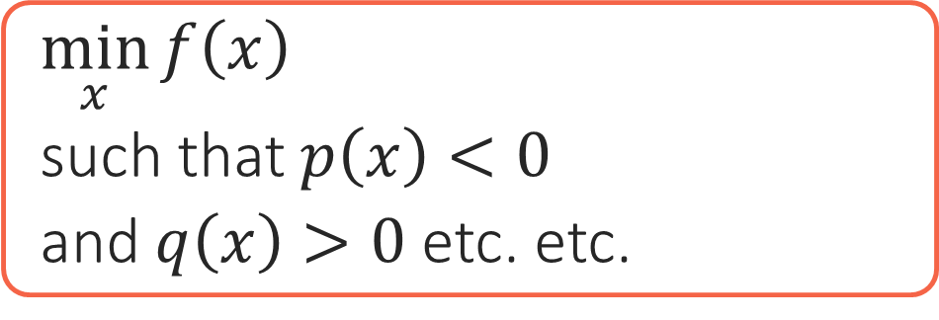
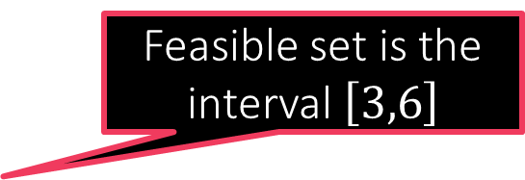
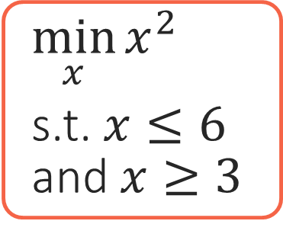
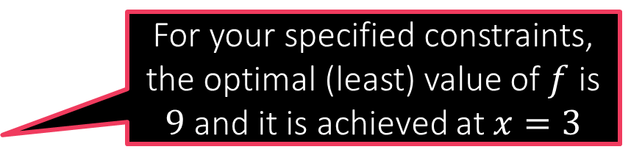

Constrained Optimization 101
Constraints are usually specified using math equations. The set of points that satisfy all the constraints is called the feasible set of the optimization problem
How WE MUST SPEAK TO MS M
How we speak to a human
Objective
Constraints
$\min_{x}{f\left(x\right)}$
such that $p\left(x\right)<0$
and $q\left(x\right)>0$ etc. etc.
I want to find an unknown $x$ that gives me the best value according to this function $f$
Oh! btw, not any $x$ would do! $x$ must satisfy these conditions
All I am saying is, of the values of $x$ that satisfy my conditions, find me the one that gives the best value according to $f$
You optimization problem has no solution since no point satisfies all your constraints ☹
For your specified constraints, the optimal (least) value of $f$ is $9$ and it is achieved at $x=3$
Feasible set is empty!
$\min_{x}{x^{2}}$
s.t. $x≤6$ and $x≥3$
Feasible set is the interval $\left[3,6\right]$
s.t. $x≥6$ and $x≤3$
3 6

Slide 12

Back to SVMs
Assume there do exist params that perfectly classify all train data
Consider one such params $\left(w,b\right)$ which classifies train data perfectly
Now, ${\left|w^{⊤}x^{i}+b\right|}/{{\left\|w\right\|}_{2}}={\left|y^{i}⋅\left(w^{⊤}x^{i}+b\right)\right|}/{{\left\|w\right\|}_{2}}$ as $y^{i}∈\left\{−1,1\right\}$
Thus, geometric margin is same as $\min_{i=1…n}{{\left|y^{i}⋅\left(w^{⊤}x^{i}+b\right)\right|}/{{\left\|w\right\|}_{2}}}=$ $\min_{i=1…n}{{y^{i}⋅\left(w^{⊤}x^{i}+b\right)}/{{\left\|w\right\|}_{2}}}$ since model has perfect classification!
We will use this useful fact to greatly simplify the optimization problem
What if train data is non-linearly separable i.e no linear classifier can perfectly classify it? For example
We will remove this assumption later

Slide 13
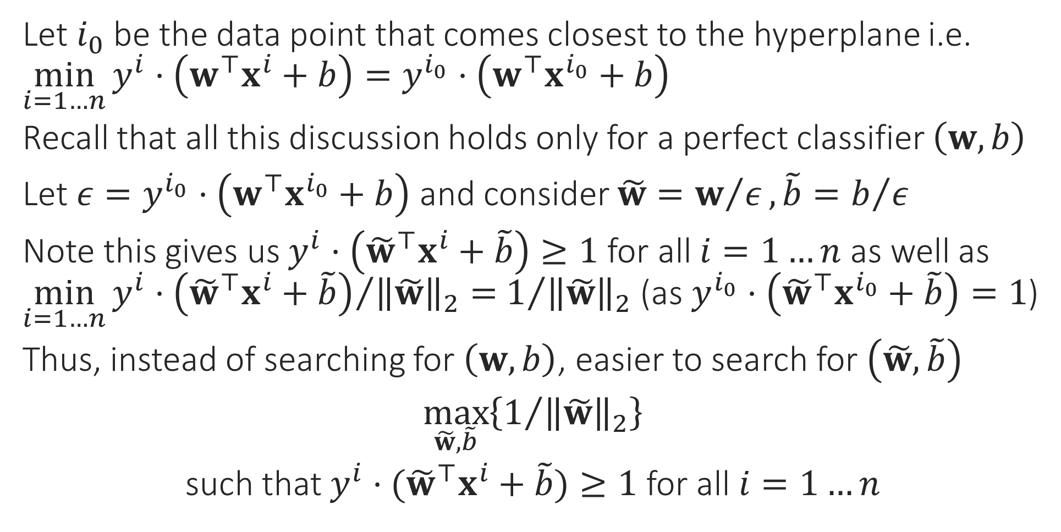


Support Vector Machines
Let $i_{0}$ be the data point that comes closest to the hyperplane i.e. $\min_{i=1…n}{y^{i}⋅\left(w^{⊤}x^{i}+b\right)}=y^{i_{0}}⋅\left(w^{⊤}x^{i_{0}}+b\right)$
Recall that all this discussion holds only for a perfect classifier $\left(w,b\right)$
Let $ε=y^{i_{0}}⋅\left(w^{⊤}x^{i_{0}}+b\right)$ and consider $\tilde{w}=w/ε, \tilde{b}=b/ε$
Note this gives us $y^{i}⋅\left({\tilde{w}}^{⊤}x^{i}+\tilde{b}\right)≥1$ for all $i=1…n$ as well as $\min_{i=1…n}{{y^{i}⋅\left({\tilde{w}}^{⊤}x^{i}+\tilde{b}\right)}/{{\left\|\tilde{w}\right\|}_{2}}}=$ $1/{{\left\|\tilde{w}\right\|}_{2}}$ (as $y^{i_{0}}⋅\left({\tilde{w}}^{⊤}x^{i_{0}}+\tilde{b}\right)=1$)
Thus, instead of searching for $\left(w,b\right)$, easier to search for $\left(\tilde{w},\tilde{b}\right)$
$\max_{\tilde{w},\tilde{b}}\left\{1/{{\left\|\tilde{w}\right\|}_{2}}\right\}$
such that $y^{i}⋅({\tilde{w}}^{⊤}x^{i}+\tilde{b})≥1$ for all $i=1…n$
$${}^{2}$$
$$\min_{\tilde{w},\tilde{b}}\left\{{\left\|\tilde{w}\right\|}_{2}\right\}$$

Slide 14


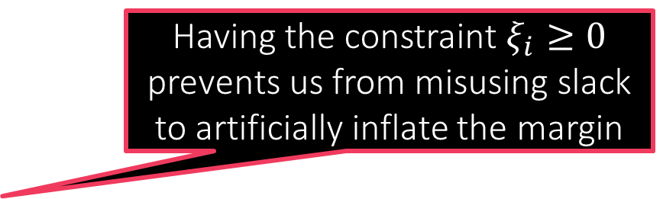

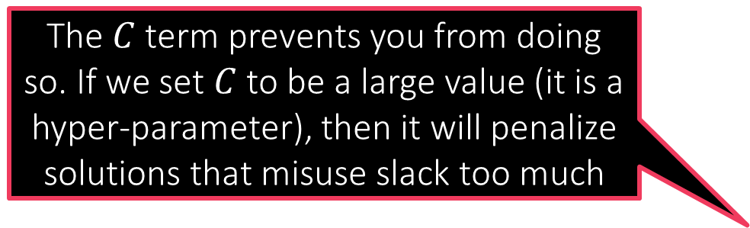
The C-SVM Technique
What prevents me from misusing the slack variables to learn a model that misclassifies every data point?
For linearly separable cases where we suspect a perfect classifier exists
$\min_{\tilde{w},\tilde{b}}{{\frac{1}{2}\left\|\tilde{w}\right\|}_{2}^{2}}$
s.t. $y^{i}⋅({\tilde{w}}^{⊤}x^{i}+\tilde{b})≥1$ for all $i∈\left[n\right]$
If a linear classifier cannot perfectly classify data, then find model using
$\min_{\tilde{w},\tilde{b},\left\{ξ_{i}\right\}}{{\frac{1}{2}\left\|\tilde{w}\right\|}_{2}^{2}+C\sum_{i=1}^{n}{ξ_{i}}}$
s.t. $y^{i}⋅\left({\tilde{w}}^{⊤}x^{i}+\tilde{b}\right)≥1−ξ_{i}$ for all $i∈\left[n\right]$
as well as $ξ_{i}≥0$ for all $i∈\left[n\right]$
The $C$ term prevents you from doing so. If we set $C$ to be a large value (it is a hyper-parameter), then it will penalize solutions that misuse slack too much
Having the constraint $ξ_{i}≥0$ prevents us from misusing slack to artificially inflate the margin
Recall English phrase “cut me some slack”
The $ξ_{i}$ terms are called slack variables. They allow some data points to come close to the hyperplane or be misclassified altogether

Slide 15
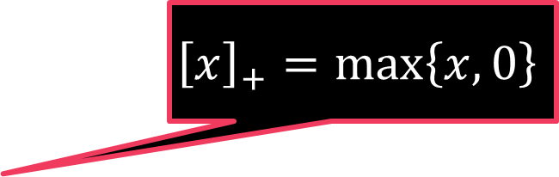
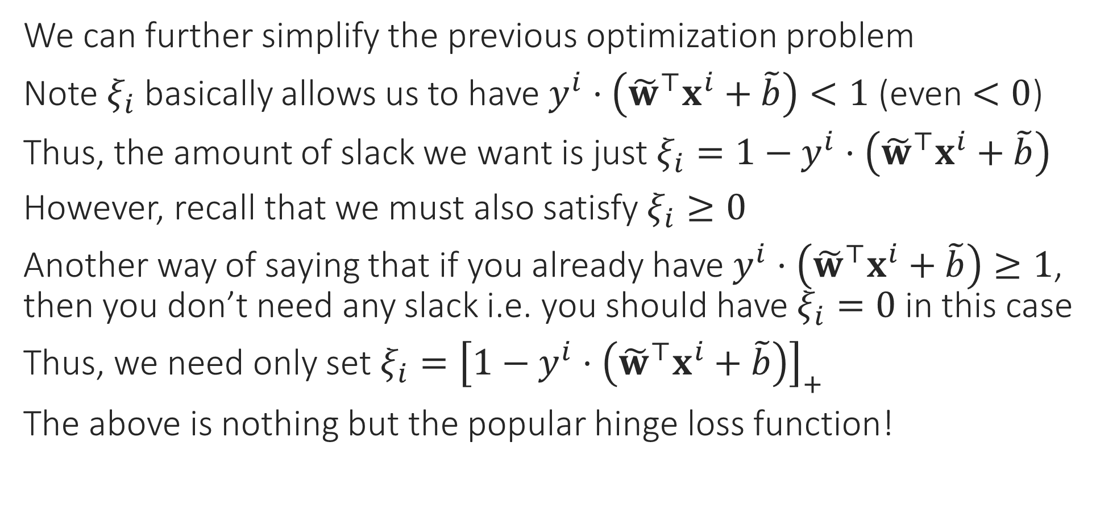
From C-SVM to Loss Functions
We can further simplify the previous optimization problem
Note $ξ_{i}$ basically allows us to have $y^{i}⋅\left({\tilde{w}}^{⊤}x^{i}+\tilde{b}\right)<1$ (even $<0$)
Thus, the amount of slack we want is just $ξ_{i}=1−y^{i}⋅\left({\tilde{w}}^{⊤}x^{i}+\tilde{b}\right)$
However, recall that we must also satisfy $ξ_{i}≥0$
Another way of saying that if you already have $y^{i}⋅\left({\tilde{w}}^{⊤}x^{i}+\tilde{b}\right)≥1$, then you don’t need any slack i.e. you should have $ξ_{i}=0$ in this case
Thus, we need only set $ξ_{i}={\left[1−y^{i}⋅\left({\tilde{w}}^{⊤}x^{i}+\tilde{b}\right)\right]}_{+}$
The above is nothing but the popular hinge loss function!
$${\left[x\right]}_{+}=\max\left\{x,0\right\}$$

Slide 16
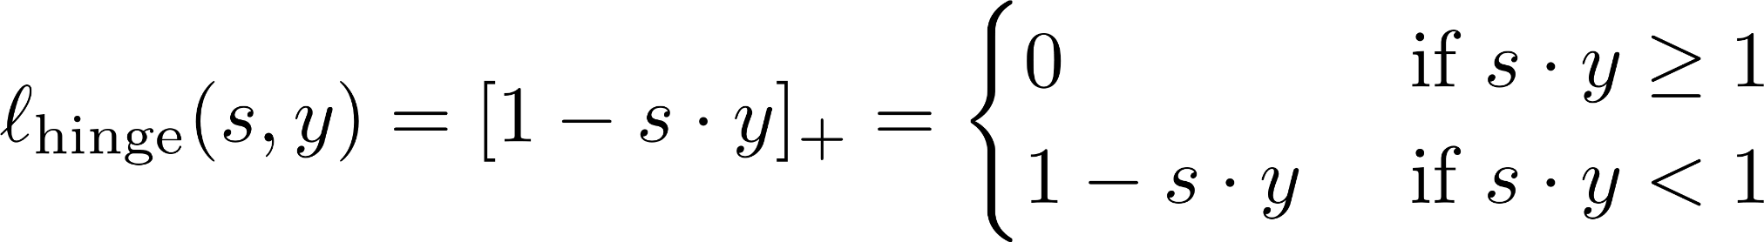

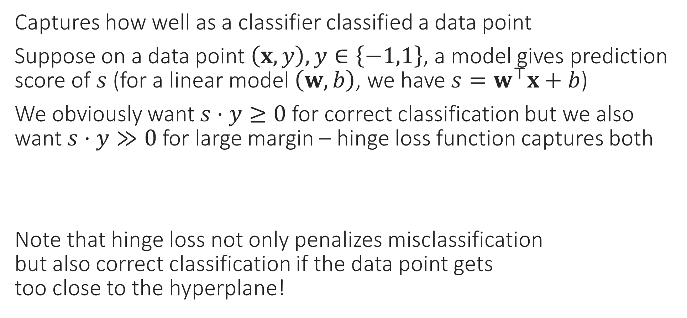
Hinge Loss
Captures how well as a classifier classified a data point
Suppose on a data point $\left(x,y\right), y∈\left\{−1,1\right\}$, a model gives prediction score of $s$ (for a linear model $\left(w,b\right)$, we have $s=w^{⊤}x+b$)
We obviously want $s⋅y≥0$ for correct classification but we also want $s⋅y≫0$ for large margin – hinge loss function captures both
Note that hinge loss not only penalizes misclassification but also correct classification if the data point gets too close to the hyperplane!

Slide 17
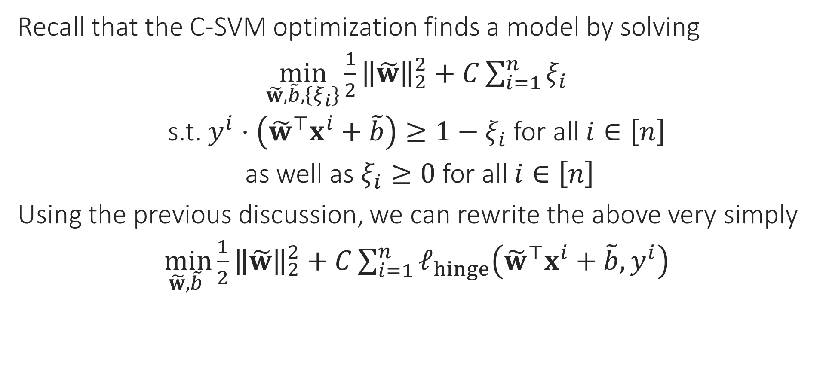
Final Form of C-SVM
Recall that the C-SVM optimization finds a model by solving
$\min_{\tilde{w},\tilde{b},\left\{ξ_{i}\right\}}{{\frac{1}{2}\left\|\tilde{w}\right\|}_{2}^{2}+C\sum_{i=1}^{n}{ξ_{i}}}$
s.t. $y^{i}⋅\left({\tilde{w}}^{⊤}x^{i}+\tilde{b}\right)≥1−ξ_{i}$ for all $i∈\left[n\right]$
as well as $ξ_{i}≥0$ for all $i∈\left[n\right]$
Using the previous discussion, we can rewrite the above very simply
$\min_{\tilde{w},\tilde{b} }{{\frac{1}{2}\left\|\tilde{w}\right\|}_{2}^{2}+C\sum_{i=1}^{n}{ℓ_{hinge}\left({\tilde{w}}^{⊤}x^{i}+\tilde{b},y^{i}\right)}}$

