Slide 1
My first Solver
Optimization for ML

Slide 2
Use Calculus for Optimization
Method 2: Perform (sub)gradient descent
Recall that direction opposite to gradient offers steepest descent
(SUB)GRADIENT DESCENT
Given: obj. func. $f:ℝ^{d}→ℝ$ to minimize
Initialize $w^{0}∈ℝ^{d}$
For $t=0, 1, …$
Obtain a (sub)gradient $g^{t}∈∂f\left(w^{t}\right)$
Choose a step length $η_{t}$
Update $w^{t+1}←w^{t}−η_{t}⋅g^{t}$
Repeat until convergence
How to initialize $w^{0}$?
How to choose $η_{t}$
Often called “step length” or “learning rate”
What is convergence?
How to decide if we have converged?

Slide 3
Practical Issues with GD Variants
How to initialize?
How to decide convergence?
How to decide step lengths?

Slide 4
How to Initialize?
Initializing close to the global optimum is obviously preferable ☺
Easier said than done. In some applications however, we may have such initialization e.g. someone may have a model they trained on different data
For convex functions, bad initialization may mean slow convergence, but if step lengths are nice then GD should converge eventually
For non-convex functions (e.g. while training deepnets), bad initialization may mean getting stuck at a very bad saddle point
Random restarts most common solution to overcome this problem
For some nice non-convex problems, we do know very good ways to provably initialize close to the global optimum (e.g. collaborative filtering in recommendation systems) – details beyond scope of CS771

Slide 5
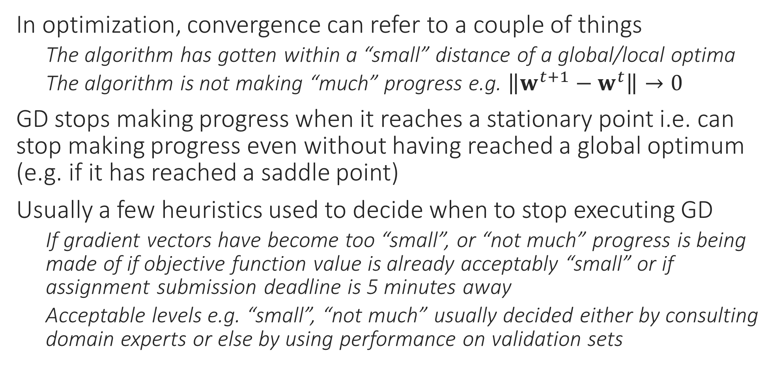
How to decide Convergence?
In optimization, convergence can refer to a couple of things
The algorithm has gotten within a “small” distance of a global/local optima
The algorithm is not making “much” progress e.g. $\left\|w^{t+1}−w^{t}\right\|→0$
GD stops making progress when it reaches a stationary point i.e. can stop making progress even without having reached a global optimum (e.g. if it has reached a saddle point)
Usually a few heuristics used to decide when to stop executing GD
If gradient vectors have become too “small”, or “not much” progress is being made of if objective function value is already acceptably “small” or if assignment submission deadline is 5 minutes away
Acceptable levels e.g. “small”, “not much” usually decided either by consulting domain experts or else by using performance on validation sets

Slide 6
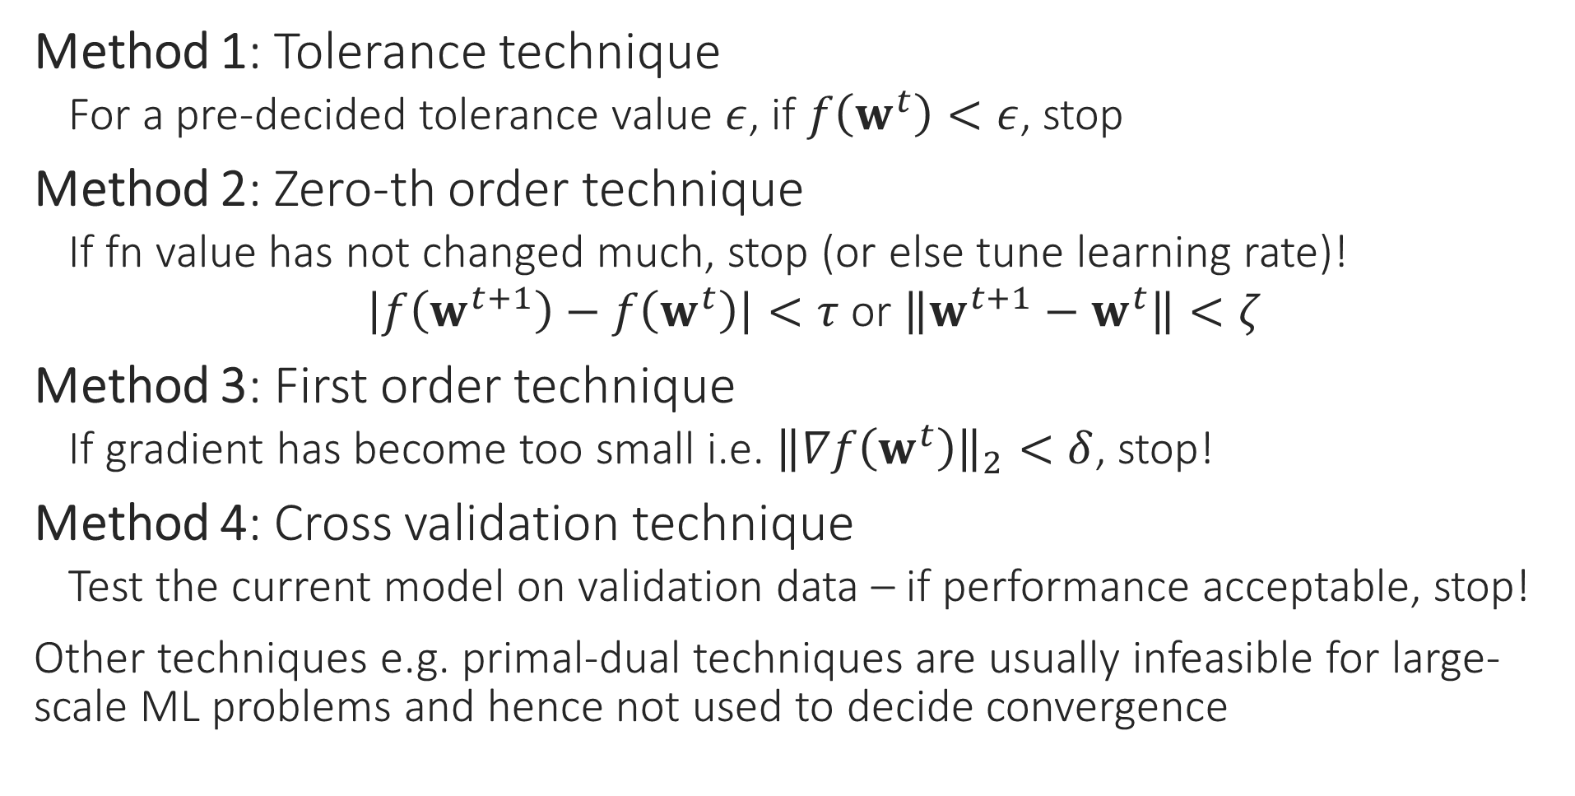
How to detect convergence
Method 1: Tolerance technique
For a pre-decided tolerance value $ε$, if $f\left(w^{t}\right)<ε$, stop
Method 2: Zero-th order technique
If fn value has not changed much, stop (or else tune learning rate)!
$\left|f\left(w^{t+1}\right)−f\left(w^{t}\right)\right|<τ$ or $\left\|w^{t+1}−w^{t}\right\|<ζ$
Method 3: First order technique
If gradient has become too small i.e. ${\left\|∇f\left(w^{t}\right)\right\|}_{2}<δ$, stop!
Method 4: Cross validation technique
Test the current model on validation data – if performance acceptable, stop!
Other techniques e.g. primal-dual techniques are usually infeasible for large-scale ML problems and hence not used to decide convergence

Slide 7
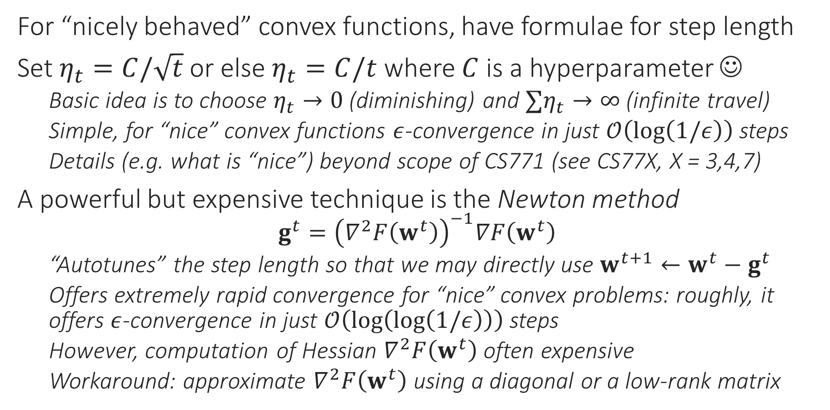
How to choose Step Length?
For “nicely behaved” convex functions, have formulae for step length
Set $η_{t}=C/\sqrt{t}$ or else $η_{t}=C/t$ where $C$ is a hyperparameter ☺
Basic idea is to choose $η_{t}→0$ (diminishing) and $∑η_{t}→∞$ (infinite travel)
Simple, for “nice” convex functions $ε$-convergence in just $𝒪\left(\log\left(1/ε\right)\right)$ steps
Details (e.g. what is “nice”) beyond scope of CS771 (see CS77X, X = 3,4,7)
A powerful but expensive technique is the Newton method
$$g^{t}={\left(∇^{2}F\left(w^{t}\right)\right)}^{−1}∇F\left(w^{t}\right)$$
“Autotunes” the step length so that we may directly use $w^{t+1}←w^{t}−g^{t}$
Offers extremely rapid convergence for “nice” convex problems: roughly, it offers $ε$-convergence in just $𝒪\left(\log\left(\log\left(1/ε\right)\right)\right)$ steps
However, computation of Hessian $∇^{2}F\left(w^{t}\right)$ often expensive
Workaround: approximate $∇^{2}F\left(w^{t}\right)$ using a diagonal or a low-rank matrix

Slide 8
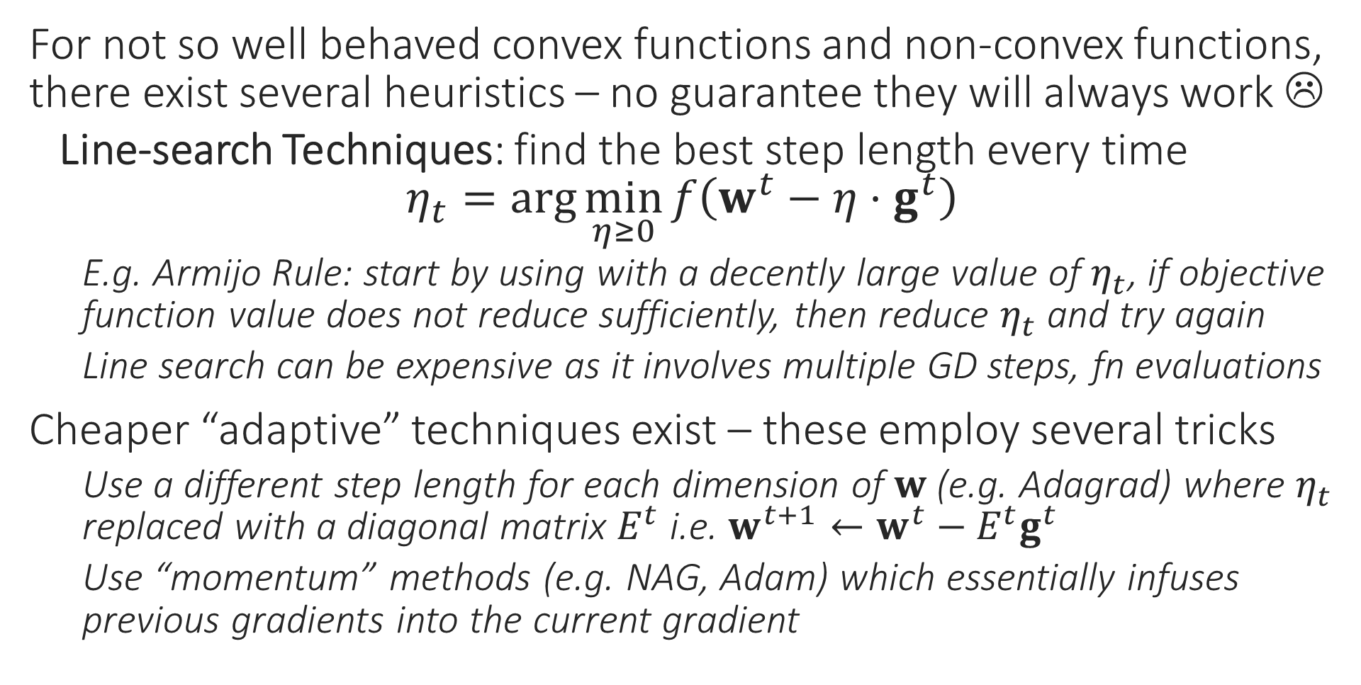
How to choose Step Length?
For not so well behaved convex functions and non-convex functions, there exist several heuristics – no guarantee they will always work ☹
Line-search Techniques: find the best step length every time $η_{t}=\arg{\min_{η≥0}{f\left(w^{t}−η⋅g^{t}\right)}}$
E.g. Armijo Rule: start by using with a decently large value of $η_{t}$, if objective function value does not reduce sufficiently, then reduce $η_{t}$ and try again
Line search can be expensive as it involves multiple GD steps, fn evaluations
Cheaper “adaptive” techniques exist – these employ several tricks
Use a different step length for each dimension of $w$ (e.g. Adagrad) where $η_{t}$ replaced with a diagonal matrix $E^{t}$ i.e. $w^{t+1}←w^{t}−E^{t}g^{t}$
Use “momentum” methods (e.g. NAG, Adam) which essentially infuses previous gradients into the current gradient

Slide 9
Decision Trees

Slide 10
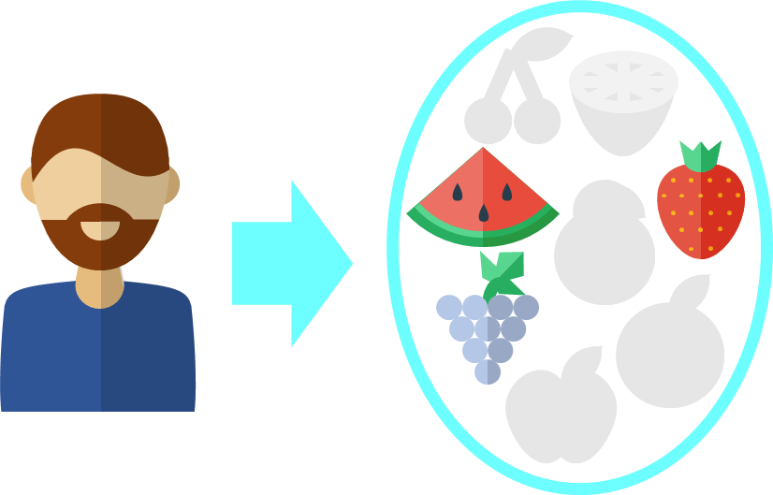
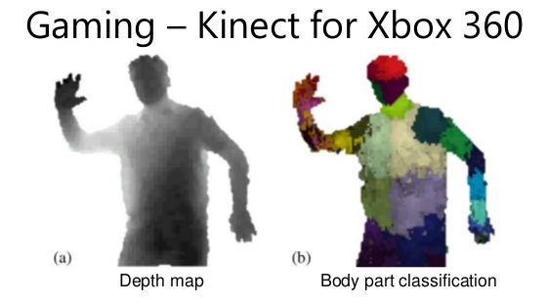
Decision Trees
Recommendation Systems
Can handle non-numeric features easily
Very popular in ML – classification, recsys
Extremely fast at making predictions
Easy to interpret by humans too
Model size can be large
Can give good train perf. but bad test perf. (known as overfitting)

Slide 11



Decision Trees for Classification
Repeatedly partition feature space $ℝ^{d}$
For test data point, find out in which partition does it lie
Can consider assigning the test point, the label of other points in its partition
Can be easily extended to binary, multi-class and multi-label classification problems!
1 2 3 4 5 6 7 8 9 10 11 12
However, if your partitions are fine enough, this will happen very rarely and not hurt performance too much!
1 2 3 4 5 6 7 8 9 10 11 12 13 14
What about points like this? The point might be a green or a red point ☹
Yes, as with all classifiers, decision trees may also get confused at their decision boundaries

Slide 12
Building Decision Trees
Root
Yes
X < 5.5
No
Internal Node
Y > 10.5
Y > 9
1 2 3 4 5 6 7 8 9 10 11 12
Internal Node
X < 11.5
X < 8.5
Internal Node
Y > 2.5
Y > 5.5
1 2 3 4 5 6 7 8 9 10 11 12 13 14
Leaf
X < 12
Leaf
Leaf
Leaf

