Slide 1
Practice Session

Slide 2
Subgradient and supporting hyperplanes
Epigraph
Tangent is a
supporting Hyperplane for
differentiable functions
Supporting Hyperplanes

Slide 3
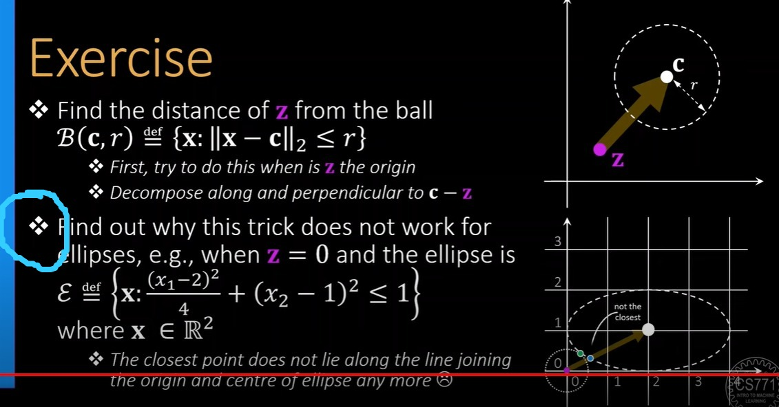
Doubt

Slide 4
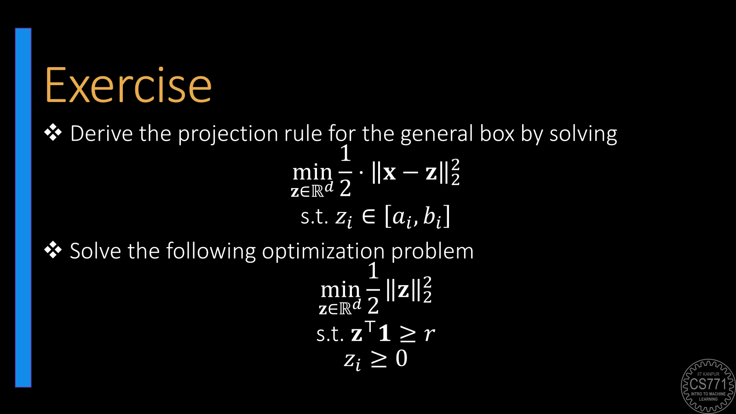
Doubt

Slide 5

A bit of Gyan
Also recall that you had designed a CD/CM solver for ridge regression as an exercise problem. Sometimes, descent-based solvers are faster even if closed-form solutions are available
Why are we solving the same problem in so many ways? $\min_{w∈ℝ^{d}}{\frac{1}{2}{\left\|w\right\|}_{2}^{2}}+\sum_{i=1}^{n}{{\left(y^{i}−w^{⊤}x^{i}\right)}^{2}}$
FOO on primal problem gives us $w^{∗}=2{\left(2X^{⊤}X+I_{d}\right)}^{−1}X^{⊤}y$
$I_{d}∈ℝ^{d×d}$ is the $d$-dimensional identity matrix
Solving the dual problem gives us $w^{∗}=2X^{⊤}{\left(2XX^{⊤}+I_{n}\right)}^{−1}y$
$I_{n}∈ℝ^{n×n}$ is the $n$-dimensional identity matrix
The reason is time complexity
Computing $2{\left(2X^{⊤}X+I_{d}\right)}^{−1}X^{⊤}y$ takes $𝒪\left(d^{2}n+d^{3}\right)$ time
Computing $2X^{⊤}{\left(2XX^{⊤}+I_{n}\right)}^{−1}y$ takes $𝒪\left(n^{2}d+n^{3}\right)$ time
Use primal solution if $n>d$ and dual solution if $d>n$ ☺

Slide 6

Naïve Matrix Multiplication
$X∈R^{a×b},Y∈R^{b×c}$
$XY∈R^{a×c}$
Time : $O\left(abc\right)$

Slide 7

Midsem Exam
Feb 22 (Thu), 6PM, L16,17,18,19,20
Only for registered students (regular + audit)
Assigned seating – will be announced soon
Open notes (handwritten only)
No mobile phones, tablets etc
Bring your institute ID card
If you don’t bring it, you may have to spend precious time during the exam getting verified separately
Syllabus:
All videos, slides, code linked on the course discussion page (link below) till 21 Feb 2024 (Wed)
https://www.cse.iitk.ac.in/users/purushot/courses/ml/2023-24-w/discussion.html
See GitHub for practice questions

Slide 8

True or False
$𝒞≝\left\{\left(x,y\right)∈ℝ^{2}:2≤x+y≤3\right\}$ is the set of all 2D vectors whose sum of coordinates is between $2$ and $3$. $𝒞$ is a convex set.
Technique 1: $𝒜≝\left\{\left(x,y\right):2≤x+y\right\}$ and $ℬ≝\left\{\left(x,y\right):x+y≤3\right\}$
$𝒞=𝒜∩ℬ$
Prove both $𝒜,ℬ$ convex and use int rule
Technique 2: first principles (mid point)
$\left(a,b\right),\left(p,q\right)∈𝒞$
$\left(\frac{a+p}{2},\frac{b+q}{2}\right)∈𝒞$

Slide 9
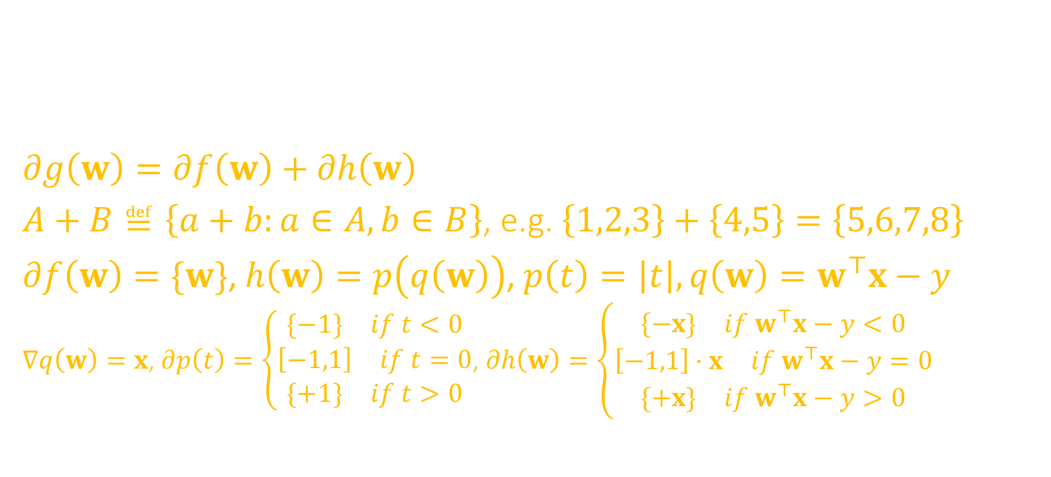
Subgradients
Consider the function $g\left(w\right)=\frac{1}{2}{\left\|w\right\|}_{2}^{2}+\left|w^{⊤}x−y\right|$ with $w,x∈ℝ^{d}$ and $y∈ℝ$. Write an expression for the subdifferential of $g$ at $w^{0}$ for any value of $w^{0},x∈ℝ^{d}$ and $y∈ℝ$.
$∂g\left(w\right)=∂f\left(w\right)+∂h\left(w\right)$
$A+B≝\left\{a+b:a∈A,b∈B\right\}$, e.g. $\left\{1,2,3\right\}+\left\{4,5\right\}=\left\{5,6,7,8\right\}$
$∂f\left(w\right)=\{w\}$, $h\left(w\right)=p\left(q\left(w\right)\right)$, $p\left(t\right)=\left|t\right|,q\left(w\right)=w^{⊤}x−y$
$∇q\left(w\right)=x$, $∂p\left(t\right)=\left\{\begin{matrix}\begin{matrix}\{−1\} & if t<0\end{matrix} \\ \begin{matrix}\left[−1,1\right] & if t=0\end{matrix} \\ \begin{matrix}\{+1\} & if t>0\end{matrix}\end{matrix}\right.$, $∂h\left(w\right)=\left\{\begin{matrix}\{\begin{matrix}−x\} & if w^{⊤}x−y<0\end{matrix} \\ \begin{matrix}\left[−1,1\right]⋅x & if w^{⊤}x−y=0\end{matrix} \\ \begin{matrix}\{+x\} & if w^{⊤}x−y>0\end{matrix}\end{matrix}\right.$

Slide 10



Subdifferential Calculus Rules
$$x∈ℝ^{d},a∈ℝ^{d},b,c∈ℝ$$
Regular Calculus
Subdifferential Calculus
Scaling Rule
Sum Rule
Chain Rule
$∇\left(c⋅f\right)\left(x\right)=c⋅∇f\left(x\right)$
$∇\left(f+g\right)\left(x\right)=∇f\left(x\right)+∇g\left(x\right)$
$∇f\left(a^{⊤}x+b\right)=f^{′}\left(a^{⊤}x+b\right)⋅a$
$∂\left(c⋅f\right)\left(x\right)=c⋅∂f\left(x\right)$
$≝\left\{c⋅v :v∈∂f\left(x\right)\right\}$
$∂\left(f+g\right)\left(x\right)=∂f\left(x\right)+∂g\left(x\right)$
$≝\left\{u+v :u∈∂f\left(x\right),v∈∂g\left(x\right)\right\}$
$∂f\left(a^{⊤}x+b\right)=∂f\left(a^{⊤}x+b\right)⋅a$
$≝\left\{c⋅a :c∈∂f\left(a^{⊤}x+b\right)\right\}$

Slide 11

Subdifferential of norms

Slide 12

Subdifferential Calculus Rules – Max Rule
If $h\left(x\right)≝\max{ \left\{f\left(x\right),g\left(x\right)\right\}}$, then $∂h\left(x^{0}\right)=\left\{\begin{matrix}\begin{matrix}∂f\left(x^{0}\right) & if f\left(x^{0}\right)>g\left(x^{0}\right)\end{matrix} \\ \begin{matrix}∂g\left(x^{0}\right) & if g\left(x^{0}\right)>f\left(x^{0}\right)\end{matrix} \\ \begin{matrix}S\left(x^{0}\right) & if f\left(x^{0}\right)=g\left(x^{0}\right)\end{matrix}\end{matrix}\right.$ where $S\left(x^{0}\right)≝\left\{λu+\left(1−λ\right)v :u∈∂f\left(x^{0}\right),v∈∂g\left(x^{0}\right),λ∈\left[0,1\right]\right\}$
There is no counterpart to the max rule in regular calculus
This is because functions of the form $h\left(x\right)≝\max{ \left\{f\left(x\right),g\left(x\right)\right\}}$ usually turn out to be non-differentiable and so regular calculus falls silent anyway

Slide 13
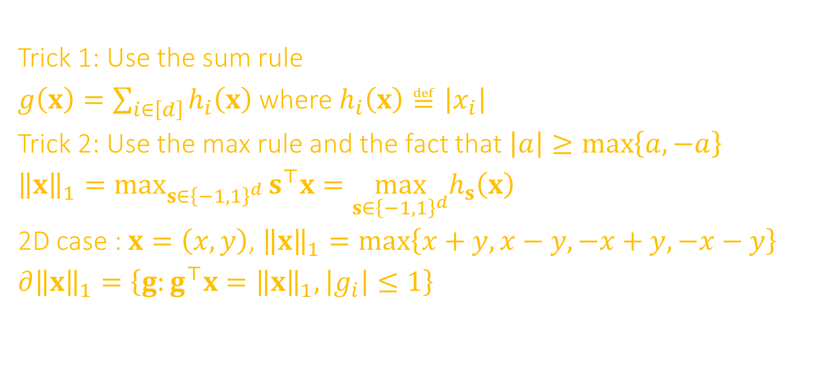
Subdifferential of norms
$g\left(x\right)={\left\|x\right\|}_{1}=\left|x_{1}\right|+\left|x_{2}\right|+\left|x_{3}\right|+\left|x_{4}\right|+…+\left|x_{d}\right|$
Trick 1: Use the sum rule
$g\left(x\right)=\sum_{i∈\left[d\right]}{h_{i}\left(x\right)}$ where $h_{i}\left(x\right)≝\left|x_{i}\right|$
Trick 2: Use the max rule and the fact that $\left|a\right|≥\max\left\{a,−a\right\}$
${\left\|x\right\|}_{1}=\max_{s∈{\left\{−1,1\right\}}^{d}}{s^{⊤}x}=\max_{s∈{\left\{−1,1\right\}}^{d}}h_{s}\left(x\right)$
2D case : $x=\left(x,y\right)$, ${\left\|x\right\|}_{1}=\max\left\{x+y,x−y,−x+y,−x−y\right\}$
$∂{\left\|x\right\|}_{1}=\left\{g:g^{⊤}x={\left\|x\right\|}_{1},\left|g_{i}\right|≤1\right\}$

Slide 14

Dual Derivation
Derive the dual for $\min_{w∈ℝ^{d}}{\frac{1}{2}}{\left\|w\right\|}_{2}^{2}+{\left\|w\right\|}_{1}+\frac{1}{2}\sum_{i∈\left[n\right]}{{\left(y^{i}−w^{⊤}x^{i}\right)}^{2}}$
$\min_{\begin{aligned}w,z∈ℝ^{d} \\ r∈ℝ^{n}\end{aligned}}{\frac{1}{2}}{\left\|w\right\|}_{2}^{2}+z^{⊤}1+\frac{1}{2}\sum_{i∈\left[n\right]}{r_{i}^{2}}$
$y^{i}−w^{⊤}x^{i}−r_{i}=0$, for all $i∈\left[n\right]$ → lambda
$w_{j}−z_{j}≤0$, for all $j∈\left[d\right]$ → alpha
$−w_{j}−z_{j}≤0$ , for all $j∈\left[d\right]$ → beta
${\left\|x\right\|}_{1}=\sum_{j∈\left[d\right]}{\left|x_{j}\right|}$
Suppose $\left|x_{j}\right|≤z_{j}$, then $−z_{j}≤x_{j}≤z_{j}$
Then ${\left\|x\right\|}_{1}=\sum_{j∈\left[d\right]}{z_{j}}$

Slide 15
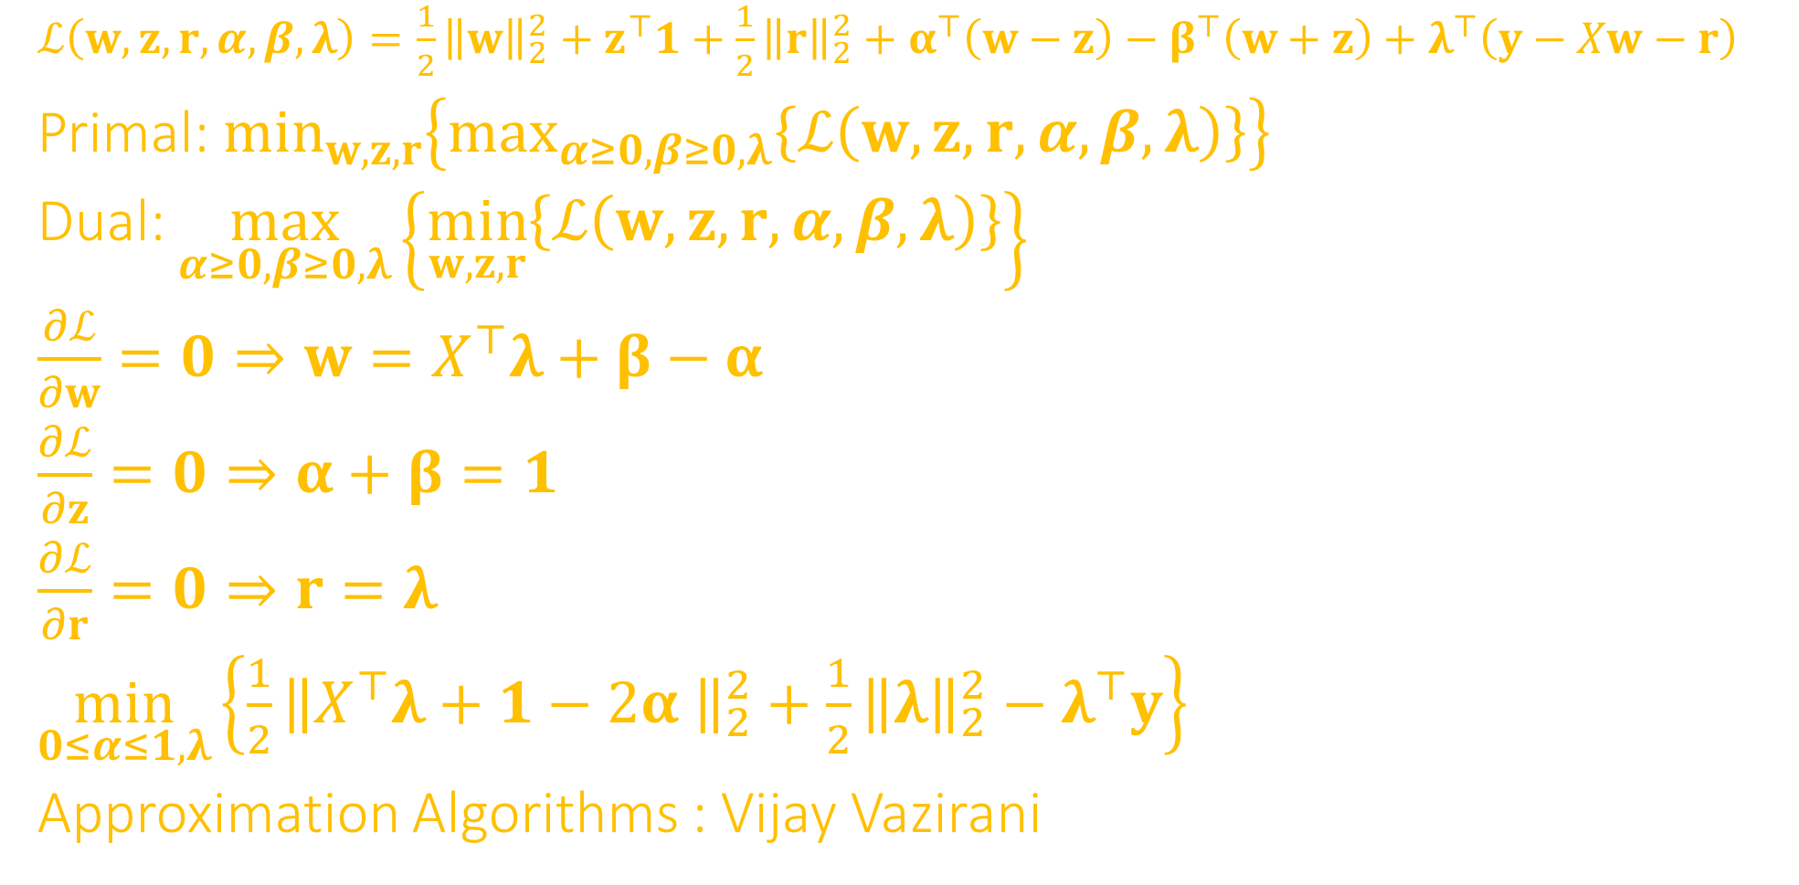
Dual Derivation
$ℒ\left(w,z,r,α,β,λ\right)=\frac{1}{2}{\left\|w\right\|}_{2}^{2}+z^{⊤}1+\frac{1}{2}{\left\|r\right\|}_{2}^{2}+α^{⊤}\left(w−z\right)−β^{⊤}\left(w+z\right)+λ^{⊤}\left(y−Xw−r\right)$
Primal: $\min_{w,z,r}\left\{\max_{α≥0,β≥0,λ}\left\{ℒ\left(w,z,r,α,β,λ\right)\right\}\right\}$
Dual: $\max_{α≥0,β≥0,λ}\left\{\min_{w,z,r}\left\{ℒ\left(w,z,r,α,β,λ\right)\right\}\right\}$
$\frac{∂ℒ}{∂w}=0⇒w=X^{⊤}λ+β−α$
$\frac{∂ℒ}{∂z}=0⇒α+β=1$
$\frac{∂ℒ}{∂r}=0⇒r=λ$
$\min_{0≤α≤1,λ}\left\{\frac{1}{2}{\left\|X^{⊤}λ+1−2α \right\|}_{2}^{2}+\frac{1}{2}{\left\|λ\right\|}_{2}^{2}−λ^{⊤}y\right\}$
Approximation Algorithms : Vijay Vazirani

Slide 16
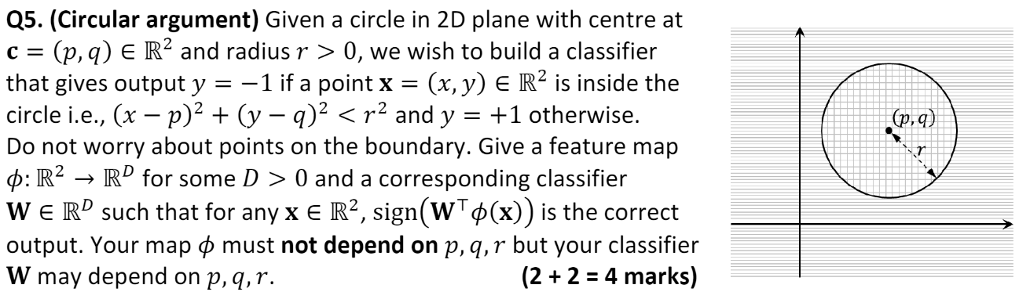
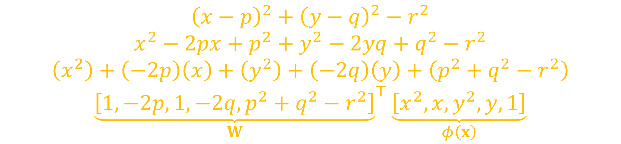
Feature Construction
$${\left(x−p\right)}^{2}+{\left(y−q\right)}^{2}−r^{2}$$
$$x^{2}−2px+p^{2}+y^{2}−2yq+q^{2}−r^{2}$$
$$\left(x^{2}\right)+\left(−2p\right)\left(x\right)+\left(y^{2}\right)+\left(−2q\right)\left(y\right)+\left(p^{2}+q^{2}−r^{2}\right)$$
$${\underset{W}{\underbrace{\left[1,−2p,1,−2q,p^{2}+q^{2}−r^{2}\right]}}}^{⊤}\underset{φ\left(x\right)}{\underbrace{\left[x^{2},x,y^{2},y,1\right]}}$$

