Slide 1
Probabilistic ML

Slide 2

Assignment 1 (extended) Deadline
2 April 2024 (Tue), 9:59PM IST
Do not use prohibited libraries in your submission code
pandas, pickle, os, sys, skopt, keras, tf
Do not use non-linear models
Verify your code with Google Colab validation script before submitting
Read instructions in assignment package carefully

Slide 3

Extra Classes
April 03, 2024 (Wed) 6PM L20
April 10, 2024 (Wed) 6PM L20
Timing and venue same for both
In lieu of missed classes on account of Institute and Gymkhana holidays
All regrade requests to be resolved before final grades are uploaded

Slide 4
Maximum Likelihood
The expression $ℙ\left[ y^{i} | x^{i},w\right]$ tells us if the model $w$ thinks the label $y^{i}$ is a very likely label given the feature vector $x^{i}$ or not likely at all!
$ℙ\left[y^{1},…,y^{n} | x^{1},…,x^{n},w\right]$ similarly tells us how likely does the model $w$ think the labels $y^{1},…,y^{n}$ are, given the feature vectors $x^{1},…,x^{n}$
Since we trust our training data as clean and representative of reality, we should look for a $w$ that considers training labels to be very likely
E.g. in RecSys example, let $y^{t}=1$ if customer makes a purchase and $y^{t}=0$ otherwise. If we trust that these labels do represent reality i.e. what our customers like and dislike, then we should learn a model $w$ accordingly
Totally different story if we mistrust our data – different techniques for that
Maximum Likelihood Estimator (MLE): the model that gives highest likelihood to observed labels ${\hat{w}}_{MLE}=\arg{\max_{w∈ℝ^{d}}{\prod_{i=1}^{n}{ℙ\left[ y^{i} | x^{i},w\right]}}}$

Slide 5
Logistic Regression
Suppose we learn a model as the MLE while using sigmoidal map
${\hat{w}}_{MLE}=\arg{\max_{w∈ℝ^{d}}{\prod_{i=1}^{n}{σ\left(y^{i}⋅w^{⊤}x^{i}\right)}}}$
Working with products can be numerically unstable
Since $σ\left(⋅\right)∈\left[0,1\right]$, product of several such values can be extremely small
Solution: take logarithms and exploit that $\max_{w}{f\left(w\right)}=\max_{w}{\ln\left(f\left(w\right)\right)}$
${\hat{w}}_{MLE}=\arg{\max_{w∈ℝ^{d}}{\ln\left(\prod_{i=1}^{n}{σ\left(y^{i}⋅w^{⊤}x^{i}\right)}\right)}}$
$=\arg{\min_{w∈ℝ^{d}}{\sum_{i=1}^{n}{\ln\left(1+\exp\left(−y^{i}⋅w^{⊤}x^{i}\right)\right)}}}$
Thus, the logistic loss function pops out automatically when we try to learn a model that maximizes the likelihood function
Also called negative log-likelihood

Slide 6


Probabilistic Multiclassification
Just as we had the Bernoulli distributions over the support $\left\{0,1\right\}$, if the support instead has $C>2$ elements, then the distributions are called either Multinoulli distributions or Categorical distributions
Suppose we have $C$ classes, then for every data point we would have to output a PMF over the support $\left[C\right]$
Popular way: assign a positive score to all classes and normalize so that the scores form a proper probability distribution
Common trick: to convert any score to a positive score – exponentiate!!
Learn $C$ models $w^{1},…,w^{C}$, given a point $\left(x^{t},y^{t}\right)$, $x^{t}∈ℝ^{d}$, $y^{t}∈\left[C\right]$
Assign a positive score per class $η_{c}=\exp\left(\left\langle w^{c},x^{t}\right\rangle \right)$
Normalize to obtain a PMF $ℙ\left[ y | x^{t},\left\{w^{c}\right\}\right]={η_{y}}/{\sum_{c=1}^{C}{η_{c}}}$ for any $y∈\left[C\right]$
Likelihood in this case is $ℙ\left[ y^{t} | x^{t},\left\{w^{c}\right\}\right]={η_{y^{t}}}/{\sum_{c=1}^{C}{η_{c}}}$
Log-likelihood in this case is $\ln\left({η_{y^{t}}}/{\sum_{c=1}^{C}{η_{c}}}\right)$
To specify a multinoulli distribution over $C$ labels, we need to specify $C$ non-negative numbers that add up to one

Slide 7


Softmax Regression
I may find other ways to assign a PMF over $\left[C\right]$ to each data point by choosing some function other than $\exp\left(⋅\right)$ e.g. ReLU ${\left[t\right]}_{+}$ to assign positive scores i.e. let $η_{c}={\left[\left\langle w^{c},x^{t}\right\rangle \right]}_{+}$ , let $ℙ\left[ y | x^{t},\left\{w^{c}\right\}\right]={η_{y}}/{\sum_{c=1}^{C}{η_{c}}}$ and then proceed to obtain an MLE. Something similar to this is indeed used in deep learning
If we now want to learn the MLE, we would have to find
$\left\{{\hat{w}}_{MLE}^{1},…,{\hat{w}}_{MLE}^{C}\right\}=\arg{\max_{w^{1},…,w^{C}∈ℝ^{d}}{\prod_{i=1}^{n}{ℙ\left[ y^{i} | x^{i},w\right]}}}$
$=\arg{\max_{w^{1},…,w^{C}∈ℝ^{d}}{\prod_{i=1}^{n}{{η_{y^{t}}^{i}}/{\sum_{c=1}^{C}{η_{c}^{i}}}}}}$ where $η_{c}^{i}=\exp\left(\left\langle w^{c},x^{i}\right\rangle \right)$
Using the negative log-likelihood for numerical stability
$=\arg{\min_{w^{1},…,w^{C}∈ℝ^{d}}{\sum_{i=1}^{n}{−\ln\left({η_{y^{t}}^{i}}/{\sum_{c=1}^{C}{η_{c}^{i}}}\right)}}}$
Note: this is nothing but the softmax loss function we saw earlier, also known as the cross entropy loss function
Reason for the name: it corresponds to something known as the cross entropy between the PMF given by the model and the true label of the data point
It should be noted that this is not the only way to do probabilistic multiclassification. It is just that this way is simple to understand, implement and hence popular
However, be warned that generating a PMF using DT need not necessarily be an MLE since we have not explicitly maximized any likelihood function here
I could do also DT and invoke the “probability as proportions” interpretation to assign a test data point to a PMF that simply gives the proportion of each label in the leaf of that data point!!

Slide 8
General Recipe for MLE Algorithms
Given a problem with label set $𝒴$, find a way to map data features $x$ to PMFs $ℙ\left[⋅| x, m\right]$ with support $𝒴$
The notation $m$ captures parameters in the model (e.g. vectors, bias terms)
For binary classification, $𝒴=\left\{−1,1\right\}$ and $m=w$
For multiclassification,$𝒴=\left[C\right]$ and $m=\left\{w^{1},…,w^{C}\right\}$
The function $ℙ\left[⋅| x, m\right]$ is often called the likelihood function
The function $−\ln{ℙ\left[⋅| x, m\right]}$ called negative log likelihood function
Given data ${\left\{\left(x^{i},y^{i}\right)\right\}}_{i=1}^{n}$, find the model parameters that maximize likelihood function i.e. think that the training labels are very likely ${\hat{m}}_{MLE}=\arg{\min_{m}{ \sum_{i=1}^{n}{−\ln{ℙ\left[y^{i} | x^{i}, m\right]}}}}$

Slide 9



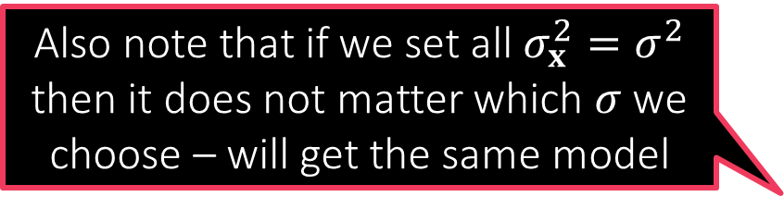
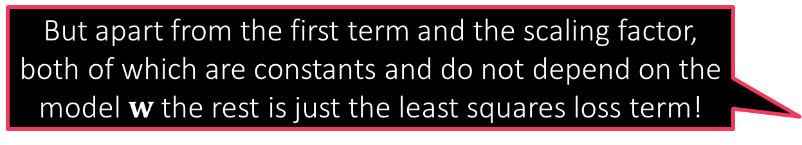
Probabilistic Regression
But apart from the first term and the scaling factor, both of which are constants and do not depend on the model $w$ the rest is just the least squares loss term!
In order to perform probabilistic regression I have to assign a label distribution over all $ℝ$ for every data point $x$ using a PDF
Suppose I decide to do that using a Gaussian distribution – need to decide on a mean $μ_{x}$ and a variance $σ_{x}^{2}>0$
Popular choice: Let $μ_{x}=w^{⊤}x$ and $σ_{x}^{2}=σ^{2}$ i.e. $𝒩\left(⋅| w^{⊤}x,σ^{2}\right)$
We can also choose a different $σ$ for every data point – more complicated
Likelihood function w.r.t a data point $\left(x^{i},y^{i}\right)$ then becomes $𝒩\left(y^{i} | w^{⊤}x^{i},σ^{2}\right)=\frac{1}{\sqrt{2πσ^{2}}}\exp\left(−{\left(y^{i}−w^{⊤}x^{i}\right)}^{2}/{2σ}^{2}\right)$
Negative log likelihood w.r.t a set of data points ${\left\{\left(x^{i},y^{i}\right)\right\}}_{i=1}^{n}$ $\frac{n}{2}ln\left(2πσ^{2}\right)+\frac{1}{2σ^{2}}\sum_{i=1}^{n}{{\left(y^{i}−w^{⊤}x^{i}\right)}^{2}}$
The MLE with respect to the Gaussian likelihood indeed the minimizes least squares loss
Also note that if we set all $σ_{x}^{2}=σ^{2}$ then it does not matter which $σ$ we choose – will get the same model
$$\min_{w∈ℝ^{d}}{}$$

Slide 10





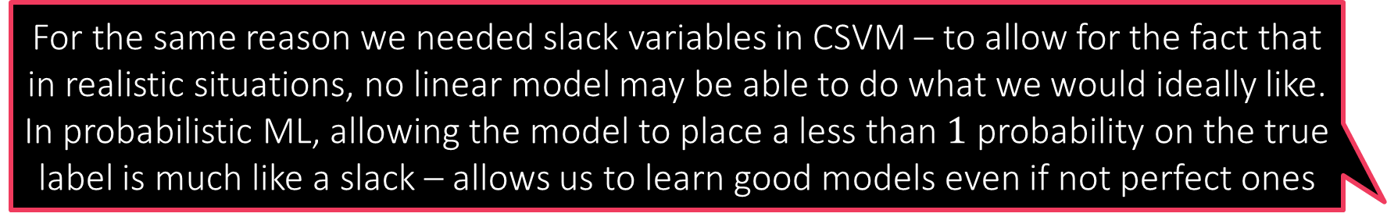
Probabilistic Regression
Be warned though – the $σ$ we chose will start mattering the moment we add regularization! It is just that in these simple cases it does not matter. $σ$ is usually treated like a hyperparameter and tuned.
Suppose I decide to use a Laplacian distribution instead and choose $μ_{x}=w^{⊤}x$ and $σ_{x}=σ$ i.e. $Lap\left(⋅| w^{⊤}x,σ\right)$
Likelihood function w.r.t a data point $\left(x^{i},y^{i}\right)$ then becomes $Lap\left(y^{i} | w^{⊤}x^{i},σ\right)=\frac{1}{2σ}\exp\left(−\left|y^{i}−w^{⊤}x\right|/σ\right)$
Negative log likelihood w.r.t a set of data points ${\left\{\left(x^{i},y^{i}\right)\right\}}_{i=1}^{n}$ $\min_{w∈ℝ^{d}}{ n⋅ln\left(σ\right)+\frac{1}{σ}\sum_{i=1}^{n}{\left|y^{i}−w^{⊤}x^{i}\right|}}=\min_{w∈ℝ^{d}}{ \sum_{i=1}^{n}{\left|y^{i}−w^{⊤}x^{i}\right|}}$
Thus, if we change the likelihood function to use the Laplacian distribution instead, the MLE ends up minimizing absolute loss!
As before, does not matter which $σ$ we choose
So I am a bit confused. All MLEs (classification/regression) demand a model that places maximum probability on the true label. Why don’t we just ask the model to predict the true label itself?
That is like asking the PMF/PDF to place probability $1$ on the true label and $0$ everywhere else – why can’t we do just that?
For the same reason we needed slack variables in CSVM – to allow for the fact that in realistic situations, no linear model may be able to do what we would ideally like. In probabilistic ML, allowing the model to place a less than $1$ probability on the true label is much like a slack – allows us to learn good models even if not perfect ones

Slide 11
Probabilistic Regularization??
We have seen that MLE often reduces to loss minimization e.g. logistic regression/least squares regression but without regularization terms ☹
Even probabilistic methods can do regularization by way of priors
Recall: regularization basically tells us which kinds of models we prefer
L2 regularization means we prefer models with small L2 norm
L1 regularization means we prefer models with small L1 norm/sparse models
In the language of probability, the most direct way of specifying such a preference is by specifying a probability distribution itself
Prior: a probability distribution over all possible models
Just like we usually decide regularization before seeing any data, prior distribution also does not consider/condition on, any data
But our models are vectors right? Can we have probability distribution over vectors as well?
Of course we can. But first, let us see the basic operations in a toy 1D setting before getting into the complications of vector-valued r.v.s

Slide 12



Can you Guess the Mean?
In this case we are said to have a prior belief or simply prior, on the models $μ$, in this case the uniform prior $UNIF\left(\left[0,2\right]\right)$. This means that unless we see any data to make us believe otherwise, we will think $ℙ\left[μ\right]=\left\{\begin{aligned}0.5 \\ 0\end{aligned} \begin{matrix}if x∈\left[0, 2\right] \\ if x∉\left[0, 2\right]\end{matrix}\right.$.
There is a Gaussian with unknown mean but known variance (for sake of simplicity) from which we receive $n$ independent samples $x_{1},x_{2},…,x_{n}∼𝒩\left(μ^{∗},1\right)$
Can we estimate the “model” $μ^{∗}$ from these samples?
Likelihood function: for a candidate model $μ$ and sample $x_{i}$ $ℙ\left[x_{i} | μ,1\right]=\frac{1}{\sqrt{2π}}\exp\left(−{\left(x_{i}−μ\right)}^{2}/2\right)$
MLE: $\arg{\max_{μ∈ℝ}{\prod_{i=1}^{n}{ℙ\left[x_{i} | μ,1\right]}}}=\arg{\min_{μ∈ℝ}{\sum_{i=1}^{n}{{\left(x_{i}−μ\right)}^{2}}}}$
Suppose we believe (e.g. someone tells us) even before the samples have been presented that $μ^{∗}$ definitely lies in the interval $\left[0,2\right]$ (but could otherwise be any value within that interval)
What happens we do see some data, namely the actual samples from the distribution?
We use the samples and the rules of probability to update our beliefs about what $μ$ can and cannot be. Let us see how to do this

Slide 13
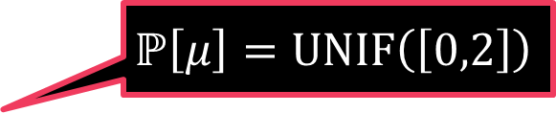
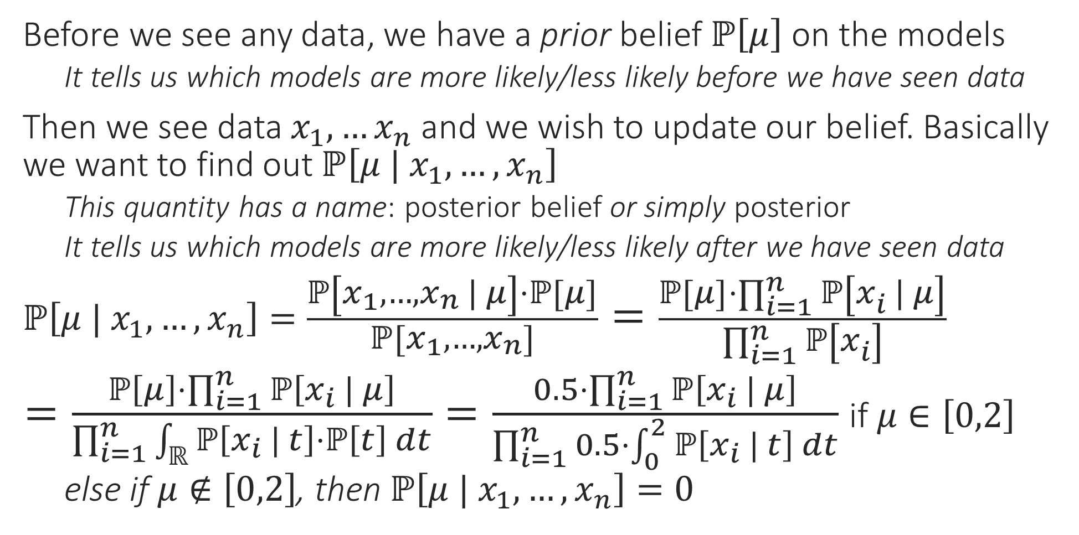

Posterior
Before we see any data, we have a prior belief $ℙ\left[μ\right]$ on the models
It tells us which models are more likely/less likely before we have seen data
Then we see data $x_{1},…x_{n}$ and we wish to update our belief. Basically we want to find out $ℙ\left[μ | x_{1},…,x_{n}\right]$
This quantity has a name: posterior belief or simply posterior
It tells us which models are more likely/less likely after we have seen data
$ℙ\left[μ | x_{1},…,x_{n}\right]=\frac{ℙ\left[x_{1},…,x_{n} | μ\right]⋅ℙ\left[μ\right]}{ℙ\left[x_{1},…,x_{n}\right]}=\frac{ℙ\left[μ\right]⋅\prod_{i=1}^{n}{ℙ\left[x_{i} | μ\right]}}{\prod_{i=1}^{n}{ℙ\left[x_{i}\right]}}$
$=\frac{ℙ\left[μ\right]⋅\prod_{i=1}^{n}{ℙ\left[x_{i} | μ\right]}}{\prod_{i=1}^{n}{\int_{ℝ}{ℙ\left[x_{i} | t\right]⋅ℙ\left[t\right] dt}}}=\frac{0.5⋅\prod_{i=1}^{n}{ℙ\left[x_{i} | μ\right]}}{\prod_{i=1}^{n}{0.5⋅\int_{0}^{2}{ℙ\left[x_{i} | t\right] dt}}}$ if $μ∈\left[0,2\right]$
else if $μ∉\left[0,2\right]$, then $ℙ\left[μ | x_{1},…,x_{n}\right]=0$
Note that when we say $ℙ\left[μ\right]$ or $ℙ\left[μ | x_{1},…,x_{n}\right]$, we mean probability density and not probability mass since $μ$ is a continuous r.v.
Bayes Rule
Samples are independent
Law of total probability
$$ℙ\left[μ\right]=UNIF\left(\left[0,2\right]\right)$$

Slide 14


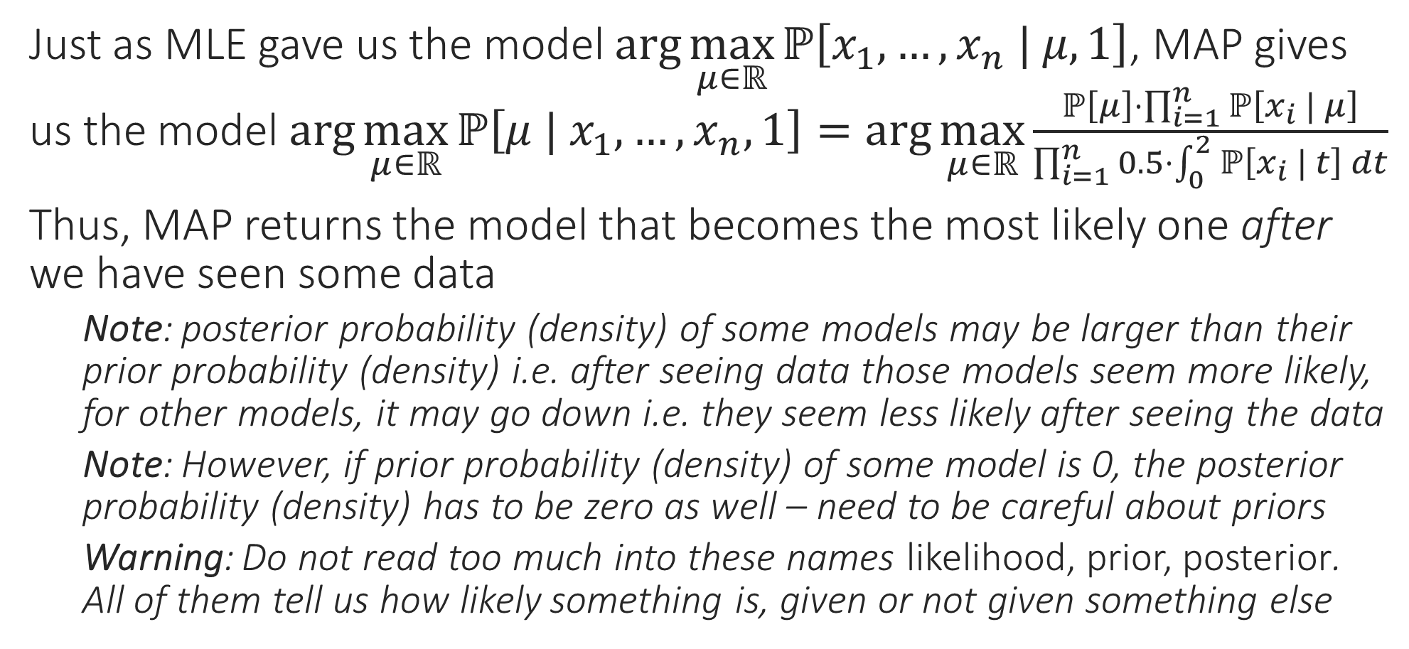

Maximum a Posteriori (MAP) Estimate
It is better to choose priors that do not completely exclude some models by giving them 0 probability (as we did)
Just as MLE gave us the model $\arg{\max_{μ∈ℝ}{ℙ\left[x_{1},…,x_{n} | μ,1\right]}}$, MAP gives us the model $\arg{\max_{μ∈ℝ}{ℙ\left[μ | x_{1},…,x_{n},1\right]}}=\arg{\max_{μ∈ℝ}}\frac{ℙ\left[μ\right]⋅\prod_{i=1}^{n}{ℙ\left[x_{i} | μ\right]}}{\prod_{i=1}^{n}{0.5⋅\int_{0}^{2}{ℙ\left[x_{i} | t\right] dt}}}$
Thus, MAP returns the model that becomes the most likely one after we have seen some data
Note: posterior probability (density) of some models may be larger than their prior probability (density) i.e. after seeing data those models seem more likely, for other models, it may go down i.e. they seem less likely after seeing the data
Note: However, if prior probability (density) of some model is 0, the posterior probability (density) has to be zero as well – need to be careful about priors
Warning: Do not read too much into these names likelihood, prior, posterior. All of them tell us how likely something is, given or not given something else
True! Even in general, if your priors are bad, or too strong, then you may end up getting funny models as a result of doing MAP estimation
Indeed! For example if we were wrong and $μ^{∗}$ was actually not $∈\left[0,2\right]$ then not matter how many samples we see, we will never estimate $μ^{∗}$ correctly!!

Slide 15
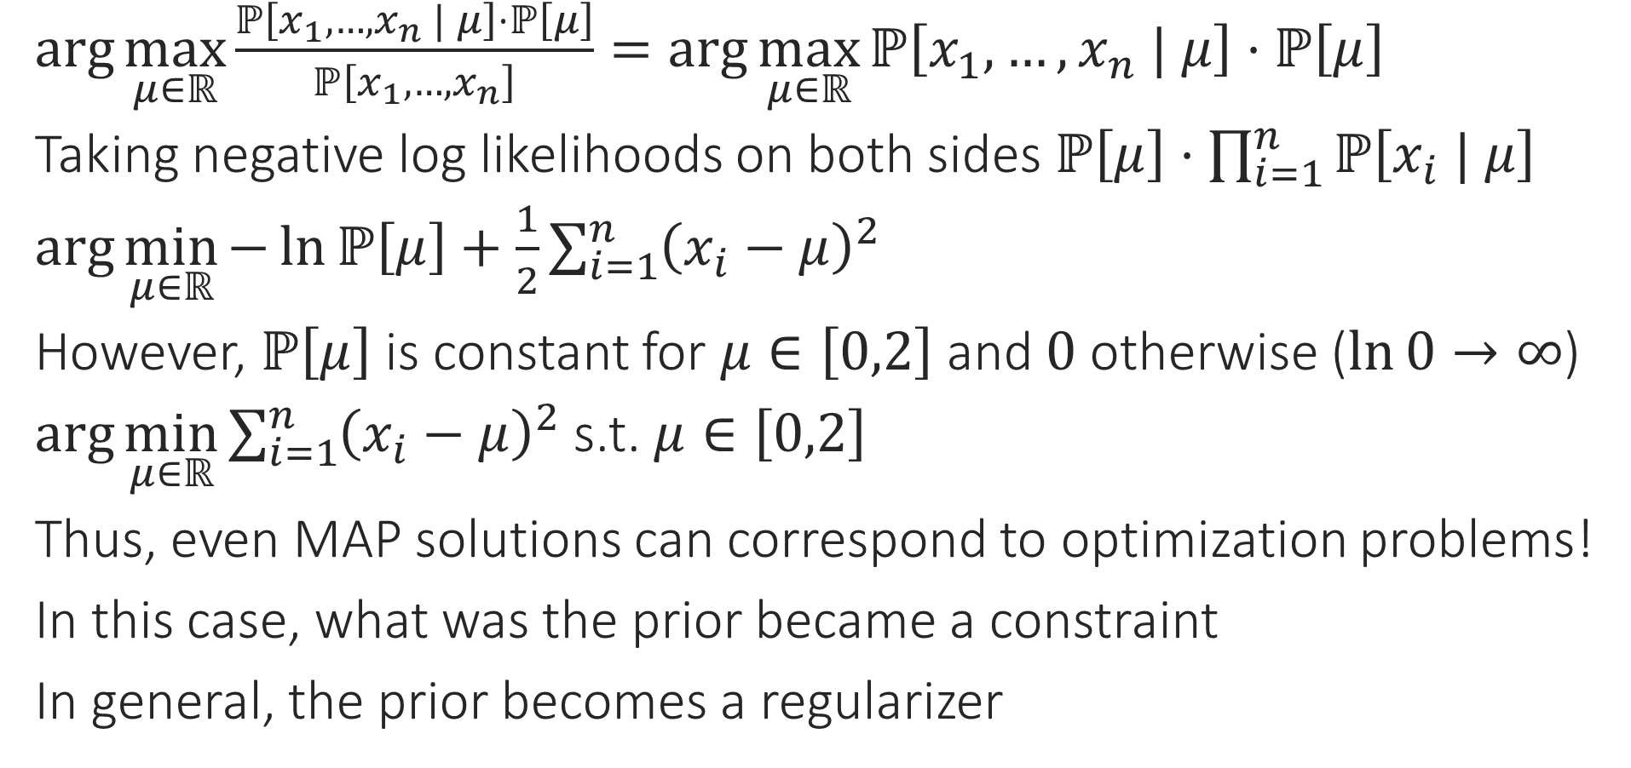
MAP vs Regularization
$\arg{\max_{μ∈ℝ}{\frac{ℙ\left[x_{1},…,x_{n} | μ\right]⋅ℙ\left[μ\right]}{ℙ\left[x_{1},…,x_{n}\right]}}}=\arg{\max_{μ∈ℝ}{ℙ\left[x_{1},…,x_{n} | μ\right]⋅ℙ\left[μ\right]}}$
Taking negative log likelihoods on both sides $ℙ\left[μ\right]⋅\prod_{i=1}^{n}{ℙ\left[x_{i} | μ\right]}$
$\arg{\min_{μ∈ℝ}{−\ln{ℙ\left[μ\right]}+\frac{1}{2}\sum_{i=1}^{n}{{\left(x_{i}−μ\right)}^{2}}}}$
However, $ℙ\left[μ\right]$ is constant for $μ∈\left[0,2\right]$ and $0$ otherwise ($\ln{0}→∞$)
$\arg{\min_{μ∈ℝ}{\sum_{i=1}^{n}{{\left(x_{i}−μ\right)}^{2}}}}$ s.t. $μ∈\left[0,2\right]$
Thus, even MAP solutions can correspond to optimization problems!
In this case, what was the prior became a constraint
In general, the prior becomes a regularizer

Slide 16


MAP vs Regularization
Similarly, had we used a Laplacian prior, we would have obtained L1 regularization instead
Consider the same problem as before but a different prior
This time we do not believe $μ$ must have been in the interval $\left[0,2\right]$ but a much milder prior that $μ$ is not too large in magnitude
A good way to express this is to use a Gaussian prior $ℙ\left[μ\right]=𝒩\left(μ ; 0,σ^{2}\right)=\frac{1}{\sqrt{2πσ^{2}}}\exp\left(−\frac{μ^{2}}{2σ^{2}}\right)$
MAP: $\arg{\min_{μ∈ℝ}{−\ln{ℙ\left[μ\right]}+\frac{1}{2}\sum_{i=1}^{n}{{\left(x_{i}−μ\right)}^{2}}}}$
$=\arg{\min_{μ∈ℝ}{\frac{μ^{2}}{{2σ}^{2}}+\frac{1}{2}\sum_{i=1}^{n}{{\left(x_{i}−μ\right)}^{2}}}}=\arg{\min_{μ∈ℝ}{\frac{μ^{2}}{σ^{2}}+\sum_{i=1}^{n}{{\left(x_{i}−μ\right)}^{2}}}}$
Thus, a Gaussian prior gave us L2 regularization!
Note: $σ$ effecitely dictates the regularization constant – not useless!!
Note: this is basically ridge regression except in one dimension!!
The regularization constant is dictated by the strength of the regularization. Be careful not to have strong priors (uninformed strong opinions are bad in real life too ☺)

