Slide 1
IBM Hackchallenge
Problem Statement3 :
Help me in my mood
Submitted By:
Aakriti Jain
Noopur Rathore
Pranjal Sharma

Slide 2
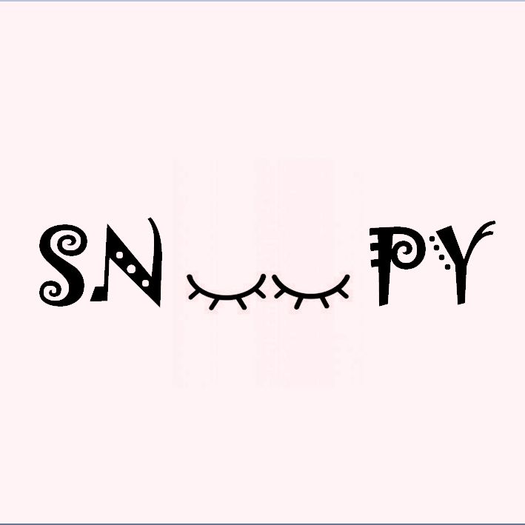
OUR LOGO
-MOOD SHOULD NOT DICTATE YOUR DECISIONS-

Slide 3
ABOUT PROJECT
This is a sentiment analyser using optical character recognition (OCR) technology and IBM Watson.
Technologies used:
-IBM Watson
-OCR
Platforms used:
-Android studio
API’s:
-IBM Watson’s Tone Analyser API
Programming language used:
-Java

Slide 4
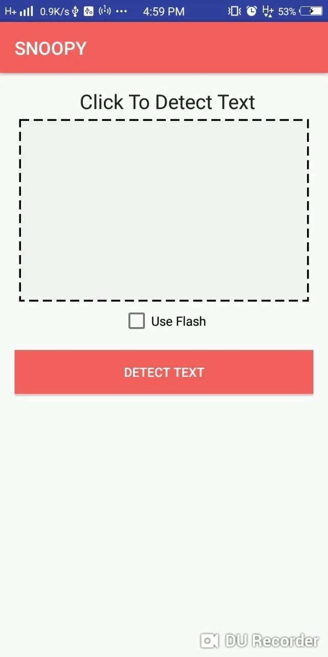
WORKING
When we open the app
detect text button appears,
which leads to camera .
Moreover there is an
additional feature of
‘use flash’ considering dim
light.

Slide 5
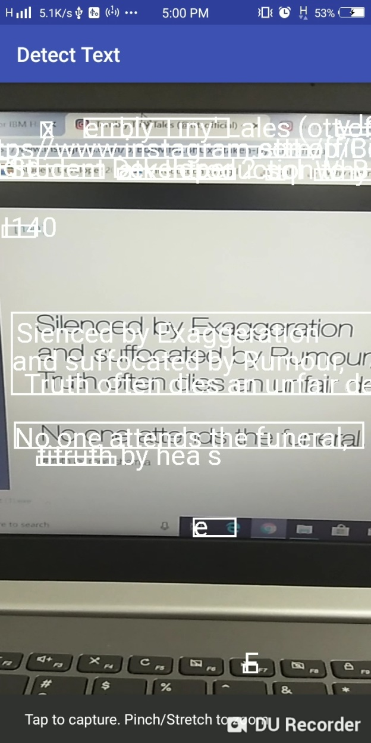
WORKING(cont.)
This image depicts fetching of text from social content using OCR .
It’ll select multiple text and user can pick accordingly.

Slide 6
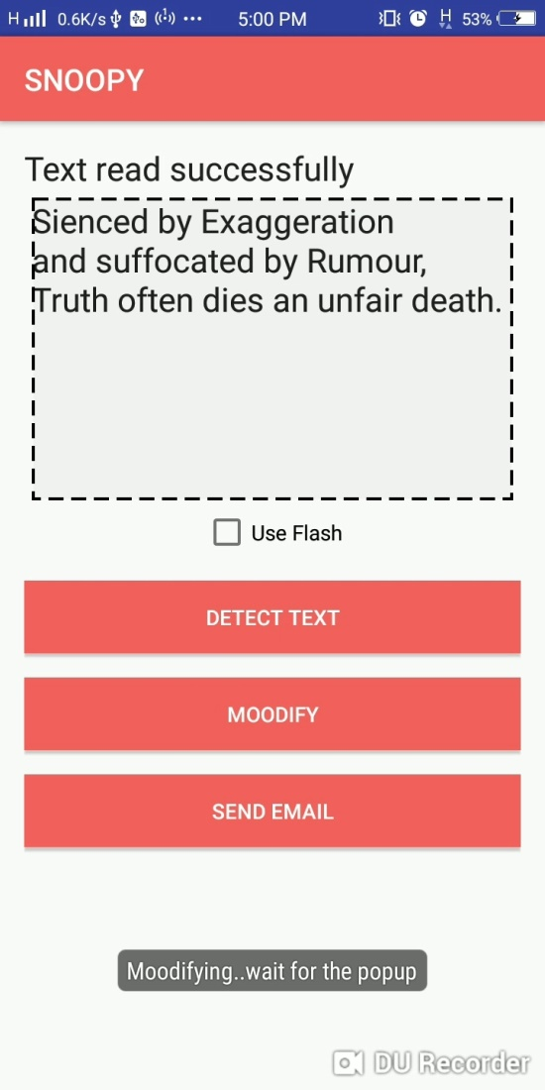
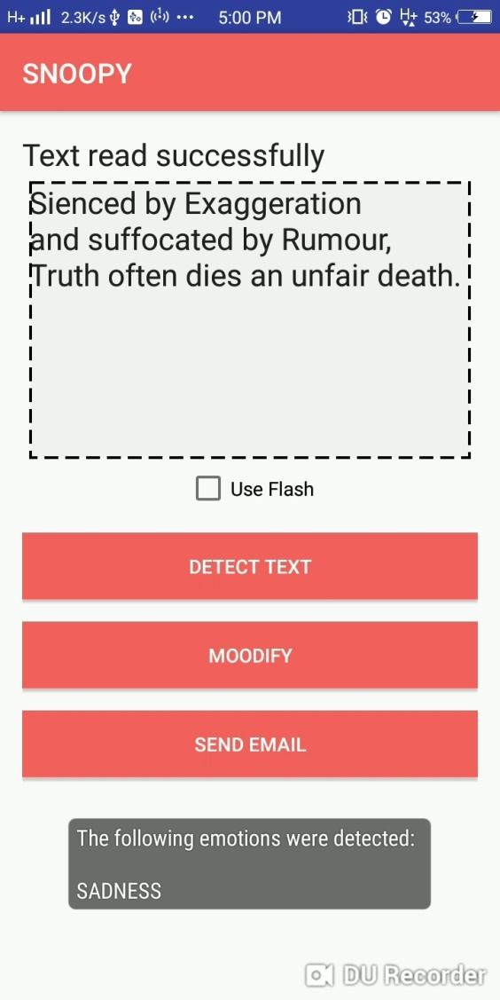
WORKING(cont.)
<----After fetching the text user need to click ‘moodify’ to detect the sentiments.
Wait for the popup to --->
appear .It’ll display the sentiments in a while.

Slide 7
SCOPE
We are providing an additional feature of ‘send mail’ which in future can be used for providing advices as well as song suggestions to lighten up ones mood to keep them healthy and fit.
In this era of modernisation people tend to stress more and ignore their health so this app is one step towards resolving this problem.

Slide 8
VISION
At present this app is successfully depicting ones emotions in future we are looking forward to have this app uploaded on google play store to generate revenue.
We are also thinking of including the daily log of the person’s mood based on the number of detections and analyse them weekly and inturn suggest the beneficial measures to soothe,calm down and have a stable happy life.

Slide 9
THANK YOU

