Slide 1
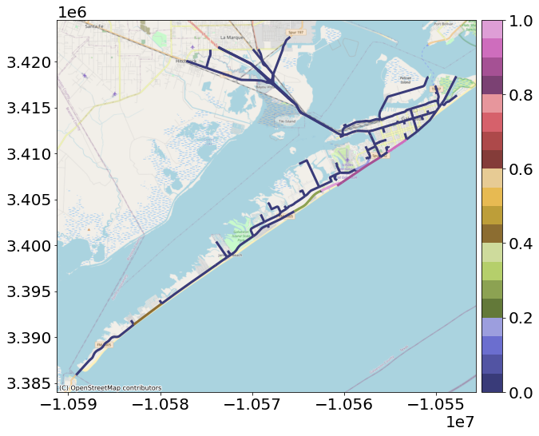
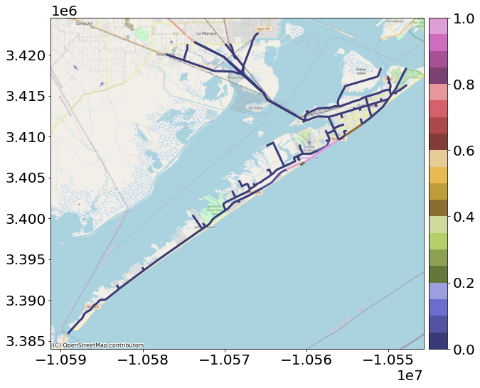

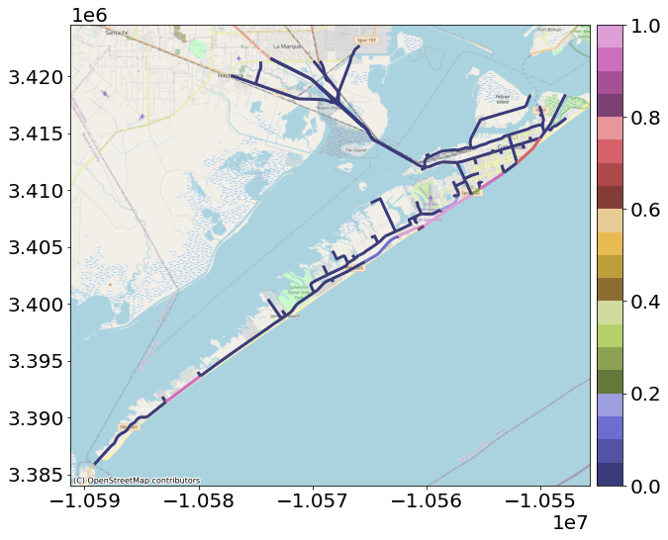
(a)
(b)
(c)
(d)
Notes:
Figure_No1_IkeHindcast
Figure_No2_50yrReturnPeriod
Figure_No3_100yrReturnPeriod
Figure_No4_500yrReturnPeriod

