Slide 1

CRM Data Analyst Case
Noa P Prada Schnor
May 2021

Slide 2


TOPICS
COMPANY
PROBLEM
CUSTOMERS
TOP CUSTOMERS
PREDICTION MODEL

Slide 3
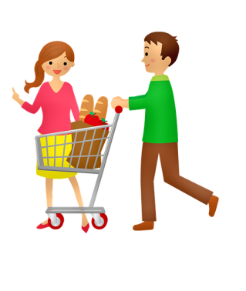



COMPANY
Well-established company operating in the retail food sector
Serve almost one million consumers a year.
Customer Database:
Around several hundred thousand registered customers
5 major categories of Products:
Wines
Rare meat products
Exotic fruits
Specially prepared fish
Sweet products
Gold Products
Regular Products
Sales channels:
Physical stores
Catalogs
Online (company’s website)

Slide 4

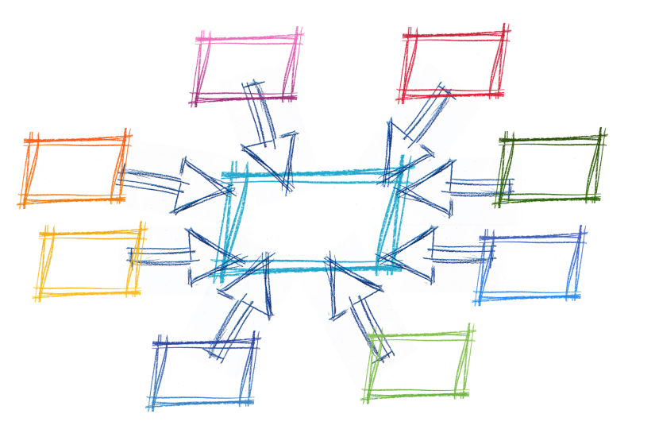
PROJECTIONS
In the last 3 years, the company had:
solid revenues
healthy bottom line
Profit growth perspectives for
the next 3 years are NOT promising
Several strategic initiatives are being considered to invert this situation.
Performance of marketing
Special focus on
Marketing Campaigns.

Slide 5


CAMPAIGN 6 PILOT
Aims at selling NEW Gadget
Randomly selected customers: 2240
Figures
Data: Socio demographic & Firmographic
Cost: 6720 MU
Revenue: 3674 MU
Success rate: 15%
Profit: -3046 MU

Slide 6




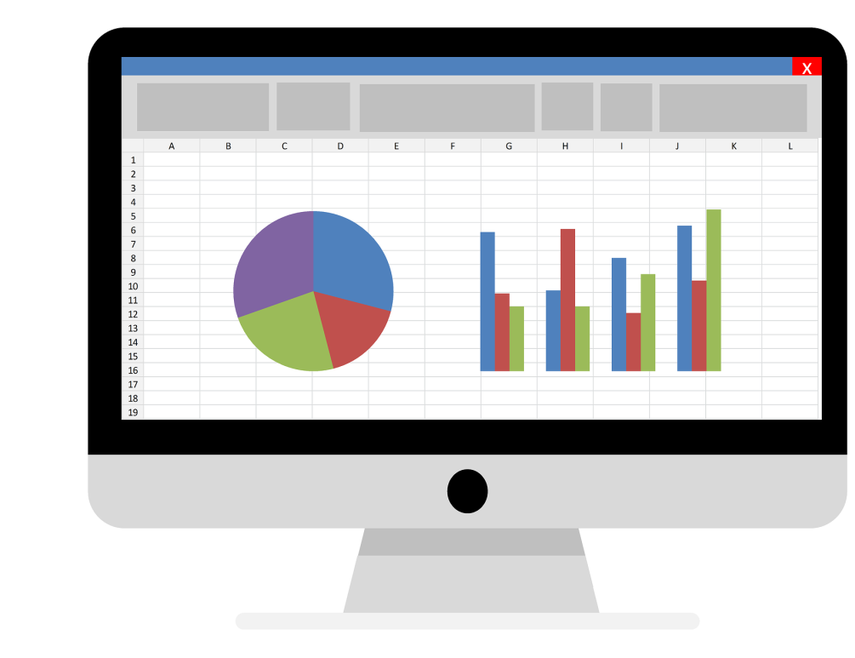

CAMPAIGN 6 PILOT

Slide 7

CUSTOMERS

Slide 8
CUSTOMERS
Age | Accepted vs Not Accepted Last Campaign
Education | Accepted vs Not Last Campaign
Customers (%)
Marital Status | Accepted vs Not Last Campaign
Customers (%)

Slide 9
CUSTOMERS
Annual Income | Accepted vs Not Last Campaign
1.3 times higher annual income
1.3 x
Median

Slide 10
CUSTOMERS
Children | Accepted vs Not Last Campaign
50% do not have children
Customers (%)

Slide 11
CUSTOMERS
Previous Campaigns | Accepted vs Not Last Campaign
4 x
Customers (%)
Customers (%)

Slide 12
CUSTOMERS
Enrolled | Accepted vs Not Last Campaign
8 years
3 months
Not ‘New’ Customers
Diff. only 6 months
Months
7 years
10 months

Slide 13
CUSTOMERS
Monetary | Accepted vs Not Last Campaign
Spend 3.5 times more on products
3.5 x

Slide 14
CUSTOMERS
Products | Accepted vs Not Last Campaign
Both groups spend more on
Wines and meat
Amount Spend(%)

Slide 15
CUSTOMERS
Recency | Accepted vs Not Last Campaign
Recently
purchased
1.5 x
Last transaction made(Median Days)

Slide 16
CUSTOMERS
Spend/Purchase | Accepted or Not last Campaign
Spend 2.4 times
more per purchase made
2.4x
Number of Purchases(Median)

Slide 17
CUSTOMERS
Sales Channels | Accepted or Not last Campaign
Purchases (%)
1.5 x

Slide 18
CUSTOMERS
Web Visits | Accepted vs Not Last Campaign
Median

Slide 19

CUSTOMER SEGMENTATION
RFM Technique
TOP
AT RISK
LOWER
LOST

Slide 20




ACCEPTED LAST CAMPAIGN
TOP
TOP

Slide 21
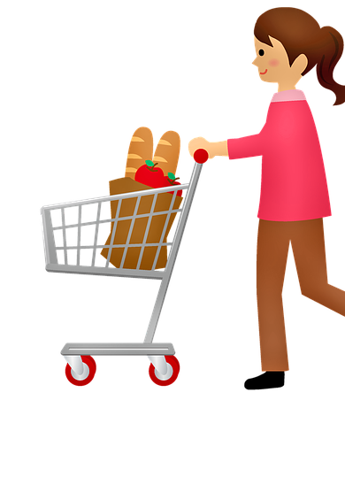
TOP CUSTOMERS
I love a wine, and meat. If the product is good, I really don’t mind to spend more!
53 year old
No kids
Married
Graduated in Business
High income
Purchases frequently
Spend more per purchase
Buys wines and meat
Prefer to buy in store and by catalog
Respond to campaigns

Slide 22
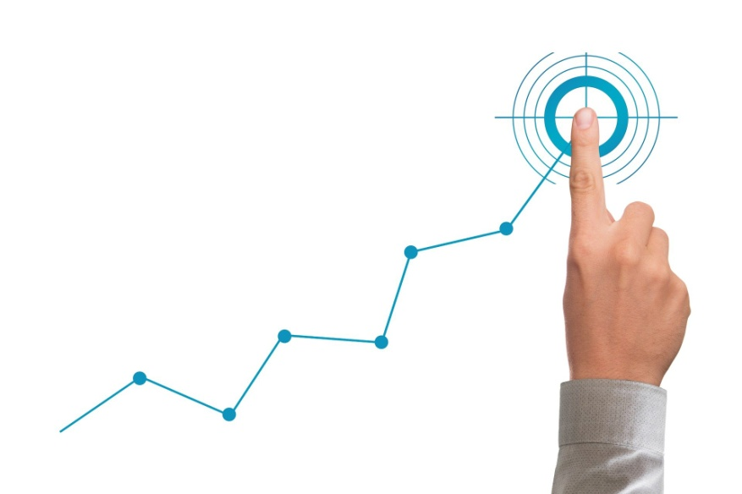
PROJECTIONS
 | N(%) | Gadgets Sold(%)
All Customers | 2208 (100%) | 331(15%)
Top Customers | 541 (24.5%) | 147(44.4%)
 | N | Gadgets Sold(%) | Cost | Revenue | Profit
All Customers | 2208 | 331 | 6624 | 3641 | -2983
Top Customers | 2208 | 980 | 6624 | 10780 | 4156
Globally profit
2.9

Slide 23
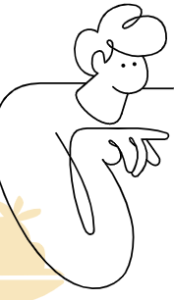
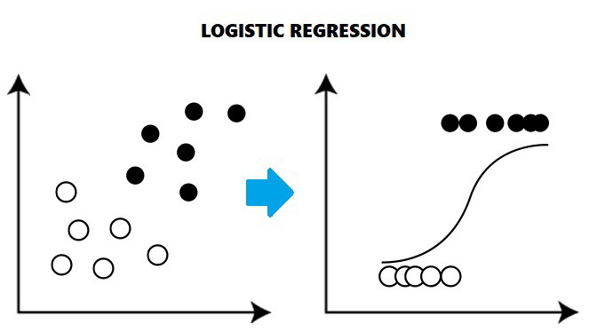
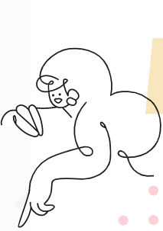
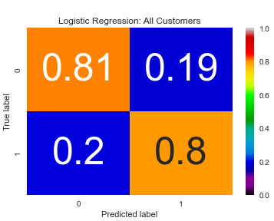
PREDICTIVE MODEL
Logistic Regression Model
Accept the offer
Predicts the probability of a customer to
Not accept the offer
Prediction based on 10 features
Income | Num Children
Total Campaigns | Campaign 1 | Campaign 3 | Campaign 4
Recency
Deals Purchases | Store Purchases
Web Visits
Correctly predicts:
80% who would buy the gadget
81% who wouldn’t buy the gadget

Slide 24

PREDICTIVE MODEL
Goal Nº. Gadget to be sold | Customers needed | Cost | Revenue | Profit
100.000 | 667.000 | 2.001.000 | 1.100.000 | -901.000
100.000 | 285.000 | 855.000 | 1.100.000 | 245.000

Slide 25
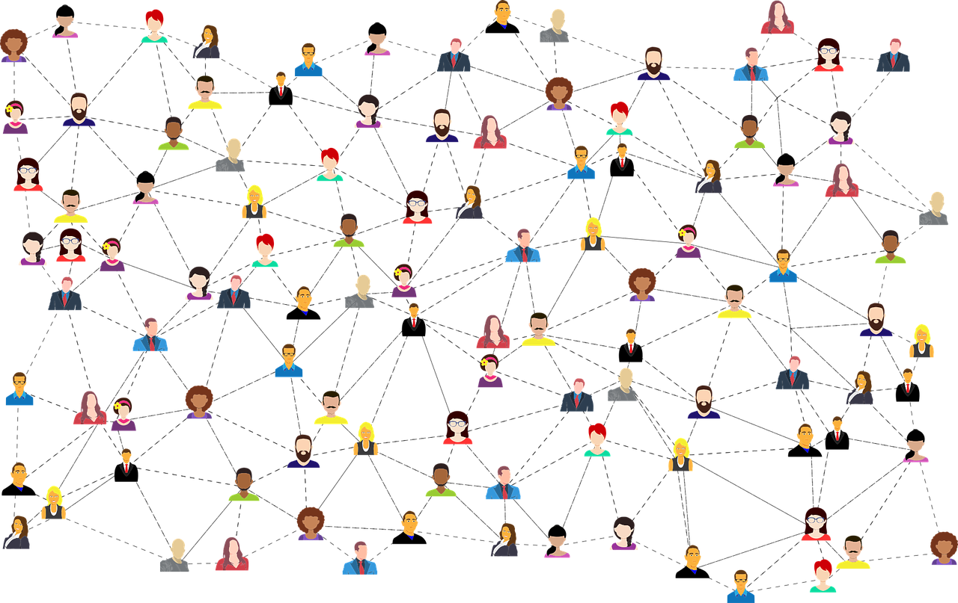
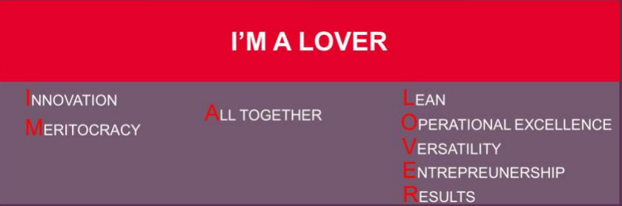
VALUES

Slide 26

TEAM WORK
Working TOGETHER to:
Data driven decisions
+
Target campaigns
=
Spend budget wisely and efficiently
Increase campaign’s profit

Slide 27


QUESTIONS?
npradaschnor@gmail.com
https://www.linkedin.com/in/npradaschnor/

