Slide 1


SUBMITTED BY, KARTIK M 2SD19IS402 PRASHANT S N 2SD18IS031 SARDAR PARAMJEET SINGH 2SD18IS044 SUSHMA S 2SD18IS056
SDM COLLEGE OF ENGINEERING AND TECHNOLOGY DHAVALAGIRI, DHARWAD
DEPARTMENT OF INFORMATION SCIENCE & ENGINEERING
Team :P15

Slide 2

Design Phase On Gesture Volume Control Using Machine Learning
CONTENTS
Data flow.
Architectural design.
Client Server model.
UML Diagram 4.1 Advanced Class Design.
4.2 Advanced State Design. 4.3 Advanced Interaction Model.
4.3.1 User case model.
4.3.2 Sequence model.
5.Swimlane Activity model.
6.User interface design.

Slide 3
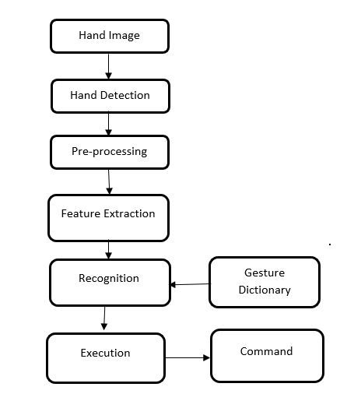
Data Flow Diagram:
The data flow diagram of our project consists of six steps.
In the first part, the hand images is detected and the database is developed.
After detection, the hand present in the image is pre-processed for gesture recognition is done using Open CV. This is done because during circulation lot of noise is added to images, which has to be removed for gesture extraction.
In next step important features are extracted. The features are selected by keeping in mind the two important features. Firstly, the features should have good discriminative power. Secondly, the features should be easily extractable.
These features are passed to neural network for classification in the fourth step.
In fifth step the input extracted is compared with the already available data set. The fifth part is related to gesture recognition.
And sixth step is related to command execution. These steps are shown in the below diagram

Slide 4
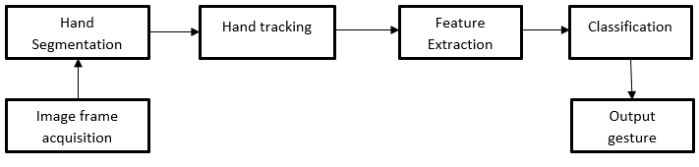
Architectural Design :
Input Hand Image
Browsing Images
Image Processing
Feature Extraction
Command Execution

Slide 5
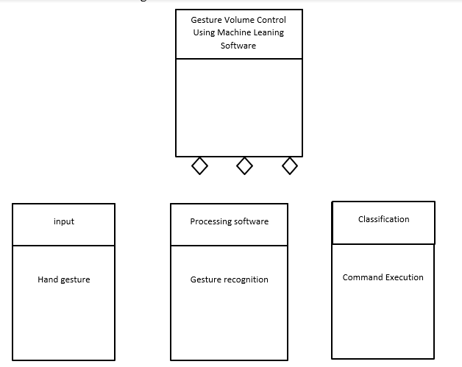
Client Server Model:
We are using a software where we do not need active internet connection. So there will be no communication between client and server
UML Diagram:
Advanced Class Design:

Slide 6
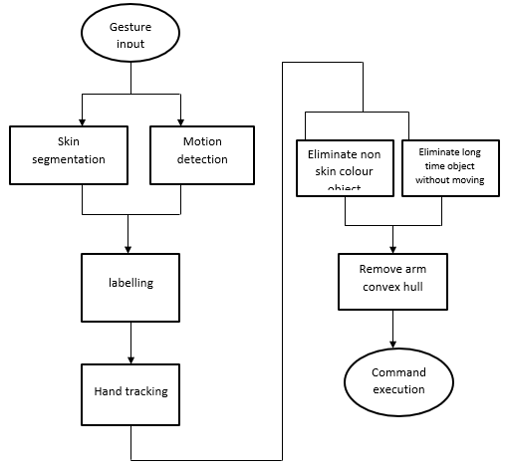
Advanced State Design:

Slide 7
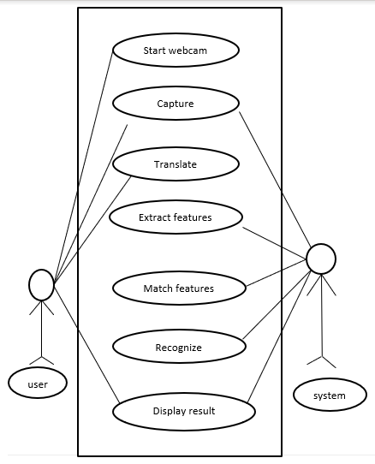
Advanced Interaction Model
Use Case Model :

Slide 8
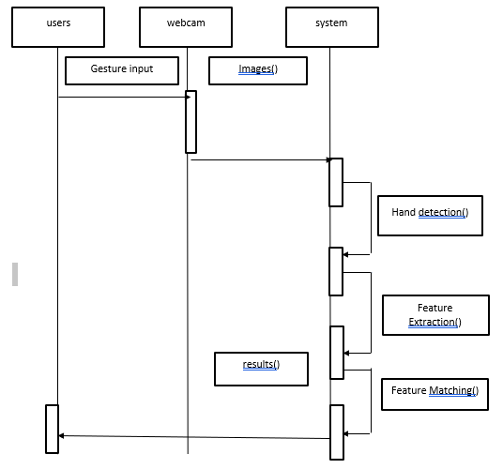
Sequence Model:
Messages:
Launching the software.
Uploading gesture image as an input.
Exit.
Reply messages:
Give the output as the increasing ,
decreasing or muting sound.

Slide 9
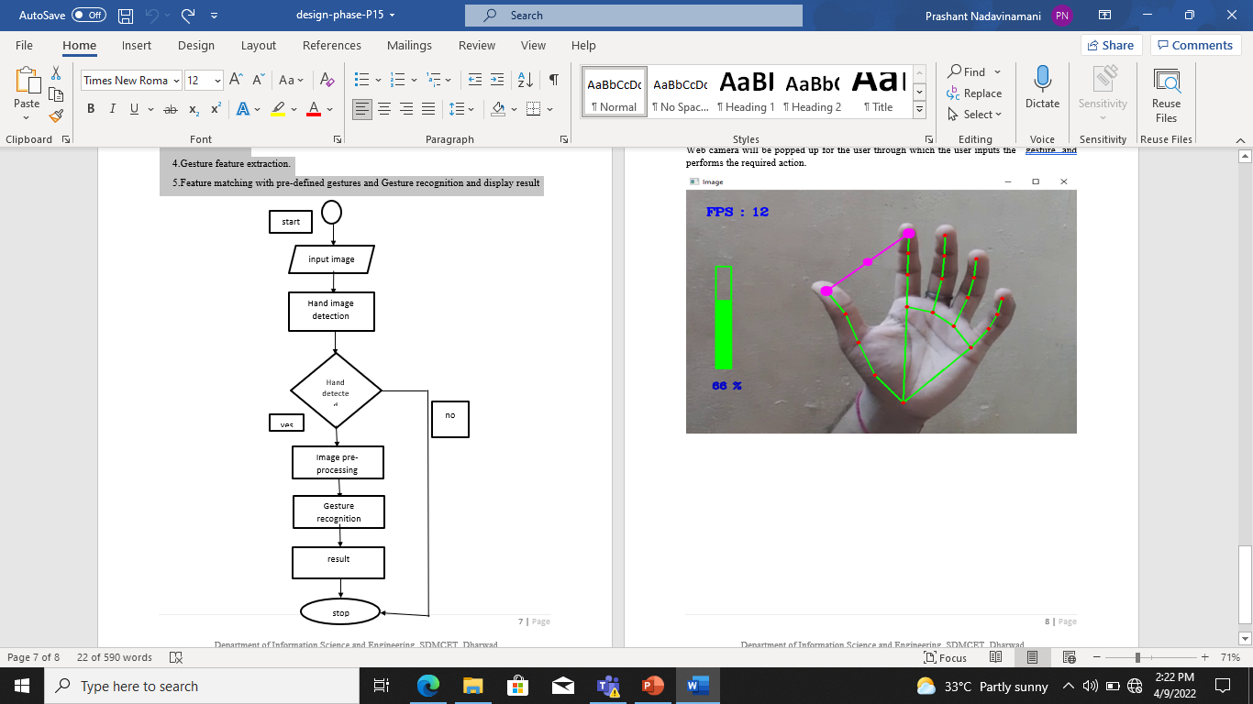
Swimlane Activity Model:
1.Launch the software.
2.Provide input gesture.
3.Hand detection.
4.Gesture feature extraction.
5.Feature matching with pre-defined gestures
and Gesture recognition and display result

Slide 10
User Interface Design:
Web camera will be popped up for the user through which the user inputs the gesture and performs the required action.

Slide 11
Thank You

