Slide 1
Compound Money Talk
Fact-checked Jul 7, 2026
TRADING — THE HOW
How to Buy Stocks
One topic at three depths: open an account and buy, understand what your order actually does, then read a stock's whole page like you own it.
Notes:
• This week is the 'how' of trading — the 'why buy this business' question was week 2 (valuation). Cross-reference, don't re-teach. • Format is new: a linear lesson, no module voting. Three self-contained levels, ~12 / 13 / 15 min. • If the room needs to linger on Level 1, do it — Level 3 degrades gracefully into a faster live-page flyover. • Re-pull the NVDA snapshot, cash yields, and the SPCX quote the morning of class — live figures drift.

Slide 2
OPENER · 10 MIN
What's new with your money?
1
2
3
Anything new you did with money this week?
Something interesting you learned about money or finance?
A new investment you're looking at or like right now?
This week: show of hands — who has actually placed a stock trade? Who has an account but never traded? Who has neither?
How to Buy Stocks
Notes:
• The show of hands calibrates how long to spend on Level 1. • If someone hasn't started, ask the real blocker: money, confusion, or fear of doing it wrong? • Ask: what's one number or button on a stock page you've never understood? Collect these — Level 3 should answer every one. • Keep it to ~10 minutes; the lesson runs dense.

Slide 3
ROADMAP · 40 MINUTES
One topic, three levels
L1
Open an account & buy your first stock
12 min
start here
L2
Know what you're actually doing when you trade
13 min
L3
Read a Yahoo Finance page like you own the stock
15 min
How to Buy Stocks
Notes:
• Same topic taught three times at increasing depth — not three separate topics. • Levels are self-contained; you can slow down on Level 1 and compress Level 3 without breaking the arc. • The worked-example ticker throughout is NVDA; broker demos are Robinhood and Fidelity. • After the lesson: a 10-minute market moment (the SpaceX IPO) that puts Levels 2 and 3 into one live stock.

Slide 4
Level 1
Open an account & buy your first stock
Audience: $0 invested, no account. The goal — you could do this tonight.
12 min
Notes:
• Audience mindset: $0 invested, no account. The promise is that you could do this tonight. • Budget ~12 minutes; this is the level most likely to need extra room.

Slide 5
L1 · THE WHOLE PROCESS
Four steps: Open → Fund → Order → Own
1
2
3
4
Open
Fund
Order
Own
→
→
→
a brokerage account — about 10 minutes, online
link your bank; move money you won't need this month
pick a ticker, enter dollars, submit
the position shows up in your app
~15 minutes start to finish
$1 fractional-share minimum
$0 commissions, every major broker
Buying Stocks · L1
Notes:
• Both demo apps sell fractional shares with a $1 minimum — 'I don't have enough to start' stopped being true years ago. • US stock/ETF commissions are $0 at every major broker; you pay through other channels (that's Level 2). • Total friction end-to-end is about 15 minutes and $1. • Approval is often near-instant; occasionally a few days if ID needs manual review.

Slide 6
L1 · CHOOSING A BROKER
Robinhood vs. Fidelity
Robinhood
Fidelity
optimizes for starting
optimizes for staying
Fastest zero-to-first-trade; app-first
$0 to open · $1 fractional minimum
Idle cash: 3.35% APY — only with Gold ($5/mo)
Instant buying power up to $1,000 ($5k w/ Gold)
Sells order flow (PFOF); FIFO tax lots only
1% match on IRA contributions (3% w/ Gold)
Full-service; you'll never outgrow it
$0 to open · $1 'Stocks by the Slice'
Idle cash: 3.30% automatically (SPAXX sweep)
Up to $25,000 same-day on ACH before 4 p.m. ET
No PFOF on stocks; full specific-ID lots
Strong IRA platform; no contribution match
Robinhood optimizes for starting, Fidelity for staying — either is fine. Schwab and Vanguard are also excellent, and everything transfers. The expensive choice is opening neither.
Buying Stocks · L1
Notes:
• Cash yields (3.35% / 3.30%) drift — re-pull the morning of class. • Robinhood Gold is $5/mo; without it, idle cash effectively earns nothing. • Fidelity's SPAXX sweep is automatic, no subscription (7-day yield as of Jul 1, 2026). • Tax-lot choice (FIFO vs specific-ID) matters at tax time — revisited in Level 2.

Slide 7
L1 · OPENING THE ACCOUNT (LIVE DEMO)
What you need, and why they ask
Same requirements at both apps — the teacher demos the real app on screen.
What you need: 18+, an SSN, a US address, and answers to employment / income / net-worth questions.
Why they ask: federal law (USA PATRIOT Act) and FINRA know-your-customer rules — every broker asks; it's not them being nosy.
Pick the account type at signup: 'Individual brokerage' is the default taxable account.
If this is retirement money, see the Roth beat next — before you click.
Fund it: link your bank, transfer what you won't need this month; note the availability difference from the table.
Buying Stocks · L1
Notes:
• Application takes minutes; approval is often near-instant, occasionally a few days for manual ID review. • Bank linking is usually instant and login-based. • The identity questions are standard across all brokers — reassure nervous first-timers. • Fund only what you won't need this month; note the availability difference from the broker table.

Slide 8
L1 · YOUR FIRST ORDER (LIVE DEMO)
The order ticket, annotated
NVDA
$196.93
NVIDIA Corp
1
Ticker
The symbol — NVDA. Price is live.
Dollars
Shares
2
Dollars vs. shares
$50.00
Enter $50; the app buys the fraction.
Amount
3
Order type
Market or Limit — that's all you need tonight.
Order type
Est. quantity
Market ▾
0.254 sh
4
Review
$50 at $196.93 = 0.254 shares. Confirm.
Review order
Buying Stocks · L1
Notes:
• The app does the fractional math — you just enter dollars. • Market = 'fill me now at the going price' — fine for $50 in a megacap during market hours (9:30–4 ET). • Limit = 'fill me only at $X or better' — the default habit worth building (Level 2 shows why). • Fractional orders execute during regular hours only; placed at night they queue for the open. • After you buy: position shows shares, average cost, today's change, unrealized gain/loss. That green/red number isn't 'real' until you sell.

Slide 9
L1 · TWO 60-SECOND BEATS
Same ticket, two smart defaults
Start with an index ETF
Retirement money? Use a Roth IRA
the 'own everything' core
same apps, different wrapper
A broad S&P 500 fund — VOO, IVV, or SPY
Bought through the exact same order ticket
~90% of pro stock-pickers trail it over 20 yrs
Individual stocks go on top of this core
Trades inside are never taxed
Contributions (2026 limit $7,500) withdrawable anytime
Earnings tax-free after age 59½
A ~10–12% bracket buys 'never taxed again' cheaply
Same 10 minutes, same order ticket — the wrapper is the only difference. Robinhood adds a 1% match on IRA contributions.
Buying Stocks · L1
Notes:
• The ETF is the default first buy for most people; individual stock-picking is week 2's checklist on top of that core. • Roth mechanics: contributions (not earnings) come out anytime penalty-free; earnings tax-free after 59½ and the 5-year rule. • A student in a low bracket locks in tax-free growth at the cheapest price they may ever get. • Sources: IRS 2026 limits; Pub 590-B. Robinhood adds a 1% IRA-contribution match (3% w/ Gold).

Slide 10
Level 2
Know what you're actually doing when you trade
The same buy button — but now you can see the machinery behind it.
13 min
Notes:
• Same buy button as Level 1 — now we open the hood. • Budget ~13 minutes; the core slide is the '$185' three-outcomes contrast.

Slide 11
L2 · ORDER TYPES
Every order is two independent switches
BECOMES MARKET
BECOMES LIMIT
Market
Bite: no price guarantee in a thin or fast market.
ACTS NOW
Market
Limit
Limit
Bite: may never fill — the stock runs without you.
Stop
Promises an exit, not a price. Bite: gaps.
AT A TRIGGER
Stop
Stop-limit
Stop-limit
Promises a price, not an exit. Bite: no fill at all.
Trailing
Ratchets behind a rising price. Bite: volatility shakes you out.
Time-in-force: Day (dies at 4 p.m.) vs. GTC — good-till-canceled, broker-capped (~180 days).
Buying Stocks · L2
Notes:
• The frame that makes it click: WHEN it activates (now vs at a trigger) × WHAT it becomes (market vs limit). • A stop has a trigger but no price floor; a limit has a floor but no trigger; a stop-limit has both — and its own failure mode. • Trailing stop = a stop that ratchets up behind a rising price, then freezes on reversal. • Definitions per investor.gov and the SEC stop-orders bulletin. GTC cap example: Fidelity 180 days.

Slide 12
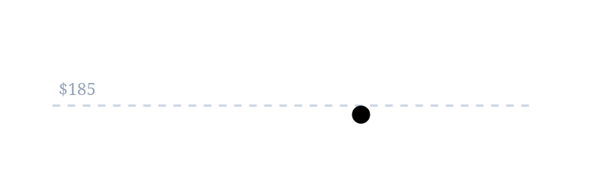
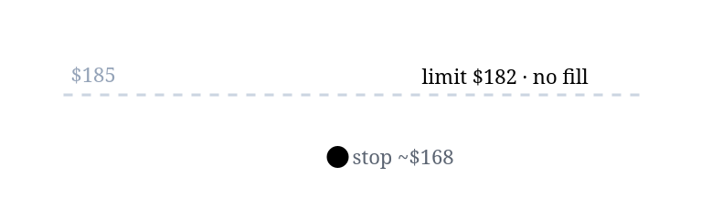
L2 · THE CORE CONTRAST
Same "$185" intention, three outcomes
A plain sell limit at $185 fills immediately at ~$197 — "$185 or better," and $197 is better. A limit order cannot protect your downside.
GOTCHA 0
Scenario A · Slow slide
Scenario B · Earnings gap
Choosing
$197 → $186 → $184 over weeks
closes $195, opens $168, slides to $150
Fear being stuck in a collapse → Stop (guaranteed exit, unknown price).
Fear selling a spike-down bottom → Stop-limit (guaranteed floor, maybe no exit).
Stop $185 → fills ~$184.90 ✓
Stop $185 → market at open ~$168 ($17 below)
Stop-limit $185/$182 → fills ~$184.90 ✓
Stop-limit $185/$182 → no fill, rides to $150
Buying Stocks · L2
Notes:
• In orderly markets a stop and a stop-limit are near-identical — the difference only exists in gaps and fast markets. • The events most likely to TRIGGER a stop (earnings, news) are exactly the ones most likely to GAP past it — doubly so at NVDA's beta 2.21. • Practical middle ground: set the limit well below the stop (e.g. $185/$175) so ordinary gaps still get you out; a limit 50¢ under the stop is the worst of both worlds. • Limits are for targets ('sell at $220 if it gets there') or dip-buys ('buy at $185') — never for downside protection.

Slide 13
L2 · WHERE YOUR ORDER GOES
Your tap, the spread, and who gets paid
Wholesaler (pays for order flow)
Your tap
→
Broker
→
→
Fill
Exchange
THE LEVEL-1 QUOTE (NVDA, AFTER HOURS)
196.05 bid ×3000
spread = a cost you pay
197.29 ask ×200
NBBO · National Best Bid & Offer
Spreads by liquidity
Payment for order flow
The highest bid and lowest ask across all exchanges. Brokers must fill you at the NBBO or better (Reg NMS).
Large caps ≲0.15%; small caps 5%+ — why market orders are fine in megacaps, risky in small names.
Wholesalers pay Robinhood to route orders — that funds $0 commissions. Fidelity takes none on stocks.
Buying Stocks · L2
Notes:
• NBBO = National Best Bid & Offer — the single consolidated best price the SEC forces brokers to honor; it's why you get the same fill whichever exchange the order lands on. • The spread is a real cost you pay when you cross it; limit orders make the spread your choice. • Robinhood's SEC Rule 606 report (Jan 2026): Virtu ~48%, Citadel ~18% of S&P 500 flow. • PFOF is legal and disclosed — practical takeaway, not scandal: your fill quality is disclosure-regulated either way; know who's paid. • After-hours spreads widen because liquidity leaves the book.

Slide 14
L2 · WHEN YOU CAN TRADE
The trading day is being rebuilt
Pre-market
Regular · 9:30–4
After-hours
Overnight
4 a.m.
9:30 a.m.
4 p.m.
8 p.m.
next open
Fidelity
Robinhood
7–9:28 a.m. & 4–8 p.m.
4–9:30 a.m. & 4–8 p.m. + a 24-Hour Market (Sun–Fri, whole-share limits only)
SEC approved Nasdaq's 23-hour day and a consolidated tape running Sun 9 p.m. → Fri 8 p.m. The clock itself is changing.
LAUNCHING DEC 6, 2026
Buying Stocks · L2
Notes:
• Extended hours = thin books, wide spreads, exaggerated news reactions — the reason brokers force limit orders there (FINRA). • Robinhood's 24-Hour Market runs Sun 8 p.m.–Fri 8 p.m. on select names, whole-share limit orders only. • SEC approved Nasdaq's 23-hour day (Apr 10, 2026); the consolidated tape runs Sun 9 p.m.→Fri 8 p.m. — both launch Dec 6, 2026. • The Dec 6 launch is a genuine structural change.

Slide 15
L2 · A RULE JUST DIED
The pattern day trader rule: 2001 → 2026
2001
2026
"You need $25,000 to day-trade."
"You need margin that matches your intraday risk."
→
A FINRA margin rule from the dot-com bust. 4+ day trades in 5 business days → tagged a pattern day trader → hold $25k minimum equity or get frozen out.
New intraday margin standards tie required equity to your real-time exposure — regulate the leverage, not the person.
repealed Jun 4, 2026
Why everyone hated it: the $25k never adjusted for inflation in 25 years, and it gated by wealth, not risk.
Two caveats: brokers phase in through Oct 2027 (your app may still enforce limits); the repeal removed a guardrail, not the odds.
Buying Stocks · L2
Notes:
• The most-complained-about rule in retail trading: a $2,000 student making four $50 round-trips got locked out, while anyone over $25k could day-trade with 4:1 intraday leverage. • The new standard regulates the leverage, not the person (FINRA Notice 26-10). • 'The rule is gone' ≠ 'your app will let you' — brokers phase in through Oct 2027. • Repeal removed a guardrail, not the odds — week 2's base rates on active trading still apply.

Slide 16
L2 · THE PLUMBING
Settlement, cash vs. margin
T+1: trades settle the next business day (since May 28, 2024). Sell Monday → withdrawable cash Tuesday.
Cash account (the default): you trade settled money.
Spend unsettled proceeds then sell that = a good-faith violation; 3 in 12 months → settled-cash-only for 90 days.
Margin account: the broker lends up to 50% (Reg T; $2,000 minimum equity).
For this class: know it exists, skip the leverage.
Buying Stocks · L2
Notes:
• T+1 shortened settlement from T+2 in May 2024 (SEC). • Good-faith violations are easy to trip accidentally in a cash account — worth flagging for active first-timers. • Margin adds leverage and margin calls; not needed for anything in this class.

Slide 17
L2 · DIVIDEND MECHANICS
Four dates, one habit: own it before the ex-date
own it BEFORE this
Declaration
Ex-date
Record
Pay
Apr 30
Jun 15
Jun 15 (same day, T+1)
Jul 1
LIVE EXAMPLE · KO
DRIP
$0.53/share, paid Jul 1, 2026 — Coca-Cola's 64th straight annual raise.
One toggle auto-reinvests dividends into fractional shares. Still taxable in a taxable account.
Buying Stocks · L2
Notes:
• Qualified dividends (held >60 days around the ex-date) get capital-gains rates; otherwise ordinary rates (IRS Pub 550). • DRIP locations: Robinhood → Account → Investing → Dividend Reinvestment; Fidelity → Positions → Dividend view → Manage Dividends. • Under T+1 the ex-date and record date are now normally the same day. • Sources: investor.gov, DTCC T+1 dividend FAQ, Coca-Cola IR.

Slide 18
L2 · WHAT SELLING COSTS YOU
Two lanes, and a student superpower
taxed like wages — your ordinary income rate
Held ≤ 1 yr
Held > 1 yr
long-term rates 0 / 15 / 20%
2026 single filers pay 0% on long-term gains up to $49,450 taxable (~$65,550 gross after the standard deduction). Many of you can realize long-term gains tax-free right now.
THE STUDENT SUPERPOWER
Wash sale
Pick your lots
Paperwork does itself
Sell at a loss & rebuy within 30 days → loss disallowed. Rebuy in an IRA → loss gone permanently.
Default FIFO. Fidelity lets you choose ("Specific Shares"); Robinhood is FIFO-only.
Consolidated 1099-B by ~Feb 15, pre-filled. Inside an IRA: none of this exists.
Buying Stocks · L2
Notes:
• Lot example: 10 NVDA @ $60 (2 yrs) + 10 @ $150 (6 mo), now $170. Sell 10: FIFO = $1,100 long-term gain; choosing the $150 lot = $200 short-term gain. Same click, different tax bill. • These five facts cover ~95% of cases. Inside an IRA, none of this section exists — no taxable events, no 1099-B. • Sources: IRS Topic 409, Rev. Proc. 2025-32, Rev. Rul. 2008-5, Pub 550. • The 0% bracket is the headline for students — many can harvest long-term gains at zero federal tax.

Slide 19
Level 3
Read a Yahoo Finance page like you own the stock
A live walkthrough of finance.yahoo.com/quote/NVDA — everything here is on the free tier.
15 min
Notes:
• Run this level as a live walkthrough of finance.yahoo.com/quote/NVDA next to the slides. • Everything shown is on the free tier. Re-pull the figures morning-of. • Budget ~15 minutes; degrade to a faster flyover if Level 1 ran long.

Slide 20

L3 · THE PAGE AT A GLANCE
Four regions, one tab row
4
Summary
News
Chart
Statistics
Analysis
Holders
196.93 +1.38 (+0.71%)
1
1
Price header — today's move + overnight
At close · 196.84 (−0.05%) Overnight
2
Summary panel
3
Chart
2
Summary panel — 16 fields, next slide
3
Chart — range buttons + compare
4
Tab row — most of it is free
Buying Stocks · L3
Notes:
• Tab order: Summary · News · Research · Chart · Community · Statistics · Historical Data · Profile · Financials · Analysis · Options · Holders. • Research + 'Research Reports' are the main paywalled surfaces; the rest is free. • The 'Overnight' print is real trading (Blue Ocean ATS, 8 p.m.–4 a.m.) — the 24-hour era from Level 2, visible on the page. • Have the live page open beside the deck; re-pull figures morning-of.

Slide 21
L3 · THE SUMMARY PANEL
The 16-field panel, in plain English
PREV CLOSE / OPEN
Opened below prev close, recovered — gaps are normal.
BID / ASK
Level 2's spread, live — pennies during the session.
195.55 / 192.37
196.05 / 197.29
DAY / 52-WK RANGE
A year of context in one line; price sits mid-range.
VOLUME / AVG
~77% of normal = nothing special happened.
191–198 / 158–237
122.6M / 158.8M
MARKET CAP
Why "$197, that's cheap!" is meaningless.
BETA (5Y)
Moves ~2× the market — size positions for it.
4.77T
2.21
P/E / EPS (TTM)
Price ÷ trailing earnings — the week-2 multiple.
EARNINGS DATE
The next scheduled volatility event — check first.
30.16 / 6.53
Aug 26, 2026
1Y TARGET EST
Average analyst target — sentiment, not prophecy.
FWD DIV & EX-DATE
The two dividend fields, decoded in full.
301.62
→ next slide
Buying Stocks · L3
Notes:
• The full 16 fields also include Forward Dividend & Yield and Ex-Dividend Date — each gets its own treatment next. • 30.16 × 6.53 ≈ 196.9 — the page does the P/E arithmetic in front of you. • Volume far above average is the tell that something happened; ~77% means it didn't. • Check the earnings date BEFORE you trade, not after. All values are the Jul 7, 2026 close — re-pull morning-of.

Slide 22
L3 · ONE FIELD, DECODED
Forward Dividend & Yield
$0.25
$1.00
$196.93
0.51%
× 4 →
÷ price →
=
quarterly
annualized
today
$1,000 → ~$5/yr
"Forward" means "assumed"
The board sets the dividend; the market sets the yield
A projection that the current rate holds — inferred, not promised. Compare KO: $0.53 × 4 = $2.12 ≈ 2.6% yield , five times NVDA's. KO returns cash via dividends; NVDA mostly via buybacks.
Price falls 30% with the payout unchanged → yield jumps ~43%. A strikingly high yield is often a warning, not a gift — the market pricing in a cut.
Buying Stocks · L3
Notes:
• The Statistics tab also shows trailing yield (actual past-12-month payments); forward is the better 'what do I get from here' number. They diverge right after a dividend change. • See 8% on a screener → be suspicious (week 2's yield trap — the market pricing in a cut). • Ex-Dividend Date Jun 4, 2026 says WHEN you must own it; forward dividend says HOW MUCH.

Slide 23
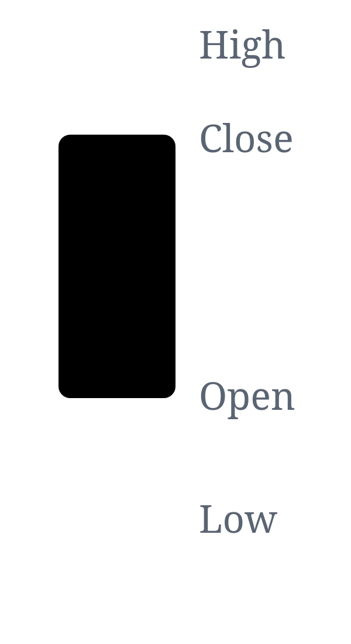

L3 · THE CHART TAB
Three skills in three minutes
Range buttons · 1D → 5Y → Max
Same stock, different stories. Zoom out before you react.
Line vs. candles
One candle = open, high, low, close. Green closed above open.
Compare
Overlay SPY — are you actually beating "just the index"?
Buying Stocks · L3
Notes:
• Green candle: close above open; red: close below. That's the whole secret — you can now read candlestick charts. • Line vs candles: a candle packs open/high/low/close into one mark. • The SPY overlay is the Level 1 default (index ETF) checked visually — is the stock actually beating 'just the index'? • Always zoom out (5Y, Max) before you react to a 1D move.

Slide 24
L3 · STATISTICS & THE DEEPER TABS
The dense tabs, decoded
Valuation
Financial health
Ownership
week-2 concepts, auto-computed
the dashboard
who owns it, who's short
P/E — what you pay per $1 of profit (30.2 vs ~19.8 fwd)
PEG — P/E adjusted for growth; under ~1 is cheap-for-growth
EV/EBITDA — a debt-neutral profit multiple
Price/Sales — works when profits are zero
ROE — profit per shareholder dollar (quality marker)
Debt/Equity — the leverage dial (>100% = more borrowed than owned)
Current Ratio — can it pay this year's bills? (>1 = yes)
Levered FCF — what's left after the business & the bank
Float — what's actually tradable; small float = bigger moves
Institutions ≈ 69% · Insiders ≈ 4%
Short % of float 1.29% — nobody's fighting it
Payout Ratio — dividends ÷ profit; 80%+ = cut risk
Financials = the three statements (week-2 red flags). Analysis = estimate revisions + the target's high/low/mean spread. Options = its own future class.
Buying Stocks · L3
Notes:
• Full glossary (every term → the math → read-it-as) is in your notes packet — this slide is the concepts. • Enterprise Value = market cap + debt − cash (the true takeover price). EBITDA flatters by ignoring real costs like equipment spend. • Week 2 taught that revisions move stocks — the Analysis tab is the free place to watch them. • GameStop-era short interest ran >100% of float; NVDA's 1.29% means no crowded short. Watch insider transactions more than levels.

Slide 25
L3 · THE PAYOFF
The 10-minute pre-trade check
1
Summary panel — spread sane? volume normal? earnings imminent?
2
Chart, 1Y + 5Y — where in the 52-week range am I buying? vs. SPY?
3
Statistics — multiple vs. its own history; short interest crowded?
4
Analysis — are estimates being revised up or down?
5
News — anything from the last 48 hours I'm about to learn the hard way?
6
Place the order — a limit, sized so beta × position doesn't ruin your week.
Buying Stocks · L3
Notes:
• One pass through the page before any buy or sell. • Whether to buy it at all is week 2's checklist — this is the mechanical pre-flight. • Emphasize step 6: a limit order, position sized for beta.

Slide 26
MARKET MOMENT · 10 MIN
June 12, 2026
The SpaceX IPO: retail's biggest front-row seat ever
The largest IPO ever priced at a fixed $135 and sold directly to retail through five apps — then handed the room a month of Level 2 and 3 in one stock.
$135
▲ ~$15B
▲ +19%
fixed IPO price (~$75B raise)
to retail — ~20% of the deal
day-one close, $160.95
CNBC · Bloomberg · Vanda · Citadel Securities
Market Moment
Notes:
• Run-of-show: two definitions (~3 min) → what SpaceX did differently (~2) → what's happened since (~3) → lesson + discussion (~2). • Re-pull the SPCX quote morning-of — it's moving fast. • This ties Level 1 (the order ticket), Level 2 (order types, timing) and Level 3 (targets, index rules) into one live stock.

Slide 27
MARKET MOMENT · SETUP 1
Retail vs. institutional — you're in this story
Retail
Institutional
your own money
other people's pooled money
An individual investing through a brokerage account
Everyone who did Level 1 tonight
~20–25% of US equity volume (spiked ~35% Apr 2025)
~6 in 10 US adults own stock (Gallup)
Funds, pensions, endowments — trading at scale
Historically first in line for IPO allocations
The 'accredited investor' gate (~$200k income / $1M net worth)
…kept SpaceX legally off-limits to the public for 24 years
Retail isn't a sideshow — it's a market force. The IPO was the first day the public could own SpaceX at all.
Market Moment
Notes:
• Off-exchange wholesaler flow pushes retail's share to ~30–37% (MEMX). • Accredited-investor rules (~$200k income / $1M net worth) gated pre-IPO companies like SpaceX from regular people for 24 years. • Sources: SEC, JPMorgan, MEMX, Gallup.

Slide 28
MARKET MOMENT · SETUP 2
What a normal IPO looks like
Banks underwrite → S-1 filed → ~2-week roadshow → bookbuilding → priced the night before → allocated → first trade at the opening auction.
Offer-price shares go historically ~90% institutions / 10% retail — and even that 10% is gated.
The pop: US IPOs average +19% on day one (1980–2025); 2025 averaged +29% and left $13.1B 'on the table.'
Allocated buyers pay the offer price; everyone else pays the pop.
Circle priced $31 → closed $83 (+168%); Figma priced $33 → closed $115.50 (+250%).
Market Moment
Notes:
• The standing retail experience: you're structurally the buyer at the open, ~19% above what insiders and institutions just paid. • Ritter/U. Florida dataset: 9,343 IPOs, 1980–2025. • 'On the table' = money the issuer could have raised had it priced higher. • Even the retail 10% was gated: Fidelity requires $100k–$500k+ assets; Robinhood's IPO Access (2021) is a lottery among requesters.

Slide 29
MARKET MOMENT · JUNE 12, 2026
What SpaceX did differently
Largest IPO ever — fixed $135 (~$75B raise), sold directly to retail through five apps : Robinhood, Fidelity, Schwab, SoFi, E*TRADE.
Typical IPO
SPCX
Retail targeted ~30%, cut to ~20% (≈$15B) — still about double the historical norm.
The mechanics = Level 1's ticket: a conditional offer to buy (activates when the deal prices). Allocation was a lottery — requesting more didn't improve your odds.
90% institutions · 10% retail
~70% inst · ~20% retail · ~10% hedge
Market Moment
Notes:
• Every eligible requester at all five brokers got ≥1 share (855,424 people at Robinhood alone) — but thin: 17 on a 1,000-share request; 11 of 75 at Schwab. • The asterisk: flipping penalties hit retail only (Fidelity up to permanent; SoFi bans + $50 fee). One institution flipped a $300M allocation within 5 days. • Retail orders exceeded $100B — 5×+ oversubscribed. • Sources: CNBC, Bloomberg, Robinhood, Reuters.

Slide 30
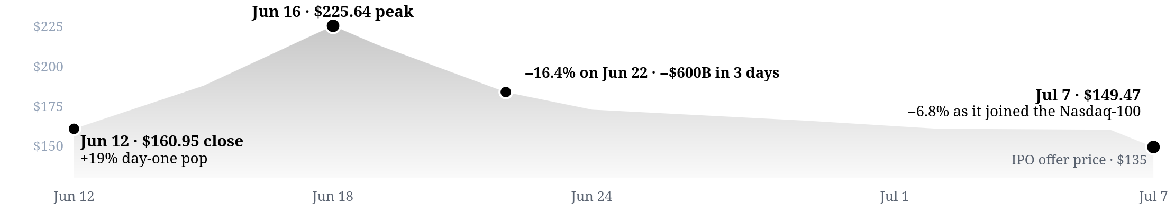
MARKET MOMENT · SINCE JUNE 12
A month of Level 2 and 3 in one stock
SPCX · SpaceX — daily close, Jun 12 – Jul 7, 2026
Reconstructed from reported figures · not a live quote
DAY ONE · JUN 12
EUPHORIA
GRAVITY
JUL 7
$160.95 +19%
$225.64
−$600B
$149.47 −6.8%
Near the long-run average pop — a record retail net-buying day.
Briefly the 4th most valuable company on Earth — above Amazon and Microsoft.
A three-day ~23% slide on a $25B bond sale and unlock fears.
Joined the Nasdaq-100 yet still fell as the quiet period expired.
Market Moment
Notes:
• Remember Level 3's '1y Target Est' caveat? Here it is with a $669 spread on the same stock ($131 'no credible model' to $800). • Not in the S&P 500 — fails the four-quarters-of-profit + seasoning screens (lost $4.28B last quarter; S&P declined to fast-track Jun 4). Index inclusion is rules, not fame. • Ahead: staggered lockups — first big unlock ~2 days after the expected Aug 6 first earnings; up to ~44% of shares free by early September; Musk's 85.1% voting control (10-vote Class B) locked until June 2027. • Sources: CNBC, Bloomberg, Vanda, JPMorgan.

Slide 31
MARKET MOMENT · THE LESSON
Same company, three very different trades
Allocated at the offer
Bought the open, day one
Chased the peak, week two
Conditional offer through the app, at $135
Market order at ~$150
Market order at ~$225
+10.7%
−0.4%
−34%
One company, one month — the how and when of the purchase spans a 45-point return spread. Access, order type, and timing are not details.
Market Moment
Notes:
• All returns priced at the Jul 7 close, $149.47. • This table is the whole lesson: Level 1 (how you buy), Level 2 (order type), Level 3 (timing/valuation) in one row each. • Whether to buy it at all is still week 2's question.

Slide 32
DISCUSS
Talk it through
1
Everyone got at least one share, but 17-of-1,000 was typical. Genuine access, or marketing with a guaranteed audience?
2
Is there anything fair or unfair here? What would you change?
3
Analyst targets on the same stock ran $131 to $800. What does that do to your trust in the '1y Target Est'?
4
Knowing everything above — would you have requested shares? Would you buy today?
Notes:
• Let the room drive — these are deliberately open. • Tie answers back to the 3-buyer table and the target-spread slide. • A good closer before sources.

Slide 33
Sources
Compound Money Talk
BROKERS & MECHANICS
MARKETS & THE IPO
Robinhood — fractional shares, cash rates, IPO Access, Rule 606
Fidelity — accounts, Stocks by the Slice, cash mgmt, cost basis
FINRA — extended hours; PDT repeal (Notice 26-10)
investor.gov / SEC — order types, T+1, stop-orders bulletin
Yahoo Finance — live NVDA quote page
Ritter / U. Florida — IPO underpricing dataset
CNBC · Bloomberg · Reuters · Vanda · MEMX · JPMorgan
SIP / Nasdaq — extended-hours SEC approval
TAX & DIVIDENDS
IRS — Topic 409, Pub 550, Pub 590-B, Rev. Proc. 2025-32
IRS — Rev. Rul. 2008-5 (wash sale)
DTCC — T+1 dividend processing
The Coca-Cola Company — Investor Relations
How to Buy Stocks
Notes:
• Every figure was fact-checked as of Jul 7, 2026 against primary sources. • Live quotes, yields, rates, and the SPCX price drift — re-pull the morning of class.

