Slide 1
Switch Hitters in Baseball
Bellevue University
DSC530 Final Project

Slide 2
Question
I want to try and understand if switch hitters would be more productive if they hit from their strongest side of the plate versus switching based on the handedness of the pitcher they are facing.

Slide 3
Variables
Batting Average (BA) - Number of hits divided by number of at-bats. Note that an at-bat is different than a plate appearance.
On-base + Slugging (OPS) - A hitters on-base percentage, which is number of times they reached base divided by at-bats, plus their slugging percentage. Slugging is how many total bases they hit for divided by number of hits.
Batting Average Balls in Play (BAbip) - Of the balls a batter hit into the field of play, how many turned into hits
Launch Speed - Average speed a batted ball came off a hitters bat
Launch Angle - Average trajectory a batted ball came off a hitters bat
Whiffs - How many times a player swung and missed
Swings - How many times a player swung
Batter Handedness - Which side of the plate the batter hit from. A B indicated they hit from both sides, pending the pitcher handedness
Pitcher Handedness - Which arm a pitcher threw the ball with
Year - The year the statistics are from. My dataset includes years 2015-2019

Slide 4
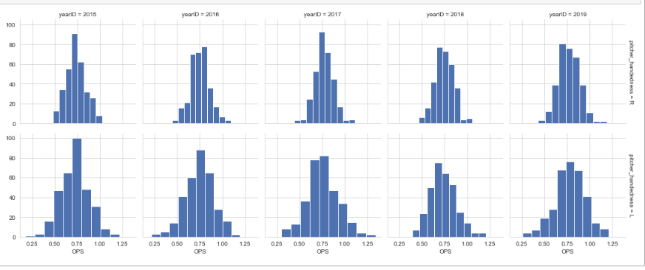
Histograms OPS

Slide 5
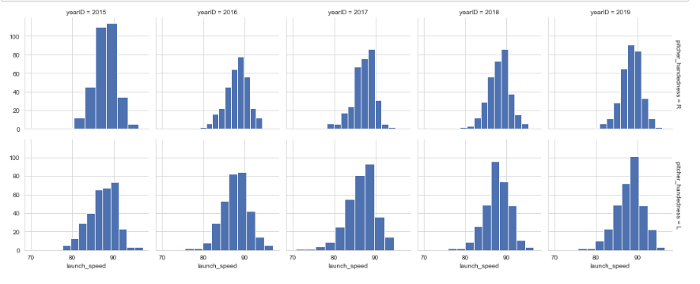
Histograms Launch Speed

Slide 6
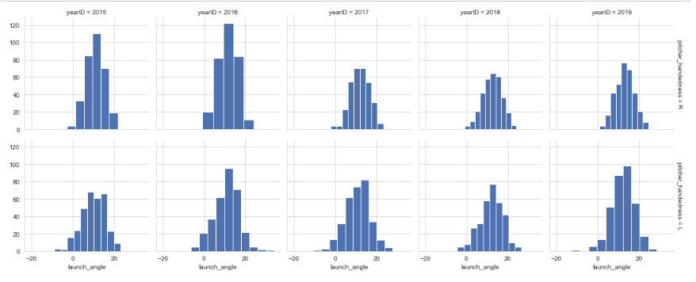
Histograms Launch Angle

Slide 7
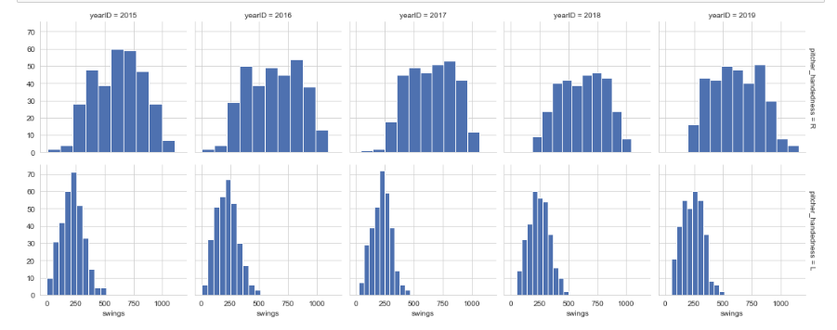
Histograms Swings

Slide 8
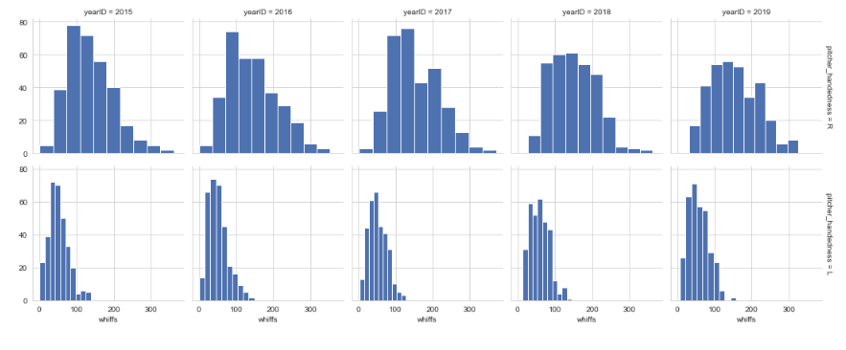
Histograms Whiffs

Slide 9
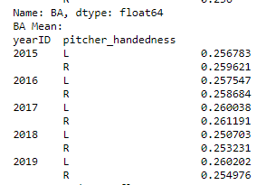
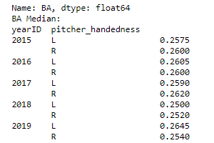
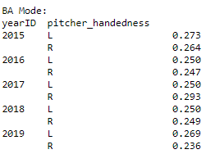
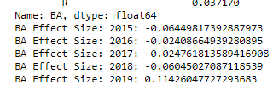
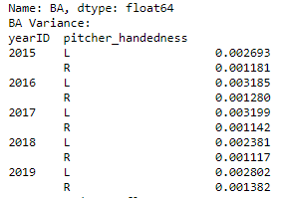
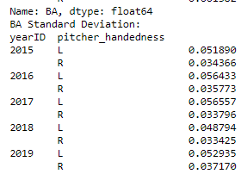
Descriptive Statistics
Most of my descriptive statistics are broken down by pitcher handedness and or batter handedness. This makes for a lot of subsets of data.
Batting Average

Slide 10
Descriptive Statistics
There are additional descriptive statistics in the Jupyter notebook that accompany this project, including statistics for:
OPS
Swings
Whiffs
Launch Angle
Launch Speed

Slide 11
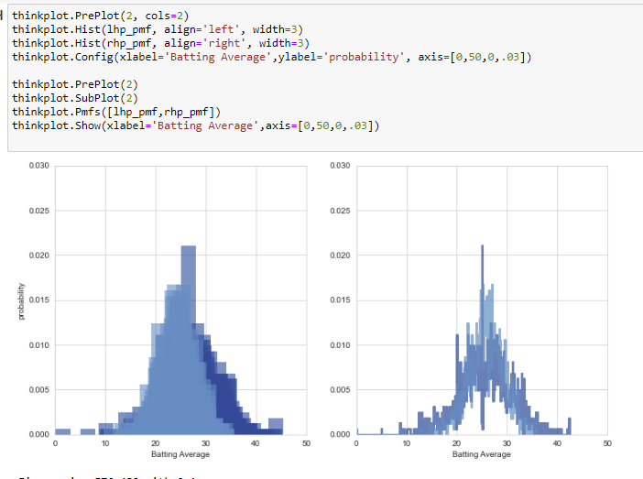
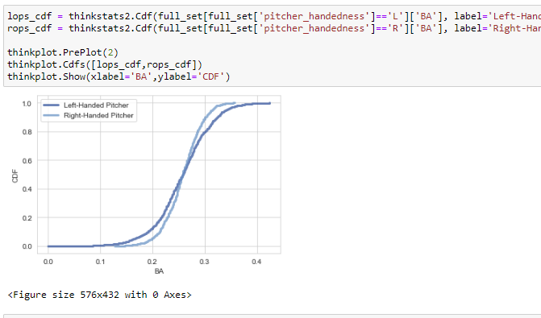
PMFs and CDFs
Using the code provided in the book, I was able to produce PMFs and CDFs of batting average by pitcher handedness.

Slide 12
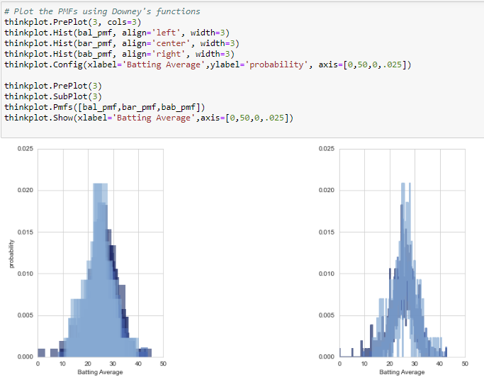
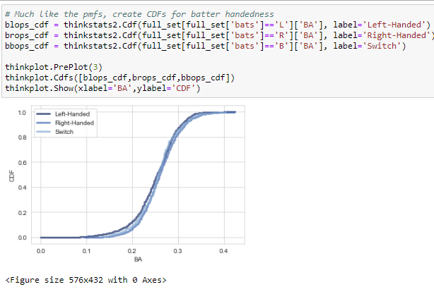
PMFs and CDFs
I also did the PMF and CDF by batter handedness, not accounting for pitcher handedness

Slide 13
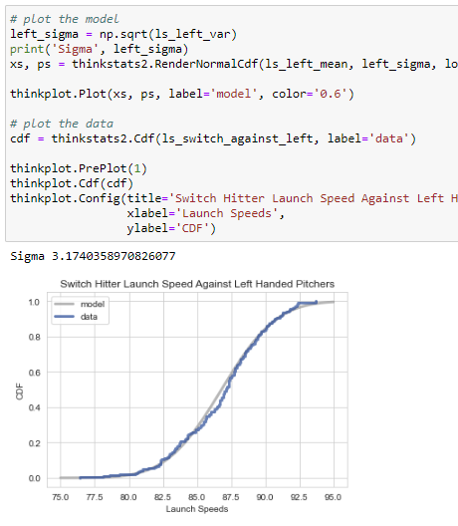
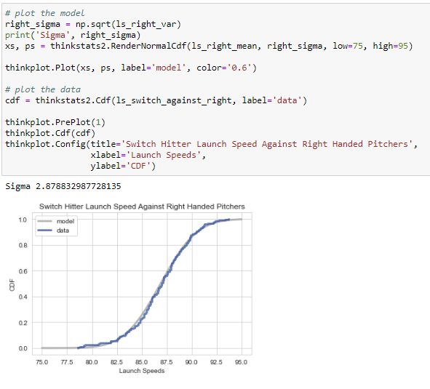
Analytic Distribution
For my analytic distribution, I went with the normal probability plot. I first plotted the CDF against a model for switch hitters based on pitcher handedness.

Slide 14
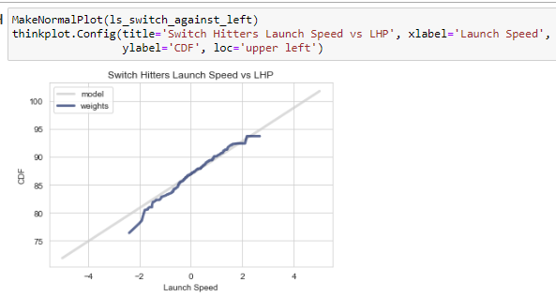
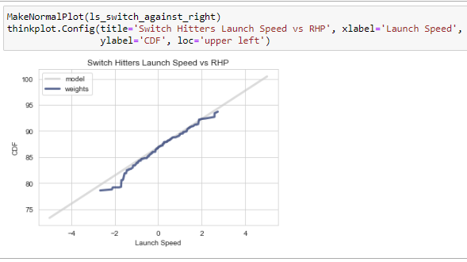
Analytic Distribution
I then generated the normal probability plot, which if the distribution is normal would follow a straight line

Slide 15
Scatterplots
I explored the relationship between launch speed and OPS. My thought was that a higher launch speed would translate to a higher OPS.
After looking at the covariance and the correlation coefficient and the scatter plots there appears to be a moderate positive correlation between launch speed and OPS.
I also reviewed launch angel versus batting average, expecting this to be a non-linear relationship. It turns out this is true. It is not linear, but also not the shape of the scatter plot I was expecting.
My last scatterplot slide is launch speed vs OPS for separated by pitcher handedness and colored by batter handedness.

Slide 16
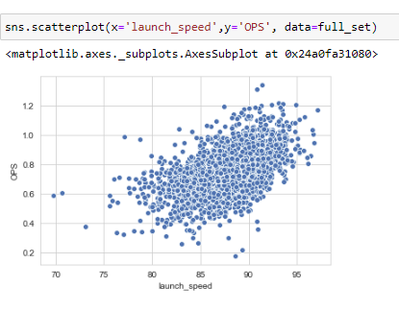
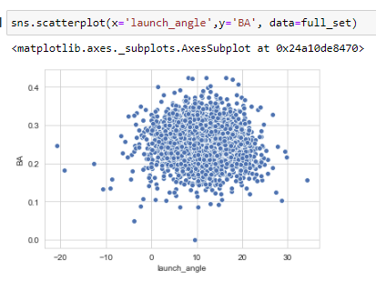
Scatterplots

Slide 17
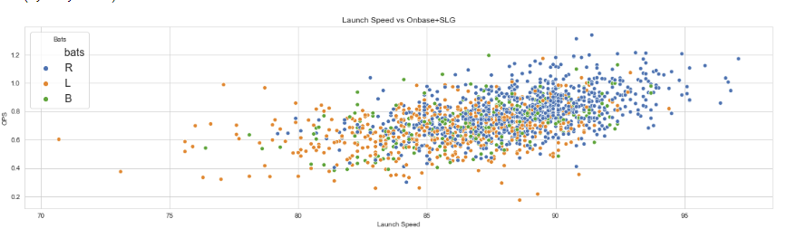
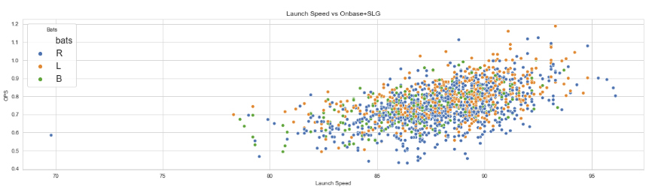

Slide 18
Hypothesis Testing
I've been frustrated because after doing all of this work, I don't think I had a very good statistical question. Or at least, I'm not good enough at this point yet to get myself to an answer. I've been a bit all over the place. And I'm not sure how to indicate switch-hitters should bat from only one side or not.
Up to this point, I can't discern much difference between switch-hitters and non-switch hitters. For my hypothesis testing, I use the difference in means model presented in Chapter 9 on page 104.
I tried several different combinations to run through the hypothesis tests and my p-values leave a little something to be desired.

Slide 19
Regression Testing
I ran several different multiple regression models using ordinary least squares.
I used various models and various data sets. Most of the data sets are broken down by batter handedness and pitcher handedness.
The various models mostly differed by the explanatory variables.
While launch speed and launch angle seem to be significant in predicting batting average and OPS, handedness does not.

