Slide 1

Scraping Project: Italki

Slide 2
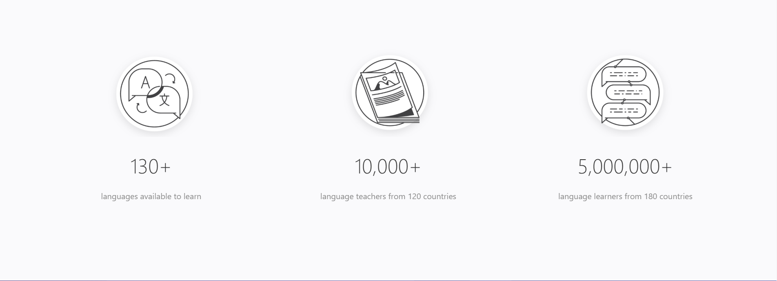
An Online Community of Language Teachers and Learners

Slide 3
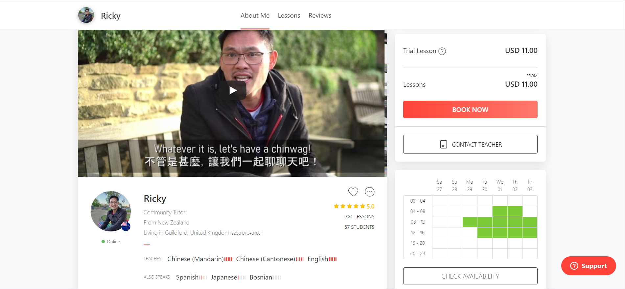


Slide 4
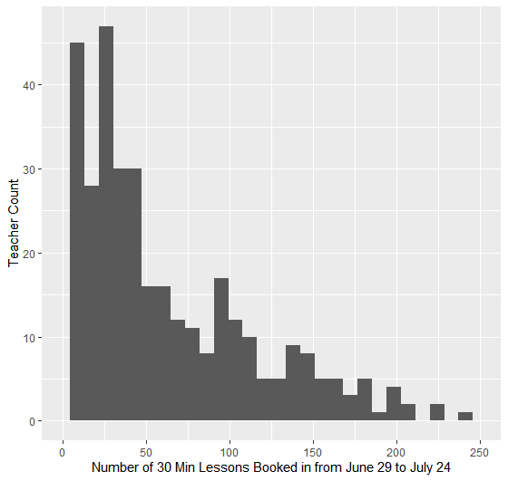
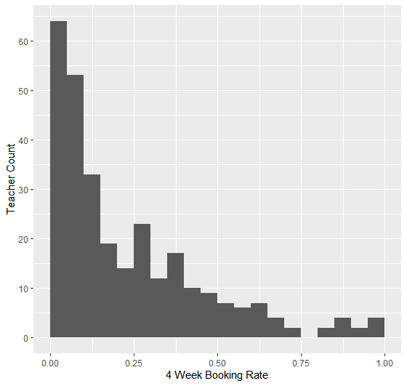
Booking Rate and Quantity

Slide 5
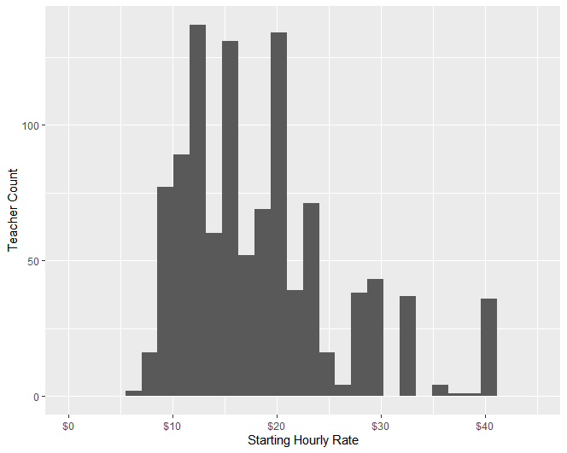
Starting Hourly Rates
Mean: $18.53
Standard Deviation: $7.71

Slide 6
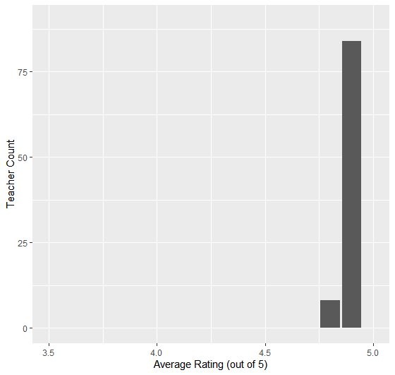
What Doesn’t Matter
No relationship between 4 Week Bookings and:
Total Lessons Taught
Total Students Taught
Average Rating

Slide 7
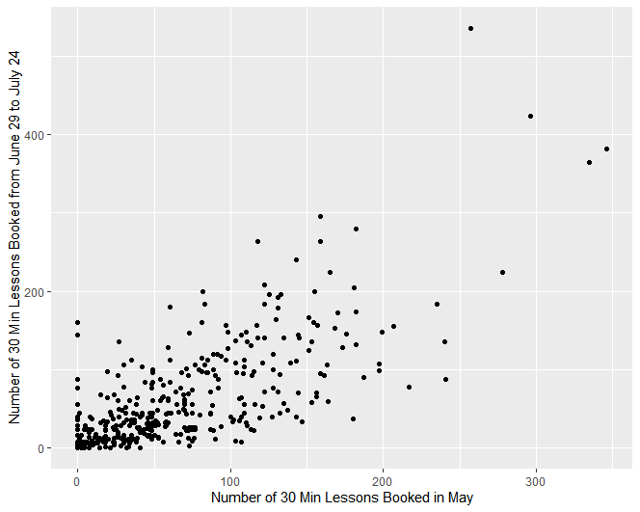
What Matters: Recent Teaching History

Slide 8
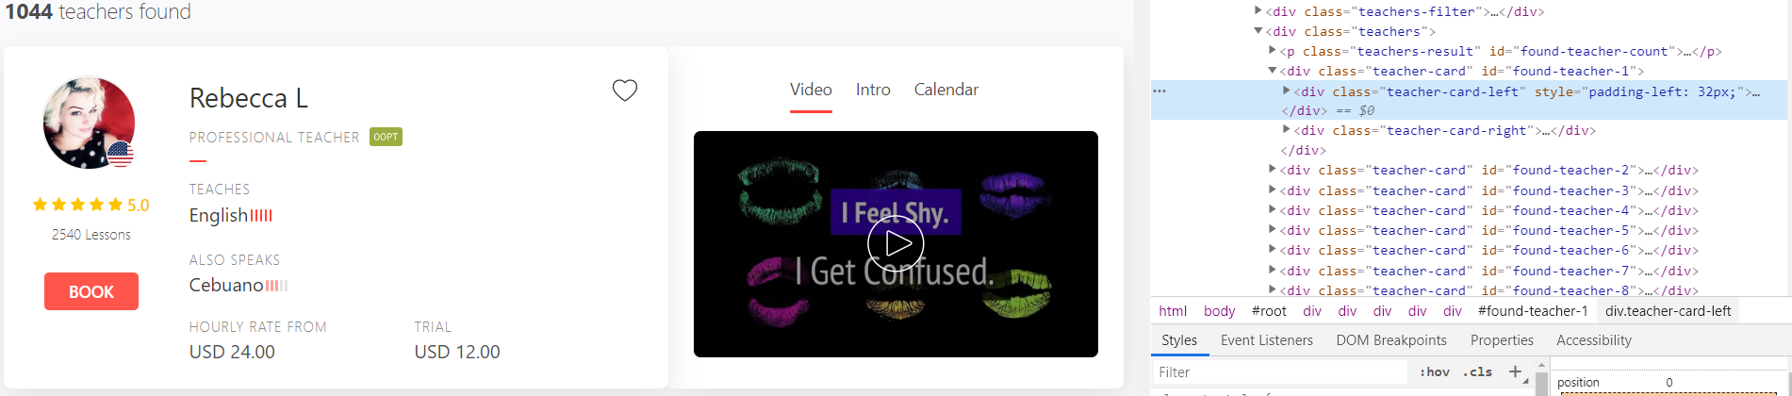

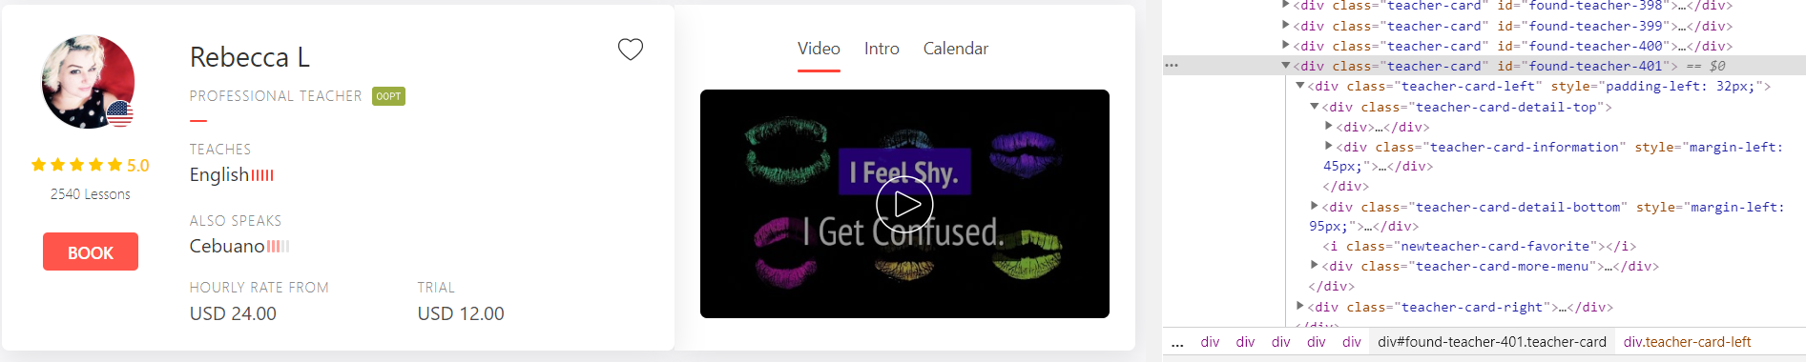
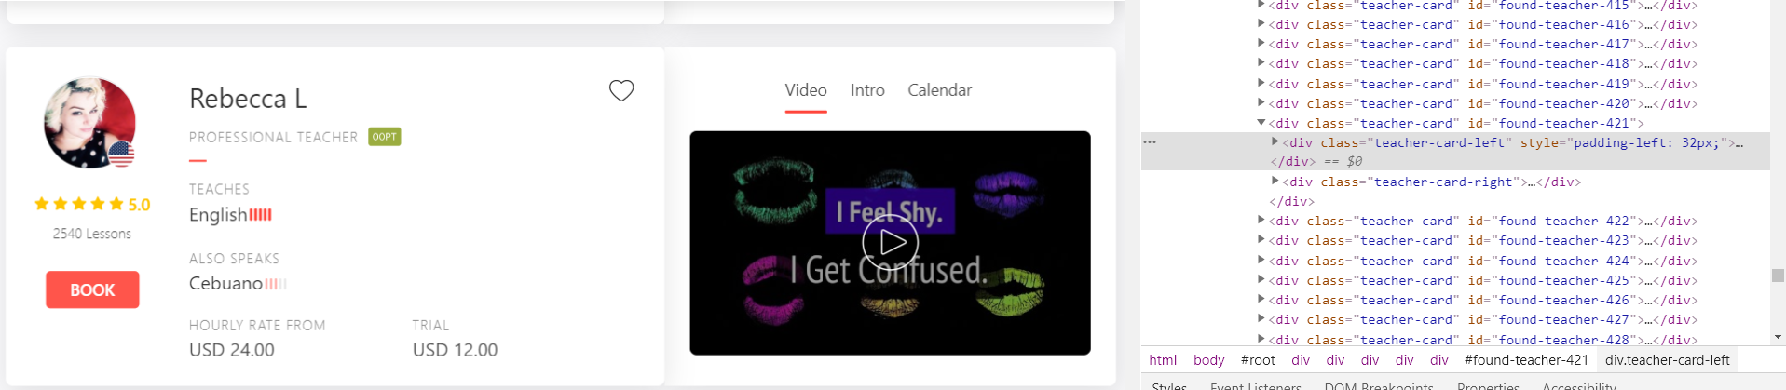
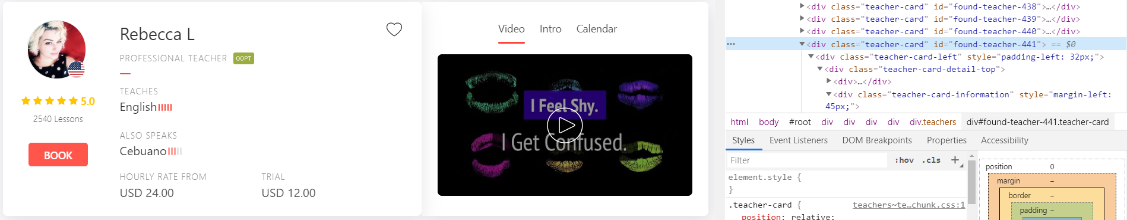
Profile Repetition?

