Slide 1
ABSTRACTIVE AUTOMATED QUICK SUMMARIZATION USING NLP

Slide 2
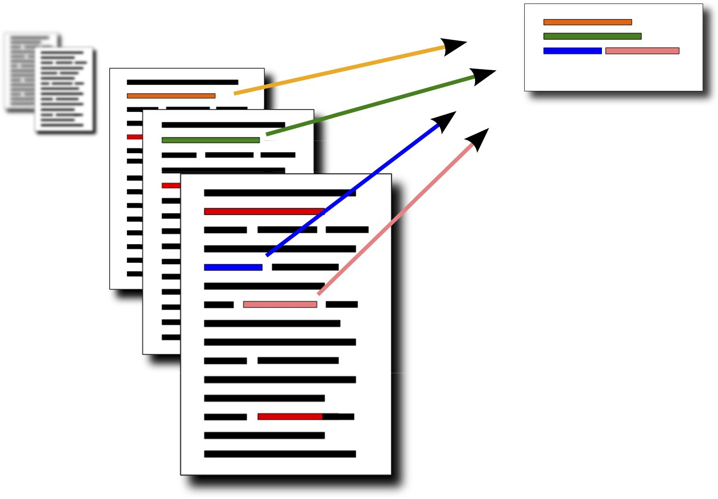
ABSTRACT
This project aims to develop an abstractive automated text summarization system using state-of-the-art Natural Language Processing (NLP) techniques. The system leverages the BART model to extract and condense essential information from lengthy texts into concise and coherent summaries. Various NLP components, including tokenization, sentence segmentation, named entity recognition, and sentence weighting, are integrated to achieve optimal summarization performance.

Slide 3
PROBLEM STATEMENT
Manual summarization is time-consuming and subjective.
Extractive methods may miss the essence of the text.
Abstractive summarization poses challenges in preserving meaning.
Abstractive Automated systems are needed for efficient and accurate summarization.

Slide 4
Develop an abstractive text summarization system to condense large volumes of text accurately.
GOALS AND OBJECTIVES
Utilize the BART model, designed for sequence-to-sequence tasks, to leverage advanced natural language processing capabilities.
Implement various NLP techniques like tokenization, named entity recognition, and sentence weighting to enhance summarization.
Aim to create a scalable solution for diverse domains such as news articles, Documents and performing web scraping.

Slide 5
DATASETS
The project utilizes multinews dataset for training and evaluation.
https://huggingface.co/datasets/multi_news

Slide 6
METHODOLOGY
Data Preprocessing
Tokenization, cleaning, and formatting of datasets.
Handling special characters, punctuation, and stopwords.
Model Selection and Fine-Tuning
Iterative approaches to corporate strategy
Establish a management framework from the inside
Exploration of pre-trained BART models.
Fine-tuning the dataset with optimization of hyperparameters such as learning rate, batch size, and dropout rates to optimize model performance.

Slide 7
METHODOLOGY
Training and Evaluation
Model training with suitable loss hyperparameters .
Inference
Iterative approaches to corporate strategy
Establish a management framework from the inside
Implementation of inference mechanisms for generating summaries.

Slide 8
METHODOLOGY
Post-Processing
Post-processing techniques for enhancing summary coherence and fluency.
Scalability and Adaptability
Ensuring scalability and adaptability across different domains.
Consideration of deployment strategies for wider adoption.

Slide 9
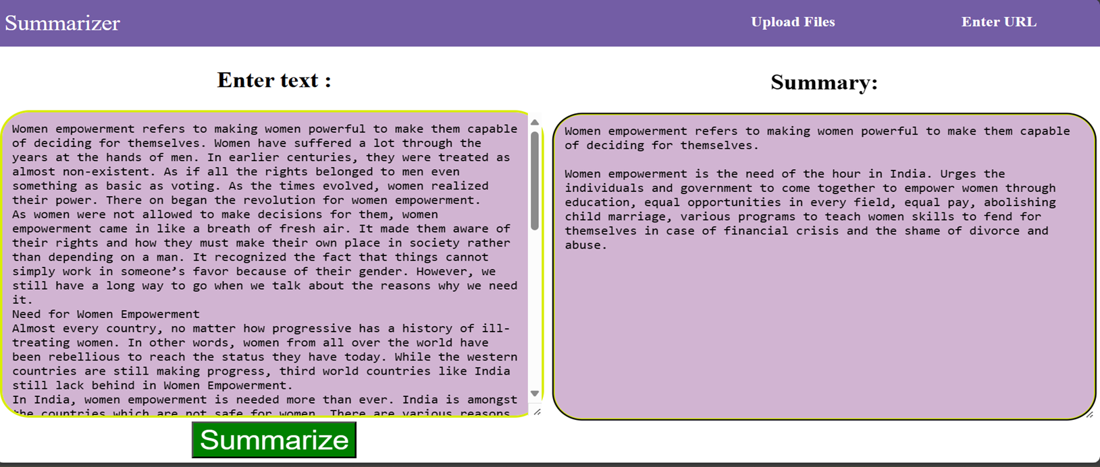
OUTPUTS
The project outputs include:
Abstractive summaries generated by the BART model.
Feature-1 :

Slide 10
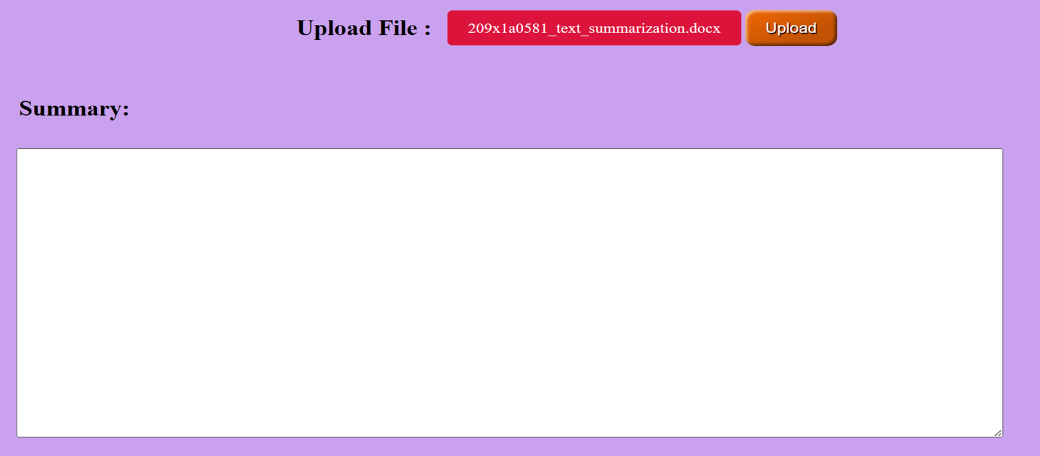
OUTPUTS
Feature 2: File Summarizer: Extracting Key Insights from Documents

Slide 11
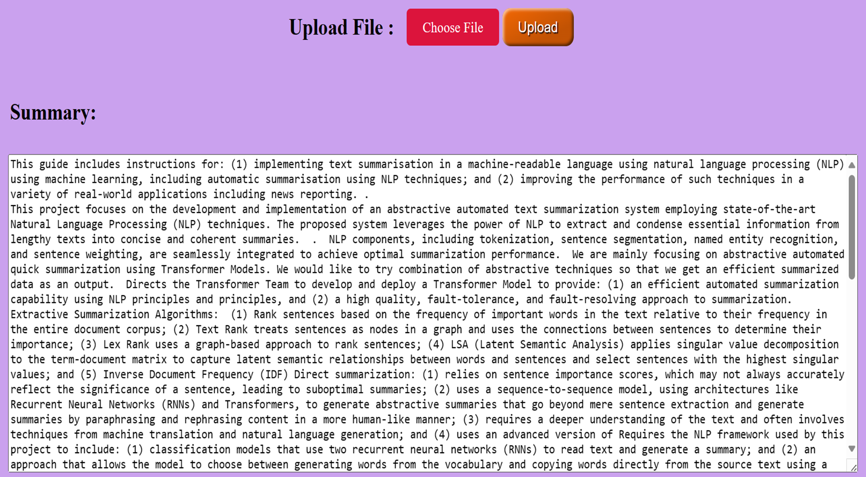
OUTPUTS

Slide 12
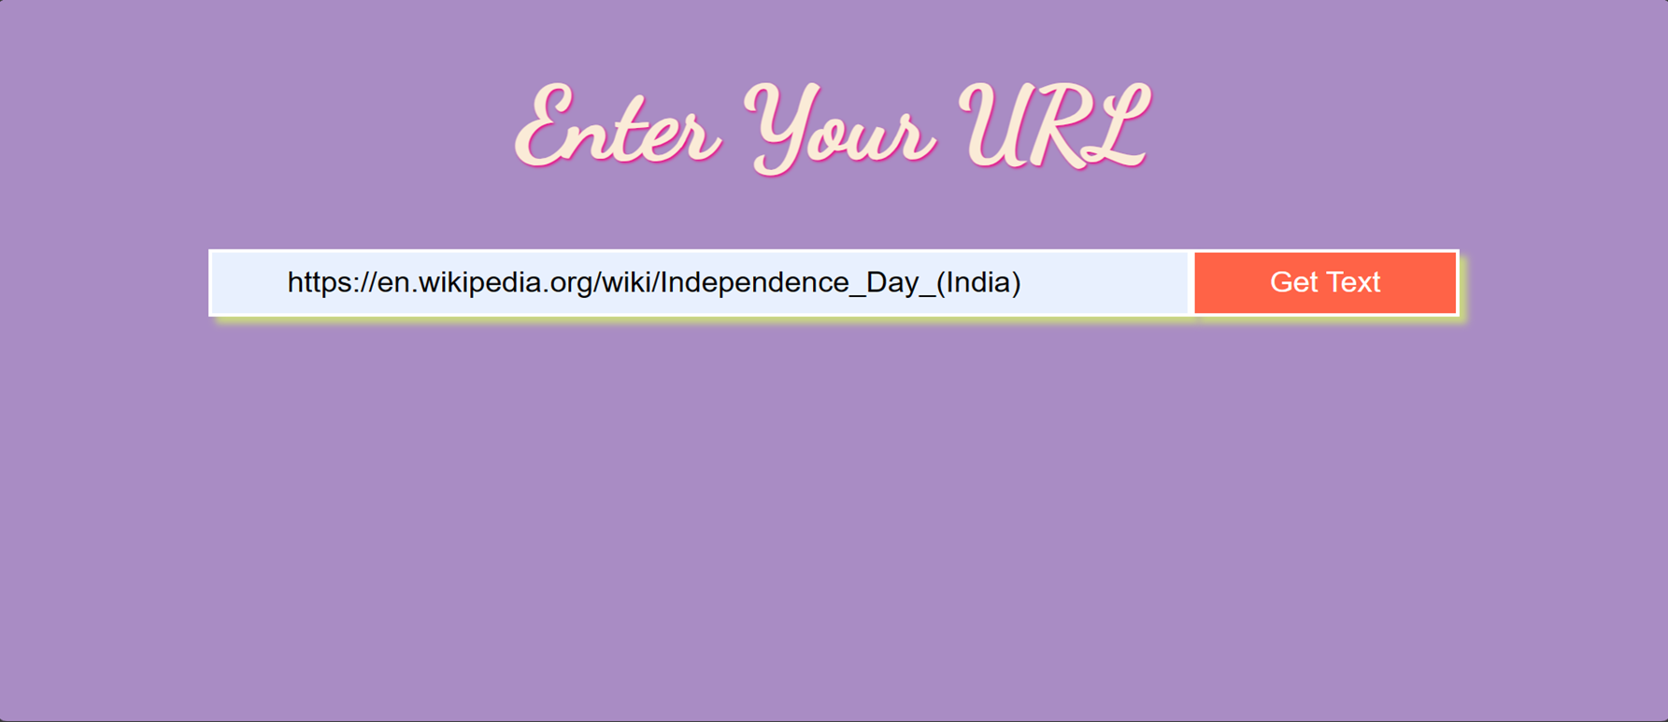
OUTPUTS
Feature 3: URL Summarizer: Automated Web Scraping for Concise Insights

Slide 13
CONCLUSION
The project aims to address the challenge of manual text summarization through automation using advanced NLP techniques.
Abstractive automated text summarization using the BART model holds promise for various applications, including news articles, research papers, and conversational data.
Further advancements in automated summarization technology are expected to enhance the system's performance and applicability in real-world scenarios.

Slide 14
Thank you
By,
N.P.UJWALA (209X1A0581)
P.MANI ARYANI (209X1A0587)
M.BHAVITHA (209X1A0579)

