Slide 1

OFFLINE PPTX FORGE | BENCHMARK STORY
Teaching Laptop Ultra to Teach Laptop Ultra



16 decks scored, 2 briefs, 1 round of frontier distillation

Surface Laptop Ultra | NVIDIA RTX Spark
Notes:
This is the story of a pitch-deck generator that runs entirely on a Surface Laptop Ultra. We built it, graded it against frontier cloud models, let it learn from them once, and measured what changed.

Slide 2
The Test: Customer Decks, Zero Cloud Calls
Same prompt, same renderer, same rubric for every lane.




2
3
6
4
Briefs: Contoso sales, Zava technical
Templates to choose from
Cloud configs: Opus + Astra
Criteria: cost, CO2, time, quality
fictional clients
MS, Surface, Ultra
low, high, max
graded per deck
Surface Laptop Ultra | NVIDIA RTX Spark | Benchmark story
2
Notes:
Two fictional customers: an executive sales pitch for Contoso and an engineering briefing for Zava. Each lane got the identical brief. Cloud specs went through the same renderer and rubric as the local ones, so only the model and harness differ.

Slide 3
How It Works: Everything Stays on the Laptop
Brief in, native PowerPoint out; drafting and rendering run on-device.
SURFACE LAPTOP ULTRA | NVIDIA RTX SPARK

Brief

Qwen3-Coder 30B

JSON spec

Renderer

Cloud APIs
0 calls
targeted fixes
Lint

Measured per deck: seconds, tokens, watt-hours (nvidia-smi)

PPTX
Surface Laptop Ultra | NVIDIA RTX Spark | Benchmark story
3
Notes:
The local model only writes a JSON blueprint. A deterministic renderer turns it into native, editable shapes and charts. In v1.1 a lint step checks the rendered deck and sends targeted fixes back to the model. The cloud is never called.

Slide 4
Like an Architect and a Builder
The model designs; deterministic code builds to spec.

Forge pipeline
is like
Architect + builder

LLM writes JSON spec
Architect draws blueprint
Renderer draws shapes
Builder follows the plan
Lint checks the render
Inspector walks the site
Templates
Finish packages
Surface Laptop Ultra | NVIDIA RTX Spark | Benchmark story
4
Notes:
Separating design from construction is why a 30B local model can produce clean slides: it never has to draw. Swapping templates is like swapping finishes; the structure stays.

Slide 5
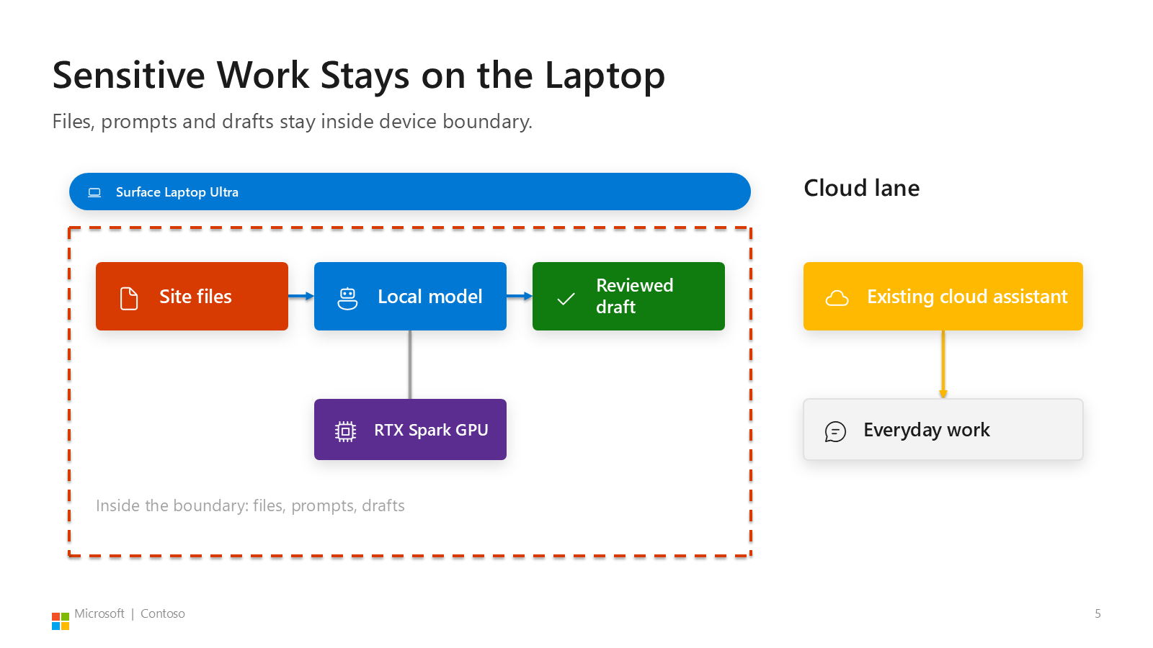
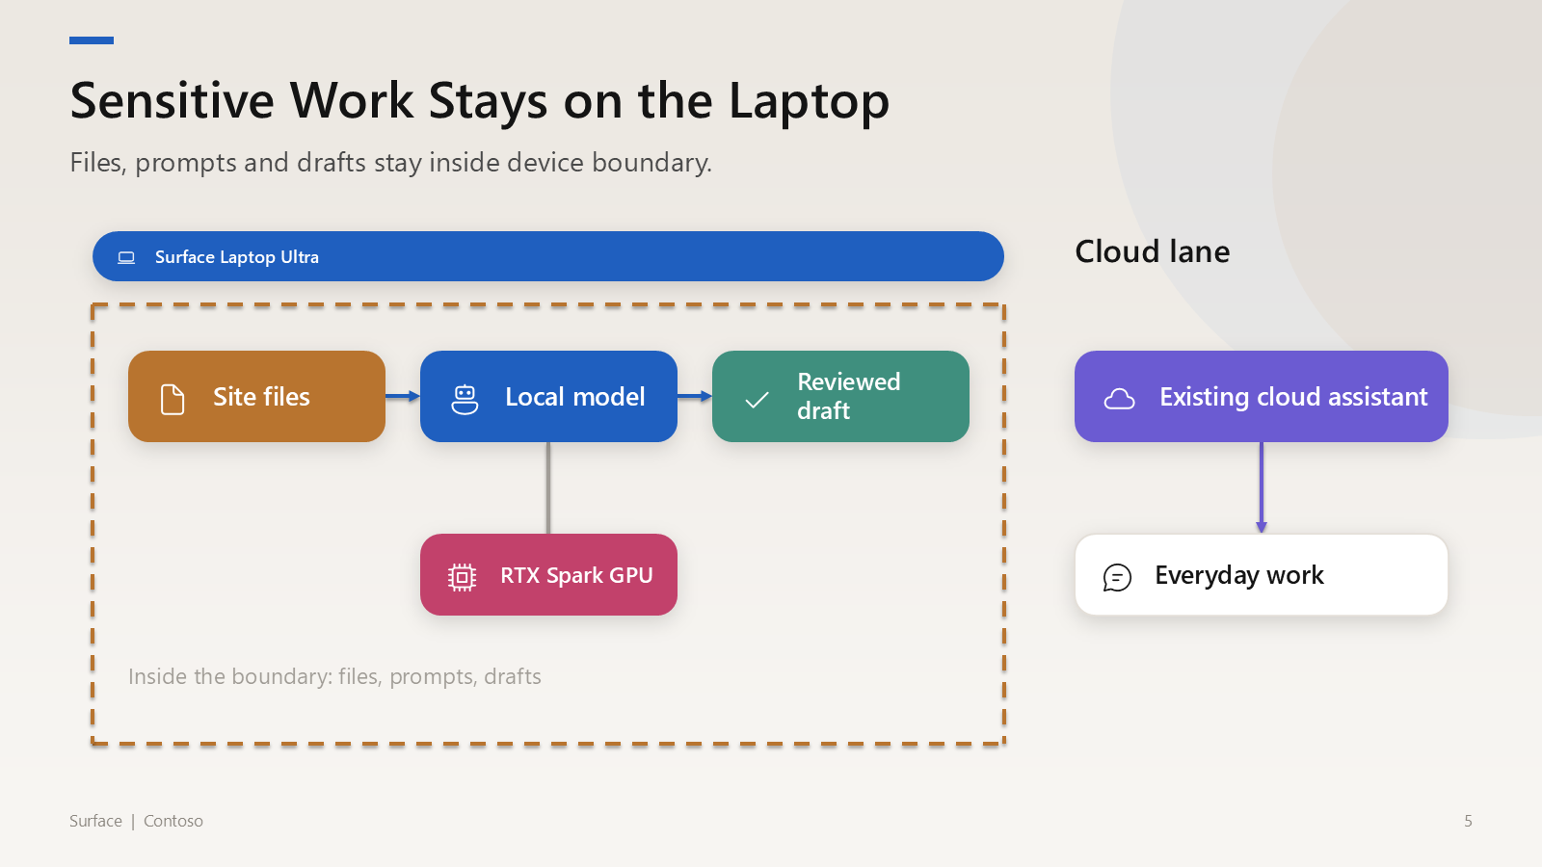
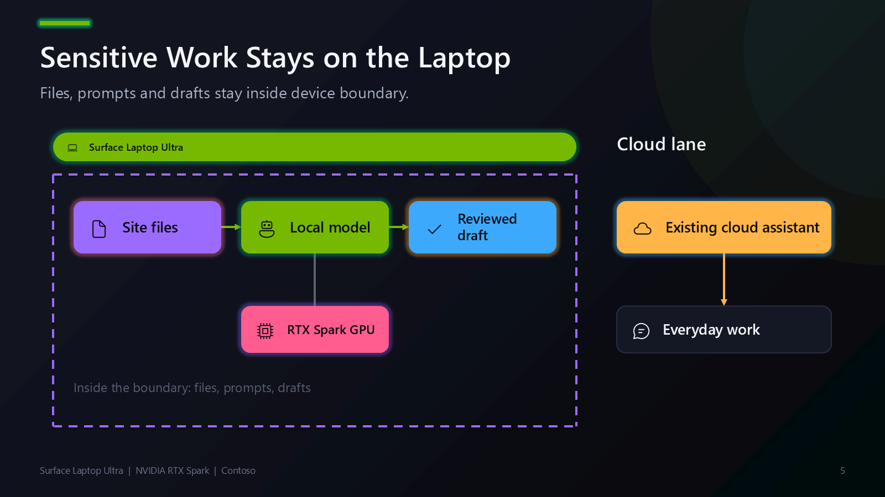
One Spec, Three Templates
Pick Microsoft, Surface or Surface Ultra at build time, or re-render later.
Microsoft
Surface
Surface Ultra
re-rendered in 0.14 s
re-rendered in 0.12 s
re-rendered in 0.13 s

1 JSON spec, 3 templates, 0 LLM calls to restyle
Surface Laptop Ultra | NVIDIA RTX Spark | Benchmark story
5
Notes:
Same Contoso v1.1 slide, three templates. Re-rendering the full 11-slide deck took 0.12 to 0.14 seconds per template on this laptop, measured while building this story deck.

Slide 6
Round 1: The Laptop Came Last
v1.0 scored 19.5/50 with the blind judge; frontier scored 36 to 40.5.

19.5
/50 | Local v1.0
Blind judge, anonymized slide sheets, mean of 2 briefs
Surface Laptop Ultra | NVIDIA RTX Spark | Benchmark story
6
Notes:
Our first harness was fast and cheap, and it passed most automated checks, but the blind judge saw label titles, mixed-unit charts and floating diagram nodes. It came last on both briefs.

Slide 7
Frontier Bought Quality With Tokens
Opus max used 21x Opus low's tokens for +4.5 judge points.

71,181
tok | Opus max
Exact output tokens per deck, incl. reasoning
Surface Laptop Ultra | NVIDIA RTX Spark | Benchmark story
7
Notes:
Reasoning effort mostly bought polish. Opus max hit its 32k output cap twice per brief. That reasoning is expensive to buy per deck, so we captured it once instead.

Slide 8
What Frontier Did That v1.0 Didn't
The judge's notes became the v1.1 playbook.

v1.0 habits

Frontier habits

Label titles

Insight titles
VS

Mixed-unit charts

Like-for-like charts

Floating diagram nodes

Connected diagrams

Back-to-back analogies

Analogies that map caveats

Distill the habits, not the weights.
Surface Laptop Ultra | NVIDIA RTX Spark | Benchmark story
8
Notes:
We studied the best frontier decks and the judge's critiques, then wrote down the habits: a slot-by-slot story arc, an analogy bank, worked examples and checks a script can enforce.

Slide 9
Distillation Is Like an Apprenticeship
Same apprentice, better playbook.

Harness v1.1
is like
Apprentice

Frontier decks
Master's portfolio
Blind judge notes
Studio critique
Lint rules
Pre-flight checklist
Weights unchanged
Same apprentice
Surface Laptop Ultra | NVIDIA RTX Spark | Benchmark story
9
Notes:
No fine-tuning. The local model is identical in v1.0 and v1.1; only the program around it changed.

Slide 10
v1.1: Draft, Check, Repair
Lint issues fell from 30 to 24 across both decks before grading.





01
02
03
04
05
Deck arc
Analogy bank
JSON draft
Render + lint
Targeted repair
Slot-by-slot story
Caveat-mapped analogies
Local model, JSON mode
Deterministic checks
Keep only improvements
Surface Laptop Ultra | NVIDIA RTX Spark | Benchmark story
10
Notes:
Each v1.1 deck used 3 local model passes: one draft and up to two repair passes. A repair is kept only if it reduces lint issues.

Slide 11
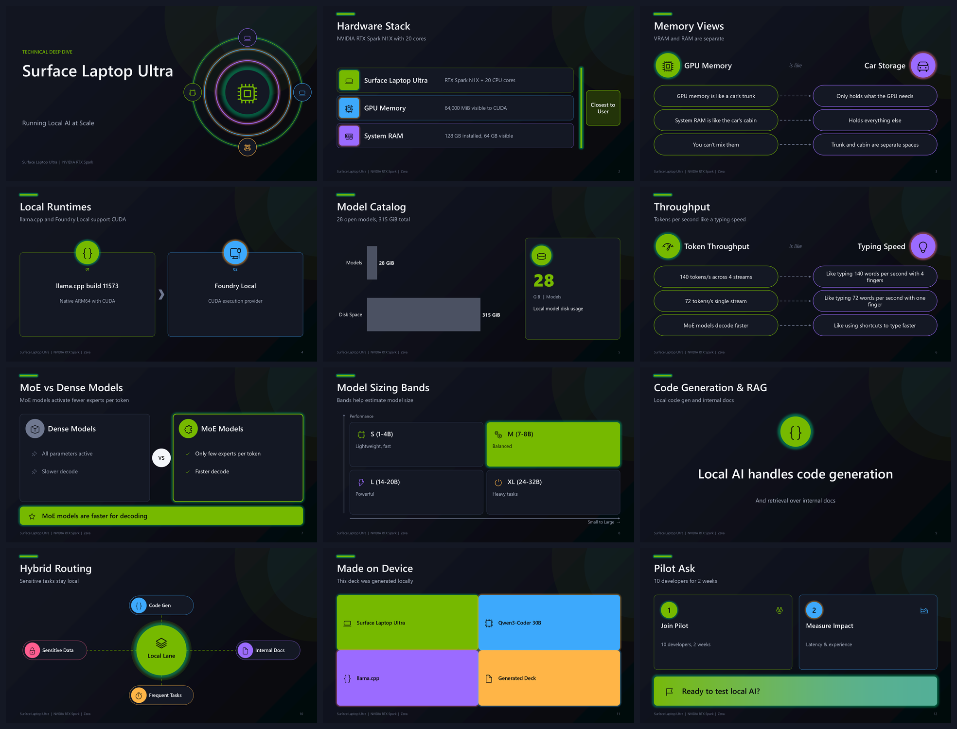
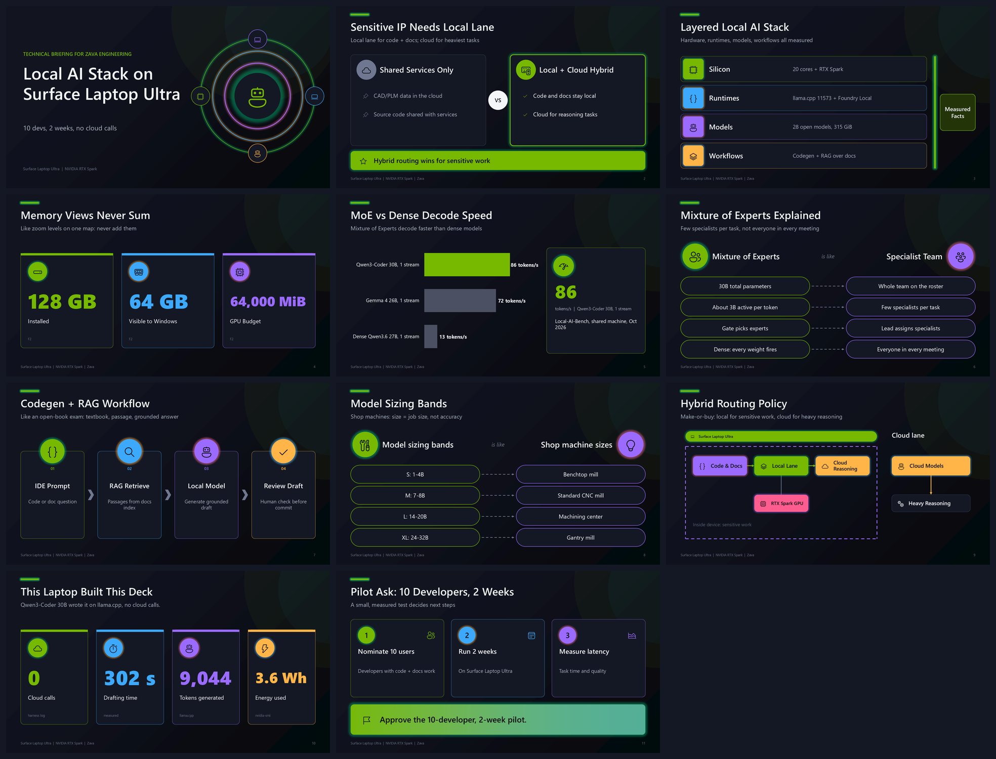
Zava: Judge 18 to 41 of 50
Same model, same renderer; only the harness changed.
v1.0 | 12 slides | judge 18/50
v1.1 | 11 slides | judge 41/50
Surface Laptop Ultra | NVIDIA RTX Spark | Benchmark story
11
Notes:
Left is v1.0, right is v1.1, both exported from the real decks. v1.1 opens on why local matters for CAD and source-code IP, keeps the speed chart like-for-like, and ends on measured proof that this laptop built the deck.

Slide 12
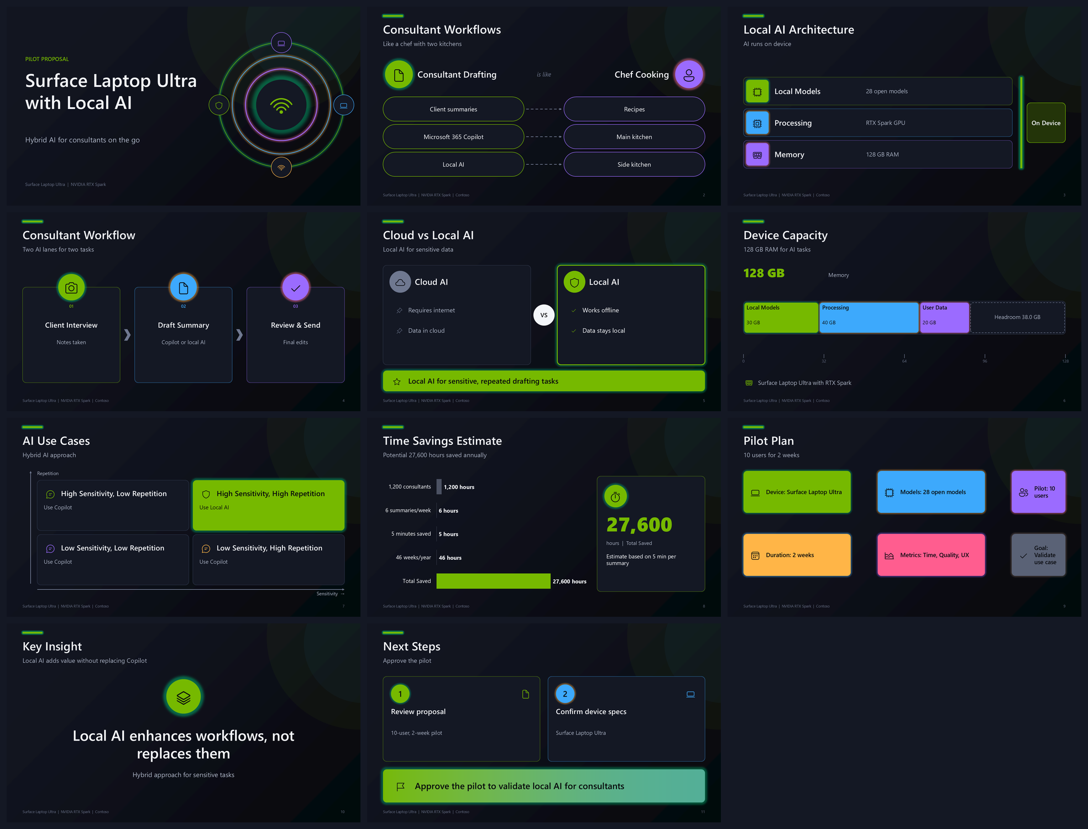
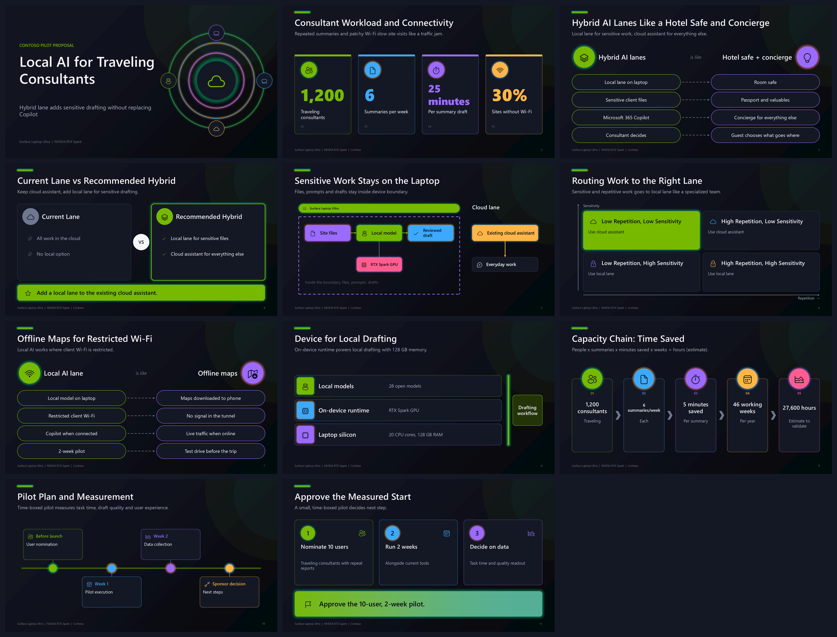
Contoso: Judge 21 to 37 of 50
Exec story: hotel-safe and offline-maps analogies, sponsor-ready ask.
v1.0 | 11 slides | judge 21/50
v1.1 | 11 slides | judge 37/50
Surface Laptop Ultra | NVIDIA RTX Spark | Benchmark story
12
Notes:
The judge still flagged v1.1 Contoso for label titles and one overstated Wi-Fi line, which feeds the v1.2 backlog.

Slide 13
One Round: D to B
Quality rose sharply with model weights unchanged.




63 → 86
2.0x
86 → 93
0
Overall score
Blind judge: 19.5 → 39 /50
Auto rubric /100
Weight updates
rubric + judge
mean of 2 briefs
rubric 1.0.1
prompt + program only
Surface Laptop Ultra | NVIDIA RTX Spark | Benchmark story
13
Notes:
Overall is half automated rubric, half blind judge. v1.1 lint targets some rubric checks, so the judge-only jump from 19.5 to 39 is the cleaner signal.

Slide 14
Frontier-Band Quality at Laptop Cost
v1.1 judge 39 sits inside the cloud band (36-40.5) at 692x lower cost.
Blind judge /50
Opus
Astra
40
Local v1.1
judge 39 | $0.41
Frontier cloud: 6 configs
30
$74-$1,430 | judge 36-40.5
692x cheaper than cloud median
20
Local v1.0
judge 19.5 | $0.10
$0.10
$1
$10
$100
$1,000
Cost per 1,000 decks (log scale)
Surface Laptop Ultra | NVIDIA RTX Spark | Benchmark story
14
Notes:
Cost per 1,000 decks: local v1.1 $0.41 in electricity versus $285 at the cloud median list price. Device and subscriptions are excluded for both lanes. Parity, not a win: Opus max and Astra max scored 40.5.

Slide 15
Per 1,000 Decks: Less Energy, Zero Water
Measured local power vs published cloud per-token estimates.




3.2 kWh
9.4 kWh
31 L
2.3 kg
Local v1.1 energy
Cloud median energy
Cloud water avoided
CO2e avoided
nvidia-smi + 10 W
1.1 Wh per 1k tokens
3.6 mL per 1k tokens
0.367 kg per kWh
Surface Laptop Ultra | NVIDIA RTX Spark | Benchmark story
15
Notes:
Local GPU power was measured on a shared GPU that other workloads were also using, so local energy is overstated. Cloud energy and water use published per-token estimates.

Slide 16
The Trade-Off: Drafting Time
v1.1 needs 241 s: slower than the 108 s cloud median, faster than Astra max.

241
s | Local v1.1
Local: wall-clock. Cloud: API generation seconds.
Surface Laptop Ultra | NVIDIA RTX Spark | Benchmark story
16
Notes:
Three passes on a shared server slot made v1.1 3.8x slower than v1.0. The best-quality cloud config, Astra max, took 268 s.

Slide 17
Self-Grade: Quality Up, Speed Down
Composite B+ to C+: time is now the gap to close.




D → B
A+
A → B
A+ → F
Deck grade
Cost savings (held)
Sustainability
Time to generate
overall score
vs cloud median
energy + water
vs cloud median
Surface Laptop Ultra | NVIDIA RTX Spark | Benchmark story
17
Notes:
Composite is an equal-weight mean of the four criteria: 89.6 for v1.0 and 78.4 for v1.1. The deck got much better; drafting time is what v1.2 has to win back.

Slide 18
Next: v1.2 Keeps Quality, Wins Back Time
Every step is measurable with this same benchmark.
1

2

3

4

Fix judge flags
Dedicated GPU slot
Early-stop repair
Held-out briefs
Hedge claims, fix boundaries
No shared-server contention
Skip passes that can't win
Prove it generalizes
Run v1.2 on new briefs and re-benchmark.

Surface Laptop Ultra | NVIDIA RTX Spark | Benchmark story
18
Notes:
Both briefs informed v1.1, so the honest next test is unseen briefs. Rendered offline by the Forge renderer; every number comes from bench/results.json.

