Slide 1
Problem: Which users are the best prospects for PodNN?
Dataset Length: 970,470 rows
Features:
Marital Status
Gender
Income
Streamlined Media Subs
Streamlined Entertainment Subs
State
Number of New Subs
Age
Presence of Child Residing at Home
Results from Random Classifier Model:
Accuracy: 93.33%
AUC: 98.2%
The model we created did a good job in determining which users were to listen to a podcast based on its input features. Moving forward, we should collect more data to refine our model such that we can improve it even more, and have a better balance between non-listeners and listeners to train on.

Slide 2
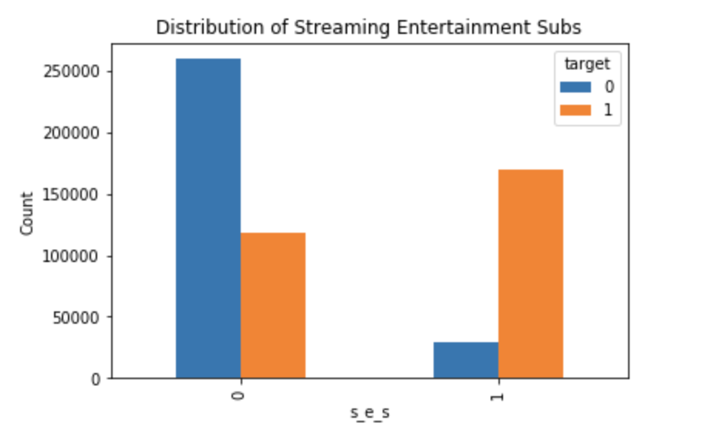
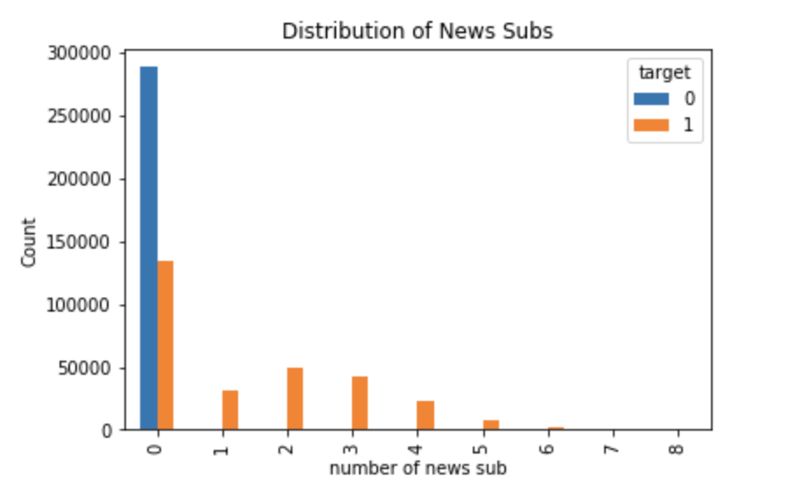
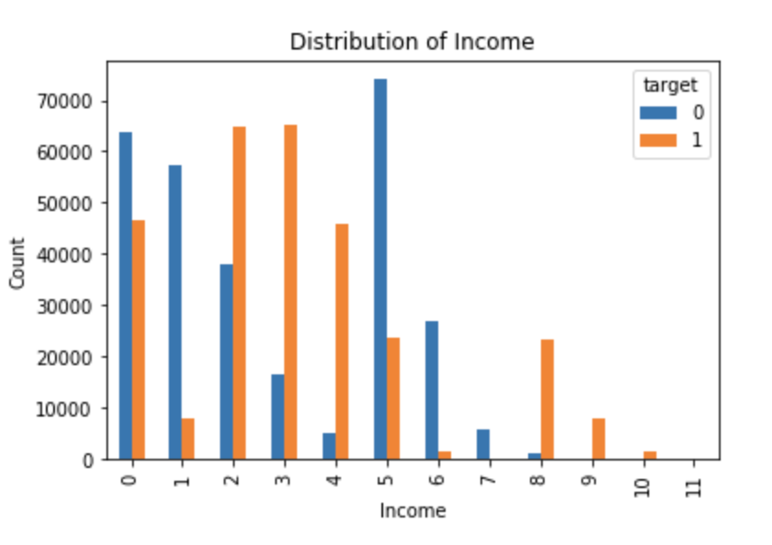
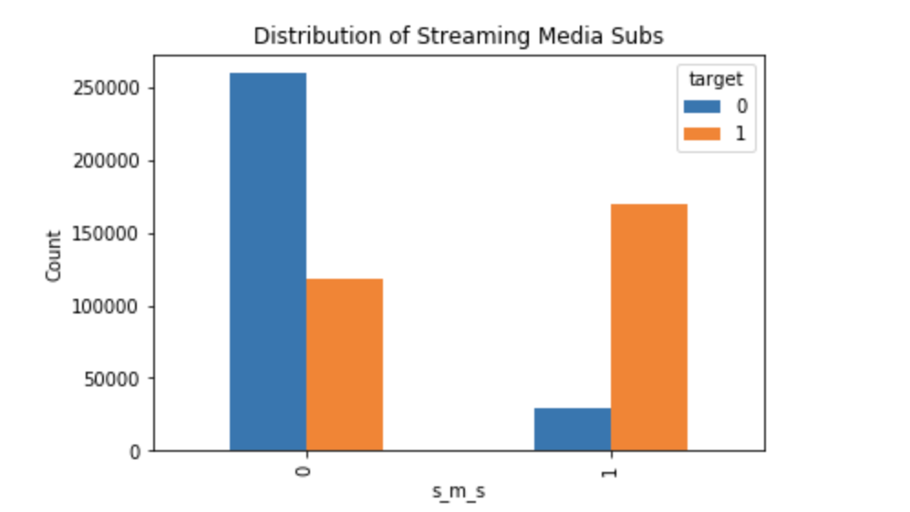
Most Influential Features
Important Features Identified from Classifier:
Streaming Media Subs
Streaming Entertainment Subs
Presence of Child at Home
Number of News Subs
Age
From Data Exploration:
key features identified: # of news subs, income, streaming media and entertainment subs
Summary: A lot of the influential features that we distinguished through data exploration were identified by the classifier as important as well. It seems the data exploration was useful in understanding the roles each feature played. The people we should target are those who are subscribed to media, news, and entertainment subs and those who have a child at home as these groups of people are more likely to listen to the podcast and have the app.

