Slide 1


Embedded System Design
Mini Project
FAULT DETECTION SYSTEM
Group 8
Viraj Gotmare
22410068
Athrava Pandey
22410069
Suprit Bashetti
22410073
Pushkar Nashikkar
22410074

Slide 2

Introduction
Purpose : Fault Detection for gas tanks and safety device.
Microcontroller : LPC2138/LPC2148.
Real Time Monitoring and abnormality detection.
Automatic Alerts

Slide 3
System Overview
Temperature Sensor and Pressure Sensor.
ARM7 Controller (LPC2138/48).
Data Acquisition using on-chip ADC.
Data Visualization using Bluetooth Module HC-05.
Real Time Alert Buzzer and Nozzle shutter.

Slide 4
Components Used
Temperature Sensor : LM35.
Pressure Sensor : MPX4115.
ARM7 ( LPC2138 ).
HC-05 Bluetooth Module.

Slide 5
CIRCUIT
SCHEMATIC

Slide 6

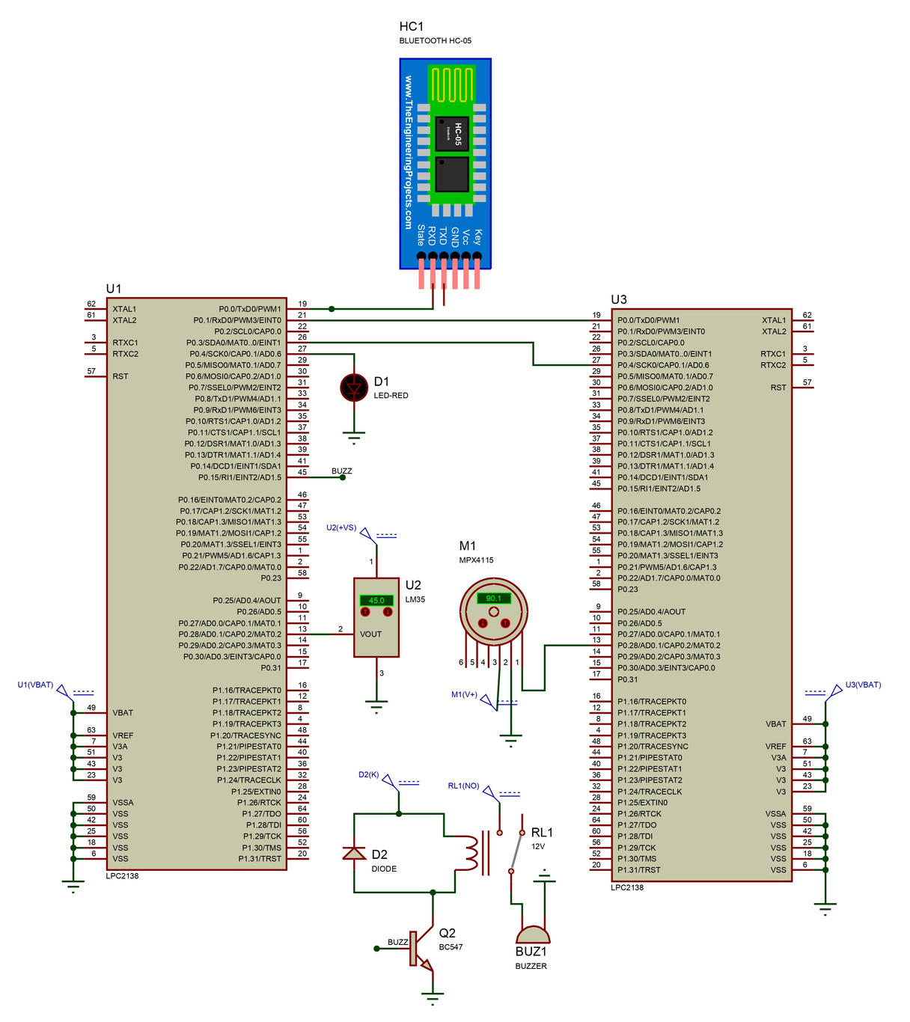
Circuit Schematic

Slide 7
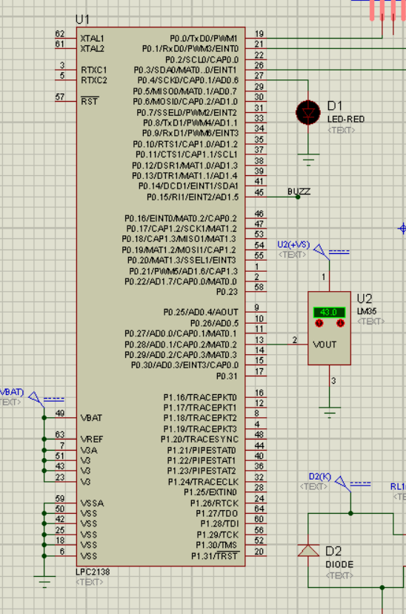
Circuit Overview
Controller 1
Temperature Data Acquisition & threshold check.
Automatic Alert.
Serial Comm. Using Bluetooth.
LED toggle for Nozzle Closure Demonstration

Slide 8
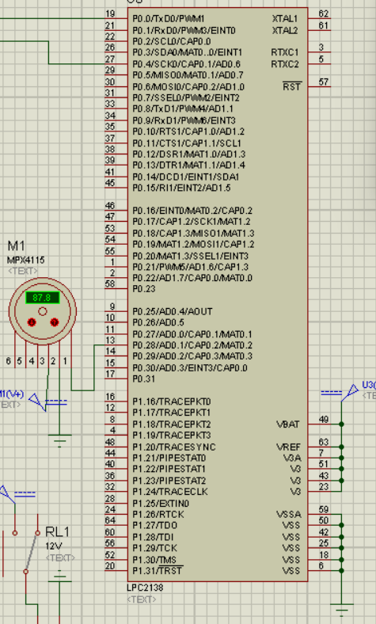
Circuit Overview
Controller 2
Pressure Data Acquisition & threshold check.
Automatic Alert bit transfer.
Data Transfer to Main Controller for alert generation.

Slide 9
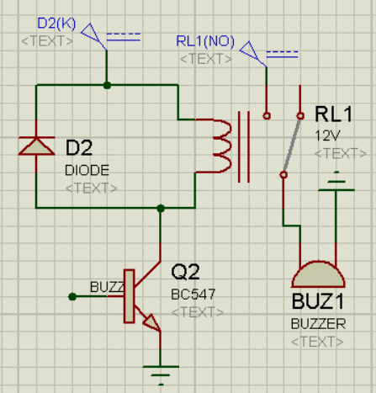
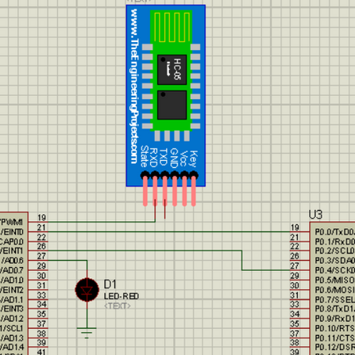
Circuit Overview
Buzzer Circuit
Automatic Trigger based on acquired temperature and pressure sensor.
SCOM Mechanism
Data transmission to Mobile Serial Port.

Slide 10
ALGORITHM
&
WORKFLOW

Slide 11


Block Diagram
sfdadfsdfsdfdfsdf
sfdadfsdfsdfdfsdf
sfdadfsdfsdfdfsdf
Temperature from LM35
Controller 1
Mobile
sfdadfsdfsdfdfsdf
sfdadfsdfsdfdfsdf
Pressure from PX4115
Controller 2

Slide 12
Basic Workflow
sfdadfsdfsdfdfsdf
Preparation of String to be Transmitted.
sfdadfsdfsdfdfsdf
Variable Declarations
sfdadfsdfsdfdfsdf
Transmission of Acquired Data
sfdadfsdfsdfdfsdf
Peripheral Initialization
sfdadfsdfsdfdfsdf
Verifying Thresholds and acting accordingly
sfdadfsdfsdfdfsdf
Data Acquisation & Conversion
sfdadfsdfsdfdfsdf
END

Slide 13
Code
Walkthrough

Slide 14
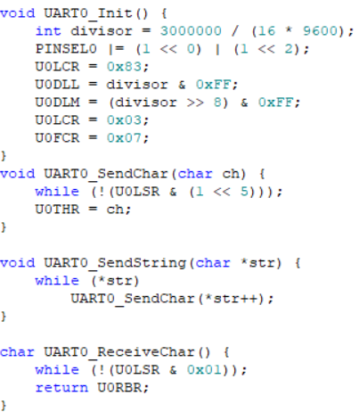
UART
Baud Rate Calculation: 9600 baud rate.
Pin Configuration : Sets P0.0 (TX) and P0.1 (RX) for UART0.
DLAB and Data Length : Configures 8-bit length.
Divisor Registers : Loads divisor into U0DLL and U0DLM to finalize baud rate.
Transmit Function : Waits for THR to empty before sending each character.
Receive Function : Waits for data in RBR before reading, ensuring reliable communication.

Slide 15
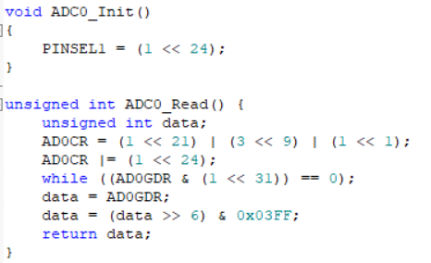
Data Acquisition
ADC0 Channel Select using PINSEL.
Monitoring Done bit Status.
Capturing and returning Data.

Slide 16


Temperature Data Conversion
Dout = Ain / StepSize.
10mV change for 1 degree.
Converting Float to String.
Pressure Data Conversion
Dout = Ain / StepSize.
0.009V change for 1 KPa.
Converting Float to String.

Slide 17
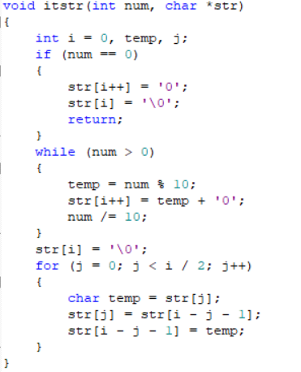
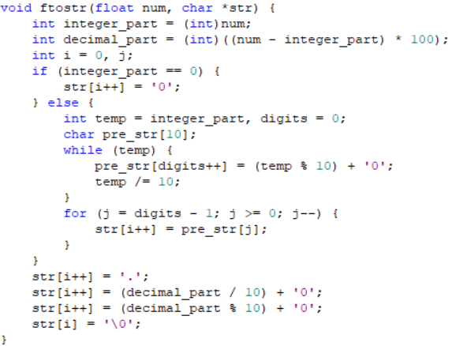
Converting req. values to Strings

Slide 18
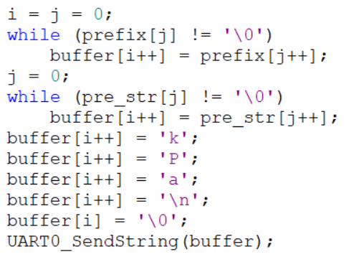
Preparing Strings for Transmission

Slide 19
Applications
Automotive CNG Safety Systems.
Gas Refueling Station Safety System.
Household LPG Cylinder Safety Monitor.
Transport and Logistics for Gas Cylinders.

Slide 20
Advantages
Direct Cylinder Surface Monitoring.
Automated Safety Measures
Enhanced Reliability with Dual-Sensor Setup.

Slide 21
Disadvantages
Calibration and Maintenance Needs.
Potential for False Positives.
Single-Point Measurement Limitations.

Slide 22
THANK
YOU

