Slide 1


Machine Learning-Based Disease Prediction with Mutation Awareness
An intelligent, mutation-aware ML platform for early multi-disease healthcare prediction
STUDENT NAME
Nandini P V
USN
U18GH23S0113
GUIDE
Mrs Prathibha P M
Notes:
Greet the panel. Introduce the project title, your name, USN, guide, and department. One-line hook: this project predicts multiple diseases early using both clinical data and mutation-aware genomic analysis.

Slide 2






Abstract
Problem: Manual diagnosis is slow and misses hidden genomic patterns
WORKFLOW
Objective: Build an intelligent system for early, multi-disease prediction
Data Input
Solution: ML pipeline combining clinical data with mutation-aware analysis
Technologies: Python, Scikit-learn, XGBoost, FastAPI, Streamlit
Preprocessing
Diseases Predicted: Breast cancer, heart disease, diabetes
Mutation Features
Mutation-Aware Feature: Gene expression variation flags biological abnormalities
Hybrid ML Model
Expected Outcome: Reliable, real-time, multi-disease healthcare decision support
Prediction Result
02
Notes:
Summarize the problem, objective and solution in one breath, then point to the workflow graphic: raw data flows in, gets cleaned, mutation-aware features are extracted, the hybrid model trains, and a prediction comes out.

Slide 3




Existing System — Limitations
Manual & Clinical-Only
No Genomic Insight
Relies on manual diagnosis and basic clinical parameters alone
Ignores gene expression and mutation-related patterns entirely
High-Dimensional Data Struggles
No Real-Time Integration
Cannot efficiently process large gene expression datasets
Standalone tools with no backend API or automation support
03
Notes:
Walk through why current systems fall short: manual and clinical-only, blind to genomic mutation data, struggle with high-dimensional gene expression data, and lack real-time backend integration.

Slide 4







Proposed System
Mutation-Aware
Multi-Disease
Hybrid ML Model
Real-Time API
Modular & Scalable
WORKFLOW
Data
Collection
Preprocessing
Mutation-Aware
Features
Hybrid Model
(RF + XGB)
Multi-Disease
Prediction
Dashboard
04
Notes:
Explain the five core advantages briefly, then walk left to right through the workflow: data collection, preprocessing, mutation-aware feature extraction, the hybrid Random Forest + XGBoost model, multi-disease prediction, and finally the dashboard.

Slide 5
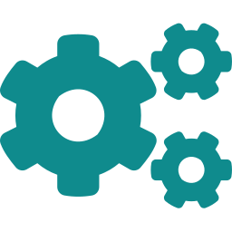
Data & Feature Pipeline
Data Collection
Data Preprocessing
IN Raw CSV/Excel OUT Structured data
IN Raw data OUT Clean data
Loads healthcare & genomic datasets from reliable public sources.
Removes missing values, duplicates and inconsistencies before analysis.
Feature Engineering
Mutation Feature
IN Clean data OUT ML-ready features
IN Gene expression data OUT Mutation-aware features
Converts raw healthcare & genomic data into meaningful structured features.
Extracts mean, std. deviation & range to flag abnormal gene activity.
05
Notes:
These four modules form the data pipeline: collect raw datasets, clean them, engineer meaningful features, and extract mutation-aware statistical features from gene expression data.

Slide 6


Modeling Pipeline
Anomaly Detection
Model Training
IN Engineered features OUT Validated feature set
IN Validated features OUT Trained ML models
Flags outliers and abnormal patterns that could affect prediction accuracy.
Trains classification models on healthcare and genomic data.
Hybrid Model
Prediction Module
IN Trained models OUT Optimized ensemble
IN Patient input data OUT Disease prediction
Combines Random Forest + XGBoost via soft voting for higher accuracy.
Generates real-time disease prediction results for new patients.
06
Notes:
Moving to the modeling side: anomaly detection cleans the feature set further, models are trained, combined into a hybrid Random Forest + XGBoost ensemble, and used by the prediction module.

Slide 7


Delivery & Interface
Multi-Disease Prediction
Evaluation
Visualization
IN Patient data OUT Multi-class results
IN Predictions OUT Performance metrics
IN Evaluation results OUT Graphs & charts
Predicts multiple diseases simultaneously using multi-class classification.
Computes accuracy, precision, recall, F1-score & ROC analysis.
Generates visual healthcare insights and analytical reports.
Dashboard / UI
Backend API
IN User actions OUT Interactive display
IN Frontend requests OUT Processed responses
Streamlit frontend for patient input, selection & result viewing.
FastAPI layer connecting the UI to ML prediction modules in real time.
07
Notes:
The final layer: multi-disease prediction, evaluation metrics, visualization, the Streamlit dashboard, and the FastAPI backend that ties the frontend to the models in real time.

Slide 8
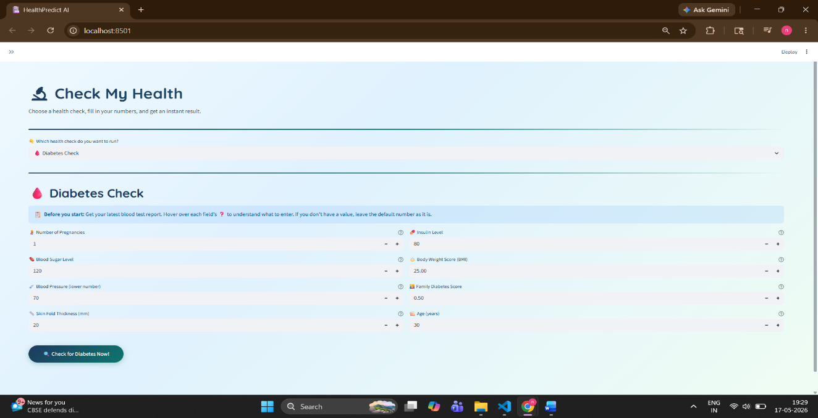
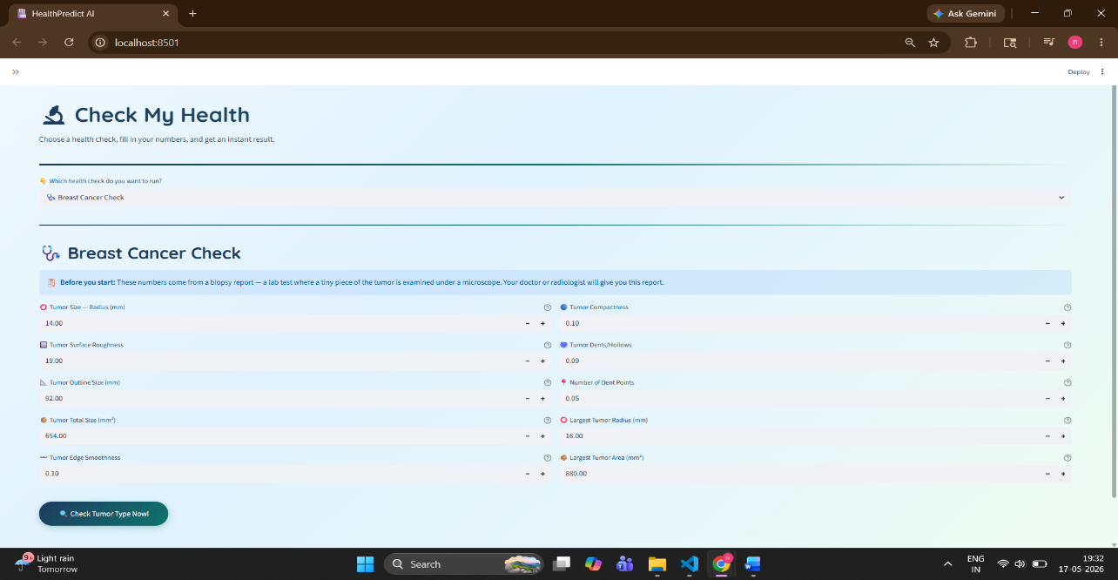
Dashboard & Prediction Input
DASHBOARD
PREDICTION PAGE
Home dashboard with disease selection cards
Patient input form for diabetes prediction
08
Notes:
Show the dashboard first — the entry point where users pick a disease. Then the prediction page, where patient details are entered for the model to analyze.

Slide 9
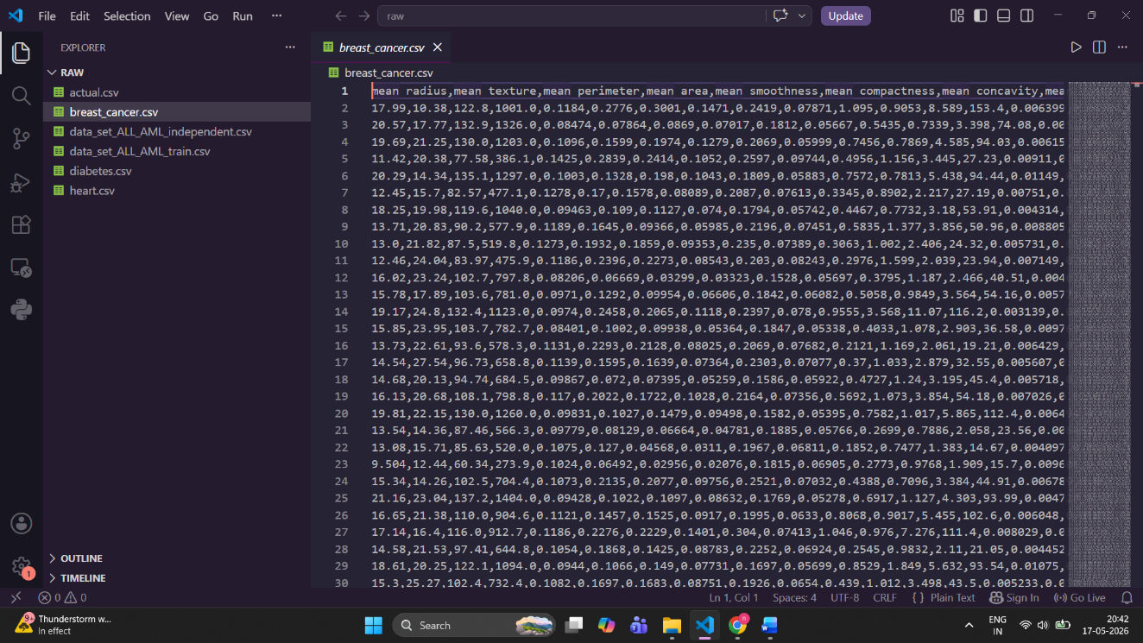
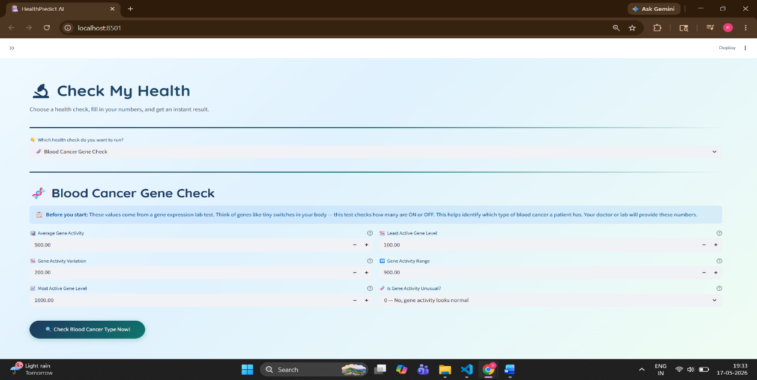
Results & Performance
RESULT PAGE
PERFORMANCE GRAPH
Prediction result with confidence score
Model accuracy comparison across diseases
09
Notes:
The result page shows the predicted outcome with a confidence score. The performance graph compares accuracy across all four disease models — breast cancer performs best at 95.6%.

Slide 10

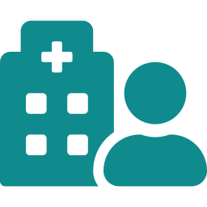
Conclusion
Achievement
Key Technologies
Built a working multi-disease prediction platform with mutation-aware analysis
Python, Scikit-learn, XGBoost, FastAPI & Streamlit power the full pipeline
Benefit
Applications
Faster, more accurate early detection with a genomic-level perspective
Supports healthcare professionals, researchers & academic use cases
10
Notes:
Close with the achievement, the core tech stack, the practical benefit of earlier detection, and who this system serves: clinicians, researchers, and students.

Slide 11






Future Enhancements
AI Healthcare
Chatbot
Mobile
Application
Real-Time
Monitoring
Personalized
Recommendations
Voice
Assistant
Cloud
Deployment
Advanced Genomic
Prediction
11
Notes:
End on the roadmap: chatbot and voice assistant for accessibility, a mobile app, cloud deployment, real-time monitoring, deeper genomic mutation modeling, and personalized healthcare recommendations.

