Slide 1

ENGINEERING RESULTS OVERVIEW
Making LLM Inference Faster
A hand-written GPU kernel, wrapped for production — explained for a general audience, with the real, measured numbers
Model: Phi-3-mini-4k-instruct • GPU: NVIDIA RTX 3080 • Project: TensorRT_plugin

Slide 2


THE BIG PICTURE
What Happens When You Chat With an AI?
A Language Model Is a Giant Math Machine
Why It Needs a GPU, Not Just a CPU
A large language model (LLM) turns your text into a huge list of numbers, then runs those numbers through billions of simple multiply-and-add calculations to predict the next word, one piece at a time. It has no "understanding" module — it is calculation, repeated at enormous scale.
A CPU is like one highly skilled chef: fast and flexible, but working through tasks mostly one at a time. A GPU is like a kitchen with thousands of line cooks, each doing one simple, repeated step — perfect for the millions of small, identical multiplications an LLM needs, all at once.
This project is about making that GPU math run faster — without changing what the model predicts.
TensorRT_plugin — Engineering Results Overview
2

Slide 3

THE BIG PICTURE
Why Shrink the Model? (Quantization)
An LLM stores billions of numbers ("weights"). Normally each one is measured very precisely — like pricing something to the exact penny. Quantization rounds those numbers to a coarser scale to save memory and time, at a small, controlled accuracy cost.
Full Precision
INT4 (this project)
Trade-off
A weight stored with lots of decimal detail — accurate, but takes more memory and more time to move around.
Each weight is rounded to one of 16 compact codes, plus a small shared "scale" (conversion factor) per neighborhood — 4x smaller, much faster to read.
Small, measured accuracy loss in exchange for a much smaller, much faster model. This project keeps that loss standard and well understood, and focuses on the speed side.
Pricing to the penny
Pricing to the nearest dollar
A deliberate, honest trade
TensorRT_plugin — Engineering Results Overview
3

Slide 4

CORE CONCEPT
What Is a "CUDA Kernel"?
A CUDA kernel is a small program written to run on the GPU — executed by thousands of threads at the same time, each one handling one tiny piece of a big calculation. Writing one by hand (instead of using an off-the-shelf library) means you control exactly how that work is split up.
First Version: Naive
Second Version: Optimized
One thread computes one output value, working through its piece of the math step by step — simple to write, and a safe way to first prove the math is correct. But it turns out to be slow: it wastes most of the GPU’s time waiting on memory (next slide).
Groups of 32 threads ("a warp") cooperate: they share work through fast on-chip memory and read data in neighboring chunks instead of scattered ones. Same math, same answer — verified against the first version — just far less wasted GPU work.
4.3x faster — the optimized kernel vs. the naive one, same GPU, same shape, same correctness checks.
TensorRT_plugin — Engineering Results Overview
4

Slide 5
CORE CONCEPT
Why Was the First Kernel Slow? Memory "Sectors"
GPU memory isn’t fetched one number at a time — it comes in fixed-size chunks, called sectors (like pulling a whole tray off a shelf even if you only wanted one item on it). If neighboring threads ask for scattered data, most of every tray fetched goes unused.
Naive Kernel: Scattered Requests
Optimized Kernel: Neighboring Requests
10.67 trays fetched to get the data that fit in about 2
1.60 trays fetched for the same data
14% used • 86% wasted
Nearly every byte fetched gets used
Only 38% of the GPU’s compute power was even being used — it spent most of its time waiting on memory, not calculating.
Measured on the GPU with NVIDIA’s Nsight Compute profiler, both before and after the fix — not estimated.
TensorRT_plugin — Engineering Results Overview
5

Slide 6
TWO QUICK DEFINITIONS
Before the Numbers: Two Terms You’ll See
What’s a "Warm-Up"?
What’s a "Group Size"?
The very first time any program runs on the GPU, there’s one-time setup overhead — like a car engine on a cold morning, or a printer’s first page taking longer. To measure true, steady-state speed, every benchmark in this project runs a few throwaway "warm-up" passes first, then times many real runs afterward and reports the middle (median) value — so one unlucky slow run doesn’t skew the result.
Instead of one single conversion factor for an entire giant list of weights, the numbers are split into small neighborhoods of 128, and each neighborhood gets its own tiny scale — like a local exchange rate per city block instead of one rate for an entire country. Smaller groups keep more accuracy; this project uses 128 as a standard, well-understood balance of accuracy and storage cost.
TensorRT_plugin — Engineering Results Overview
6

Slide 7


HOW IT FITS TOGETHER
From Model Weights to a Running Server
Quantized
Weights
→
CUDA
Kernel
→
TensorRT
Plugin
→
TensorRT
Engine
→
C++
Harness
serves many requests at once, in parallel →
Req 1
Req 2
Req 3
Req 4
What’s a "Plugin"?
What’s an "Inference Harness"?
TensorRT is NVIDIA’s automatic deployment optimizer — but it doesn’t know our custom operation out of the box. A plugin teaches it a brand-new building block, the same way installing an add-on lets a photo editor open a file format it wasn’t originally built to handle.
The production wrapper: it loads the compiled, optimized engine, manages GPU memory safely, and serves many requests at once — like a restaurant kitchen with several cooks working in parallel, instead of one cook finishing an entire order before starting the next.
TensorRT_plugin — Engineering Results Overview
7

Slide 8

RESULTS
Four Ways to Run the Same Math
Same weights, same input, same warm-up-then-median timing — lower is faster. Each bar is one way of running the identical dequantize-and-multiply operation.
~9x faster
than the default PyTorch path, using the standalone hand-written kernel.
No wrapper tax
The TensorRT engine (0.0768ms) ties the standalone kernel (0.0759ms) within noise — wrapping it for production cost nothing measurable.
TensorRT_plugin — Engineering Results Overview
8

Slide 9
RESULTS, EXPLAINED
Why Is Plain PyTorch So Much Slower?
The Slow Way: Two Separate Trips
The Fast Way: Fused in One Pass
1. Decompress the entire compact weight table into a full-size table in memory
Decompress and multiply together, on the fly — no detour through a throwaway full-size table
2. Then read that full-size table back and multiply
Extra full round-trip through GPU memory for a table that’s used once and thrown away.
This is what the hand-written kernel and the TensorRT plugin both do.
Found twice, independently: a plain vendor-library baseline (cuBLAS) built the slow way was also the slowest option tested for the kernel alone — this isn’t a one-off result.
TensorRT_plugin — Engineering Results Overview
9

Slide 10

RESULTS
Serving Many Requests at Once
The C++ harness can run several requests in parallel, each with its own GPU "lane" (stream). More lanes should mean more throughput — up to a point.
+37%
more throughput running 4 requests in parallel vs. one at a time, fully overlapped.
Gains level off
8 streams gave no further gain. This is a small, single-operation workload — not much waiting-around time was left to fill with overlap.
TensorRT_plugin — Engineering Results Overview
10

Slide 11

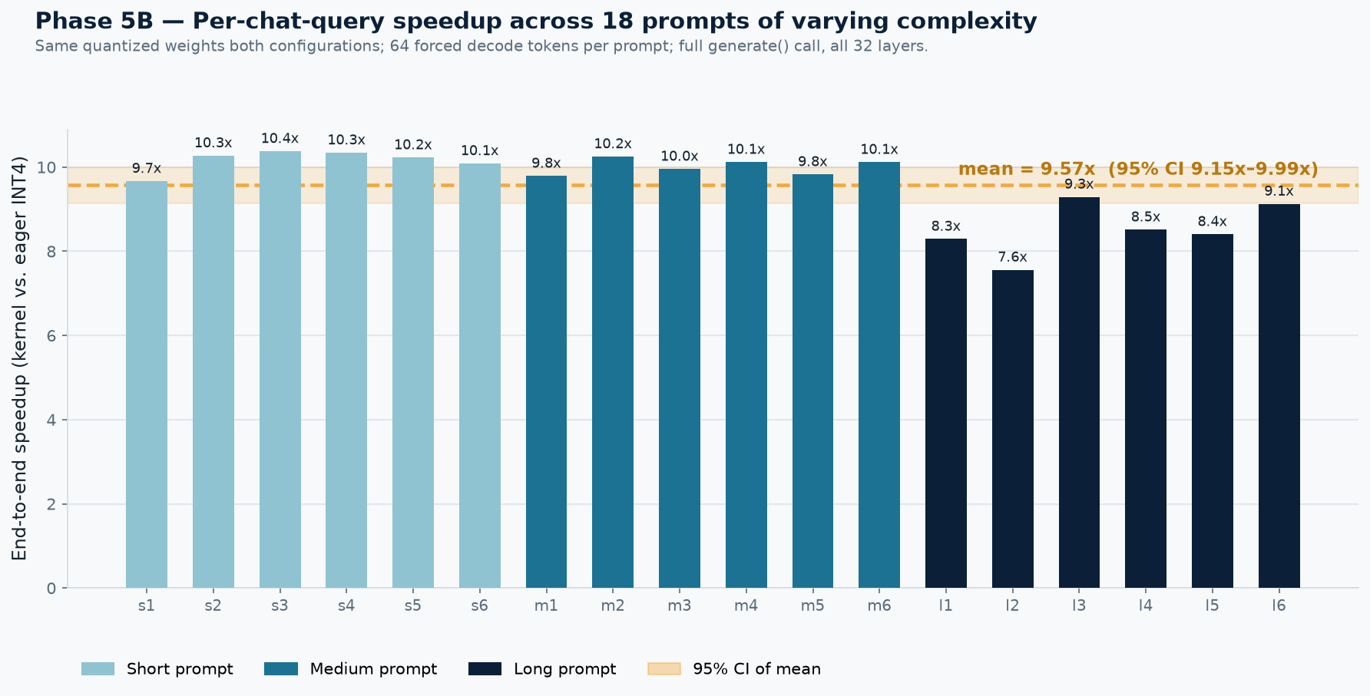
FOLLOW-UP TEST
Does It Hold Up in a Real Chat Response?
Yes: 9.57x end-to-end across 18 full chat responses (95% CI 9.15x–9.99x) — matching Phase 5’s isolated ~9x finding almost exactly. The speedup is a property of the kernel, not an artifact of testing it alone.
TensorRT_plugin — Engineering Results Overview
11

Slide 12

READING THE RESULTS HONESTLY
Are These Numbers Representative of Real Use?
Updated answer: the single-user, one-chat-at-a-time case is now tested and confirmed. What’s still open is production-scale serving.
What’s Now Been Tested
What’s Still Not Tested
A full, real chat response — all 32 transformer layers, real tokenizer, real generate() loop, not one isolated layer
18 different prompts spanning short, medium, and long complexity
Result: 9.57x speedup survives end to end, matching the isolated ~9x finding almost exactly
Concurrent, multi-user production serving at real scale (the concurrency test used one synthetic workload, not many simultaneous chats)
Longer contexts and larger batch sizes than tested here
Attention and KV-cache work, which this project didn’t build (noted stretch goal)
The op-level win generalizes to a full response for one user. The remaining open question is whether it holds under real concurrent production load — not whether it holds for a single chat.
TensorRT_plugin — Engineering Results Overview
12

Slide 13

STRETCH GOAL
A Different Idea: Speculative Decoding
The Idea
How We Proved It’s Still Correct
What if a small, fast "helper" model quickly guesses several next words at once, and the big, accurate model just checks those guesses in one pass — instead of writing every single word itself? When the guesses are right, that’s much faster than the big model working word by word.
The helper’s guesses are only ever a proposal — the big model always has final say. This design guarantees the output must always exactly match what the big model would have written alone, word for word. We didn’t just trust that guarantee — we checked real outputs against each other directly, and only then trusted any speed measurement.
Like a junior writer drafting a paragraph and a senior editor reviewing it in one pass — instead of the editor writing every single word themselves.
TensorRT_plugin — Engineering Results Overview
13

Slide 14
STRETCH GOAL
Result: Not Faster Here — A Useful Negative Finding
9%
Why
The helper model (a small general-purpose chatbot) and the target model (Phi-3) were trained completely independently, by different teams, on different data. They happen to share the same vocabulary — which this trick requires — but sharing a vocabulary isn’t the same as usually picking the same next word. Like two writers who use the same dictionary but rarely happen to write identical sentences.
of the helper model’s guesses were actually right
~3.8x SLOWER
Reported honestly, not hidden: this project’s discipline is to report what the numbers say, whether or not it’s the flattering result — sharing a vocabulary turned out to be necessary but not sufficient for this technique to pay off.
TensorRT_plugin — Engineering Results Overview
14

Slide 15
KEY TAKEAWAYS
What This Project Actually Showed
1
A thin wrapper adds no real cost
The production TensorRT plugin ties the raw hand-written kernel’s speed, within noise.
2
Fixing memory access alone bought 4.3x
From a concrete profiler diagnosis (86% of memory fetches wasted), not a guess.
3
Skipping the fused path is consistently the slowest route
Found two separate, independent ways: a vendor-library baseline, and plain PyTorch.
4
torch.compile helps, but doesn’t close the gap
Automatic compilation gets partway there; hand-tuned code still wins by ~2x.
5
Confirmed end to end, not just in isolation
9.57x survives a full 18-prompt chat benchmark (95% CI 9.15x–9.99x) — concurrent production-scale serving is the next open question.
TensorRT_plugin — Engineering Results Overview
15

