Slide 1
PROJECT
POPULATION
GENETICS
Nguyen Pham Xuan Huy

Slide 2
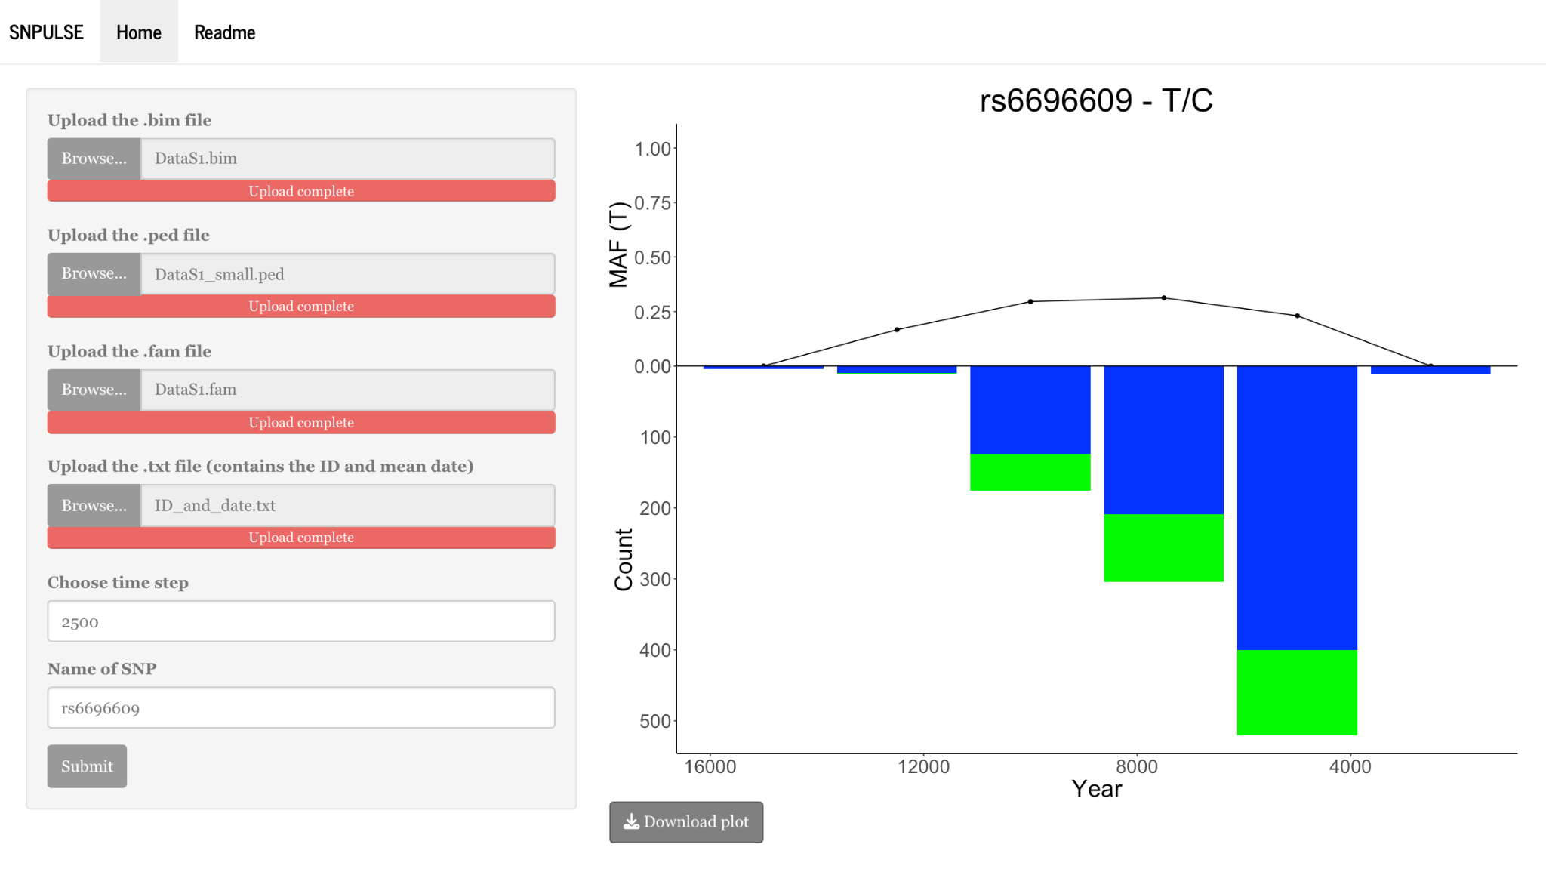
SNPulse

Slide 3
1.
Background Information
MAF: is the frequency at which the less common allele occurs in a population.
provides information about genetic variation within a population.

Slide 4
2.
SNPulse Information
Complexity
Feature

Slide 5
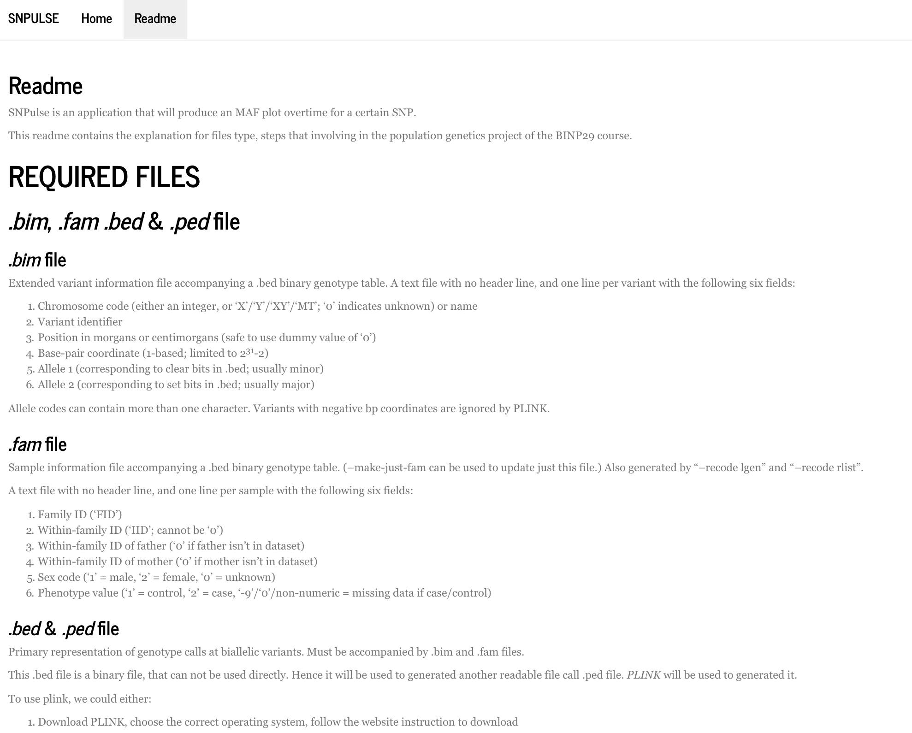

Slide 7
2.
SNPulse Information
Complexity
Feature
Robust and Limitation

Slide 8
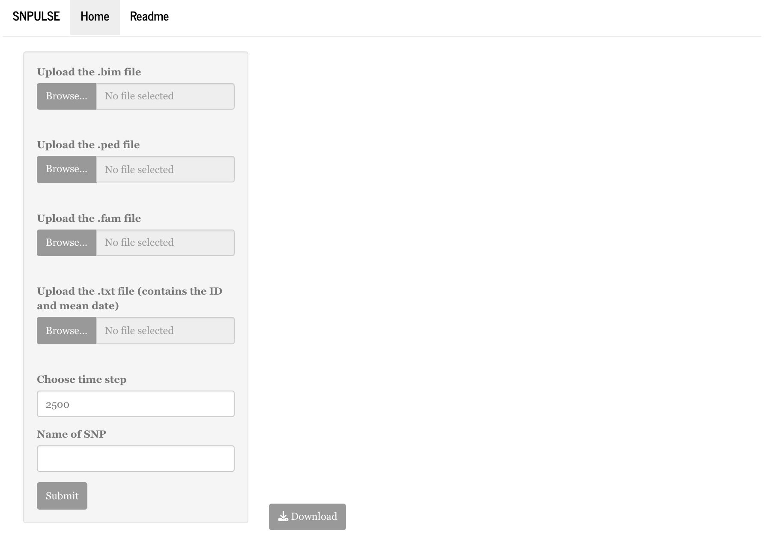
3.
Tool present

Slide 10
4.
Methodology

Slide 11
5.
Summary

