Slide 1

Big Mountain Resort Price Analysis
Report Presented by: Ni Qie

Slide 2
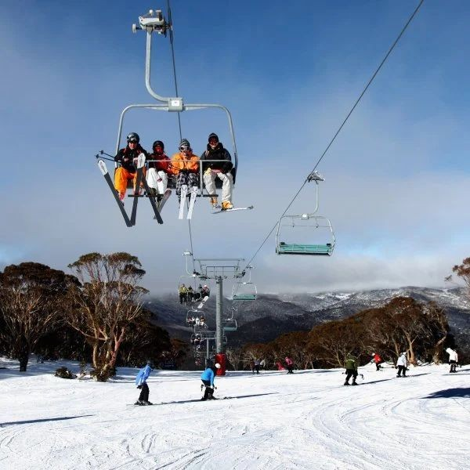
Problem
New chair lift: increases distribution of visitors throughout the resort
Adds an additional $1.54 million in operation costs
Current Ticket Price: $81.00
How do we increase revenue and stay competitive for this upcoming season?

Slide 3
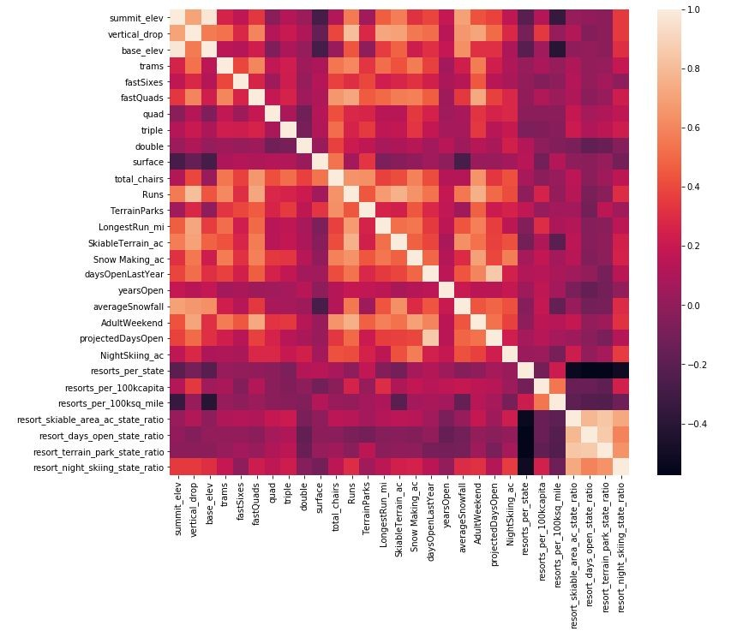
Key Findings
Four features have a strong positive correlation with ticket pricing:
fastQuads
SnowMaking_Ac
Runs
Night skiing ratio
Random Forest Model price: $94.22
Big Mountain Resort has signiﬁcant enough facilities to justify this cost

Slide 4
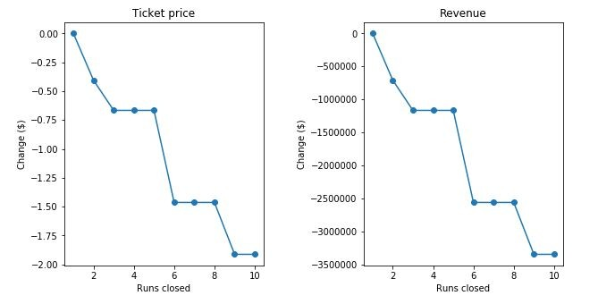
Model and Analysis
The resort can close up to 6 runs each day without a large drop in revenue

Slide 5
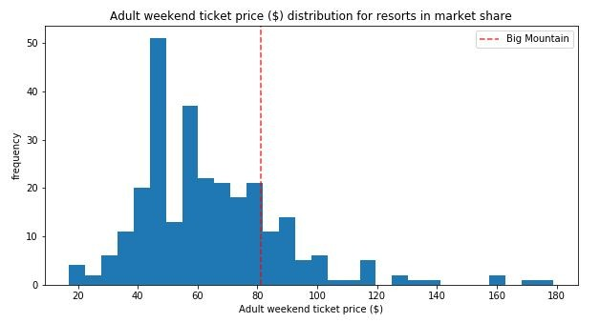
Model and Analysis
Big Mountain Resort ranks in the top quartile in seven of the eight most important qualities
Total Area of Snow Makers
Vertical Drop
Total Number of Chairs
Fast Quads
Total Number of Runs
Longest Run
Skiable Terrain Area
Raising the price would keep us around the same region in this distribution

Slide 6
Recommendations
Raise ticket prices to $89.99
Have 4-6 runs closed each day to save on operation costs
Increase vertical drop by lowering a run 150ft, Install one additional chair lift, Add one additional run, and increase acres of snow cover by two.
The model predicts that this could justify a $2 increase in ticket price, which would increased revenue by $3,464,638

Slide 7
Conclusion
Big Mountain Resort is a high end resort with many signiﬁcant amenities and attractions to oﬀer
You can justify raising the cost if you continue oﬀering high quality amenities, like the new chair lift, to your customers
There is plenty of room to grow revenue and cover the additional operation costs. Any of these recommendations should keep Big Mountain Resort open for many years to come

Slide 8
Thank You!
Questions?

