Slide 1
Distributed Web-Based Systems

Slide 2
Given Credit Where It is Due
Most of the slides are from Beyhan Akporay at Bilkent University,Turkey and Aditya Akella at University of Wisconsin, Madison.
Some slides are from Dijiang Huang at Arizona State University, Marlon Pierce at Indiana University and http://www.brics.dk/ixwt/slides.html.
Some slides are from Stefan Saroiu at University of Toronto and Chiyoung Seo at University of Southern California
I have modified and added some slides.

Slide 3
INTRODUCTION
What is World Wide Web?

Slide 4
INTRODUCTION
The World Wide Web (WWW) can be viewed as a huge distributed system with millions of clients and servers for accessing linked documents.
Servers maintain collections of documents while clients provide users an easy-to-use interface for presenting and accessing those documents.
A document is fetched from a server, transferred to a client, and presented on the screen. To a user there is conceptually no difference between a document stored locally or in another part of the world.

Slide 5
INTRODUCTION
Now, Web has become more than just a simple document based system.
With the emergence of Web services, it is becoming a system of distributed services rather than just documents offered to any user or machine.
What can we get from WWW?
  Read news, listen to music and watch video;
  Buy or sell goods such as books, airline tickets;
  Make reservations on hotel room, rental car, restaurant, etc.;
  Pay bills and transfer money from one bank account to another;
  …

Slide 6
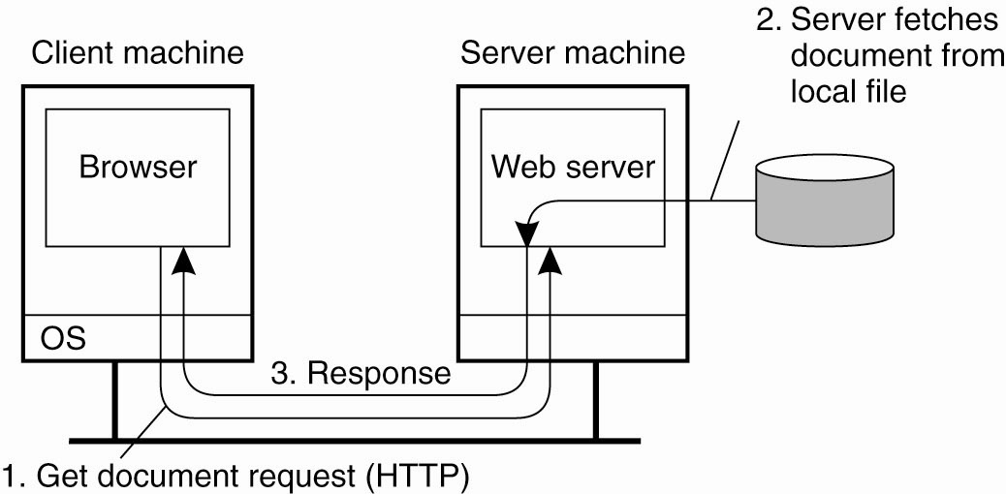
TRADITIONAL WEB-BASED SYSTEMS
Many Web-based systems are still organized as simple client-server architectures.

Slide 7
TRADITIONAL WEB-BASED SYSTEMS
The core of a Web site: a process that has access to a local file system storing documents.

Slide 8
TRADITIONAL WEB-BASED SYSTEMS
How to refer to a document?
  URL (Uniform Resource Locator)?
Notes:
Uniform Resource Locator (URL)

Slide 9
Uniform Resource Locator
A reference called Uniform Resource Locator (URL) is used to refer a document.
The DNS name of its associated server along with a file name is specified.
The URL also specifies the protocol for transferring the document across the network.
Example:
http://www.cse.unl.edu/~ylu/csce855/notes/web-system.ppt

Slide 10
TRADITIONAL WEB-BASED SYSTEMS
A client interacts with Web servers through a special application known as browser.
What’s the key function of a browser?
  Responsible for displaying documents.

Slide 11
WEB DOCUMENTS
A Web document does not only contain text, but it can include all kinds of dynamic features such as audio, video, animations, etc.
In many cases special helper applications (interpreters) are needed, and they are integrated into the browser.
  E.g., Windows Media Player and QuickTime Player for playing streaming content
The variety of document types forces browser to be extensible. As a result, plug-ins are required to follow a standard interfaces so that they can be easily integrated with the browsers.

Slide 12
MULTITIERED ARCHITECTURES
Web documents can be built in two ways:
  Static – locates and returns the object identified in the request. Static objects include predefined HTML pages and JPEG or GIF files. does not require web servers to communication with any server-side application.
  Dynamic – the request is forwarded to an application system where the reply is generated dynamically, i.e. data is generated through a server-side program execution.
Although Web started as simple two-tiered client-server architecture for static Web documents, this architecture has been extended to support advanced type of documents.

Slide 13
MULTITIERED ARCHITECTURES
Because of the server-side processing, many Web sites are now organized as three-tiered architectures consisting of a Web server, an application server, and a database server.
User data comes from an HTML form, specifying the program and parameters.
Server-side scripting technologies are used to generate dynamic content:
  Microsoft: Active Server Pages (ASP.NET)
  Sun: Java Server Pages (JSP)
  Netscape: JavaScript
  Free Software Foundation: PHP

Slide 14
What is the most popular Web server software?
  By far the most popular Web server is Apache. As of March 2007, 58% of all websites are using it.

Slide 15
How to make a web site scalable?

Slide 16
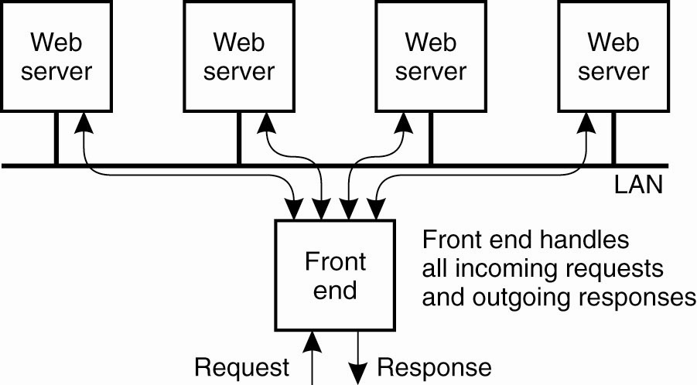
WEB SERVER CLUSTERS
Web servers are replicated and combined with a front end
to improve performance.

Slide 17

WEB SERVER CLUSTERS
The front end can be designed in two ways:
  Transport-layer switch – simply passes data sent along the TCP connection to one of the servers, depending on some measurement of the server’s load.
  Content-aware request distribution – it first inspects the HTTP request and decides which server it should forward that request to.
    For example, if the front end always forwards requests for the same document to the same server, the server may cache the document resulting in better response times.
  Approach that combines the efficiency of transport-layer switch and the functionality of content-aware distribution has been developed.

Slide 18
WEB SERVER CLUSTERS
Another alternative to set up a Web server cluster is to use round-robin DNS.
With round-robin DNS a single domain name is associated with multiple IP addresses.
When resolving a host name, a browser would receive a list of multiple addresses, each address corresponding to a server.
Normally, browsers choose the first address on the list, but most DNS servers circulate the entries.
As a result, simple distribution of requests over the servers in the cluster is achieved.

Slide 19
HTTP
All communication between clients and servers is based on HTTP. Servers listen on port 80.
HTTP is a simple protocol; a client sends a request to a server and waits for a response.
HTTP is stateless; it does not have any concept of open connection and does not require a server to maintain information on its clients. (Can use HTTP cookies to store session information.)
HTTP is based on TCP; whenever a client issues a request to a server, it first sets up a TCP connection and sends the message on that connection. The same connection is used for receiving the response.
One of the problems with the first versions of HTTP was its inefficient use of TCP connections.
  HTTP 1.0 vs. HTTP 1.1

Slide 20
HTTP CONNECTIONS
A Web document is constructed from a collection of different files from the same server.
In HTTP version 1.0 and older, each request to a server required setting up a separate connection. When server had responded, the connection was broken down. These connections are referred as nonpersistent.
In HTTP version 1.1, several requests and their responses can be issued without the need for a separate connection. These connections are referred as persistent.
Furthermore, a client can issue several requests in a row without waiting for the response to the first request which is referred as pipelining.

Slide 21
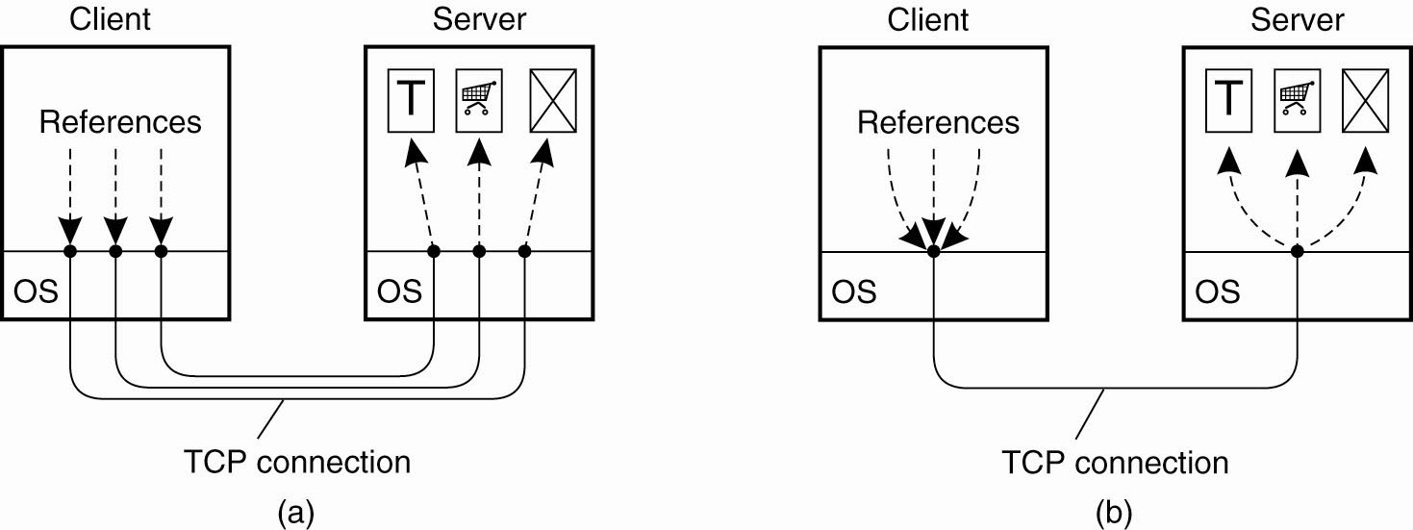
HTTP CONNECTIONS
(a) Using non-persistent connections.
(b) Using persistent connections.

Slide 22
HTTP Caching
Clients often cache documents
  Challenge: update of documents
  If-Modified-Since requests to check
When/how often should the original be checked for changes?
  Check every time?
  Check each session? Day? Etc?
  Use “Expires” header
    If no Expires, often use Last-Modified as estimate

Slide 23
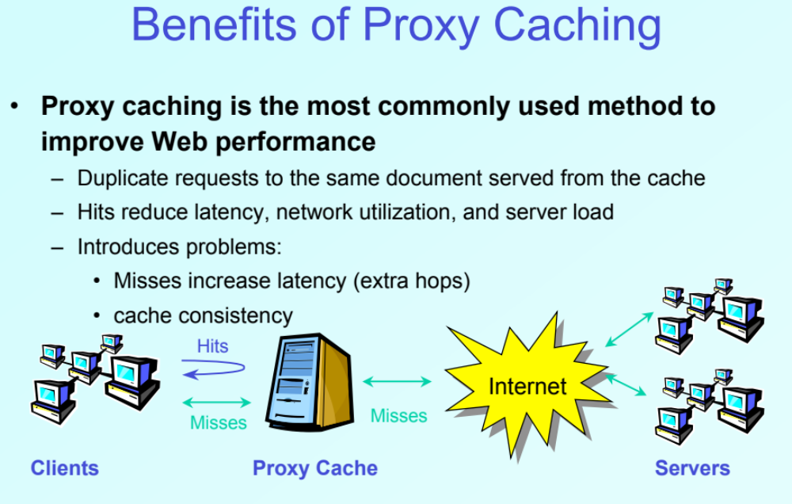

Slide 24
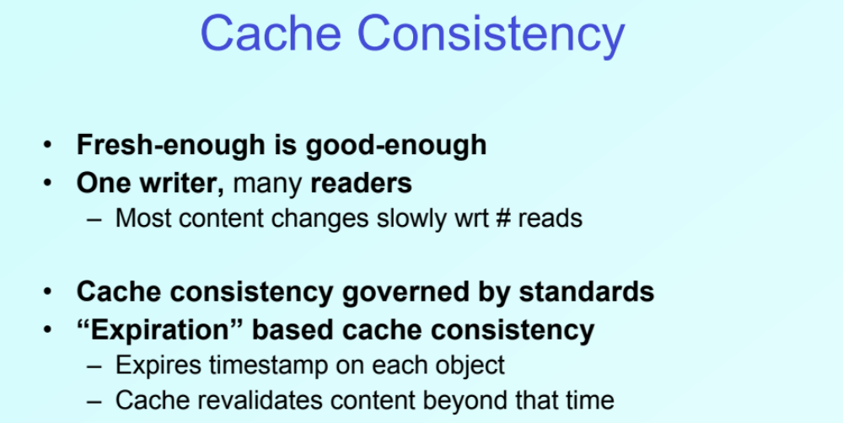

Slide 25
Problems
Over 50% of all HTTP objects are uncacheable – why?
Not easily solvable
  Dynamic data → stock prices, scores, web cams
  CGI scripts → results based on passed parameters
  SSL → encrypted data is not cacheable
  Cookies → results may be based on passed data
  Hit metering → owner wants to measure # of hits for revenue, etc.

Slide 26
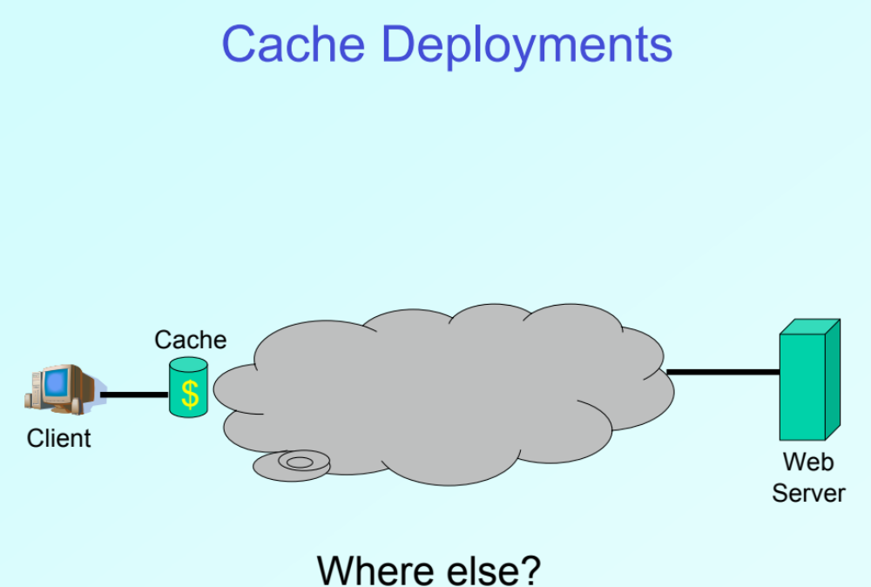
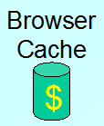

Slide 27
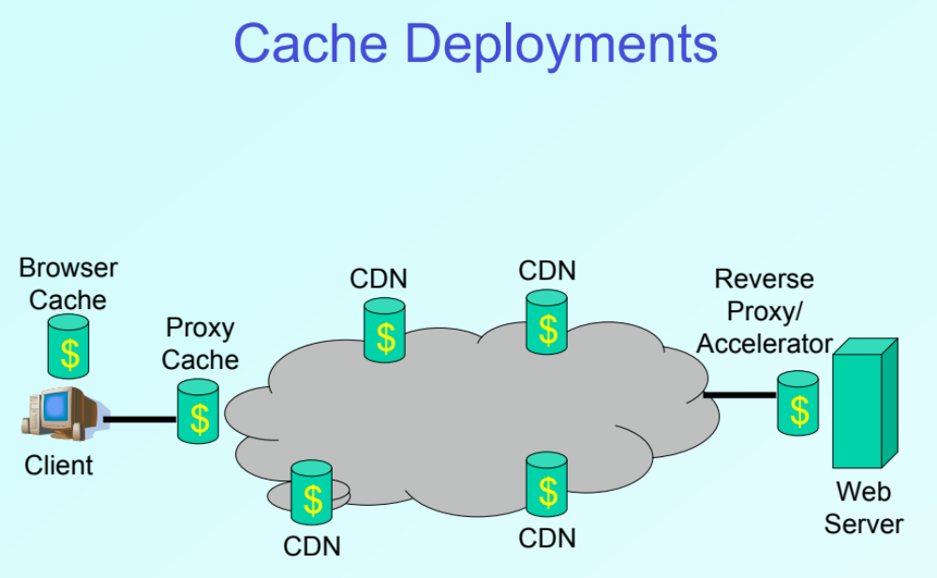

Slide 28
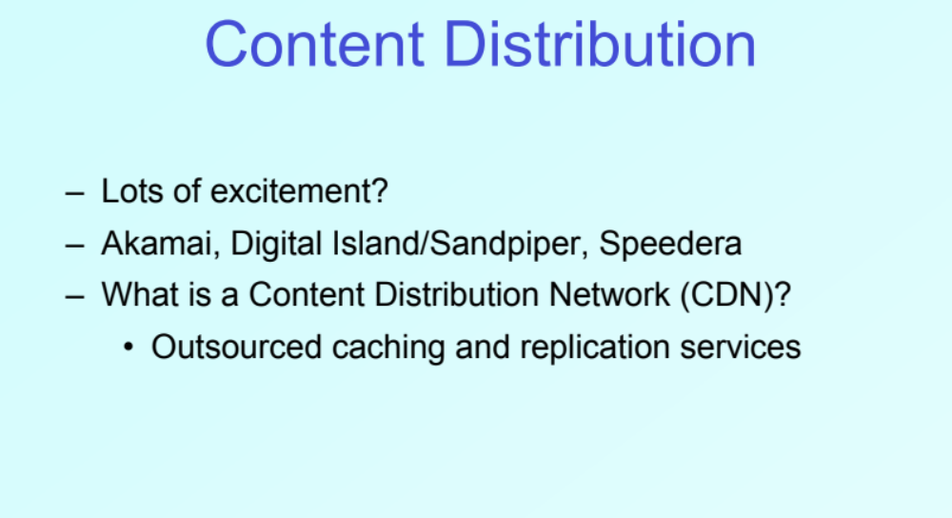


Slide 30
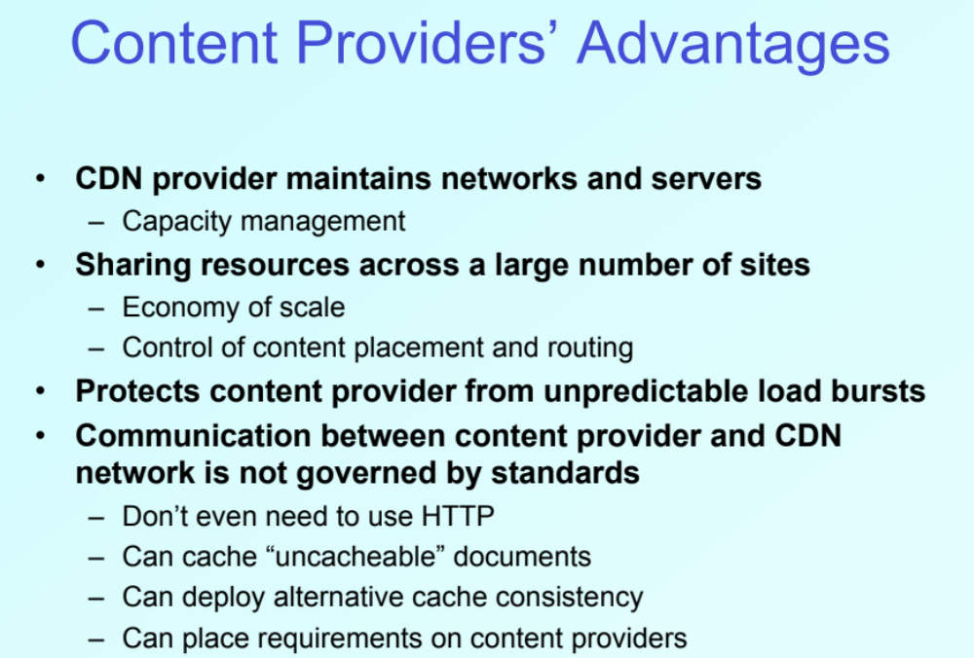

Slide 31
CDN’s Challenges
How to replicate content?
Where to replicate content?
How to find replicated content?
How to choose among known replicas?
How to direct clients towards replica?

Slide 32
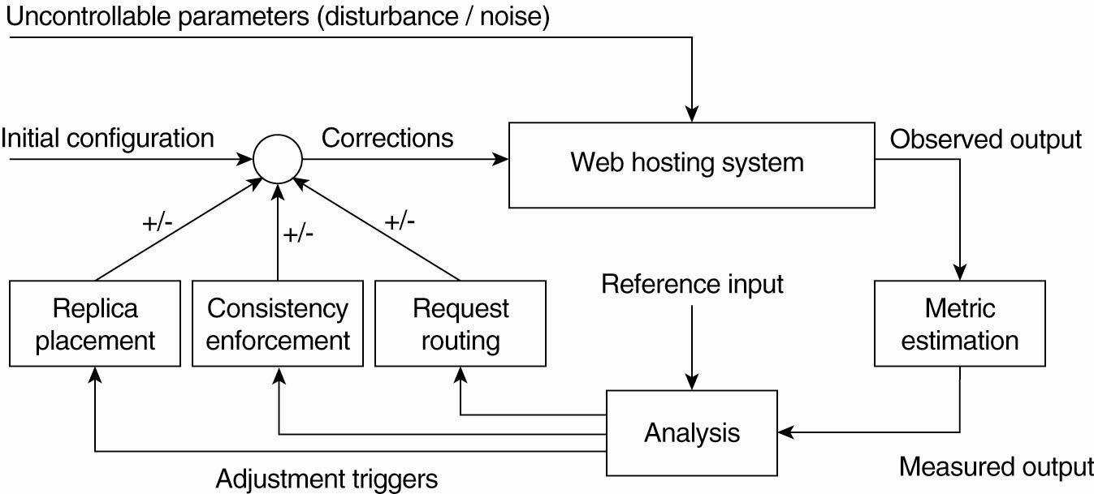
Content Distribution Networks
Replicate content on many servers
Figure 12-18. The general organization of a CDN as a feedback-control system (adapted from Sivasubramanian et al., 2004b).

Slide 33
How Akamai Works
Clients fetch html document from primary server
  E.g. fetch index.html from cnn.com
“Akamaized” URLs for replicated content are replaced in html
  E.g. <img src=“http://cnn.com/af/x.gif”> replaced with <img src=“http://a73.g.akamaitech.net/7/23/cnn.com/af/x.gif”>
Client is forced to resolve aXYZ.g.akamaitech.net hostname

Slide 34
How Akamai Works
Root server gives NS record for akamaitech.net
akamaitech.net name server returns NS record for g.akamaitech.net
g.akamaitech.net name server chooses server in region

Slide 35
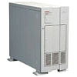
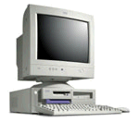
How Akamai Works
cnn.com (content provider)
DNS root server
Get foo.jpg
12
11
Get index.html
1
2
3
5
Akamai high-level DNS server
4
6
7
Akamai low-level DNS server
8
Nearby matching
Akamai server
9
End-user
10
Get /cnn.com/foo.jpg

Slide 36
Akamai – Subsequent Requests
cnn.com (content provider)
DNS root server
Get index.html
1
2
Akamai high-level DNS server
7
Akamai low-level DNS server
8
Nearby matching
Akamai server
9
End-user
10
Get /cnn.com/foo.jpg

Slide 37
What is a Web Service?
Web Service:
  “Web-based applications that dynamically interact with other Web applications using open standards that include XML, UDDI and SOAP”
Service-Oriented Architecture (SOA):
  “Development of applications from distributed collections of smaller loosely coupled service providers”
  “A collection of services or software agents that communicate freely with each other”

Slide 38
Web Service Advantages for E-Business
Allow companies to reduce the cost of doing e-business, to deploy solutions faster
  Need a common program-to-program communications model
Allow heterogeneous applications to be integrated more rapidly, easily and less expensively
Facilitate deploying and providing access to business functions over the Web

Slide 39
Web Services Terminology
SOAP (Simple Object Access Protocol)
  exchanging XML messages on a network
  Like RPC, it provides a way to communicate between applications
  Unlike RPC, it communicates over HTTP
  Because HTTP is supported by all Internet browsers and servers, SOAP can run on different operating systems, with different technologies and programming languages
WSDL (Web Service Description Language )
  describing interfaces of Web services
UDDI (Universal Description, Discovery and Integration)
  managing registries of Web services

Slide 40
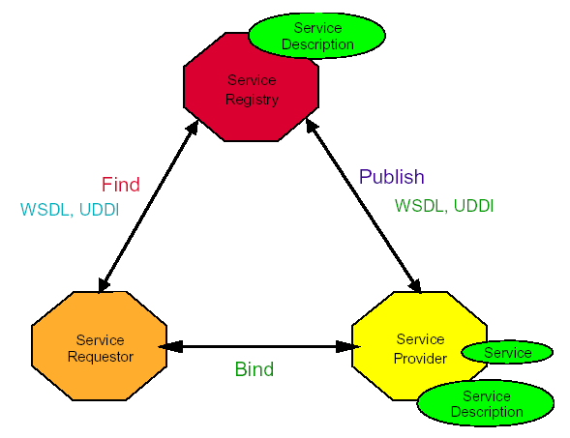
Web Service Model (1/3)

Slide 41
Web Service Model (2/3)
Roles in a Web Service Architecture
  Service provider
    Owner of the service
    Platform that hosts access to the service
  Service requestor
    Business that requires certain functions to be satisfied
    Application looking for and invoking an interaction with a service
  Service registry
    Searchable registry of service descriptions where service providers publish their service descriptions

Slide 42
Web Service Model (3/3)
Operations in a Web Service Architecture
  Publish
    Service descriptions need to be published in order for service requestor to find them
  Find
    Service requestor queries the service registry for the service required
  Bind
    Service requestor invokes or initiates an interaction with the service at runtime

Slide 43
Fault Tolerance Challenges
How to deal with web service replications
How to combine Byzantine fault tolerance with web services
  Merideth et al. “Thema: Byzantine-Fault-Tolerant Middleware for Web-Service Applications”, 2005.

Slide 44
Web Security Issues
The Web has become the visible interface of the Internet
  Many corporations now use the Web for advertising, marketing and sales
Web servers might be easy to use but…
  Complicated to configure correctly and difficult to build without security flaws
  They can serve as a security hole by which an adversary might access other data and computer systems
 | Threats | Consequences | Countermeasures
Integrity | Modification of Data Trojan horses | Loss of Information Compromise of Machine | MACs (mandatory access control) and Hashes
Confidentiality | Eavesdropping Theft of Information | Loss of Information Privacy Breach | Encryption
DoS | Stopping Filling up Disks and Resources | Stopped Transactions
Authentication | Impersonation Data Forgery | Misrepresentation of User Accept false Data | Signatures, MACs

Slide 45
So Where to Secure the Web?
There are many strategies to securing the web
We may attempt to secure the IP Layer of the TCP/IP Stack: this may be accomplished using IPSec, for example.
We may leave IP alone and secure on top of TCP: this may be accomplished using the Secure Sockets Layer (SSL) or Transport Layer Security (TLS)
We may seek to secure specific applications by using application-specific security solutions: for example, we may use Secure Electronic Transaction (SET)
The first two provide generic solutions, while the third provides for more specialized services

Slide 46
A Quick Look at Securing the TCP/IP Stack
HTTP
FTP
SMTP
HTTP
FTP
SMTP
SSL/TLS
TCP
TCP
IP/IPSEC
IP
At the Network Level
At the Transport Level
S/MIME
PGP
SET
Kerberos
SMTP
HTTP
UDP
TCP
IP
At the Application Level

