Slide 1
Design analysis and algorithm
Lecturer : mr.Nguyễn Chí Thiện
Student : Nguyễn Quốc Cường – 518H0003
Hà Quán Quân – 518H0047

Slide 2
CHAPTER I: THE BRUTE-FORCE Algorithm
Introduction of Brute-Force algorithm :
The brute-force algorithm is the most honest form of problem solving , usually based on the problem posed and the definition of the concepts involved
The bonus of the algorithm :
- "Force" is implied in the definition of strategy is the definition of computer, not the definition of intelligence.
- "Just do it" could be another way of describing the law of exhaustion. And usually, the relaxation tactic is one of the simplest.

Slide 3
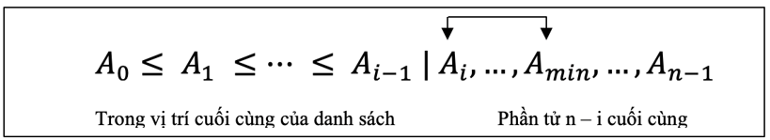
Examples for the algorithm:
Sort option:
Algorithm Ideas :
- We start the sorting method by scanning the entire given list, then continue to find the smallest element in the list and change its place with the element header in the list. Next, we continue to scan the list and start with the second element to find the smallest of the n-1 elements and swap places with the second item of the list. Again, for the ith element of each scan in the list, we will number from 0 to n-2, the algorithm finds the smallest element in the last n-1 element and changes with Ai:
- After scanning n-1 times, the list has been sorted.

Slide 4
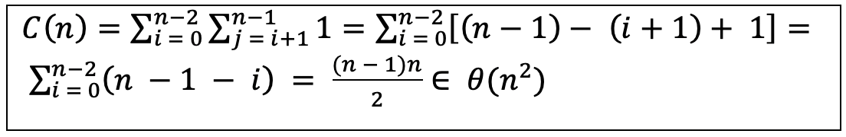
Code: SelectionSort(A[0..n−1]) # Sorts a given array by selection sort # Input: An array A[0..n − 1] of orderable elements # Output: Array A[0..n − 1] sorted in nondecreasing order #import time for i ← 0 to n − 2 do min ← i for j ← i + 1 to n − 1 do if A[j] < A[min] min ← j swap A[i] and A[min]
Analysis algorithm:
- Head size is chosen by n number of elements; The math is essentially the comparison in line 8 "A [j] <A [min]". The total number of executions depends only on the size of the array, which is calculated using the following formula:

Slide 5
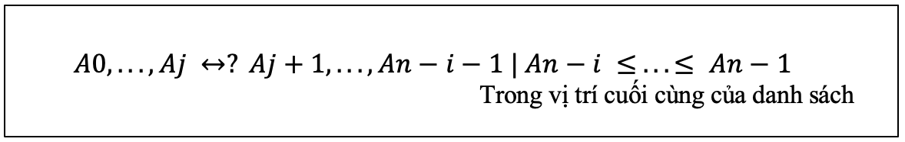
Bubble Arrangement Algorithm (Arrange bubbles):
Algorithm idea :
- Another application of the brute-force algorithm in job sorting is to compare adjacent elements of a list and change their position if they are out of order. By the reset, we will place the largest elements at the bottom of the list. The next step is to do the same for the 2nd largest element, and so on until after n - 1, the list is sorted. The pass i (0 ≤ i ≤ n - 2) of the bubble arrangement can be represented by the following diagram :

Slide 6
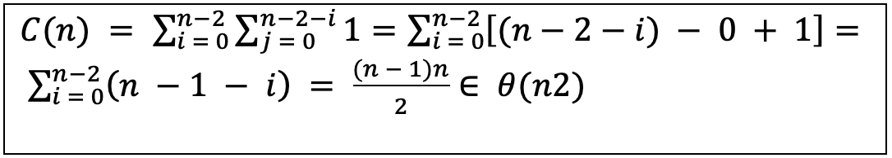
Code : BubbleSort (A [0..n - 1]) # Sorts a given array by bubble sort # Input: An array A [0..n - 1] of orderable elements # Output: Array A [0..n - 1] sorted in nondecreasing order import time for i ← 0 to n - 2 do for j ← 0 to n - 2 - i do if A [j + 1] <A [j] swap A [j] and A [j + 1] Analysis algorithm : - Head size is chosen by n number of elements; The math is essentially the comparison in line 7 "A [j + 1] <A [j]". The total number of executions depends only on the size of the array, which is calculated using the following formula :

Slide 7
Sequence Search Algorithm (Sequence Search) :
Algorithm Ideas:
The algorithm only needs to compare linking parts of a given list with a certain key search definition until there is a match (successful search) or the list ends without the result see match (search failed). One simple addition trick is commonly used in implementing sequential search: if we append the search key to the end of the list, then the search key will have to be successful and therefore we can eliminate Remove Complete the last list check.

Slide 8
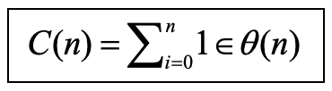
Code : SequentialSearch2 (A [0..n], K) // Deploy a sequential search with the search key as a guard station // Input: An array A of n elements and the search key K // Output: Index of the first element in A [0..n - 1] is valid // equals K or −1 if no such element is found A [n] ← K I ← 0 while A [i]! = K do i ← i + 1 if I <n return me the other returns −1
Analysis algorithm:
Searching in such a list can be stopped as soon as the element is larger or by key search. Auto search provides a great illustration of the exhausting approach, with special features (simplicity) and weaknesses (less efficiency).

Slide 9
CHAPTER II: THE SHARING AND SHARING ALGORITHM
Introduction to Divide & Conquer algorithm:
The division and conquer algorithm (divide and conquer) is the best known general algorithm design technique. Although its popularity may be related to its name appeal, it deserves: some very good and effective algorithms are possible implementations of this general strategy.

Slide 10
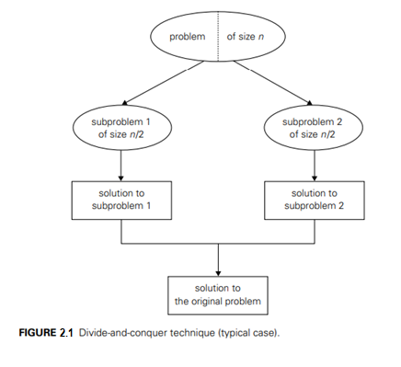
The idea of ​​the algorithm:
- Share algorithms and conquer operations according to the following general plan :
+ A problem is divided into many problems of the same type, ideally about each other's size.
+ The problems are solved (usually recursively, albeit compounding using a different algorithm, especially when the problems become small enough).
+ If necessary, the solutions to the problems are combined to get a solution to the beginning of the problem.

Slide 11
Examples for the algorithm:
Merge Sort algorithm:
Algorithm Ideas:
- Merge Sort is an example for successful application of the division and conquest technique. Sort algorithm a given A [0..n-1] by dividing into 2 small segments A [0..n / 2-1] and A [n / 2… n-1], sort 2 The array by recursive is followed by a sequence. The results are obtained with a sequence arranged in order.

Slide 12
Code :
Mergesort(A[0..n − 1])
//Sorts array A[0..n − 1] by recursive mergesort
//Input: An array A[0..n − 1] of orderable elements
//Output: Array A[0..n − 1] sorted in nondecreasing order
if n > 1
copy A[0..n/2 − 1] to B[0..n/2 − 1]
copy A[n/2..n − 1] to C[0..n/2 − 1]
Mergesort(B[0..n/2 − 1])
Mergesort(C[0..n/2 − 1])
Merge(B, C, A)
Merge(B[0..p − 1], C[0..q − 1], A[0..p + q − 1])
//Merges two sorted arrays into one sorted array
//Input: Arrays B[0..p − 1] and C[0..q − 1] both sorted
//Output: Sorted array A[0..p + q − 1] of the elements of B and C
i ← 0; j ← 0; k ← 0
while i < p and j < q do
if B[i]≤ C[j]
A[k]← B[i]; i ← i + 1
else A[k]← C[j]; j ← j + 1
k ← k + 1
if i = p
copy C[j..q − 1] to A[k..p + q − 1]
else copy B[i..p − 1] to A[k..p + q − 1]

Slide 13
Quick sort algorithm (Quick Sort):
Algorithm Ideas:
Quick sort is another important sorting algorithm based on a scaling approach. Unlike unified sort, which divides its input elements by their position in the array, quick sort splits them by their value. Partitioning is the arrangement of the elements of the array such that all elements to the left of some elements A [s] are less than or equal to A [s] and all elements to the right of A [ s] is both greater than or equal to it. After the partition is reached, A [s] will be at its last position in the sorted array and we can continue to sort the left and right subarrays of A [s] independently. (example: follow the same method).

Slide 14
Code :
Quicksort(A[l..r])
//Sorts a subarray by quicksort
//Input: Subarray of array A[0..n − 1], defined by its left
//and right
// indices l and r
//Output: Subarray A[l..r] sorted in nondecreasing order
if l < r
s ←Partition(A[l..r]) //s is a split position
Quicksort(A[l..s − 1])
Quicksort(A[s + 1..r])
HoarePartition (A [l..r])
// Divide a sub-array according to Hoare's algorithm, use
// first element
// as an axis
// Input: Array of array A [0..n - 1], defined to its left
// and right
// index l and r (l <r)
// Output: Partition of A [l..r], with split position
// return as
// value of this function
p ← A [l]
i ← l; j ← r + 1
say again
repeat i ← i + 1 until A [i] ≥ p
repeat j ← j - 1 until A [j] ≤ p
swap (A [i], A [j])
until I ≥ j
swap (A [i], A [j]) // undo last swap when I ≥ j
swap (A [l], A [j])
return j

Slide 15
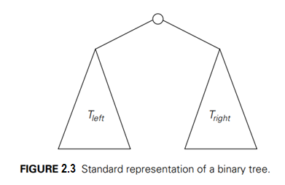
Algorithm Binary Tree Traversals (Binary Tree Traversals):
Algorithm Ideas:
A binary tree T is defined as a set of owners of empty nodes or consisting of a root and two discrete binary trees TL and TR called the fruit and the right of the root.
Since the tree binary into 2 is smaller than the structure of the same type, left and right, we will calculate the height of the tree by calculating the height of the tree on the left and right then adding 1.

Slide 16
Code :
Height (T)
// Recursively calculate the height of the binary tree
// Input: A binary tree T
// Output: The height of T
if T = ∅ returns −1
else returns the maximum {Height (Tleft), Height (Height)} + 1

Slide 17
CHAPTER III: GREEN ALGORITHM
Introduction about Greedy algorithm:
- Brute-force algorithm is a format of the problem to be that the way of true, usually based on the problem posed and defining the concepts involved.
The idea of ​​the algorithm:
- "Force" is implied by the sense of strategy is the definition of the computer, not the definition of intelligence.
- "Please do it" (just do it) can be a other way to description of the undergone. And often, the tactic of exhausting is one of the simplest of the way.

Slide 18
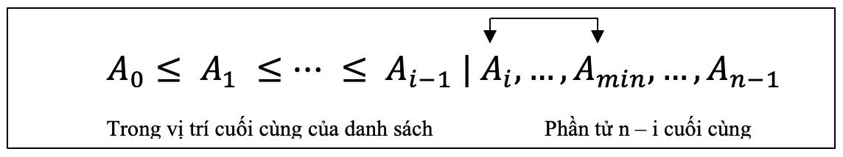
Examples for the algorithm :
Prim algorithm :
Algorithm Ideas :
We start the sorting method by scanning the entire given list, then continue to find the smallest element in the list and change its place with the element header in the list. Next, we continue to scan the list and start with the second element to find the smallest of the n-1 elements and swap places with the second item of the list. Again, for the ith element of each scan in the list, we will number from 0 to n-2, the algorithm finds the smallest element in the last n-1 element and changes with Ai:
After scanning n-1 times, the list has been sorted.

Slide 19
code
Prim (G)
// Prim's algorithm to create minimal spanning tree
// Input: Connected graph weighted G = {V, E}
// Output: ET, the set of edges that create the minimum spanning tree of G
VT ← {v0} // set of tree vertices can be initialized with any vertex
ET ← ∅
for me ← 1 to | V | - 1 do
find an edge with least weight e ∗ = (v ∗, u ∗) among all sides (v, u)
such that v belongs to VT and u belongs to V - VT
VT ← VT ∪ {u ∗}
ET ← ET ∪ {e ∗}
return ET

Slide 20
Analysis algorithm :
Head size is chosen by n number of elements; The math is essentially the comparison in line 8 "A [j] <A [min]". The total number of executions depends only on the size of the array, which is calculated using the following formula :

Slide 21
Kruskal Algorithm:
Algorithm Ideas:
Another application of the brute-force algorithm for sorting compares adjacent elements of a list and changing their place if they are out of order. By setting it up again, we'll put the biggest elements at the bottom of the list. The next step is to do the same for the 2nd largest element, and so on, until after n - 1 the list is sorted. The pass i (0 ≤ i ≤ n - 2) of the bubble arrangement can be represented by the following diagram:

Slide 22
Code :
BubbleSort (A [0..n - 1])
# Sort a certain array by sorting bubbles
# Input: An A [0..n - 1] array of elements that can be ordered
# Output: Array A [0..n - 1] is sorted in order without decreasing input time
give me ← 0 to n - 2 do
for j ← 0 to n - 2 - I do
if A [j + 1] <A [j] swaps A [j] and A [j + 1]

Slide 23
Analysis algorithm:
- Head size is chosen by n number of elements; The basic math is compared in line 7 "A [j + 1] <A [j]". The total number of executions depends only on the size of the array, which is calculated using the following formula:

Slide 24
Kruskal Algorithm:
Algorithm Ideas:
Another application of the brute-force algorithm for sorting compares adjacent elements of a list and changing their place if they are out of order. By setting it up again, we'll put the biggest elements at the bottom of the list. The next step is to do the same for the 2nd largest element, and so on, until after n - 1 the list is sorted. The pass i (0 ≤ i ≤ n - 2) of the bubble arrangement can be represented by the following diagram:

Slide 25
Code :
BubbleSort (A [0..n - 1])
# Sort a certain array by sorting bubbles
# Input: An A [0..n - 1] array of elements that can be ordered
# Output: Array A [0..n - 1] is sorted in order without decreasing input time
give me ← 0 to n - 2 do
for j ← 0 to n - 2 - I do
if A [j + 1] <A [j] swaps A [j] and A [j + 1]

Slide 26
Analysis algorithm:
- Head size is chosen by n number of elements; The basic math is compared in line 7 "A [j + 1] <A [j]". The total number of executions depends only on the size of the array, which is calculated using the following formula:

Slide 27
Dijkstra's algorithm:
Algorithm Ideas:
The algorithm only needs to compare linking parts of a given list with a certain key search definition until there is a match (successful search) or the list ends without the result see match (search failed). One simple addition trick is commonly used in implementing sequential search: if we append the search key to the end of the list, then the search key will have to be successful and therefore we can eliminate Remove Complete the last list check.

Slide 28
Code :
SequentialSearch2(A[0..n], K)
//Implements sequential search with a search key as a sentinel
//Input: An array A of n elements and a search key K
//Output: The index of the first element in A[0..n − 1] whose value
//is equal to K or −1 if no such element is found
A[n]← K
i ← 0
while A[i]!= K do
i ← i + 1
if i < n return i
else return −1

Slide 29
Analysis algorithm:
Searching in such a list can be stopped as soon as the element is larger or by key search. Auto search provides a great illustration of the exhausting approach, with special features (simplicity) and weaknesses (less efficiency).

Slide 30
CHAPTER IV: PROGRAMMING ACTIONS OF Mathematics
Introduction to Dynamic Programming algorithm:
Dynamic Programming (Dynamic Programming) is a design technique with an interesting history. It was invented by a famous American mathematician, Richard Bellman, in the 1950s as a general method for optimizing multilayer decision processes.
- "Programming" in the name of this technique stands for "planning" and does not refer to computer setup. After proving its value as an important tool of mathematical application, the program's ultimately established itself as a general design technique, at least in the computer science world, as a tech sytic plan general plan to manage the world in content-intensive products

Slide 31
The idea of ​​the algorithm :
Active programming is a technique for solving problems with cross operations. Usually, these problems arise from repetition relating to the solution of a given problem with the solution of its smaller problems. Instead of solving the problem of repeated overlap, make a proposal to only solve each problem less than once and record the results in the table so that the solution can be obtained for the original problem.

Slide 32

Examples for the algorithm:
Item Coin Algorithm:
Algorithm Ideas:
- There are a row include n coins whose value is a positive integer that is not necessarily distinguishable. The goal is to maximize the currency collected provided that 2 adjacent coins are not selected,
- Let F (n) be the largest amount that can be collected from n coins. To deduce F (n) to access the system, we need to divide the selected coins into 2 groups:
Group 1: group includes the end of the coin.
▪ The largest collected currency is taken from group 1: cn + F (n -2).
▪ The value of the coin nth plus the maximum value we can choose from [1… n-2].
o Group 2: group excluding the end of the coin.
▪ Collect the most amount of money from group 2: F (n-1)
- From there, we infer the retrieval system from the above conditional constraints:

Slide 33
Code :
CoinRow(C[1..n])
//Applies formula (8.3) bottom up to find the maximum amount of money //that can be picked up from a coin row without picking two adjacent coins
//Input: Array C[1..n] of positive integers indicating the coin values
//Output: The maximum amount of money that can be picked up
F[0]← 0; F[1]← C[1]
for i ← 2 to n do
F[i]← max(C[i] + F[i − 2], F[i − 1])
return F[n]

Slide 34

Algorithm Change Implementation:
Algorithm Ideas:
- Exchange change for the amount using the minimum amount.
- Cho F (n) is the Minimum number of the coins that value of they up to n; to easy for F (0) = 0. Amount n can only increase by 1 coin with the value of dj to the amount n -dj with j = 1,2, .., m such that n> = dj. Hence, we can choose a minimum number F (n-dj) +1. And since 1 is a constant, we can find the first minimum F (n-dj) and complementary tool 1. From there we can deduce the retrieval system for F (n):

Slide 35
Code :
ChangeMaking(D[1..m], n)
//Applies dynamic programming to find the minimum number of coins
//of denominations d1 < d2 < ... < dm where d1 = 1 that add up to a
//given amount n
//Input: Positive integer n and array D[1..m] of increasing positive
// integers indicating the coin denominations where D[1] = 1
//Output: The minimum number of coins that add up to n
F[0]← 0
for i ← 1 to n do
temp ← ∞; j ← 1
while j ≤ m and i ≥ D[j ] do
temp ← min(F[i − D[j ]], temp)
j ← j + 1
F[i]← temp + 1
return F[n]

Slide 36

Robot Algorithm Coin Collection:
Algorithm Ideas:
- Some coins are placed in each cell of the table, such that each cell is not more than one cent. A robot located in the top left cell of the board needs to collect as many coins as possible and put them in the bottom right cell of the board. Each step, the robot can only move right or down one square. The robot will collect the coin of that slot.
- Let F (I, j) is a number of the clock big most that robot can be decimal and bring to ô (i, j) at the lines ith and jth column in table, it can to be this box information through. Its adjacent elements like F (i-1, j) or F (i, j-1) and the largest number of coins that can be carried across the cells are F (i-1, j) and F (i, j-1). For rows and columns we assume that F (i-1, j) and F (i, j-1) are 0 for non-existent cells. From there we have the following formula:

Slide 37
Code :
RobotCoinCollection (C [1..n, 1..m])
// Apply dynamic programming to calculate the maximum number
// coins that robot can collect on n × m board by starting at (1, 1)
// and move right and down from top left corner to right corner
// Input: Matrix C [1..n, 1..m] has elements equal to 1 and 0
// for cells with and without coins, respectively
// Output: Maximum number of coins that robot can bring to cell (n, m)
F [1, 1] ← C [1, 1]; for j ← 2 to m do F [1, j] ← F [1, j - 1] + C [1, j]
let me ← 2 to n do
F [i, 1] ← F [i - 1, 1] + C [i, 1]
for j ← 2 to m do
F [i, j] ← max (F [i - 1, j], F [i, j - 1]) + C [i, j]
returns F [n, m]

Slide 38
Thanks for watching

