Slide 1

CHAPTER 8
Algorithms
Notes:
1.#

Slide 2
Objectives
After studying this chapter, the student should be able to:
Define an algorithm and relate it to problem solving.
Define three construct and describe their use in algorithms.
Describe pseudocode and how they are used in algorithms.
Describe UML diagrams and how they are used in algorithms.
List basic algorithms and their applications.
Describe the concept of sorting and understand the mechanisms
behind three primitive sorting algorithms.
Describe the concept of searching and understand the
mechanisms behind two common searching algorithms.
Define subalgorithms and their relations to algorithms.
Distinguish between iterative and recursive algorithms

Slide 3

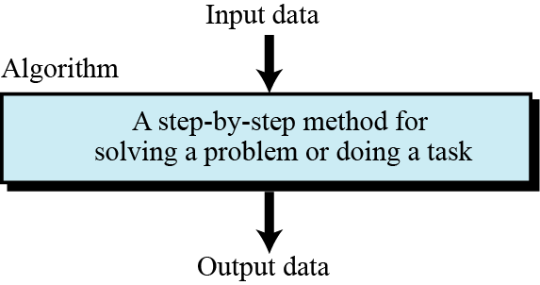
8-1 CONCEPT
In this section we informally define an algorithm and elaborate on the concept using an example.
8.1.1 Informal definition
An informal definition of an algorithm is:
Algorithm: a step-by-step method for solving a problem
or doing a task.
Figure 8.1 Informal definition of an algorithm used in a computer

Slide 4
8.1.2 Example
Let us elaborate on this simple definition with an example. We want to develop an algorithm for finding the largest integer among a list of positive integers. The algorithm should find the largest integer among a list of any size (for example 5, 1000, 10 000, 1 000 000). The algorithm should be general and not depend on the number of integers.
It is obvious that finding the largest integer among many integers is a task that cannot be done in one step, either by a human or a computer. The algorithm needs to test each integer one by one.

Slide 5
To solve this problem, we need an intuitive approach. First use a small number of integers (for example, five), then extend the solution to any number of integers. Our solution for five integers follows the same principles and restrictions for one thousand or one million integers. Assume, even for a five-integer case, that the algorithm handles the integers one by one. It looks at the first integer without knowing the values of the remaining integers. After it handles the first one, it looks at the second integer, and so on. Figure 8.2 shows one way to solve this problem.
We call the algorithm FindLargest. Each algorithm has a name to distinguish it from other algorithms. The algorithm receives a list of five integers as input and gives the largest integer as output.

Slide 6
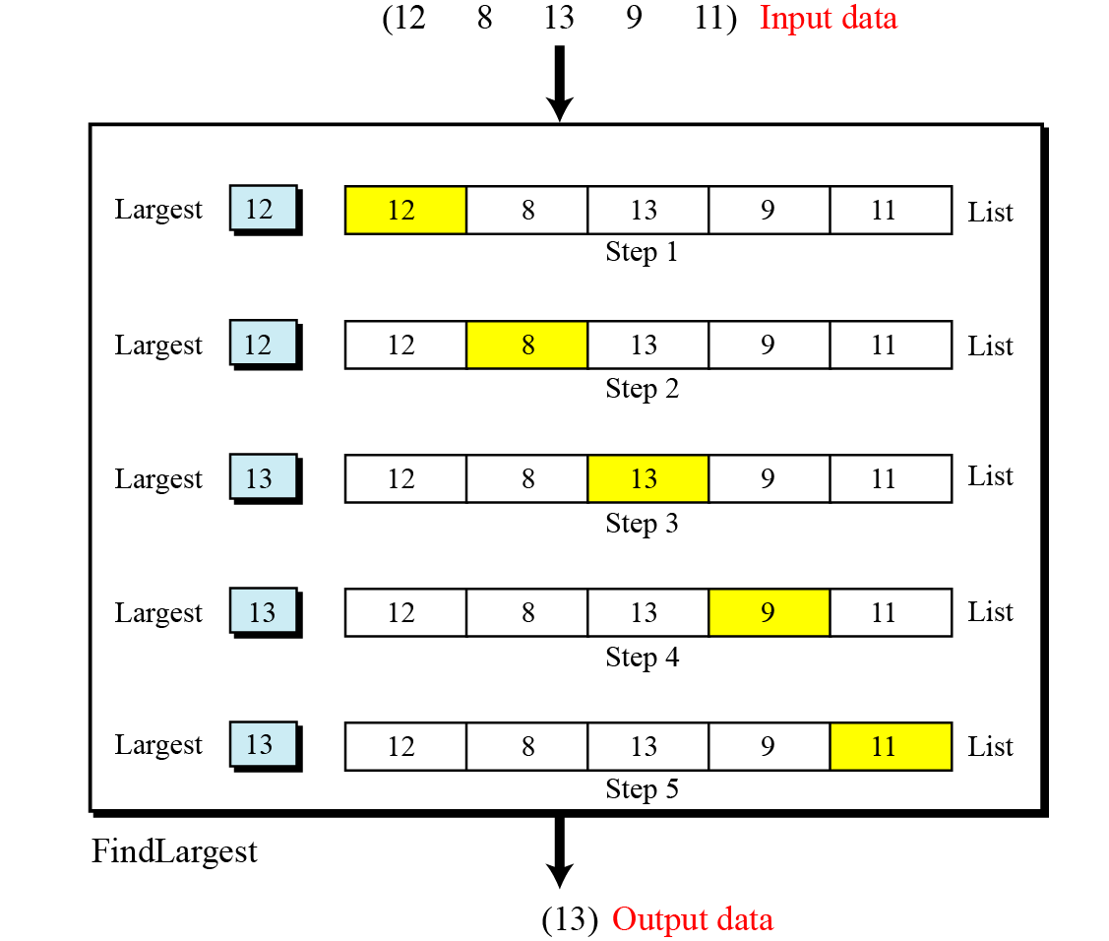
Figure 8.2 Finding the largest integer among five integers

Slide 7
Input
The algorithm accepts the list of five integers as input.
Processing
The algorithm uses the five steps to find the largest integer:
Output
Because there are no more integers to be processed, the algorithm outputs the value of Largest, which is 13.

Slide 8
8.1.3 Defining actions
Figure 8.2 does not show what should be done in each step. We can modify the figure to show more details.

Slide 9
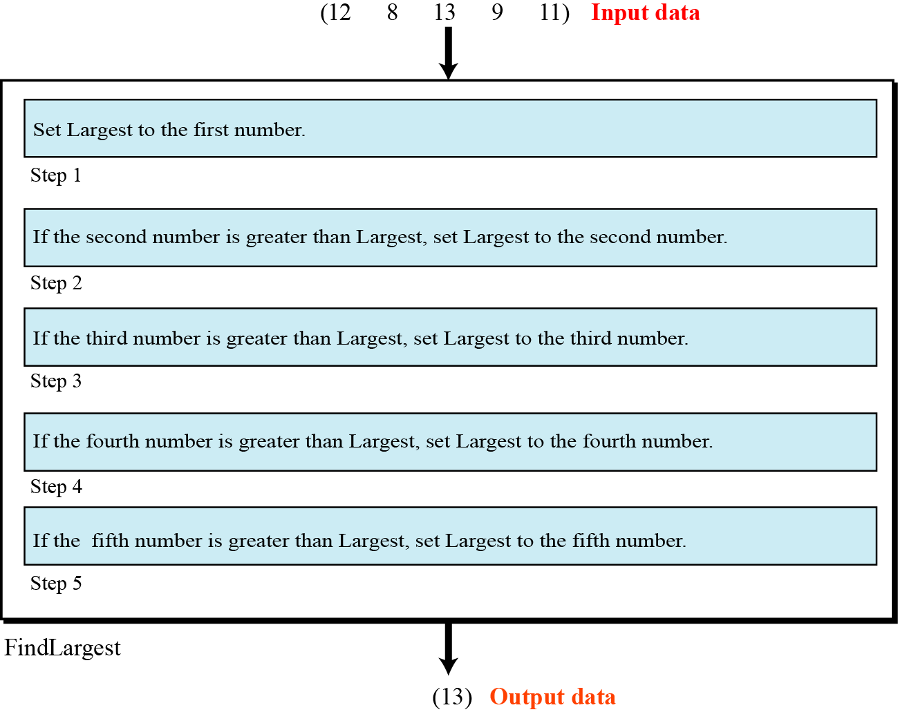
Figure 8.3 Defining actions in FindLargest algorithm

Slide 10
8.1.4 Refinement
This algorithm needs refinement to be acceptable to the programming community. There are two problems. First, the action in the first step is different than those for the other steps. Second, the wording is not the same in steps 2 to 5. We can easily redefine the algorithm to remove these two inconveniences by changing the wording in steps 2 to 5 to “If the current integer is greater than Largest, set Largest to
the current integer.” The reason that the first step is different than the other steps is because Largest is not initialized. If we initialize Largest to −∞ (minus infinity), then the first step can be the same as the other steps, so we add a new step, calling it step 0 to show that it should be done before processing any integers.

Slide 11
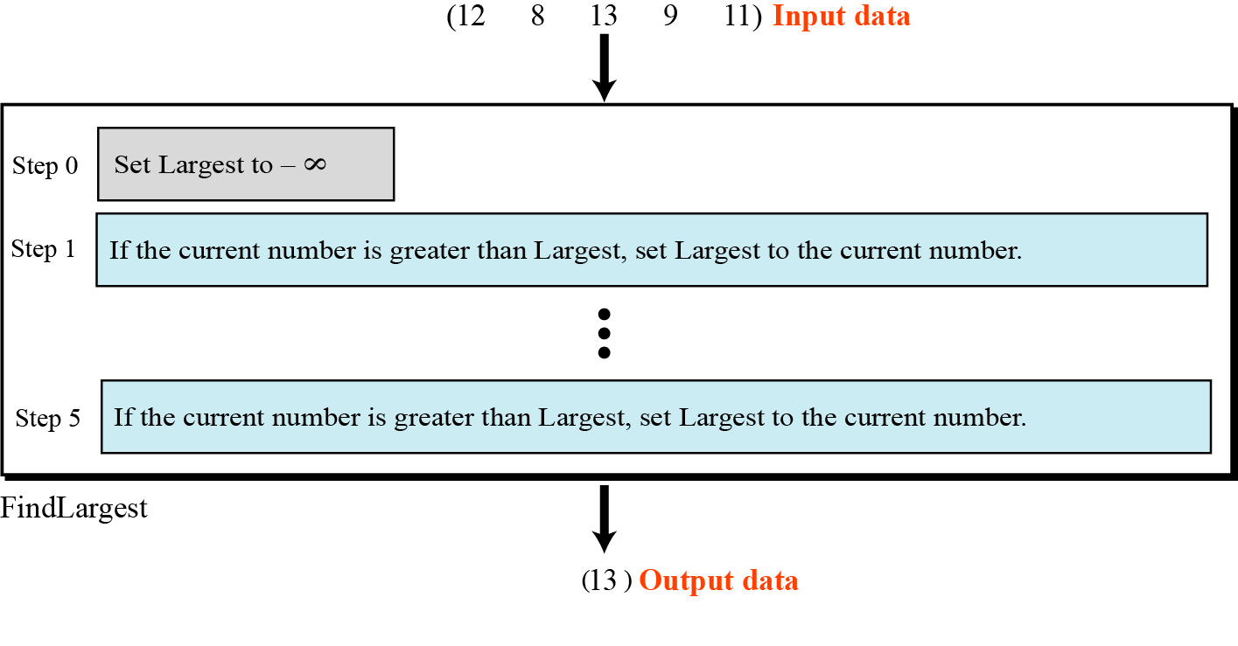
Figure 8.4 FindLargest refined

Slide 12
8.1.5 Generalization
Is it possible to generalize the algorithm? We want to find the largest of n positive integers, where n can be 1000, 1,000,000, or more. Of course, we can follow Figure 8.4 and repeat each step. But if we change the algorithm to a program, then we need to actually type the actions for n steps!
There is a better way to do this. We can tell the computer to repeat the steps n times. We now include this feature in our pictorial algorithm (Figure 8.5).

Slide 13
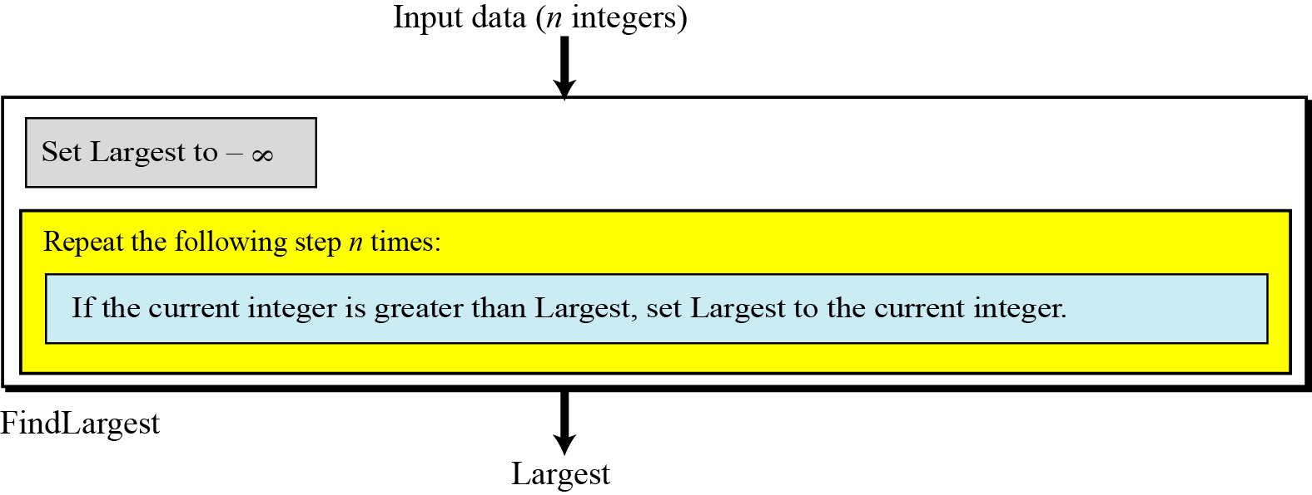
Figure 8.5 Generalization of FindLargest

Slide 14
8-2 THREE CONSTRUCTS
Computer scientists have defined three constructs for a structured program or algorithm. The idea is that a program must be made of a combination of only these three constructs: sequence, decision (selection), and repetition (Figure 8.6). It has been proven there is no need for any other constructs. Using only these constructs makes a program or an algorithm easy to understand, debug, or change.
8.<number>

Slide 15
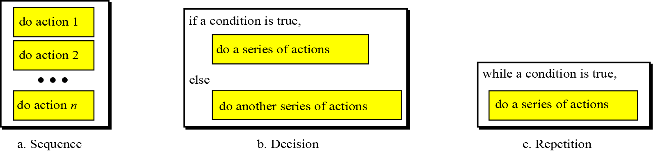
Figure 8.6 Three constructs

Slide 16
8.2.1 Sequence
The first construct is called the sequence. An algorithm, and eventually a program, is a sequence of instructions, which can be a simple instruction or either of the other two constructs.
8.2.2 Decision
Some problems cannot be solved with only a sequence of simple instructions. Sometimes we need to test a condition. If the result of testing is true, we follow a sequence of instructions: if it is false, we follow a different sequence of instructions. This is called the decision (selection) construct.
8.<number>

Slide 17
8.2.3 Repetition
In some problems, the same sequence of instructions must be repeated. We handle this with the repetition or loop construct. Finding the largest integer among a set of integers can use a construct of this kind.
8.<number>

Slide 18
8-3 ALGORITHM REPRESENTATION
So far, we have used figures to convey the concept of an algorithm. During the last few decades, tools have been designed for this purpose. Two of these tools, UML and pseudocode, are presented here.
8.<number>

Slide 19
8.3.1 UML
Unified Modeling Language (UML) is a pictorial representation of an algorithm. It hides all the details of an algorithm in an attempt to give the “big picture” and to show how the algorithm flows from beginning to end. UML is covered in detail in Appendix B. Here we show only how the three constructs are represented using UML (Figure 8.7).
8.<number>

Slide 20
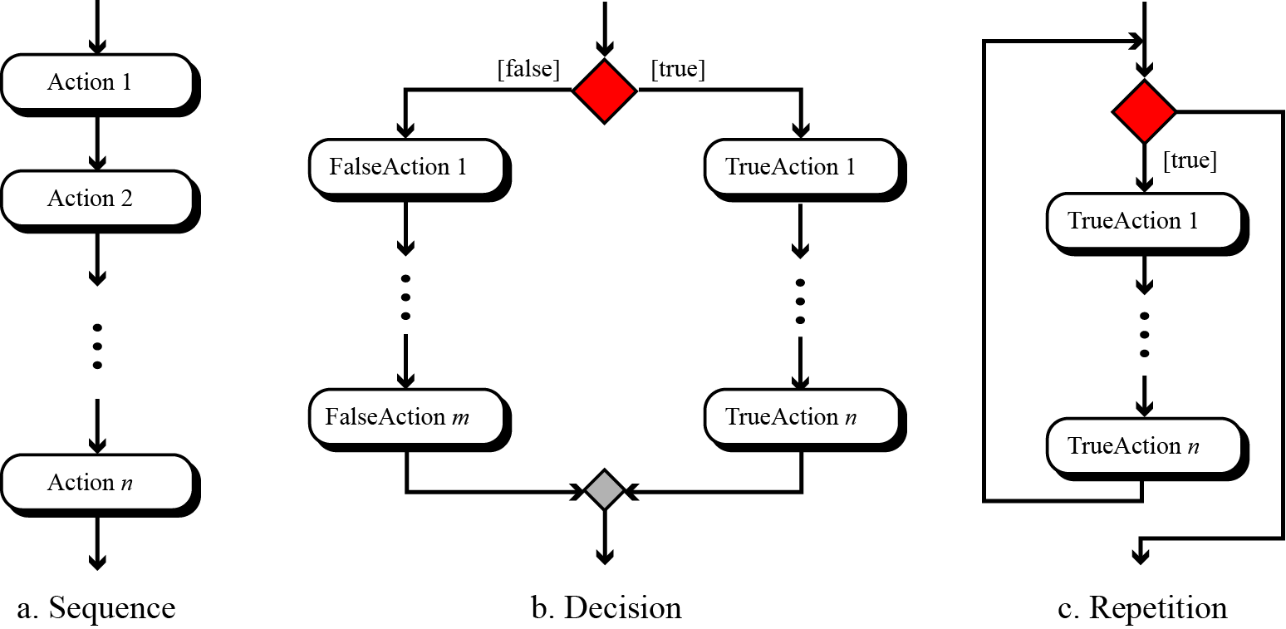
Figure 8.7 UML for three constructs

Slide 21
8.3.2 Pseudocode
Pseudocode is an English-language-like representation of an algorithm. There is no standard for pseudocode—some people use a lot of detail, others use less. Some use a code that is close to English, while others use a syntax like the Pascal programming language. Pseudocode is covered in detail in Appendix C. Here we show only how the three constructs can be represented by pseudocode (Figure 8.8).
8.<number>

Slide 22
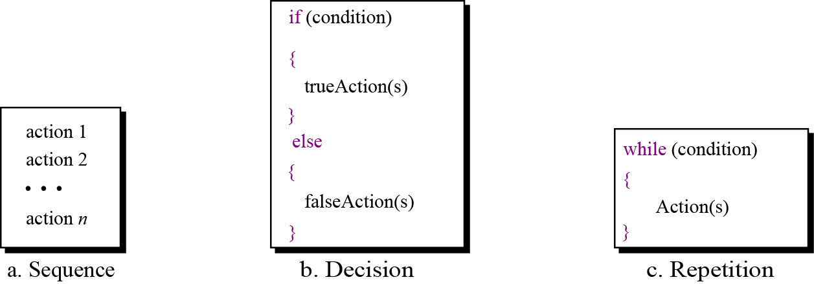
Figure 8.8 Pseudocode for three constructs

Slide 23
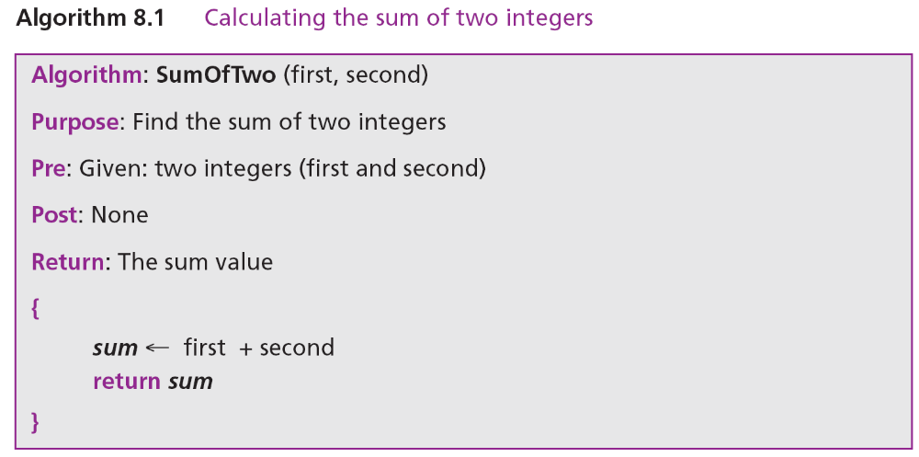
Example 8.1
Write an algorithm in pseudocode that finds the sum of two integers.
Solution
See Algorithm 8.1

Slide 24
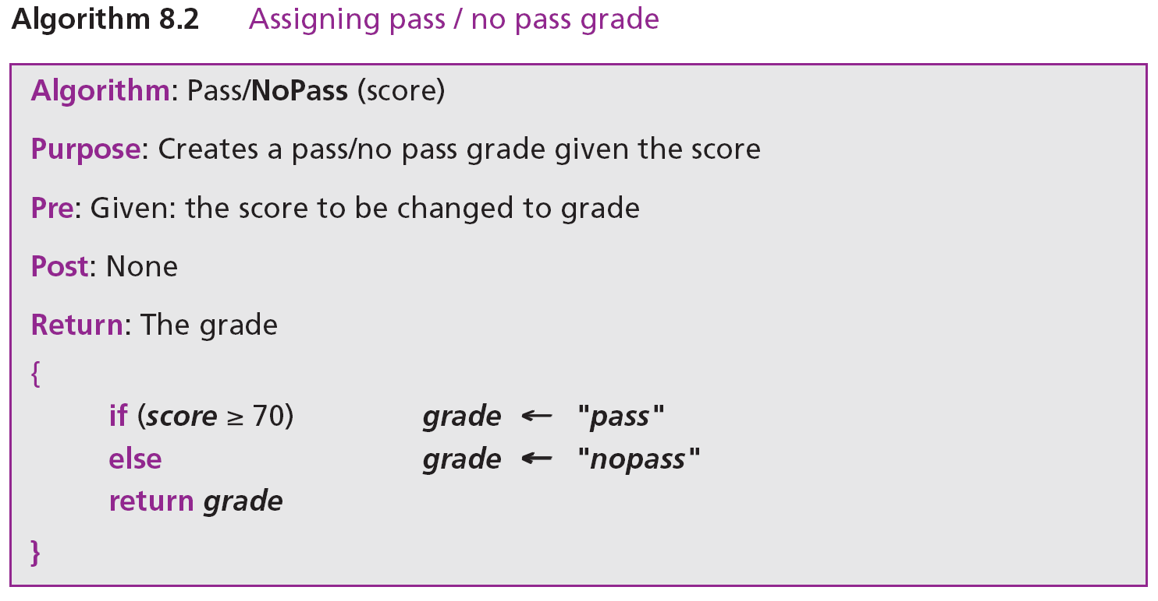
Example 8.2
Write an algorithm to change a numeric grade to a pass/no pass grade.
Solution
Algorithm 8.2 shows the pseuducode.

Slide 25
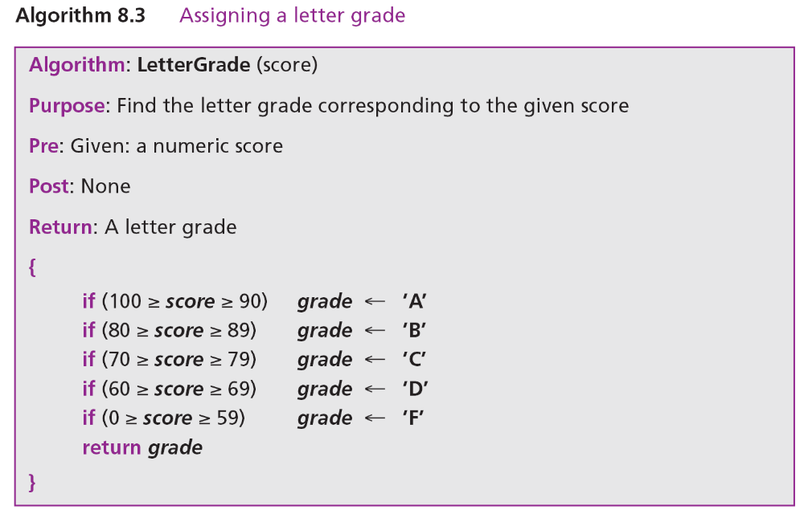
Example 8.3 8.3
Write an algorithm to change a numeric grade to a letter grade.
Solution
Algorithm 8.3 shows the pseudocode.

Slide 26
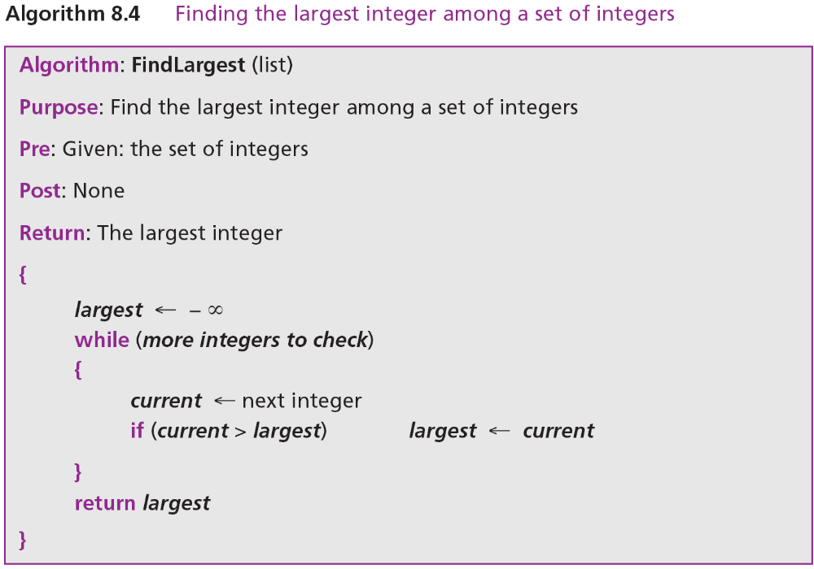
Example 8.4
Write an algorithm to find the largest of a set of integers. We do not know the number of integers.
Solution
Algorithm 8.4 shows the pseudocode.

Slide 27
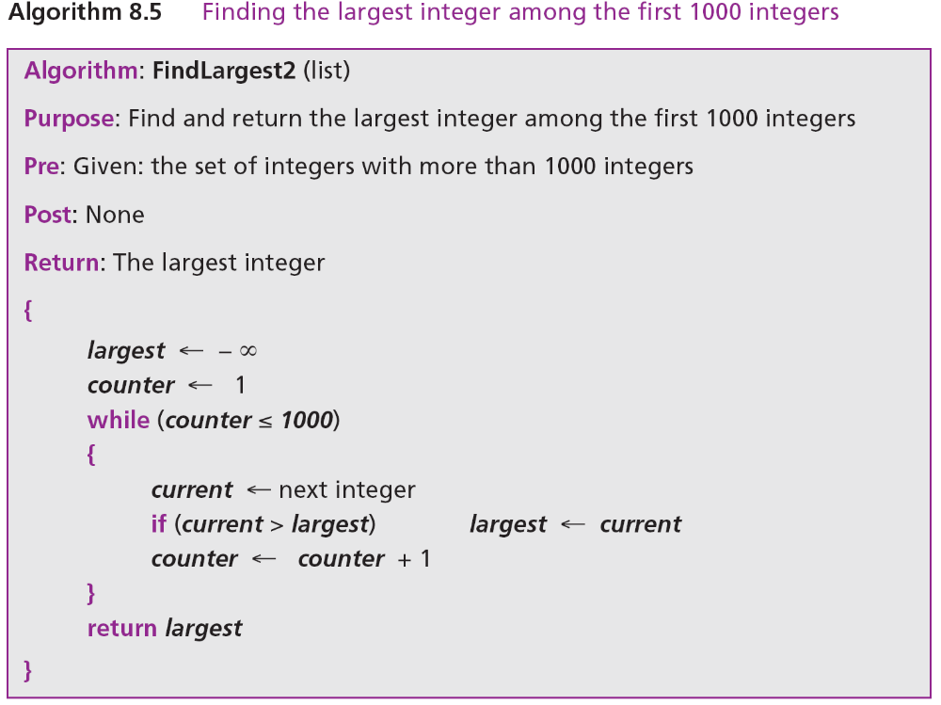
Example 8.5
Write an algorithm to find the largest of the first 1000 integers in a set of integers.
Solution
Algorithm 8.4 shows the pseudocode.

Slide 28

8-4 A MORE FORMAL DEFINITION
Now that we have discussed the concept of an algorithm and shown its representation, here is a more formal definition.
Algorithm: An ordered set of unambiguous steps that produces a result and terminates in a finite time.
8.<number>

Slide 29
8.4.1 Well-Defined
An algorithm must be a well-defined, ordered set of instructions.
8.4.2 Unambiguous steps
Each step in an algorithm must be clearly and unambiguously defined. If one step is to add two integers, we must define both “integers” as well as the “add” operation: we cannot for example use the same symbol to mean addition in one place and multiplication somewhere else.
8.4.3 Produce a result
An algorithm must produce a result, otherwise it is useless. The result can be data returned to the calling algorithm, or some other effect (for example, printing).

Slide 30
8.4.3 Terminate in a finite time
An algorithm must terminate (halt). If it does not (that is, it has an infinite loop), we have not created an algorithm. In Chapter 17 we will discuss solvable and unsolvable problems, and we will see that a solvable problem has a solution in the form of an algorithm that terminates.
8.<number>

Slide 31
8-5 BASIC ALGORITHMS
Several algorithms are used in computer science so prevalently that they are considered “basic”. We discuss the most common here. This discussion is very general: implementation depends on the language.

Slide 32
8.5.1 Summation
One commonly used algorithm in computer science is summation. We can add two or three integers very easily, but how can we add many integers? The solution is simple: we use the add operator in a loop (Figure 8.9).
A summation algorithm has three logical parts:
Initialization of the sum at the beginning.
The loop, which in each iteration adds a new integer to the sum.
Return of the result after exiting from the loop.

Slide 33
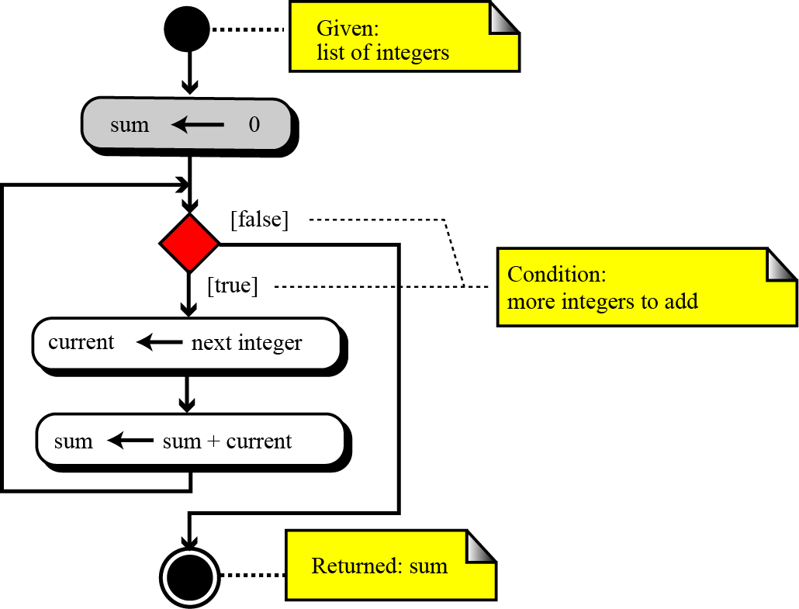
Figure 8.9 Summation algorithm

Slide 34
8.5.2 Product
Another common algorithm is finding the product of a list of integers. The solution is simple: use the multiplication operator in a loop (Figure 8.10).
A product algorithm has three logical parts:
Initialization of the product at the beginning.
The loop, which in each iteration multiplies a new integer with the product.
Return of the result after exiting from the loop.

Slide 35
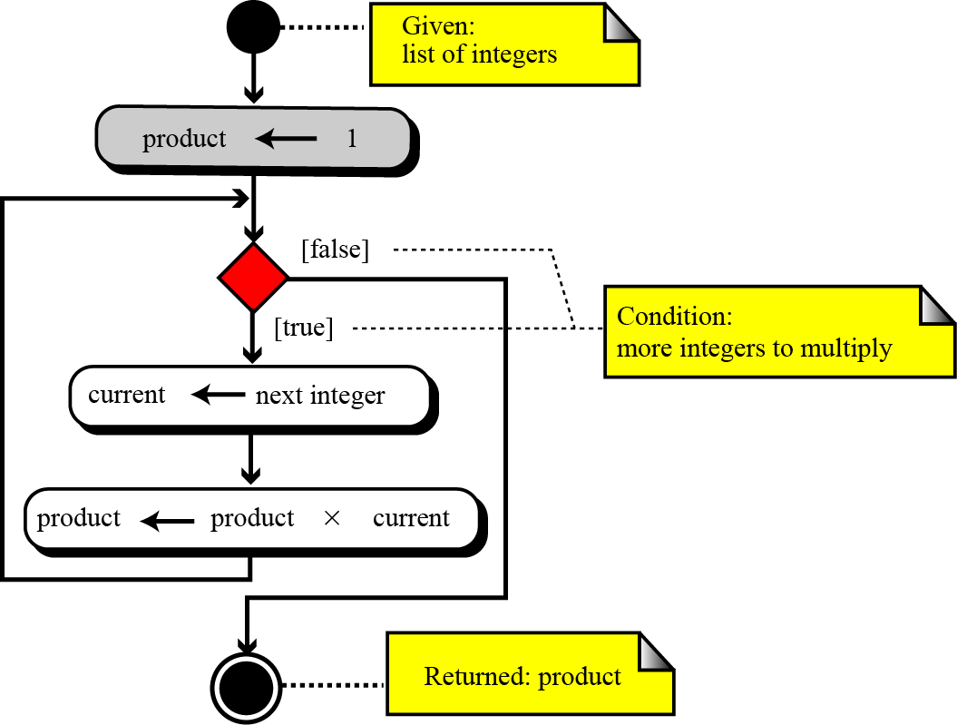
Figure 8.10 Product algorithm

Slide 36
8.5.3 Smallest and largest
We discussed the algorithm for finding the largest among a list of integers at the beginning of this chapter. The idea was to write a decision construct to find the larger of two integers. If we put this construct in a loop, we can find the largest of a list of integers.
Finding the smallest integer among a list of integers is similar, with two minor differences. First, we use a decision construct to find the smaller of two integers. Second, we initialize with a very large integer instead of a very small one.

Slide 37
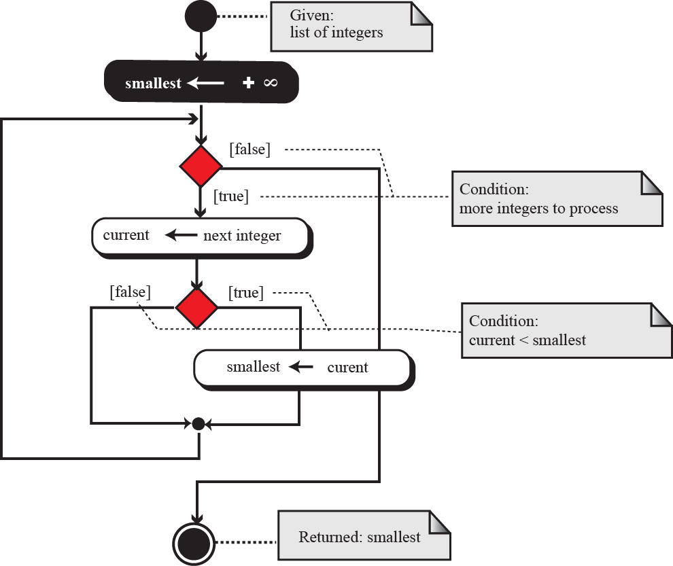
Figure 8.11 Finding the smallest data item

Slide 38
8.5.4 Sorting
One of the most common applications in computer science is sorting, which is the process by which data is arranged according to its values. People are surrounded by data. If the data was not ordered, it would take hours and hours to find a single piece of information. Imagine the difficulty of finding someone’s telephone number in a telephone book that is not ordered.
In this section, we introduce three sorting algorithms: selection sort, bubble sort, and insertion sort. These three sorting algorithms are the foundation of faster sorting algorithms used in computer science today.

Slide 39
Selection sorts
In a selection sort, the list to be sorted is divided into two sublists—sorted and unsorted—which are separated by an imaginary wall. We find the smallest element from the unsorted sublist and swap it with the element at the beginning of the unsorted sublist. After each selection and swap, the imaginary wall between the two sublists moves one element ahead.

Slide 40
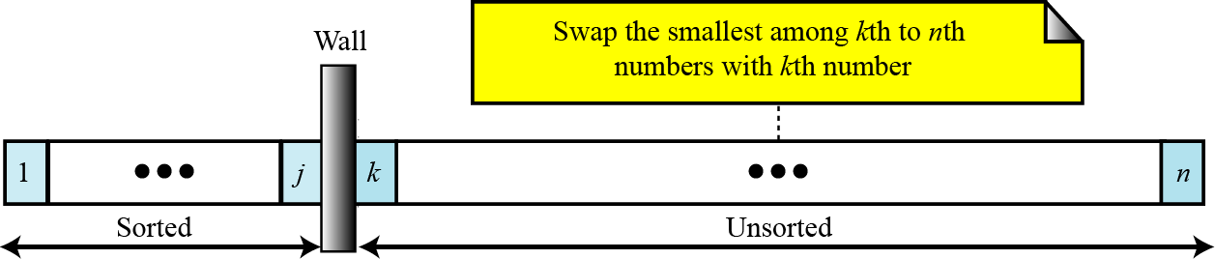
Figure 8.12 Selection sort

Slide 41
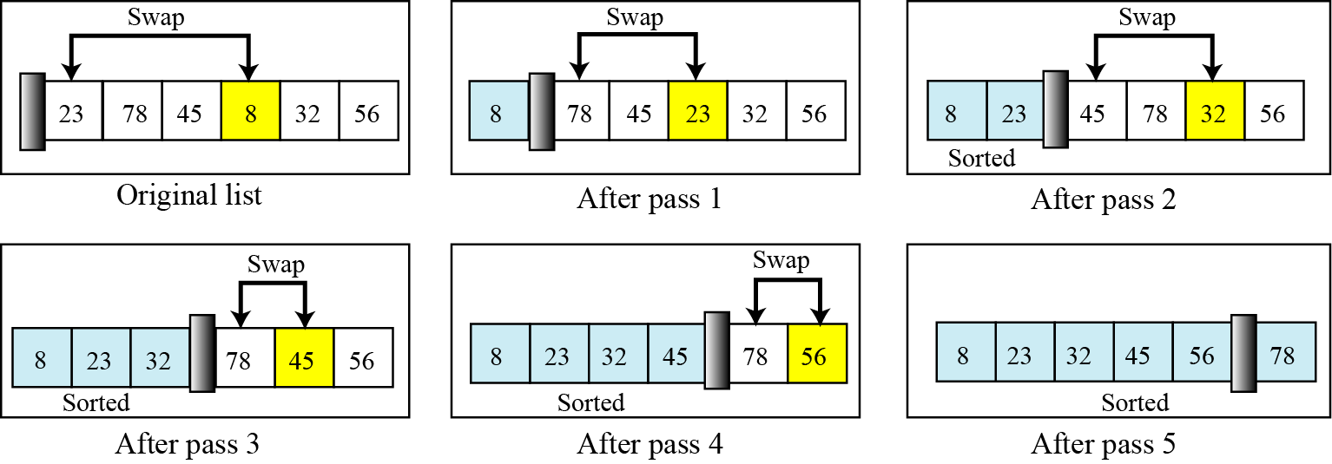
Figure 8.13 Example of selection sort

Slide 42
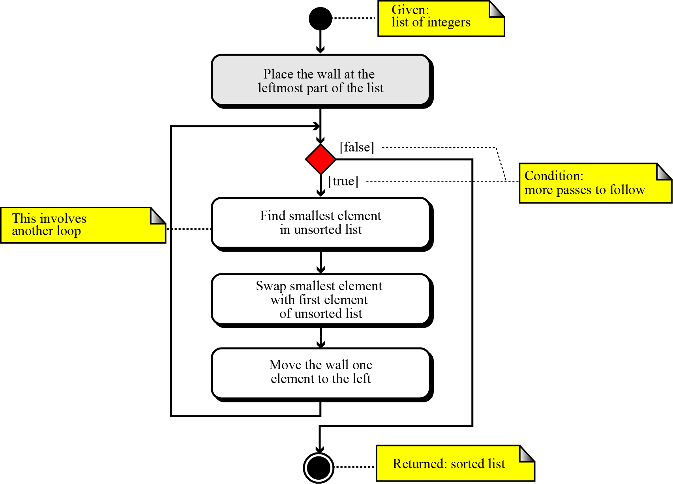
Figure 8.13 Selection sort algorithm

Slide 43
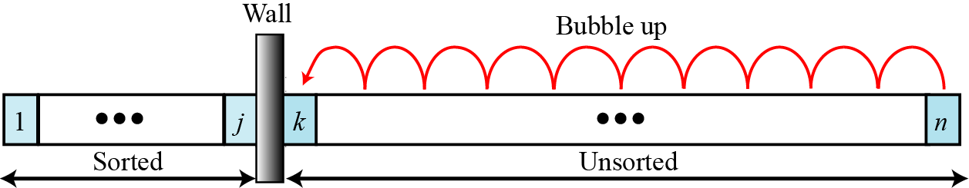
Bubble sorts
In the bubble sort method, the list to be sorted is also divided into two sublists—sorted and unsorted. The smallest element is bubbled up from the unsorted sublist and moved to the sorted sublist. After the smallest element has been moved to the sorted list, the wall moves one element ahead.
Figure 8.15 Bubble sort

Slide 44
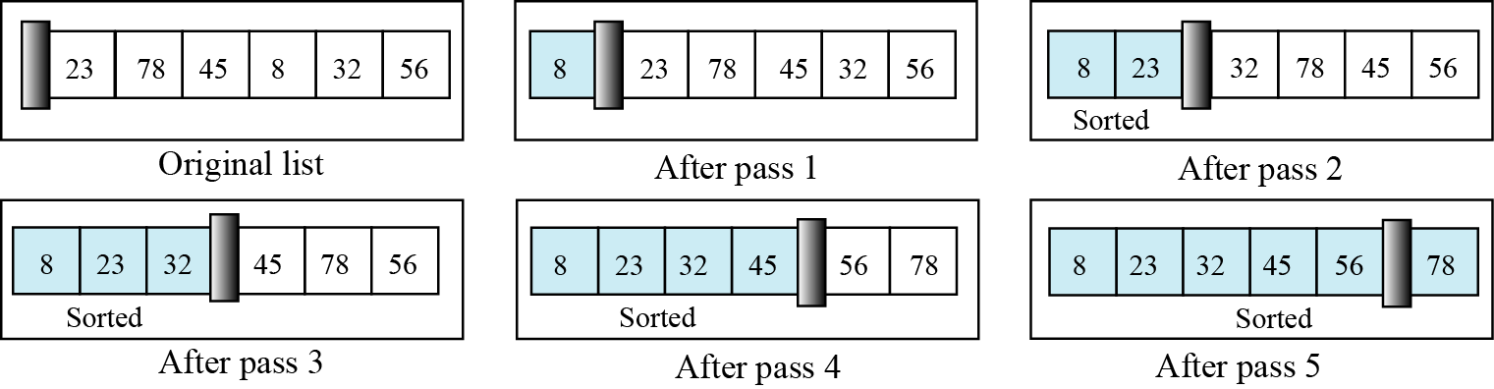
Figure 8.16 Example of bubble sort

Slide 45
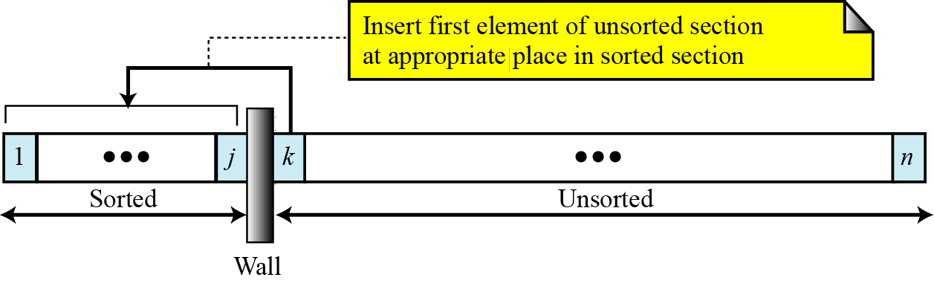
Insertion sorts
The insertion sort algorithm is one of the most common sorting techniques, and it is often used by card players. Each card a player picks up is inserted into the proper place in their hand of cards to maintain a particular sequence.
Figure 8.17 Insertion sort

Slide 46
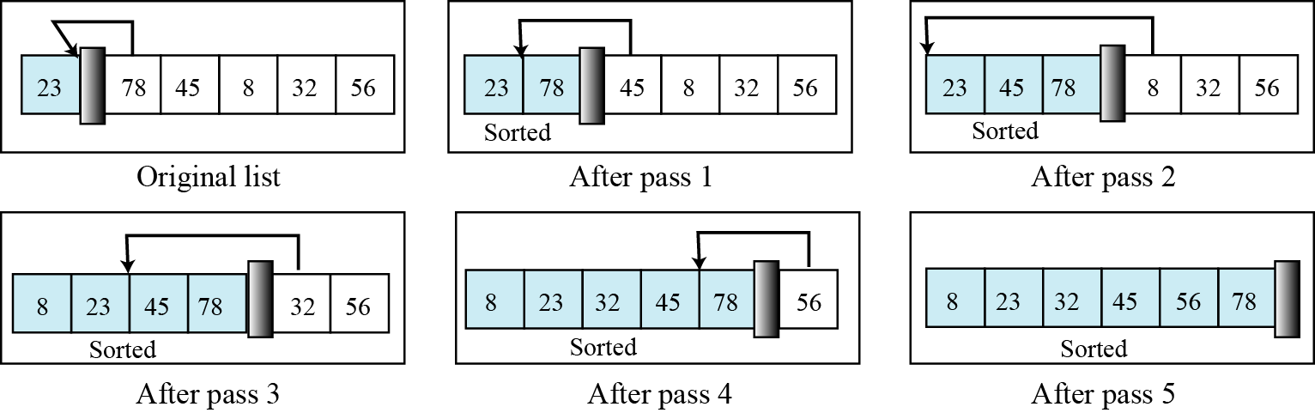
Figure 8.18 Example of insertion sort

Slide 47
8.5.5 Searching
Another common algorithm in computer science is searching, which is the process of finding the location of a target among a list of objects. In the case of a list, searching means that given a value, we want to find the location of the first element in the list that contains that value. There are two basic searches for lists: sequential search and binary search. Sequential search can be used to locate an item in any list, whereas binary search requires the list first to be sorted.

Slide 48
Sequential search
Sequential search is used if the list to be searched is not ordered. Generally, we use this technique only for small lists, or lists that are not searched often. In other cases, the best approach is to first sort the list and then search it using the binary search discussed later.
In a sequential search, we start searching for the target from the beginning of the list. We continue until we either find the target or reach the end of the list.

Slide 49
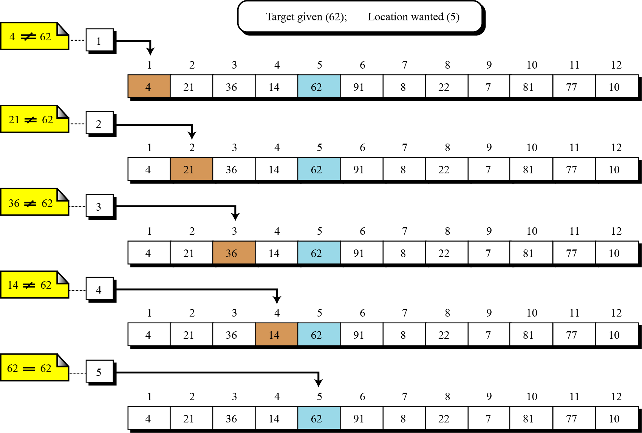
Figure 8.19 An example of a sequential search

Slide 50
Binary search
The sequential search algorithm is very slow. If we have a list of a million elements, we must do a million comparisons in the worst case. If the list is not sorted, this is the only solution. If the list is sorted, however, we can use a more efficient algorithm called binary search. Generally speaking, programmers use a binary search when a list is large.
A binary search starts by testing the data in the element at the middle of the list. This determines whether the target is in the first half or the second half of the list. If it is in the first half, there is no need to further check the second half. If it is in the second half, there is no need to further check the first half. In other words, we eliminate half the list from further consideration.

Slide 51
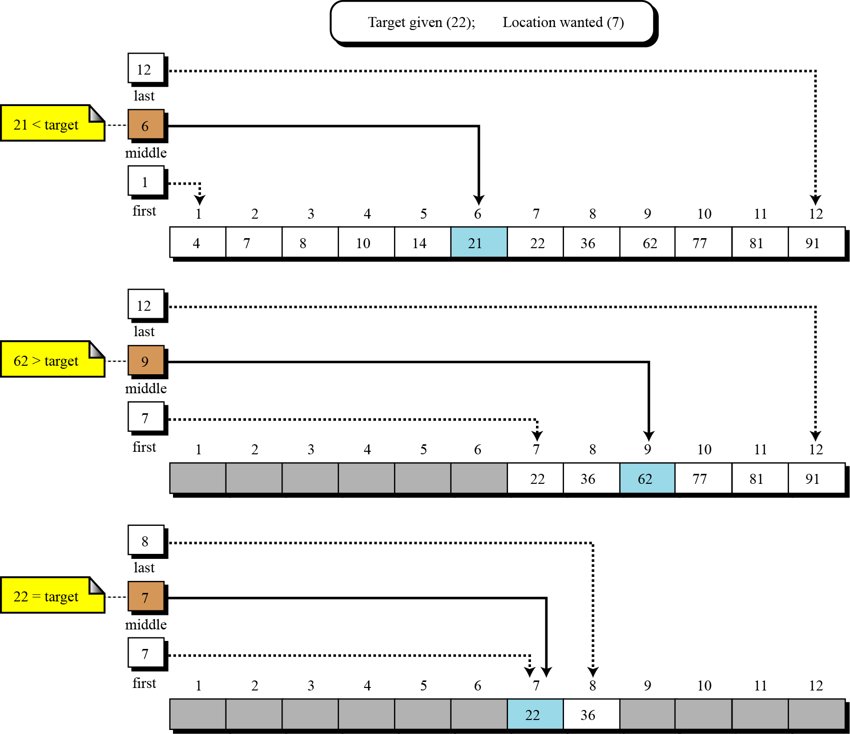
Figure 8.20 Example of a binary search

Slide 52
8-6 SUBALGORITHMS
The three programming constructs described in Section 8.2 allow us to create an algorithm for any solvable problem. The principles of structured programming, however, require that an algorithm be broken into small units called subalgorithms. Each subalgorithm is in turn divided into smaller subalgorithms. A good example is the algorithm for the selection sort in Figure 8.13.

Slide 53
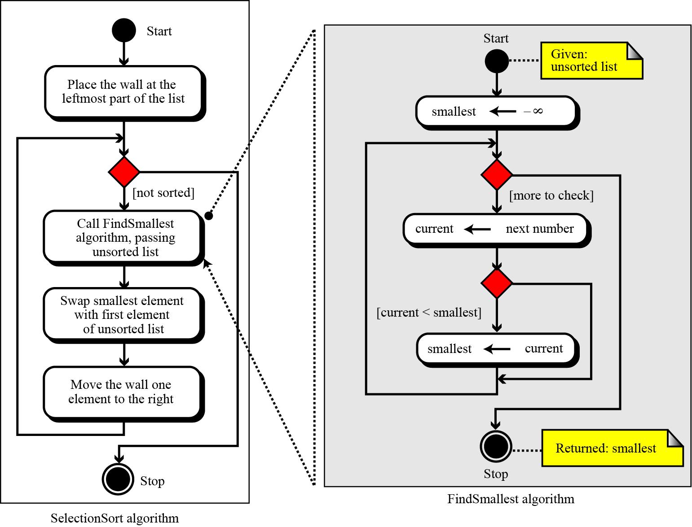
Figure 8.21 Concept of a subalgorithm

Slide 54
8.6.1 Structure chart
Another tool programmers use is the structure chart. A structure chart is a high level design tool that shows the relationship between algorithms and subalgorithms. It is used mainly at the design level rather than at the programming level. We briefly discuss the structure chart in Appendix D.

Slide 55
8-7 RECURSION
In general, there are two approaches to writing algorithms for solving a problem. One uses iteration, the other uses recursion. Recursion is a process in which an algorithm calls itself.

Slide 56
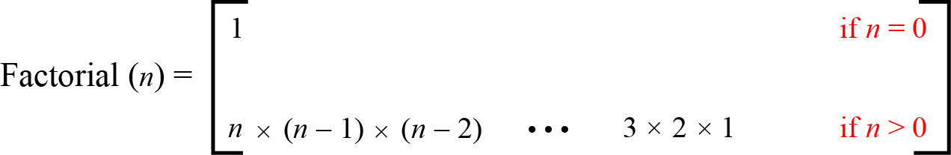
8.7.1 Iterative definition
To study a simple example, consider the calculation of a factorial. The factorial of a integer is the product of the integral values from 1 to the integer. The definition is iterative (Figure 8.21). An algorithm is iterative whenever the definition does not involve the algorithm itself.
Figure 8.22 Iterative definition of factorial

Slide 57
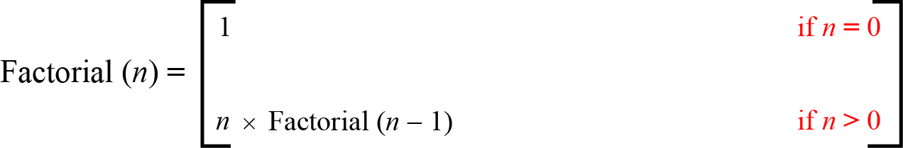
8.7.2 Recursive definition
An algorithm is defined recursively whenever the algorithm appears within the definition itself. For example, the factorial function can be defined recursively as shown in Figure 8.22.
Figure 8.23 Recursive definition of factorial

Slide 58
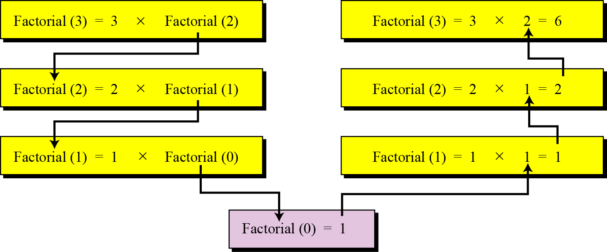
Figure 8.24 Tracing the recursive solution to the factorial problem

Slide 59
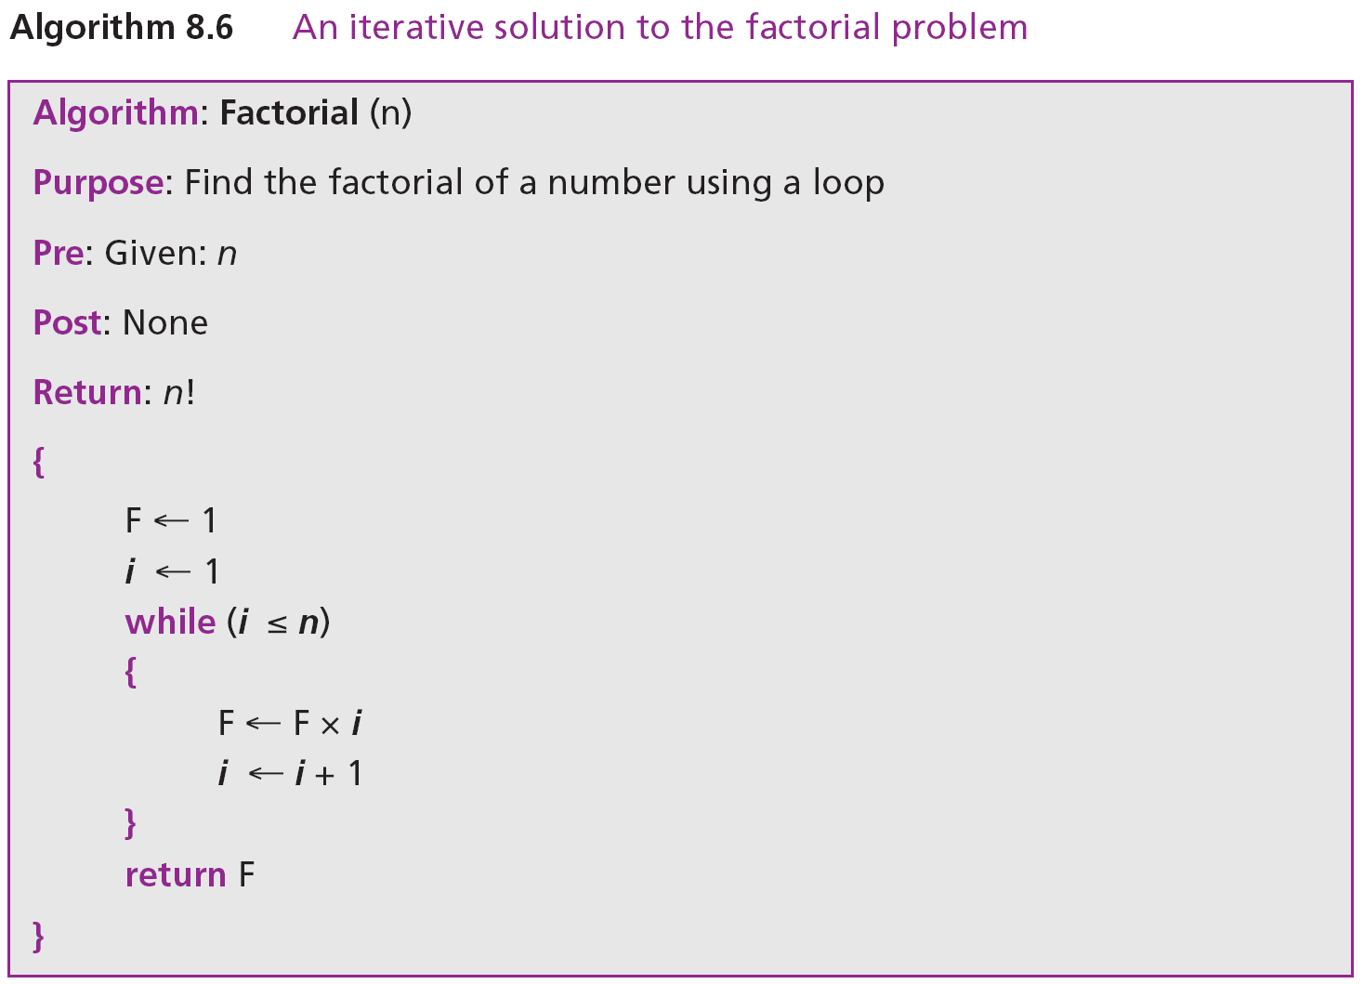
Iterative solution
This solution usually involves a loop.

Slide 60
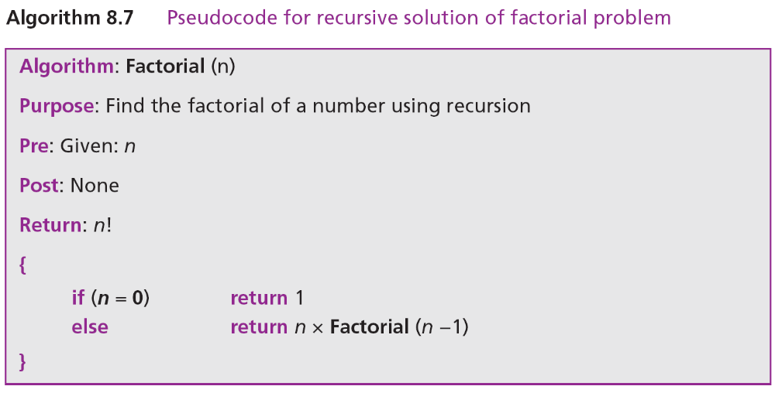
Recursive solution
The recursive solution does not need a loop, as the recursion concept itself involves repetition.

