Slide 1
Module-C-Logic
Logic Constructs
Programming Style
Walkthroughs

Slide 2
Objectives
Logic Constructs
  Structured Programming
  Sequence
  Selection
  In-Class Practice
  Iteration
  In-Class Practice
  Flags
  Dangling Else

Slide 3
Objectives…
Programming Style
  Naming
  Indentation
  Comments
  Magic Values
  General Guidelines
Walkthroughs
  Memory Map
  Walkthrough Tables
  Example

Slide 4
Logic Constructs
Expressions enable us to write programs that perform calculations and execute statements in a sequential order.
To write programs that execute different statements depending upon the satisfaction of certain conditions, we introduce selection constructs.
To write programs that keep executing sets of statements until certain condition are satisfied, we introduce iteration constructs.

Slide 5
Structured Programming
Are understandable, testable and readily modifiable.
Consist of simple logical constructs, each of which has one entry point and one exit point.
The design of a program can be described using:
  pseudo-coding or
  flow charting

Slide 6
Pseudo-coding
Is a shorthand that itemizes key steps in the flow of a program
For example: calculates the absolute
prompt the user for an integer value
accept an integer value from the user
if the value is positive, store the value in x
if the value is negative, store the negative of the value in x
display the value of x

Slide 7
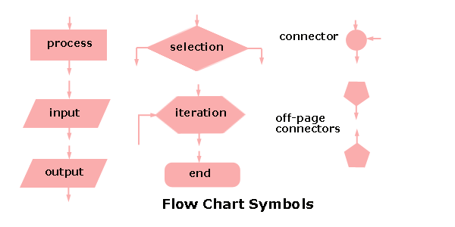
Flow Charts
Describe the flow of a program unit symbolically

Slide 8
Three Kinds of Constructs
sequence constructs
selection constructs
iteration constructs

Slide 9
Sequence constructs
A sequence is either a simple statement or a code block.
Simple Statements
  expression ;
Code Blocks
  A code block is a set of statements enclosed in curly braces.
  {
  statement
  ...
  statement
  }

Slide 10
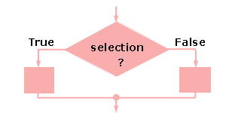
Selection
The selection constructs are:
    if
    if else
    if else if else
    switch
    ?:

Slide 11
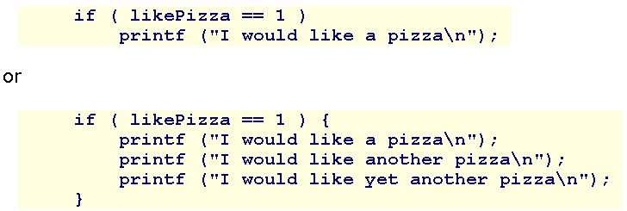
Selection - if
if ( condition )
  statement

Slide 12
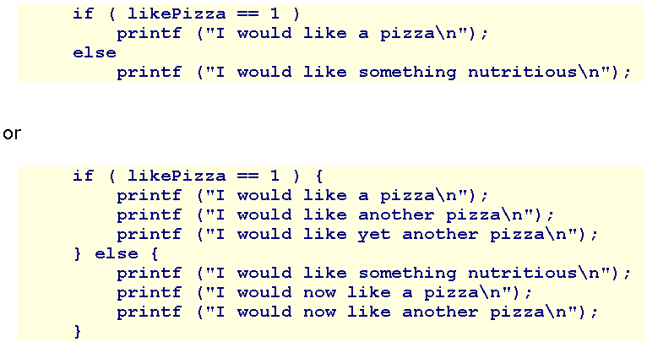
Selection – if else
if ( condition )
  Statement1;
else
  Statement2;

Slide 13
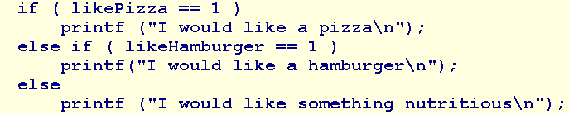
Selection - if-else if-else
if ( condition )
  statement1
else if ( condition )
  statement2
else if ( condition )
  statement3
else
  statement4

Slide 14
Selection-switch
switch ( variable or expression )
{
  case constant :
    statement
    break;
  case constant :
    statement
    break;
  default:
    statement
}

Slide 15
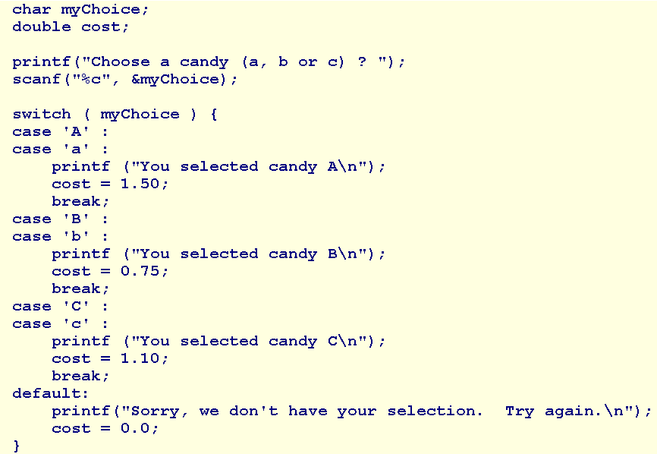
switch - Sample

Slide 16
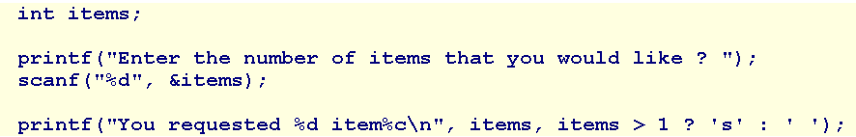
Conditional Expression
condition ? expression if true : expression if false

Slide 17
In-Class Practice
In some card games, a numbered card is worth its face value, the Jack, Queen and King, are worth 11 points each and the Ace is worth 1 point.
Write a program that accepts the rank of a card and displays the point value of that card. The user enters '0' for the number 10 card. Use an if else construct for your first version of the program.

Slide 18
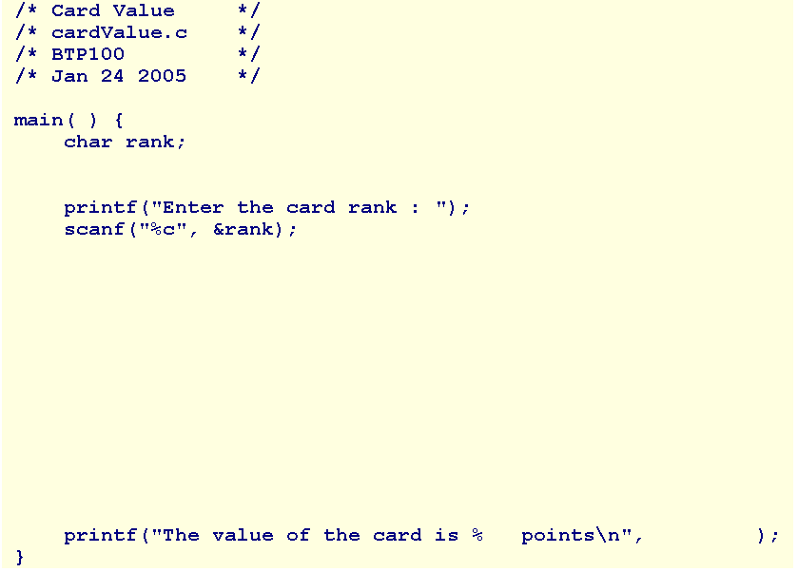

Slide 19
Iteration
The iteration constructs are:
  while
  do while
  for

Slide 20
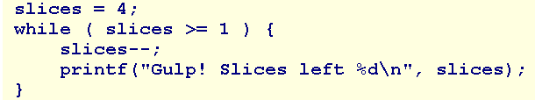

Iteration - while
while ( condition )
  statement

Slide 21
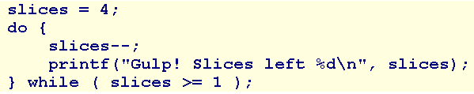

Iteration - do while
do
  statement
while ( condition );

Slide 22


Iteration - for
for ( initialization ; condition ; change )
  statement

Slide 23
In-Class Practice
An arithmetic series is the sum of the sequence of positive integers from 1 until a specified value.
Write a program that accepts the specified value and displays the sum of the positive integers up to and including the specified value.

Slide 24
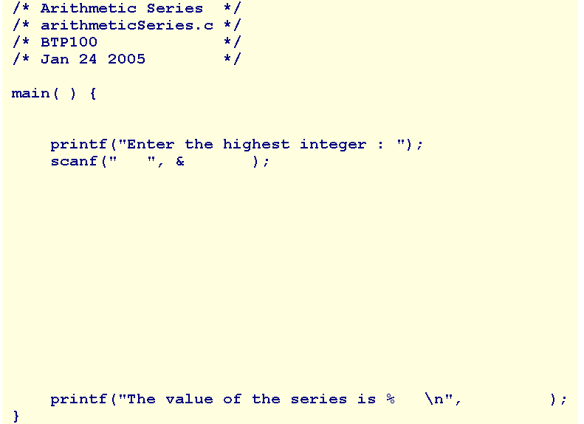

Slide 25
Flags
The one entry, one exit principle is fundamental to structured programming.
C includes three keywords that allow jumps across statements: goto, continue, and break. Using any of these keywords, except for break in a switch construct, violates the one entry, one exit principle of structured programming

Slide 26
Flags…
To improve readability, programmers advocated:
  the use of whitespace to identify the logical structure of the code
  the abolition of all goto statements
  the abolition of all continue statements
  the abolition of all break statements, except with switch
A technique for avoiding jumps is called flagging. A flag is a variable that keeps track of a true or false state.

Slide 27
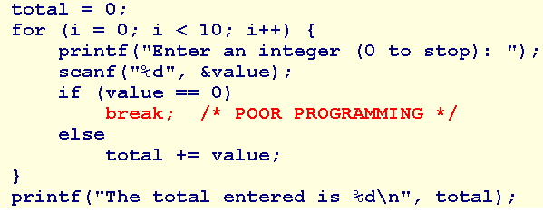
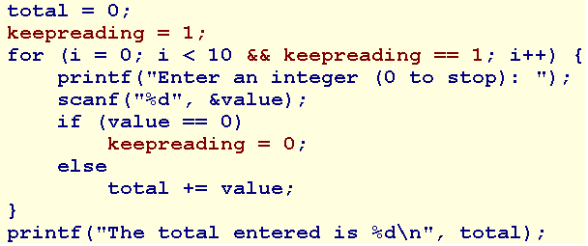
Flags…

Slide 28
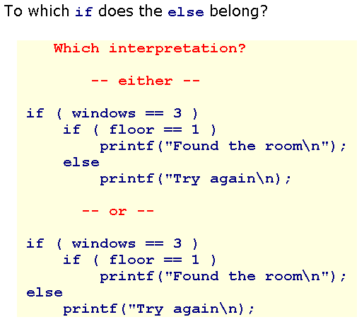
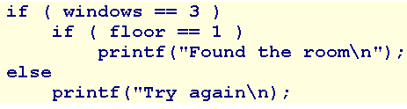
Dangling Else
We can embed one logic construct within one another. This is called nesting.
An ambiguity arises in the case of nested if else constructs.
The rule in C is that an else always belongs to the innermost if available.

Slide 29
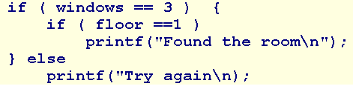
Dangling Else…
To associate an else with the next innermost selection, we must wrap the innermost selection in braces.

Slide 30
Summary
Logic Constructs
  Structured Programming
  Sequence
  Selection
  In-Class Practice
  Iteration
  In-Class Practice
  Flags
  Dangling Else
Q&A

Slide 31
Programming Style
A well-written program is a pleasure to read. Other programmers can understand it without significant effort. The coding style is consistent and clear throughout.
Develop your own style guide or adopt the style outlined here or elsewhere, but adopt some style.

Slide 32
Naming
Adopt names that are self-descriptive so that comments clarifying their meaning are unneceesary
Use names that describe identifiers completely, avoiding cryptic names
Prefer nouns for variable names
Keep variable names short - studentName rather than theNameOfAStudent
Keep the names of indices very short - treat them as mathematical notation

Slide 33
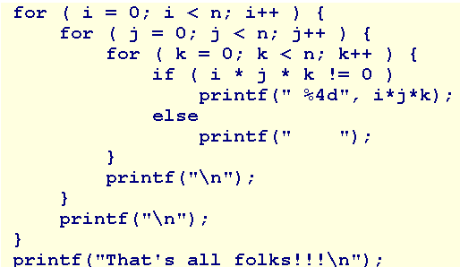
Indentation
Indent the body of any construct that is embedded within another construct. For example,

Slide 34
Comments
Use comments to declare what is done, rather than describe how it is done.
Comments introduce what follows.
Keep them brief and avoid decoration.

Slide 35
Comments
Begin every file with a header comment that includes:
  the title of the program
  the source file name
  the name of the author
  the date last modified
  other information that you consider important

Slide 36
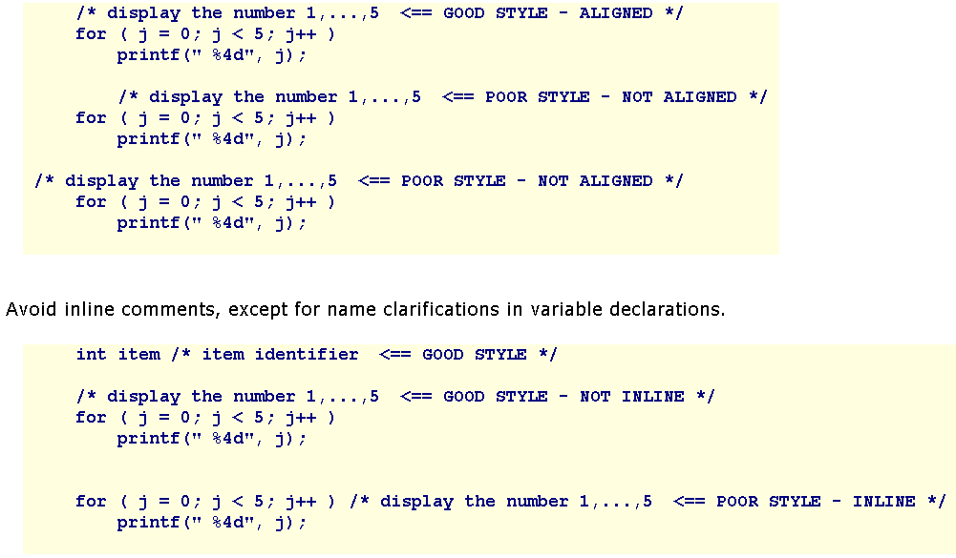
Comments…
Align comments with the code that they describe, indent both identically.

Slide 37
Magic Values
These may be mathematical constants, tax rates, default values or names.
To improve readability, assign symbolic names to these magic values and refer to the symbolic names throughout the code.
Use the directive
#define SYMBOLIC_NAME value

Slide 38
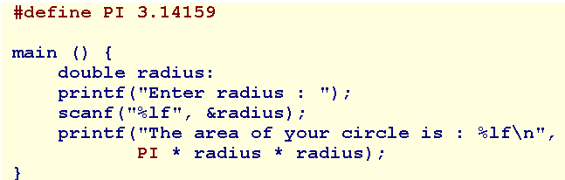
Magic Values…

Slide 39
Magic Values…
Compiler Idiosyncracies
  Use #define to manage idiosyncracies across platforms.
  For example, the Borland 5.5 compiler does not recognize the long long data type. Instead, it recognizes an _int64 data type. To improve portability, #define the data type using a symbolic name such as LONG_LONG and embed that name throughout our code.

Slide 40
General Guidelines
Limit line length to 80 characters - both comments and code
Avoid global variables
Select data types for variables wisely and carefully
Initialize a variable when declaring it only if the initial value is part of the semantic of the variable.
If the initial value is part of an algorithm, use a separate assignment statement.

Slide 41
General Guidelines…
Avoid goto, continue, break except in switch.
Avoid using the character encodings for a particular machine.
Use a single space or no spaces either side of an operator.
Use in-line opening braces or start opening braces on a newline but don't mix the two styles.
Initialize iteration variables in the context of the iteration

Slide 42
General Guidelines…
Avoid assignments nested inside logical expressions
Avoid iterations with empty bodies - reserve the body for the algorithm
Limit the initialization and iteration clauses of a for statement to the iteration variables
Distribute and nest complexity
Avoid fancy algorithms that may be efficient but are difficult to read
Add additional comments where code has been fine tuned for efficient execution
Add an extra pair of parentheses where an assignment is also used as a condition
Remove unreferenced variables
Remove all commented code and debugging statements from release and production code

Slide 43
Summary
Programming Style
  Naming
  Indentation
  Comments
  Magic Values
  General Guidelines
Q&A

Slide 44
Walkthrough
A walkthrough is
  a record of the changes that occur in the values of program variables as a program executes and
  a listing of the output, if any, produced by the program.

Slide 45
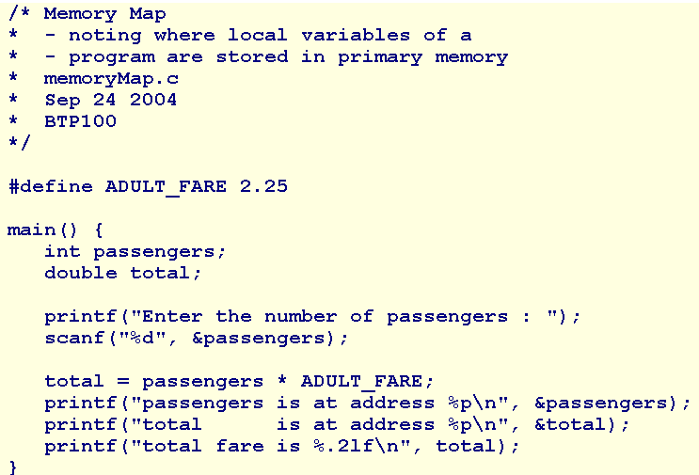
Memory Map
The local variables of a program allocates on the stack segment.

Slide 46
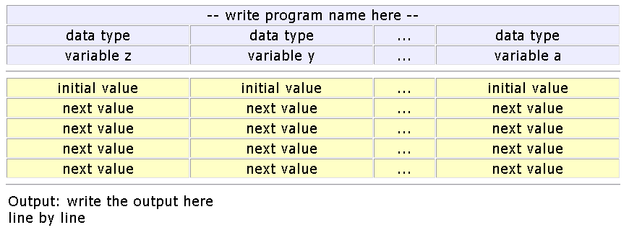
Walkthrough Tables
To prepare a walkthrough of a program, construct an abstract memory map with sufficient room to tabulate the value of each program variable:

Slide 47
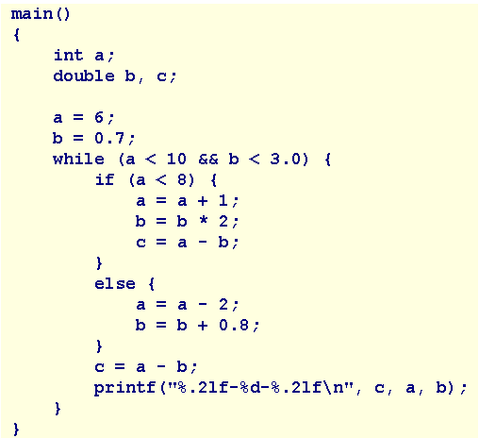
Walkthrough Example

Slide 48
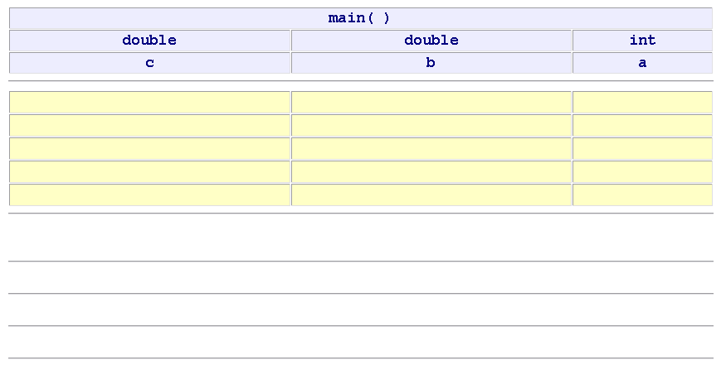
Walkthrough Example…
Prepare the table:
Output:

Slide 49
Summary
Walkthroughs
  Memory Map
  Walkthrough Tables
  Example
Q&A

