Slide 1
Module H-Files
Sequential Text Files
Records, Fields and Tables

Slide 2
Session Objectives-1
Sequential Text Files
  Bytes
  Format
  Access
  Connecting
  Opening
  Closing
  Writing To a File
  Reading From File
  Rewinding
  End of File
  Comparison Standard I/O and File I/O

Slide 3
Session Objectives-2
Records, Fields and Tables
  Records
  Fields
  Tables
  Oversized Strings
In-Class Practice

Slide 4
File
A file is a named area of secondary storage. Secondary storage is permanent. Unlike the contents of primary memory, which is volatile, the contents of a file is accessible after we have turned the power off and back on at a later time.
A file is not necessarily stored contiguously on a secondary storage device

Slide 5
Bytes
The fundamental unit of a file is a byte.
A file is a stream of bytes.
A file concludes with a special mark called the end of file mark (EOF).

Slide 6
Format
Data stored in a file in either of two formats:
  binary format, or
  text format.

Slide 7
Binary Format
In binary format, the data on the file is identical to the data stored in primary memory.
Each byte on the file is a direct image of the corresponding byte in memory

Slide 8
Text Format
In text format, the data on the file is in a form that we can display and modify using a text editor.
The data on the file is a translated form of the data stored in primary memory.
Text format is portability

Slide 9
Access
Typically, a file consists of records that we can access in either of two ways
  randomly (like CD's) or
  sequentially (like Cassette Tapes).

Slide 10
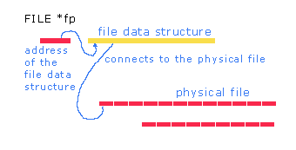
Connecting-1
We connect a file to our program using a FILE data structure. This data structure holds the connection information for the file.

Slide 11
Connecting-2
Declaration
FILE *identifier;
For example:
    #include <stdio.h>
    FILE *fp = NULL;

Slide 12
Opening-1
FILE *fopen(char file_name[], char mode[]);
file_name parameter is a null-byte terminated string containing the name of the file.
mode parameter is a null-byte terminated string containing the connection mode
  "r" - read from the file,
  "w" - write to the file: if the file exists, truncate its contents and then write; if the file does not exist, create a new file and then write to that file,
  "a" - write to the end of the file: if the file exists, append to the end of the file; if the file does not exist, create it and then write.

Slide 13
Opening-2
The other connection modes for text files are
  "r+" - opens the file for reading and possibly writing,
  "w+" - opens the file for writing and possibly reading; if the file exists, truncates its contents and then writes to the file; if the file does not exist, creates a new file and then writes to that file,
  "a+" - opens the file for writing to the end of the file and possibly reading; if the file exists, appends to the end of the file; if the file does not exist, creates it and then writes to the file
fopen returns NULL if the attempt to connect to the file fails

Slide 14
Closing
int fclose(FILE *);
File opened writing, fclose writes any data remaining in the file stream's buffer to the file and concludes by appending an end of file mark immediately after the last character.
File opened reading, fclose ignores any data left in the file stream's buffer and closes the connection.

Slide 15
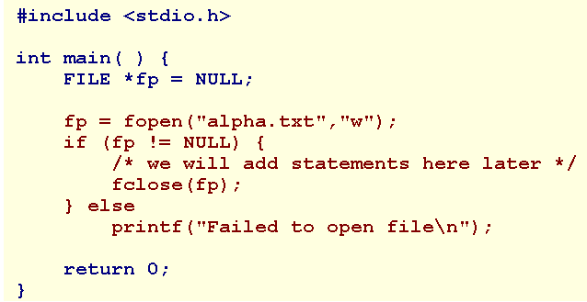
For example
Open a file named alpha.txt ..
fclose returns 0 if successful, EOF if unsuccessful. fclose can fail if the secondary storage medium is full, an I/O error occurs or the medium has been prematurely removed.

Slide 16
Writing To a File-1
int fprintf(FILE *, char [], ...);
The first parameter receives the address of the file connection data structure.
The second parameter is the format string containing the text to be written directly to the file and the conversion specifiers.

Slide 17
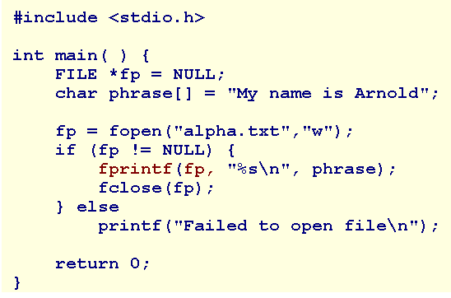
Example

Slide 18
Writing To a File-2
int fputc(int ch, FILE *fp);
int fputs(char str[], FILE *fp);

Slide 19
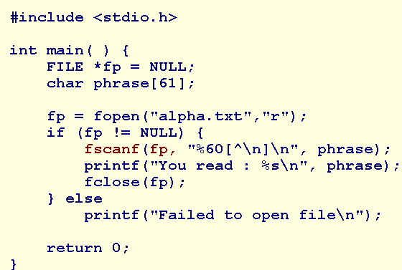
Reading From File-1
int fscanf(FILE *, char [], ...);

Slide 20
Reading From File-2
int fgetc(FILE *fp);
char* fgets(char str[], int max, FILE *fp);
The string str will hold the set of bytes ending in a newline character up to max-1 bytes from fp. fgets appends the null byte to the string stored in primary memory. fgets returns the address of str, or NULL in the event of an end of file or an I/O error.

Slide 21
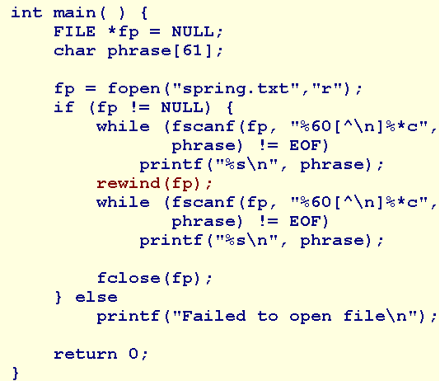
Rewinding
Jump to the beginning of a file.
void rewind(FILE *fp);

Slide 22
End of File
int feof(FILE *fp);
The library function feof indicates whether or not a program has attempted to read beyond the last character in a file.

Slide 23
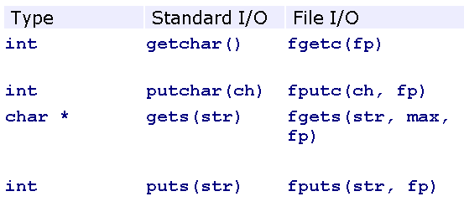
Comparison

Slide 24
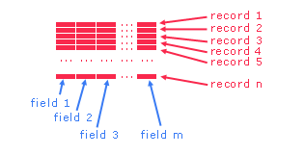
Records, Fields and Tables
A file consists of records. A record consists of fields. A collection of records with equal numbers of fields in each record constitutes a table.

Slide 25
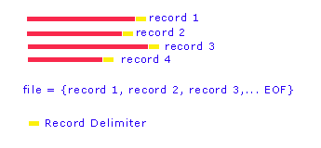
Records
We call each line in a text file a record.
A record is a sequence of characters that ends with a newline delimiter.
Typically, one record refers to one entity of information.

Slide 26
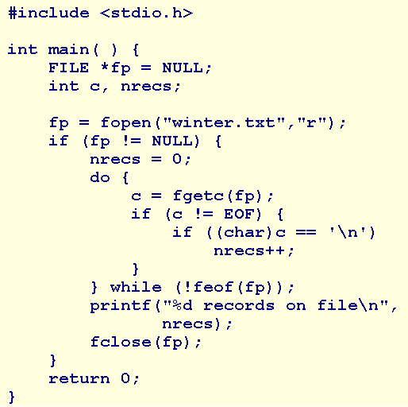
Example

Slide 27
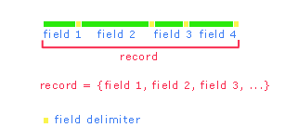
Fields
A field is one element of a record.
A field holds an integral piece of data.
A field may be of any data type.
Separate any two adjacent fields in a record using a field delimiter.

Slide 28
Example-1
A text file named winter.txt that contains the following information:
    5 Pairs of Boots
    2 Coats
    3 Hats
    3 Pairs of Gloves

Slide 29
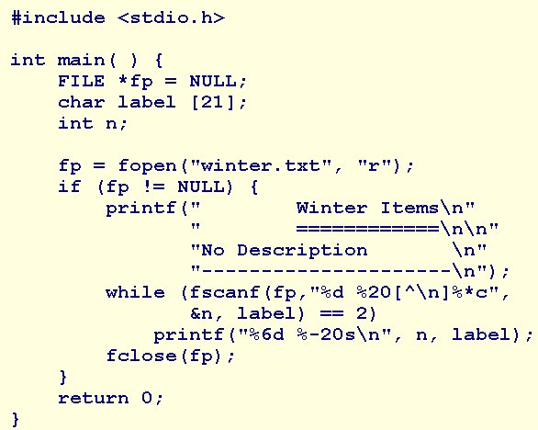
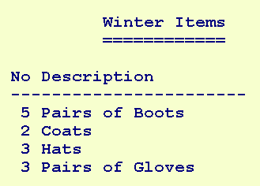
Example-2

Slide 30
Tables
A file named spring.txt. The contents of this file are listed below:
2;Light Jacket;95.89
    3;Long-Sleeved Shirts;67.89
    2;Large Skateboards;45.98

Slide 31
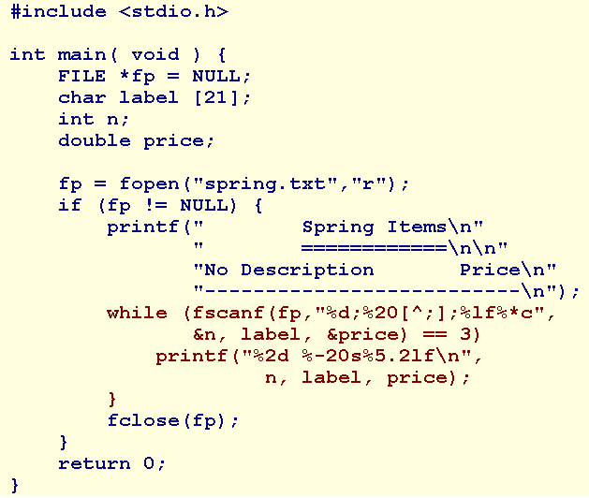
Example

Slide 32
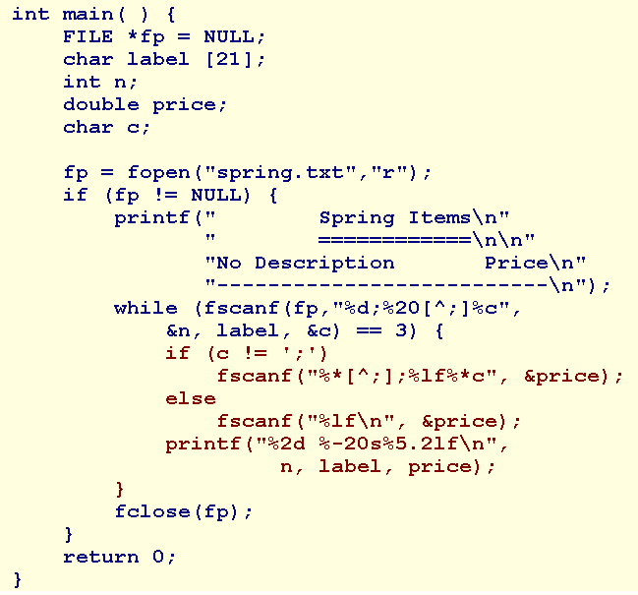
Oversized Strings
Example

Slide 33
Summary
Sequential Text Files
  Connecting
  Opening
  Closing
  Writing To a File
  Reading From
  Rewinding
Records, Fields and Tables
  Records
  Fields
  Tables
  Oversized Strings
Q&A

Slide 34
In-Class Practice
Write a program that reads information from a file named input.dat and displays the information in tabular form on standard output.
Each record on the file contains the information for a single transaction and is delimited by a newline character.
Each record consists of an integer value holding an account number, a floating-point value holding an amount and a sequence of characters holding a textual description of the transaction that may include embedded blanks.
Adjacent fields are delimited by a semi-colon character.

