Slide 1
Object-Oriented using Java
Course Introduction
Session 0 - Course Introduction

Slide 2
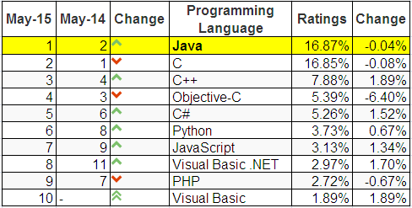
Why should you study Java?
Top ten common programming languages:
From http://www.tiobe.com/index.php/content/paperinfo/tpci/index.html
Session 0 - Course Introduction

Slide 3
Why Java?
Java is Architecture Neutral (i.e. platform independent).
Java Provides “One-Stop Shopping” (customers can get all they need in just "one stop" ).
Java is Object-Oriented from the Ground Up.
Java is an Open Standard.
Java is Free!
Session 02 - Java Fundamentals

Slide 4
Instructor introduction
Name: Lê Phương Chi
Contacts:
Email: chilp@fpt.edu.vn

Slide 5
Course Overview
Prerequisite:
  Programming Fundamentals Using C

Slide 6
Course objectives
Introduce fundamental object-oriented (OO) terminology and concepts.
Getting to know the “World of Java”.
Understand the implementation of a Java Application.
Understand the roles of java built-in packages.
Session 0 - Course Introduction

Slide 7
Contents
Learning the Java Language
Classes and Objects
More on Classes
Nested Classes
Numbers and strings
Exceptions
Collections
Algorithms
Generics
Basic I/O
Session 0 - Course Introduction

Slide 8
Resources
Tool
  NetBean IDE 8.x
  JDK8
Text book
  http://docs.oracle.com/javase/tutorial/
  http://www.oracle.com/technetwork/java/javase/documentation/jdk8-doc-downloads-2133158.html
Session 0 - Course Introduction

Slide 9
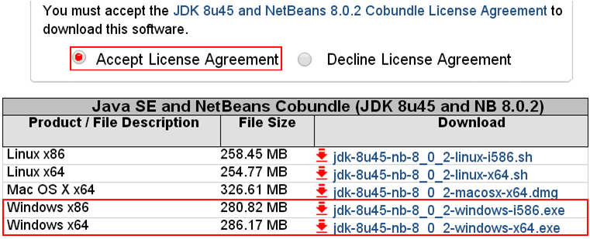
Download & Install
NetBeans 8 & JDK
http://www.oracle.com/technetwork/java/javase/downloads/jdk-netbeans-jsp-142931.html
Session 0 - Course Introduction

Slide 10
Course Plan
See course plan on CMS

Slide 11
Course Requirements
Following lessons in classroom
Reading textbook and documents at home
Completing chapter assessment in time
Discussing actively in your teams and in classroom

Slide 12
Grading policy
On-going assessment:
- 10 Workshops (WS): 10%
- 1 Assignments (AS): 20%
- 2 Progress tests (PT): 10%
Practical and Final Exams:
- 1 Practical Exam (PE): 30%
- 1 Final Exam (FE): 30%
Total score (TS) = 0.1*WS +0.2*AS + 0.1*PT + 0.3*PE + 0.3*FE
Completion Criteria:
1) Every on-going assessment (average) component > 0
2) PE > 0 (no resit)
3) FE >= 4 & TS >= 5

Slide 13
Academic policy
Cheating, plagiarism and breach of copyright are serious
offenses under this Policy.
Cheating
  Cheating during a test or exam is construed as talking, peeking at another student’s paper or any other clandestine method of transmitting information.
Plagiarism
  Plagiarism is using the work of others without citing it; that is, holding the work of others out as your own work.
Breach of Copyright
  If you photocopy a textbook without the copyright holder's permission, you violate copyright law.

