Slide 1
Session 09
Algorithms
(http://docs.oracle.com/javase/tutorial/collections/algorithms/index.html)
Session10 - Algorithms
Notes:
Operations such as adding, searching, removing, updating are common works on a list. Their algorithms are very common and in almost of cases, they do not depend on specific type.
This chapter will introduce 2 pre-defined classes, Collections and Arrays, declared in the java.utils package, which make utilities when these group operations are needed.

Slide 2
Objectives
Support Classes: Collections, Arrays
Use the Collections class
  Sorting/ Shuffling
  Routine Data Manipulation
  Searching/ Composition
  Finding Extreme Values
Use the Arrays class
Session10 - Algorithms

Slide 3

Introduction
An algorithm on a list can be applied on some lists although the type of elements in each list can be different.
The polymorphic algorithms described here are pieces of reusable functionality provided by the Java platform.
All of them come from the Collections class and the Arrays class (support classes), and all take the form of static methods whose first argument is the collection on which the operation is to be performed.
Session10 - Algorithms

Slide 4
The Collections class
A support class containing static methods which accept collections as their parameters.
file:///J:/Softs/JavaSofts/JavaDocs/docs-Java8/api/java/util/Collections.html
Session10 - Algorithms

Slide 5
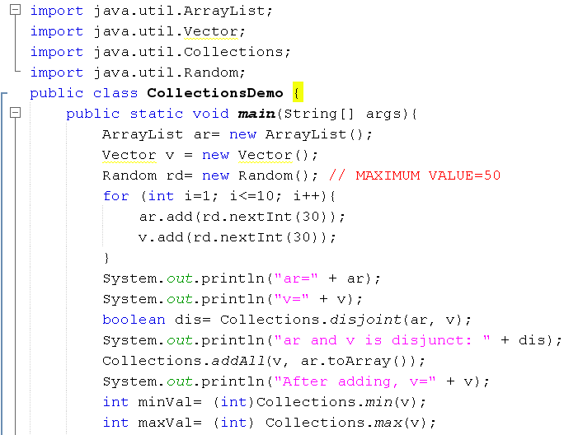
Collections Demo.
Session10 - Algorithms

Slide 6
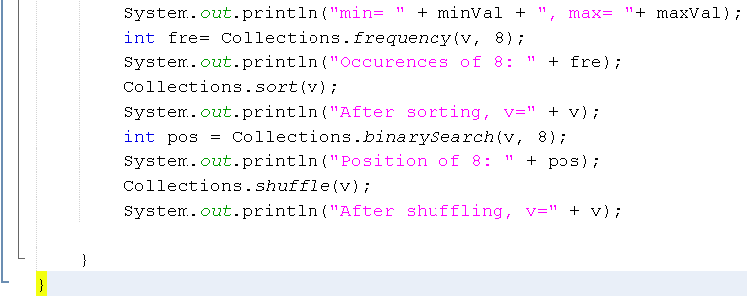
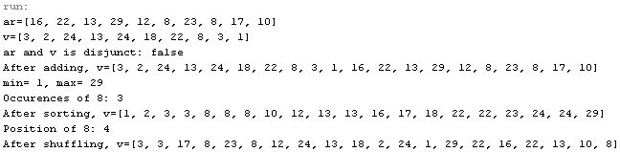
Collections Demo.
Session10 - Algorithms

Slide 7
Sorting
The sort algorithm reorders a List so that its elements are in ascending order according to an ordering relationship.
Example
  public class Sort {
  public static void main(String[] args) {
  List<String> list = Arrays.asList(args);
  Collections.sort(list);
  System.out.println(list);
  }
  }
Session10 - Algorithms

Slide 8
Comparator Interface
A comparison function, which imposes a total ordering on some collection of objects
The following demonstration will show you the way to sort a list based on your own criteria: A list of employees will be sorted based on descending salaries then ascending IDs.
Session10 - Algorithms

Slide 9
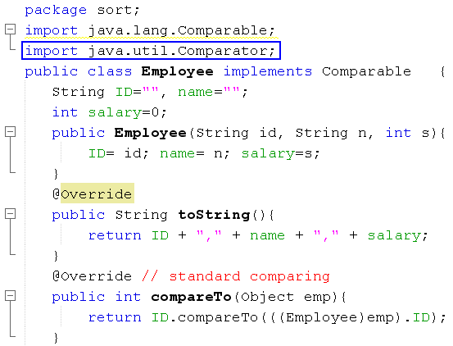
Comparator Interface – Demo.
Session10 - Algorithms

Slide 10
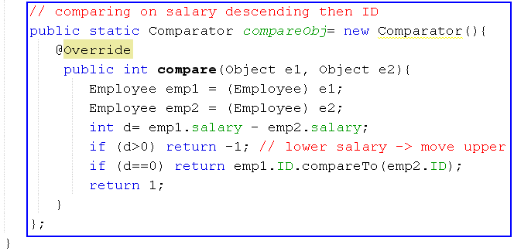
Comparator Interface- Demo.
Comparing 2 employees based on descending salaries then ascending IDs
Create an anonymous object for comparing 2 employees
Session10 - Algorithms

Slide 11
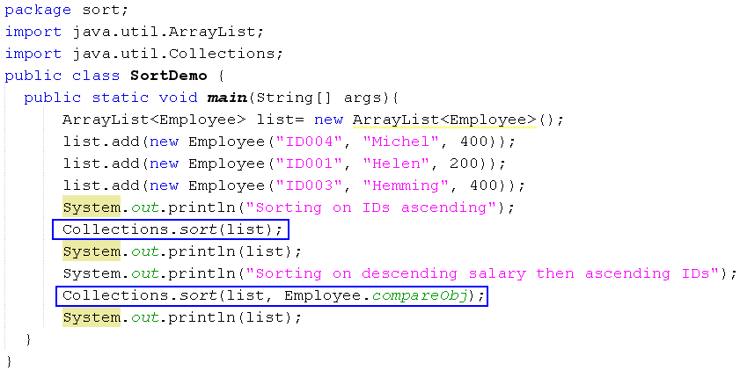

Comparator Interface- Demo.
Session10 - Algorithms

Slide 12
Routine Data Manipulation (1)
The Collections class provides five algorithms for doing routine data manipulation on List objects, including:
  reverse()
  fill()
  copy()
  swap()
  addAll()
Session10 - Algorithms

Slide 13
Searching
Condition: The list in ascending order
The binarySearch algorithm searches for a specified element in a sorted List.
  Return pos >=0 → Present
  Return pos<0 → Absent
Session10 - Algorithms

Slide 14
Composition
frequency — counts the number of times the specified element occurs in the specified collection.
disjoint — determines whether two Collections are disjoint; that is, whether they contain no elements in common.
Session10 - Algorithms

Slide 15
Finding Extreme Values
Methods: min(…), max(…)
Session10 - Algorithms

Slide 16
The Arrays Class
It it similar to the Collections class, but it accepts arrays as it’s parameters.
file:///J:/Softs/JavaSofts/JavaDocs/docs-Java8/api/java/util/Arrays.html
Session10 - Algorithms

Slide 17
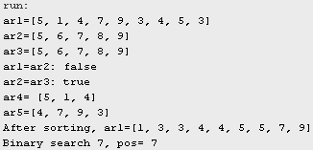
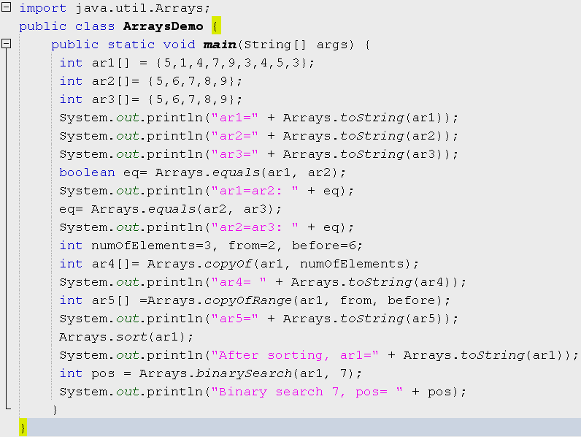
Arrays Class: Demo.
Session10 - Algorithms

Slide 18
Summary
Support Classes: Collections, Arrays
Use the Collections class
  Sorting/ Shuffling
  Routine Data Manipulation
  Searching/ Composition
  Finding Extreme Values
Use the Arrays class
Session10 - Algorithms

