Slide 2
Access Text Files … Case study 1
Problem
Each employee details include: code, name, salary
The text file, named employees.txt contains some initial employee details in the following line-by-line format
code, name,salary
Write a Java program having a simple menu that allows users managing a list of employees. Functions are supported:
Adding new employee
Removing employee.
Promoting the salary of an employee.
Listing employee details.
Save the list to file
Quit

Slide 3
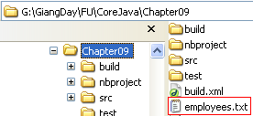
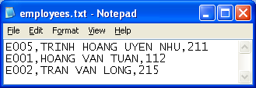
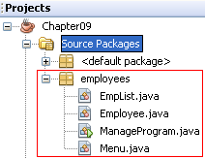
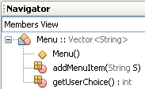
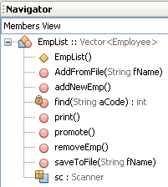
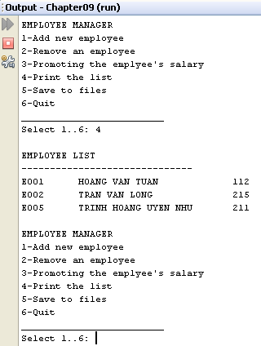
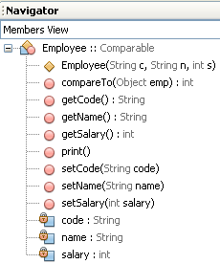

Access Text Files …: Case study 1- Design

Slide 4
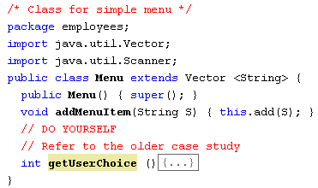
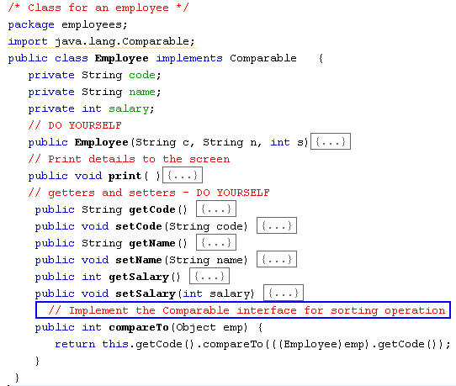
Access Text Files …: Case study 1- Implementations

Slide 5
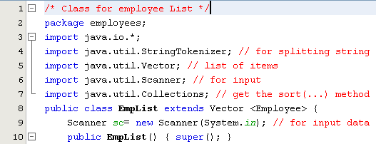
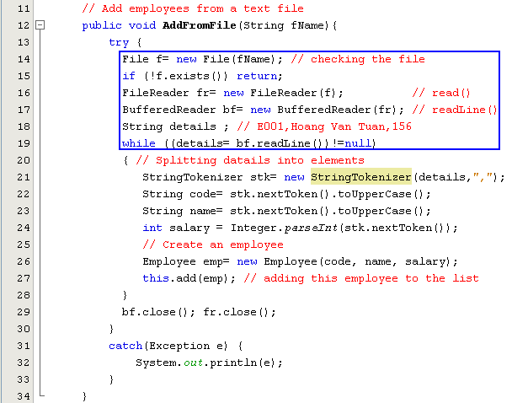
Access Text Files …: Case study 1- Implementations

Slide 6
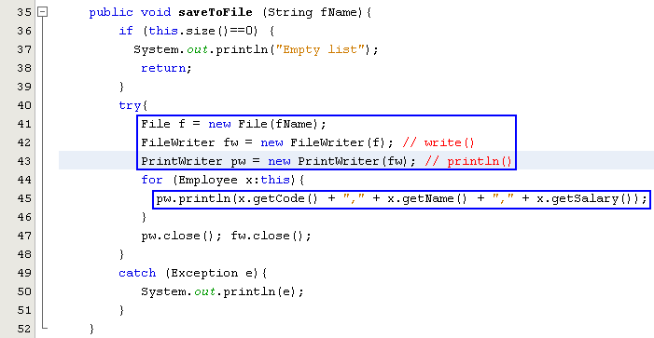
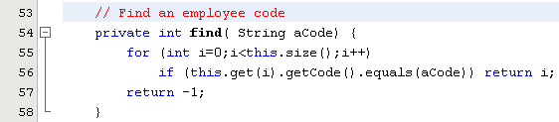
Access Text Files …: Case study 1- Implementations

Slide 7
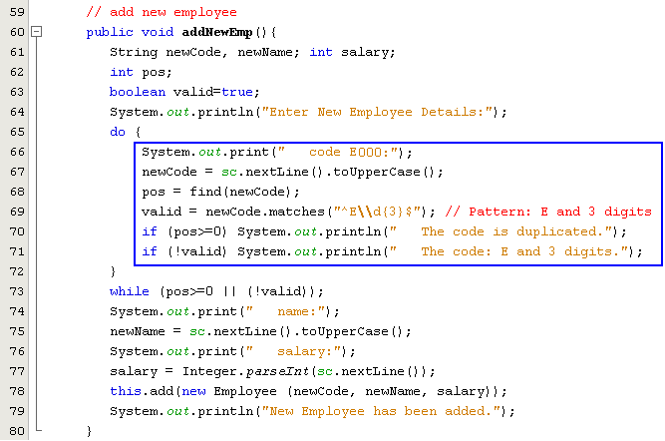
Access Text Files …: Case study 1- Implementations

Slide 8
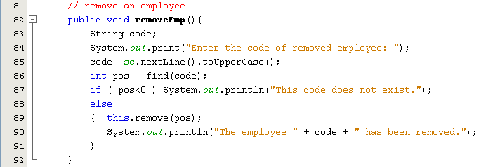
Access Text Files …: Case study 1- Implementations

Slide 9
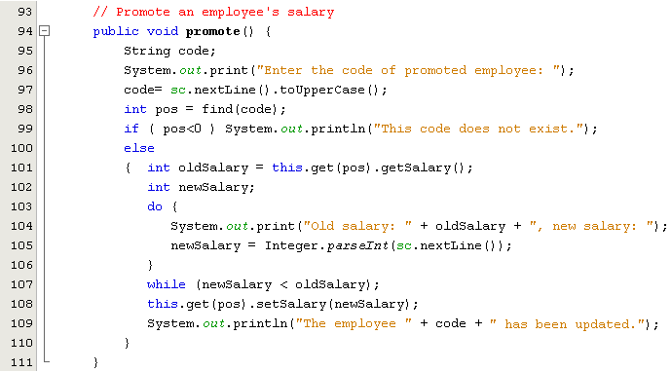
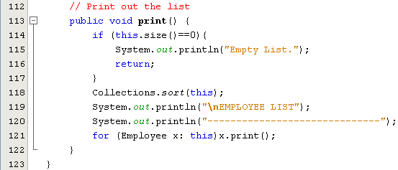
Access Text Files …: Case study 1- Implementations

Slide 10
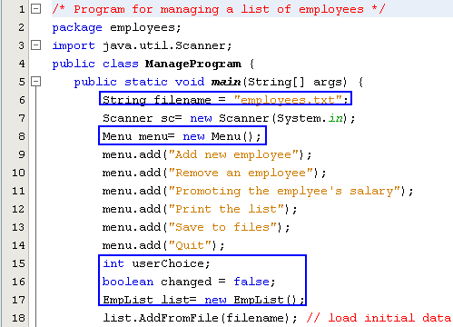
Access Text Files …: Case study 1- Implementations

Slide 11
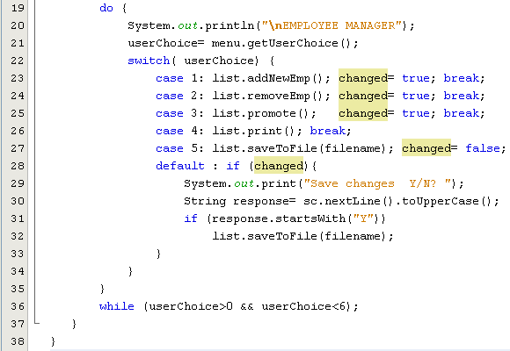
Access Text Files …: Case study 1- Implementations

Slide 12
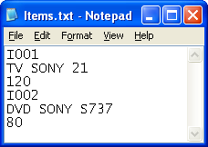
Access Text Files …: Case study 2.- Append File Demo.
Problem
Each item details include: code, name, price. The item’s code can not be duplicated.
An accountant can not be allowed to view all stored items ( in the text file, named items.txt) but he/she can add some new items to this file.
Data format in this file (line by line):
Line for the code of item
Line for the name of item
Line for the price of item
Write a Java program having a simple menu which allows users managing a item list through program’s functions:
Add new item
Update an item
Delete an item
Save items( Appending items to this file)

Slide 13
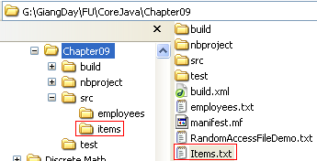
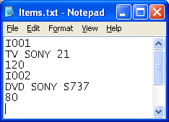
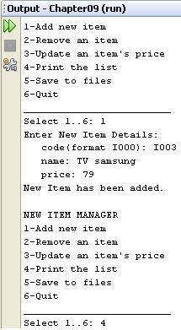
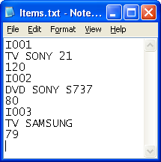
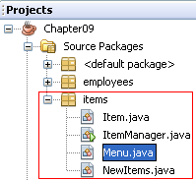
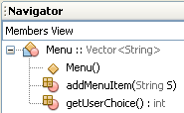
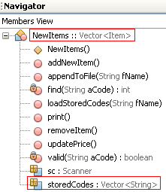
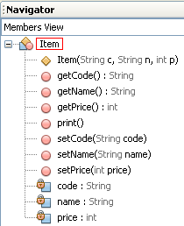
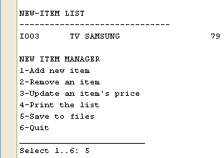

Access Text Files …: Case study 2.-Design

Slide 14
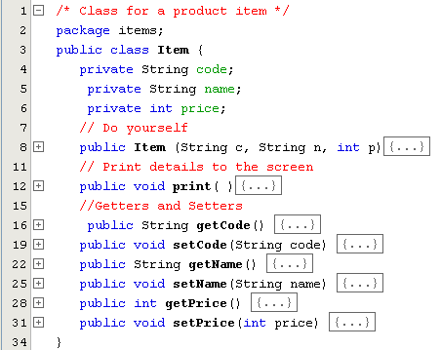
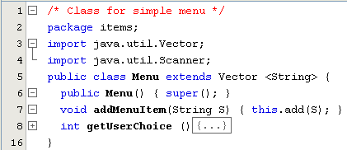
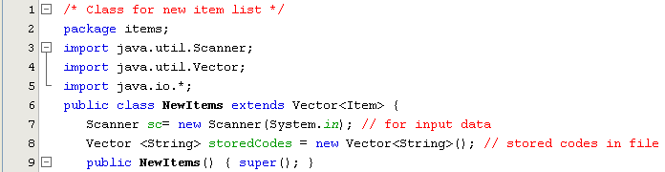
Access Text Files …: Case study 2- Implementations
Refer to the case study 1.
DO YOURSELF

Slide 15
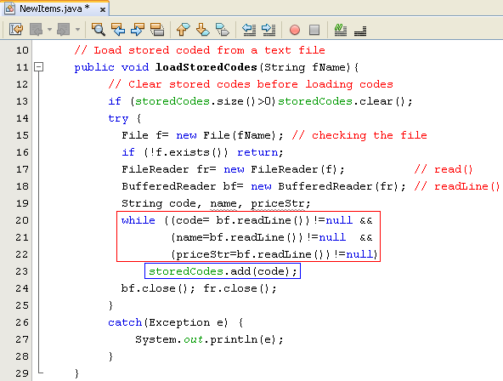
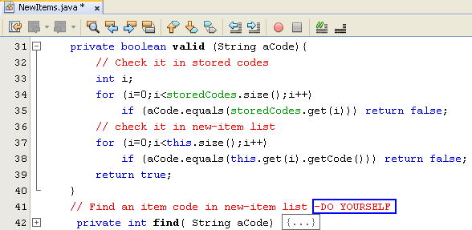
Access Text Files …: Case study 4.- Implementations

Slide 16
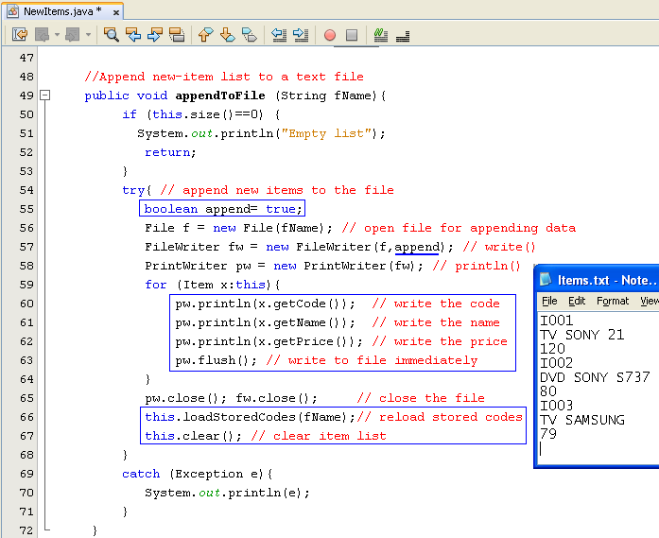
Access Text Files …: Case study 2- Implementations

Slide 17
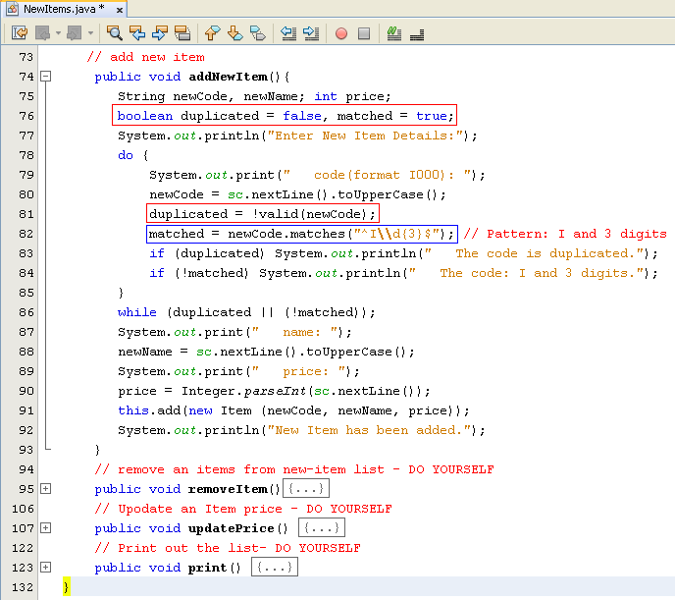
Access Text Files …: Case study 2- Implementations

Slide 18
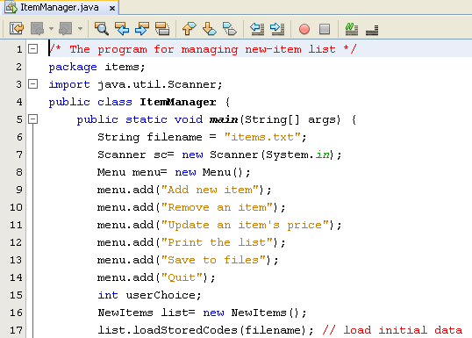
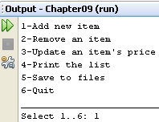
Access Text Files …: Case study 2- Implementations

Slide 19
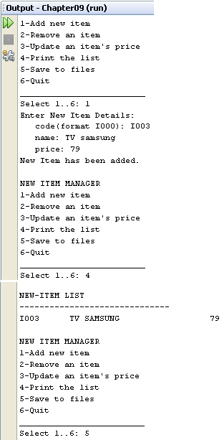
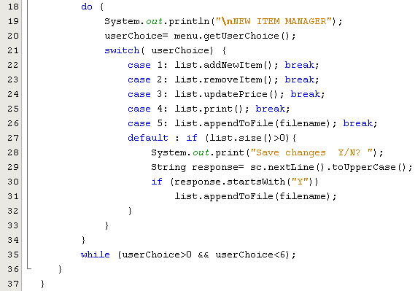
Access Text Files …: Case study 2- Implementations

