Slide 1
Chapter 5. Recursion

Slide 2
Objectives
Recursive definition
Method calls and recursion implementation
Anatomy of a recursive call
Tail recursion
Non-tail recursion
Indirect recursion (*)
Nested recursion (*)
Excessive recursion
Backtracking (*)
(*) Students are required to understand essential features only (the problem explaination, definitions, the outline of algorithms…), not in details.

Slide 3
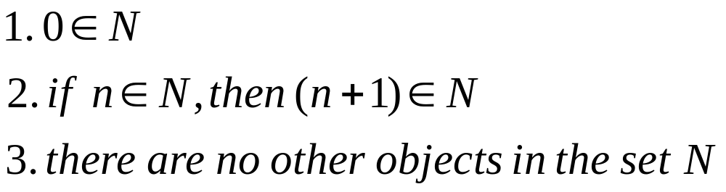
Recursive definition
Wikipedia: “A recursive definition or inductive definition is one that defines something in terms of itself (that is, recursively). For it to work, the definition in any given case must be well-founded, avoiding an infinite regress”.
A recursive definition consists of at least 2 parts:
  1) A base case (anchor or the ground case) that does not contain a reference to its own type.
  2) An inductive case that does contain a reference to its own type.
For example: Define the set of natural numbers

Slide 4
Recursive program/algorithm
A recursive program/algorithm is one that calls itself again.
There are three basic rules for developing recursive algorithms.
  • Know how to take one step.
  • Break each problem down into one step plus a smaller problem.
  • Know how and when to stop.
  Example for recursive program:
public static void convertToBin(int decimalNum)
{ int quotient = decimalNum / 2; // One step
int remainder = decimalNum % 2; // One step
if (quotient > 0)
{convertToBin(quotient); // smaller problem
}
System.out.print(remainder); // after all recursive calls have been
// made last remainder printed first
}

Slide 5
Recursion application
Recursive definitions are used in defining functions or sequences of elements
Purpose of recursive definition:
  Generating a new elements
  Testing whether an element belongs to a set (*)
(*) The problem is solved by reducing it to a simpler problem

Slide 6
Example – factorial calculation
1 if n = 0 (anchor)
n*(n-1)! if n>0 (inductive step)
n! =
  int factorial(int n)
  { if(n == 0)
  return 1;
  else
  return(n*factorial(n-1));
  }

Slide 7
Method calls and recursion implementation - 1
How does recursion actually work?
  Each time a method is called, an activation record (AR) is allocated for it. This record usually contains the following information:
    Parameters and local variables used in the called method.
    A dynamic link, which is a pointer to the caller's activation record.
    Return address to resume control by the caller, the address of the caller’s instruction immediately following the call.
    Return value for a method not declared as void. Because the size of the activation record may vary from one call to another, the returned value is placed right above the activation record of the caller.
  Each new activation record is placed on the top of the run-time stack
  When a method terminates, its activation record is removed from the top of the run-time stack
  Thus, the first AR placed onto the stack is the last one removed

Slide 8
Method calls and recursion implementation - 2
Creating an activation record whenever a method is called allows the system to handle recursion properly. Recursion is calling a method that happens to have the same name as the caller. Therefore, a recursive call is not literally a method calling it-self, but rather an instantiation of a method calling another instantiation of the same original. These invocation are represented internally by different activation records and are thus differentiated by the system.

Slide 9
Anatomy of a recursive Call
N = 1
N <= 1? YES
Return (1)
factorial(1)
1
N = 2
N <= 1? NO
return (2 * factorial (1)) =
1
factorial(2)
2
N = 3
N <= 1? NO
return (3 * factorial (2)) =
2
factorial(3)
6
N = 4
N <= 1? NO
return (4 * factorial (3)) =
6
factorial(4)
24
First call
24

Slide 10
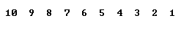
Tail recursion
Direct recursion
There is only one recursive call at the very end of a method implementation
class Main
{static void tail(int n)
{if(n >0)
{ System.out.print(n + " ");
tail(n-1);
}
}
public static void main(String [] args)
{tail(10);
System.out.println();
}
}
void nonTail (int i)
{ if (i > 0)
{tail(i-1);
System.out.print (i + "");
tail(i-1);
}
}

Slide 11
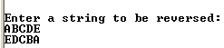
Non-tail recursion
Direct recursion
The recursive call is not at the very end of a method implementation
public class Main
{public static void reverse() throws Exception
{char ch = (char) System.in.read();
if(ch != '\n')
{reverse();
System.out.print(ch);
}
}
public static void main(String [] args) throws Exception
{System.out.println("\nEnter a string to be reversed:");
reverse();
System.out.println("\n");
}
}

Slide 12
Convert recursion implementation to iterative implementation using stack
{public static void nonRecursiveReverse() throws Exception
{MyStack t = new MyStack();
char ch;
while(true)
{ch = (char) System.in.read();
if(ch == '\n') break;
t.push(ch);
}
while(!t.isEmpty())
System.out.print(t.pop());
}

Slide 13
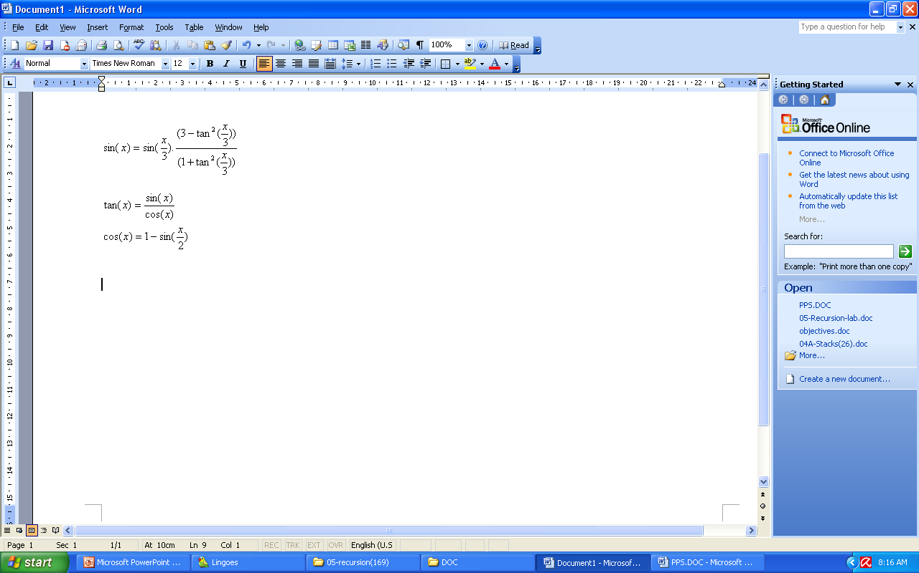
Indirect recursion
If f() calls itself, it is direct recursive
If f() calls g(), and g() calls f(). It is indirect recursion. The chain of intermediate calls can be of an arbitrary length, as in:
f() -> f1() -> f2() -> ... -> fn() -> f()
Example: sin(x) calculation
sin(x)
sin(x/3)
tan(x/3)
tan(x/3)
sin(x/3)
cos(x/3)
sin(x/3)
cos(x)
sin(x/6)
sin(x/6)
Recursive call tree for sin(x)
Notes:
?

Slide 14
Nested recursion
A function is not only defined in terms of itself but also is used as one of the parameters
Consider the following examples:
0 if n=0
n if n>4
h(2 +h(2n)) if n<=4
h(n) =
Another example of nested recursive recursion is Ackermann’s function:
  A(0, y) = y + 1
  A(x, 0) = A(x - 1, 1)
  A(x, y) = A(x - 1, A(x, y - 1))
This function is interesting because of its remarkably rapid growth.
A(3,1) = 2⁴ - 3
A(4,1) = 2⁶⁵⁵³⁶ - 3
Notes:
http://en.wikipedia.org/wiki/Fibonacci_numbers

Slide 15
Excessive recursion
Consider the Fibonacci sequence of numbers
This implementation looks very natural but extremely inefficient!
n if n<2
fibo(n-1) +fibo(n-2) otherwise
fibo(n) =
static long fibo(long n)
{if (n<2)
  return n;
  else
  return(fibo(n-1)+fibo(n-2));
}
Notes:
http://en.wikipedia.org/wiki/Fibonacci_numbers

Slide 16
The tree of calls for fibo(4)
Fib(4)
Fib(2)
Fib(3)
Fib(0)
Fib(1)
Fib(1)
Fib(2)
0
1
1
Fib(0)
Fib(1)
0
1

Slide 17
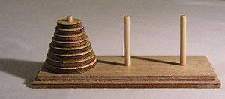
More Example – The Tower of Hanoi
Rules:
  Only one disk may be moved at a time.
  Each move consists of taking the upper disk from one of the rods and sliding it onto another rod, on top of the other disks that may already be present on that rod.
  No disk may be placed on top of a smaller disk.
Source: http://en.wikipedia.org/wiki/Hanoi_tower
Notes:
Reference: wikipedia
http://en.wikipedia.org/wiki/Hanoi_tower

Slide 18

More Example – The Tower of Hanoi
Algorithm
void moveDisks(int n, char fromTower, char toTower, char auxTower)
{if (n == 1) // Stopping condition
  Move disk 1 from the fromTower to the toTower;
  else
  {moveDisks(n - 1, fromTower, auxTower, toTower);
  move disk n from the fromTower to the toTower;
  moveDisks(n - 1, auxTower, toTower, fromTower);
  }
}

Slide 19
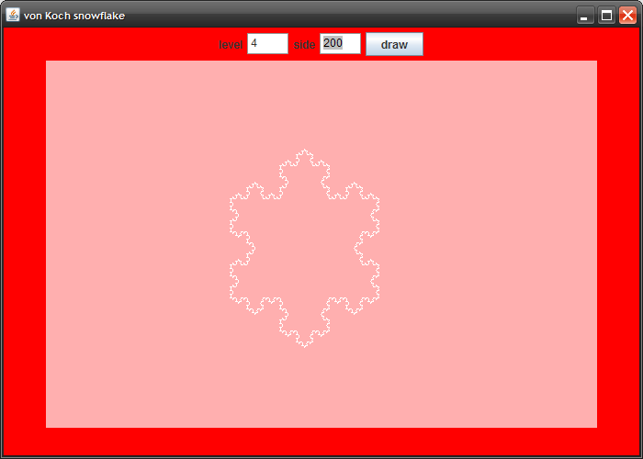




More Examples – drawing fractals
Notes:
Demo
Image source: http://www.javacoffeebreak.com/articles/fractal/index.html

Slide 20
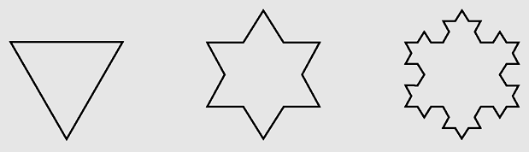
More Examples – von Knoch snowflakes
Divide an interval side into three even parts
Move one-third of side in the direction specified by angle
Examples of von Koch snowflakes

Slide 21
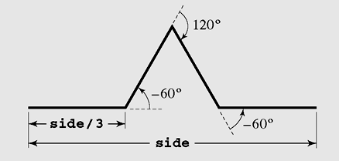
von Knoch snowflakes - 2
Turn to the right 60° (i.e., turn –60°) and go forward one-third of side
Turn to the left 120° and proceed forward
one-third of side
Turn right 60° and again draw a line one-third of side long
The process of drawing four sides of one segment of
the von Koch snowflake

Slide 22
von Knoch snowflakes - 3
  drawFourLines (side, level)
  if (level = 0)
  draw a line;
  else
  drawFourLines(side/3, level-1);
  turn left 60°;
  drawFourLines(side/3, level-1);
  turn right 120°;
  drawFourLines(side/3, level-1);
  turn left 60°;
  drawFourLines(side/3, level-1);

Slide 23
von Knoch snowflakes - 4
private void drawFourLines(double side, int level, Graphics g) {
if (level == 0) {
// arguments to sin() and cos() must be angles given in radians,
// thus, the angles given in degrees must be multiplied by PI/180;
pt.x = ((int)(Math.cos(angle*Math.PI/180)*side)) + currPt.x;
pt.y = ((int)(Math.sin(angle*Math.PI/180)*side)) + currPt.y;
g.drawLine(currPt.x, currPt.y, pt.x, pt.y);
currPt.x = pt.x;
currPt.y = pt.y;
}
else {
drawFourLines(side/3.0,level-1,g);
left (60);
drawFourLines(side/3.0,level-1,g);
right(120);
drawFourLines(side/3.0,level-1,g);
left (60);
drawFourLines(side/3.0,level-1,g);
}
}

Slide 24
Recursion vs. Iteration
Some recursive algorithms can also be easily implemented with loops
  When possible, it is usually better to use iteration, since we don’t have the overhead of the run-time stack (that we just saw on the previous slide)
Other recursive algorithms are very difficult to do any other way

Slide 25
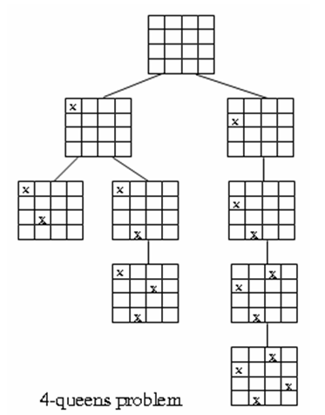
Backtracking - 1
In solving some problems, a situation arises where there are different ways leading from a given position, none of them known to lead to a solution. After trying one path unsuccessfully, we return to this crossroad and try to find a solution using another path. However, we must ensure that such a return is possible and that all paths can be tried. This technique is called backtracking. This technique is used in artificial intelligence, and one of the problems in which backtracking is very useful is the n-queens problem.
Each choice leads to another set of choices. Make one choice and continue. If you reach a dead end, go back to previous choice and try next alternative.

Slide 26
Backtracking - 2
  putQueen(row)
  for every position col on the same row
  if position col is available
  place the next queen in position col;
  if (row < n)
  putQueen(row+1);
  else success;
  remove the queen from position col;

Slide 27
Summary
Recursive definitions are programming concepts that define themselves
Recursive definitions serve two purposes:
  Generating new elements
  Testing whether an element belongs to a set
Recursive definitions are frequently used to define functions and sequences of numbers
Tail recursion is characterized by the use of only one recursive call at the very end of a method implementation.
Backtracking is a technique for returning to a given position (e.g., entry point) after trying other avenues that are unsuccessful in solving a particular problem.

Slide 28
Reading at home
Text book: Data Structures and Algorithms in Java, Second Edition by Adam Drozdek
5.1 Recursive definition 169
5.2 Method calls and recursion implementation 172
5.3 Anatomy of a recursive call 174
5.4 Tail recursion 178
5.5 Non-tail recursion 179
5.6 Indirect recursion (*) 185
5.7 Nested recursion (*) 187
5.8 Excessive recursion 188
5.9 Backtracking (*) 191
(*) Students are required to understand essential features only (the problem explaination, definitions, the outline of algorithms…), not in details.

