Slide 1
Chapter 6. Binary Trees
Part 2

Slide 2
Objectives
Balancing a Tree
  The DSW Algorithm (*)
  AVL Trees
Heaps
Polish Notation and Expression Trees (*)
(*) Students are required to understand essential features only (the problem explaination, definitions, the outline of algorithms…), not in details.

Slide 3
Balancing a Tree - 1
A binary tree is height-balanced or balanced if the difference in height of both subtrees of any node in the tree is either zero or one.
A tree is considered perfectly balanced if it is balanced and all leaves are to be found on one level or two levels
What is a balanced tree in general?
- A balanced binary tree is one where no leaf is more than a certain amount farther from the root than any other.
- The definition is vague but, no matter the variation, a balanced tree should maintain the O(log n) invariant for most operations

Slide 4
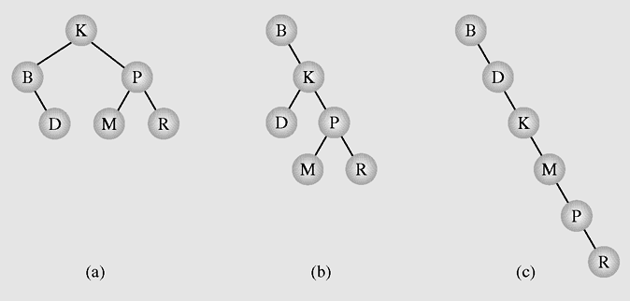
Balancing a Tree - 2
Different binary search trees with the same information

Slide 5
Simple Balance Algorithm
Balancing a Tree - 3
public void balance(T data[], int first, int last) {
if (first <= last) {
int middle = (first + last)/2;
insert(data[middle]);
balance(data,first,middle-1);
balance(data,middle+1,last);
}
}
public void balance(T data[]) {
balance(data,0,data.length-1);
}
Balancing a tree:
Copy all tree nodes to an array
Sort the array
Clear the tree
Call balance() method to rebuild the tree
Notes:
Do it in Eclipse

Slide 6
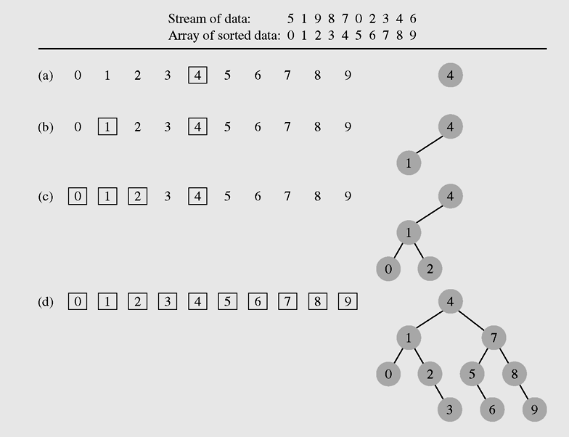
Balancing a Tree - 4
Simple Balance Algorithm
Creating a binary search tree from an ordered array

Slide 7
The DSW Algorithm - 1
The balance() method described above needs an sorted array for balancing a tree => inefficient
DSW (Day, Stout, Warren) algorithm requires little additional intermediate variables and use no sorting algorithm
The building block for tree transformations in this algorithm is the rotation
There are two types of rotation, left and right, which are symmetrical to one another
Notes:
DSW: Colin Day, Quentin F.Stout, Bette L. Warren

Slide 8
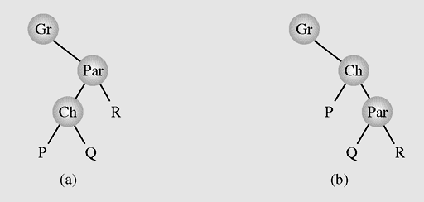
Right Rotation
The DSW Algorithm - 2
rotateRight (Gr, Par, Ch)
if Par is not the root of the tree // i.e., if Gr is not null
grandparent Gr of child Ch becomes Ch’s parent;
right subtree of Ch becomes left subtree of Ch’s parent Par;
node Ch acquires Par as its right child;
Right rotation
Left rotation
Right rotation of child Ch about parent Par
Notes:
package weiss.nonstandard;
class Rotations
{
/**
* Rotate binary tree node with left child.
* For AVL trees, this is a single rotation for case 1.
*/
static BinaryNode rotateWithLeftChild( BinaryNode k2 )
{
BinaryNode k1 = k2.left;
k2.left = k1.right;
k1.right = k2;
return k1;
}
/**
* Rotate binary tree node with right child.
* For AVL trees, this is a single rotation for case 4.
*/
static BinaryNode rotateWithRightChild( BinaryNode k1 )
{
BinaryNode k2 = k1.right;
k1.right = k2.left;
k2.left = k1;
return k2;
}
/**
* Double rotate binary tree node: first left child
* with its right child; then node k3 with new left child.
* For AVL trees, this is a double rotation for case 2.
*/
static BinaryNode doubleRotateWithLeftChild( BinaryNode k3 )
{
k3.left = rotateWithRightChild( k3.left );
return rotateWithLeftChild( k3 );
}
/**
* Double rotate binary tree node: first right child
* with its left child; then node k1 with new right child.
* For AVL trees, this is a double rotation for case 3.
*/
static BinaryNode doubleRotateWithRightChild( BinaryNode k1 )
{
k1.right = rotateWithLeftChild( k1.right );
return rotateWithRightChild( k1 );
}
}

Slide 9
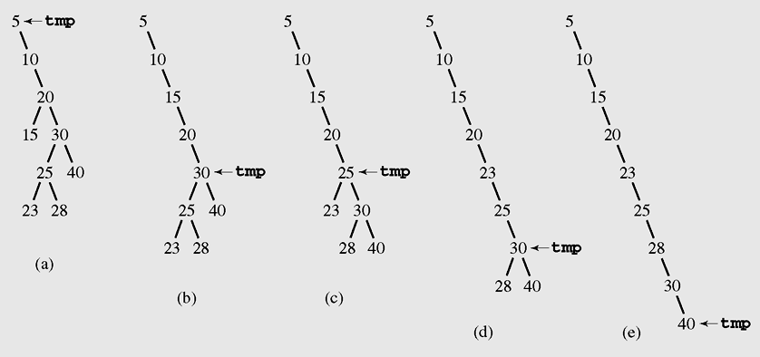
Tree transformation
The DSW Algorithm - 3
createBackbone(root, n)
temp = root;
while(temp!=null)
if (temp has a left child)
rotate this child about temp;
set temp to the child that just became parent;
else set temp to its right child;
A binary search tree is transformed to a linked-list like tree

Slide 10
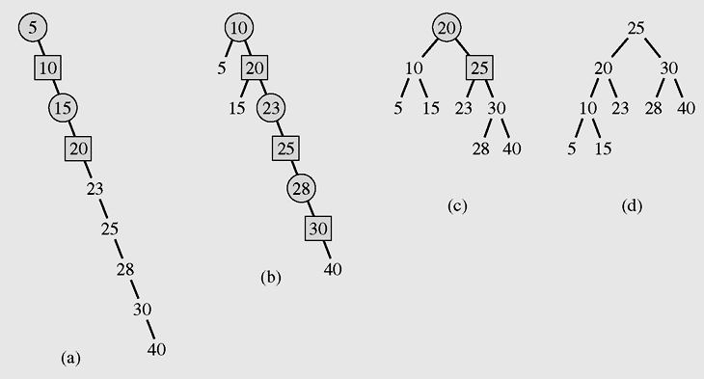
Creating perfect tree
The DSW Algorithm - 4
createPerfectTree(n)
m = 2^{|_lg(n+1)_|} -1;
make n-m rotations starting from the top of the backbone;
while (m>1)
m = m / 2;
make m rotations starting from the top of the backbone;
From the backbone, a perfectly balanced tree is built
Notes:
L = log2(N+1) = number of levels needed to hold N nodes in a tree
n = 9 =>m = 7

Slide 11
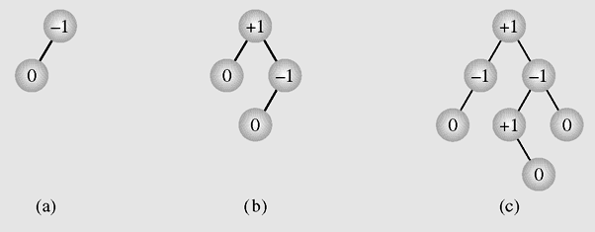
AVL Trees
An AVL tree (by Adelson Velskii, Landis) is a balanced binary search tree in which the height of the left and right subtrees of every node differ by at most one
Balance factor = height(right)- height(left)
Examples of AVL trees
Notes:
Admissible tree

Slide 12
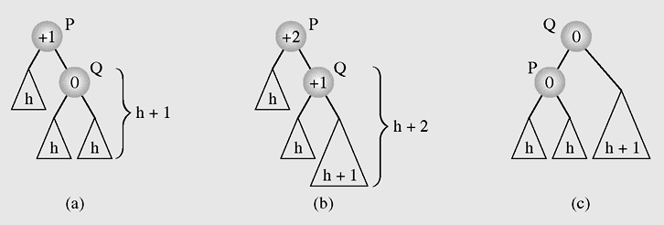
Insertion in an AVL Tree - 1
Balancing a tree after insertion of a node in the right
subtree of node Q

Slide 13
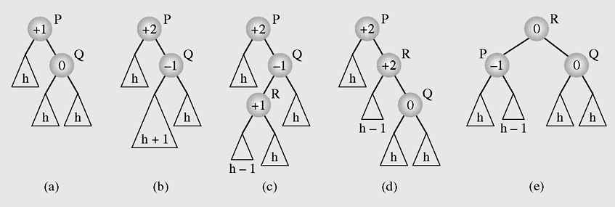
Insertion in an AVL Tree - 2
Balancing a tree after insertion of a node in the left
subtree of node Q

Slide 14
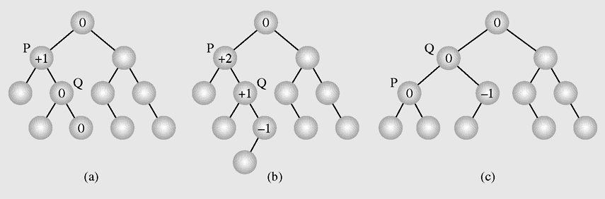
Insertion in an AVL Tree - 3
An example of inserting a new node (b) in an AVL tree (a), which requires one rotation (c) to restore the height balance

Slide 15
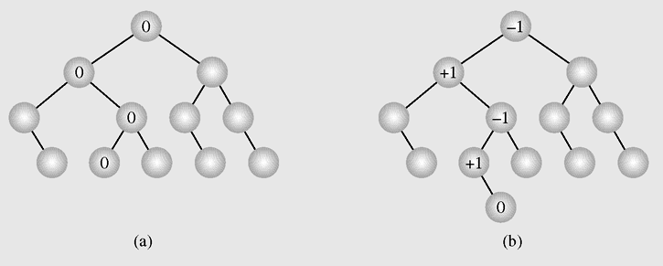
Insertion in an AVL Tree - 4
In an AVL tree (a) a new node is inserted
(b) requiring no height adjustments

Slide 16
Insertion in an AVL Tree - 5
Notes about insertion algorithm in an AVL Tree
Insert a node as in a binary search tree.
Recalculate balance fator of nodes from the inserted node back to the root.
  If there is no unbalanced node (which means that no balance factors -2 or 2) in the tree then stop.
  If we found the first node p whose balance factor is 2 or -2 then we should rotate p about his son. If p's and his son's balance factors have the same sign, then only single rotation should be done. If the signs of p and q are different then double rotation should be done: at first q is rotated, and then p.
  Rotation rule: for left unbalane the right rotation should be used and vice versa.

Slide 17
Insertion in an AVL Tree - 6
Example
44
44
78
62
17
17
50
50
78
32
88
32
48
62
48
54
88
Just inserted
54
After restructured
unbalanced
Notes:
Example:Goodrich’s
Use the applet to build the tree, show the balance factor

Slide 18
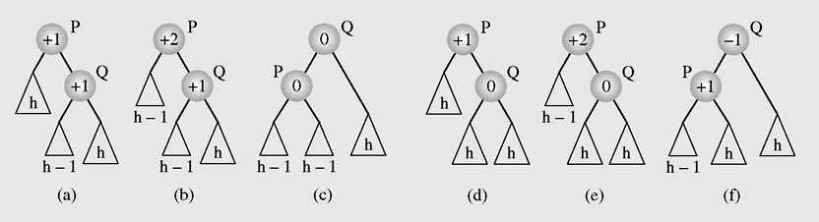
Deletion in an AVL Tree - 1
Rebalancing an AVL tree after deleting a node

Slide 19
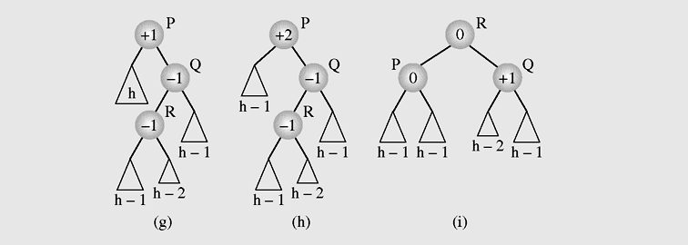
Deletion in an AVL Tree - 2
Rebalancing an AVL tree after deleting a node
(continued)

Slide 20
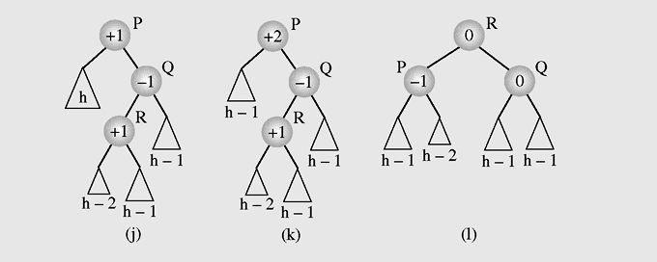
Deletion in an AVL Tree - 3
Rebalancing an AVL tree after deleting a node
(continued)

Slide 21

Heaps - 1
A particular kind of binary tree, called a heap, has two properties:
  The value of each node is greater than or
  equal to the values stored in each of its children
  The tree is nearly complete, i.e. it is perfectly balanced, and the leaves in the last level are all in the leftmost positions
These two properties define a max heap
If “greater” in the first property is replaced with “less,” then the definition specifies a min heap
Heap is used as Priority Queue and for heap-sorting

Slide 22

Heaps - 2
We can represent heap by array in level order, going from left to right. The array corresponding to the heap above is [25, 13, 17, 5, 8, 3].
PARENT (i)
return floor((i-1)/2)
LEFT (i)
return 2i+1
RIGHT (i)
return 2(i + 1)
The root of the tree A[0] and given index i of a node, the indices of its parent, left child and right child can be computed:

Slide 23
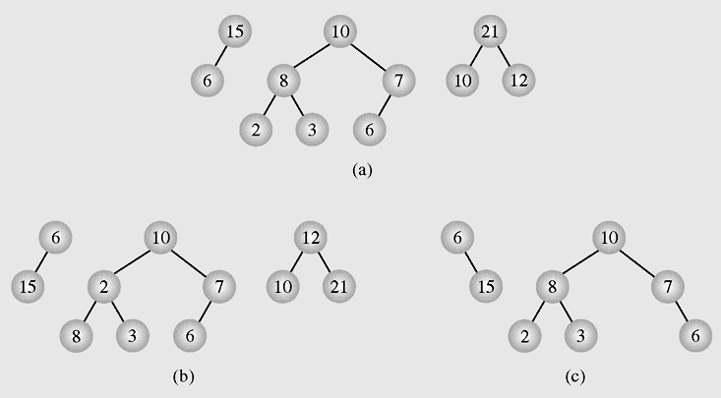
Heaps - 3
Examples of (a) heaps and (b–c) nonheaps

Slide 24
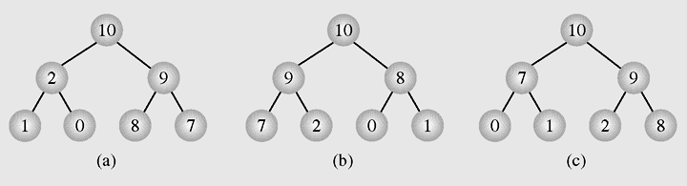
Heaps - 4
Different heaps constructed with the same elements

Slide 25
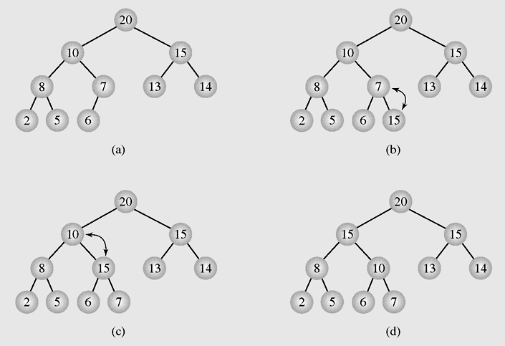
Heaps as Priority Queues - 1
Enqueuing an element to a heap

Slide 26
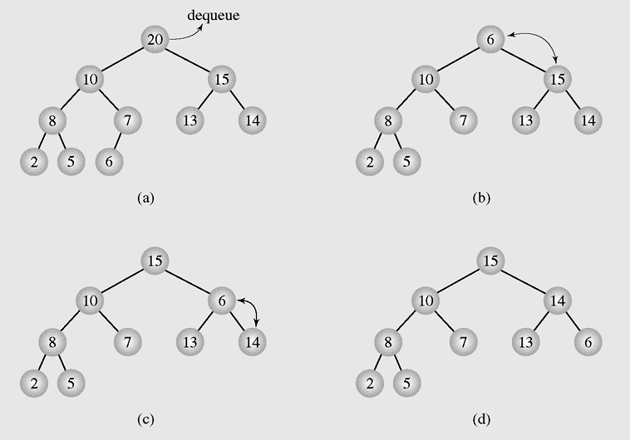
Heaps as Priority Queues - 2
Dequeuing an element from a heap

Slide 27
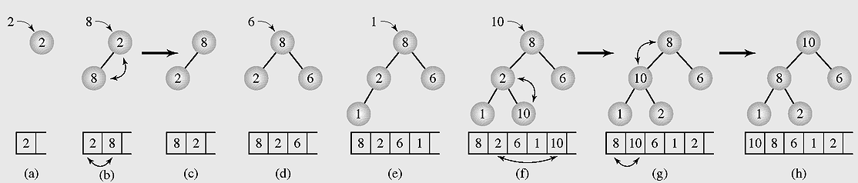
Organizing Arrays as Heaps - 1
Organizing an array as a heap with a top-down method

Slide 28
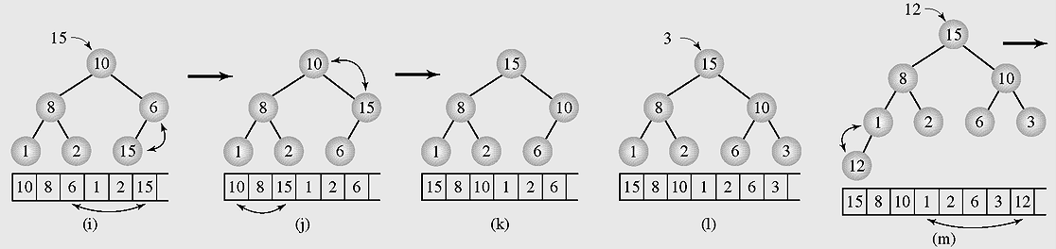
Organizing Arrays as Heaps - 2
Organizing an array as a heap with a top-down method
(continued)

Slide 29
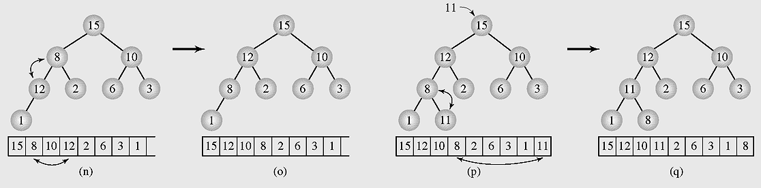
Organizing Arrays as Heaps - 3
Organizing an array as a heap with a top-down method
(continued)

Slide 30
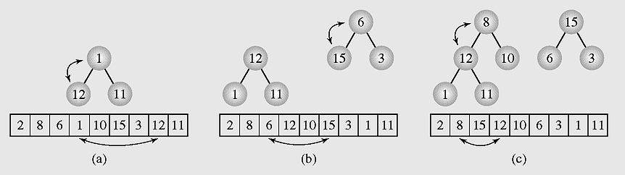
Organizing Arrays as Heaps - 4
Transforming the array [2 8 6 1 10 15 3 12 11] into
a heap with a bottom-up method

Slide 31
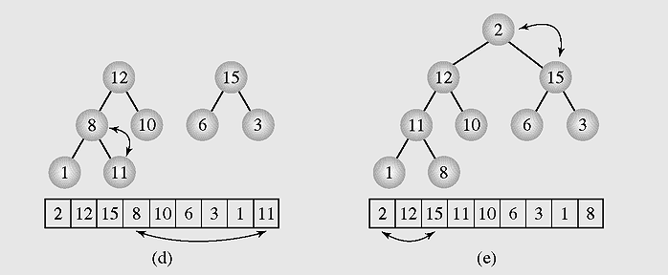
Organizing Arrays as Heaps - 5
Transforming the array [2 8 6 1 10 15 3 12 11] into
a heap with a bottom-up method (continued)

Slide 32
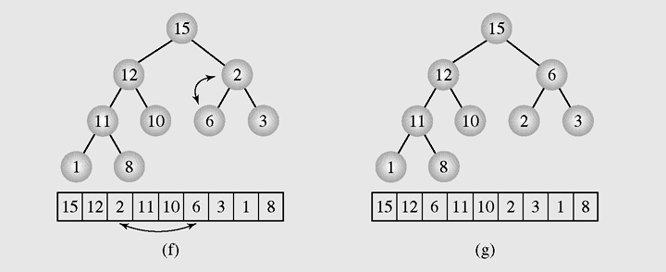
Organizing Arrays as Heaps - 6
Transforming the array [2 8 6 1 10 15 3 12 11] into
a heap with a bottom-up method (continued)

Slide 33
Organizing Arrays as Heaps - 7
//Transform the array to HEAP
int i,s,f;int x;
for(i=1;i<n;i++)
{ x=a[i]; s=i; //s is a son, f=(s-1)/2 is father
while(s>0 && x>a[(s-1)/2])
{ a[s]=a[(s-1)/2]; s=(s-1)/2; };
a[s]=x;
}
}

Slide 34
Organizing Arrays as Heaps - 8
// Transform heap to sorted array
for(i=n-1;i>0;i--)
{ x=a[i];a[i]=a[0];
f=0; //f is father
s=2*f+1; //s is a left son
// if the right son is larger then it is selected
if(s+1<i && a[s]<a[s+1]) s=s+1;
while(s<i && x<a[s])
{ a[f]=a[s]; f=s; s=2*f+1;
if(s+1<i && a[s]<a[s+1]) s=s+1;
};
a[f]=x;
};

Slide 35
Polish Notation and Expression Trees - 1
Polish notation is a special notation for propositional logic that eliminates all parentheses from formulas:
(5 − 6) * 7 = * − 5 6 7 (prefix notation)
The compiler rejects everything that is not essential to retrieve the proper meaning of formulas.

Slide 36

Polish Notation and Expression Trees - 2
Examples of three expression trees and results of their traversals

Slide 37
Summary - 1
A tree is a data type that consists of nodes and arcs.
The root is a node that has no parent; it can have only child nodes.
Each node has to be reachable from the root through a unique sequence of arcs, called a path.
An orderly tree is where all elements are stored according to some predetermined criterion of ordering.
A binary tree is a tree whose nodes have two children (possibly empty), and each child is designated as either a left child or a right child.

Slide 38
Summary - 2
A decision tree is a binary tree in which all nodes have either zero or two nonempty children.
Tree traversal is the process of visiting each node in the tree exactly one time.
An AVL tree is one in which the height of the left and right subtrees of every node differ by at most one.
Polish notation is a special notation for propositional logic that eliminates all parentheses from formulas.

Slide 39
Reading at home
Text book: Data Structures and Algorithms in Java, Second Edition by Adam Drozdek
6.7 Balancing a Tree 249
  6.7.1 The DSW Algorithm (*) 252
  6.7.2 AVL Trees 255
6.9 Heaps 267
6.10 Polish Notation and Expression Trees (*) 275
(*) Students are required to understand essential features only (the problem explaination, definitions, the outline of algorithms…), not in details.

