Slide 1
Chapter 8. Graphs
Part 1

Slide 2
Objectives
Graphs
Graph Representation
Graph Traversals
Connectivity
Cycle Detection
Shortest Paths
  Dijsktra algorithm
  Floyd algorithm
  Bellman-Ford algorithm

Slide 3
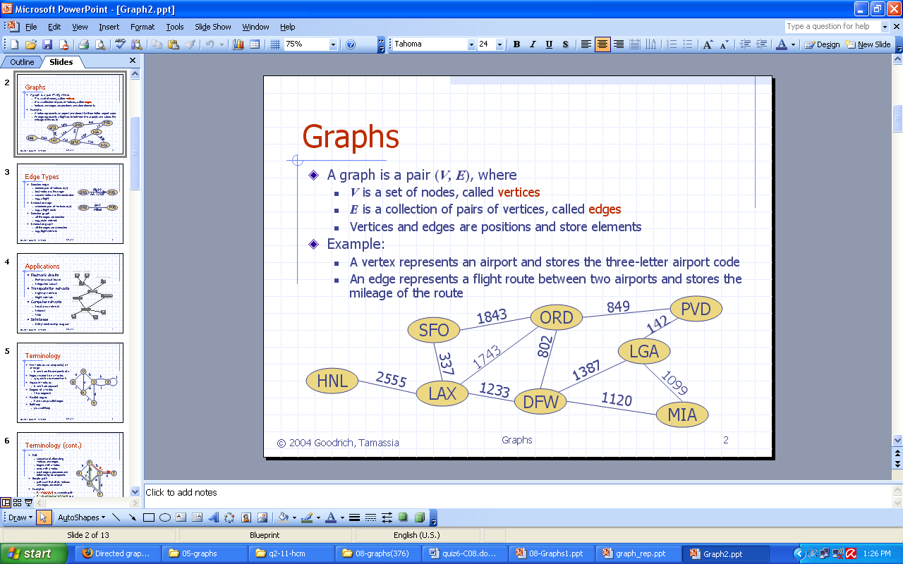
Graph definition
In briefly saying, a graph is a collection of
vertices and the connections between them
Notes:
Graph = đồ thị
Vertex = đỉnh = node
Edge = arcs = cung = cạnh

Slide 4
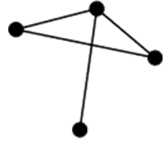
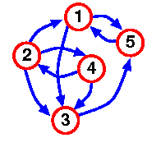
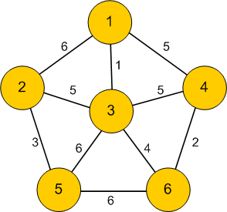
Graph Terminology - 1
An undirected graph: A graph G=(V, E) is called undirected graph if each edge e being a set of two vertices from V ( e = {u,v} ).
A directed graph, or a digraph: A G=(V, E) is called directed graph if each edge e is an ordered pair of vertices from V ( e = (u,v) ).
A weighted graph: A G=(V, E) is called weightted graph if each edge e has an assigned number, called the weight of the edge e.
Undirected graph
Directed graph
Weighted graph
Notes:
Graph = đồ thị
Vertex = đỉnh = node
Edge = arcs = cung = cạnh

Slide 5
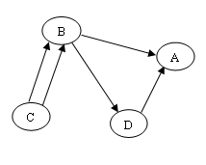
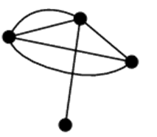
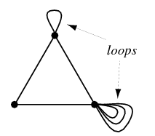
Graph Terminology - 2
A multiple and single edges: Multiple edges are two or more edges connecting the same two vertices
(note that in directed graph the pair (u,v) is not the same as the pair (v,u))
An undirected graph with multiple edges
An directed graph with multiple edges
Single undirected graph
Single directed graph
A graph loops: A degenerate edge of a graph which joins a vertex to itself, also called a self-loop
Notes:
Graph = đồ thị
Vertex = đỉnh = node
Edge = arcs = cung = cạnh

Slide 6
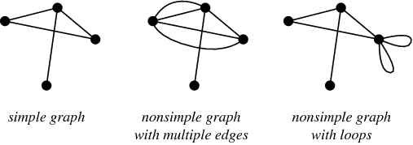
Graph Terminology - 3
A simple graph: A simple graph, also called a strict graph, is an unweighted, undirected graph containing no graph loops or multiple edges. Unless stated otherwise, the unqualified term "graph" usually refers to a simple graph.
Notes:
Graph = đồ thị
Vertex = đỉnh = node
Edge = arcs = cung = cạnh

Slide 7
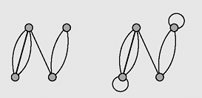
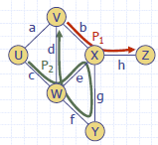
Graph Terminology - 4
A multigraph is a graph in which two vertices (with the condition v_{i} ≠ v_{j}) can be joined by multiple edges (1)
If we remove the condition v_{i} ≠ v_{j} in the definition of a multigraph then we get the notion of a pseudograph, which allows for loops to occur (2)
Path from v_{i} to v_{n} is a sequence of edges (v₁,v₂), (v₂,v₃),.., (v_{n-1},v_{n}). If v₁=v_{n} and no edge is repeated, then the path is called a circuit. If all vertices in a circuit are different, then it is called a cycle.
(1)
(2)
Notes:
Cycle = chu trình

Slide 8
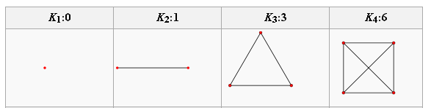
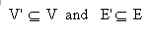
Graph Terminology - 5
A complete graph is a graph where every pair of vertices is connected by an edge.
A simple complete graph on n vertices has n vertices and n(n-1)/2 edges, and is denoted by Kn
A graph G'=(V', E') is a subgraph of another graph G=(V, E) iff V
Notes:
Cycle = chu trình

Slide 9
Graph Terminology - 6
Two vertices u and v are called adjacent if the edge(u,v) is in E. Such an edges called incident with the vertices u and v.
The degree of a vertice u, deg(u), is the number of edges incident with u.
If deg(u) = 0 then u is called isolated vertex.
Notes:
Cycle = chu trình

Slide 10
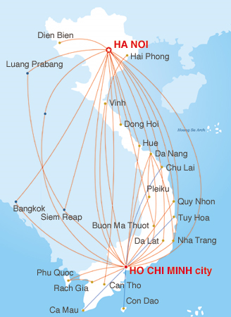
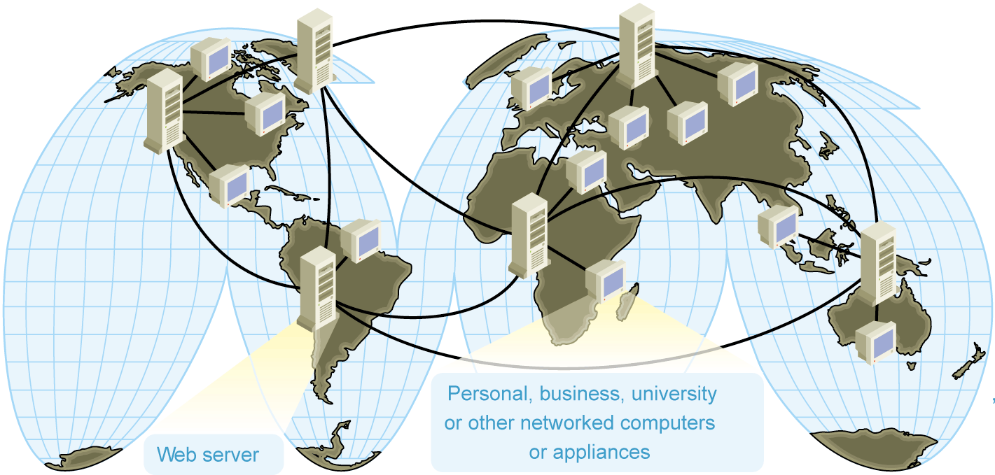
Graph applications
Electronic circuits
Transportation networks
Computer networks
Database
  Entity-relationship diagram
Notes:
Image source:
Computer network:http://www.microsoft.com/mspress/books/sampchap/4800/0735611874-01.gif
Air Flight map: http://www.vietnamairlines.com.vn

Slide 11
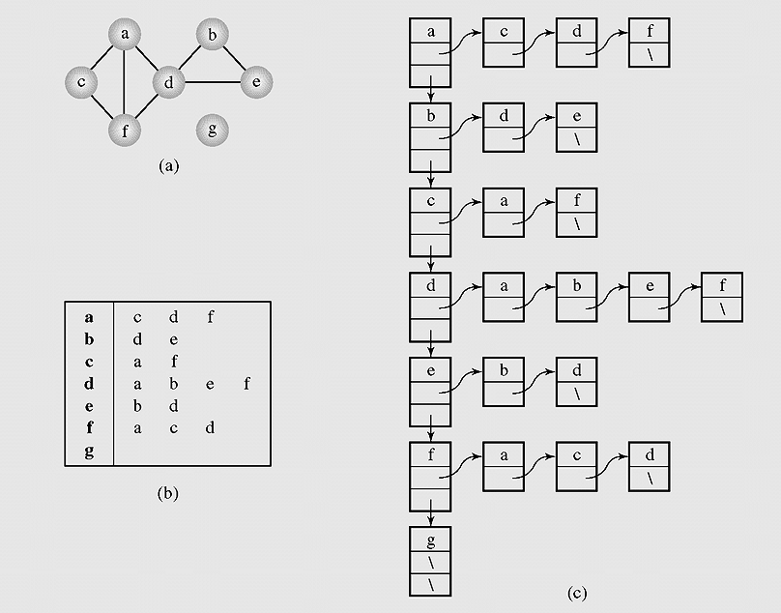
Graph Representation – 1
(Adjacency list)
Graph representations.
A graph (a) can be represented as
(b–c) an adjacency list.
Notes:
Let them discuss how to implement, try some lines

Slide 12
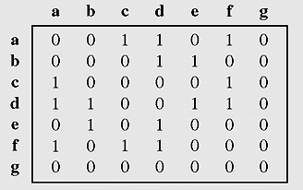
Graph Representation – 2
(Adjacency matrix)
Graph represented by an adjacency matrix
Notes:
Build on papers
More: incident matrix = ma tran lien thuoc

Slide 13
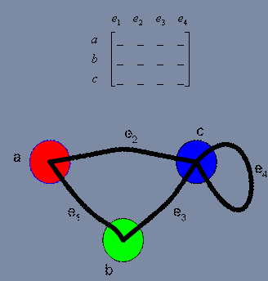
Graph Representation – 3
(Incident matrix)
A vertex is said to be incident to an edge if the edge is connected to the vertex.
Graph represented by incident matrix
Notes:
Build on papers
More: incident matrix = ma tran lien thuoc

Slide 14
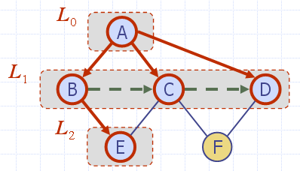
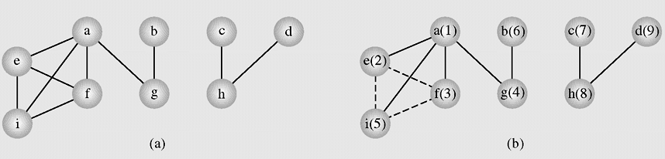
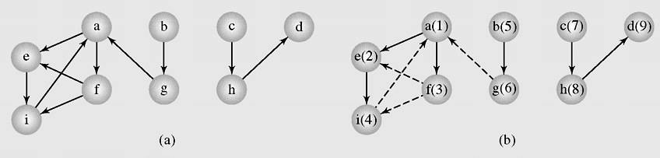
Breadth-first Search
Graph Traversals
In the breadth-first search algorithm, at first a selected vertex v is visited and then each unvisited vertex adjacent to v is visited. Suppose these adjacents are v₁ , v₂,… v_{k}. After all these vertices are visited, all adjacents of v₁ are visited, then all adjacents of v₂ are visited and so on. If there are still some unvisited vertices in the graph, the traversal continues restarting for one of the unvisited vertices.

Slide 15
Breadth-first Search Algorithm
Search a graph (directed or not) in breadth first, this is done by using a queue where the vertices found are stored.
BFS(Graph G)
{ all vertices of G are first painted white
the graph root is painted gray and put in a queue
while the queue is not empty
{ a vertex u is removed from the queue
for all white successors v of u
{ v is painted gray
v is added to the queue
}
u is painted black
}
}

Slide 16
Breadth-first Search code
// bread first traverse from vertex k
void breadthFirst(int k)
{MyQueue q = new MyQueue();int i,h;
boolean [] enqueued = new boolean[n];
for(i=0;i<n;i++) enqueued[i]=false;
q.enqueue(new Integer(k));enqueued[k]=true;
while(!q.isEmpty())
{h=Integer.parseInt((q.dequeue()).toString().trim());
visit(h);
for(i=0;i<n;i++)
if((!enqueued[i]) && a[h][i]>0)
{q.enqueue(new Integer(i));
enqueued[i] = true;
}
}
System.out.println();
}

Slide 17
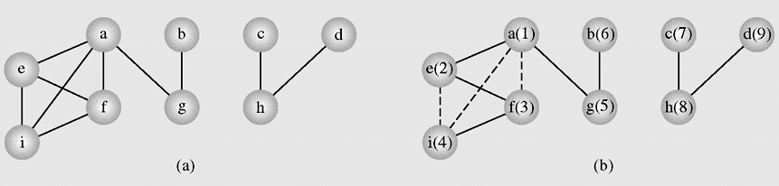
Depth-first Traversal
In the depth-first search algorithm, at first selected vertex v is visited and then each unvisited vertex adjacent to v is visited by depth-first search. If there are still some unvisited vertices in the graph, the traversal continues restarting for one of the unvisited vertices.
An example of application of the depthFirstSearch() algorithm to a graph

Slide 18
Depth-First Search algorithm
DFS-visit (Graph G, Vertex u)
{ the vertex u is painted gray
for all white successors v of u
{ dfs-visit(G, v)
}
u is painted black
}
DFS (Graph G)
{ all vertices of G are first painted white
DFS-visit(G, root of G)
}
The idea is the same, but we now use a stack instead of a queue. With recursion of course, so the stack management is all done by Java.
Here is a brief description of the DFS algorithm:
DFS on a graph with n vertices and m edges takes O(n + m ) time

Slide 19
Depth-First Traverse code
void visit(int i)
{System.out.print(" " + v[i]);
}
void depthFirst(boolean visited[], int i)
{visit(i);visited[i] = true;
int j;
for(j=0;j<n;j++)
if(a[i][j]>0 && (!visited[j]))
depthFirst(visited,j);
}
void depthFirst(int k)
{int i; boolean [] visited = new boolean[20];
for(i=0;i<n;i++) visited[i]=false;
depthFirst(visited,k);
for(i=0;i<n;i++)
if(!visited[i])
depthFirst(visited,i);
System.out.println();
}

Slide 20
Connectivity - 1
An undirected graph is called connected when there is a path between any two vertices of the graph
A graph is called n-connected if there are at least n different paths between any two vertices; that is, there are n paths between any two vertices that have no vertices in common
A 2-connected or biconnected graph is when there are at least two nonoverlapping paths between any two vertices
A directed graph is called weakly connected if replacing all of its directed edges with undirected edges produces a connected (undirected) graph. It is connected if it contains a directed path from u to v or a directed path from v to u for every pair of vertices u,v.
It is strongly connected or strong if it contains a directed path from u to v and a directed path from v to u for every pair of vertices u,v. The strong components are the maximal strongly connected subgraphs.

Slide 21
Connectivity - 2
If the vertex is removed from a graph (along with incident edges) and there is no way to find a path from a to b, then the graph is split into two separate subgraphs called articulation points, or cut-vertices
If an edge causes a graph to be split into two subgraphs, it is called a bridge or cut-edge
Connected subgraphs with no articulation points or bridges are called blocks
We can use depth first traverse to check the connectivity of a graph

Slide 22
Cycle detection
Pseudo-code for detecting cycles in an undirected graph:
initialize num[v] to 0 for all v
initialize edgeSet to the empty set
cycleDetectionDFS(u)
num[u] = i++;
for all vertices v adjacent to u
if num[v] == 0
add edge (u,v) to edgeSet
cycleDetectionDFS(u)
else if edge(uv) is not in edges
cycle detected

Slide 23
Shortest Path problem
The problem: find the shortest path between a pair of vertices of a graph
The graph: may contain negative edges but no negative cycles
A representation: a weighted matrix where
W(i,j) = 0 if i=j.
W(i,j) = ∞ if there is no edge between i and j.
W(i,j) = weight of the edge (i,j)

Slide 24
Shortest Path methods
The methods solving the shortest path problem are divided in two classes:
  Label-setting methods
    In each pass through the vertices still to be processed, one vertex is set to a value that remains unchanged to the end of the execution
  Label-correcting methods
    Allow for the changing of any label during application of the method
Most of the label-setting and label-correcting methods, however, can be subsumed to the same form, which allows finding the shortest paths from one vertex to all other vertices.

Slide 25

Dijkstra Algorithm
DijkstraAlgorithm(non-gegative weighted simple digraph, vertex first)
for all vertices v # first currDist(v) = ∞;
currDist(first) = 0;
toBeChecked = V (all vertices);
checked = empty;
while toBeChecked is not empty
u = a vertex in toBeChecked with min.currDist(u);
remove u from toBeChecked and add to checked;
for all vertices v adjacent to u and in toBeChecked
if (currDist(v) > currDist(u) + weight(edge(uv)))
{currDist(v) = currDist(u) + weight(edge(uv))
predeccessor(v) = u;
}
Notes:
Image source: http://en.wikipedia.org/wiki/File:Dijksta_Anim.gif

Slide 26

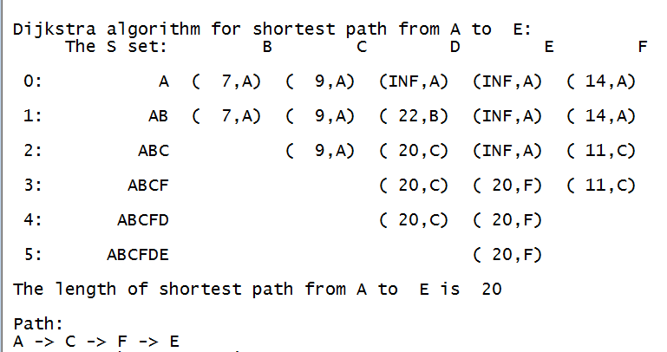
Dijkstra Algorithm (cont.)
A(1), B(2), C(3), D(4), E(5), F(6)
Dijkstra’s algorithm keeps two sets of vertices:
  S Vertices whose shortest paths have already been determined
  V-S Remainder
Also
  d Best estimates of shortest path to each vertex
  p Predecessors for each vertex
int [][] b = {
{ 0, 7, 9, 99, 99, 14},
{ 7, 0, 10, 15, 99, 99},
{ 9, 10, 0, 11, 99, 2},
{99, 15, 11, 0, 6, 99},
{99, 99, 99, 6, 0, 9},
{14, 99, 2, 99, 9, 0}
};
Notes:
Image source: http://en.wikipedia.org/wiki/File:Dijksta_Anim.gif

Slide 27
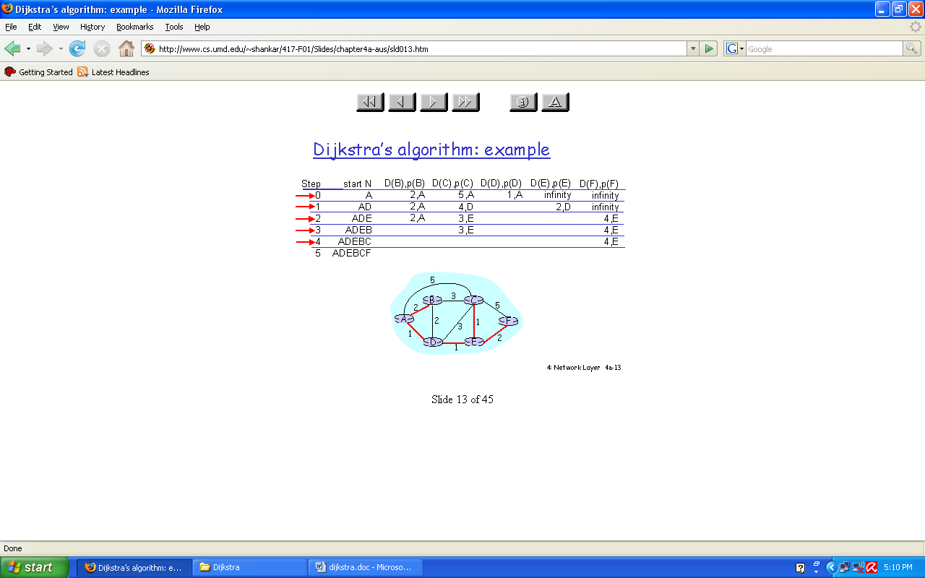
Dijkstra Algorithm – example 1
The complexity of Dijkstra's algorithm is O(|V|²). This algorithm is not general enough in that it may fail when negative weights are used in graphs.

Slide 28
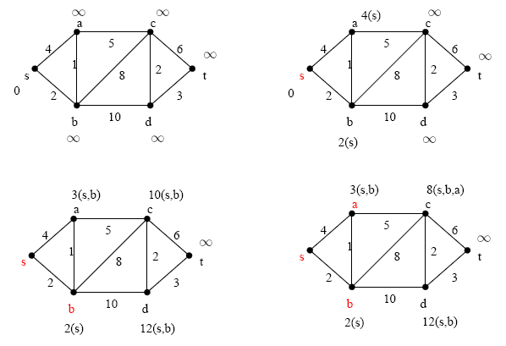
Dijkstra Algorithm – example 2

Slide 29
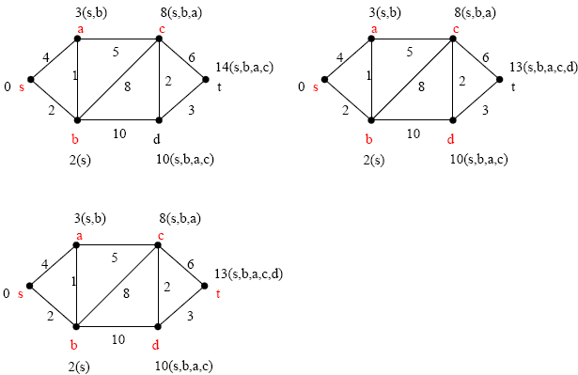
Dijkstra Algorithm – example 2 (cont…)

Slide 30
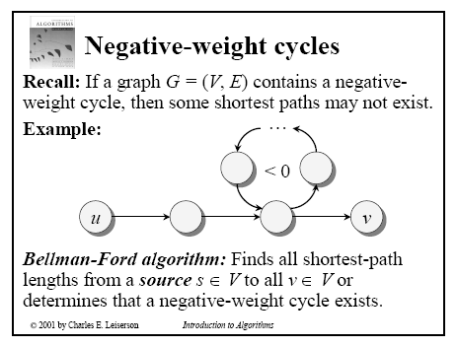
Bellman-Ford Algorithm - 1
Notes:
This algorithm uses label-correcting method

Slide 31
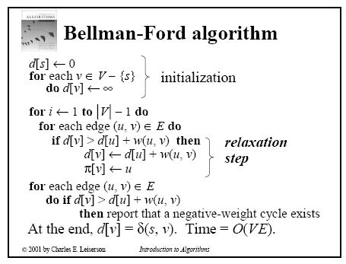
Bellman-Ford Algorithm - 2
Notes:
This algorithm uses label-correcting method

Slide 32
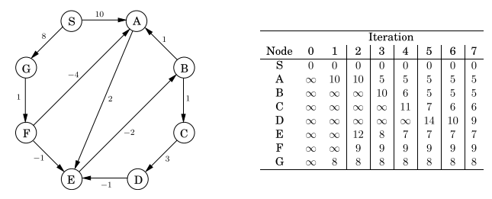
Bellman-Ford Algorithm - example

Slide 33
Floyd Algorithm
All pairs shortest path
The problem: find the shortest path between every pair of vertices of a graph
The graph: may contain negative edges but no negative cycles
1. D = W // initialize D array to W [ ]
2. P = 0 // initialize P array to [0]
3. for k = 1 to n
4. do for i = 1 to n
5. do for j = 1 to n
6. if (D[ i, j ] > D[ i, k ] + D[ k, j ] )
7. then { D[ i, j ] = D[ i, k ] + D[ k, j ]
8. P[ i, j ] = P[k,j];
}
Complexity O(|V|³)
Notes:
This algorithm uses label-correcting method

Slide 34
Floyd Algorithm example 1
1
2
3
1
0
4
5
W = D⁰ =
1
2
2
0
∞
5
3
∞
-3
0
4
2
3
1
2
3
2
-3
1
0
0
0
P =
2
0
0
0
3
0
0
0
Floyd’s Algorithm <number>
Notes:
Algorithms
CS333 / class 22

Slide 35
k = 1
Vertex 1 can be intermediate node
1
2
3
D⁰ =
1
5
1
0
4
5
3
2
2
0
∞
4
2
3
∞
-3
0
2
-3
1
2
3
1
0
4
5
D¹[2,3] = min( D⁰[2,3], D⁰[2,1]+D⁰[1,3] )
= min (∝, 7)
= 7
D¹[3,2] = min( D⁰[3,2], D⁰[3,1]+D⁰[1,2] )
= min (-3,∝)
= -3
D¹ =
2
2
0
7
3
∞
-3
0
1
2
3
1
0
0
0
P =
2
0
0
1
3
0
0
0
Floyd’s Algorithm <number>
Notes:
Algorithms
CS333 / class 22

Slide 36
k = 2
Vertices 1, 2 can be intermediate
1
2
3
D¹ =
1
0
4
5
1
5
2
2
0
7
4
2
3
3
∞
-3
0
2
-3
1
2
3
1
0
4
5
D²[1,3] = min( D¹[1,3], D¹[1,2]+D¹[2,3] )
= min (5, 4+7)
= 5
D²[3,1] = min( D¹[3,1], D¹[3,2]+D¹[2,1] )
= min (∝, -3+2)
= -1
D² =
2
2
0
7
3
-1
-3
0
1
2
3
1
0
0
0
P =
2
0
0
1
3
2
0
0
Floyd’s Algorithm <number>
Notes:
Algorithms
CS333 / class 22

Slide 37
k = 3
Vertices 1, 2, 3 can be intermediate
1
2
3
D² =
1
0
4
5
1
5
2
2
0
7
4
2
3
3
-1
-3
0
2
-3
1
2
3
1
0
2
5
D³ =
D³[1,2] = min(D²[1,2], D²[1,3]+D²[3,2] )
= min (4, 5+(-3))
= 2
D³[2,1] = min(D²[2,1], D²[2,3]+D²[3,1] )
= min (2, 7+ (-1))
= 2
2
2
0
7
3
-1
-3
0
1
2
3
1
0
3
0
P =
2
0
0
1
3
2
0
0
Floyd’s Algorithm <number>
Notes:
Algorithms
CS333 / class 22

Slide 38

Floyd Algorithm example 2

Slide 39

The final distance matrix and P
The values in parenthesis are the non zero P values.

Slide 40
Summary
Graphs
Graph Representation
Graph Traversals
Connectivity
Cycle Detection
Shortest Paths
  Dijsktra algorithm
  Floyd algorithm
  Bellman-Ford algorithm

Slide 41
Reading at home
Text book: Data Structures and Algorithms in Java, Second Edition by Adam Drozdek
8.1 Graph Representation 377
8.2 Graph Traversals 379
8.6 Connectivity 399
8.4 Cycle Detection 392
8.3 Shortest Paths 383
  Dijsktra algorithm
  Floyd algorithm
  Bellman-Ford algorithm

