Slide 1
Chapter 8. Graphs
Part 2

Slide 2
Objectives
Spanning Trees
  Kruskal algorithm
  Dijktra algorithm
Eulerian and Hamiltonian Graphs
Graph coloring

Slide 3
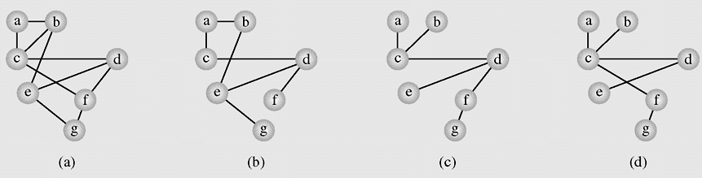
Spanning Trees
In graph theory, a tree is an undirected, connected graph without simple cycles
A spanning tree is a tree in which there is an algorithm that guarantees generating a tree (or a forest, a set of trees) that includes or spans over all vertices of the original graph
A graph representing (a) the airline connections between
seven cities and (b–d) three possible sets of connections

Slide 4
Spanning Tree Application
Minimum Spanning Trees (MST) are useful in many applications, for example, finding the shortest total connections for a set of edges.
If we are running cable to the nodes, representing cities, and we wish to minimize cable cost, the MST would be a viable option.
An algorithms will be presented: Kruskal’s Algorithm

Slide 5
Kruskal Algorithm
(A popular algorithm, all edges are ordered by weight, each edge is checked to see whether it can be considered part of the tree. It is added to the tree if no cycle arises after its inclusion)
KruskalAlgorithm(weighted connected undirected graph)
tree = null;
edges = sequence of all edges of graph sorted by weight
for (i = 1; i<=|E| and |tree|<|V| - 1; i++)
if e_i from edges does not form a cycle with edges in tree
add e_i to tree
Notes:
|E| = number of edges
|V| = number of vertices

Slide 6
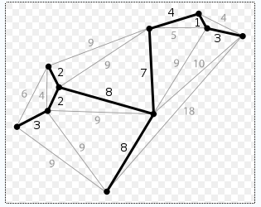
Kruskal Algorithm – example - 1
(a)
A spanning tree of graph (a) found with Kruskal’s algorithm

Slide 7
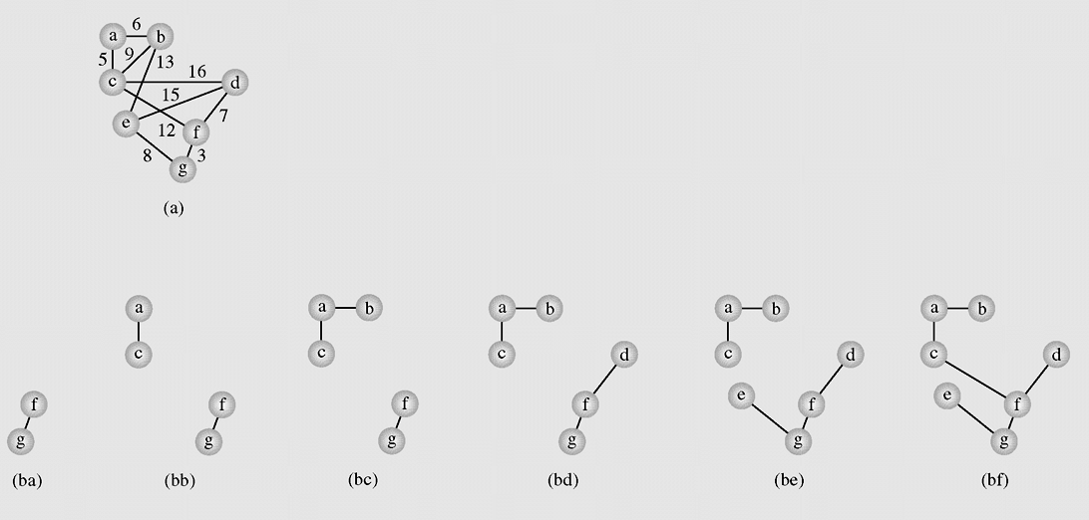
Kruskal Algorithm – example - 2
(b)
A spanning tree of graph (b) found with Kruskal’s algorithm

Slide 8
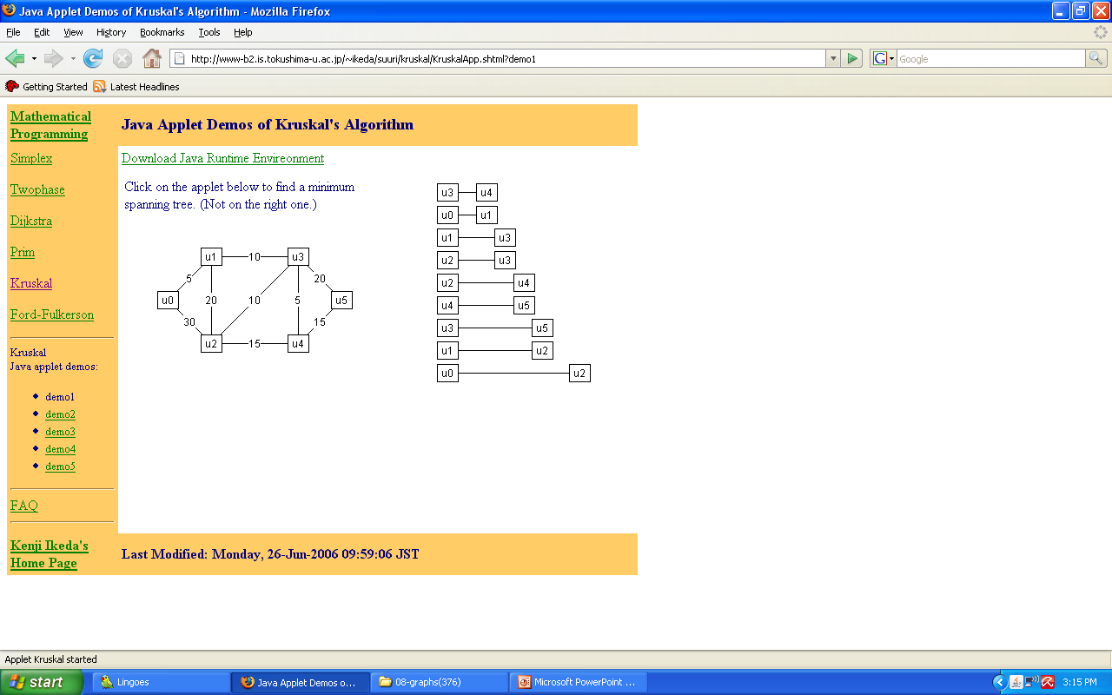
Kruskal Algorithm – example - 3
(c)
A spanning tree of graph (c) found with Kruskal’s algorithm

Slide 9
Dijkstra’s method - 1
DijkstraMethod(weighted connected undirected graph)
tree = null;
edges = an unsorted sequence of all edges of graph
for (i = 1; i<=|E|)
add e_{i} to tree;
if there is a cycle in tree
remove an edge with maximum weight from this cycle;
Notes:
No need to order the edges

Slide 10
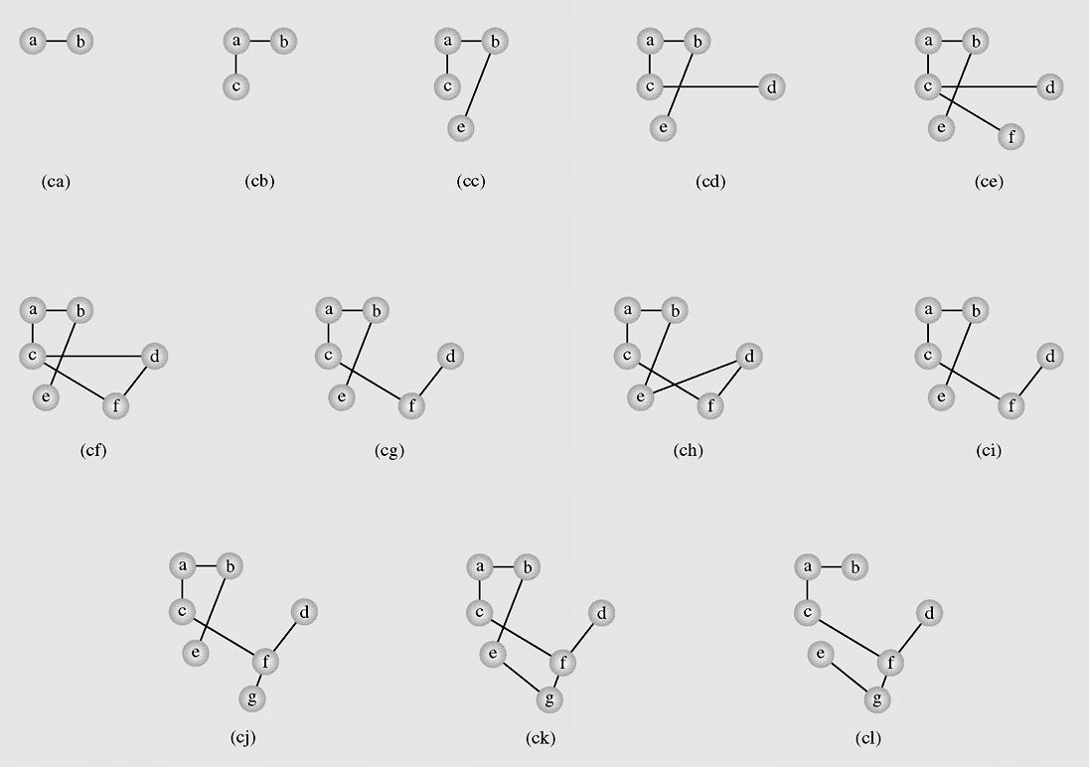
Dijkstra’s method - 2
A spanning tree of graph (a) found with Dijkstra’s method

Slide 11
Euler and Hamilton Cycles and Paths
A Euler Circuit in a graph G is a simple circuit that includes all edges of G.
A Euler Path in a graph G is a simple path that includes all edges of G.
A Hamilton circuit is a circuit where each vertex in G is visited exactly once
A Hamilton Path is a path where each vertex in G is visited exactly once
Visit each
edge once
Visit each
vertex once

Slide 12
Euler cycle and paths
Euler path: a path traversing all the edges of the graph
exactly once
Euler cycle: a cycle traversing all the edges of the graph exactly once
No Euler cycle
no Euler path
Has Euler cycle
Has Euler path,
but no Euler cycle

Slide 13
The Bridges of Königsberg
C
Is it possible to start at some
location, travel across all the
bridges without crossing any
bridge twice, and return to
the same starting point?
A
D
B
C
A D
B
Kneiphof island on Pregel river and 7 bridges built in 18-th century in Königsberg town (Kaliningrad).
Rephrasing in terms of Euler cycles:

Slide 14
Necessary and sufficient conditions for Euler cycles
Theorem 1: A connected multigraph has an Euler cycle if and only if each of its vertices has even degree.
No Euler cycle
no Euler path
Has Euler cycle
C
A D
B
Euler cycle???
path???
Has Euler path,
but no Euler cycle

Slide 15
Necessary condition for Euler cycle
Theorem 1: A connected multigraph has an Euler cycle if and only if each of its vertices has even degree.
Proof Sketch, PART 1:
Assume the graph has an Euler cycle.
Observe that every time the cycle passes through a vertex, it contributes 2 to the vertex’s degree
(since the cycle enters via an edge incident with this vertex and leaves via another such edge)

Slide 16
Sufficient condition for Euler cycle
Theorem 1: A connected multigraph has an Euler cycle if and only if each of its vertices has even degree.
Proof Sketch, PART 2: Demonstrate an algorithm for finding the Euler cycle in a graph where all vertices have even degree.
Assume every vertex in a multigraph G has even degree. Start at an arbitrary non-isolated vertex v₀, choose an arbitrary edge (v0,v1), then choose an arbitrary unused edge from v1 and so on. Then after a finite number of steps the process will arrive at the starting vertex v0, yielding a cycle with distinct edges.
If the cycle includes all edges of G, this will be an Euler cycle; if not, begin the procedure again from a vertex contained in this cycle and splice the two cycles together; continue until all edges are used.

Slide 17
Note
In the above procedure, once you entered a vertex v, there will
always be another unused edge to exit v because v has an even degree and only an even number of the edges incident with it had been used before you entered it.
The only edge from which you may not be able to exit after entering it is v₀ (because an odd number of edges incident with v₀ have been used as you didn’t enter it at the beginning) , but if you
have reached v₀, then you have already constructed a required cycle.

Slide 18
A procedure for constructing an Euler cycle
Algorithm Euler(G)
//Input: Connected graph G with all vertices having even degrees
//Output: Euler cycle
Construct a cycle in G
Remove all the edges of cycle from G to get subgraph H
while H has edges
find a non-isolated vertex v that is both in cycle and in H
//the existence of such a vertex is guaranteed by G’s connectivity
construct subcycle in H
splice subcycle into cycle at v
remove all the edges of subcycle from H
return cycle

Slide 19
Example
1 3 5 7
2 4 6 8
G
1 3 5 7
2 4 6 8
1 3 5 7
2 4 6 8
cycle
1231
H
1 3 5 7
2 4 6 8
subcycle
34653
splicing
34653 into
1231
1 3 5 7
2 4 6 8
1 3 5 7
2 4 6 8
H

Slide 20
Example (cont.)
1 3 5 7
2 4 6 8
1 3 5 7
2 4 6 8
H
splicing
6786 into
12346531
1 3 5 7
2 4 6 8
1 3 5 7
2 4 6 8
H
Euler cycle obtained
12346786531

Slide 21
Algorithm for finding an Euler cycle from the vertex X using stack
Algorithm Euler(G)
//Input: Connected graph G with all vertices having even degrees
//Output: Euler cycle
declare a stack S of characters
declare empty array E (which will contain Euler cycle)
push the vertex X to S
while(S is not empty)
{ch = top element of the stack S
if ch is isolated then remove it from the stack and put it to E
else
select the first vertex Y (by alphabet order), which is adjacent
to ch,push Y to S and remove the edge (ch,Y) from the graph
}
the last array E obtained is an Euler cycle of the graph

Slide 22
Necessary and sufficient conditions for Euler paths
Theorem 2. A connected multigraph has an Euler path but not an Euler cycle if and only if it has exactly two vertices of odd degree.

Slide 23
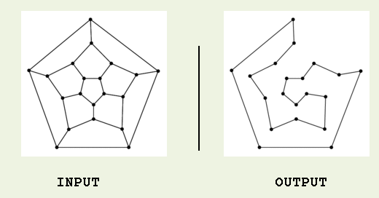
Hamilton paths and cycles - 1
Hamilton cycle: visits every vertex of the graph exactly once before returning, as the last step, to the starting vertex.
Examples:
Hamilton path: visits every vertex of the graph exactly once.

Slide 24
Hamilton paths and cycles - 2
No property is known to efficiently verify existence of a Hamilton cycle/path for general graphs. Moreover, the problem is known to be as difficult as the TSP (find the shortest H. cycle through n cities).
Dirac’s Theorem: If G is a simple graph with n ≥ 3 vertices such that the degree of every vertex is at least n/2, then G has a Hamilton cycle.
Ore’s Theorem: If G is a simple graph with n ≥ 3 vertices such that the deg(u) + deg(v) ≥ n for every pair of nonadjacent vertices u and v, then G has a Hamilton cycle.
Ore’s condition is more general than Dirac’s but neither is necessary for existence of a Hamilton cycle.
Theorem. If G = (V,E) is a complete directed graph then G has a Hamilton cycle.

Slide 25
Finding Hamilton’s cycles using Backtracking
Given the graph G = (V,E) and X is a vertex of G. Suppose there exists at least one Hamilton Cycle for the graph. The following is a backtracking algorithm for finding one Hamilton cycle from the vertex X:
declare an empty array H (which will contain Hamilton cycle)
(1) Put the vertex X to H
(2) Check if H is a Hamilton cycle then stop, else go to (3)
(3) Consider the last vertex Y in H, if there is/are vertex(es) adjacent to Y, select an adjacent vertex Z and put it to H. If there no adjacent vertex, remove Y from H and denote it as a bad selection (so you do not select it in the same way again).
Go to (2).

Slide 26
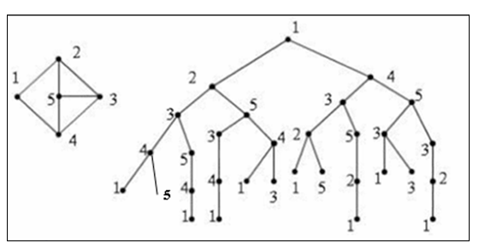
List all Hamilton’s cycles using Backtracking

Slide 27
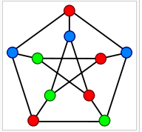
Graph coloring - 1
In graph theory, graph coloring is a way of coloring the vertices of a graph such that no two adjacent vertices share the same color.
The chromatic number of a graph is the minimum number of colors one can use to color the vertices of the graph so that no two adjacent vertices are the same color.
If the chromatic number of the graph G is denoted by χ(G). A graph for which k = χ(G) is called k-colorable. For a complete
graph χ(K_{n})=n, χ(C_{2n})=2, χ(C_{2n+1})=3; and for bipartite graph χ(G)≤ 2.
Determining a chromatic number of a graph G is an NP-complete problem.

Slide 28
Graph coloring - 2
Sequential coloring establishes the sequence of vertices and a sequence of colors before coloring them, and then color the next vertex with the lowest number possible
sequentialColoringAlgorithm(graph = (V, E))
put vertices in a certain order v_{P1}, v_{P2}, . . . , v_{Pv} ;
put colors in a certain order c₁, c₂, . . . , c_{k};
for i = 1 to |V|
j=the smallest index of color that does not appear in any neighbor of v_{Pi};
color(v_{Pi}) = c_{j};
The complexity of this algorithm is O(|V|²)

Slide 29
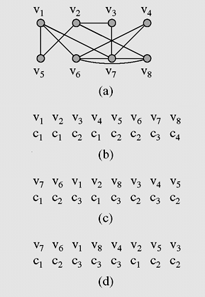
Graph Coloring - 3
(a) A graph used for coloring; (b) colors assigned to vertices with
the sequential coloring algorithm that orders vertices by index number;
(c) vertices are put in the largest first sequence; (d) graph coloring obtained
with the Brélaz algorithm

Slide 30
Summary
Spanning Trees
  Kruskal algorithm
  Dijktra algorithm
Eulerian and Hamiltonian Graphs
Graph coloring

Slide 31
Reading at home
Text book: Data Structures and Algorithms in Java, Second Edition by Adam Drozdek
8.5 Spanning Trees 395
  Kruskal algorithm
  Dijktra algorithm
8.10 Eulerian and Hamiltonian Graphs 432
8.11 Graph coloring 442

