Slide 1
Chapter 9. Sorting

Slide 2
Objectives
Elementary Sorting Algorithms
  Selection Sort
  Insertion Sort
  Bubble Sort
Efficient Sorting Algorithms
  Shell sort
  Quick Sort
  Merge Sort
  Heap sort
  Radix Sort (*)
Sorting in java.util
(*) Students are required to understand essential features only (the problem explaination, definitions, the outline of algorithms…), not in details.

Slide 3
Elementary Sorting Algorithms

Slide 4
Selection Sort
Selection sort is an attempt to localize the exchanges of array elements by finding a misplaced element first and putting it in its final place
selectionsort(data[])
for i = 0 to data.length-2
select the smallest (or largest) element data[k] among
data[i], . . . , data[data.length-1];
swap data[i] with data[k];
Complexity O(n²)

Slide 5
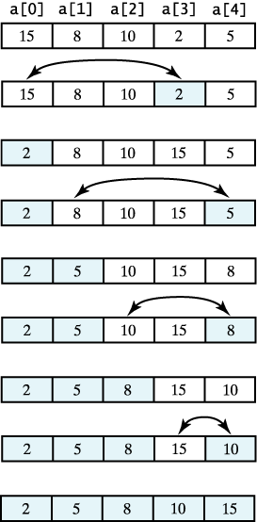
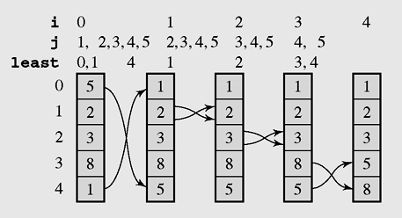
Selection Sort example
A selection sort of an array of integers into ascending order.
The array [5 2 3 8 1] sorted by selection sort

Slide 6
Selection sort code
void selectSort() //Simple Selection Sort
{ int i,j,k;int min;
for(i=0;i<n-1;i++)
{ min=a[i];k=i;
for(j=i+1;j<n;j++)
if(a[j]<min) {k=j;min=a[j];}
if(k!=i) swap(a,i,k);
}
}

Slide 7
Insertion sort algorithm
An insertion sort starts by considering the two first elements of the array data, which are
data[0] and data[1]
Next, the third element, data[2], is considered and inserted into its proper place (ascending)
insertionsort(data[]) {
  for i = 1 to data.length–1
  tmp = data[i];
  move all elements data[j] greater than tmp by one position;
  place tmp in its proper position;
Complexity O(n²)
Best case O(n)

Slide 8
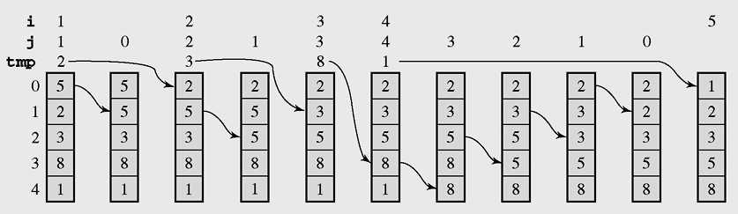
Insertion sort example
The array [5 2 3 8 1] sorted by insertion sort

Slide 9
Insertion sort code
void insertSort()
{ int i,j,x;
for(i=1;i<n;i++)
{ x=a[i]; j=i;
while(j>0 && x<a[j-1])
{ a[j]=a[j-1]; j--;
};
a[j]=x;
}
}
}

Slide 10
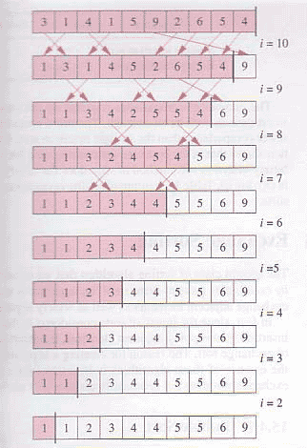
Bubble sort
void bubbleSort()
{ int i; boolean swapped;
do
{ swapped=false;
for(i=0;i<n-1;i++)
if(a[i]>a[i+1])
{ swap(a,i,i+1);
swapped=true;
}
}
while(swapped);
}
Complexity O(n²)
Best case O(n)

Slide 11
Efficient Sorting Algorithms

Slide 12
Shell sort
Shell sort is a sorting algorithm that is a generalization of insertion sort, with two observations:
Insertion sort is efficient if the
input is "almost sorted".
Insertion sort is typically
inefficient because it moves
values just one position at a time. Shell sort improves insertion sort by comparing elements separated by a gap of several positions. This lets an element take "bigger steps" toward its expected position. Multiple passes over the data are taken with smaller and smaller gap sizes.
// step[0]>step[1]>...>step[stepnum]
void shellSort(int [] step)
{ int h,i,stepnum;
stepnum = step.length;
for(i=0;i<stepnum;i++)
{ h=step[i];
insertSort(h);
}
};
void shellSort()
{ int [] step = {5,3,1};
shellSort(step);
};
void insertSort(int h)
{int i,j,x;
for(i=h;i<n;i++)
{x=a[i]; j=i;
while(j-h>=0 && x<a[j-h])
{a[j]=a[j-h]; j=j-h; };
a[j]=x;
}
};
The last step of Shell sort is a plain insertion sort, but by then, the array of data is guaranteed to be almost sorted.
Complexity about O(n^{1.5})
Best case O(n)

Slide 13
Quicksort - 1
Efficient sorting algorithm
  Discovered by C.A.R. Hoare
Example of Divide and Conquer algorithm
Two phases
  Partition phase
    Divides the work into half
  Sort phase
    Conquers the halves!

Slide 14
Quicksort - 2
Partition
  Choose a pivot
  Find the position for the pivot so that
    all elements to the left are less
    all elements to the right are greater
≤ pivot
pivot
> pivot
Conquer
  Apply the same algorithm to each half
≤ pivot
> pivot
≤ p’
p’
> p’
pivot
≤ p”
p”
> p”

Slide 15
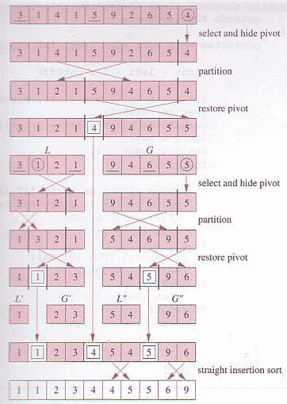
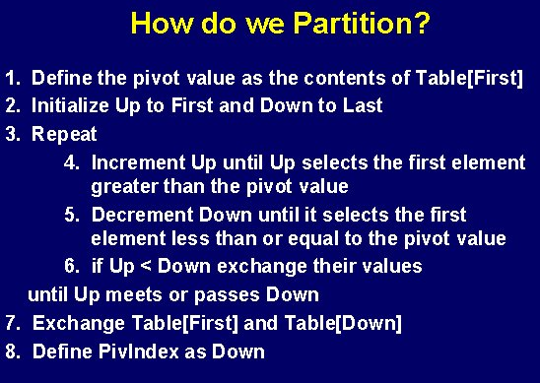
Quicksort - 3

Slide 16
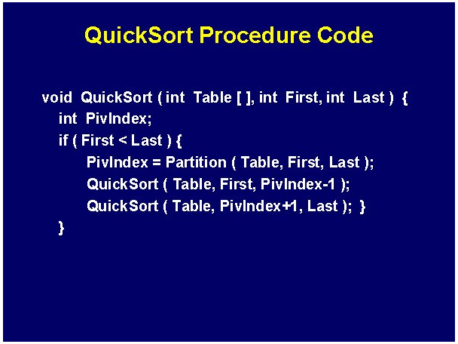
Quicksort code

Slide 17
Quicksort complexity
Quick Sort
    In the best case and average case: O(n log n) but ….
    Can be O(n²), the (rear) worst case. Moreover, the constant hidden in the O-notation is small.
    Depends on pivot selection
      Median-of-3
      Random pivot
      Better but not guaranteed

Slide 18
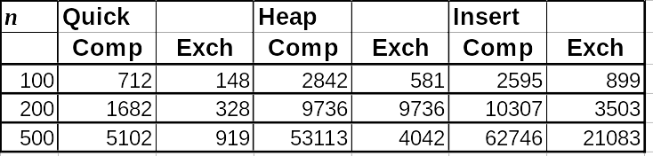
Quicksort - Why bother?
Use Heapsort instead?
Quicksort is generally faster
  Fewer comparisons and exchanges
  Some empirical data

Slide 19
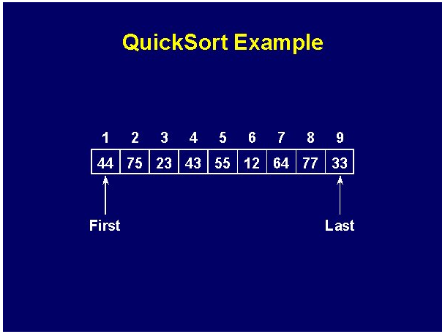
Quicksort example - 1

Slide 20
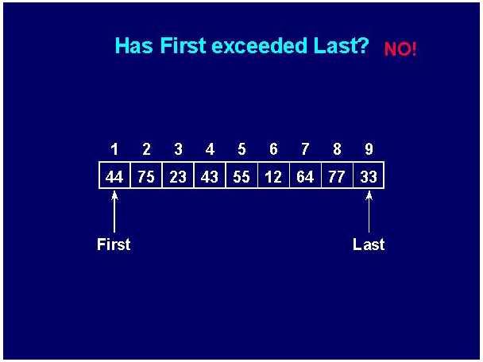
Quicksort example - 2

Slide 21
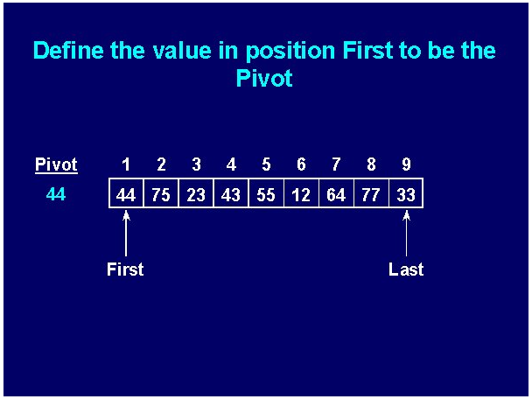
Quicksort example - 3

Slide 22
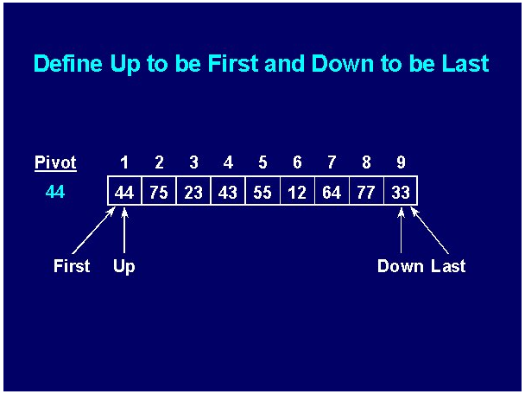
Quicksort example - 4

Slide 23
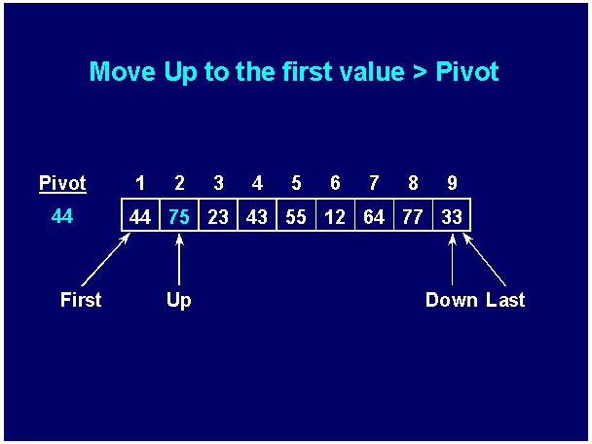
Quicksort example - 5

Slide 24
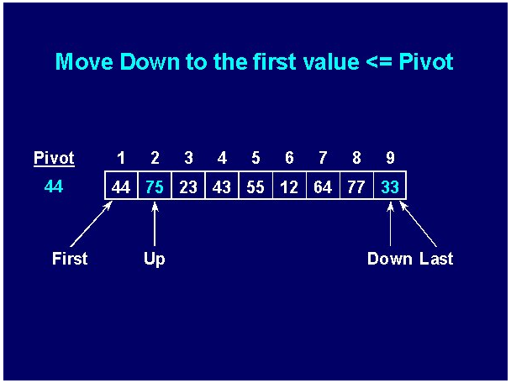
Quicksort example - 6

Slide 25
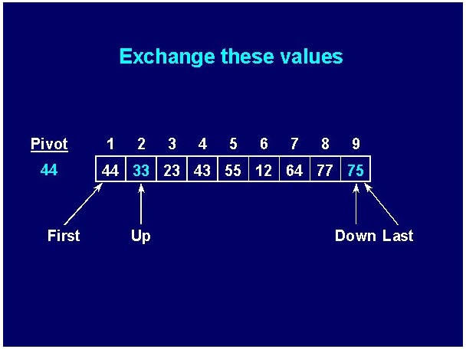
Quicksort example - 7

Slide 26


Quicksort example - 8

Slide 27
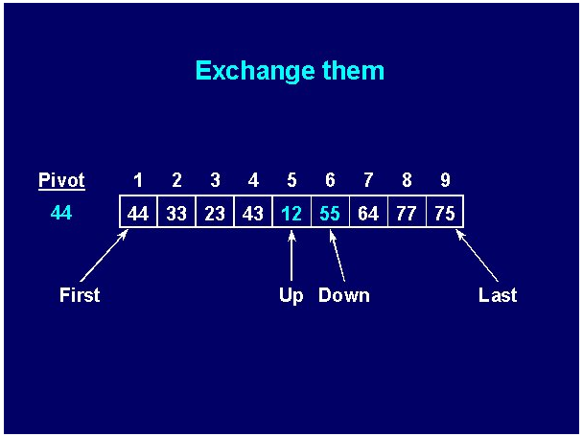
Quicksort example - 9

Slide 28


Quicksort example - 10

Slide 29
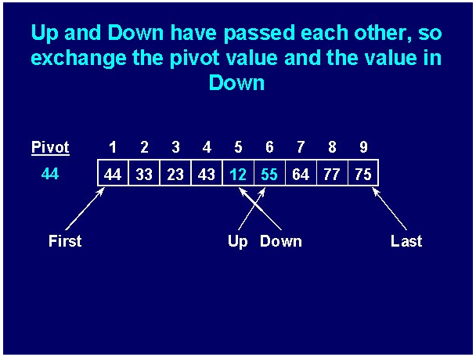
Quicksort example - 11

Slide 30
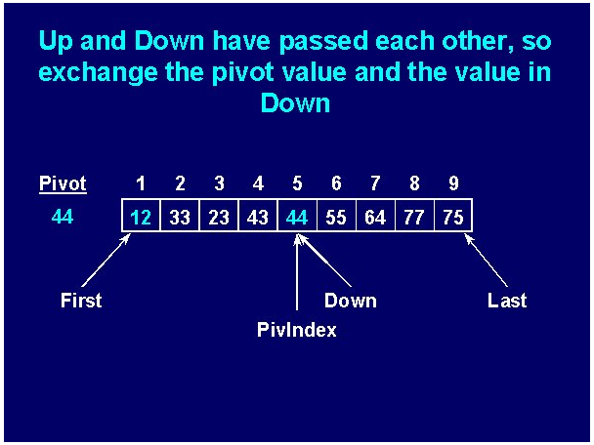
Quicksort example - 12

Slide 31
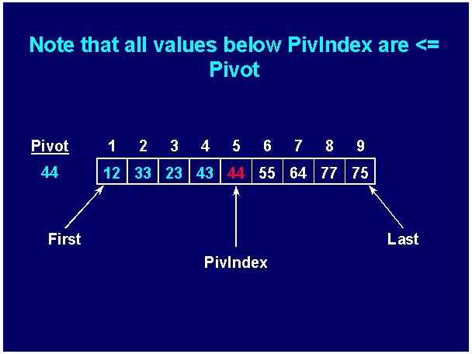
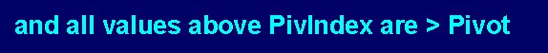
Quicksort example - 13

Slide 32
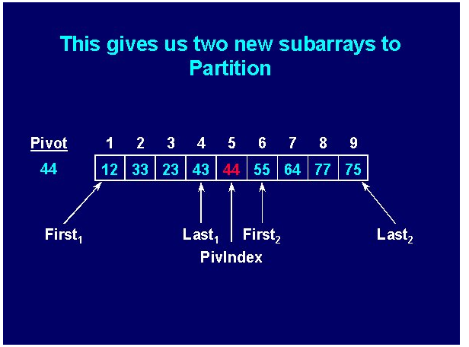
Quicksort example - 14

Slide 33
Mergesort
Mergesort makes partitioning as simple as possible and concentrates on merging sorted halves of an array into one sorted array
Complexity is O(nlogn)
It was one of the first sorting algorithms used on a computer and was developed by John von Neumann
    mergesort(data)
    if data have at least two elements
    mergesort(left half of data);
    mergesort(right half of data);
    merge(both halves into a sorted list);

Slide 34
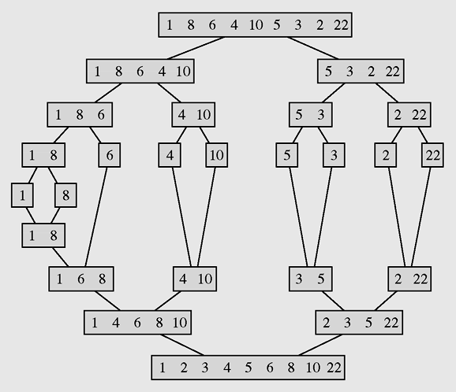
Mergesort example
The array [1 8 6 4 10 5 3 2 22] sorted by mergesort

Slide 35
Merge sort code
void mergeSort(int p, int r)
{if(p>=r) return;
int q = (p+r)/2;
mergeSort(p,q);
mergeSort(q+1,r);
merge(p,q,r);
}
void merge(int p, int q, int r)
{if(!(p<=q) && (q<=r)) return;
int n,i,j,k,x; n = r-p+1;
int [] b = new int[n];
i=p;j=q+1;k=0;
while(i<=q && j<=r)
{if(a[i]<a[j])
b[k++] = a[i++];
else
b[k++] = a[j++];
}
while(i<=q) b[k++] = a[i++];
while(j<=r) b[k++] = a[j++];
k=0;
for(i=p;i<=r;i++) a[i] = b[k++];
}
public class Main
{public static void main(String args[])
{int [] b = {7,3,5,9,11,8,6,15,10,12,14};
EffSort t = new EffSort(b);
int n=b.length;
t.mergeSort(0,n-1);t.display();
System.out.println();
}
}

Slide 36

Heap data structure - 1
Heap is a particular kind of binary tree, which has two properties:
  The value of each node is greater than or equal to the values stored in each of its children.
  If the height of the tree is h, then the tree is complete at level d for d = 1, 2, ..., h-1, and the leaves in the last level are all in the leftmost positions
(This kind of binary tree is called nearly complete binary tree)
These two properties define a max heap
If “greater” in the first property is replaced with “less,” then the definition specifies a min heap

Slide 37

Heap data structure - 2
We can represent heap by array in level order, going from left to right. The array corresponding to the heap above is [25, 13, 17, 5, 8, 3].
The root of the tree A[0] and given index i of a node, the indices of its parent, left child and right child can be computed:
PARENT (i)
return floor((i-1)/2)
LEFT (i)
return 2i+1
RIGHT (i)
return 2(i + 1)

Slide 38
Heap Sort - 1
Heap sort consists of 2 steps as shown in the following pseudo-code:
heapsort(data[])
transform data into a heap;
for i = data.length-1 downto 2
swap the root with the element in position i;
restore the heap property for the tree
data[0], . . . , data[i-1];
Complexity O(nlog₂n)

Slide 39
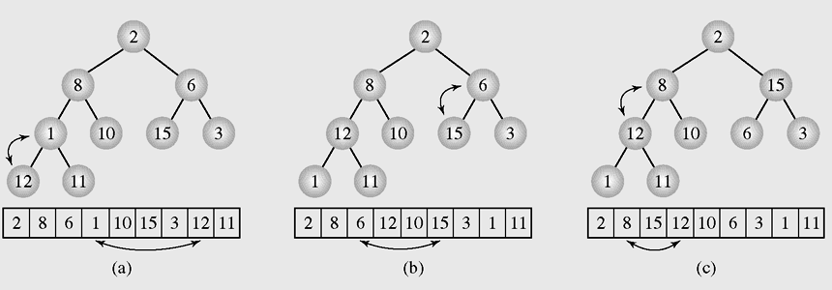
Heap Sort - 2
Transforming the array [2 8 6 1 10 15 3 12 11] into a heap

Slide 40
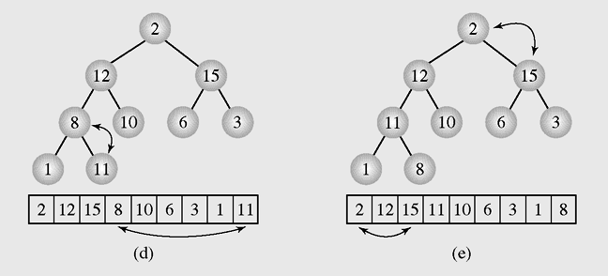
Heap Sort - 3
Transforming the array [2 8 6 1 10 15 3 12 11] into a heap
(continued)

Slide 41
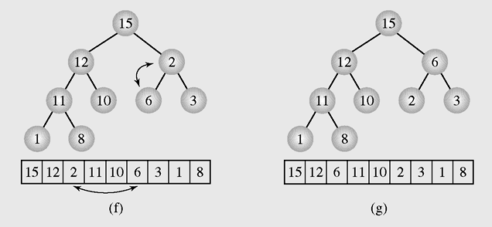
Heap Sort - 4
Transforming the array [2 8 6 1 10 15 3 12 11] into a heap
(continued)

Slide 42
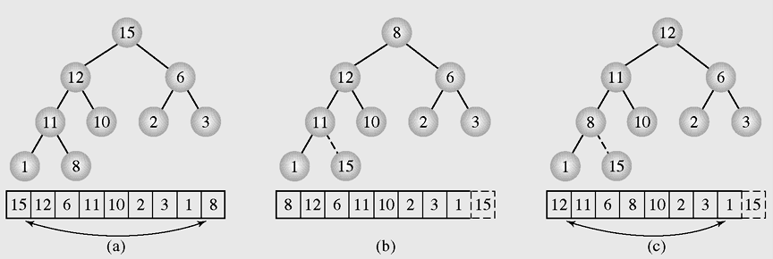
Heap Sort - 5
Execution of heap sort on the array [15 12 6 11 10 2 3 1 8],
which is the heap constructed in Figure 9.9

Slide 43
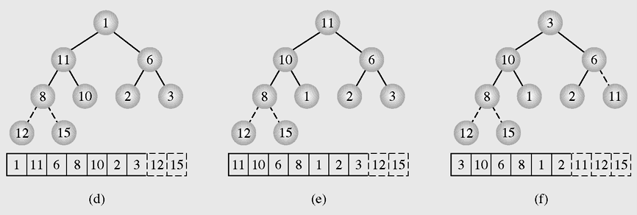
Heap Sort - 6
Execution of heap sort on the array [15 12 6 11 10 2 3 1 8],
which is the heap constructed in Figure 9.9 (continued)

Slide 44
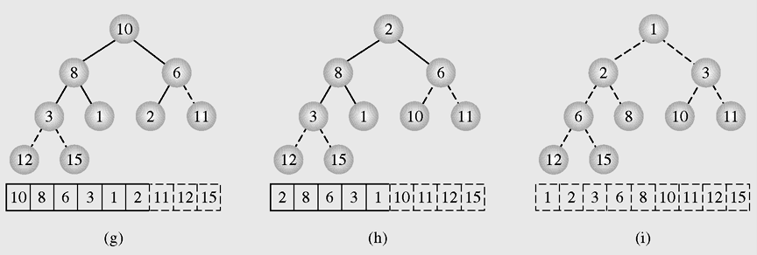
Heap Sort - 7
Execution of heap sort on the array [15 12 6 11 10 2 3 1 8],
which is the heap constructed in Figure 9.9 (continued)

Slide 45
Heap sort algorithm summary
Heap sort consists of two steps:
1.Construct a heap. At first the heap
has only one element: a[0]. Then
for i =1 to n-1 we insert the
element a[i] to heap so that the
heap property is maintained.
2.When all items have been added,
remove them one by one
(restoring the heap property as
each one is removed).
void heapSort()
{ //Transform the array to HEAP
int i,s,f;int x;
for(i=1;i<n;i++)
{ x=a[i]; s=i; //s is a son, f=(s-1)/2 is father
while(s>0 && x>a[(s-1)/2])
{ a[s]=a[(s-1)/2]; s=(s-1)/2; };
a[s]=x;
};
// Transform heap to sorted array
for(i=n-1;i>0;i--)
{ x=a[i];a[i]=a[0];
f=0; //f is father
s=2*f+1; //s is a left son
// if the right son is larger then it is selected
if(s+1<i && a[s]<a[s+1]) s=s+1;
while(s<i && x<a[s])
{ a[f]=a[s]; f=s; s=2*f+1;
if(s+1<i && a[s]<a[s+1]) s=s+1;
};
a[f]=x;
};
};
Addition and deletion are both O(logn) operations. We need to perform n additions and deletions, leading to an O(nlogn) algorithm.
Complexity O(nlog₂n)

Slide 46
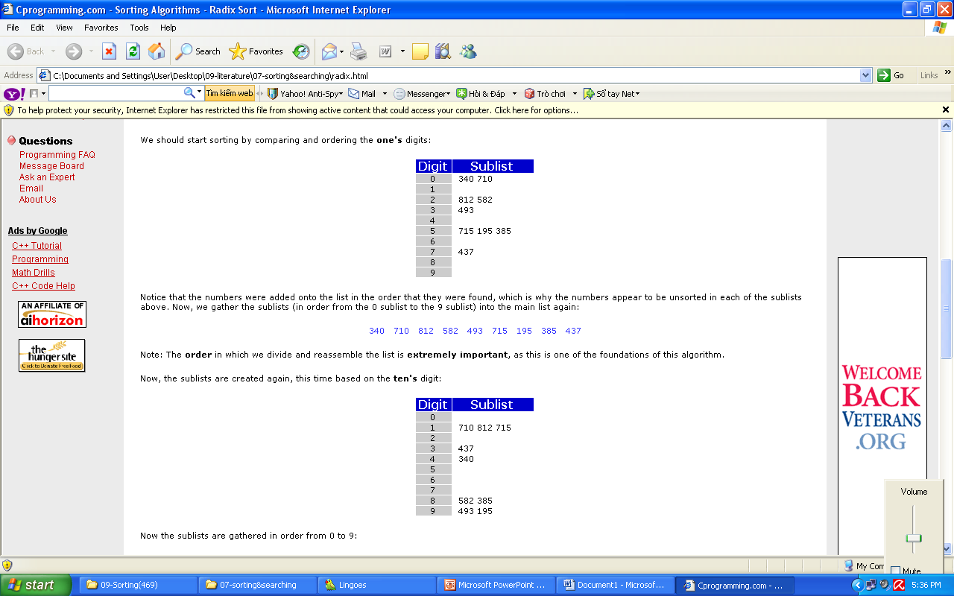
Radix sort - 1
Radix Sort is a clever and intuitive little sorting algorithm. Radix Sort puts the elements in order by comparing the digits of the numbers. We will explain with an example.
Consider the following 9 numbers:
493 812 715 710 195 437 582 340 385
We should start sorting by comparing and ordering the one's digits:
Notice that the numbers were added onto the list in the order that they were found, which is why the numbers appear to be unsorted in each of the sublists above. Now, we gather the sublists (in order from the 0 sublist to the 9 sublist) into the main list again:
340 710 812 582 493 715 195 385 437
Note: The order in which we divide and reassemble the list is extremely important, as this is one of the foundations of this algorithm.

Slide 47
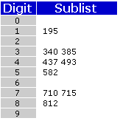
Radix sort - 2
Now, the sublists are created again, this time based on the ten's digit:
Now the sublists are gathered in order from 0 to 9:
710 812 715 437 340 582 385 493 195
Finally, the sublists are created according to the hundred's digit:
At last, the list is gathered up again:
195 340 385 437 493 582 710 715 812
And now we have a fully sorted array! Radix Sort is very simple, and a computer can do it fast. When it is programmed properly, Radix Sort is in fact one of the fastest sorting algorithms for numbers or strings of letters.
Disadvantages
Still, there are some tradeoffs for Radix Sort that can make it less preferable than other sorts.
The speed of Radix Sort largely depends on the inner basic operations, and if the operations are not efficient enough, Radix Sort can be slower than some other algorithms such as Quick Sort and Merge Sort. These operations include the insert and delete functions of the sublists and the process of isolating the digit you want.

Slide 48
Sorting in java.util - 1
Java provides two sets of versions of sorting methods: one for arrays and one for lists
The utility class Arrays includes a method for:
  Searching arrays for elements with binary search
  Filling arrays with a particular value
  Converting an array into a list, and sorting methods

Slide 49
Sorting in java.util - 2
The sorting methods are provided for arrays with elements of all elementary types except Boolean
For each type of sorting method there are two versions:
  One for sorting an entire array
  One for sorting a subarray
public static void sort(int[] a);
public static void sort(int[] a, int first, int last);

Slide 50
Summary - 1
Sorting is a two step process: Choose the criteria that will be used to order data and determine how to put a set of data in order using that criterion
Selection sort is an attempt to localize the exchanges of array elements by finding a misplaced element first and putting it in its final place
An insertion sort starts by considering the two first elements of the array data, which are
data[0] and data[1]

Slide 51
Summary - 2
Shell sort divides the original array into subarrays, sorting them separately, and then dividing them again to sort the new subarrays until the whole array is sorted
Mergesort makes partitioning as simple as possible and concentrates on merging sorted halves of an array into one sorted array
Radix sort is a a technique to sort integers by proceeding right to left
Java provides two sets of versions of sorting methods: one for arrays and one for lists

Slide 52
Reading at home
Text book: Data Structures and Algorithms in Java, Second Edition by Adam Drozdek
9.1 Elementary Sorting Algorithms 470
  9.1.1 Insertion Sort 470
  9.1.2 Selection Sort 474
  9.1.3 Bubble Sort 475
9.2 Efficient Sorting Algorithms 481
  9.3.1 Shell sort 481
  9.3.2 Heap sort 484
  9.3.3 Quick Sort 488
  9.3.4 Merge Sort 494
  9.3.5 Radix Sort (*) 497
9.4 Sorting in java.util 502
(*) Students are required to understand essential features only (the problem explaination, definitions, the outline of algorithms…), not in details.

