Slide 1
Chapter 11. Data Compression

Slide 2
Objectives
Condition for Data Compression
Huffman Coding
Run-Length Coding
Ziv-Lempel Coding
  LZW encoding algorithm
  LZW decoding algorithm (*)
(*) Students are required to understand essential features only (the problem explaination, definitions, the outline of algorithms…), not in details.

Slide 3
Data Compression - 1
“In computer science and information theory, data compression or source coding is the process of encoding information using fewer bits (or other information-bearing units) than an unencoded representation would use through use of specific encoding schemes.” (Wikipedia)
Compression reduces the consumption of storage (disks) or bandwidth.
However, it needs processing time to restore or view the compressed code.
Raw data
encoding
Compressed data
decoding

Slide 4
Data Compression - 2
Types of compression
  Lossy: MP3, JPG
  Lossless: ZIP, GZ
Compression Algorithm:
  Huffman Encoding
  Lempel-Ziv
  RLE: Run Length Encoding
Performance of compression depends on file types.

Slide 5
Compress data by decoding symbols contained in it (lossless compression)
The information content of the set M, called the entropy of the source X = (x₁, x₂,…, x_{n} ), is defined by:
  L_{ave} = H = P(x₁)L(x₁) + · · · + P(x_{n})L(x_{n})
Where L(x_{i}) = - log₂P(x_{i}), which is the minimum length of a codeword for symbol x_{i} (Claude E.Shannon, 1948). Shannon's entropy represents an absolute limit on the best possible lossless compression of any communication.
To compare the efficiency of different data compression methods when applied to the same data, the same measure is used; this measure is the compression rate
  length(input) – length (output)
  length(input)
Codeword:
sequence of bits of a code corresponding to a symbol.

Slide 6
Uniquely Decodable Codes
A variable length code assigns a bit string (codeword) of variable length to every message value
e.g. a = 1, b = 01, c = 101, d = 011
What if you get the sequence of bits
1011 ?
Is it aba, ca, or, ad?
A uniquely decodable code is a variable length code in which bit strings can always be uniquely decomposed into its codewords.

Slide 7
Prefix Codes
A prefix code is a variable length code in which no codeword is a prefix of another codeword
e.g a = 0, b = 110, c = 111, d = 10
Can be viewed as a binary tree with message values at the leaves and 0 or 1s on the edges.
0
1
0
1
a
0
1
d
b
c

Slide 8
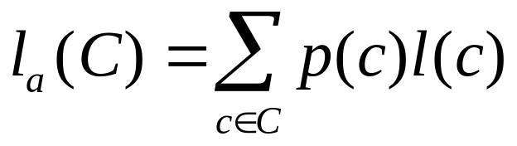
Average Length
For a code C with associated probabilities p(c) the average length is defined as
We say that a prefix code C is optimal if for all prefix codes C’, l_{a}(C) ≤ l_{a}(C’)
The Huffman code is known to be provably optimal under certain well-defined conditions for data compression.

Slide 9
Huffman Coding algorithm
Main idea: Encode high probability symbols with fewer bits
Make a leaf node for each code symbol
  Add the generation probability or the frequency of each symbol to the leaf node (arrange them in ascending order by probability)
Take the two leaf nodes with the smallest probability and connect them into a new node
  Add 1 or 0 to each of the two branches
  The probability of the new node is the sum of the probabilities of the two connecting nodes
If there is only one node left, the code construction is completed. If not, go back to (2)

Slide 10
Huffman Coding example - 1
Character (or symbol) frequencies
  A : 20% (.20) e.g., ‘A’ occurs 20 times in a 100 character document, 1000 times in a 5000 character document, etc.
  B : 9% (.09)
  C : 15% (.15)
  D : 11% (.11)
  E : 40% (.40)
  F : 5% (.05)
Also works if you use character counts
Must know frequency of every character in the document

Slide 11
Huffman Coding example - 2
Symbols and their associated frequencies.
Now we combine the two least common symbols (those with the smallest frequencies) to make a new symbol string and corresponding frequency.
E
.40
A
.20
C
.15
D
.11
B
.09
F
.05

Slide 12
Huffman Coding example - 3
Here’s the result of combining symbols once.
Now repeat until you’ve combined all the symbols into a single string.
E
.40
A
.20
C
.15
BF
.14
D
.11
B
.09
F
.05

Slide 13
Huffman Coding example - 4
Here’s the result of combining symbols once.
Now repeat until you’ve combined all the symbols into a single string.
E
.40
BFD
.25
A
.20
C
.15
BF
.14
D
.11
B
.09
F
.05

Slide 14
Huffman Coding example - 5
Here’s the result of combining symbols once.
Now repeat until you’ve combined all the symbols into a single string.
E
.40
AC
.35
BFD
.25
A
.20
C
.15
BF
.14
D
.11
B
.09
F
.05

Slide 15
Huffman Coding example - 6
BFDAC
.60
E
.40
AC
.35
BFD
.25
A
.20
C
.15
BF
.14
D
.11
B
.09
F
.05

Slide 16
Huffman Coding example - 7
Codes: (reading from top to bottom)
  A: 000
  B: 0100
  C: 001
  D: 011
  E: 1
  F: 0101
Note
None are prefixes of another
BFDACE
1.00
0
1
BFDAC
.60
E
.40
0
1
AC
.35
BFD
.25
0
1
0
1
A
.20
C
.15
BF
.14
D
.11
0
1
B
.09
F
.05

Slide 17
Huffman Coding example - 8
Character | Code | Length | Probability
A | 000 | 3 | .20
B | 0100 | 4 | .09
C | 001 | 3 | .15
D | 011 | 3 | .11
E | 1 | 1 | .40
F | 0101 | 4 | .05
Average Code Length:
(3 x 0.20) + (4 x 0.09) + (3 x 0.15) + (3 x 0.11) + (1 x 0.40) + (4 x 0.05)
= 1.89 digits

Slide 18
Huffman Coding notes
There is no unique Huffman code
  Assigning 0 and 1 to the branches is arbitrary
  If there are more nodes with the same probability, it doesn’t matter how they are connected.
  However, if the probability in each node is unique and the left node's probability is always larger than the right's one, then the code is unique (caupd).
Every Huffman code has the same average code length!

Slide 19
Lempel-Ziv Compression
Encode sequences of symbols with location of sequence in a dictionary => dictionary coder
Originated by Abraham Lempel and Jacob Ziv, improved by Tery Welch in 1984 (that is why it gets name LZW)
This coding method is lossless coding
Algorithms versions: LZ77, LZ78 and LZW

Slide 20
LZW Algorithm overview
The LZW algorithm stores strings in a "dictionary" with entries for 4,096 variable-length strings. The first 255 entries are used to contain the values for individual bytes, so the actual first string index is 256. As the string is compressed, the dictionary is built up to contain every possible string combination that can be obtained from the message, starting with two characters, then three characters, and so on.
LZWCompress()
  Enter all letters to the table;
  Initialize string s to the first letter from input;
  while any input left
    Read character c;
    if s+c is in the table
      s = s+c;
    else ouput codeword(s);
    Enter s+c to the table
    s = c
  Output codeword(s)
Notes:
GIF file

Slide 21
LZW Encoding Algorithm - 1
A Root is a single-character string.
Only code words are output. This means that the dictionary cannot be empty at the start: it has to contain all the individual characters (roots) that can occurr in the charstream;
Since all possible one-character strings are already in the dictionary, each encoding step begins with a one-character prefix, so the first string searched for in the dictionary has two characters;
The character with which the new prefix starts is the last character of the previous string. This is necessary to enable the decoding algorihtm to reconstruct the dictionary without the help of explicit characters in the codestream.
Notes:
GIF file

Slide 22
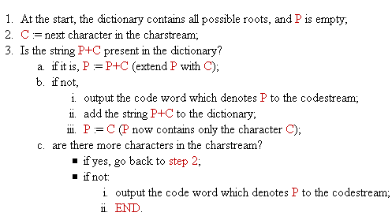
LZW Encoding Algorithm - 2
Notes:
GIF file

Slide 23
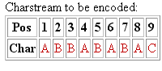
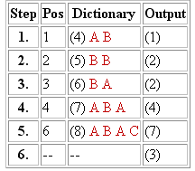
LZW Algorithm - Encoding process demo
Contents of the dictionary at the beginning of encoding: (1)A (2)B (3)C
The column Step indicates the number of the encoding step. Each encoding step is completed when the step 3.b. in the encoding algorithm is executed.
The column Pos indicates the current position in the input data.
The column Dictionary shows the string that has been added to the dictionary and its index number in brackets.
The column Output shows the code word output in the corresponding encoding step.
The compressed output: (1)(2)(2)(4)(7)(3)
Notes:
GIF file

Slide 24
LZW Decoding Algorithm overview
Decoding: additional terms
Current code word: the code word currently being processed. It's signified with cW, and the string it denotes with string.cW;
Previous code word: the code word that precedes the current code word in the codestream. It's signified with pW, and the string it denotes with string.pW.
At the start of decoding, the dictionary looks the same as at the start of encoding -- it contains all possible roots.
Let's consider a point in the process of decoding, when the dictionary contains some longer strings. The algorithm remembers the previous code word (pW) and then reads the current code word (cW) from the codestream. It outputs the string.cW, and adds the string.pW extended with the first character of the string.cW to the dictionary.

Slide 25
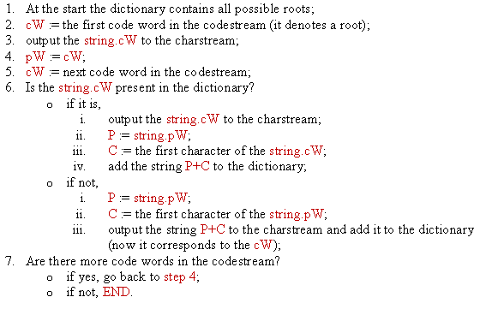
LZW Decoding Algorithm

Slide 26
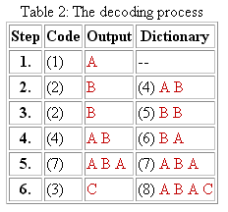
LZW Algorithm - Decoding process demo
Contents of the dictionary at the beginning of decoding: (1)A (2)B (3)C
Let's analyze the step 4. The previous code word (2) is stored in pW, and cW is (4). The string.cW is output ("A B"). The string.pW ("B") is extended with the first character of the string.cW ("A") and the result ("B A") is added to the dictionary with the index (6).
We come to the step 5. The content of cW=(4) is copied to pW, and the new value for cW is read: (7). This entry in the dictionary is empty. Thus, the string.pW ("A B") is extended with its own first character ("A") and the result ("A B A") is stored in the dictionary with the index (7). Since cW is (7) as well, this string is also sent to the output.
The decompressed output: ABBABABA
Notes:
GIF file

Slide 27
Run-Length Encoding
FFFFOOOOFFFOOFFFFFOOOOOOOO
Raw :
4
4
3
2
5
7
Compressed:
4F4O3F2O5F7O
Compression Rate = (25-12)/25 = 52%

Slide 28
Compression in Java
Java.util.zip package
Key classes
Java provides the java.util.zip package for zip-compatible data compression
It provides classes that allow you to read, create, and modify ZIP and GZIP file formats
ZipFile
ZipEntry
ZipInputStream
ZipOutputStream
GZIPInputStream
GZIPOutputStream
Notes:
Java.util.zip
ZipFile
Used to read entries from a ZIP file (data is cached -> much faster for reading purpose| read-only)
ZipEntry
Used to read entries from a ZIP file
ZipInputStream
An input stream filter for reading files in the ZIP file format
ZipOutputStream
An output stream filter for writing files in the ZIP file format
GZIPInputStream
GZIPInputStream

Slide 29
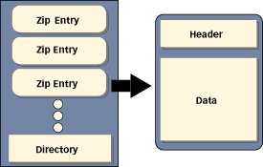
Zip file structure

Slide 30
Summary - 1
To compare the efficiency of different data compression methods when applied to the same data, the same measure is used; this measure is the compression rate
The construction of an optimal code was developed by David Huffman, who utilized a
tree structure in this construction: a binary tree for a binary code

Slide 31
Summary - 2
A run is defined as a sequence of identical characters
Run-length encoding is useful when applied to files that are almost guaranteed to have many runs of at least four characters, such as relational databases
Null suppression compresses only runs of blanks and eliminates the need to identify the character being compressed
The Ziv-Lempel code is an example of a universal data compression code

Slide 32
Reading at home
Text book: Data Structures and Algorithms in Java, Second Edition by Adam Drozdek
11.1 Condition for Data Compression 570
11.2 Huffman Coding 572
11.3 Run-Length Coding 586
11.4 Ziv-Lempel Coding 587
  LZW encoding algorithm
  LZW decoding algorithm (*)
(*) Students are required to understand essential features only (the problem explaination, definitions, the outline of algorithms…), not in details.

Slide 33
J. Von Neuman: “No one knows exactly what entropy really is, so in a debate you will always have the advantage”

