Slide 1
Session 8
Chapter 4 – High-level Database Models - ER model
Database Systems

Slide 2
Objectives
1
Understand the Database Design Process
2
Understand what is the high-level design (or Conceptual Design)
3
Understand why must use Conceptual Design (or Logical Design)
4
Understand the purpose of a ERD
5
Know what are Entity, Entity Set, Entity Instances, Attributes and others
6
Know what is a relation-ship and how to realize it
7
Know how to draw an ERD

Slide 3
Contents
1
Database design process
2
Entity relationship model
3
What are entity, entity set, attribute, relationship?
4
ERD
5
Attributes on Relationships
6
Weak Entities
7
Sub-class

Slide 4
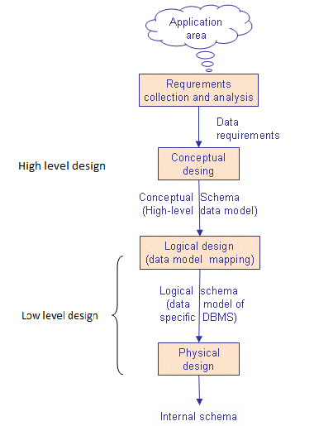
Database Design Process

Slide 5
The Requirements Problem
In the USA, a study found that 31% of all software projects were canceled before completion
Further results were that 53% of projects cost an average of 189% of their original estimates
$81B for canceled projects; additional $59B for projects that exceeded their original estimates
Notes:
Tại Mỹ, một nghiên cứu cho thấy rằng 31% của tất cả các dự án phần mềm đã bị hủy bỏ trước khi hoàn thành
Kết quả hơn nữa là có tới 53% các dự án có giá trung bình 189% dự toán ban đầu của họ
$ 81B cho các dự án bị hủy bỏ; thêm $ 59B cho các dự án mà vượt quá ước tính ban đầu của họ

Slide 6
The Requirements Problem
The first step to resolving any problem is to identify the root cause
The same study identified the following root causes:
  Lack of user input
  Incomplete requirements and specifications
  Changing requirements and specifications

Slide 7
The Requirements Problem
Even though the majority of projects experienced time overruns, if not outright cancellation, successful projects had the following “success factors”:
  User involvement
  Executive management support
  Clear statement of requirements
Notes:
Mặc dù phần lớn các dự án có kinh nghiệm vượt thời gian, nếu không hủy hoàn toàn,
dự án thành công đã có "yếu tố thành công" sau đây:
sự tham gia của người sử dụng
Hỗ trợ quản lý điều hành
Rõ ràng tuyên bố của yêu cầu

Slide 8
The Requirements Problem
The problems associated with “leakage” from requirements phase:
  Respecification
  Redesign
  Recoding
  Retesting
  Corrective action – recall, scrap, liability, service calls, documentation changes
Notes:
Scrap: phe lieu
Liability: trach nhiem

Slide 9
The Requirements Problem
0.1
Requirements
0.5
Design
1
Coding
2
Unit Testing
5
Acceptance Testing
20
Maintenance
Relative Cost To Repair Defect

Slide 10
High-level design
Now, we have know the important role of getting user requirements
So, how to express User Requirements exactly, correctly and easily when designing database? The solution is: we must do the high-level design step first because it is the bridge between the Customer and Programmer.
It helps us to exchange ideas with the customer and understand what their needs

Slide 11
High-level design
High-level design describes exactly the information needs of the business
It facilitates the discussions
It helps to prevent mistakes, misunderstanding
It forms the important “idea system” document
Notes:
facilitates : tao dieu kien

Slide 12
How to express High-Level Design - ERD and UML
There are several options for the notation in which the high-level design is expressed
The first and oldest method is the “Entity Relationship Diagram”
A more recent trend is the use of UML (“Unified Modeling Language”)
We don’t focus on UML in our lessons now but ERD

Slide 13
Low-level design
Logical design is process of constructing a model of information used in an enterprise based on a specific data model, but independent of a particular DBMS or other physical considerations
Physical design is process translating the logical description of the data into technical specifications for storing and retrieving data

Slide 14
4.1 E/R Model and ERD
Entity Relationship Model (E/R model) represents the structure of data graphically as an “ERD” using 3-principal element types:
1. Entity Sets
2. Attributes
3. Relationships
We shall cover all them next

Slide 15
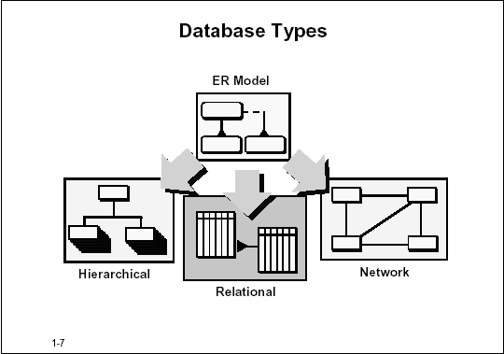
Purpose of E/R Model
Capture all required information
Information appears only once
Model no information that is derivable from other information already modeled
Information is in predictable, logical place

Slide 16
4.1.1. Entity
An Entity is:
- “Something” important to the business about which data must be known
- A name for the things that you can list
- Usually a non
An Entity is an abstract object of some sort
An Entity can have many instances
name
manf
Beers

Slide 17
Entity and Instances
Entities | Instances
PERSON | Bill Clinton, Obama
PRODUCT | Chair, Table, Motor
JOB | Violinist, Programmer
SKILL LEVEL | Fluent

Slide 18
Entity Sets
An Entity Set is a collection of similar entities
Example: Each movie is an entity; And the set of all movies is called Movie Entity Set

Slide 19

Example – Entity, Entity Sets
Id
name
This is an Attribute of “Houses” Entity Set
Houses
This is an Entity Set named “Houses”
This is an Entity of “House” Entity Set

Slide 20
How to realize Entities?
Entities are usually NOUNs
Entities can be:
- Tangible (exp: HOUSE, CAR..)
- In-Tangible (exp: LOVE, RING-TONE…)
- Events (exp: ELECTION)
Generalize NOUNs that are similar.
Exp:
+ TOYOTA, MITSUBISHI, HUYNDAI can be generalized to “Car-maker”
+ HONDA, SYM, YAMAHA can be generalized to “Motor-maker”
+ Nokia 6600, Samsung, Motorola can be generalized to what?
+ David Beckham, Ronaldo, Ronaldinho can be generalized to what?
+ ZIXEL, ZOOM, LINK SYS can be generalized to what?
+ Think pad IBM, FPT Elead, Compact HP can be genralized to what ?

Slide 21
4.1.2. Attributes of an Entity
Also represents something that are important to the business
Is a single valued property detail of an Entity
Is a specific piece of information that:
- Can be Described
- Can be Quantified
- Can be Qualified
- Can be Classified
- Can be Specified
An attribute is a property of the Entity or a small detail about the entity
An attribute has values. And ussually the values for a particular attribute have the same data type => Every attribute has a data type
Some attributes are volatile (unstable). Example: AGE. So, we must always look for non-volatile attributes (exp: we can replace AGE by DATE-OF-BIRTHDAY)
Notes:
Classified: phan loai
volatile : khong ben vung

Slide 22
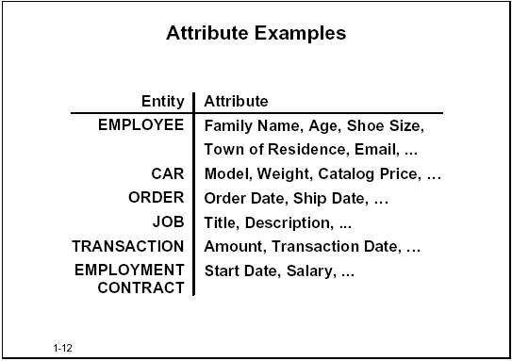
Example: Attributes

Slide 23
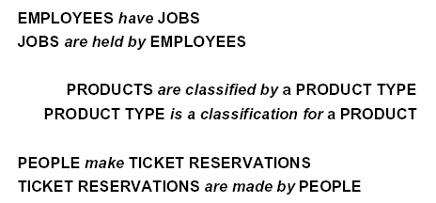
4.1.3 Relation-ship
Also represent something that are important to the business
Always exist between two Entities (or one Entity twice)
A relation-ship connects 2 entities
A relation-ship represents an important dependency of 2 entities – Always 2 entities
Example:

Slide 24
How to realize relation-ship?
Relationships are usually VERBs
To determine a relation-ship we ask questions like this:
+ “Must every employee has a job?”
+ “Must every job be done by an employee?”
Other questions:
+ Can a employee have more than 1 job?
+ Can a job can be done by more than 1 employee?

Slide 25
Types of relationship?
Cardinality: describes the maximum number of possible relationship occurrences for an entity participating in a given relationship type
  MANY-MANY relationship
  ONE-MANY relationship
  ONE-ONE relationship
Participation: determines whether all entity occurrences are involved in a particular relationship or only some
  Mandatory
  Optional

Slide 26
4.1.4 Entity relationship diagram
How to represent Entities Set
In an entity-relationship diagram:
  Entity set = rectangle.
  Attribute = oval, with a line to the rectangle representing its entity set.
  Underline the key attribute(s)
name
manf
Beers

Slide 27
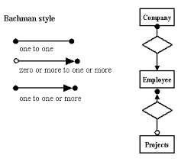
4.1.4 Entity relationship diagram
How to represent Relationship
  Relationship are represented by diamonds
  Edges connect a relationship to its entity sets
  Need to node the type of relationship
There are different notation styles for representing relationships: Chen, IDEFlX, Crow’s Foot, Min-max

Slide 28
How to represent an attribute of a relation-ship?
Sometimes it is useful to attach an attribute to a relationship.
Think of this attribute as a property of tuples in the relationship set.
Sells
Bars
Beers
price

Slide 29
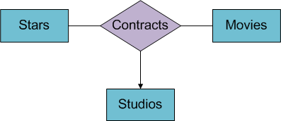
4.1.5 Another extend concept
Multi-way relationships

Slide 30
Weak Entity Set
A Weak Entity is an entity that cannot be uniquely identified by its attributes alone; therefore, it must use a foreign key in conjunction with its attributes to create a primary key
In ERD, a weak entity set is indicated by a Bold Rectangle (the entity) connected by a bold type Arrow to a bold Diamond (the relationship).
name
number
name
Players
Plays-
on
Teams
Note: must be rounded
because each player needs
a team to help with the key.

Slide 31
SUB-CLASSES
Subclass = special case = fewer entities = more properties
Example: Ales are a kind of beer.
  Not every beer is an ale, but some are.
  Let us suppose that in addition to all the properties (attributes and relationships) of beers, ales also have the attribute color
name
Beers
manf
isa
Ales
color

Slide 32
Summary
Database design process has three phase: conceptual, logical and physical design.
E/R model has used in conceptual design phase to capture requirements of applications.
Main concepts in E/R model are: entity, entity instances, entity set, attribute, relationship (many-many, one-many, one-one, mandatory, optional)
Others concepts are: weak entity, multi-way relationship, sub-class

Slide 33
Thank You !

