Slide 1
Chapter 10: Statistical inference for Two Samples
LEARNING OBJECTIVES
1. Introduction
2. Inference on the difference in means of two normal distributions,
variances known
variances unknown
3. Inference on two population proportions

Slide 2
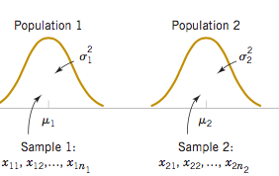
Inference on the difference in means of two normal distributions, variances known

Slide 3
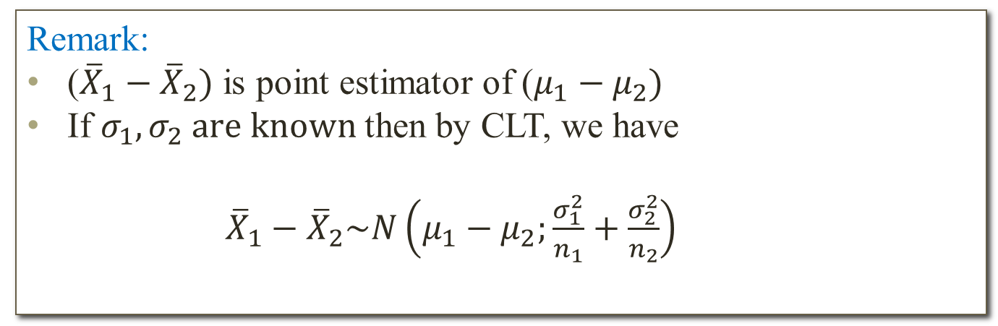
Inference on the difference in means of two normal distributions, variances known.
Assumption for two sample inference:
The two populations have normal distributions.
Remark:
(${\overline{X}}_{1}−{\overline{X}}_{2})$ is point estimator of ($μ_{1}−μ_{2})$
If $σ_{1}, σ_{2} are known$then by CLT, we have
${\overline{X}}_{1}−{\overline{X}}_{2}\sim N\left(μ_{1}−μ_{2};\frac{σ_{1}^{2}}{n_{1}}+\frac{σ_{2}^{2}}{n_{2}}\right)$

Slide 4
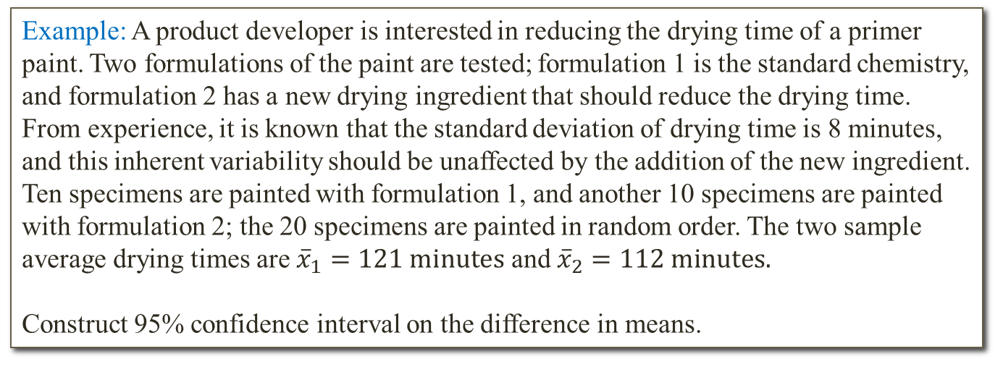
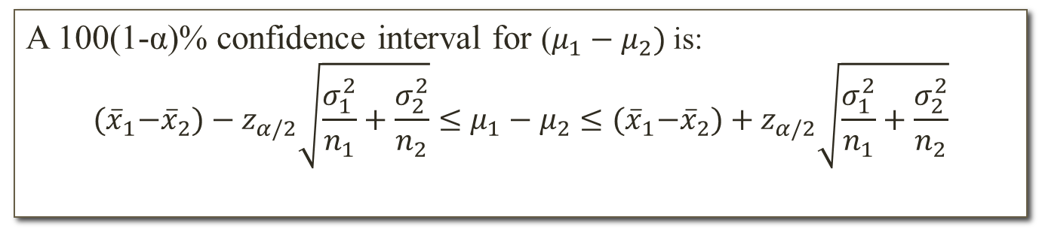
Inference on the difference in means of two normal distributions, variances known.
Confidence interval on the difference in means:
A 100(1-α)% confidence interval for ($μ_{1}−μ_{2})$ is:
$${(\overline{x}}_{1}−{\overline{x}}_{2})−z_{α/2}\sqrt{\frac{σ_{1}^{2}}{n_{1}}+\frac{σ_{2}^{2}}{n_{2}}}≤μ_{1}−μ_{2}≤{(\overline{x}}_{1}−{\overline{x}}_{2})+z_{α/2}\sqrt{\frac{σ_{1}^{2}}{n_{1}}+\frac{σ_{2}^{2}}{n_{2}}}$$
Example: A product developer is interested in reducing the drying time of a primer paint. Two formulations of the paint are tested; formulation 1 is the standard chemistry, and formulation 2 has a new drying ingredient that should reduce the drying time. From experience, it is known that the standard deviation of drying time is 8 minutes, and this inherent variability should be unaffected by the addition of the new ingredient. Ten specimens are painted with formulation 1, and another 10 specimens are painted with formulation 2; the 20 specimens are painted in random order. The two sample average drying times are ${\overline{x}}_{1}=121 minutes$ and ${\overline{x}}_{2}=112 minutes.$
Construct 95% confidence interval on the difference in means.

Slide 5
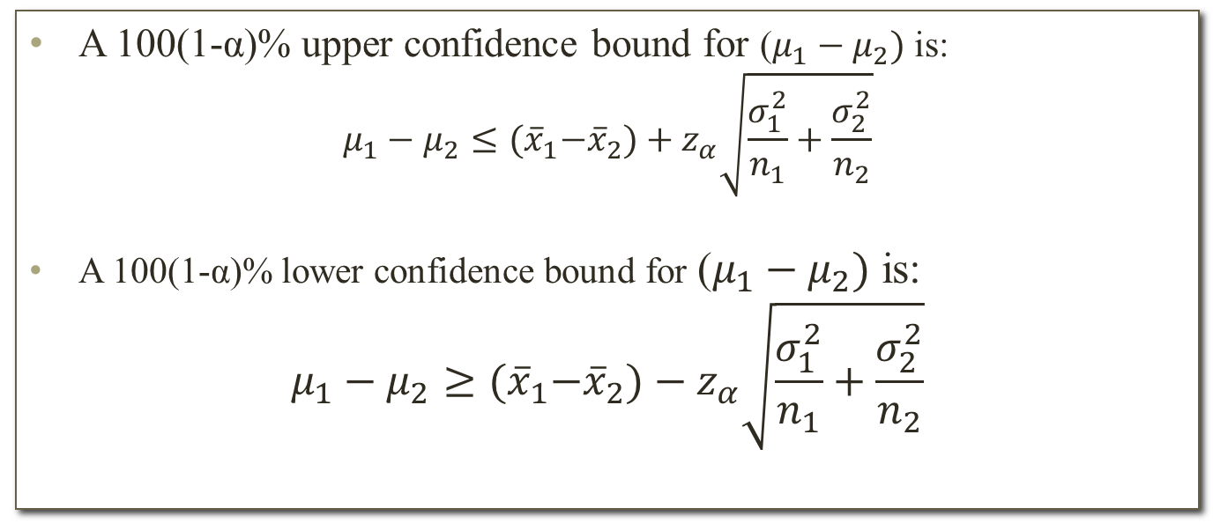
Inference on the difference in means of two normal distributions, variances known.
One-sided confidence bound on the difference in means:
A 100(1-α)% upper confidence bound for ($μ_{1}−μ_{2})$ is:
$$μ_{1}−μ_{2}≤{(\overline{x}}_{1}−{\overline{x}}_{2})+z_{α}\sqrt{\frac{σ_{1}^{2}}{n_{1}}+\frac{σ_{2}^{2}}{n_{2}}}$$
A 100(1-α)% lower confidence bound for ($μ_{1}−μ_{2})$ is:
$$μ_{1}−μ_{2}≥{(\overline{x}}_{1}−{\overline{x}}_{2})−z_{α}\sqrt{\frac{σ_{1}^{2}}{n_{1}}+\frac{σ_{2}^{2}}{n_{2}}}$$

Slide 6
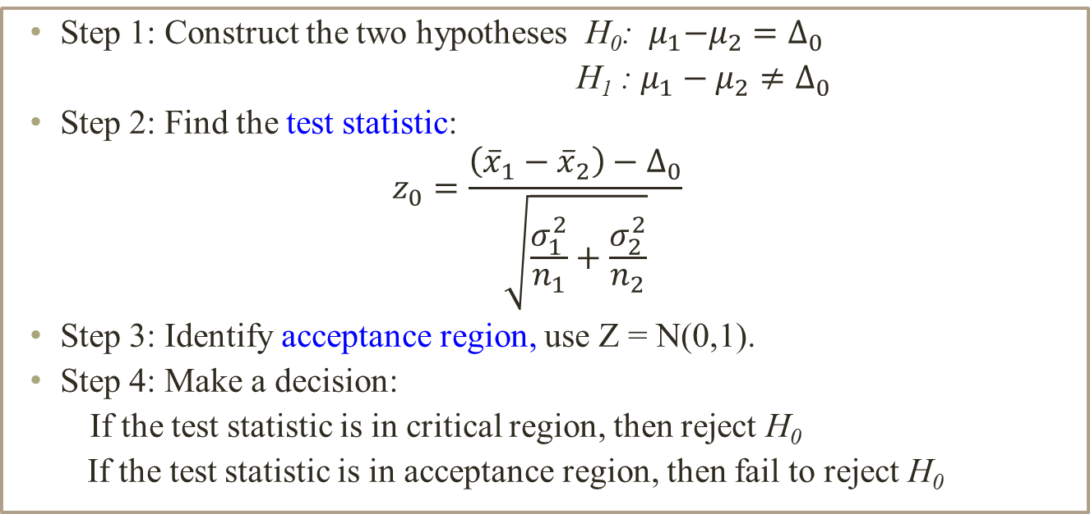
Inference on the difference in means of two normal distributions, variances known.
Test of hypotheses for difference in means
Step 1: Construct the two hypotheses H₀: ${ μ}_{1}−μ_{2}=∆_{0}$
H₁ : $μ_{1}−μ_{2}≠∆_{0}$
Step 2: Find the test statistic:
$$z_{0}=\frac{\left({\overline{x}}_{1}−{\overline{x}}_{2}\right)−∆_{0}}{\sqrt{\frac{σ_{1}^{2}}{n_{1}}+\frac{σ_{2}^{2}}{n_{2}}}}$$
Step 3: Identify acceptance region, use Z = N(0,1).
Step 4: Make a decision:
If the test statistic is in critical region, then reject H₀
If the test statistic is in acceptance region, then fail to reject H₀

Slide 7
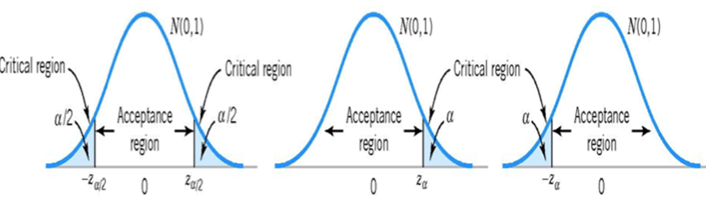
Inference on the difference in means of two normal distributions, variances known.
Example: (Continues the previous example)
What conclusions can the product developer draw about the effectiveness of the new ingredient, using α = 0.05?
Remark: We can also use P-value method to solve this problem.

Slide 8
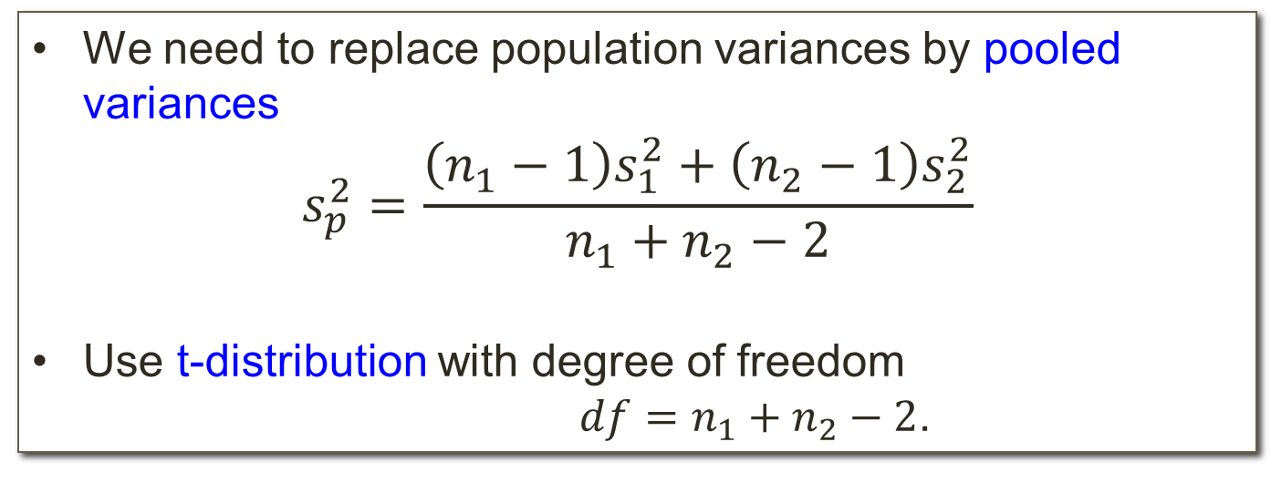
Inference on the difference in means of two normal distributions, variances unknown (assume equal variances)
Question: What if we do not know population variances? (Assume equal variances)
We need to replace population variances by pooled variances
$$s_{p}^{2}=\frac{\left(n_{1}−1\right)s_{1}^{2}+\left(n_{2}−1\right)s_{2}^{2}}{n_{1}+n_{2}−2}$$
Use t-distribution with degree of freedom
$df=n_{1}+n_{2}−2$.

Slide 9
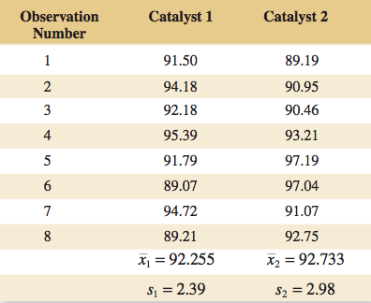
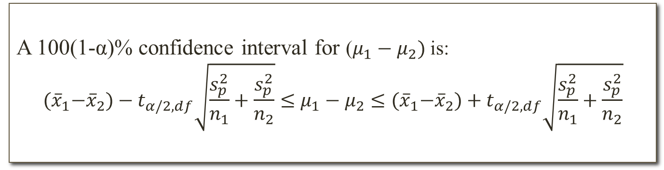
Inference on the difference in means of two normal distributions, variances unknown (assume equal variances)
Confidence interval on the difference in means:
A 100(1-α)% confidence interval for ($μ_{1}−μ_{2})$ is:
$${(\overline{x}}_{1}−{\overline{x}}_{2})−t_{α/2,df}\sqrt{\frac{s_{p}^{2}}{n_{1}}+\frac{s_{p}^{2}}{n_{2}}}≤μ_{1}−μ_{2}≤{(\overline{x}}_{1}−{\overline{x}}_{2})+t_{α/2,df}\sqrt{\frac{s_{p}^{2}}{n_{1}}+\frac{s_{p}^{2}}{n_{2}}}$$
Example: Two catalysts are being analyzed to determine how they affect the mean yield of a chemical. Construct 95% confidence interval for difference in means.

Slide 10
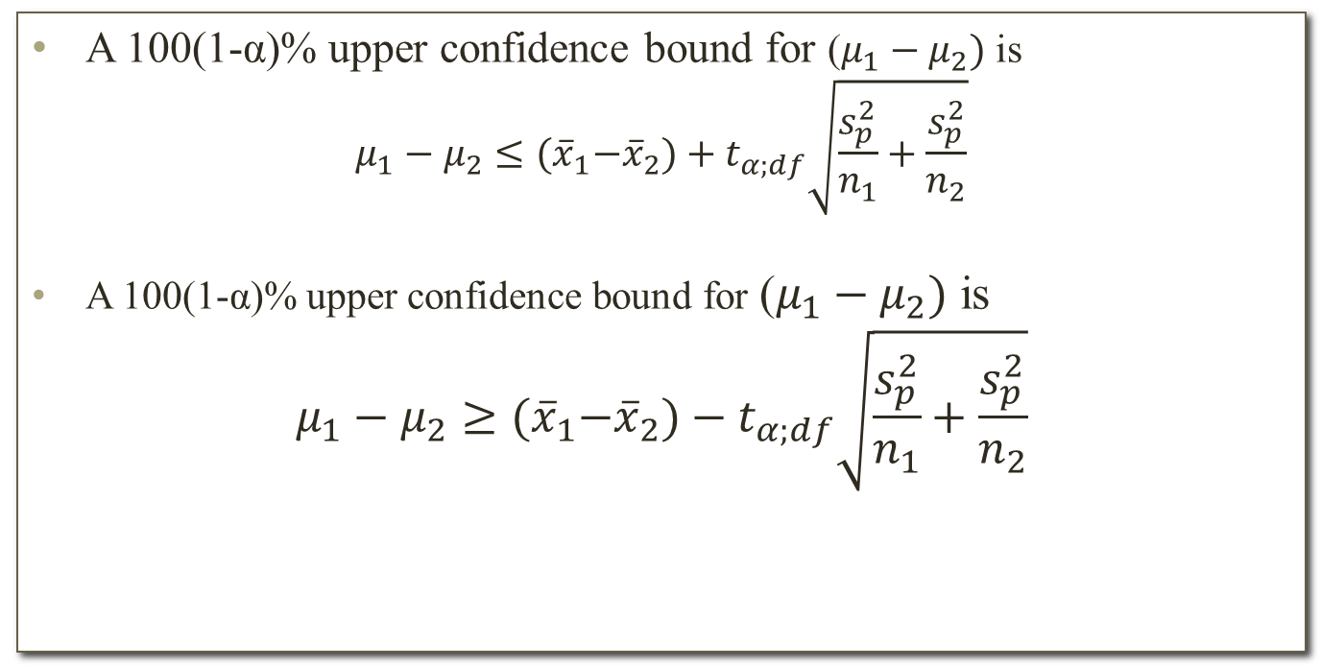
Inference on the difference in means of two normal distributions, variances unknown (assume equal variances)
One-sided confidence bound on the difference in means:
A 100(1-α)% upper confidence bound for ($μ_{1}−μ_{2})$ is
$$μ_{1}−μ_{2}≤{(\overline{x}}_{1}−{\overline{x}}_{2})+t_{α;df}\sqrt{\frac{s_{p}^{2}}{n_{1}}+\frac{s_{p}^{2}}{n_{2}}}$$
A 100(1-α)% upper confidence bound for ($μ_{1}−μ_{2})$ is
$$μ_{1}−μ_{2}≥{(\overline{x}}_{1}−{\overline{x}}_{2})−t_{α;df}\sqrt{\frac{s_{p}^{2}}{n_{1}}+\frac{s_{p}^{2}}{n_{2}}}$$

Slide 11
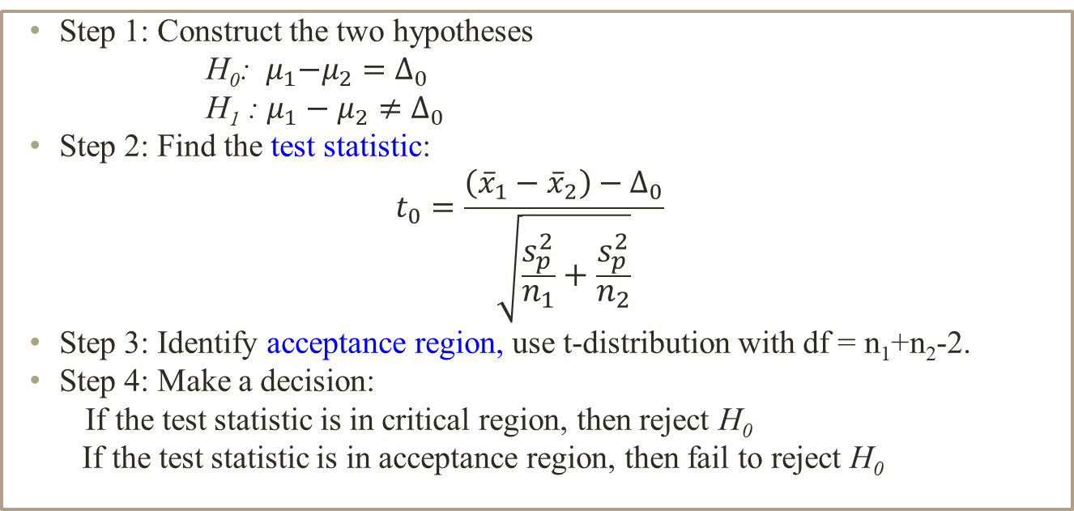
Inference on the difference in means of two normal distributions, variances unknown (assume equal variances)
Test of hypotheses for difference in means
Step 1: Construct the two hypotheses
H₀: ${ μ}_{1}−μ_{2}=∆_{0}$
H₁ : $μ_{1}−μ_{2}≠∆_{0}$
Step 2: Find the test statistic:
$$t_{0}=\frac{\left({\overline{x}}_{1}−{\overline{x}}_{2}\right)−∆_{0}}{\sqrt{\frac{s_{p}^{2}}{n_{1}}+\frac{s_{p}^{2}}{n_{2}}}}$$
Step 3: Identify acceptance region, use t-distribution with df = n₁+n₂-2.
Step 4: Make a decision:
If the test statistic is in critical region, then reject H₀
If the test statistic is in acceptance region, then fail to reject H₀

Slide 12
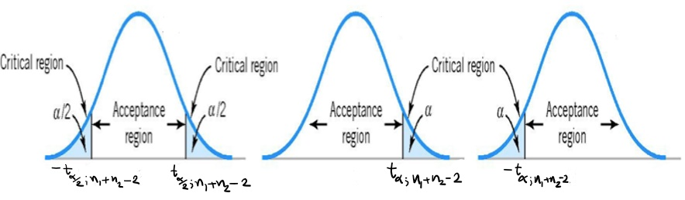
Inference on the difference in means of two normal distributions, variances unknown (assume equal variances)
Example: (Continue the previous example)
Use significant level 0.05 and assume equal variances, is there any difference in the mean yields.
Remark: We can also use P-value method to solve this problem.

Slide 13
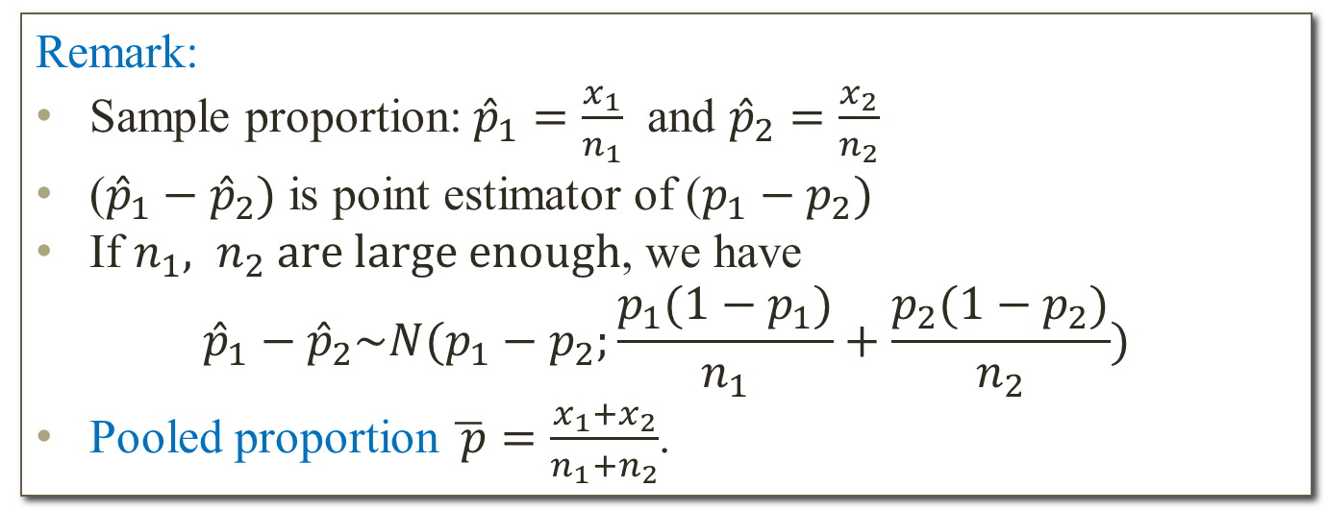
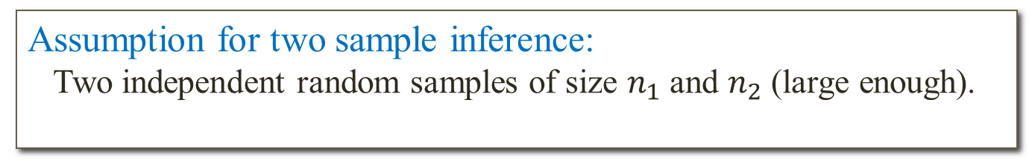
Inference on two population proportions
Assumption for two sample inference:
Two independent random samples of size $n_{1}$and $n_{2}$ (large enough).
Remark:
Sample proportion: ${\hat{p}}_{1}=\frac{x_{1}}{n_{1}}$ and ${\hat{p}}_{2}=\frac{x_{2}}{n_{2}}$
(${\hat{p}}_{1}−{\hat{p}}_{2})$ is point estimator of ($p_{1}−p_{2})$
If $n_{1}, n_{2} are large enough$, we have
$${\hat{p}}_{1}−{\hat{p}}_{2}\sim N(p_{1}−p_{2};\frac{p_{1}(1−p_{1})}{n_{1}}+\frac{p_{2}(1−p_{2})}{n_{2}})$$
Pooled proportion $\overline{ p}=\frac{x_{1}+x_{2}}{n_{1}+n_{2}}$.

Slide 14
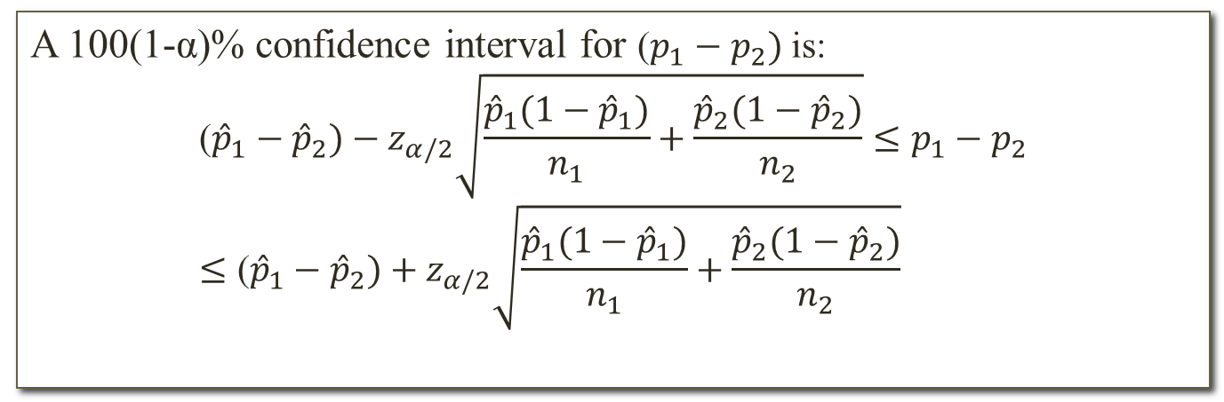
Inference on two population proportions
Confidence interval on the difference of 2 proportions:
A 100(1-α)% confidence interval for ($p_{1}−p_{2})$ is:
$$\text{(}{\hat{p}}_{1}−{\hat{p}}_{2})−z_{α/2}\sqrt{\frac{{\hat{p}}_{1}(1−{\hat{p}}_{1})}{n_{1}}+\frac{{\hat{p}}_{2}(1−{\hat{p}}_{2})}{n_{2}}}≤p_{1}−p_{2}≤\text{(}{\hat{p}}_{1}−{\hat{p}}_{2})+z_{α/2}\sqrt{\frac{{\hat{p}}_{1}(1−{\hat{p}}_{1})}{n_{1}}+\frac{{\hat{p}}_{2}(1−{\hat{p}}_{2})}{n_{2}}}$$

Slide 15
Inference on two population proportions
Example: Extracts of St. John’s Wort are widely used to treat depression. An article in the April 18, 2001, issue of the Journal of the American Medical Association (“Effectiveness of St. John’s Wort on Major Depression: A Randomized Controlled Trial”) compared the efficacy of a standard extract of St. John’s Wort with a placebo in 200 outpatients diagnosed with major depression. Patients were randomly assigned to two groups; one group received the St. John’s Wort, and the other received the placebo. After eight weeks, 19 of the placebo-treated patients showed improvement, and 27 of those treated with St. John’s Wort improved.
Construct 95% confidence interval for difference of two these proportions.

Slide 16
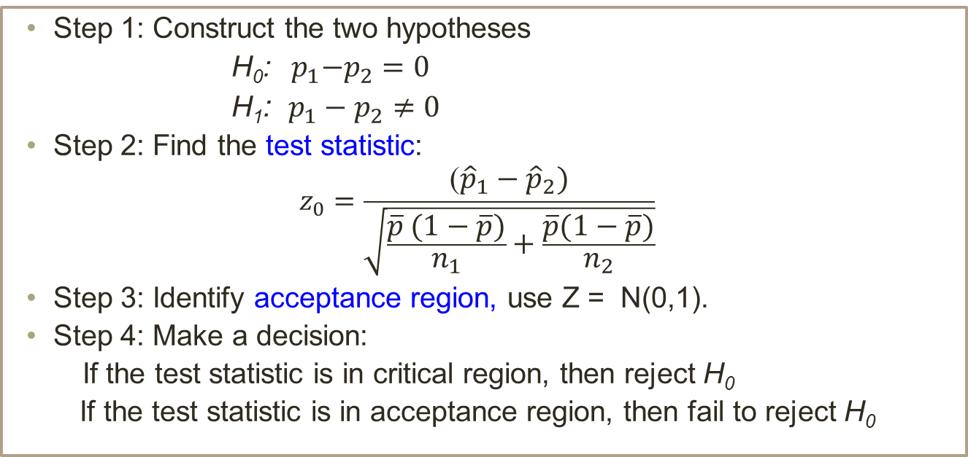
Inference on two population proportions
Test of hypotheses for difference in proportions
Step 1: Construct the two hypotheses
H₀:${ p}_{1}−p_{2}=0$
H₁: $p_{1}−p_{2}≠0$
Step 2: Find the test statistic:
$$z_{0}=\frac{\text{(}{\hat{p}}_{1}−{\hat{p}}_{2})}{\sqrt{\frac{\overline{p} (1−\overline{p})}{n_{1}}+\frac{\overline{p}(1−\overline{p})}{n_{2}}}}$$
Step 3: Identify acceptance region, use Z = N(0,1).
Step 4: Make a decision:
If the test statistic is in critical region, then reject H₀
If the test statistic is in acceptance region, then fail to reject H₀

Slide 17
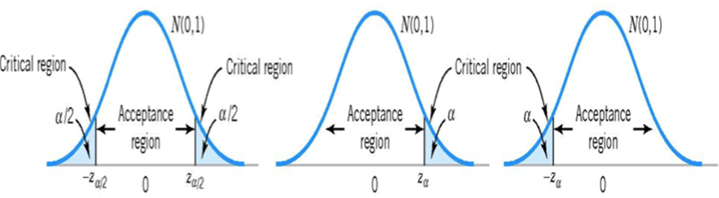
Inference on two population proportions
Example: (Continue the previous example)
Is there any reason to believe that St. John’s Wort is effective in treating major depression? Use α = 0.05.
Remark: We can also use P-value method to solve this problem.

