Slide 1
Chapter 11: Simple linear regression and Correlation
LEARNING OBJECTIVES
1. Introduction.
2. Simple linear regression.
3. Hypothesis test in simple linear regression.
4. Correlation.

Slide 2
Introduction
House Price in $1000s (Y) | Square Feet (X)
245 | 1,400
312 | 1,600
279 | 1,700
308 | 1,875
199 | 1,100
219 | 1,550
405 | 2,350
324 | 2,450
319 | 1,425
255 | 1,700
Random Sample
What is the best predicted price for a house of 2,000 square feet?
Population
Sample

Slide 3
Introduction
Regression analysis is used to:
Predict the value of a dependent variable based on the value of at least one independent variable.
Explain the impact of changes in an independent variable on the dependent variable.
Dependent variable Y: the variable we wish to predict or explain.
Independent variable X: the variable used to predict or explain the dependent variable.
A scatter plot can be used to:
Visualize the relationship between X and Y variables.
Help suggest a starting point for regression analysis.

Slide 4
Introduction
Y
Y
Linear Relationships
X
X
Y
Y
Curvilinear Relationships
Y
X
X
X
Y
Y
No Relationship
X
X

Slide 5


Simple linear regression
Simple linear regression model: $Y=β_{0}+β_{1}x+ε,$
where $ε\sim N(0,σ^{2})$ is the random error of the model
Y
$$\hat{y}=β_{0}+β_{1}x$$
Observed Value of Y for X_{i}
ε_{i}
Slope = β₁
Predicted Value of Y for X_{i}
Random Error for this X_{i} value
Intercept = β₀
X_{i}
X

Slide 6
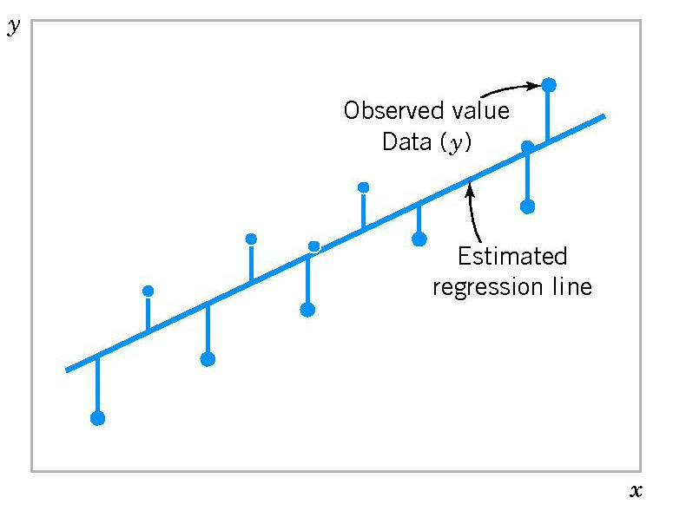
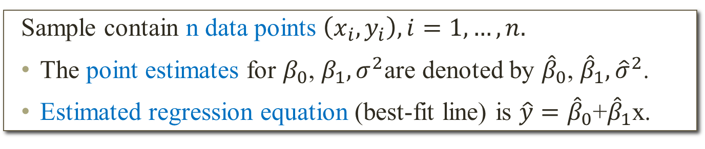
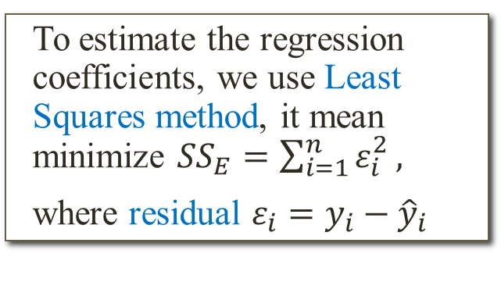
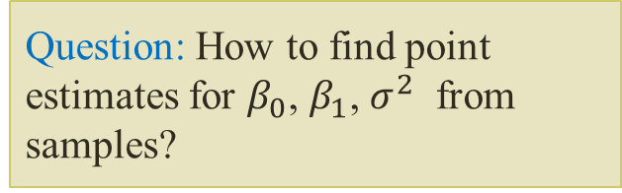
Simple linear regression
Sample contain n data points $\left(x_{i},y_{i}\right), i=1,…,n.$
The point estimates for $β_{0}$, $β_{1},σ^{2}$are denoted by ${\hat{β}}_{0}$, ${\hat{β}}_{1},{\hat{σ}}^{2}$.
Estimated regression equation (best-fit line) is $\hat{y}={\hat{β}}_{0}$+${\hat{β}}_{1}$x.
Question: How to find point estimates for $β_{0}$, $β_{1}$, $σ^{2}$ from samples?
To estimate the regression coefficients, we use Least Squares method, it mean minimize ${SS}_{E}=\sum_{i=1}^{n}{ε_{i}^{2}},$
where residual $ε_{i}=y_{i}−{\hat{y}}_{i}$

Slide 7
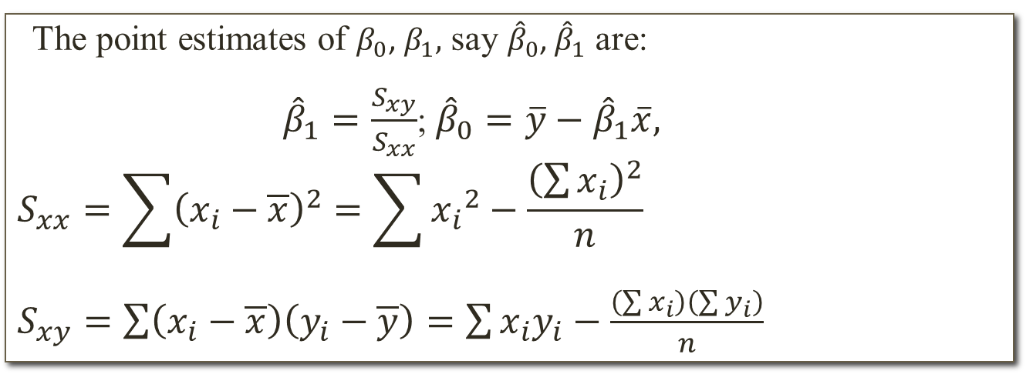
Estimated regression line
Best-fit line
The point estimates of $β_{0}$, $β_{1},$ say ${\hat{β}}_{0}$, ${\hat{β}}_{1}$ are:
${\hat{β}}_{1}=\frac{S_{xy}}{S_{xx}}$; ${\hat{β}}_{0}=\overline{y}−{\hat{β}}_{1}\overline{x},$
$$S_{xx}=\sum{{\left(x_{i}−\overline{x}\right)}^{2}=\sum{{x_{i}}^{2}−\frac{{\left(\sum{x_{i}}\right)}^{2}}{n}}}$$
$S_{xy}=\sum{\left(x_{i}−\overline{x}\right)\left(y_{i}−\overline{y}\right)=\sum{x_{i}y_{i}−\frac{\left(\sum{x_{i}}\right)\left(\sum{y_{i}}\right)}{n}}}$
Example: A mail-order firm is interested in estimating the number of order that need to be processed on a given day from the weight of the mail received. A close monitoring of mail on 4 randomly selected business days produced the results below. Find the equation of the least squares regression line relating the number of orders to the weight of the mail and use this equation to predict the number of orders when x = 15.
Mail (x) | 10 | 12 | 13 | 17
Orders (y) | 8 | 10 | 6 | 10

Slide 8
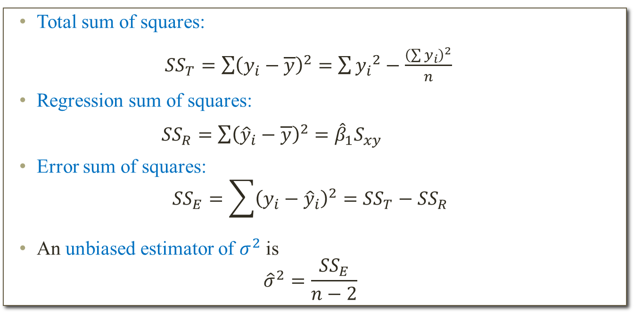
Standard error of estimate
Question: How well the model describes the data?
Total sum of squares:
${SS}_{T}=\sum{{\left(y_{i}−\overline{y}\right)}^{2}=\sum{{y_{i}}^{2}−\frac{{\left(\sum{y_{i}}\right)}^{2}}{n}}}$
Regression sum of squares:
${SS}_{R}=\sum{{\left({\hat{y}}_{i}−\overline{y}\right)}^{2}={\hat{β}}_{1}S_{xy}}$
Error sum of squares:
$${SS}_{E}=\sum{{\left(y_{i}−{\hat{y}}_{i}\right)}^{2}}={SS}_{T}−{SS}_{R}$$
An unbiased estimator of $σ^{2}$ is
$${\hat{σ}}^{2}=\frac{{SS}_{E}}{n−2}$$
Example: Find error sum of squares and the estimate of the variance of the random error in the previous example.

Slide 9
Use Regression in Excel
Example: The following data was determined for 10 randomly selected houses. Find the estimated regression line and error sum of squares.
House Price in $1000s (Y) | Square Feet (X)
245 | 1,400
312 | 1,600
279 | 1,700
308 | 1,875
199 | 1,100
219 | 1,550
405 | 2,350
324 | 2,450
319 | 1,425
255 | 1,700

Slide 10
Use Regression in Excel
Regression Statistics
Multiple R | 0.76211
R Square | 0.58082
Adjusted R Square | 0.52842
Standard Error | 41.33032
Observations | 10
ANOVA | df | SS | MS | F | Significance F
Regression | 1 | 18934.9348 | 18934.9348 | 11.0848 | 0.01039
Residual | 8 | 13665.5652 | 1708.1957
Total | 9 | 32600.5000
 | Coefficients | Standard Error | t Stat | P-value | Lower 95% | Upper 95%
Intercept | 98.24833 | 58.03348 | 1.69296 | 0.12892 | -35.57720 | 232.07386
Square Feet | 0.10977 | 0.03297 | 3.32938 | 0.01039 | 0.03374 | 0.18580
The regression equation is:

Slide 11
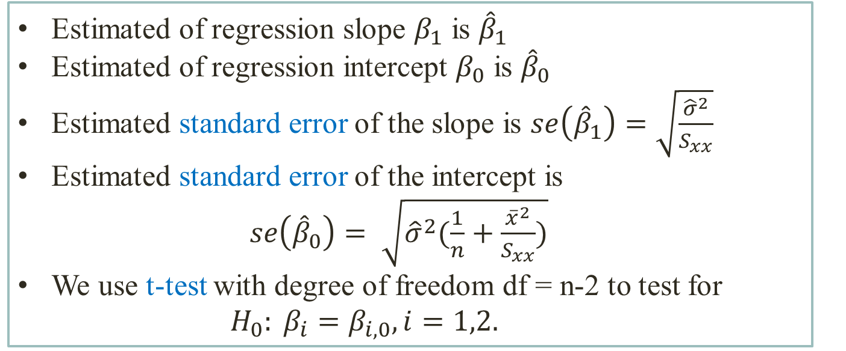
Test hypothesis about the slope and intercept
Remark
Estimated of regression slope $β_{1}$ is ${\hat{β}}_{1}$
Estimated of regression intercept $β_{0}$ is ${\hat{β}}_{0}$
Estimated standard error of the slope is $se\left({\hat{β}}_{1}\right)=\sqrt{\frac{{\hat{σ}}^{2}}{S_{xx}}}$
Estimated standard error of the intercept is $se\left({\hat{β}}_{0}\right)= \sqrt{{\hat{σ}}^{2}(\frac{1}{n}+\frac{{\overline{x}}^{2}}{S_{xx}})}$
We use t-test with degree of freedom df = n-2 to test for ${ H}_{0}: β_{i}=β_{i,0}, i=1,2.$

Slide 12
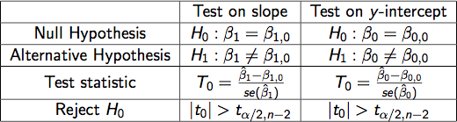
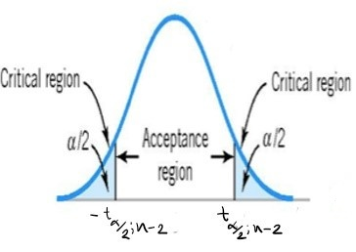
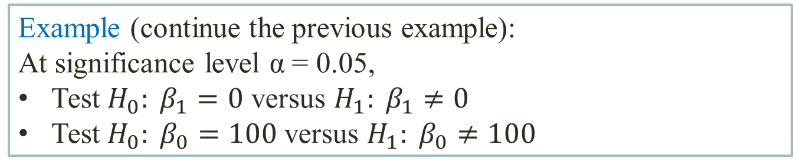
Test hypothesis about the slope and intercept
Example (continue the previous example):
At significance level α = 0.05,
Test $H_{0}: β_{1}=0$ versus $H_{1}: β_{1}≠0$
Test $H_{0}: β_{0}=100$ versus $H_{1}: β_{0}≠100$

Slide 13
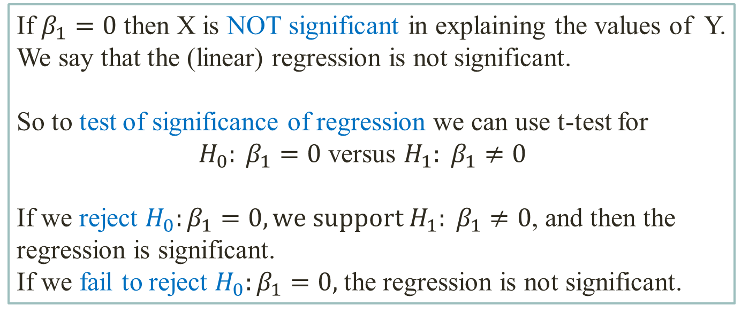
Test for significance of regression
Remark
If $β_{1}=0$ then X is NOT significant in explaining the values of Y.
We say that the (linear) regression is not significant.
So to test of significance of regression we can use t-test for ${ H}_{0}: β_{1}=0$ versus $H_{1}: β_{1}≠0$
If we reject $H_{0}:β_{1}=0, we support H_{1}: β_{1}≠0$, and then the regression is significant.
If we fail to reject $H_{0}:β_{1}=0,$the regression is not significant.

Slide 14
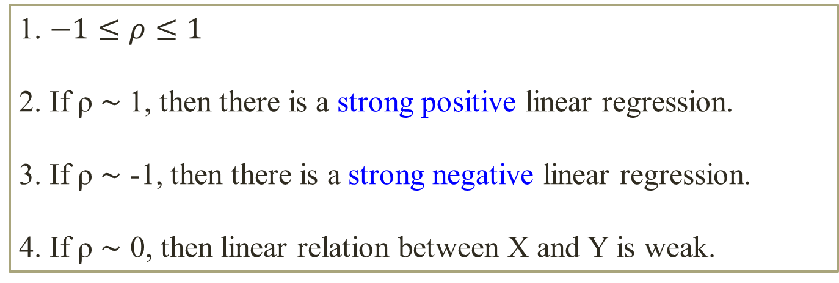
Correlation coefficient
To measure the strength of the linear relationship between X and Y we can use the correlation coefficient ρ.
Properties of ρ:
1. $−1≤ρ≤1$
2. If ρ ∼ 1, then there is a strong positive linear regression.
3. If ρ ∼ -1, then there is a strong negative linear regression.
4. If ρ ∼ 0, then linear relation between X and Y is weak.

Slide 15
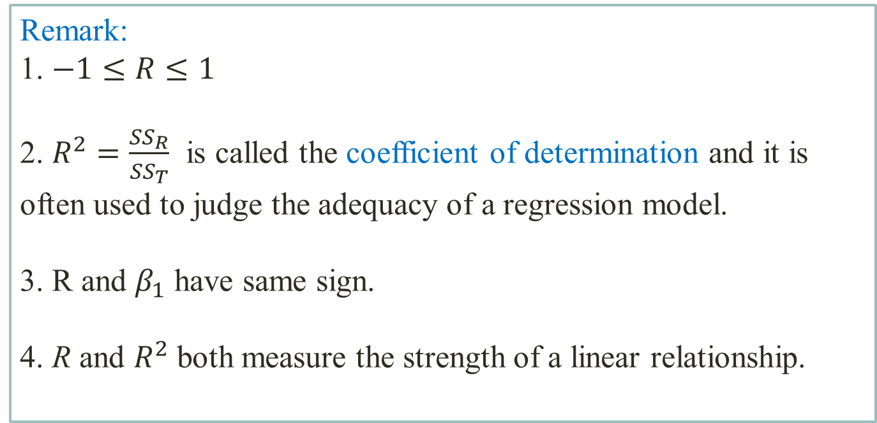
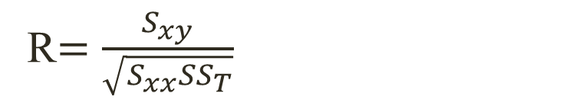
Correlation coefficient
Sample correlation coefficient R
R$=\frac{S_{xy}}{\sqrt{S_{xx}{SS}_{T}}}$
Remark:
1. $−1≤R≤1$
2. $R^{2}=\frac{{SS}_{R}}{{SS}_{T}}$ is called the coefficient of determination and it is often used to judge the adequacy of a regression model.
3. R and $β_{1}$ have same sign.
4. R and $R^{2}$ both measure the strength of a linear relationship.

Slide 16
Correlation
y
y
r = −0.91
r = 0.88
x
x
Strong negative correlation
Strong positive correlation
y
y
r = 0.42
r = 0.07
x
x
Weak positive correlation
Nonlinear Correlation

Slide 17
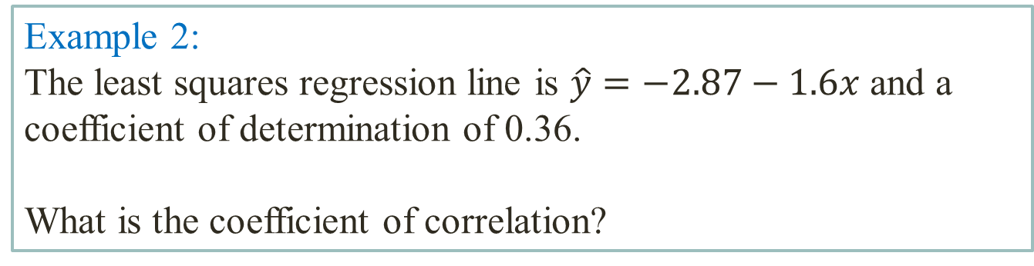
Correlation
Example1: In a regression problem the following pairs of (x, y) are given (-4; 8); (-1; 3); (0; 0); (1; -3).
What does this indicate about the value of coefficient of correlation and coefficient of determination?
Example 2:
The least squares regression line is $\hat{y}=−2.87−1.6x$ and a coefficient of determination of 0.36.
What is the coefficient of correlation?

Slide 18

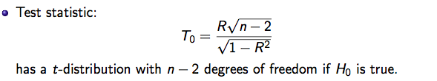
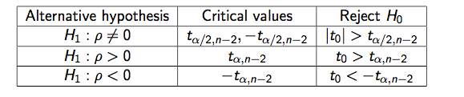
Test for zero correlation

Slide 19
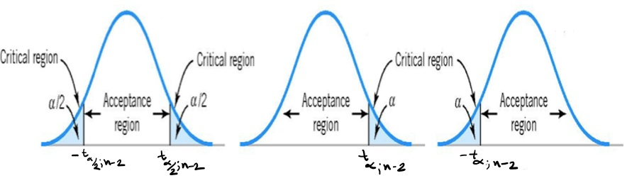
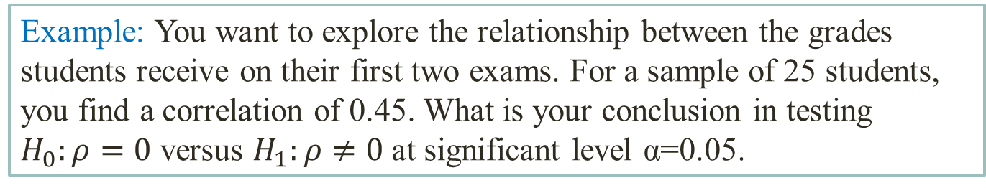
Test for zero correlation
Example: You want to explore the relationship between the grades students receive on their first two exams. For a sample of 25 students, you find a correlation of 0.45. What is your conclusion in testing $H_{0}:ρ=0$ versus $H_{1}:ρ≠0$ at significant level α=0.05.

