Slide 1
Chapter 3: Discrete random variables and Probability distribution
LEARNING OBJECTIVES:
1. Discrete random variables
2. Probability mass function and cumulative distribution function
3. Mean and Variance
4. Discrete uniform distribution
5. Binomial distribution
6. Geometric and Negative Binomial distribution
7. Hyper-geometric distribution
8. Poisson distribution

Slide 2
Discrete random variables
Definition
A discrete random variable is a random variable with a finite or countable infinite range.
Example:
1. Roll a die twice: Let X be the number of times 4 comes up then X = 0, 1, or 2.
2. Toss a coin 5 times: Let X be the number of heads
then X = 0, 1, 2, 3, 4, or 5.
3. X = The number of stocks in the Dow Jones Industrial Average that have share price increases on a given day,
then X is a discrete random variable because whose share price increases can be counted.

Slide 3
Discrete random variables
Determining a Discrete Random Variable
Let X be a discrete random variable with possible outcomes x₁, x₂, … , x_{n}.
1. Find the probability of each possible outcome.
2. Check that each probability is between 0 and 1 and that the sum is 1.
3. Summarizing results in following table, we obtain the probability distribution of X.
X | x₁ | x₂ | …. | X_{n}
P(x) | p₁ | P₂ | …. | p_{n}

Slide 4
Discrete random variables
Example: Let the random variable X denote the number of heads in three tosses of a fair coin. Determine the probability distribution of X.
Hint:
The sample space:
S = {HHH, HHT, HTH, HTT, THH, THT, TTH, TTT}.
The events: [X = 0] = {TTT}
[X = 1] = {HTT,THT,TTH}
[X = 2] = {HHT, HTH,THH}
[X = 3] = {HHH}
X | 0 | 1 | 2 | 3
P(x) | 1/8 | 3/8 | 3/8 | 1/8

Slide 5
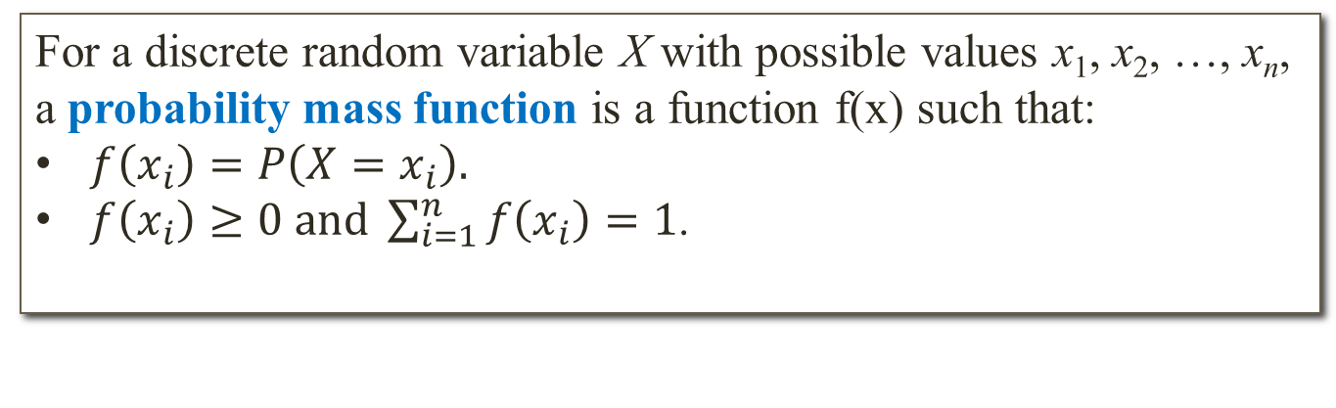
Probability mass function
Definition
For a discrete random variable X with possible values x₁, x₂, …, x_{n},
a probability mass function is a function f(x) such that:
$f\left(x_{i}\right)=P\left(X=x_{i}\right).$
$f\left(x_{i}\right)≥0 and \sum_{i=1}^{n}{f\left(x_{i}\right)=1}$.
Example: Suppose that a day’s production of 850 manufactured parts contains 50 parts that do not conform to customer requirements. Two parts are selected at random, without replacement, from the batch. Let the random variable X equal the number of nonconforming parts in the sample. What is the probability mass function of X?
Hint: f(0)=0.886; f(1)=0.111; f(2)=0.003; f(x)=0 otherwise.

Slide 6
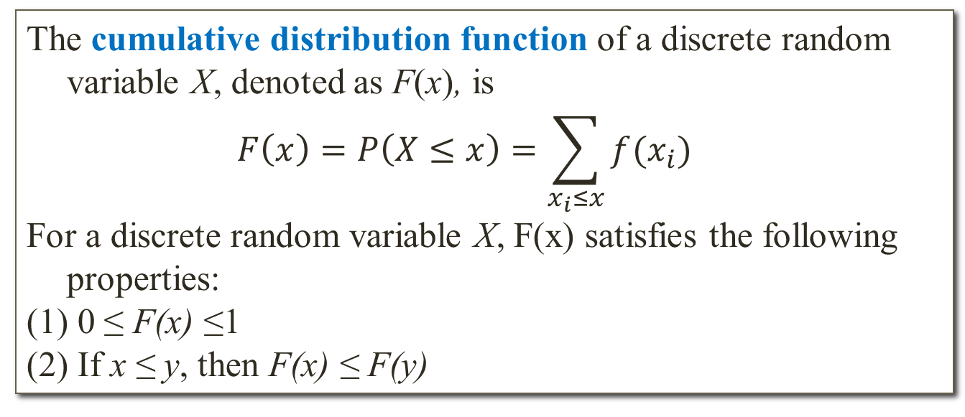
Cumulative distribution function
Definition
The cumulative distribution function of a discrete random variable X, denoted as F(x), is
$$F\left(x\right)=P\left(X≤x\right)=\sum_{x_{i}≤x}{f(x_{i})}$$
For a discrete random variable X, F(x) satisfies the following properties:
(1) 0 ≤ F(x) ≤1
(2) If x ≤ y, then F(x) ≤ F(y)
Example:
X | 0 | 1 | 2
f(x) | 0.886 | 0.111 | 0.003

Slide 7
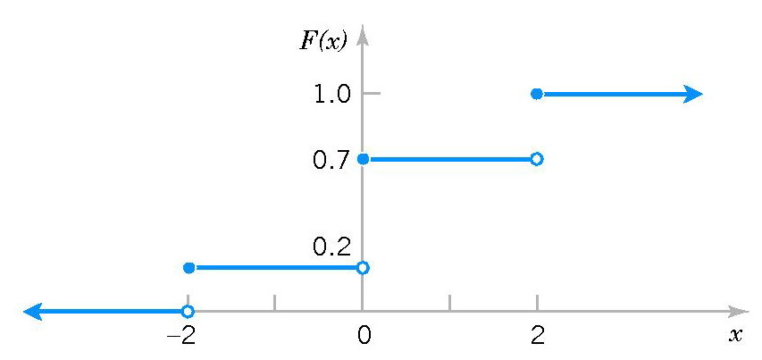
Cumulative distribution function
Example: Determine the probability mass function of X from the following cumulative distribution function:
Hint:
f(-2) = 0.2 – 0 = 0.2
f(0) = 0.7 - 0.2 = 0.5
f(2) = 1.0 - 0.7 = 0.3

Slide 8
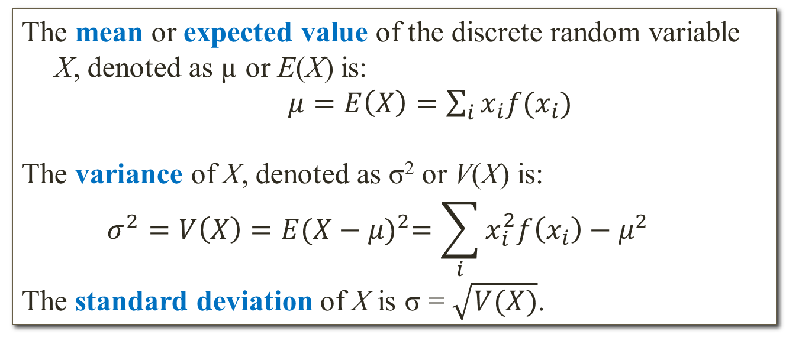
Mean and Variance
Definition
The mean or expected value of the discrete random variable X, denoted as µ or E(X) is:
$μ=E\left(X\right)=\sum_{i}{x_{i}f(x_{i})}$
The variance of X, denoted as σ² or V(X) is:
$$σ^{2}=V\left(X\right)=E{(X−μ)}^{2}=\sum_{i}{x_{i}^{2}f\left(x_{i}\right)−μ^{2}}$$
The standard deviation of X is σ = $\sqrt{V(X)}$.
Remark:
E(aX + b) = aE(X) + b
V(aX + b) = a²V(X)

Slide 9
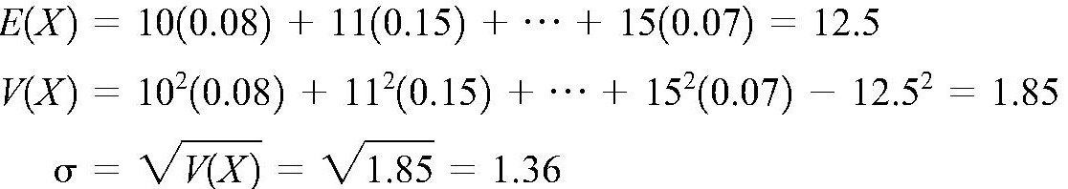
Mean and Variance
Example: The number of messages sent per hour over a computer network has the following distribution:
Determine the mean and standard deviation of the number of messages sent per hour.
X | 10 | 11 | 12 | 13 | 14 | 15
f(x) | 0.08 | 0.15 | 0.30 | 0.20 | 0.20 | 0.07
Hint:

Slide 10
Discrete uniform distribution
Definition
A random variable X has a discrete uniform distribution if each of the n values in its range, say, x₁, x₂, …, x_{n} has equal probability. Then,
f(x_{i}) = 1/n
Mean and Variance
Suppose X is a discrete uniform random variable on the consecutive integers a, a+1, …, b for a ≤ b. The mean and variance of X:
µ = E(X) = (a + b)/2

Slide 11
Binomial distribution
Definition
A random experiment consists of n trials such that:
(1) The trials are independent
(2) Each trial results in only two possible outcomes, labeled as “success” and“failure”
(3) The probability of a success in each trial, denoted as p, remains constant
The random variable X = the number of successes in n trials has a binomial distribution with parameters p and n. The probability mass function of X is:

Slide 12
Binomial distribution
Mean and Variance
µ = E(X) = np σ² = V(X) = np(1-p)
Example: Each sample of water has a 10% chance of containing a particular organic pollutant. Assume that the samples are independent with regard to the presence of the pollutant.
Let X= the number of samples that contain the pollutant in the next 18 samples analyzed.
(a) Find P(X=2)
(b) Determine the probability that at least four samples contain the pollutant.
(c) Determine the probability that 3 ≤ X < 7.
(d) Find the mean and standard deviation of X.

Slide 13
Geometric distribution
Example: The probability of a successful optical alignment in a assembly of an optical data storage product is 0.8. Assume the trials are independent. What is the probability that the first successful alignment requires exactly four trials.
Hint: Let X = the number of trials to the first success.
P(X=4) = P(FFFS)
Definition
In a series of Bernoulli trials (independent trials with constant probability p of a success), let the random variable X = the number of trials until the first success. Then X has a geometric distribution with parameter p, and the probability mass function of X is :

Slide 14
Geometric distribution
Mean and Variance
If X is a geometric random variable with parameter p then
Example: Assume that each of your calls to a popular radio station has a probability of 0.02 of connecting, that is, of not obtaining a busy signal. Assume that your calls are independent.
(a) What is the probability that your first call that connects is your tenth call?
(b) What is the probability that it requires more than five calls for you to connect?
(c) What is the mean number of calls needed to connect?

Slide 15
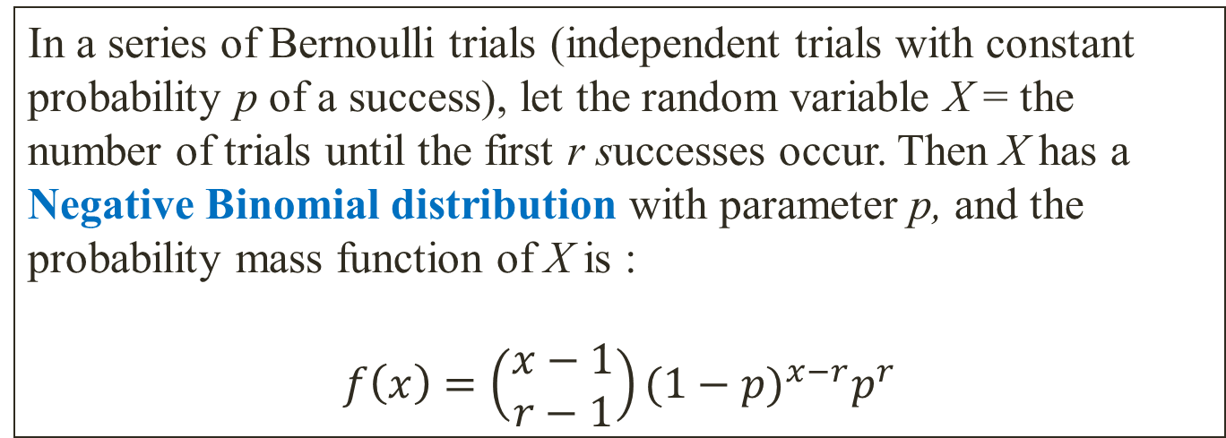
Negative Binomial distribution
Definition
In a series of Bernoulli trials (independent trials with constant probability p of a success), let the random variable X = the number of trials until the first r successes occur. Then X has a Negative Binomial distribution with parameter p, and the probability mass function of X is :
$$f\left(x\right)=\left(\begin{aligned}x−1 \\ r−1\end{aligned}\right){(1−p)}^{x−r}p^{r}$$
Example: Find the probability that a man flipping a coin gets the fourth head on the ninth flip.

Slide 16
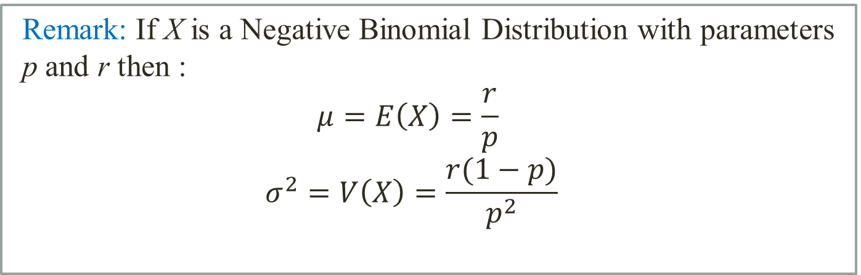
Negative Binomial distribution
Remark: If X is a Negative Binomial Distribution with parameters p and r then :
$$μ=E\left(X\right)=\frac{r}{p}$$
$$σ^{2}=V\left(X\right)=\frac{r(1−p)}{p^{2}}$$
Example: (referred to the previous example)
Find the mean and standard deviation of the number of flips
until that man gets four heads.

Slide 17
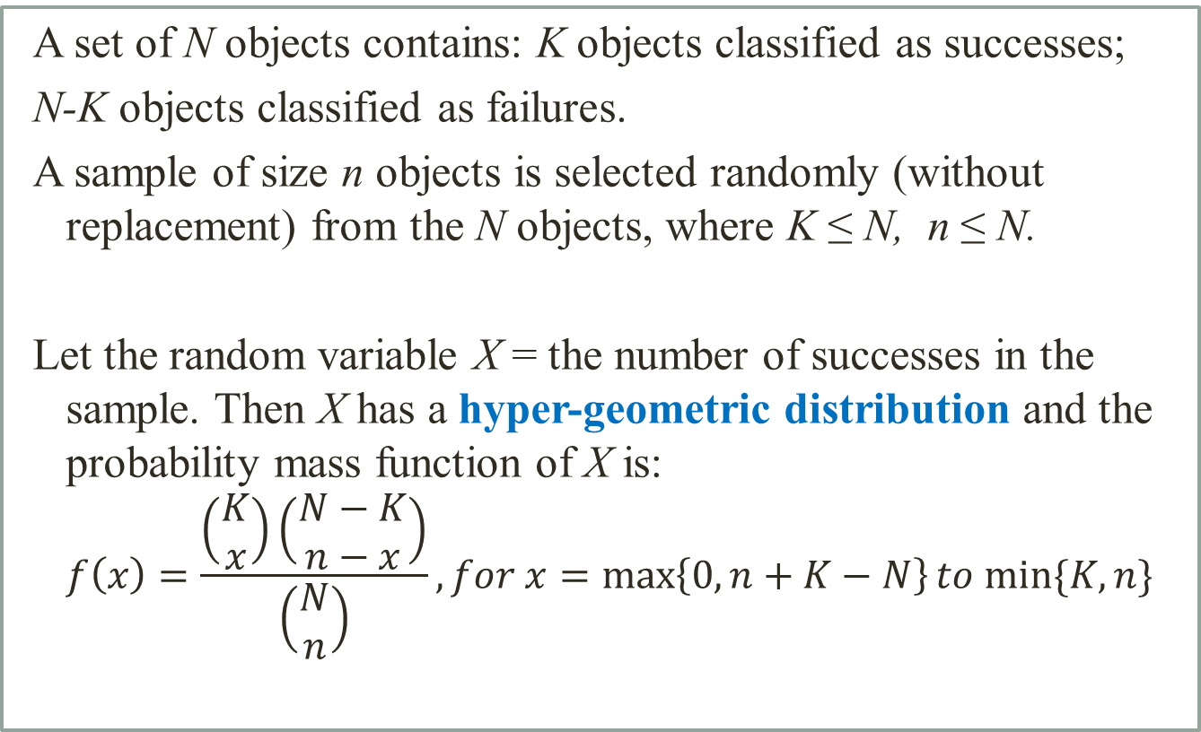
Hyper-geometric distribution
A set of N objects contains: K objects classified as successes;
N-K objects classified as failures.
A sample of size n objects is selected randomly (without replacement) from the N objects, where K ≤ N, n ≤ N.
Let the random variable X = the number of successes in the sample. Then X has a hyper-geometric distribution and the probability mass function of X is:
$$f\left(x\right)=\frac{\left(\begin{aligned}K \\ x\end{aligned}\right)\left(\begin{aligned}N−K \\ n−x\end{aligned}\right)}{\left(\begin{aligned}N \\ n\end{aligned}\right)}, for x=\max\left\{0, n+K−N\right\}to min⁡\{K,n\}$$

Slide 18
Hyper-geometric distribution
Example: A committee of size 5 is to be selected at random from 3 chemists and 5 physicists.
a. Find the probability distribution for the number of chemists on the committee.
b. Find the mean and the variance of the number of chemists on the committee.
Mean and Variance
If X is a hyper-geometric random variable with parameters N, K, and n, then

Slide 19
Poisson distribution
Given an interval of real numbers, assume events occur at random throughout the interval. If the interval can be partitioned into subintervals of small enough length such that:
1. The probability of more than one event in a subinterval is zero.
2. The probability of one event in a subinterval is the same for all subintervals and proportional to the length of the subinterval,
3. The event in each subinterval is independent of other subinterval, the random experiment is called Poisson Process.
The random variable X = the number of events in an interval of time
has a Poisson distribution with parameter λ, and the probability
mass function of X is:

Slide 20
Poisson distribution
Mean and Variance
If X is a Poisson random variable with parameter λ, then
µ = E(X) = λ σ² = V(X) = λ
Example: For the case of the thin copper wire, suppose that the number of flaws follows a Poisson distribution with a mean of 2.3 flaws per millimeter.
a. Determine the probability of exactly 2 flaws in 1 millimeter of wire.
b. Determine the probability of at least 1 flaw in 2 millimeters of wire.

