Slide 1
Chapter 4: Continuous random variables and Probability distribution
LEARNING OBJECTIVES
1. Continuous random variable
2. Probability density function
3. Cumulative distribution function
4. Mean and Variance
5. Uniform and Normal distributions
6. Normal approximation to the Binomial and Poisson.

Slide 2
Continuous random variables
Definition
A continuous random variable is a random variable whose possible values includes in an interval of real numbers.
Example:
1. The height of a student at FPT university can be any number between 150cm – 190cm.
2. The weight of a newborn can be any number between
0.5kg - 4.5kg.

Slide 3
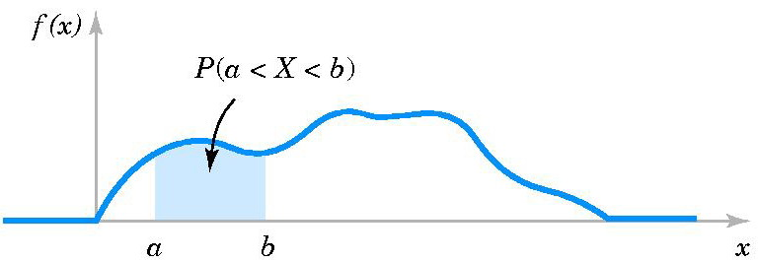
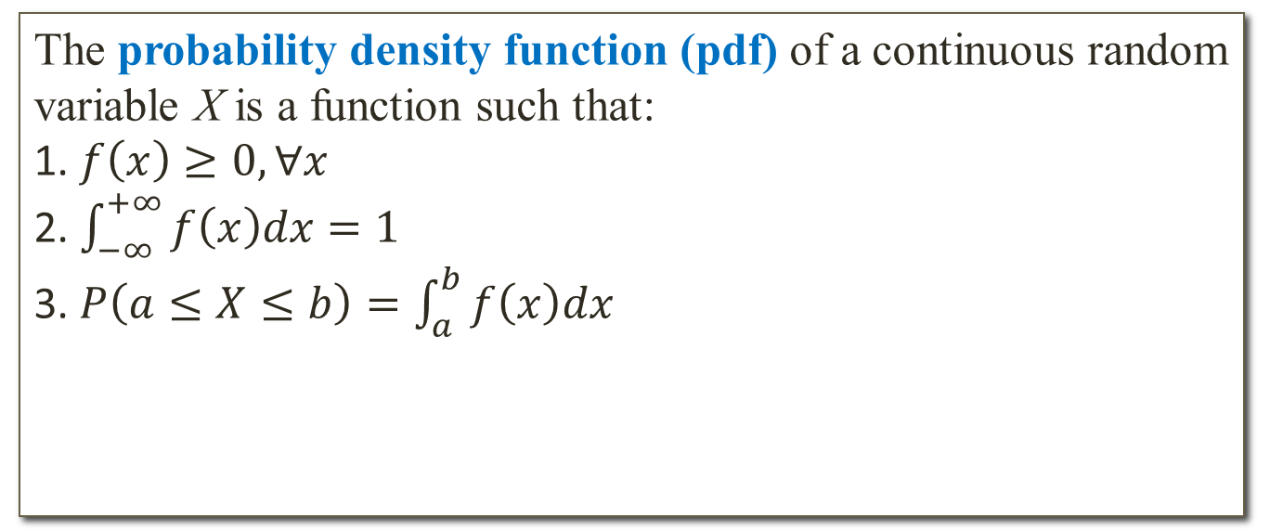
Probability density function (pdf)
Definition
The probability density function (pdf) of a continuous random variable X is a function such that:
1. $f\left(x\right)≥0,∀x$
2. $\int_{−∞}^{+∞}{f\left(x\right)dx=1}$
3. $P\left(a≤X≤b\right)=\int_{a}^{b}{f\left(x\right)dx}$
Property (X is a continuous random variable)

Slide 4
Probability density function (pdf)
Example 1: Suppose that the probability density function of a continuous random variable X is:
Determine
Example 2: The probability density function of the length of a metal rod is
What is the value of c?
Find

Slide 5
Cumulative distribution function (cdf)
Definition
The cumulative distribution function (cdf ) of a continuous random variable X is
for -∞ < x < +∞.
Remark: If X is continuous random variable with cumulative
distribution function F(x) then we can use:

Slide 6
Cumulative distribution function (cdf)
Example 1: Suppose the cumulative distribution function of the random variable X is
Find
Example 2: Suppose the probability density function of the random variable X is
Find the cumulative distribution function of X.

Slide 7
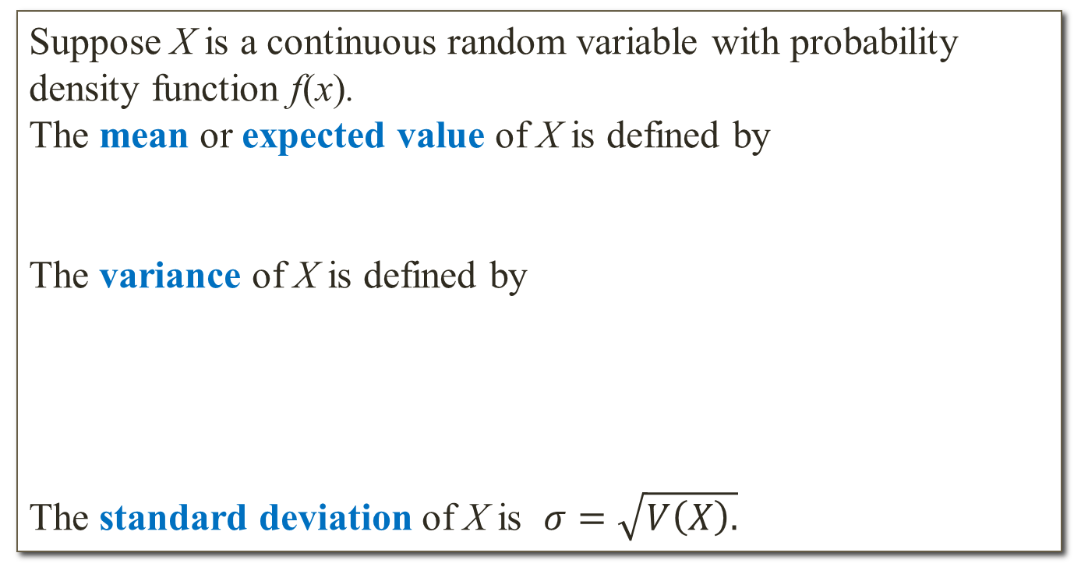
Mean and variance of a continuous random variable
Definition
Suppose X is a continuous random variable with probability density function f(x).
The mean or expected value of X is defined by
The variance of X is defined by
The standard deviation of X is $σ=\sqrt{V\left(X\right).}$

Slide 8
Mean and variance of a continuous random variable
Example 1: Assume that X is a continuous random variable with the following probability density function
Determine the mean and variance of X.
Example 2: The cumulative distribution function of the random variable X is
Find the standard deviation of X.

Slide 9
Continuous uniform distribution
pdf:
Mean and Variance:
cdf:

Slide 10
Continuous uniform distribution
Example 1: Suppose X has a continuous uniform distribution over the interval [1;10].
Determine the mean, variance and standard deviation of X.
Find P(X<6.5).
Determine the cumulative distribution function of X.
Example 2: Suppose X has a continuous uniform distribution over [5;15]. What is the mean and variance of Y=8X?

Slide 11
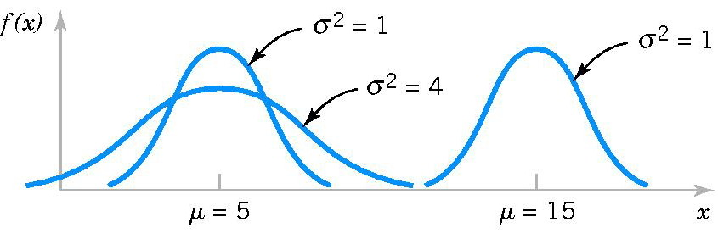
Normal distribution
Notation: X = N(µ, σ²)
pdf:
Mean and Variance:
E(X) = µ V(X) = σ²

Slide 12
Standard normal distribution
Notation: Z = N(0,1)
pdf:
cdf:
Example 1: Find the standard normal-curve area between z = −1 and z = −0.4?
Hint: Use Appendix Table III or NORM.S.DIST(a;1) in Excel to find P(z<a).
Example 2: Assume that z scores are normally distributed with a mean of 0 and a standard deviation of 1. If P(z < a) = 0.1487, find a.
Hint: Use Appendix Table III or NORM.S.INV(p) in Excel to find a such that
^{P(z < a) = p.}

Slide 13
Normal distribution
Standardizing
If X = N(µ, σ²) then
is a standard normal random variable N(0, 1).
Example 1: A machine pours beer into 16 oz. bottles. Experience has shown that the number of ounces poured is normally distributed with a standard deviation of 1.3 ounces. Find the probabilities that the amount of beer the machine will pour into the next bottle will be ^{more than 16.25 ounces.}
Example 2: The tread life of a particular brand of tire is a random variable best described by a normal distribution with a mean of 65,000 miles and a standard deviation of 1,500 miles. What warranty should the company use if they want 95% of the tires to outlast the warranty?

Slide 14
Approximation using Normal distribution
Normal Approximation to the Binomial Distribution
If X has a Binomial distribution B(n, p) then random variable
is approximately a standard random variable N(0,1).
We have
Remark: The approximation is good for np > 5 and n(1-p) > 5.

Slide 15
Approximation using Normal distribution
Example: The manufacturing of semiconductor chips produces 3% defective chips. Assume the chips are independent and that a lot contains 800 chips. Approximate the probability that more than 30 chips are defective.
Hint: X~B(n = 800; p = 0.03). Use Normal approximation.
Remark: Can use BINOM.DIST in Excel to find actual value.

Slide 16
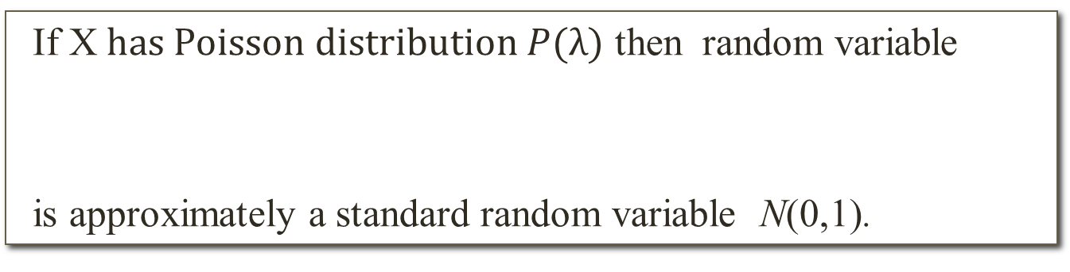
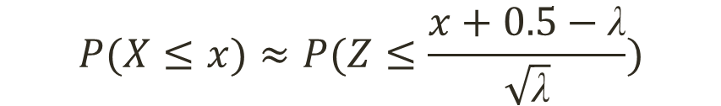
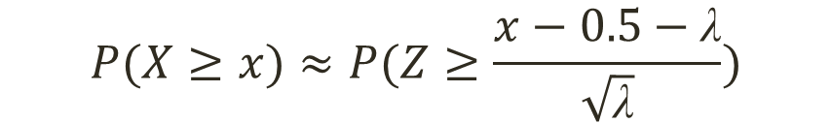
Approximation using Normal distribution
Normal Approximation to the Poisson Distribution
If X$has Poisson distribution P(λ)$ then random variable
is approximately a standard random variable N(0,1).
We have
$$P(X≤x)≈P(Z≤\frac{x+0.5−\text{λ}}{\sqrt{\text{λ}}})$$
$$P(X≥x)≈P(Z≥\frac{x−0.5−\text{λ}}{\sqrt{\text{λ}}})$$
Remark: The approximation is good for λ > 5.

Slide 17
Approximation using Normal distribution
Example: The number of customers that arrive at a fast-food business during a one-hour period is known to be Poisson distributed with a mean equal to 9.6. What is the probability that more than 10 customers will arrive in a one-hour period?
Hint: X~P(9.6). Use Normal approximation
Remark: Can use POISSON.DIST in Excel to find actual value.

Slide 18
Exponential distribution
Definition
The random variable X that equals the distance between two consecutive events with mean number of events λ > 0 per unit interval is an exponential random variable with parameter λ. The probability density function of X is:
Remark: If a random variable X has exponential distribution
with parameter λ then

Slide 19
Exponential distribution
Example 1: The time between customer arrivals at a furniture store has an approximate exponential distribution with mean of 9 minutes. If a customer just arrived, find the probability that the next customer will not arrive for at least 15 minutes.
Example 2: The time between patients arriving at an outpatient clinic follows an exponential distribution at a rate of 15 patients per hour. What is the probability that a randomly chosen arriving interval will not exceed 6 minutes?

