Slide 1
Chapter 6: Data Description
LEARNING OBJECTIVES
1. Numerical summaries of data.
2. Stem and leaf diagrams.
3. Frequency distributions and Histograms.
4. Box plots
5. Time Sequence plots

Slide 2
Introduction to statistics
Statistics
= the science of data
Descriptive Statistics
Use numerical summaries and visual displays to describe data
(Chapter 6)
Inferential Statistics
Use information from samples (data) to estimate for population
(Chapter 8, 9, 10, 11)

Slide 3
Numerical summaries of data
Sample mean
If the n observations in a sample are denoted by x₁, x₂, …, x_{n}, the sample mean is
Example: Let’s consider the weight of the eight observations collected from the prototype engine connectors: 12.6, 12.9, 13.4, 12.3, 13.6, 13.5, 12.6 and 13.1
Find the sample mean.

Slide 4
Numerical summaries of data
Sample median
The value that lies in the middle of the data when the data set is ordered.
Measures the center of an ordered data set by dividing it into two equal parts.
If the data set has an
(a) even number of entries: median is the average of the two middle data entries.
(b) odd number of entries: median is the middle data entry.
Example: The prices (in dollars) for a sample of round-trip flights from Chicago, Illinois to Cancun, Mexico are listed. Find the median of the flight prices.
872 432 397 427 388 782 397

Slide 5
Numerical summaries of data
Sample mode
The data entry that occurs with the greatest frequency.
If no entry is repeated the data set has no mode.
If two entries occur with the same greatest frequency, each entry is a mode (bimodal).
Example: At a political debate a sample of audience members was asked to name the political party to which they belong. Their responses are shown in the table. What is the mode of the responses?
Political Party | Frequency
Democrat | 35
Republican | 60
Other | 25
Did not respond | 8

Slide 6
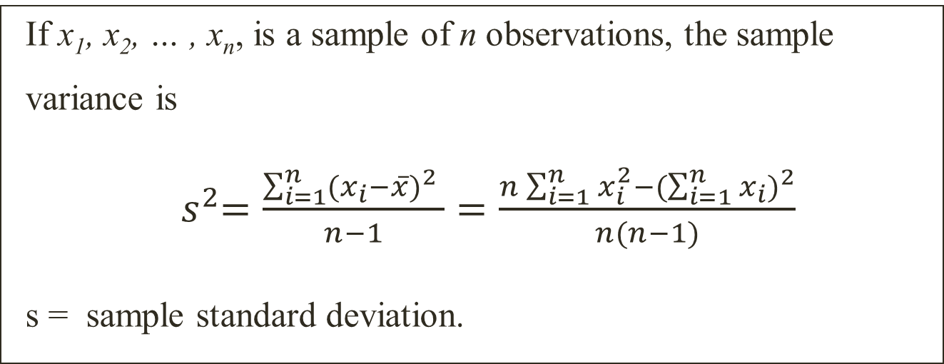
Numerical summaries of data
Sample variance and sample standard deviation
If x₁, x₂, … , x_{n}, is a sample of n observations, the sample
variance is
${ s}^{2}=\frac{\sum_{i=1}^{n}{{(x_{i}−\overline{x})}^{2} }}{n−1}=\frac{n\sum_{i=1}^{n}{x_{i}^{2}−{(\sum_{i=1}^{n}{x_{i}})}^{2}}}{n(n−1)}$
s = sample standard deviation.
Example: Let’s consider the weight of the eight observations collected from the prototype engine connectors: 12, 13, 9, 12, 10 and 12.
Find the sample standard deviation.

Slide 7
Numerical summaries of data
Sample range
The difference between the maximum and minimum data entries in the set.
The data must be quantitative.
If the n observations in a sample are denoted by x₁, x₂, … , x_{n}, the sample range is
r = max(x_{i}) – min(x_{i})

Slide 8
Stem and leaf diagram
A stem-and-leaf diagram is a good way to obtain an informative visual display of a data set where each number xi consists of at least two digits. To construct a stem-and-leaf diagram, use the following steps:
Divide each number x_{i} into two parts: a stem, consisting of one or more of the leading digits, and a leaf, consisting of the remaining digit.
List the stem values in a vertical column.
Record the leaf for each observation beside its stem.
Write the units for stems and leaves on the display.

Slide 9
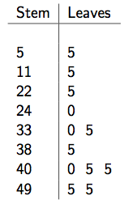
Stem and leaf diagram
Example: The listening scores of 12 students in a TOEIC test are listed below
55 115 225 240 330 335 385 400 405 405 495 495
The stem and leaf diagram:

Slide 10
Box-plots
Three quartiles
An ordered set of data is divided into four equal parts, the division points are called quartiles:
The first quartile, q₁ or Q₁: is a value that has approximately 25% of the observations below.
The sample median or second quartile, q₂ or Q₂, has approximately 50% of the observations below its value.
The third quartile, q₃ or Q₃, has approximately 75% of the observations below its value.
The interquartile range, IQR = Q₃ – Q₁
Example: Use the given sample data to find the sample quartiles, the sample mode and the IQR.
55, 52, 52, 52, 49, 74, 67, 55.

Slide 11
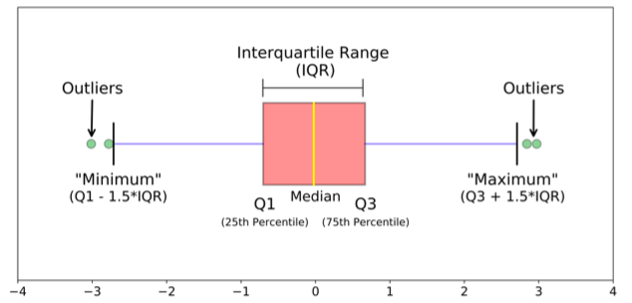
Boxplot
A box-plot is a visual display that describes important features of data: three quartiles, the minimum/maximum values, and unusual observations (outliers).

Slide 12
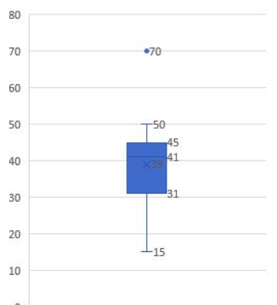
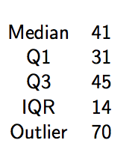
Boxplot
Example: Given a data of ages of 14 random adults from a village: 15, 20, 31, 31, 32, 40, 41, 41, 42, 43, 45, 45, 50, 70
Draw a box plot for this data.

Slide 13
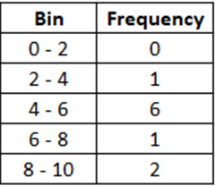
Frequency distribution
Frequency Distribution
Construction of frequency distribution: divide the range of the data into intervals (called class intervals, cells, or bins). The bins should be of equal width.
Example:
Data = Grades = {2.4, 4.4, 4.6, 5.0, 5.0, 5.8, 6.0, 7.4, 8.2, 9.0}
Divide grade ranges into 5 bins: 0 - 2, 2 - 4, 4 - 6, 6 - 8, 8 - 10.
Count the number of data values in each bin:

Slide 14
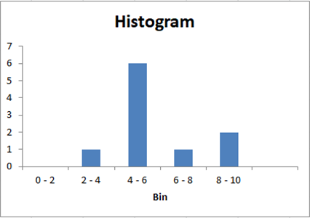
Histogram
The histogram is a visual display of the frequency distribution.
Label the bin (class interval) boundaries on a horizontal scale.
Mark and label the vertical scale with the frequencies or the relative frequencies.
Above each bin, draw a rectangle
where height is equal to the
Frequency (or relative frequency)
corresponding to that bin.

Slide 15
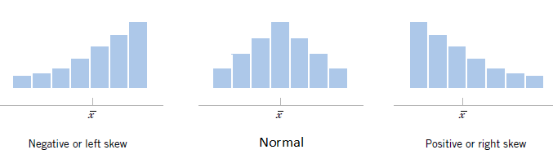
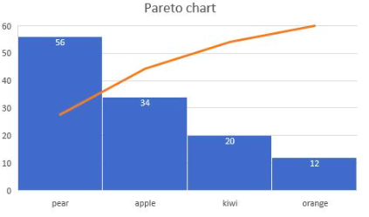
Histogram
Remark:
1. Histograms are very useful to explore the distribution of data.
2. Pareto chart:
(frequencies are
ordered decreasingly)

Slide 16
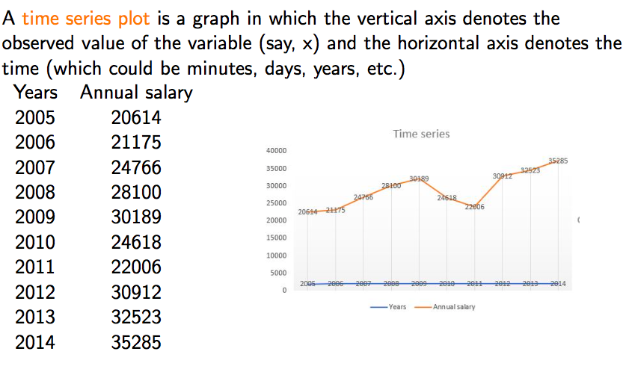
Times sequence plots

