Slide 1
Chapter 7: Sampling distribution and Point estimates of parameters
LEARNING OBJECTIVES
1. Point estimates of parameters.
2. Sampling distribution.
3. Central limit theorems.

Slide 2
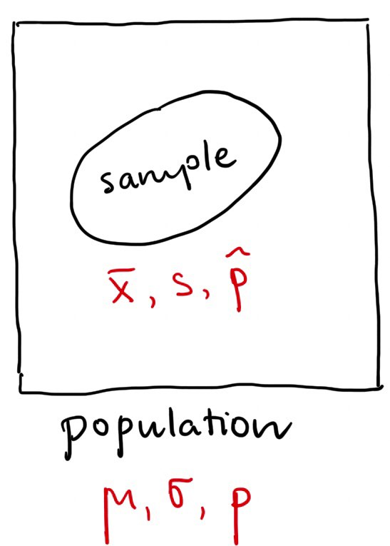
Point estimates of parameters
A central problem in statistics is to estimate a population using samples.
A parameter is a characteristic of a population.
Three most basic parameters: mean, standard deviation, proportion.
A point estimate for a parameter is a single value computed from a sample.
The best point estimate for µ is the sample mean.
The best point estimate for σ is the sample standard deviation s.
The best point estimate for p is the sample proportion .

Slide 3
Point estimates of parameters
Example 1: In a sample of 73 products, there are 7 defective products. So a point estimate for proportion p of all defective products is:
Example 2: Market researchers use the number of sentences per advertisement as a measure of readability for magazine advertisements. The following represents a random sample of the number of sentences found in 15 advertisements.
9 20 18 16 9 9 11 13 22 16 5 18 6 6 5
a. Find a point estimate of the population mean, μ.
b. Find a point estimate of the population standard deviation, σ.
Hint:

Slide 4
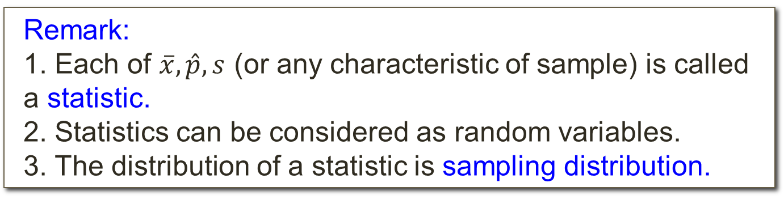
Sampling distribution
Remark:
1. Each of $\overline{x},\hat{p},s$ (or any characteristic of sample) is called a statistic.
2. Statistics can be considered as random variables.
3. The distribution of a statistic is sampling distribution.
Sample | Sample mean
2; 2 | 2
2; 3 | 2.5
2; 10 | 6
3; 2 | 2.5
3; 3 | 3
3; 10 | 6.5
10; 2 | 6
10; 3 | 6.5
10; 10 | 10
Example: Assume that {2; 3; 10} be a population.
Randomly selected (with replacement) a sample of size 2.
Find the population mean.
Find the mean of sample means.
Compare the results

Slide 5
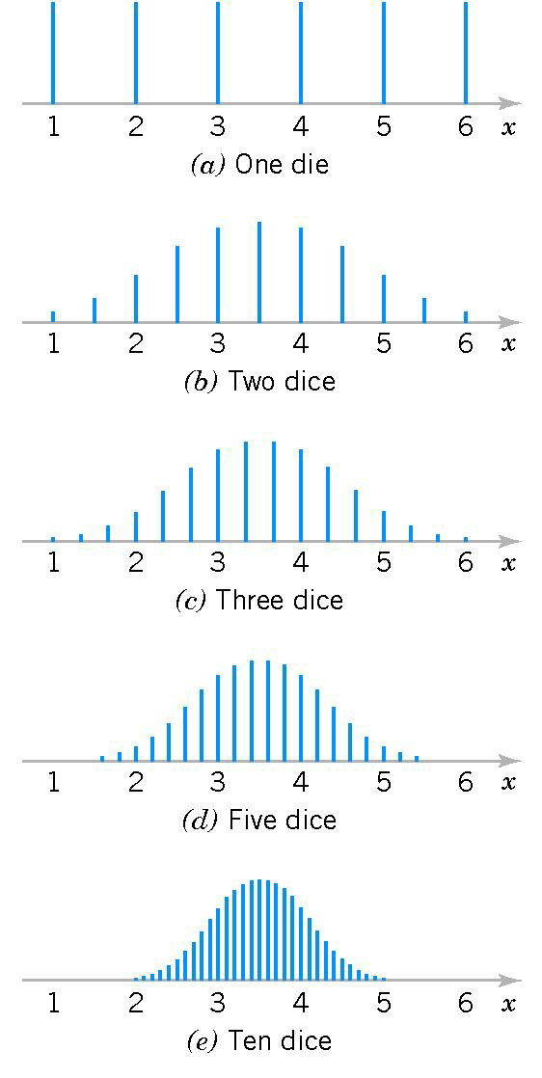
Sampling distribution
Example:
Distributions of average scores from throwing dice.

Slide 6
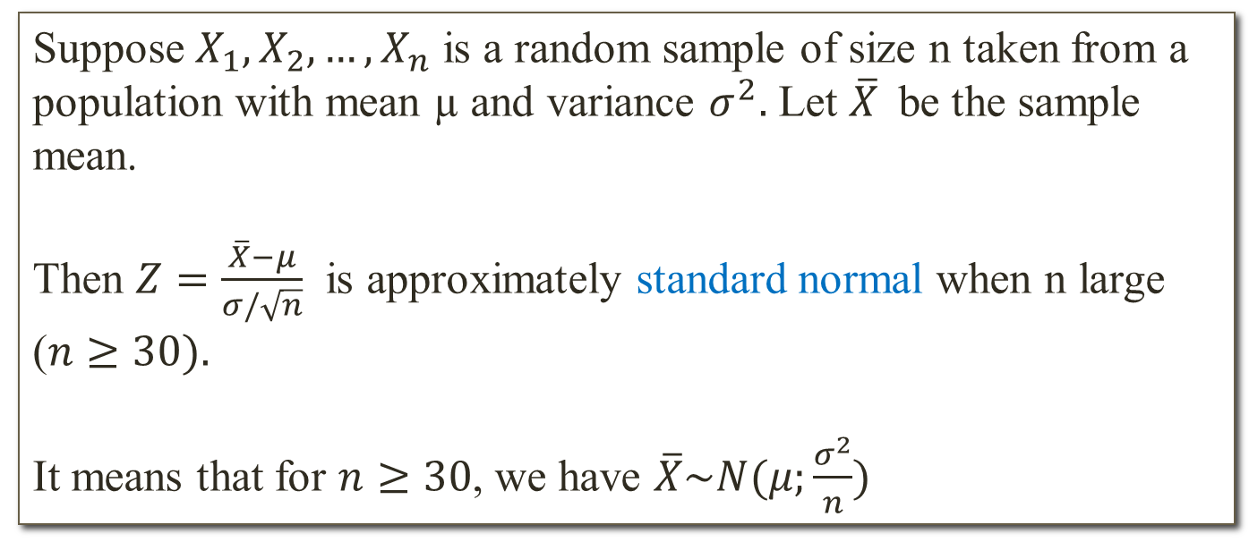
Central limit theorem
Theorem (CLT for one population)
Suppose $X_{1},X_{2},…,X_{n}$ is a random sample of size n taken from a population with mean µ and variance $σ^{2}.$ Let $\overline{X}$be the sample mean.
Then $Z=\frac{\overline{X}−μ}{σ/\sqrt{n}}$ is approximately standard normal when n large ($n≥30).$
It means that for $n≥30$, we have $\overline{X}\sim N(μ;\frac{σ^{2}}{n})$
Example: One year, professional players salaries averaged 1.5 million with a standard deviation of 0.9 million. Suppose a sample of 100 players was taken. Find the approximate probability that the average salary of these 100 players does not exceed 1.4 million.

Slide 7
Central limit theorem
Remark: If the population already has normal distribution then for any sample size:
Example: An electrical firm manufactures light bulbs that have a length of life that is approximately normally distribution, with mean equal to 800 hours and a standard deviation of 40 hours. Find the probability that a random sample of 16 bulbs will have an average life of less than 775 hours.

Slide 8
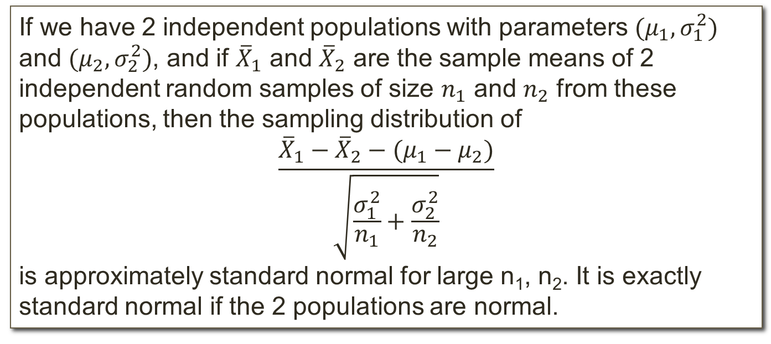
Central limit theorem
Theorem (CLT for two populations)
If we have 2 independent populations with parameters ${(μ}_{1},σ_{1}^{2})$ and ${(μ}_{2},σ_{2}^{2})$, and if ${\overline{X}}_{1}$ and ${\overline{X}}_{2}$ are the sample means of 2 independent random samples of size $n_{1}$ and $n_{2}$ from these populations, then the sampling distribution of
$$\frac{{\overline{X}}_{1}−{\overline{X}}_{2}−(μ_{1}−μ_{2})}{\sqrt{\frac{σ_{1}^{2}}{n_{1}}+\frac{σ_{2}^{2}}{n_{2}}}}$$
is approximately standard normal for large n₁, n₂. It is exactly standard normal if the 2 populations are normal.
Remark: It means that, under the conditions of CLT,

Slide 9
Central limit theorem
Example: The television picture tubes of manufacturer A have a mean lifetime of 6.5 years and a standard deviation of 0.9 year, while those of manufacturer B have mean lifetime of 6.5 years and a standard deviation of 0.8 year. What is the probability that a random sample of 36 tubes from manufacture A will have mean lifetime that is at least 1 year more than the mean lifetime of a sample of 49 tubes from manufacturer B?
Population 1 | Population 2

